Slide 1
First look at beam-beam effects with ‘Crab-Kiss’ for HL-LHC
A.Valishev (Fermilab/US LARP) and D.Shatilov (BINP), WP2 Task 2.5
July 25, 2013
Acknowledgments: S.Fartoukh

Slide 2
Common parameters
Lifetrac: weak-strong beam-beam, Gaussian strong beam, full element-by-element machine lattice
SLHCV3.1b optics, no multipole errors
  ‘nominal’ β*=15/15 cm, θ=590 μrad
  40/40 cm, θ=590 μrad
  30/7.5 cm, θ=550 μrad
ε_{x}=ε_{y}=2.5 μm
σ_{z}=7.5 cm, σ_{δ}=1.1E-4

Slide 3
Present nominal HL-LHC (1/4)
constant θ=590 μrad
full crab (head-on collisions), 3 IPs
leveling by β*
ξ=0.032 – is it OK???

Slide 4
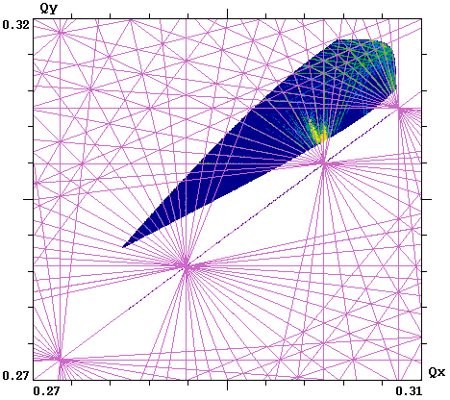
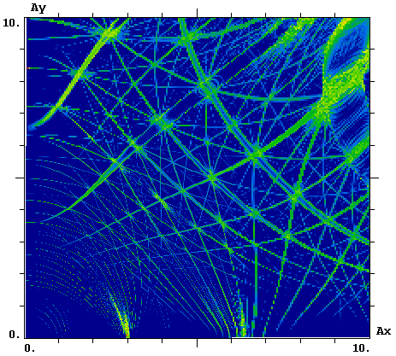
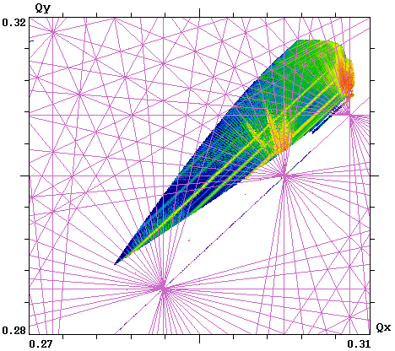
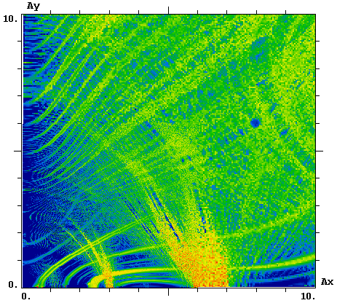
Present nominal HL-LHC (2/4)
β*=40/40cm, θ=590μrad (20.3 σ) N=2.2⋅10¹¹ , L=8.7E34
1/13
A_{s} = 0
1/10
1/7
A_{s} = 1

Slide 5
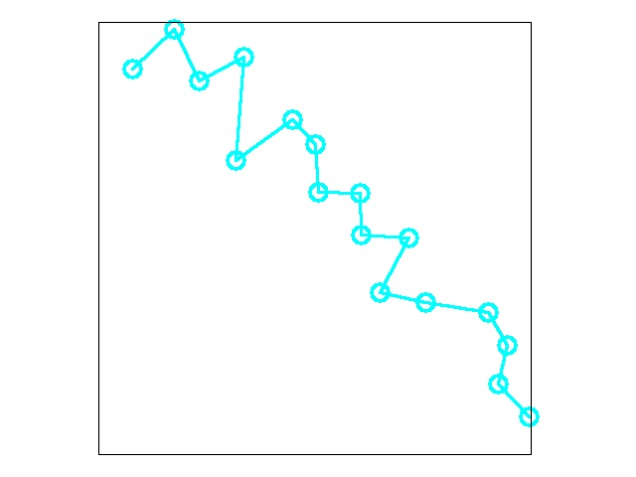
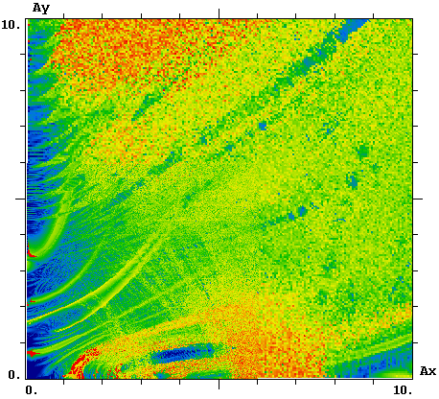
Present nominal HL-LHC (3/4)
β*=40/40cm, θ=590μrad (20.3 σ) N=2.2⋅10¹¹ , L=8.7E34
A_{s} = 2.45 σ = 2.7E-4
1E6 turns DA is over 9 σ for Δp/p=2.7E-4

Slide 6
Present nominal HL-LHC (4/4)
Conclusion:
One should not be too concerned about ξ=0.032 !

Slide 7
Crab-Kiss #1 (1/4)
constant θ=590 μrad (12.5 σ)
constant β*=15/15 cm
leveling by C-K angle in crossing plane
ξ=0.015
Are there beam-beam effects from C-K?

Slide 8
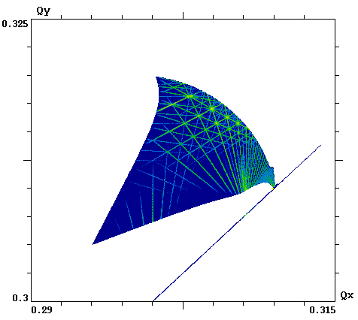
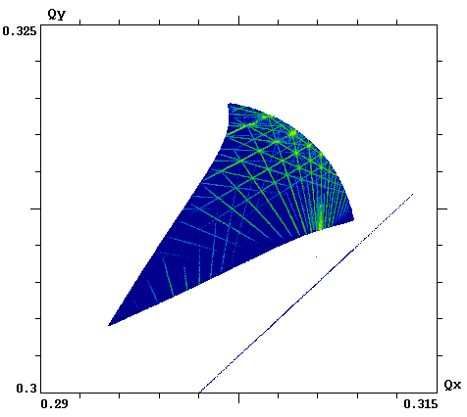
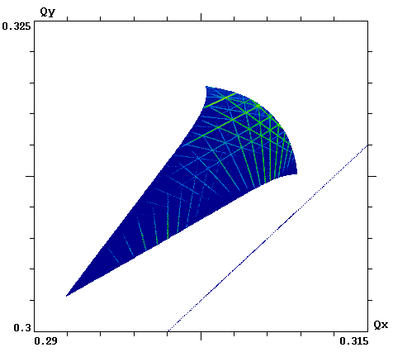
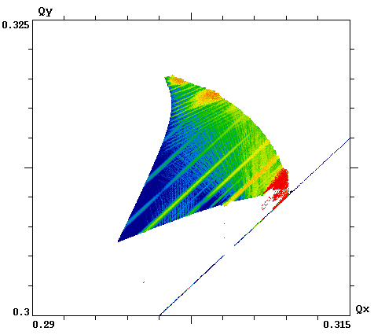
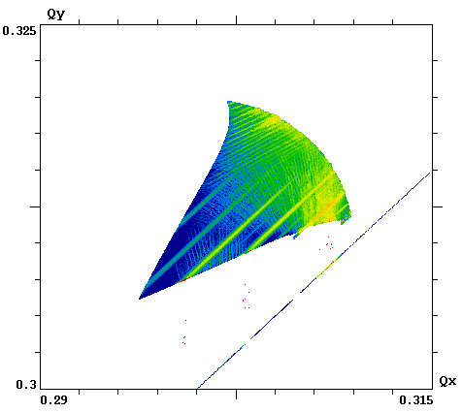
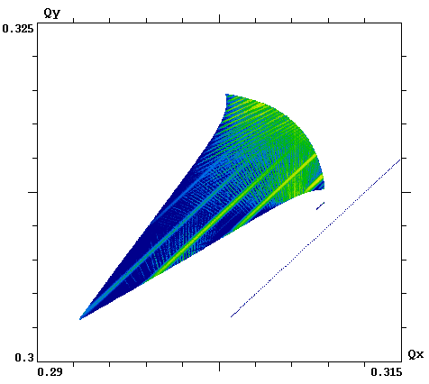
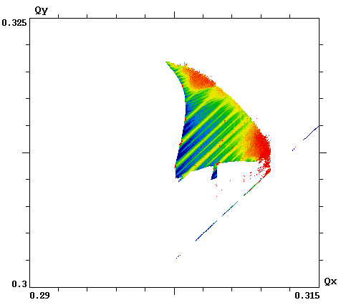
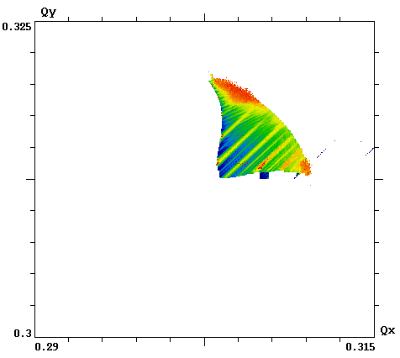
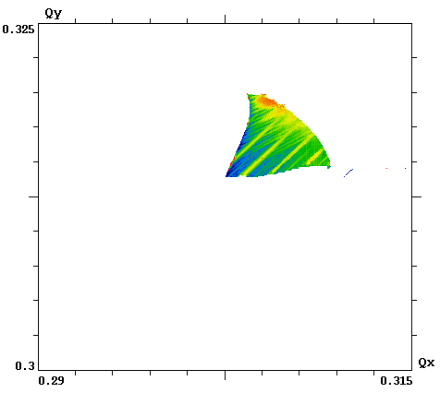
Crab-Kiss #1 (2/4)
C-K 590, N=2.2⋅10¹¹ ½ C-K, N=1.7⋅10¹¹ Crab cross., N=1.28⋅10¹¹
A_{s} = 0
A_{s} = 1
A_{s} = 2.4
L=6.9E34
L=6.9E34
L=6.9E34

Slide 9
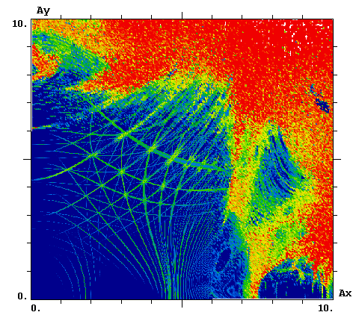
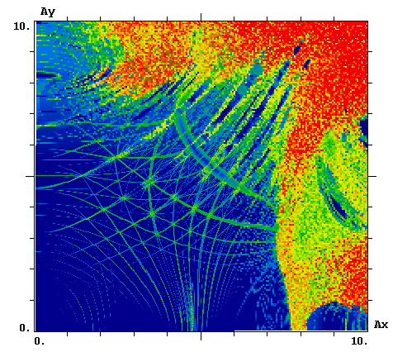
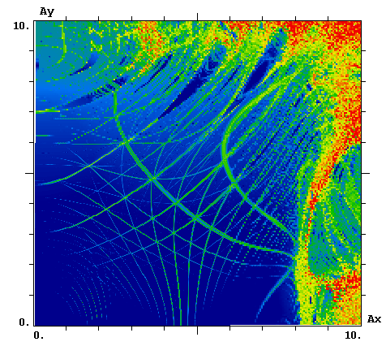
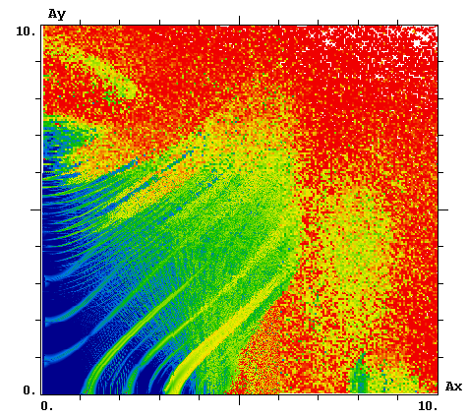
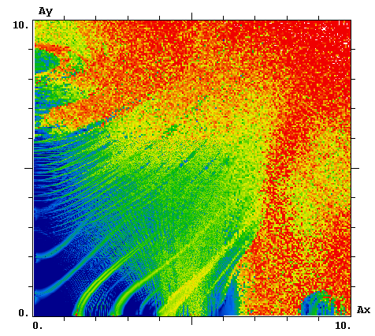
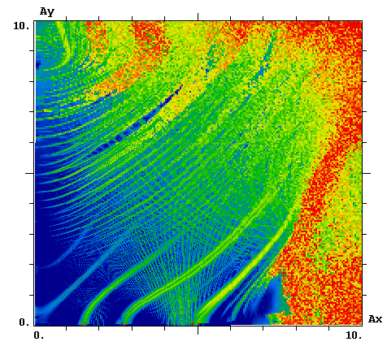
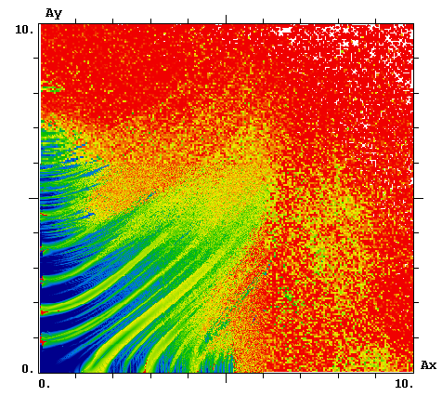
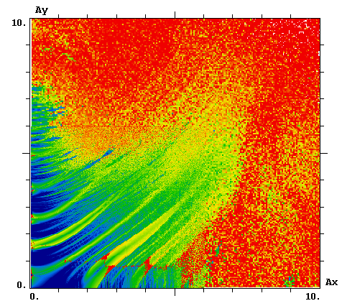
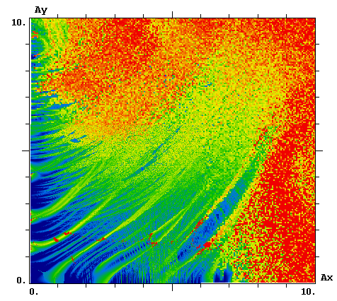
Crab-Kiss #1 (3/4)
C-K, N=2.2⋅10¹¹ ½ C-K, N=1.7⋅10¹¹ Crab cross., N=1.28⋅10¹¹
A_{s} = 0
A_{s} = 1
L=6.9E34
L=6.9E34
L=6.9E34
A_{s} = 2.4

Slide 10
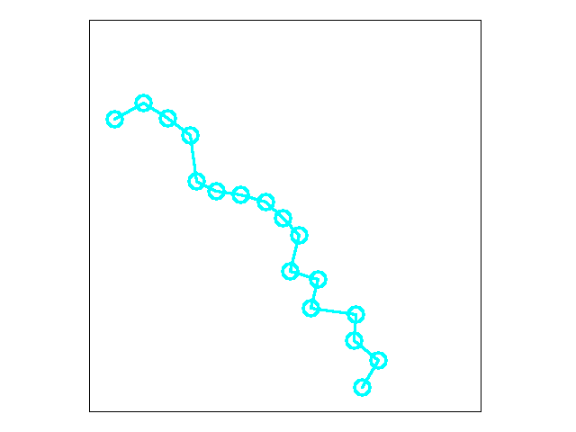
Crab-Kiss #1 (4/4)
1E6 turns DA is over 6 σ for Δp/p=2.7E-4

Slide 11
Crab-Kiss #2 (1/4)
constant θ=550 μrad (16.5 σ)
constant β*=30/7.5 cm
leveling by C-K angle in crossing plane
ξ=0.015
Are there beam-beam effects from C-K?

Slide 12
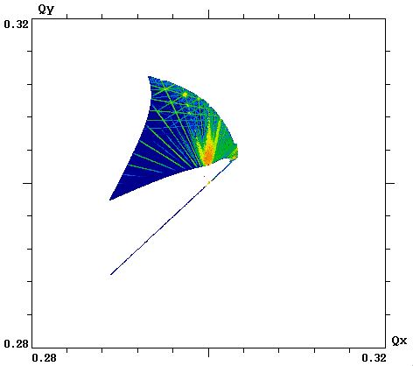
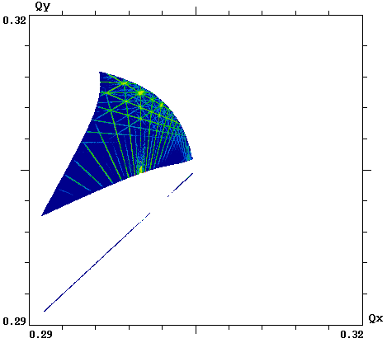
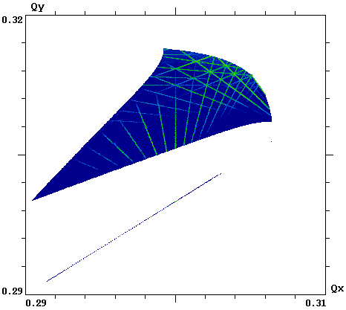
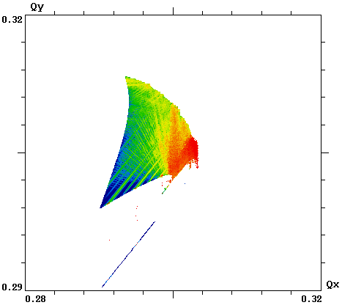
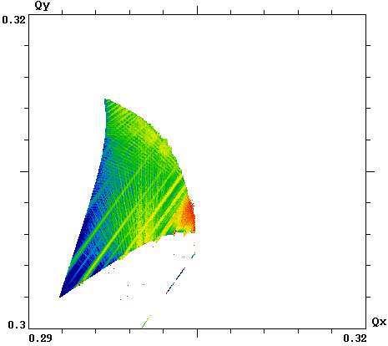
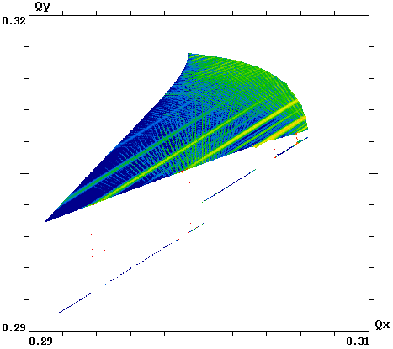
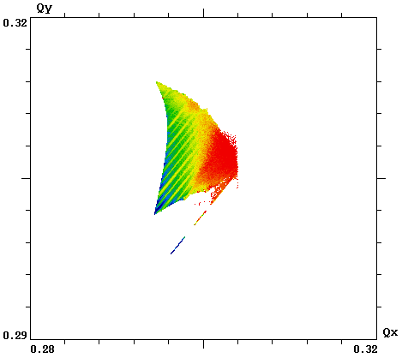
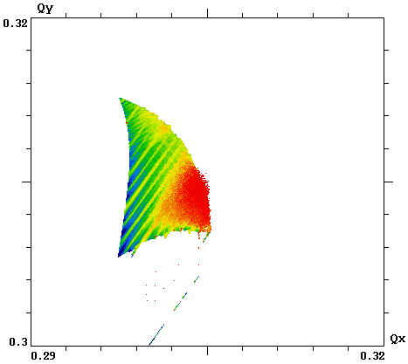
Crab-Kiss #2 (2/4)
C-K 770, N=2.2⋅10¹¹ C-K 550, N=1.66⋅10¹¹ Crab cross., N=1.1⋅10¹¹
A_{s} = 0
A_{s} = 1
A_{s} = 2.4
L=5.1E34
L=5.1E34
L=5.1E34

Slide 13
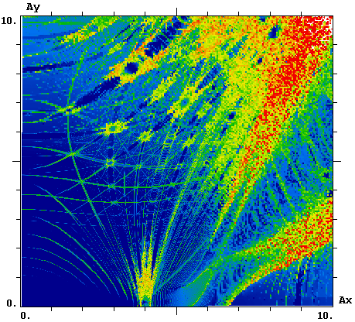
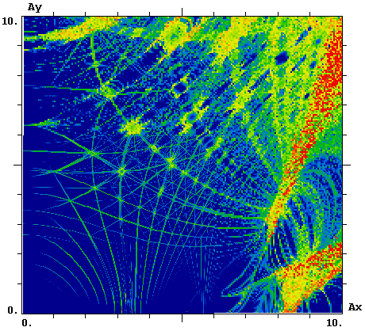
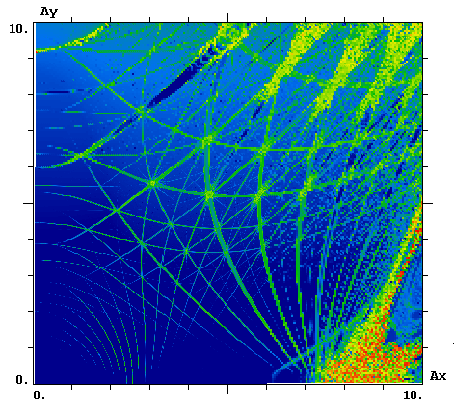
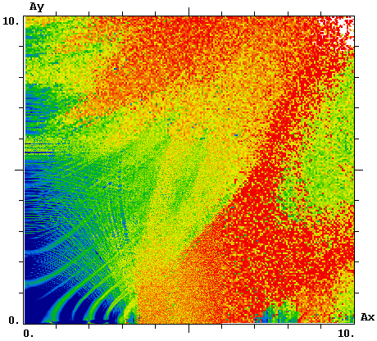
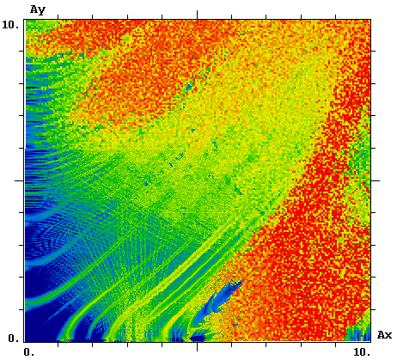
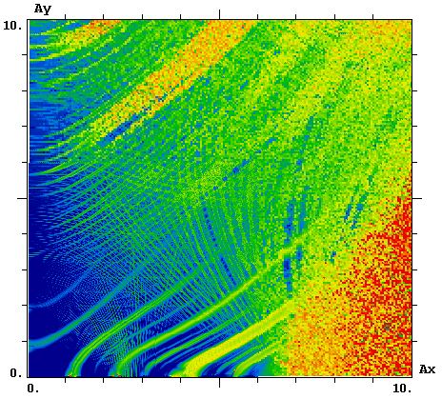
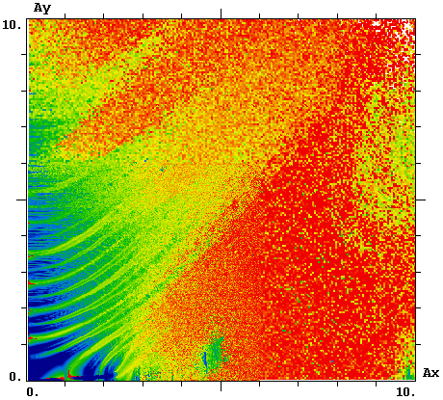
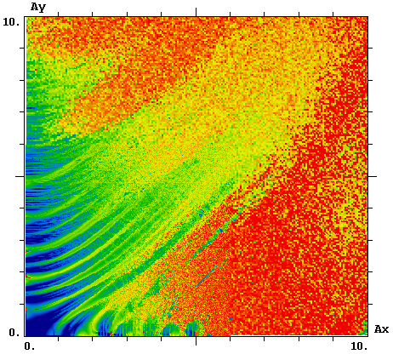
Crab-Kiss #2 (3/4)
C-K 770, N=2.2⋅10¹¹ C-K 550, N=1.6⋅10¹¹ Crab cross., N=1.1⋅10¹¹
A_{s} = 0
A_{s} = 1
L=5.1E34
L=5.1E34
L=5.1E34
A_{s} = 2.4

Slide 14
Crab-Kiss #2 (4/4)
1E6 turns DA – in progress…

Slide 15
Crab-Kiss #3 – TO BE DONE
constant θ=550 μrad (16.5 σ)
constant β*=30/7.5 cm
leveling by C-K angle in parallel separation plane
ξ=0.015
Are there beam-beam effects from C-K?

Slide 16
Summary
The high beam-beam parameter in baseline HL-LHC does not present a problem with beam-beam only
  machine nonlinearities?
The Crab-Kiss collisions in crossing plane limit DA despite lower xi. However, the DA is above 6 with some safety margin
Crab-Kiss in parallel separation plane – in progress

