Slide 1
SAM probes framework
Marian Babik
IT/SDC/MI

Slide 2
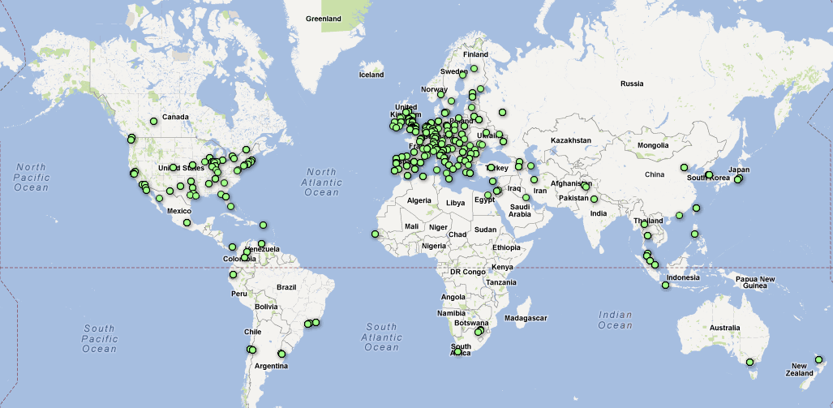
SAM today
SAM - distributed monitoring framework
for computing availability and reliability of sites and services.
179 metrics
4200 services monitored
10 VOs
40 SAM instances
700k metric results/day
Notes:
REGIONS …….. AGGREGATION (CENTRAL) ……… STATISTICS

Slide 3
Probes and metrics
30 probes used by WLCG developed by different PTs and experiments covering:
  ARC, CREAMCE, WMS
  GLEXEC
  SRM probes, LFC
  BDII
  WN probes (file replication)
  Experiment-specific probes (SRM, WN, …)
Implementing 113 metrics
Notes:
OSG

Slide 4
Probes | Used by | Maintained by
CREAMCE (WMS) DirectCREAMCE | OPS, ATLAS, ALICE, CMS, LHCb OPS, LHCb, ALICE | CREAM PT
ARC | OPS | ARC PT
GLEXEC | ATLAS, LHCb, ALICE, OPS | GLEXEC PT + SAM
CMS-GLEXEC | CMS | CMS
BDII | OPS | BDII PT
SRM | OPS | dCache PT
LFC | ATLAS, LHCb, OPS | DPM PT
ATLAS SRM CMS SRM LHCb SRM | ATLAS CMS LHCb | ATLAS CMS LHCb
ATLAS WN CMS WN LHCb WN gen. WN | ATLAS CMS LHCb OPS, ALICE | ATLAS CMS LHCb OPS
WN replication tests | OPS | DPM PT

Slide 5
Probes and metrics
Probe can implement multiple metrics
Metrics can be executed with different credentials
  31 OPS metrics (ops, pilot)
  5 ALICE metrics (alice, pilot)
  35 ATLAS (production, lcgadmin, pilot)
  22 CMS (production, lcgadmin, pilot)
  20 LHCb (production, pilot)
Notes:
OPS (ops, pilot) – 31 metrics
WLCG reports only; many more (unicore/mpi)
ALICE (alice, pilot) – 5 metrics
ATLAS (production, lcgadmin, pilot) – 35
CMS (production, lcgadmin, pilot) – 22
LHCb (production, pilot) - 20

Slide 7
NAGIOS Probes Framework
NAGIOS probe framework
  Well-defined interface for probes (status/output) and many examples
Both polling and pushing supported
Currently both approaches are used
  1. Active - Polling for BDII, Job Submission
  2. Passive – Pushing results to messaging and then via nsca or pipe to NAGIOS
    2.1 Passive - Submitted by active (WN)
    2.2. Passive – Directly published from 3rd party monitoring systems (ATLAS-HC)
Notes:
Direct MSG without NAGIOS

Slide 8
Probes Development
Different possibilities:
  Following instructions for developing NAGIOS probes (BDII, nagios-exchange)
  Using python-gridmon - SAM NAGIOS probe library (CREAMCE, WMS, SRM)
  Publishing metric results to messaging
    WN, ATLAS HC; LHCb Dirac (started)

Slide 9
Probes Development with python-gridmon
Container for metrics
Grid security support (VOMS proxy)
Configurable interaction with NAGIOS
Integration in EPEL ongoing
Used by SRM, CE probes and their extensions for experiments

Slide 10
Probes Development – 3rd party systems
Can publish metric results directly to message bus
  Automatically imported by SAM to NAGIOS
Steps:
  Adding metric(s) to Profile Management
  Add metric configuration (passive)
  Start publishing results to messaging
  Results automatically processed by SAM

Slide 11
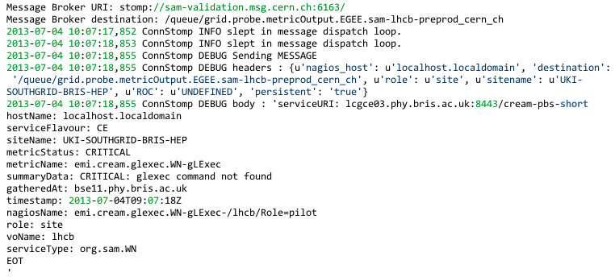
Message format

Slide 12
Questions
Is SAM monitoring with OPS credentials essential for WLCG ?
  Currently provided through EGI/NGIs
  Consuming significant amount of central resources
  Removing OPS from reports ongoing (see May WLCG MB)
Notes:
Is the current SAM probe framework sufficient for service-level monitoring in WLCG ?
using information already present in pilot frameworks as an alternative was suggested many times (but maybe more suitable to just run in parallel) ?

Slide 13
SAM OPS vs EXP infrastructure

Slide 14
Use of SAM

Slide 15
Questions
Is it essential to have all metrics in NAGIOS ?
  It’s also possible to avoid NAGIOS and publish metrics directly to SAM central service
Do we need VO independent metrics ?
  e.g. BDII
Do we need to run metrics with multiple FQANs ?
Is current metric results expiration policy appropriate ?
  not enforced right now, but important to keep aggregation performance
  metric results kept 3 months
  metric status changes kept 12 months
Notes:
VO independent metrics
Use of FQANs
Do we need all metrics in NAGIOS ?

Slide 16
Issues
How do we move away from WMS-based job submission testing ?
  job submission probe that can send WN payload depends now on WMS; used for ARC, OSG and CREAM
  what are the alternatives ? condor-g; direct-cream probe extension; new arc probes ?
Notes:
How do we split responsibility for maintaining probes ?
SAM – NAGIOS, python-gridmon
PTs – core probes (but not probe environment ! emi-nagios)
Experiment – extensions to core probes + experiment-specific probes

Slide 17
Summary
SAM/Nagios offers flexible probe framework with many existing probes
Different possibilities exists to develop probes
Job submission probes might require significant changes (soon)
  To move away from WMS
  To preserve our investment in WN tests

Slide 18
References
SAM Documentation
SAM Probe Framework
Importing results from external monitoring systems

Slide 19
Backup slides

Slide 20
Probes and metrics setup
Probe environment
  now emi-nagios, previously glite-ui
  emi-ui possible (but has unicore, etc.)
Probe configuration (Nagios API, probe defaults)
Metric configuration
  Probe to metrics mapping
  Metric dependencies
  Probe command line arguments (--add-wn-tarball)
  Probe variable arguments (vo, fqan, broker)
  Frequencies,
Metric aggregations
  Profile management (groups services and metrics)

