Slide 1
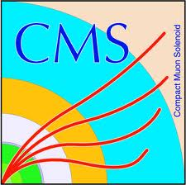

Treatment of p_{T}(gg → H) in CMS
Roberto Covarelli - U. of Rochester

Slide 2
Use of p_{T} in the CMS Higgs analysis
Important use of p_{T} in only in the H → ZZ → 4l channel analysis (search performed in 100 < m_{4l} < 1000 GeV)
  For events where there are less than 2 jets reconstructed, use to discriminate ggH from VBF and VH production
  Improves uncertainty on μ (3-dimensional analysis)
  Maybe use for a primordial differential cross-section measurement (but event yield very small)
Other channels do not have enough events, or not clean enough, for accurate use of p_{T}
  Use same theoretical description as ZZ for acceptance estimation (γγ) or use older MC and reweight (WW, ττ)

Slide 3
MC choices for gg → H
Close-to-latest POWHEG (Feb 2013)
  Including heavy-quark mass effects
    Latest b and t masses (top mass from Moriond 2013 CDF update)
  hfact tuning (hfact = m_{H}/1.2) to reproduce NNLO+NNLL spectrum
  Use of propagator scheme (CPS) for mass lineshape, with EW corrections on
    Mass window (range = m_{H} ± masswindow · Γ_{H}) for sampling Higgs virtuality had to be tuned by hand to avoid errors in the program about hitting the high limit

Slide 4
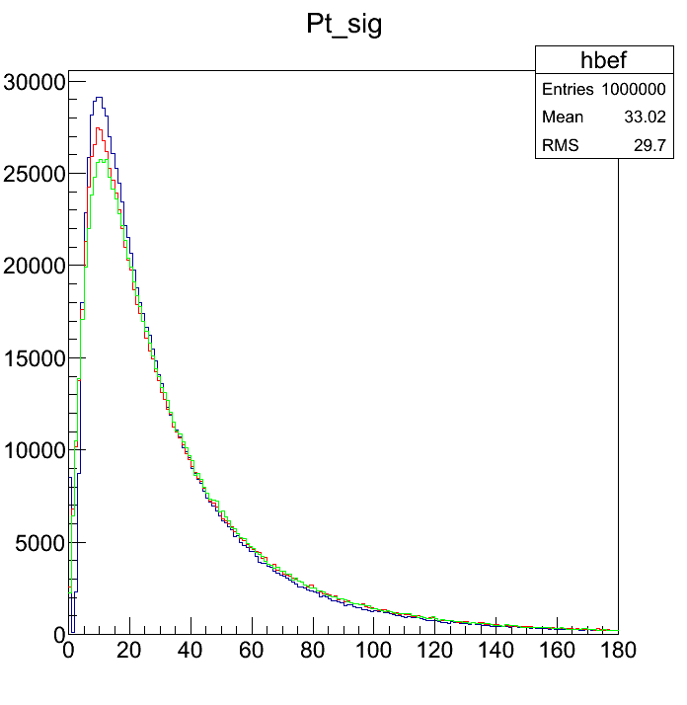
Verifying NNLO+NNLL tuning
Several spectra generated to verify correct reweighting, with:
  HRes for m_{H} <= 400 GeV
  HqT 2.0 above (HRes not available)
Following recommendations of YR2 comparison was done with NLO spectra:
  with no HQ effects
  after parton-shower only performed by PYTHIA
POWHEG LHE
LHE + PS only
LHE + PS + UE + hadronization

Slide 5
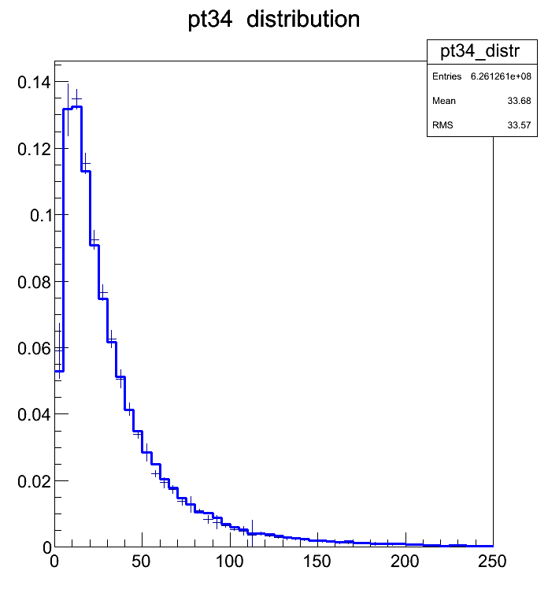
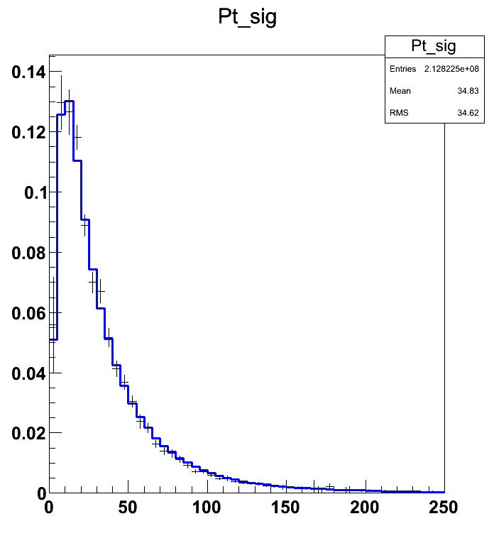
NNLO tuning: low mass
Agreement with HRes is excellent at low mass for both 7 and 8 TeV
7TeV
mH =125 GeV
8TeV
mH =125 GeV
+ HRes
- POWHEG
(PS, no UE)

Slide 6
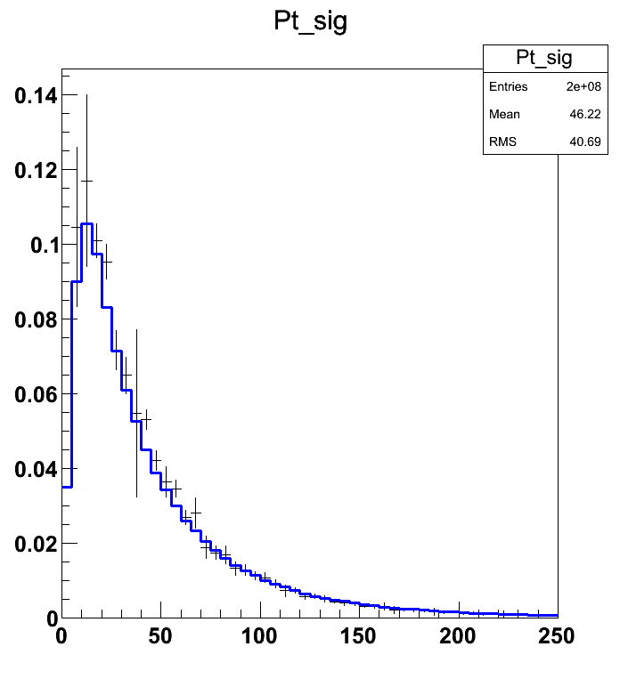
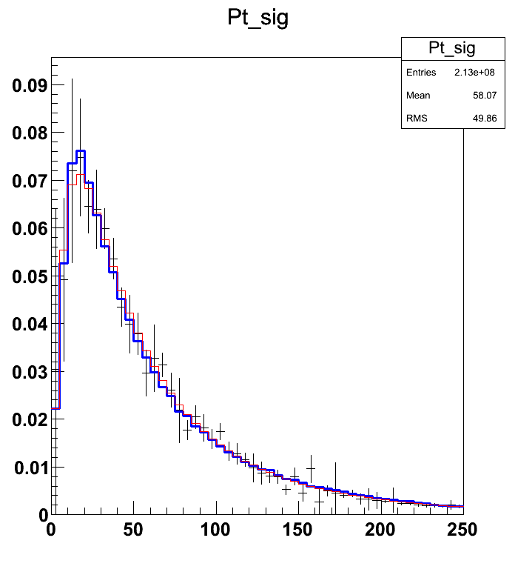
NNLO tuning: intermediate mass
8TeV
mH = 200 GeV
+ HRes
- POWHEG
(PS, no UE)
8TeV
mH =400 GeV
+ Hres
- HqT 2.0
- POWHEG
(PS, no UE)

Slide 7
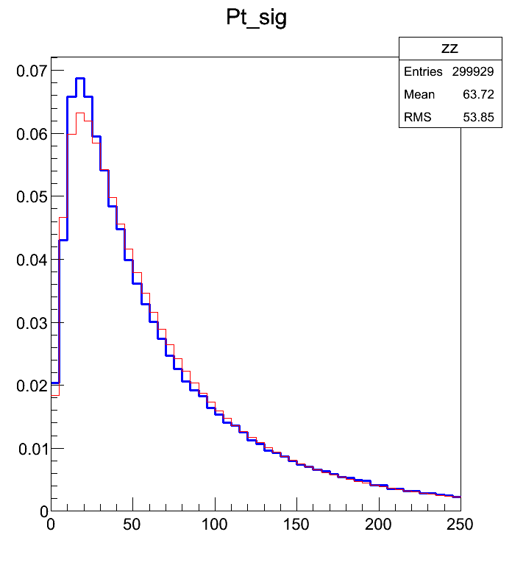
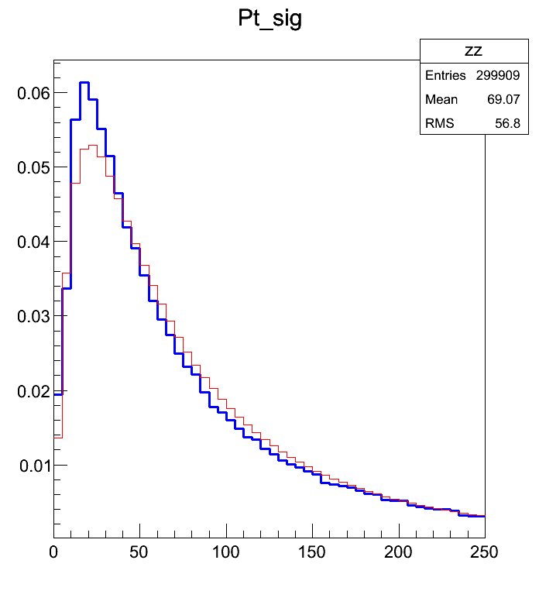
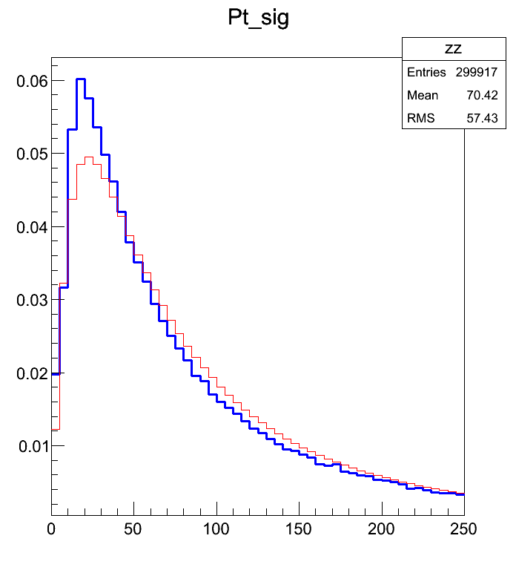
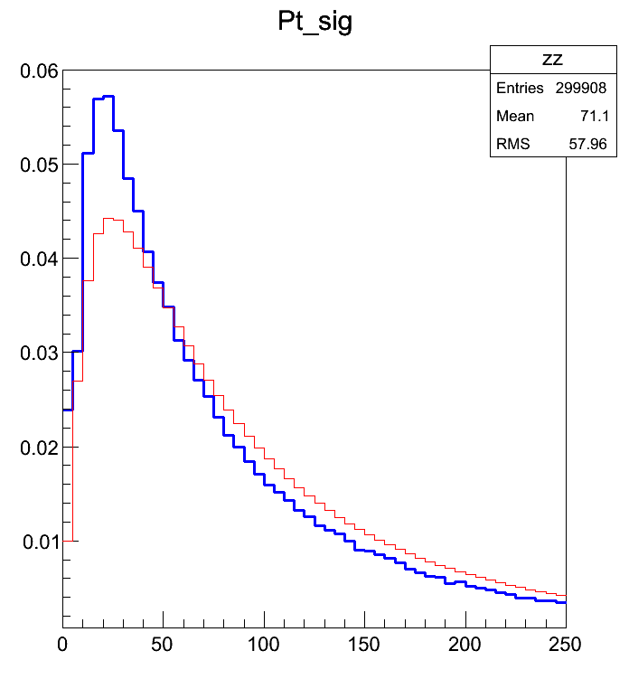
NNLO tuning: high mass
8TeV
- HqT 2.0
- POWHEG
(PS, no UE)
mH =500 GeV
mH =600 GeV
mH =700 GeV
MC reweighting needed for m_{H} > 400 GeV
mH =800 GeV
mH =1000 GeV

Slide 8
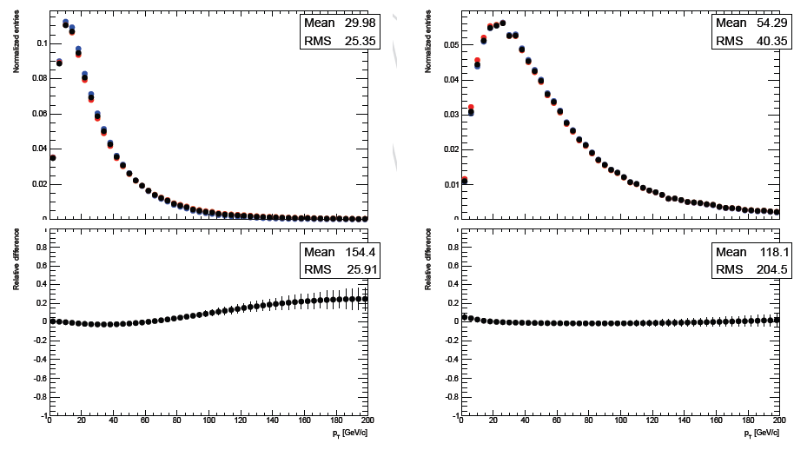
Scale systematics
Easy to include
  Re-run HRes with halved and doubled QCD scales (Res, Ren, Fact) and evaluate effect on spectrum
  Up to 20% effect at low mass, almost negligible at high mass
Default scales
Scales x2
Scales / 2
mH =125 GeV
mH =800 GeV

Slide 9
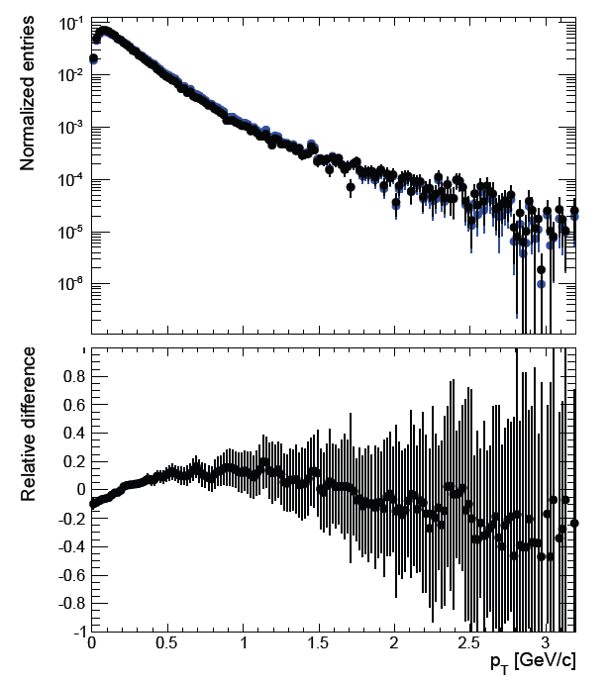
Finite heavy quark masses - PDFs
Finite top (and bottom) mass effects as described by POWHEG
  Quite large effect (up to 15%)
  For the moment use b and t mass uncertainties to establish systematics ← 1-2%, too small?
  Comparison with other generator?
    Unfortunately no productions with MC@NLO done in CMS
    Suggestions?
Other PDF sets tested (CT10, MSTW2008, NNPDF2.1)
  Effect also negligible compared to resummation
With HQM
No HQM

Slide 10
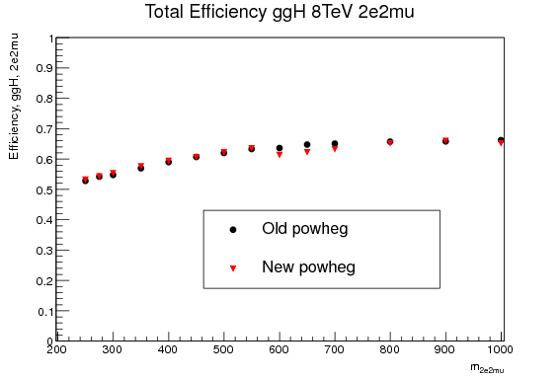
Mass window issue?
    Mass window (range = m_{H} ± masswindow · Γ_{H}) for sampling Higgs virtuality → set a default value of 10
    At high mass it had to be tuned by hand to avoid errors in the program about hitting the high limit
    Examples:
      500 GeV: 0.5 < m_{H} < 1180 GeV
      550 GeV: 0.5 < m_{H} < 1480 GeV
      600 GeV: 0.5 < m_{H} < 1707 GeV
      650 GeV: 0.5 < m_{H} < 1756 GeV
      700 GeV: 0.5 < m_{H} < 1780 GeV
      800 GeV: 0.5 < m_{H} < 1955 GeV
      …
    Caused strange “drop” in detector acceptance (had to be smoothed), not well understood
CMS internal

Slide 11
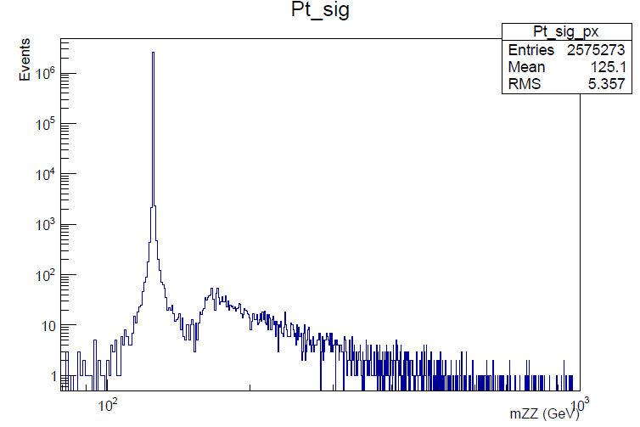
Mass window issue?
    Mass window (range = m_{H} ± masswindow · Γ_{H}) for sampling Higgs virtuality → set a default value of 10
    At low mass always kept this value → are we losing a fraction of the cross-section?
    Tested very large mass window:
      For mH = 125 GeV, 99.83% of the cross-section in the peak
      According to Kauer-Passarino the effect could be larger when considering the ZZ final state…

Slide 12
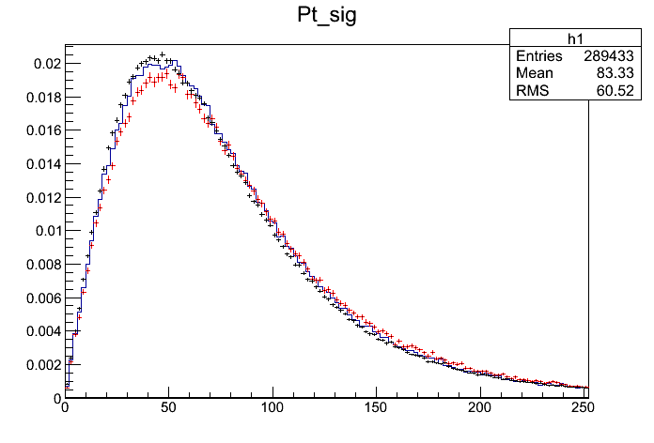
On VBF and VH p_{T}
For VBF use POWHEG p_{T} spectrum
  Vary PDFs and scales
VH was not available in POWHEG until recently
  For the moment use Pythia or ThePEG/HERWIG++ and use the difference in spectrum as systematics
  Plan to move to same treatment as VBF (vary PDFs and scales) → no big change expected
WH – 8 TeV
m_{H} = 125 GeV
HERWIG++
Pythia
New POWHEG

Slide 13
Conclusions
Most sophisticated studies on p_{T} in CMS come from ZZ → 4l Higgs analysis
  Used to discriminate ggH, VBF/VH and background in a large m_{ZZ} search range (100-1000 GeV)
Use POWHEG to describe signal spectrum
  NNLO tuning works up to mH ~ 400 GeV, reweighting needed for larger masses
  Finite HQ masses used ← uncertainty derived from HQ mass uncertainties, too optimistic?
  Using complex-pole scheme with EW corrections, strange efficiency drop at 600 GeV not very well understood
    Effect of Higgs virtuality ranges (only thing set by hand)?

