Slide 1
THE BASIS of VACUUM
G.Vandoni, CERN
Physics of gases
Flow regimes
Definitions
The pumpdown process
Conductance
Conductance calculation

Slide 2
Physics of gases

Slide 3
Units and conversions
Pressure
To From | Pa | mbar | torr
Pa | 1 | 0.01 | 7.5/1000
mbar | 100 | 1 | 0.75
torr | 133 | 1.33 | 1
To From | l /s | cm³/s | m³/h
l /s | 1 | 1000 | 3.60
cm³/s | 0.001 | 1 | 0.0036
m³/h | 0.278 | 278 | 1
Pumping speed Volumetric flow
Conductance
[Volume/time]
Flow or Throughput
To From | Pa m³/s | mbar l/s | torr l/s
Pa m³/s | 1 | 10 | 7.5
mbar l/s | 0.1 | 1 | 0.75
torr l/s | 0.133 | 1.33 | 1
[Pressure ×Volume/time]

Slide 4
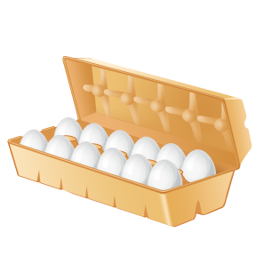

The physics of Gases
The ideal gas law
An ideal gas is composed of randomly-moving, non-interacting point particles.
1 dozen =
12 units
p = pressure
V = volume
n_{m} = amount of gas (number of moles)
T = temperature
R = general gas constant [8,314 J/(mol K)]
1 mole =
6.022x10²³ units
n = amount of gas (number of atoms or molecules)
k_{B} = Boltzmann constant = R/6.022x10²³
Notes:
The state of an amount of gas I determined by its pressure, volume and temperature.
k_{B}: relates temperature and energy
Approximation

Slide 5
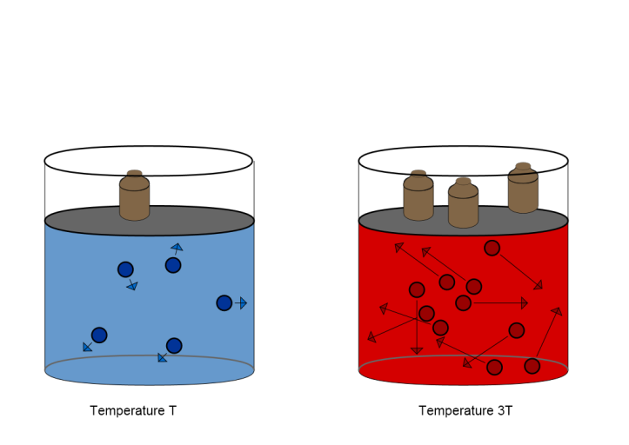
The physics of Gases
Useful forms of the ideal gas law
In a closed volume, increasing temperature from T₁ to T₂ , pressure increases proportionally from p₁ to p₂
At constant temperature, the same number of molecules distribute in 2 volumes V₁ and V₂ at pressures p₁ and p₂ such that:
V₁
V₂
Notes:
The state of an amount of gas I determined by its pressure, volume and temperature.
k_{B}: relates temperature and energy
Approximation

Slide 6
Gas Mixtures and Partial Pressures
DEFINITION
Partial pressure is the pressure which a gas would exert if it occupied the volume of the mixture on its own
n₁
n₃
n₂
Dalton law
The total pressure exerted by a mixture of (non-reactive) gases is equal to the sum of the partial pressures of individual gases

Slide 7
Flow regimes

Slide 8
Mean free path λ and density
The average distance traveled by a molecule between collisions with other molecules
Vacuum range | Pressure [mbar] | n [molecules/cm³] | Mean free path
Ambient pressure | 1013 | 2.5 × 10¹⁹ | 68 nm
Low vacuum | 300 – 1 | 10¹⁹ – 10¹⁶ | 0.1 – 100 μm
Medium vacuum | 1 – 10⁻³ | 10¹⁶ – 10¹³ | 0.1 – 100 mm
High vacuum | 10⁻³ – 10⁻⁷ | 10¹³ – 10⁹ | 10 cm – 1 km
Ultra high vacuum | 10⁻⁷ – 10⁻¹² | 10⁹ – 10⁴ | 1 km – 10⁵ km
Extremely high vacuum | <10⁻¹² | <10⁴ | >10⁵ km
λ
rarefaction
molecular chaos
trajectory of a molecule
At 296K=23C

Slide 9
Mean Free Path λ
The average distance traveled by a molecule between collisions with other molecules
n = density of molecules
σ = collisional cross section
For N₂:
mean free path × pressure, room temperature, in [m×Pa] = [cm×mbar]
In the hard sphere molecules approximation
(d = diameter)
λ inversely proportional to p
Gas | λ⋅ p | Gas | λ⋅ p
H₂ | 12x10⁻³ | CO₂ | 4 x10⁻³
N₂ | 6.4x10⁻³ | Ar | 7x10⁻³
He | 19x10⁻³ | Ne | 14x10⁻³
CO | 7x10⁻³ | Kr | 5x10⁻³
Ideal gas law
Notes:
Lambda not depending on the temperature and therefore not on the velocity of the molecules, just by the spatial distribution of targets and their size

Slide 10
Mean free path and flow regime
The flow dynamics is characterized by the comparison of the mean free path λ to the dimension D of the vacuum vessel.
Collisions with wall (much) more frequent than with molecules
Knudsen number
Free Molecular Flow | λ >D
Transitional (or intermediate) flow | D/100< λ< D
Viscous (continuum) flow | λ< D/100
K_{n} >1
0.01< K_{n}< 1
K_{n}< 0.01
Collisions with molecules dominate
Applying the previous slide, we have a useful relation between pressure and dimension of the vessel to distinguish flow regimes:
Molecular flow: p⋅D<0.064 [mbar . mm]
Viscous flow: p⋅D>6.4 [mbar . mm]
Room temperature, for N₂
λ
molecular chaos
trajectory of a molecule
trajectory in a rarefied gas, λ>D
Notes:
Chambers p.42
- Kn number: criterion for distinguish between the regimes
- Explain each regime
- No sharp transition between the regimes

Slide 11
Definitions
Throughput
Pumping speed

Slide 12


Gas Flow: throughput …
French: débit
Throughput=gas flow rate
Quantity of gas d(pV) crossing a plane along a duct in unit time dt.
From the ideal gas law written per unit time, we see that this is a energy flow rate.
Pa⋅m³⋅s⁻¹= N⋅m⋅s⁻¹ = J⋅s⁻¹= W
particle flow rate
packet of energy
count money=count dwarfs
This is equivalent to a particle flow rate only at constant temperature.
When flow doesn’t change with time (we say steady state), Q has the same value at every position along the pipework: mass is conserved.
The same flow subsists in different locations of a continuous unbranched isothermal pipework
Notes:
10: Qin=Qout meaning everything which arrives at the entrance of a pipe get to the other extremity. We will see a generalization of this later on, discussing the continuity equation.

Slide 13
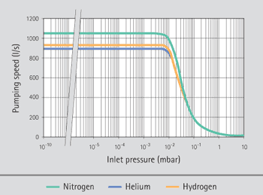
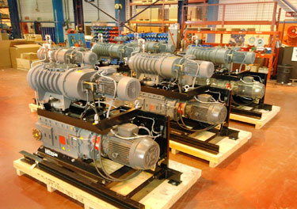
…and pumping speed
We usually call
the volumetric flow rate (débit volumétrique)
in particular, at the entrance of a pump, we call it pumping speed, S.
Substituting this in the definition of throughput, we obtain:
“The quantity of gas flowing is the product of pressure and the volumetric flow rate at that pressure”
Pumping speed is usually depending on pressure, so S=S(p)
Pumping speed is different for different gas species

Slide 14
The pumpdown process

Slide 15
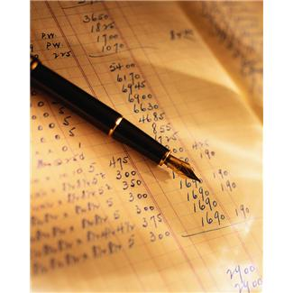
The pumping process
vessel
S* pumping speed of the pump
S pumping speed at the vessel, of volume V
p pressure in the vessel
Q_{tot} = sum of all gas loads entering the vessel: outgassing, leaks and permeation, process gas…
Q_{L}
p
pump
Q_{G}
Q_{p}
Q_{v}
S
S*
V
BASIC EQUATION OF PUMPING – or the Continuity Equation
Amount of gas getting into the free volume in a time dt at pressure p and speed S
Gas pumped away in a time dt at pressure p and speed S
Q_{Tot}dt
Spdt
V.dp
Change of amount of free gas in the volume V

Slide 16
The pumping process
vessel
S* pumping speed of the pump
S pumping speed at the vessel, of volume V
p pressure in the vessel
Q_{tot} = sum of all gas loads entering the vessel: outgassing, leaks and permeation, process gas…
Q_{L}
p
pump
Q_{G}
Q_{p}
Q_{v}
S
S*
V
BASIC EQUATION OF PUMPING – or the Continuity Equation
The difference between the quantity of gas entering the volume and the one leaving it in a small interval of time dt is equal to the net change in the quantity of gas in the volume V, d(pV)=V·dp
Q_{Tot}dt
Spdt
For conserved quantities:
«Everything which enters a volume minus everything which leaves it, equals the net increase in the quantity in the volume»
V.dp
To go deeper:
NB: T=constant, i.e. isothermal conditions, or pV is not the conserved quantity

Slide 17
The continuity equation
Usually, the quantity of gas in a pumped volume decreases with time, so we can turn the equation to better express this reduction:
The rate of change of the amount of gas in a chamber is the difference between the rate of its removal and the influx rate.
What does dp mean? Or dt?
dp is the change in pressure, not the absolute, measured pressure.
dt is a small time interval in which the change occurs.
Notice that it is not always easy to apply the continuity equation to know how pressure reduces with time:
Q_{Tot} is time dependent, and also depends on the previous history of the system. S is dependent on pressure and also on gas species…

Slide 18
Example: continuity equation
After 3h pumping, pressure is presently 5.10⁻⁷mbar. The pumping speed of the turbomolecular pump, including reduction by the conductance connecting it to the vessel, is 10ls⁻¹.
The vessel is a tube, 1m long and 400mm in diameter. Chronometer in the hand, you notice that 40s later pressure has decreased to 4.10⁻⁷mbar.
What is the rate of change of pressure in this moment?
In absence of leaks, can you evaluate the total outgassing rate of the vacuum chamber in this moment?
p=5·10⁻⁷ mbar
dt =40s, dp =1·10⁻⁷ mbar dp/dt=2.5·10⁻⁹mbar/s
S_{eff} =10 l/s
d =400mm, L=1000mm
Q_{outg}=(5·10⁻⁶ +3·10⁻⁷ ) mbar ·l·s⁻¹ = 5.3 ·10⁻⁷ mbar ·l·s⁻¹

Slide 19
Pumpdown: initial phase
Q_{pumped}
Initially, the pumpdown process is dominated by evacuation of the free gas in the volume. Let’s write Q_{tot}=0 and let’s call p_{initial}(t) the pressure decrease curve in the initial phase of pumpdown.
Gas quantity present in the volume (pV) decreases while gas is evacuated by the pump.
p_{o}
10³
10²
Pressure
Volume depletion
10¹
1
2
3
4
5
6
7
time
ln p versus t
Remember maths! A function which changes with a rate proportional to the function itself is an exponential…
Characteristic time or time constant

Slide 20
Initial pumpdown time
To make time appear alone, let’s rearrange by taking the natural logarithm on both sides:
We obtain the time to lower the pressure from the initial value p₀ to some value p
Example:
A 50l volume is pumped down with
S=1 l.s⁻¹, starting from 1000mbar to 1mbar.
What is the value of the time constant τ?
How much time does it take per decade pressure lost?
How much time in total?
p
1000
What happens here?
100
τ=V/S=50s
Time per decade=τ.ln(10)=115s
Total time=3.115s=345s
10
1
0.1
0.01
2.3τ
t

Slide 21
Pumpdown: effect of outgassing on p(t)
Below 1 Pa=10⁻²mbar, (~roughing), the curve p(t) starts to deviate from the “free volume” straight line. We cannot neglect outgassing Q_{out} anymore.
10⁻²
10⁻³
Pressure
Volume depletion
10⁻⁴
1
2
3
4
5
6
7
time
ln p versus t
with 0.5n1.2
n ~1 for metallic unbaked surfaces
~0.5 for elastomers, (for baked metallic surfaces)

Slide 22
Pumpdown: effect of outgassing on p(t)
Below 1 Pa=10⁻²mbar, (~roughing), the curve p(t) starts to deviate from the “free volume” straight line. We cannot neglect outgassing Q_{out} anymore.
10⁻²
10⁻³
Volume depletion
Pressure
10⁻⁴
1
10
100
1000
time
with 0.5n1.2
ln(p) versus ln(t)
n ~1 for metallic unbaked surfaces
~0.5 for elastomers

Slide 23
Pumpdown: effect of outgassing on p(t)
Below 1 Pa=10⁻²mbar, (~roughing), the curve p(t) starts to deviate from the “free volume” straight line. We cannot neglect outgassing Q_{out} anymore.
10⁻²
10⁻³
Pressure
Volume depletion
10⁻⁴
1
2
3
4
5
6
7
time
ln p versus t
with 0.5n1.2
n ~1 for metallic unbaked surfaces
~0.5 for elastomers
Eventually, the pressure flattens down and becomes “constant” on the time scale of observation. On a long time scale, it continues to decrease slowly.

Slide 24
Pumpdown: when outgassing dominates
When pressure ceases to fall and becomes constant on the time scale of observation, dp/dt=0.
The equation becomes:
p
We write p_{ultimate} because this pressure won’t decrease on the time scale of observation (ex. 1h)
t
Actually, it decreases, because Q_{out} decreases, but this process is much slower.
The walls of the vessel get progressively emptied from their initial gas contents and gas release to the free volume decreases.
For unbaked metals of standard rugosity,

Slide 25
Example: pumpdown with outgassing
From the pressure and applied pumping speed, you can evaluate the outgassing rate and see if it is conform to expectation
Example:
A stainless steel vacuum vessel of 1m length and 250mm diameter is evacuated by one pumping group of an effective pumping speed 50l/s. After 5h pumping, pressure has stabilized at ~1·10⁻⁶mbar.
Do you consider that everything is running fine?
p·S=5·10⁻⁷mbar·l/s
A=7850 cm²
t=5hr=18,000s ϕ=3·10⁻⁹mbar·l/cm²

Slide 26
Conductance

Slide 27
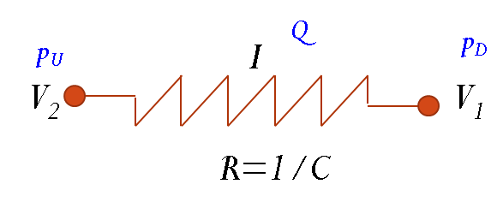
Conductance
Q
C
This equation relates throughput (fr. débit) to the difference between upstream and downstream pressure.
It is the DEFINITION of conductance.
p_{U}
p_{D}
The quantity of gas which is flowing across a given pressure difference depends on the ease of flow , described by CONDUCTANCE.
Its reciprocal 1/C is a resistance to flow; i.e., the opposition the system exerts to gas flow.
Useful (but approximate) analogy to electrical circuit
Driving force: voltage drop or pressure difference
Flowing quantity: electrical charge or molecules
Flow: electrical current or throughput
Notes:
Across the same pressure difference we have a larger flow of gas when the term C is large. C represents the opposition to flow by the system.

Slide 28
Combining conductances
In parallel
In series
Derivation:
Conservation of flux
Definition of C
Q
Q
p_{U}
p_{D}
p_{U}
p_{D}
C₁
Q
C₁
C₂
p_{U}
p_{D}
p_{U}
p_{D}
C₂
Approximate: it overestimate resistance, by neglecting beaming and entrance resistance cancelling

Slide 29
Reduction of pumping speed by connecting pipe
Application of the combination of conductances in series.
S*
p*
C
S
p
or
S* effective pumping speed at the chamber
S real pumping speed
p* pressure in the chamber
p pressure at the entrance of the pump
C connecting conductance
Q throughput through the pipe and into the pump
S* is less than S!
Lets plot S*/S reduction of pumping speed, against C/S, ratio between conductance and pumping speed
80%
Ex: If the conductance is equal to the pump’s speed, we only get 1/2 of it at the vessel. To get 80% pumping speed at the vessel, we need a conductance 4x larger than the pumping speed.
C=S
C=4S
Notes:
What is in ordinate, what is in abscissa. We have C/S, the comparison between C and S. So for example (click), this is a conductance equal to the pumping speed, say 100l/s atached to a 100l/s pump.

Slide 30
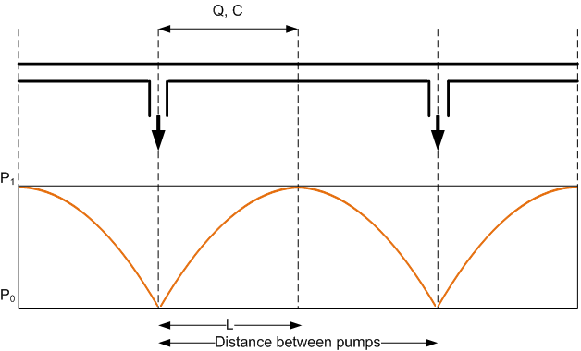
Pressure profile in long tube with localized pumps
A tube under vacuum will outgas uniformly over its whole internal surface. Pumps are installed along the tube. Due to the limited (i.e., not infinite) conductance of the tube, pressure will have maxima at equal distance from two pumps and minima above the pumps.
PRESSURE PROFILE
From the continuity equation, it is obvious that:
It is not difficult to show also that
Q: outgassing flux [mbar.l.s-1]
S: pumping speed [l/s]
C: tube conductance [l/s]
Notice differences in pressure measurement in long tubes, depending on their distance to the pump!

Slide 31
Conductance calculation
Conductance in viscous flow
Conductance in molecular flow

Slide 32
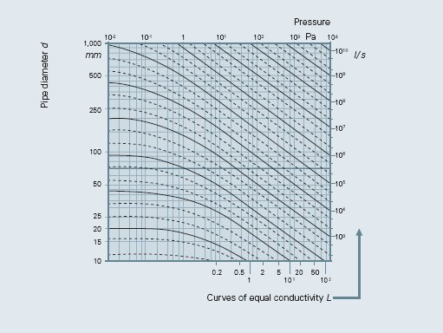
Conductances and flow regimes
On the figure: the equal conductivity curves on a p,d graph
- read for example: 10⁶ l/s and 1 l/s
10⁻⁴
10⁻³
10⁻²
10⁻¹
1
10
[mbar]
Let’s anticipate, that the conductances of pipes will differ in different flow regimes:
In continuum flow, they are proportional to mean pressure p.
In molecular flow they are not a function of pressure.
In Knudsen flow, a transition between the two types of flow, conductances vary with Knudsen number.
At the same diameter, conductance in continuum regime is much larger than in molecular regime
viscous
10⁶
molecular
1
100
Above p⋅D>6.4 mbar.mm, flow is viscous
Below p⋅D<0.064 mbar.mm, flow is molecular

Slide 33
Continuum (viscous) flow through pipes
Viscous gas flow may be:
LAMINAR:
gas flows smoothly in stream lines, parallel to the duct walls.
TURBULENT :
gas flows chaotically and irregularly brakes up into vortexes.
In most cases treated in vacuum technology, we are in laminar conditions
Inertia forces compared to viscous forces
Viscous forces are stabilizing
Inertial forces are destabilizing
Re<2000
Re>2000
Reynolds number Re compares the two effects
ρ = density of the fluid
η = viscosity
u = flow velocity
D_{h} = hydraulic diameter
A = cross sectional area
B = wetted perimeter
Notes:
Lafferty section 2.3

Slide 34
Viscous laminar flow - Poiseuille
This is valid only for long tubes, i.e., rarely in vacuum… But it helps understanding this matter.
Circular cross section, long tube
Diameter D
Between pressures p₁ and p₂
With η viscosity of the fluid
is the average pressure between entrance and exit pressure
NB:
In viscous flow, conductance is proportional to pressure! Already seen 2 slides ago
The effect of diameter D on C is with D⁴, so doubling D means a factor 16 in conductance
Notes:
Lafferty pages 110-111

Slide 35
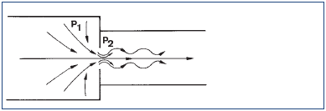
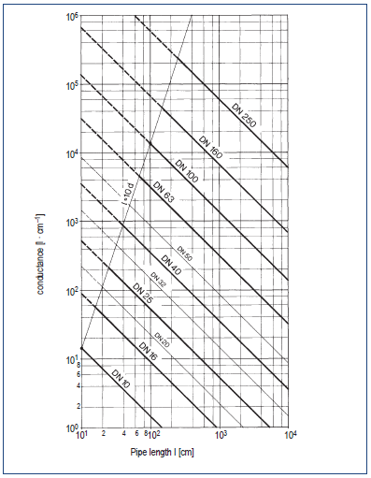
Viscous regime: Short tubes conductance
The difficulty here is that the velocity profile changes at the aperture, with a minimum cross section at the aperture, then with oscillations of contraction/expansion before reaching fully developed flow.
Nomograms may be used.
Particular case of practical use in vacuum:
choked (or sonic) flow.

Slide 36
Choked flow
An effect of compressibility of a gas…
French: flux sonique
Keep p_{U} constant and lower progressively p_{D}… At some value of p_{D}/p_{U}, you attain choked (or blocked) flow.
p_{U}
p_{D}
In choked flow, throughput is not depending on downstream pressure p_{D} any longer, but only on upstream pressure p_{U}.
This happens when flow velocity in the restriction is equal to sound velocity. For air, it occurs when p_{D}<0.53 p_{U}.
Even if pressure p_{D} is lowered, throughput remains constant.
1
Q/Q_{c}
1
0.5
0
p_{D}/p_{U}
Remember…
A choked aperture has constant pumping speed.
Perfect flow control! Controlled soft venting! …and more

Slide 37
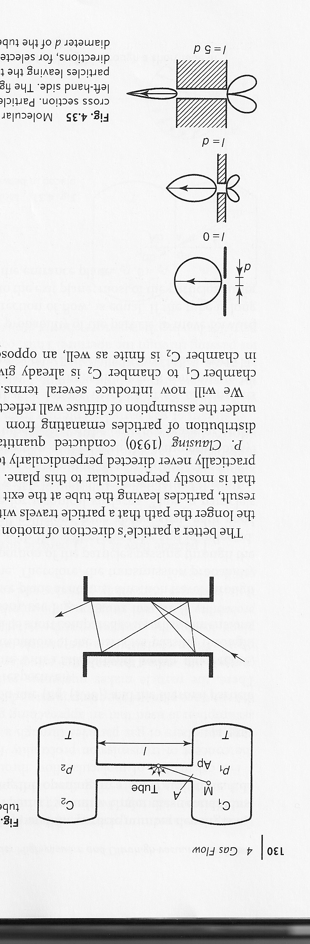
Molecular Flow: Introduction
Kn>1: the mean free path of the particles is large compared with the size of the container
The molecules-wall collisions dominate the gas behavior
Randomizing effect of molecule wall collisions: there are no favored directions, the probability of emerging in any direction is the same, not related to incident direction
In molecular flow, a molecule is not “sucked” away, it falls on the pump entrance as the result of random motion.
Important to learn about the rate of molecular impingements on a elementary surface
Notes:
Karl Jousten Handbook p.130 figure, lafferty p.85 figure

Slide 38
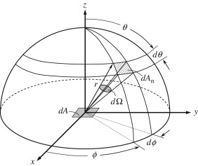
Impact rate
Impact Rate J: Number of molecular impacts on a surface per unit time and unit surface
The molecules impacting on a surface dS are those having velocity vectors comprised between v and v+dv and direction θ. Integrated over the solid angle:
average or mean speed in Maxwell-Boltzmann distribution
n = density of molecules
Notes:
m= molecular mass
Karl Jousten Handbook p.130 figure, lafferty p.85 figure

Slide 39
Conductance of an aperture
Aperture of area A in a thin wall separating two regions of pressures p₁ and p₂
J₁
A
J₂
p₁, n₁
p₂, n₂
Net flux= difference between currents in either direction
Ideal gas law: definition of flow
Definition of conductance
For air at 20°C
Notes:
Chambers p.97, Lafferty p.86

Slide 40
Conductance of standard flanges
Conductance of (infinitely thin) flange of standard opening
How to transform from N₂ to other gases?
MEMO
Small mass ↔ large conductance
DN | C_{A} Conductance (l/s)
16 | 24
25 | 58
40 | 148
63 | 368
100 | 927
150 | 2085
200 | 3707
NB
Usually, we put a ~500l/s pump on a DN150.
The flange’s conductance is >4x the pump’s pumping speed.
Conductance of standard flanges for N₂ at 296K
Notes:
Karl Jousten Handbook p.133

Slide 41
Maximal pumping speed
From the preceding, we can see that the maximal pumping speed of a high vacuum pump cannot be larger than the conductance of its aperture.
The maximum throughput a pump can feature is when all molecules crossing its aperture don’t return into the vacuum vessel.
maximal pumping speed for nitrogen, for a pump of aperture diameter D (in cm).

Slide 42
Maximal pumping speed
From the preceding, we can see that the maximal pumping speed of a high vacuum pump cannot be larger than the conductance of its aperture.
The maximum throughput a pump can feature is when all molecules crossing its aperture don’t return into the vacuum vessel.
maximal pumping speed for nitrogen, for a pump of aperture diameter D (in cm).
High vacuum pumps do not “suck” molecules into them. They rather prevent (a certain number of) molecules having crossed by chance their aperture to travel back to the vacuum vessel.
If the pumping mechanism were 100% efficient, the pumping sped would be equal to the conductance of the entrance.
Pumping speed is highest when backstreaming into the vessel is lowest.

Slide 43
Conductance of a long tube

Slide 44
Conductance of a short tube
to be used for “back of the envelope” estimations
Aperture
Long tube
Very roughly, we can consider that the conductance of a short tube is the conductance of its aperture C_{A}
followed by the conductance of a long tube, C_{L} .
From the combination of conductances formula:
Not for dimensioning a system, may be wrong up to 12%
Elaborated by Dushman, 1922
Valid with some error, but rather good in the limits L=0 and L>>D, for nitrogen, at 295K=20C.

Slide 45
Transmission probability α
If N molecules arrive at the entrance plane of a duct, a number Nα reach the exit plane, with α<1. A number N(1-α) return to the entrance. Remember that N=JA with A area and J impingement rate of molecules at the aperture of the duct.
Of the J₁A molecules entering the duct, α· J₁A reach its exit
Of the J₂A molecules entering the duct from downstream, α J₂A reach its entrance plane
J₁A
J₂A
Net flux from entrance to exit
Net throughput from entrance to exit
Substituting the expression
we make p appear.
The conductance of a component is the conductance of its aperture times a transmission probability

Slide 46
Transmission probability calculations
The concept of transmission probability was introduced by Clausing (1932). The values he has calculated by integrals (sometimes called Clausing factor) are still widely used for circular tubes and are accurate to ~ percent. Nomograms often use his values.
Cole (1976) refined the same methods, his values are very accurate.
Dushman (1992) has proposed an analytical formula (next slide) easy to apply, but not completely accurate. We use it for quick estimations.
Livesey (1998-2004) collected all transmission probability data, analyzed them and obtained analytical formulas (2004), very useful for computer calculation. For exotic forms, we have proposed his values, which are fairly simple and accurate to <1% over a wide L/D range.
One of the best ways to calculate transmission probabilities is the statistical Monte-Carlo method, which can be applied with success to complicated shapes which escape from a simple geometrical treatment.

Slide 47
Dushman transmission probability for cylindrical tubes
to be used for “back of the envelope” estimations
Transmission probability of a cylindrical tube, of diameter D and length L, or of form factor L/D.
Dushman 1992
Aperture
Long tube

Slide 48
Cylindrical ducts
l/D | α [Cole]
0.05 | 0.952399
0.15 | 0.869928
0.25 | 0.801271
0.35 | 0.74341
0.45 | 0.694044
0.5 | 0.671984
0.6 | 0.632228
0.7 | 0.597364
0.8 | 0.566507
0.9 | 0.538975
1 | 0.514231
1.5 | 0.420055
2 | 0.356572
2.5 | 0.310525
3 | 0.275438
3.5 | 0.247735
4 | 0.225263
4.5 | 0.206641
5 | 0.190941
10 | 0.109304
15 | 0.076912
20 | 0.059422
25 | 0.048448
30 | 0.040913
35 | 0.035415
40 | 0.031225
45 | 0.027925
50 | 0.025258
500 | 0.002646
l
D

Slide 49
Pumping speed measurement
Introduce a known throughput q_{pV} above the pump and measure pressure p at the inlet
q_{pV}
Pressure when
p
S
Gas flow q_{pV} may be measured by a precise flowmeter or in a double-dome with known conductance between the domes
Measure pressure p in front of the pump is problematic: directional gas flow!
Pressure is defined in an enclosed system, at equilibrium.
To avoid perturbation of the isotropic (i.e. uniform) Maxwellian distribution by the pump inlet, one would need an infinitely large volume.
Solution: Fisher-Mommsen dome (double and “isotropic”)

Slide 50
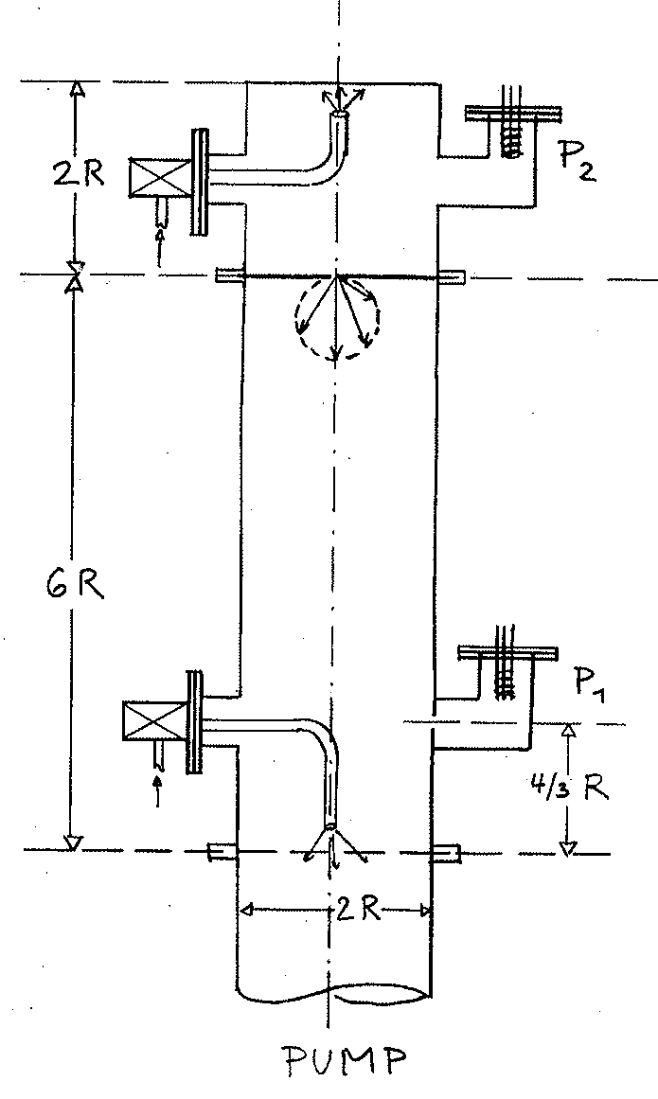
Fisher-Mommsen dome
for pumping speed measurement
Thermodynamically, p is defined only in an enclosed system at equilibrium.
To approach isotropy, we need a “infinite volume” dome, and gauges far from the pump. The gauge should then measure a isotropic, Maxwellian gas distribution.
The inlet C and pump S should have a negligible effect on the distribution.
The Fisher Mommsen dome has geometry, dimensions and position of the gauge such that measured pressures are identical to those measurable in the ideal case.
E. Fischer, H. Mommsen, Vacuum 17, 309 (1967)

Slide 51
Examples
From the table of transmission probabilities, molecular flow transmission probability for a pipe whose length is equal to its diameter is 0.51. This means that only about ½ of the molecules that enter it, pass through. What fraction will get through for a pipe with L/D=5?
α=0.19
The molecular flow transmission probability of a component with entrance area 4cm² is 0.36. Calculate its conductance for nitrogen at (a) 295K, (b) 600K.
From C_{A}=11.8A l/s (with A in cm²) for nitrogen at 295K, and C=αC_{A}, we get C=17l/s.
The effect of temperature is with √T, conductance being proportional to √T. We must divide by √295 and multiply by √600, to obtain C=24 l/s.

Slide 52
Examples
A component has a molecular flow conductance of 500l.s⁻¹ for nitrogen. What will its conductance be for (a)hydrogen, (b)carbon dioxide?
We have to multiply by the square root of the molar mass of nitrogen (N₂, M=28) and divide by the square root of the molar mass of hydrogen (H₂, M=2) or carbon dioxide (CO₂, M=44).
In the first case, this gives a factor 3.74, in the second, a factor 0.8.
So the conductance for hydrogen will be 3.74 times larger, the one for carbon dioxide 0.8 times larger. We get 1870l.s⁻¹ for hydrogen and 399l.s⁻¹ for carbon dioxide.
Notice that the square root factor “damps “ the effect of mass, but nevertheless this factor is ~4 for hydrogen if compared to air….
By what factor will the molecular flow conductance of a long pipe be increased, if its diameter is doubled?
With the simplified formula of Dushman for long tubes in molecular flow, we see that the effect of D is with D³.
So doubling D will increase conductance by a factor 8 !!

Slide 53
Examples
A vessel of volume 3m³ has to be evacuated from 1000 mbar to 1 mbar in 20 min. What pumping speed (in m³ per hour) is required?
HINT:
We apply the formula for the rough vacuum regime (which neglects outgassing), to obtain: t=6.9V/S. So S=6.9V/t=62m³/h
Notice that 3m³ is the typical volume of a Booster sector, of a SPS arc sector. With half this pumping speed, time is doubled...
How long will it take for a vessel of volume 80 l connected to a pump of speed 5 l/s to be pumped from 1000 mbar to 10 mbar? What is the time per decade?
As above: ln(po/p)=4.6, so t=4.6V/S=4.6.16≈80s
Time per decade: 5.2.3s=12s

Slide 54
Example: pressure profile
In a SPS transfer line, the diameter of the pipe is ~60mm, the distance between pumps ~60m. The effective pumping speed of each ionic pump is ~15 l/s, including a correction for the connecting element. Let’s assume an outgassing rate of 3.10⁻¹¹mbar.l.s^{-1.}cm⁻², typical after 100h pumping time.
Calculate the maximum and minimum pressure measured at a pressure gauge in a segment between 2 pumps.
Formulas to use:

Slide 55



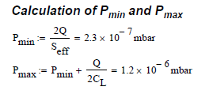
Example: pressure profile

