Slide 1
Handling Discussions
LAGUNA-LBNO/Layout Study Group - Friday 19/7/2013
Keith Kershaw EN-HE

Slide 2
Introduction
These slides follow up initial discussions of handling with Ilias.
Ilias’ proposal: target and horn to be installed in 18% slope tunnel

Slide 3
Some Recommendations for Remote Handling (ITER) – of interest at concept stage
Consider RH compatibility from earliest stage of development cycle
Prefer vertical load transfer during installation and removal
Use of a crane provides compliance in 5 d.o.f. (helps self alignment)
Provide for self alignment (into position and with handling equipment) – typically use of cones
Keep operations simple
Recovery techniques vital
Provide space for handling trajectories and for vision
Provide visual clues for gross alignment motions
Protect sensitive equipment

Slide 4
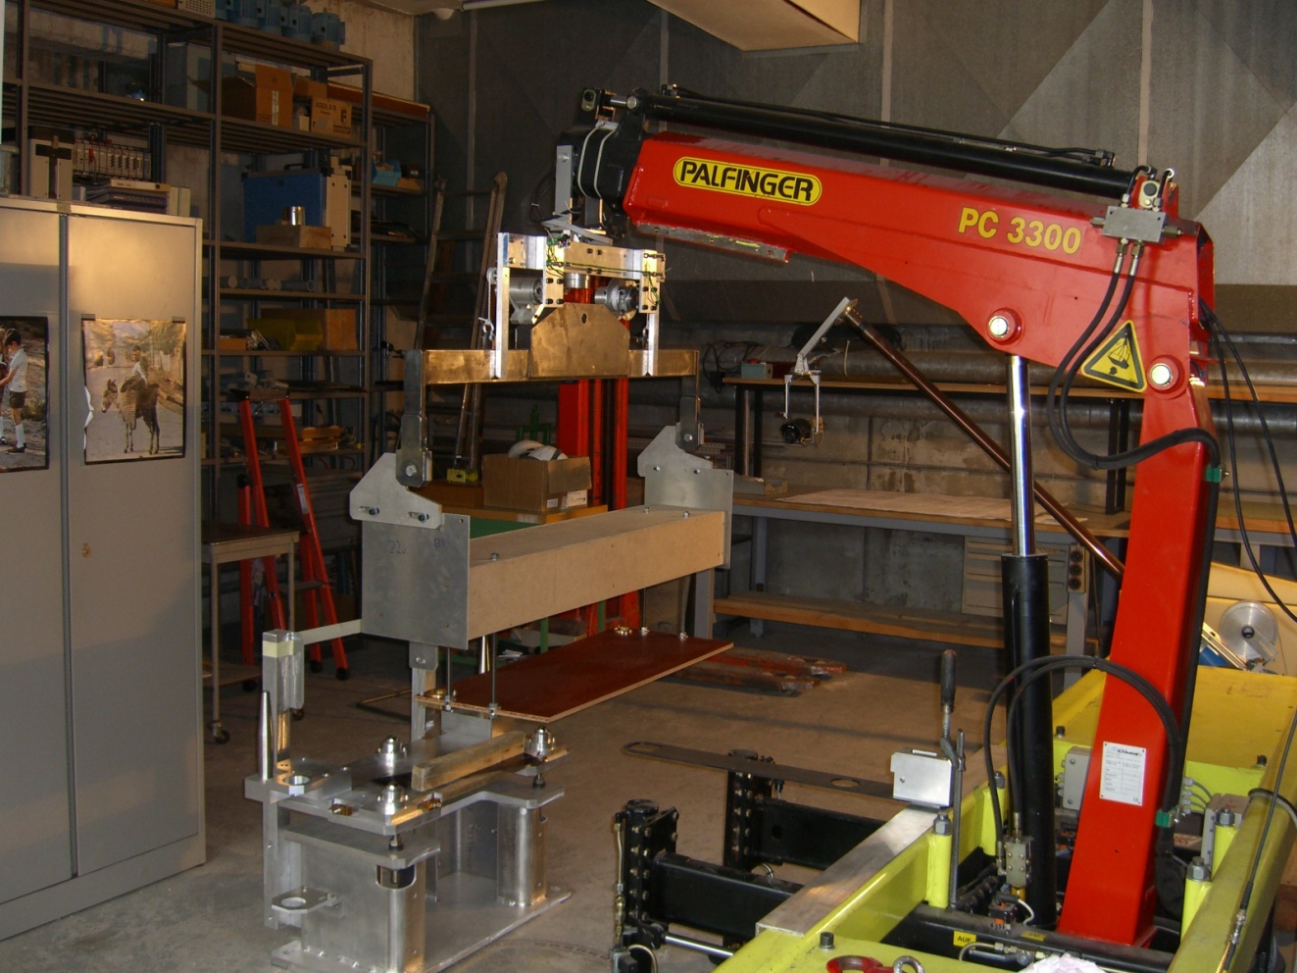
LHC Collimators: First mock up tests
Dummy collimator installed on base using modified truck loader crane fitted with hoist and spreader rotation. Operation with camera viewing and remote control

Slide 5
Reserved space for collimator handling LHCHMUMC_0001
Implications for infrastructure
Implications for collimator dimensions
It was necessary to modify water pipes

Slide 6
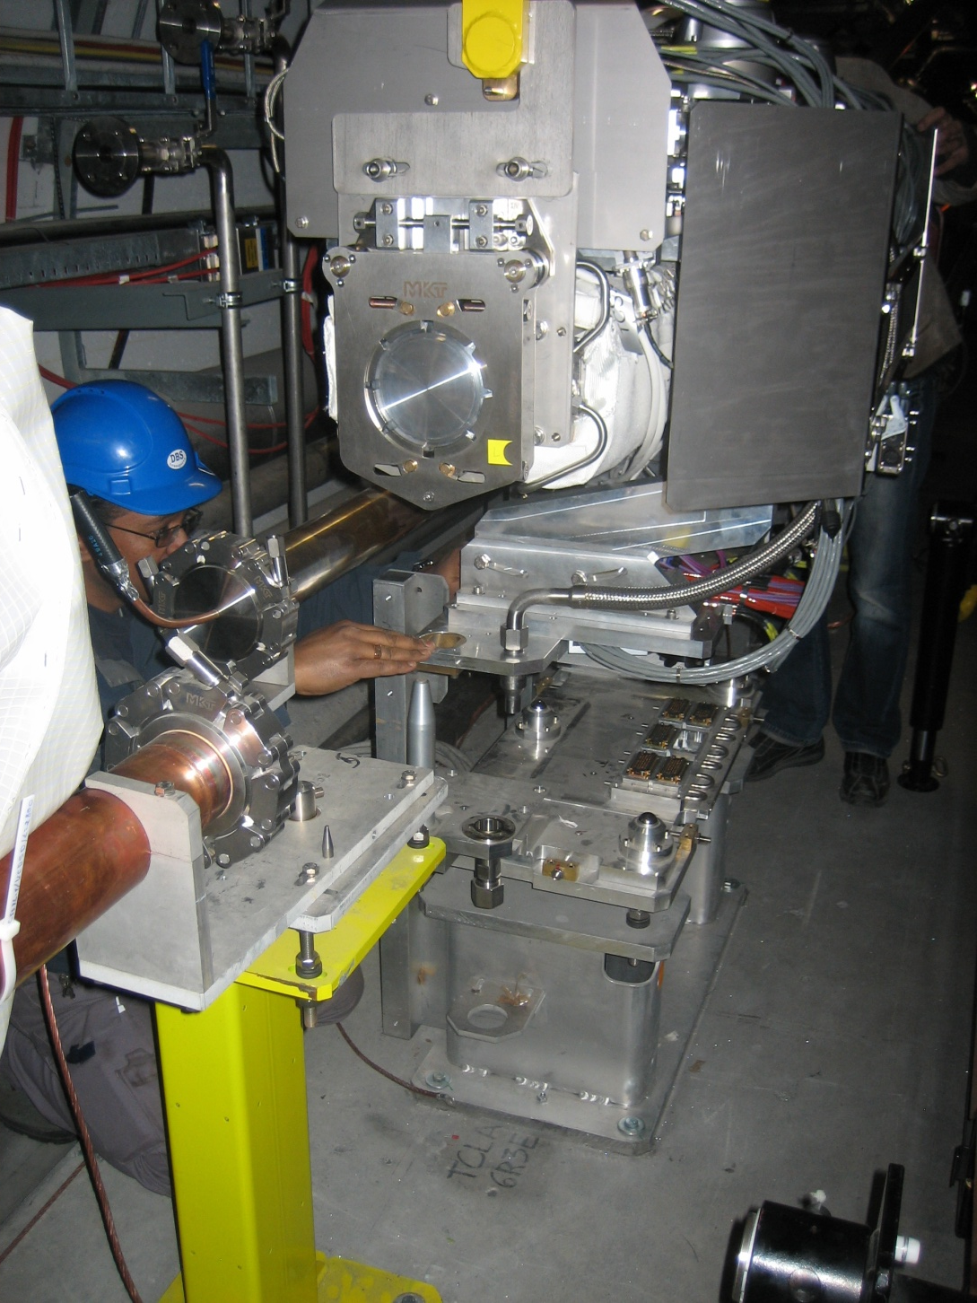
Plug – ins:
Careful guidance during LHC installation

Slide 7
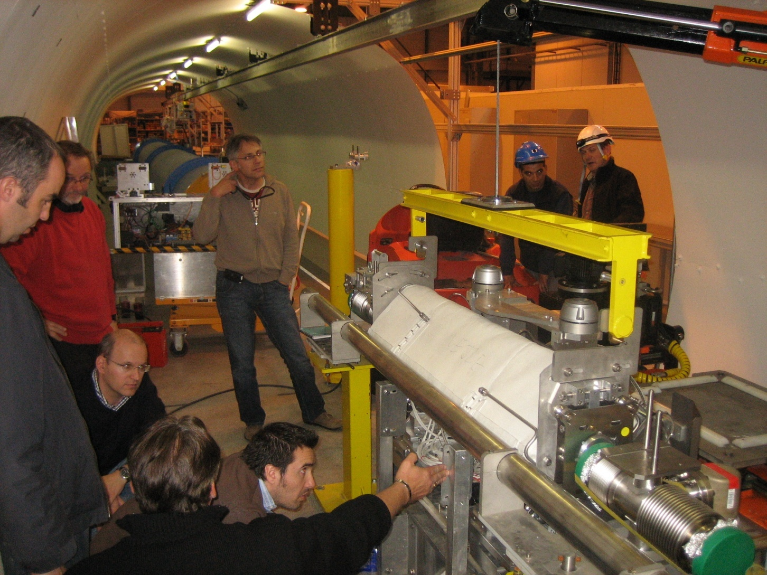
Plug-in behaviour tests 2010
Practical Investigations in mock-up by EN-STI,
EN-MME and EN-HE.

Slide 8
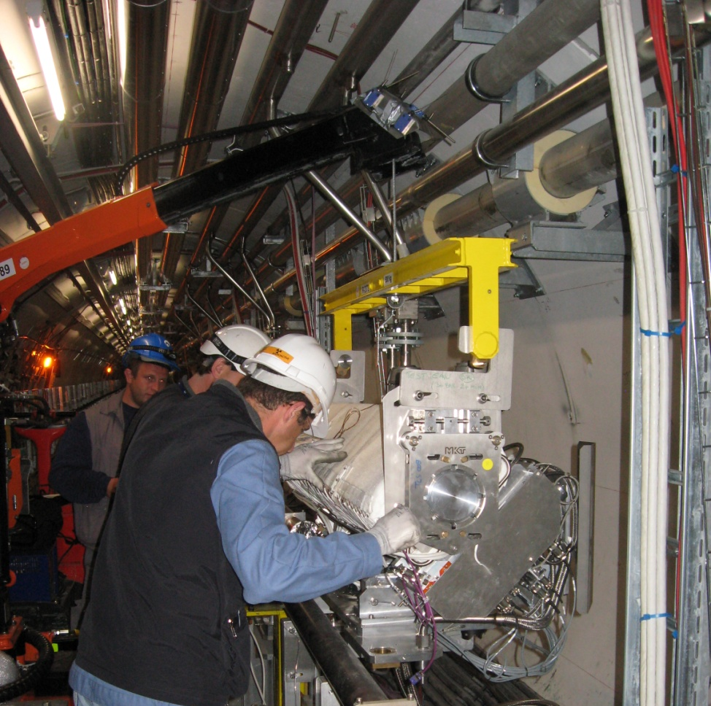
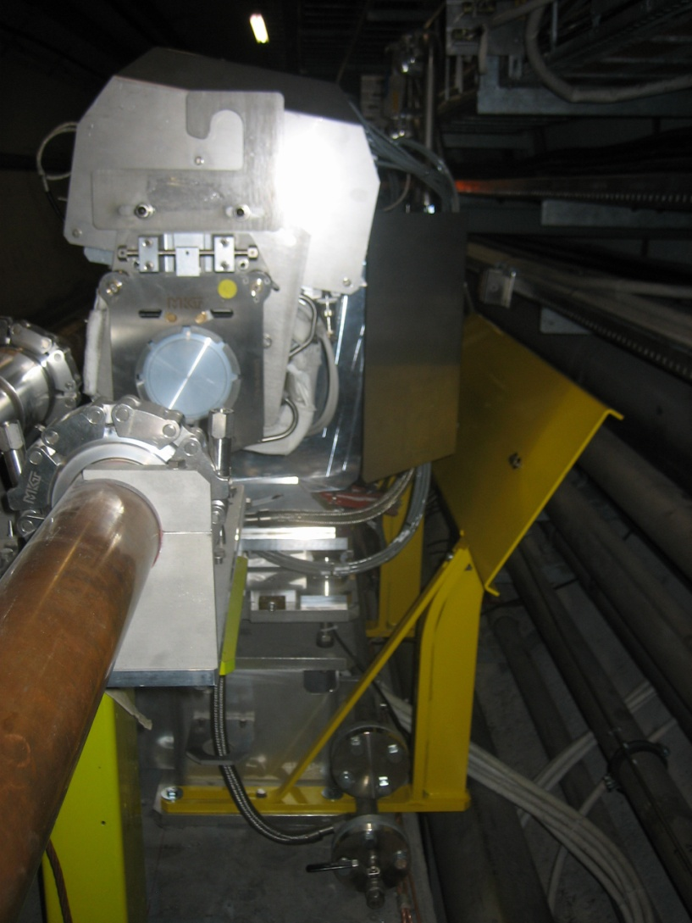
Cryoline protection
At end of crane boom
Behind collimator

Slide 9
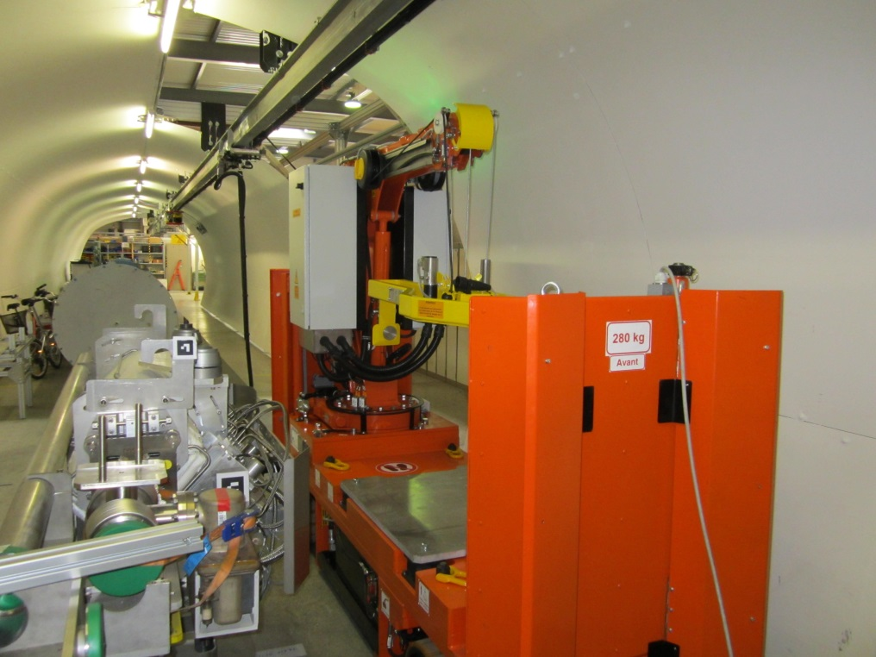
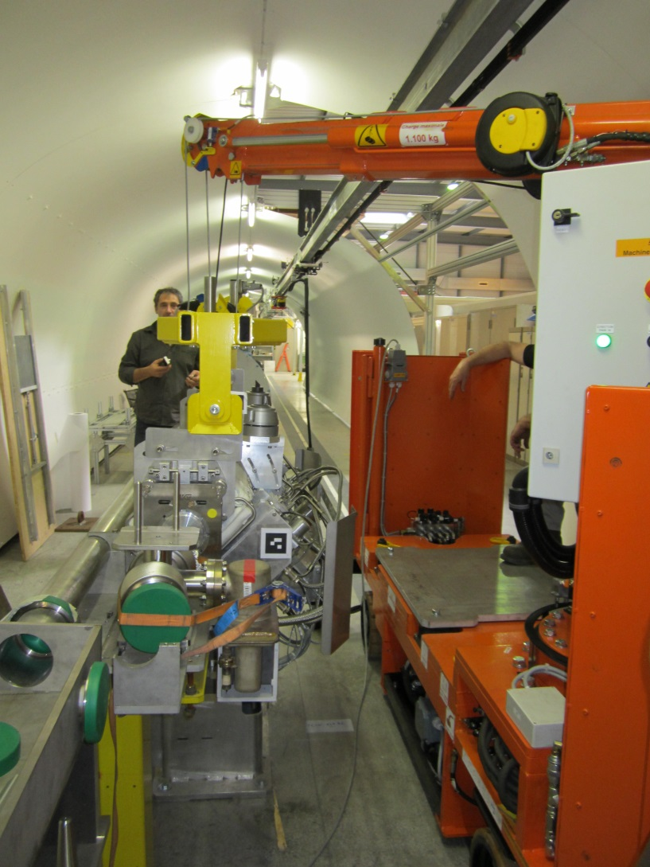
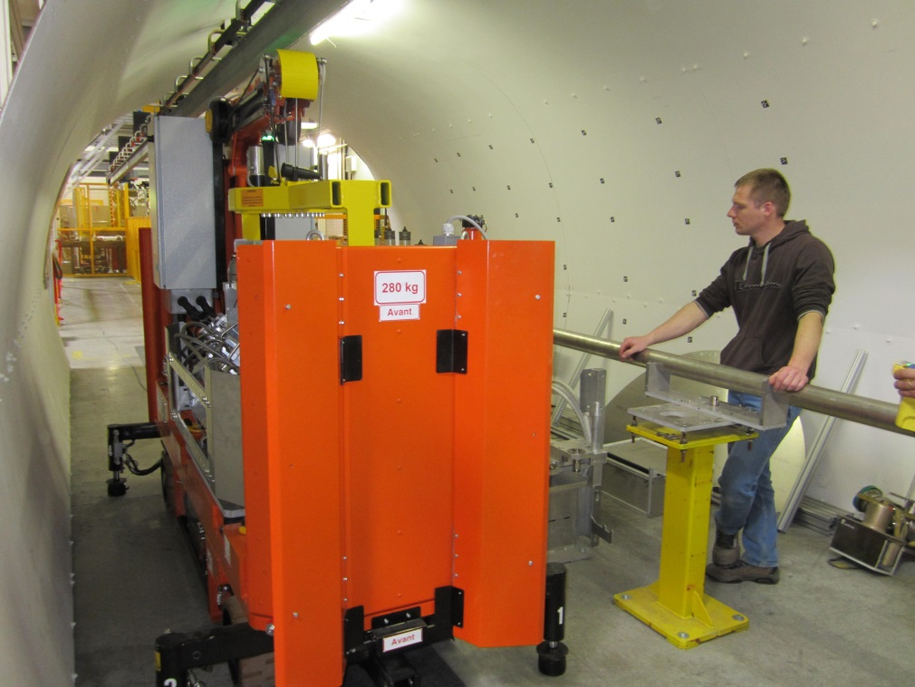
Remote collimator handling crane

Slide 10
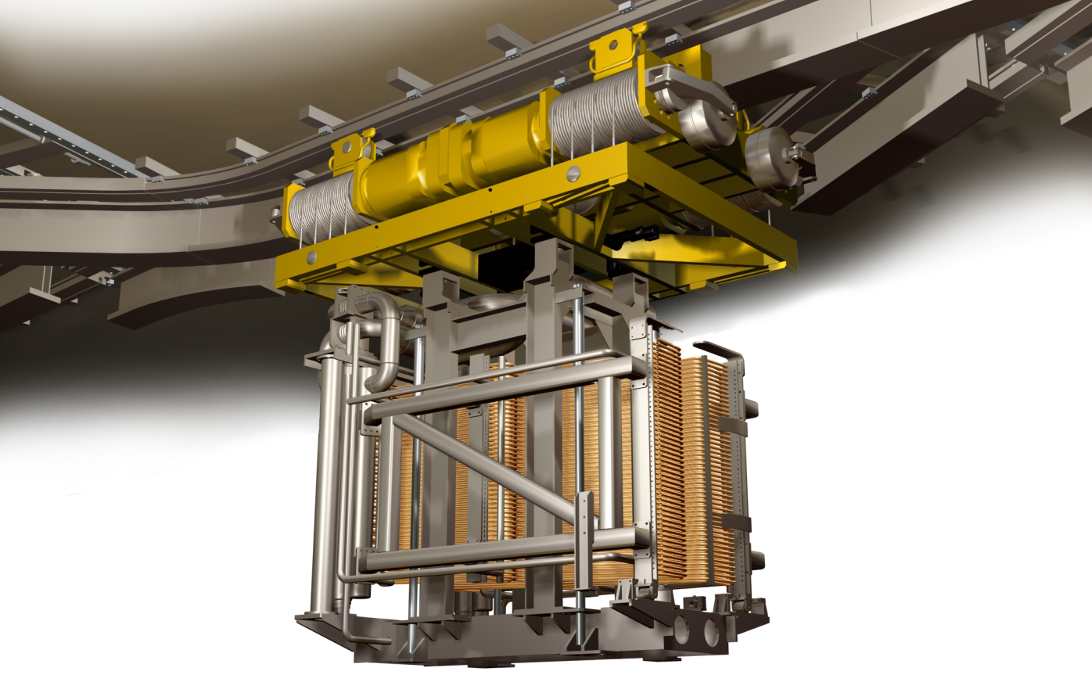
ITER Monorail Crane
(Neutral beam remote handling system)

Slide 11
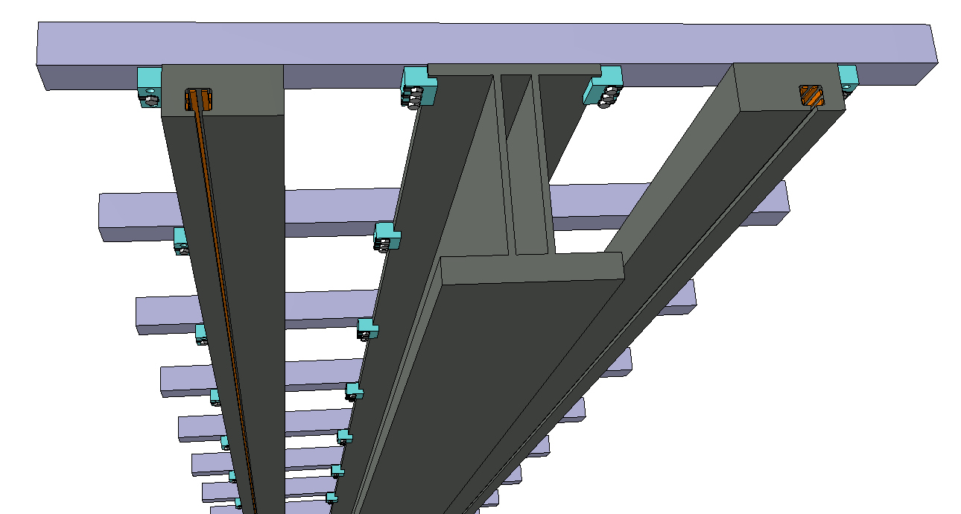
Monorail Design
Cross-beams
Stabiliser rails react eccentric loads
Rails contain bus bar power connection lines
Support Rails – Including Power & Control conductor bus
Central I beam rail has been developed to have a wider hollow vertical section to resist the torsion introduced in eccentric load conditions

Slide 12
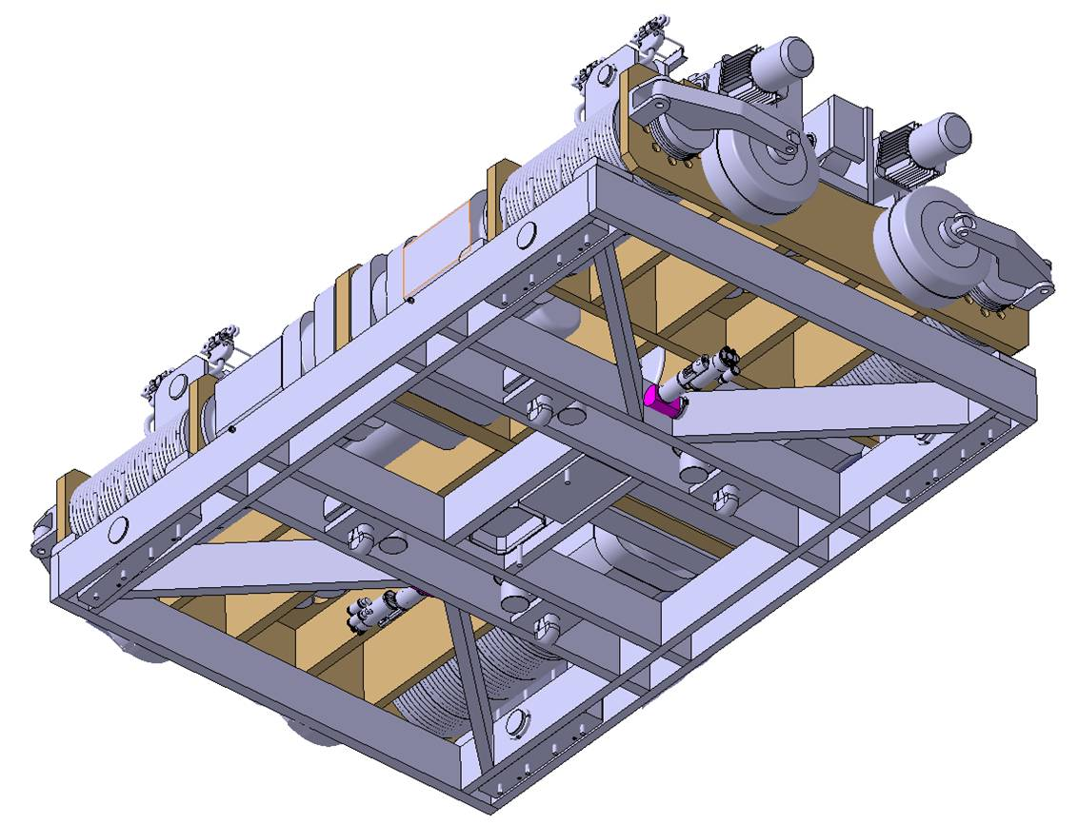
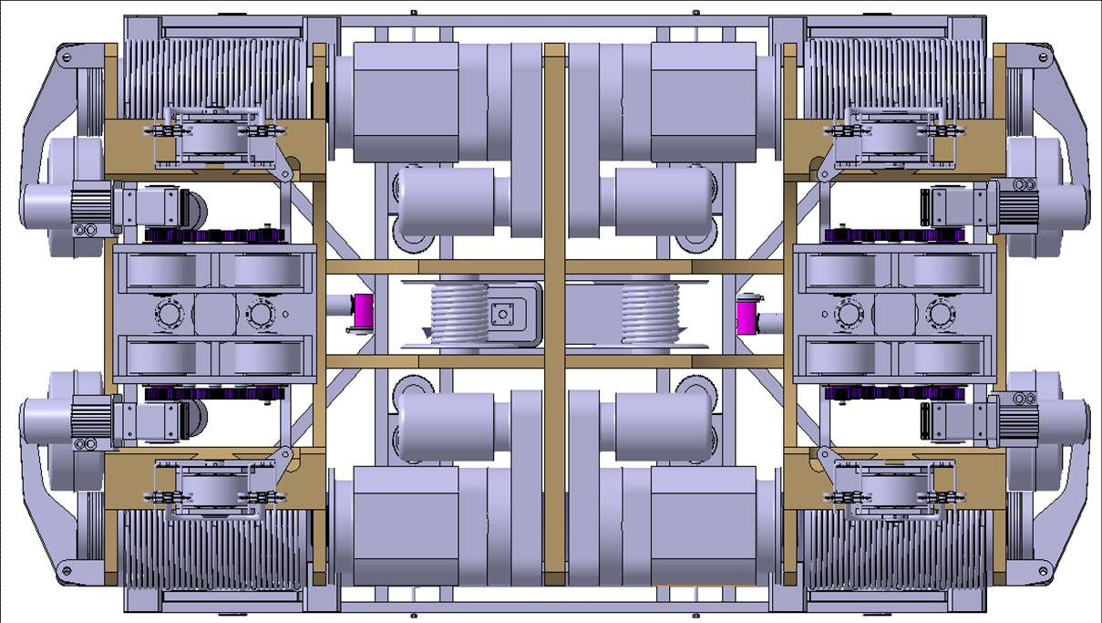
Design Layout
Power & Control Collector Trolley
Bogey with twin travel drive
Hoist Assembly
Emergency Brake
Hoist Drum
Hoist Drive
Power and control plug for lifting adaptors
Twist-locks
Cable Reeler
Equaliser Block
Support Wheel

Slide 13
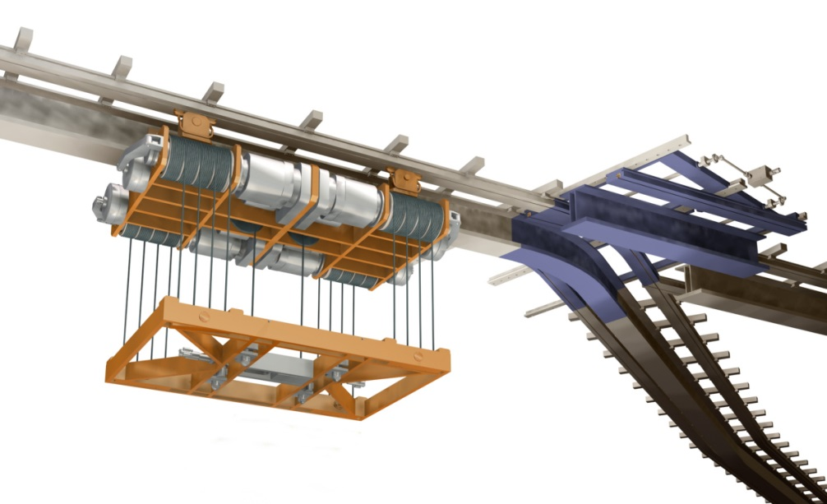
Switch System
Support Rails
Drives and linear slides
Monorail

Slide 14
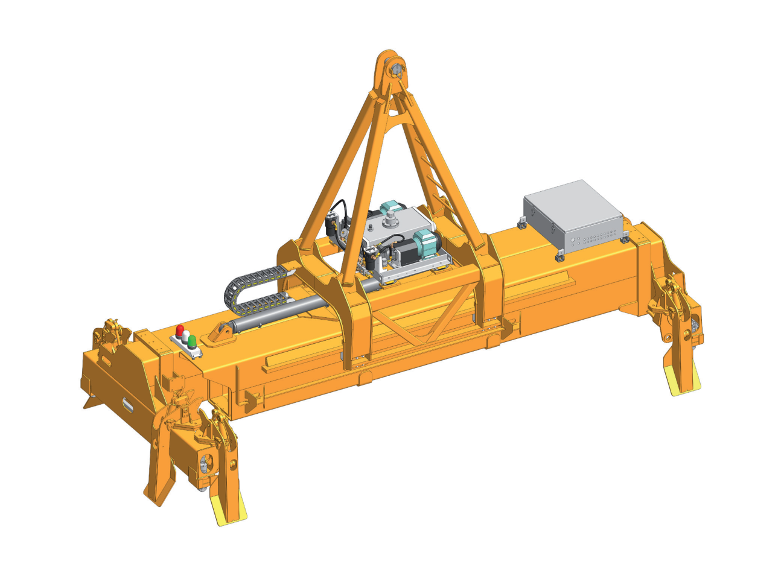
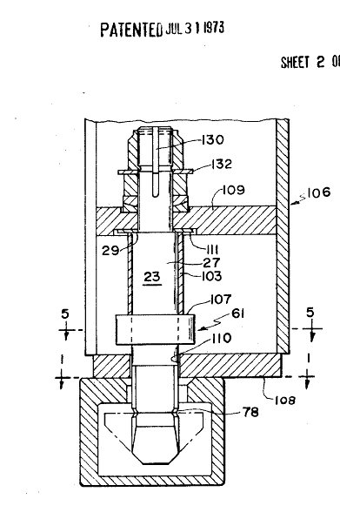
Twist locks
Any questions?

Slide 15
EXTRA SLIDES

Slide 16
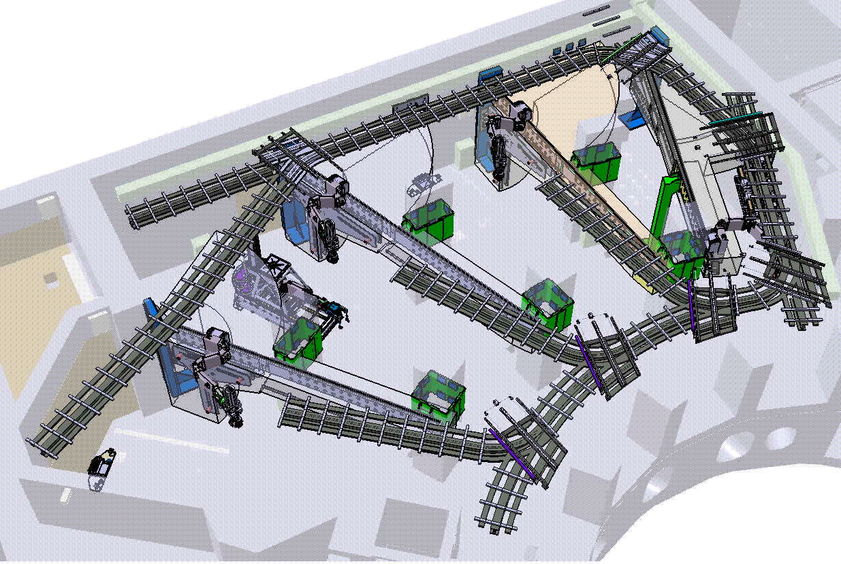
Crane, BLT and BS RHE

Slide 17
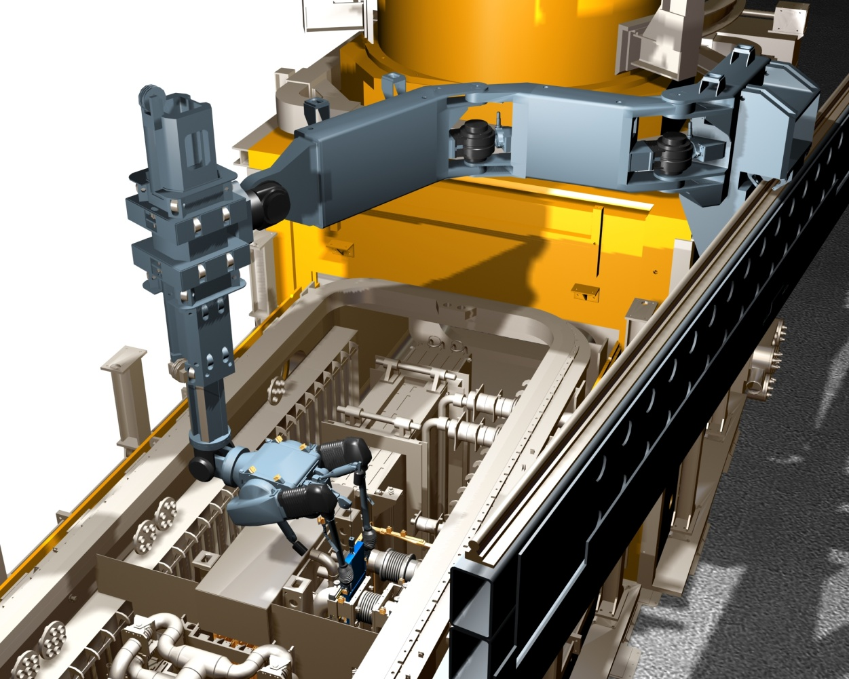
ITER Remote Handling
Beam Line Transporter

Slide 18
SOME IMPLICATIONS OF TRANSPORT AND INSTALLATION ON COLLIMATOR AND INFRASTRUCTURE DESIGN
Lift points
  Adjustable and blocked for C of G
Dimensions
  Respect transport zone when installed (covers to manage cables and hoses)
  Respect Space next to other beam pipe and infrastructure
Plug-ins
  Compatible with vertical lowering when collimator suspended from single support point
Vacuum
  Clearance when lowering on pins ( + remote disconnection…)
  Infrastructure
  Respect space required for handling (see LHCHMUMC_0001)

