Slide 1
Task 10.1 Steering Committee #1
Videoconference
24 July 2013
L. Rossi - CERN
Ph. Fazilleau - CEA

Slide 2
Collaborations
Conductor: Bi-2122
50 k€ of powder already delivered to FSU-ASC and under process as wire. How much wire we can «claim»? → Bottura
Second batch of powder: second 50 k€ CERN order in autumn 2103?
Shouldn’t we ask for a Rutherford cable?
Conductor : YBCO
Need of a second supplier: we need to compare Bruker tape with other tapes.
Possibility of agreement with TcSH
Commercial tape source: SuperPower and Fujikura (Through KEK and Univ. Kyoto?), SunAM (Korea)

Slide 3
Collaboration cont.
Magnets
Bi-2212: DOE has approved (in principle) general agreement with CERN for HiLumi and LHC upgr.)
This makes possible to start a formal agreement with LBNL. They can make
Design and construction of a CCT intended for 40 mm – 5 T K minimum at 4.2 K. We have to define the external size.
We can provide the SC wire (from OST visa FSU-ASC)…
We can also provide 1 person from CERN and 1 from CEA (or Grenoble) to LBNL for certain time.
Fermilab also would like to be involved. There is a possibility to do a costheta dipole with Rutherford cable with them.
I will explore the will of KEK/Univ. of Kyoto for magnets.

Slide 4
Decision to be taken soon
How do we organise to have YBCO (main line) and then a second line of Bi-2212? We said we need to advance Bi-2122 with Rutherford cable as “easy” deliverable? Names!
When do we need to buy a furnace for Bi-2212? With which characteristics?

Slide 5
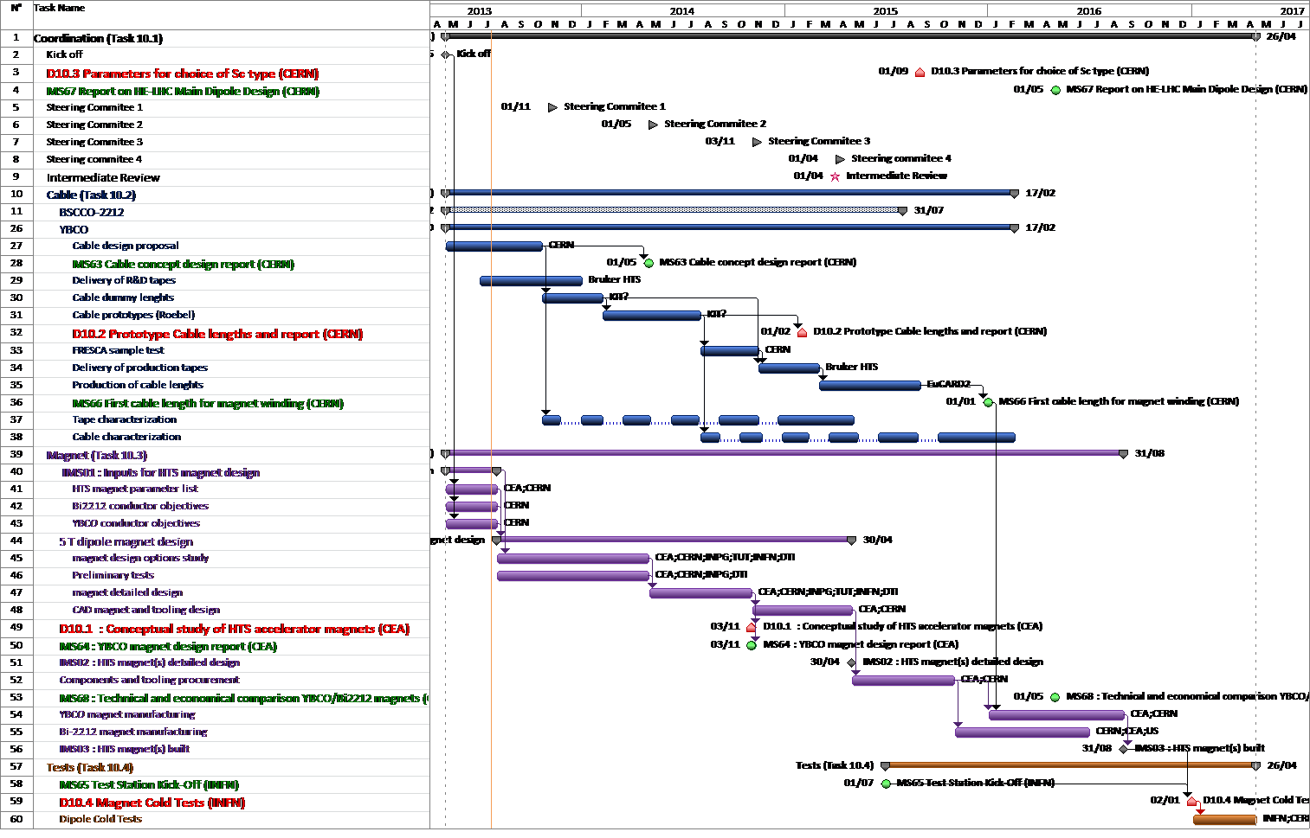
Overall Planning

