Slide 1
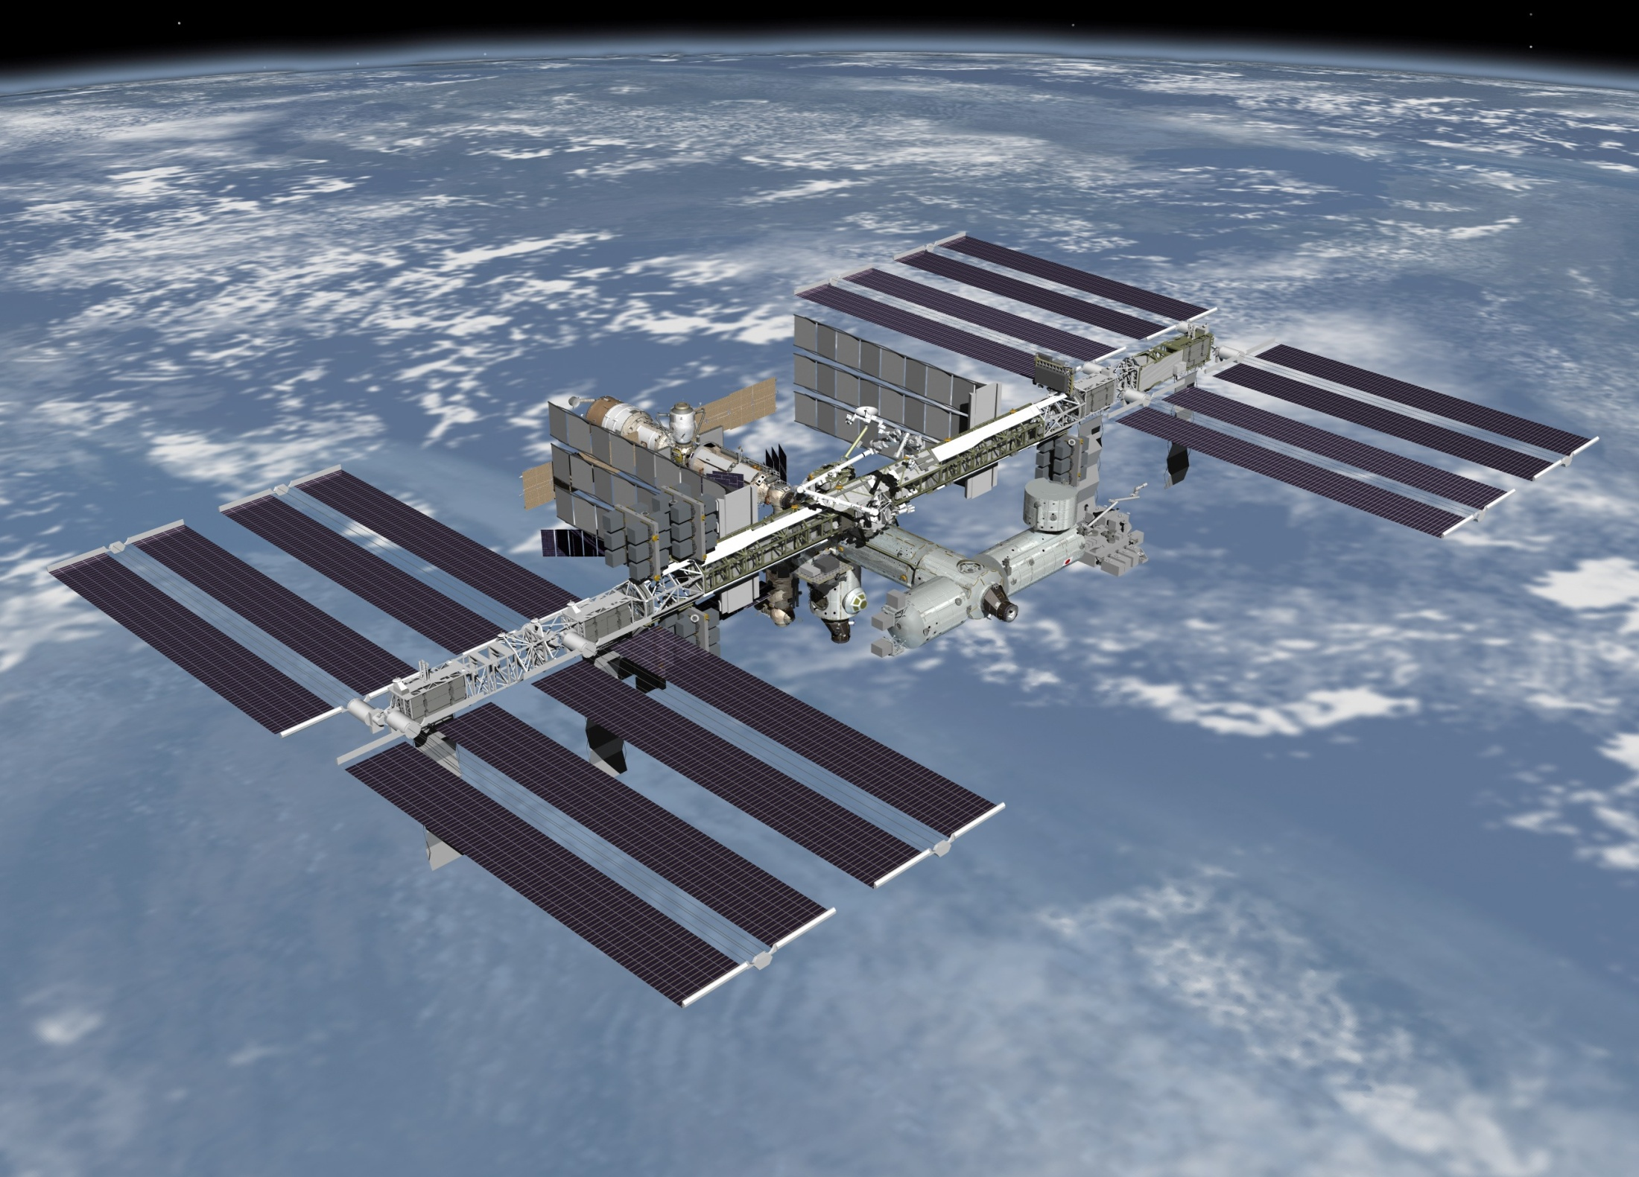
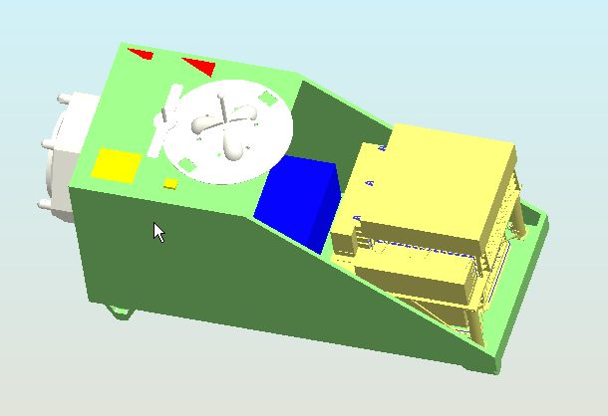
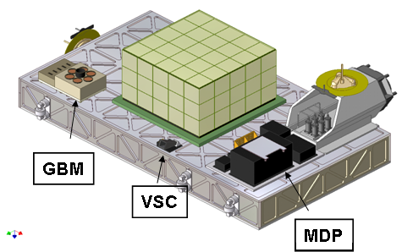


CALET Mission
for Japanese Experiment Module on ISS
CALET
CALET
Shoji Torii
on behalf of the CALET Mission Team
Waseda University
& JAXA/Space Environment Utilization Center
COSPAR July 21, 2010

Slide 2




International Collaboration Team
O. Adriani²⁰ , F. Angelini²¹ , C. Avanzini²¹, M.G. Bagliesi²³, A. Basti²¹, K. Batkov²³,
G. Bigongiari²³, W.R. Binns²⁵, L. Bonechi²⁰, S. Bonechi²³, S. Bottai²⁰, M. Calamai²⁰,
G. Castellini²⁰, R. Cesshi²³, J. Chang¹³, G. Chen⁴, M.L. Cherry⁹, G. Collazuol²¹, K. Ebisawa⁵, A. J. Ericson¹⁰, H. Fuke⁵, W. Gan¹³, T.G. Guzik⁹, T. Hams¹⁰, N. Hasebe²⁴, M. Hareyama⁵,
K. Hibino⁷, M. Ichimura², K. Ioka⁸, M. H. Israel²⁵, E. Kamioka¹⁶, K. Kasahara²⁴,
Y. Katayose²⁶,J. Kataoka²⁴, R.Kataoka ¹⁸,N. Kawanaka⁸, M.Y. Kim²³, H. Kitamura¹¹,
Y. Komori⁶, T. Kotani¹, H.S. Krawzczynski²⁵, J.F. Krizmanic¹⁰, A. Kubota¹⁶, S. Kuramata²,
Y. Ma⁴, P. Maestro²³, V. Malvezzi²², L. Marcelli²², P. S. Marrocchesi²³, V. Millucci²³,
J.W. Mitchell¹⁰, K. Mizutani¹⁵, A.A. Moissev¹⁰, M. Mori¹⁴, F. Morsani²¹, K. Munekata¹⁷,
H. Murakami²⁴, J. Nishimura⁵, S. Okuno⁷, J.F. Ormes¹⁹, S. Ozawa²⁴, F. Palma²², P. Papini²⁰,
Y. Saito⁵, C. De Santis²², M. Sasaki¹⁰, M. Shibata²⁶, Y. Shimizu²⁴, A. Shiomi¹², R. Spalvoli²²,
P. Spillantini²⁰, M. Takayanagi⁵, M. Takita³, T. Tamura⁷, N. Tateyama⁷, T. Terasawa³,
H. Tomida⁵, S. Torii²⁴, Y. Tunesada¹⁸, Y. Uchihori¹¹, S. Ueno⁵, E. Vannuccini²⁰, H. Wang⁴,
J.P. Wefel⁹, K.Yamaoka¹, J. Yang¹³, A. Yoshida¹, K. Yoshida¹⁶, T. Yuda⁷, R. Zei²³
1) Aoyama Gakuin University, Japan
2) Hirosaki University, Japan
3) ICRR, University of Tokyo, Japan
4) Institute of High Energy Physics, China
5) JAXA/ISAS, Japan
6) Kanagawa University of Human Services, Japan
7) Kanagawa University, Japan
8) KEK, Japan
9) Louisiana State University, USA
10) NASA/GSFC, USA
11) National Inst. of Radiological Sciences, Japan
12) Nihon University, Japan
13) Purple Mountain Observatory, China
14) Ritsumeikan University, Japan
15) Saitama University, Japan
16) Shibaura Institute of Technology, Japan
17) Shinshu University, Japan
18) Tokyo Technology Inst., Japan
19) University of Denver, USA
20）University of Florence and INFN, Italy
21) University of Pisa and INFN, Italy
22) University of Rome Tor Vergata and INFN, Italy
23) University of Siena, Italy
24) Waseda University, Japan
25) Washington University in St Louis, USA
26) Yokohama National University, Japan

Slide 3
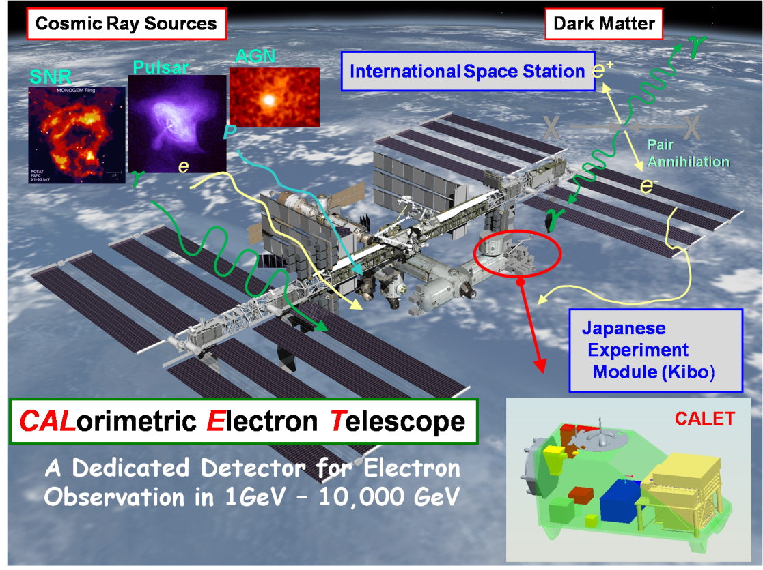
CALET Overview
Instrument
High Energy Electron and Gamma- Ray
Telescope Consisted of :
- Imaging Calorimeter (Particle ID, Direction)
Total Thickness of Tungsten (W) ： 3 X₀
Layer Number of Scifi Belts： 8 Layers ×2(X,Y)
- Total Absorption Calorimeter
(Energy Measurement, Particle ID)
PWO 20mmｘ20mmｘ320mm
Total Depth of PWO： 27 X₀ (24cm)
- Silicon Pixel Array (by Italy)
( or a substitute)
(Charge Measurement in Z=1-35)
Silicon Pixel 11.25mmx11.25mmx0.5mm
2 Layers with a coverage of 54 x54 cm²
Observation
Electrons : 1 GeV -10,000 GeV
Gamma-rays : 10 GeV -10,000 GeV (GRB > 1 GeV)
+ Gamma-ray Bursts : 7 keV-20 MeV
Protons, Heavy Nuclei:
several 10 GeV- 1000TeV ( per particle)
Solar Particles and Modulated Particles
in Solar System: 1 GeV-10 GeV (Electrons)

Slide 4
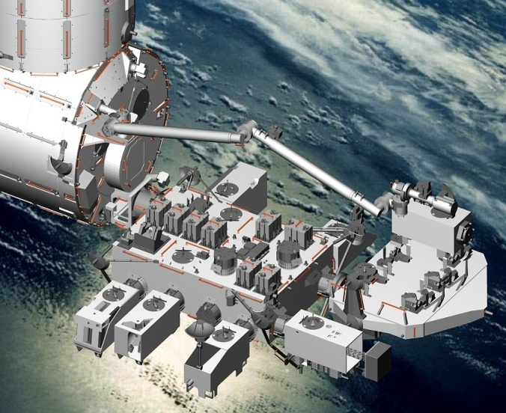
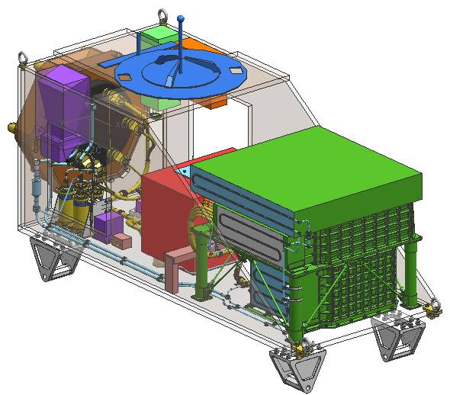
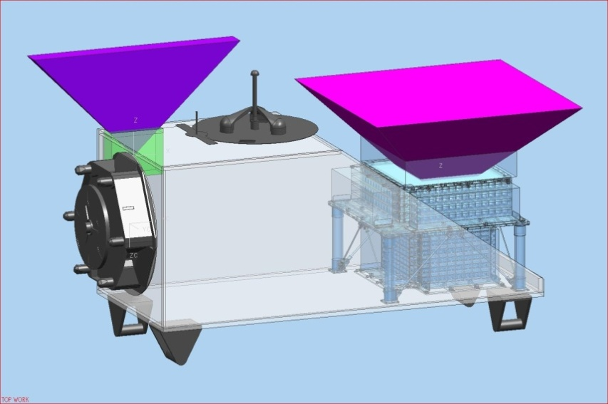
CALET System Design
The CALET mission instrument satisfies the requirements as a standard payload in size, weight, power, telemetry etc. for launching by HTV and for observation at JEM/EF.
JEM/EF & the CALET Port
CALET Payload
Star Tracker
Gamma-ray Burst Monitor
Calorimeter
＃９
Field of View (45 degrees from the zenith)
Mission Data Controller
Weight : 483.5 kg
Power Consumption: 313W

Slide 5
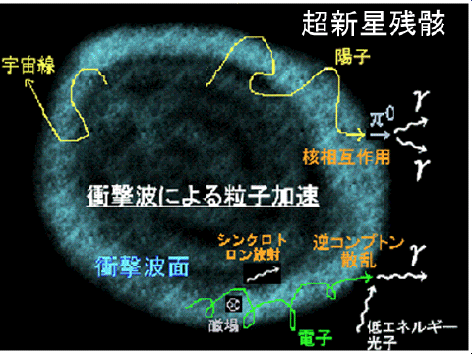
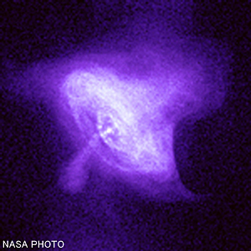
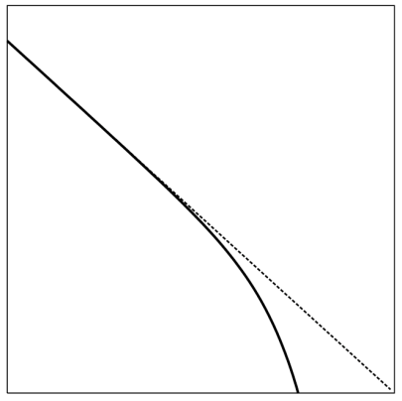
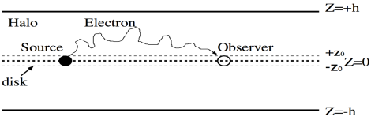
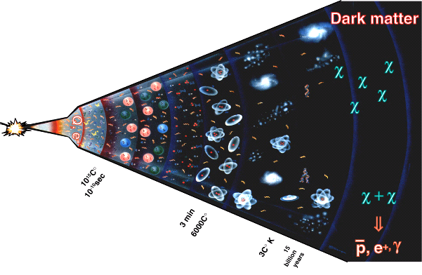
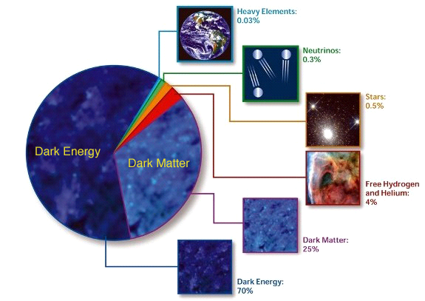
Electron & Positron Observation
Astrophysical Origin
Production Spectrum
（Power Law Distribution ＋Cutoff）
Propagation in the Galaxy
Diffusion Process
Energy Loss
dE/dt =-bE²
（Syncrotron＋Inverse Compton）
Shock Wave Acceleration in SNR
Acceleration in PWN
dN/dE ∝ E⁻²exp(-E/E_{c})
Log(dN/dE)
    π+/- or K+/- → μ+/- → e+/-
⇒
⇒
↑
E_{c}
e⁺+e⁻
Log(E)
⇒
Dark Matter Origin
Evolution of the Universe
Constitutes of
the Universe
重元素
宇宙の質量構成比
Heavy Element
宇宙の質量構成比
重元素
重元素
0.03%
0.03%
0.03%
0.03%
ニュートリノ
Neutrino
0.3%
0.3%
ニュートリノ
ニュートリノ
0.3%
0.3%
星
Star
0.
0.5
%
星
５
%
星
⇒
0.
0.
%
５
%
５
暗黒エネルギー
暗黒エネルギー
暗黒エネルギー
暗黒エネルギー
水素、
暗黒エネルギー
Hydrogen、
M_{χ}
暗黒エネルギー
暗黒エネルギー
暗黒エネルギー
暗黒物質
暗黒物質
暗黒物質
暗黒物質
ヘリウム
水素、
Helium
暗黒物質
水素、
暗黒物質
暗黒物質
暗黒物質
%
Annihilation of Dark Matter（WIMP)
４
%
４
ヘリウム
ヘリウム
Production Spectrum
%
４
%
４
χχ→e⁺,e⁻
暗黒物質
Dark Matter
(ⅰ) Monoenergetic: Direct Production of e+e- pair
（ⅱ） Uniform：Production via Intermediate Particles
（ⅲ） Double Peak： Production by Dipole Distribution
via Intermediate Particles
暗黒物質
暗黒物質
25%
25%
2３%
25%
暗黒エネルギー
Dark Energy
70%
7３%

Slide 6
e± Propagation
Diffusion
Injection
Energy loss by
IC & synchro.
← B/C ratio
For a single burst with
Power law spectrum
Atoyan 95, Shen 70
Kobayashi 03

Slide 7
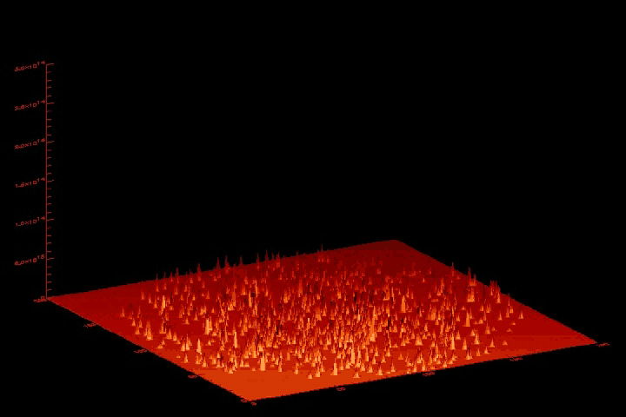
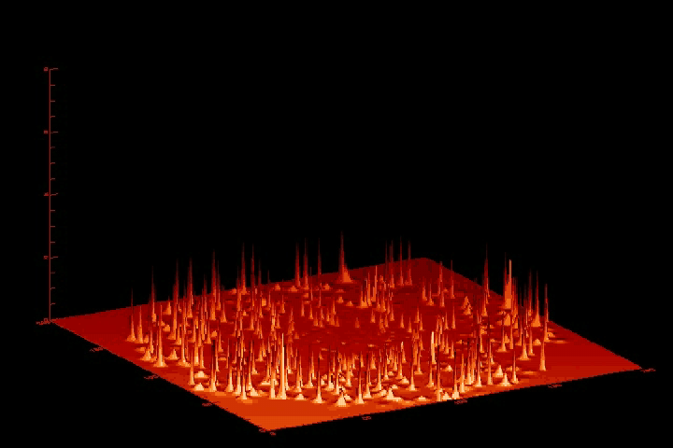
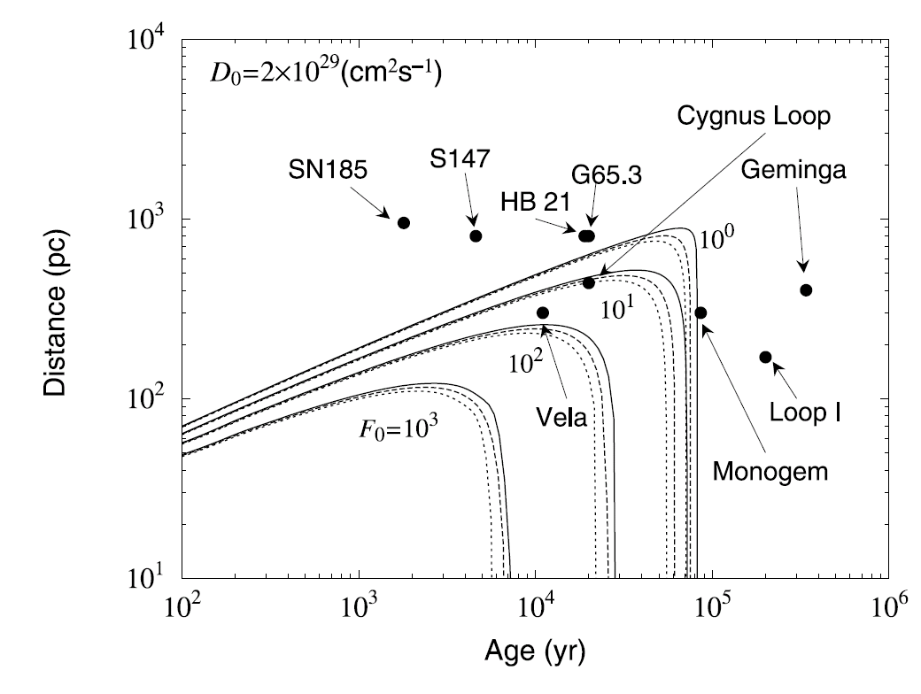
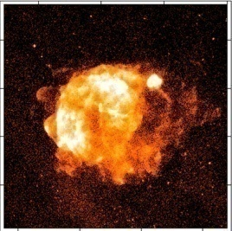
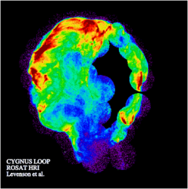
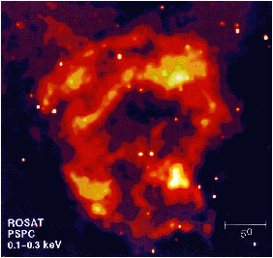
A Naïve Result from Propagation
1 GeV Electrons
100 TeV Electrons
    T (age) = 2.5 X 10⁵ X (1 TeV/E) yr
    R (distance) = 600 X (1 TeV/E)^{1/2} pc
GALPROP/credit S.Swordy
1 TeV Electron Source:
Age < a few10⁵ years
very young comparing
to ~10⁷ year at low energies
Distance < 1 kpc
nearby source
Source (SNR) Candidates :
Vela Cygnus Loop Monogem
Unobserved Sources?
(F₀: E³ x Flux at 3TeV)

Slide 8
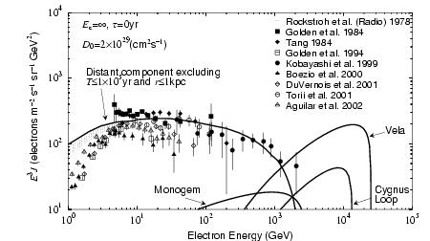
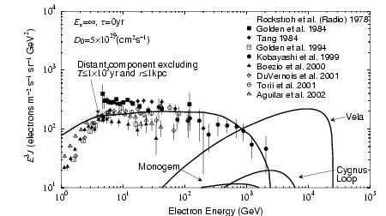
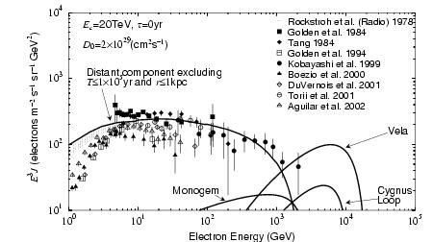
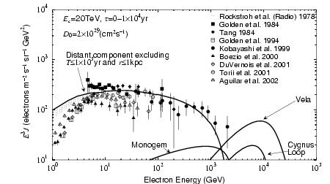
Model Dependence of Energy Spectrum and Nearby Source Effect
Ec=∞、 ΔT=0 yr, Do=2x10²⁹ cm²/s
Do=5 x 10²⁹ cm²/s
Ec= 20 TeV
Ec=20 TeV、 ΔT=1-10⁴ yr
Kobayashi et al. ApJ (2004)

Slide 9
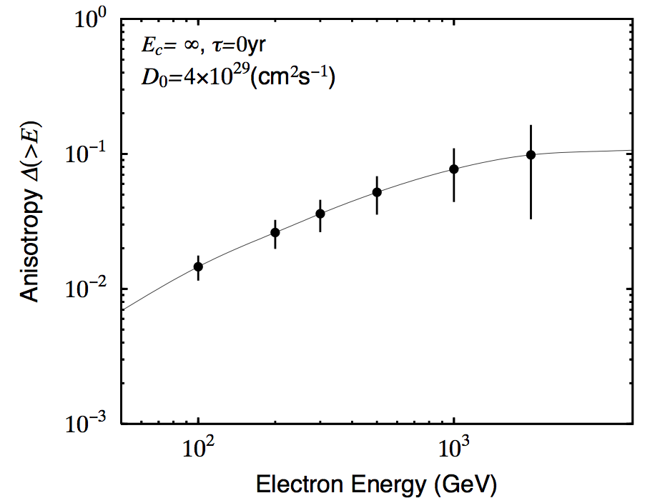
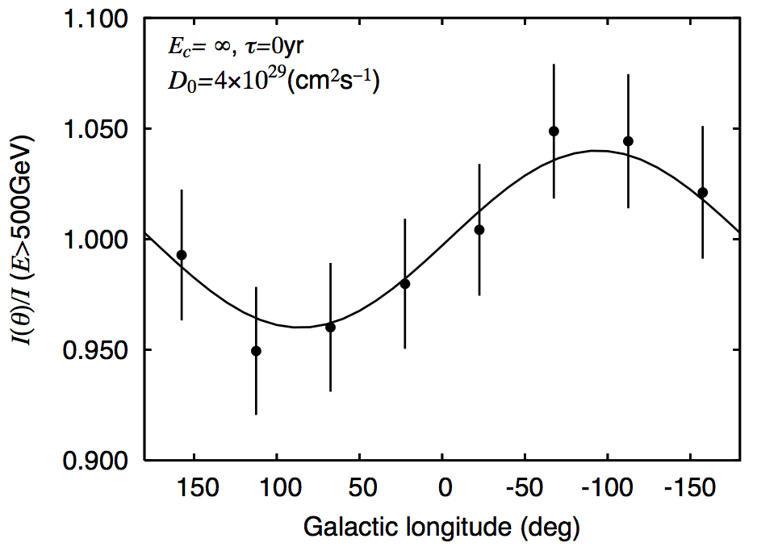
Electron Observation for Nearby Sources
Expected Anisotropy
from Vela SNR
~10% @1TeV
Expected Flux
> 1000 827 644
Monogem
Cygnus Loop
Vela

Slide 10
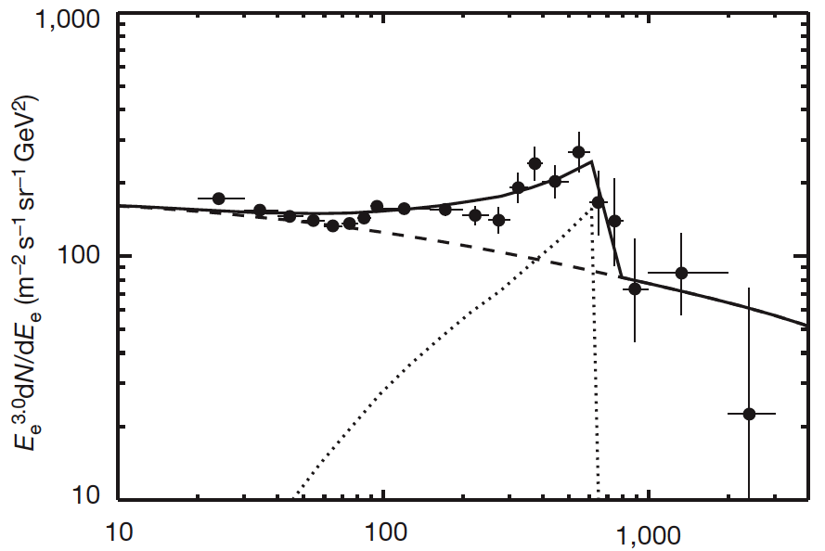
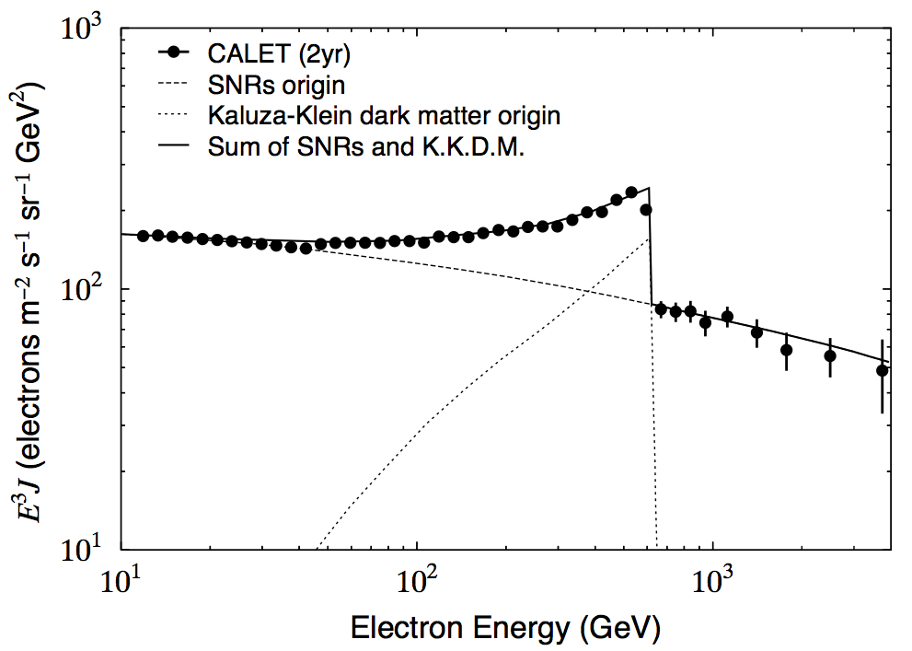
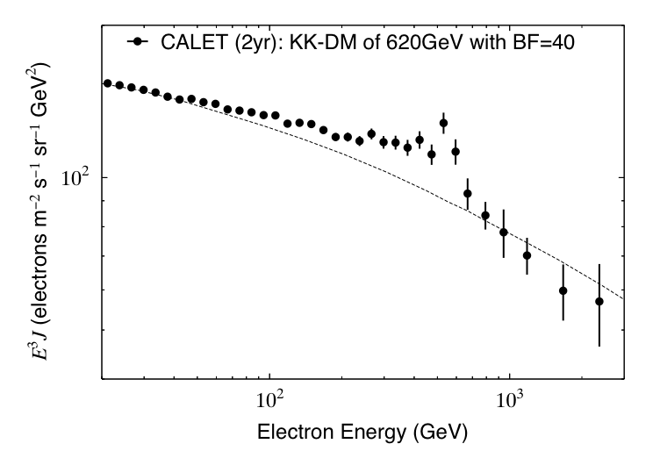
Electron (+ Positron) from Dark Matter Annihilation
Expected energy spectrum from Kaluza-Klein Dark Matter (m=620GeV)
Chang et al. (2008)
Boost Factor ~200
Expected e⁻+e⁺ energy spectrum by CALET in case of the ATIC observation
2 years （BF=40)
or 5 years（BF=16)
Dark Matter detection capability by CALET

Slide 11
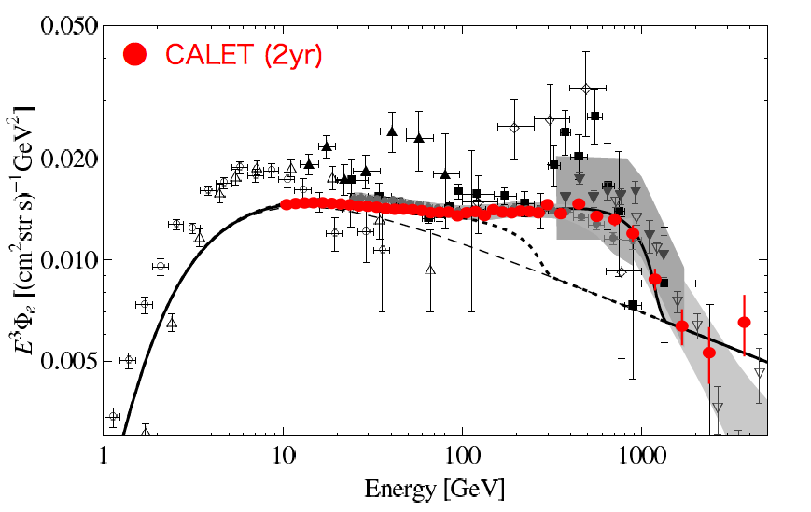
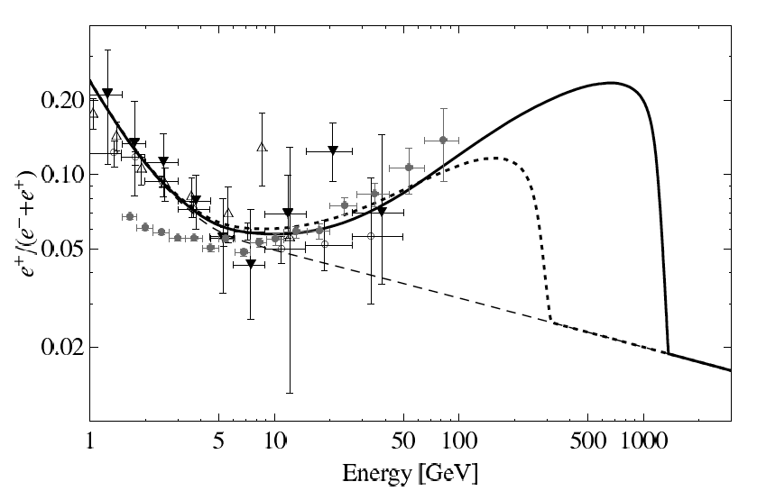
Electron and Positron from Dark Matter Decay
Decay Mode: D.M. -> l⁺l⁻ν
Mass: M_{D.M.}=2.5TeV
Decay Time: τ_{D.M.} = 2.1x10²⁶ s
Expected e⁻+e⁺ energy spectrum
by CALET observation
Expected e⁺/(e⁻+e⁺) ratio by a
theory and the observed data
Observation in the trans-TeV region
Dark Matter signal
Ibarra et al. (2010)

Slide 12
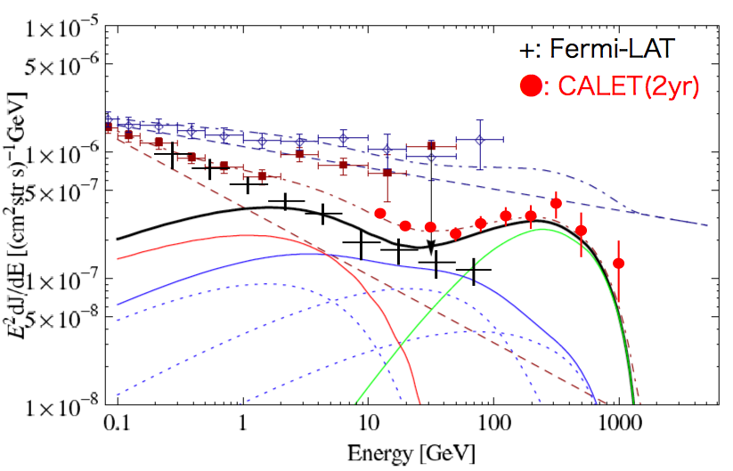
Extragalactic Diffuse Gamma-rays from Dark Matter Decay
Decay Mode: D.M. -> l⁺l⁻ν
Mass: M_{D.M.}=2.5TeV
Decay Time: τ_{D.M.} = 2.1x10²⁶ s
Extra-galactic diffuse gamma-rays
Extragalactic background
+
Gamma-rays by inverse Compton scattering of the electrons and positrons from DM decay with the inter-stellar and extragalactic photons
+
Gamma-rays from DM
EGRET
Dark Matter signal
Observation in the sub-TeV
region
Ibarra et al. (2010)

Slide 13
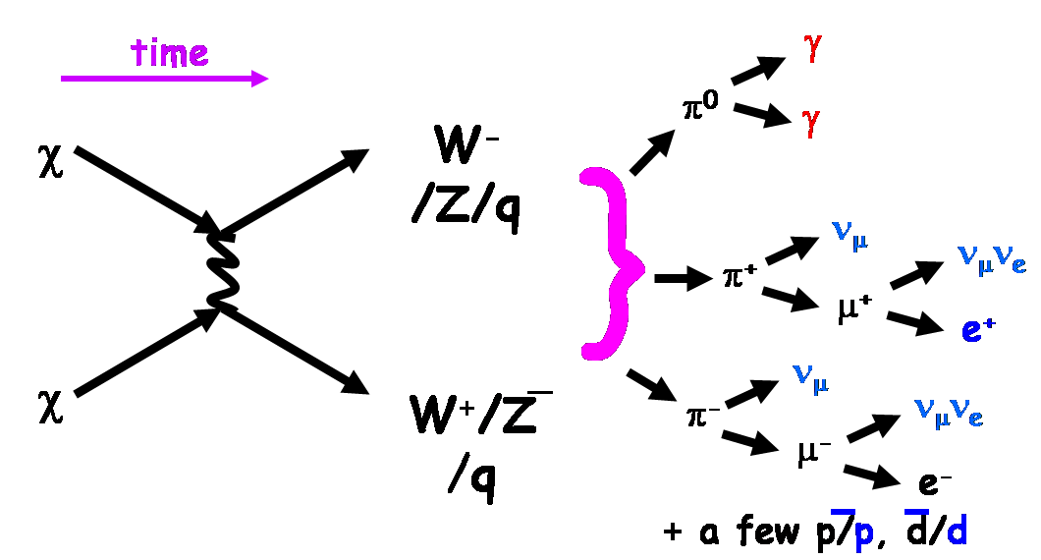
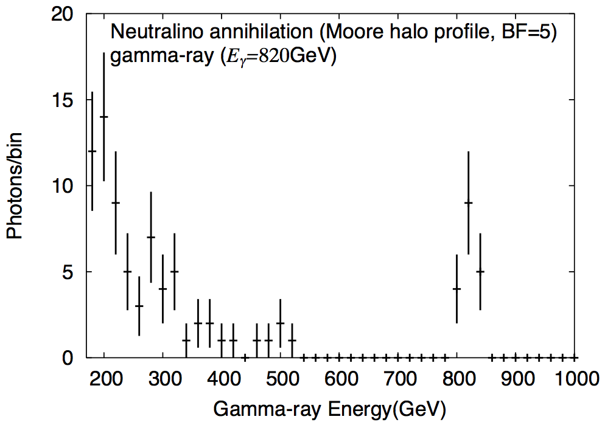
Gamma-ray line from Dark Matter
(1) WIMP line annihilation
(2) WIMP continuum emission
Excellent energy resolution with CALET （~2%：10GeV〜10TeV）
Detection capability of gamma-ray line due to DM annihilation
2yr （BF=5)
or 5yr （BF=2)
Expected gamma-ray line for DM (m=820 GeV) annihilation by CALET observation
(ref. Bergstrom et al. 2001)

Slide 14
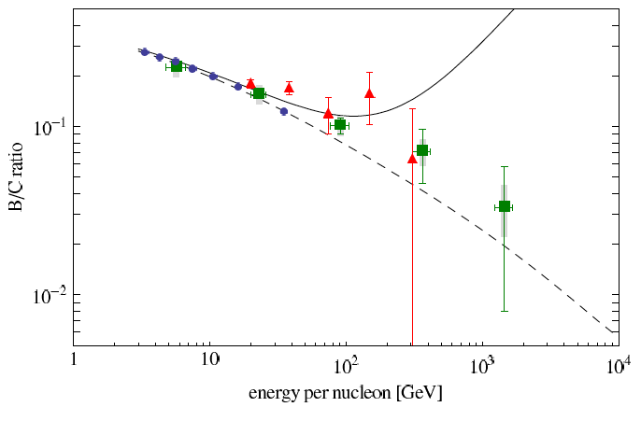
Proton and Nucleus Observation （5years)
2ry/ 1ry ratio ( B/C)
Energy dependence of diffusion constant: D ~ E^{δ}
Observation free from the atmospheric effect up
to several TeV/n
C
O
Ne
Mg
CREAM
Leaky Box Model
Si
Fe
Nearby Source Model (Sakar et al.)

Slide 15
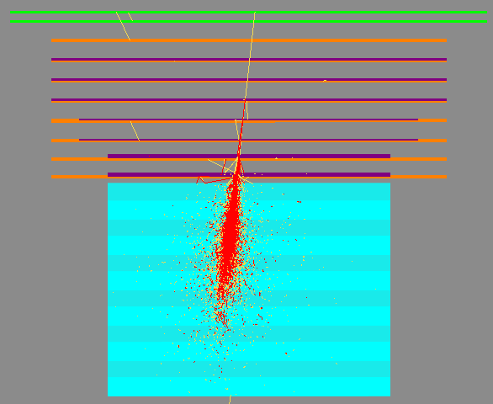
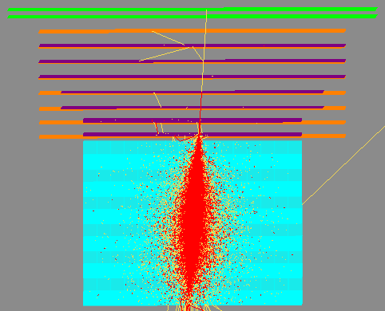
CALET Performance for Electron Observation
Electron 100 GeV
Geometrical
Factor
(Blue Mark)
SIA
IMC
TASC
Detection
Efficiency
Electron 1 TeV
Energy
Resolution
~2%
See Poster for details
( Akaike et al.)

Slide 16
CALET Performance for Electron Observation (2)
Angular Resolution
SΩ ( for electrons) vs Incident Angle
Electron
Differential
See Blue Marks
Integral
Gamma-ray

Slide 17
Comparison of Detector Performance for Electrons
CALET is optimized for the electron observation in the tran-TeV region, and the
performance is best also in 10-1000 GeV.
Detector | Energy Range (GeV) | Energy Resolution | e/p Selection Power | Key Instrument (Thickness of CAL) | SΩT （m^{２}srday)
PPB-BETS (+BETS) | 10 -1000 | 13% @100 GeV | 4000 (> 10 GeV) | IMC : (Lead: 9 X₀ ) | ~0.42
ATIC1+2 (+ ATIC4) | 10 - a few 1000 | <3% ( >100 GeV) | ~10,000 | Thick Seg. CAL (BGO: 22 X₀) + C Targets | 3.08
PAMELA | 1-700 | 5% @200 GeV | 10⁵ | Magnet+IMC (W:16 X₀) | ~1.4 (2 years)
FERMI-LAT | 20-1,000 | 5-20 % (20-1000 GeV) | 10³-10⁴ (20-1000GeV) Energy dep. GF | Tracker+ACD + Thin Seg. CAL (W:1.5X₀+CsI:8.6X₀) | 300@TeV (1 year)
AMS (less capability in PM model) | 1-1,000 (Due to Magnet) | ～2.5％ ＠100 GeV | 10⁴ (x 10² by TRD⁾ | Magnet+IMC +TRD+RICH (Lead: 17X_{o}) | ~100(?) (1year)
CALET | 1-10,000 | ~2% (>100 GeV) | ～10⁵ | IMC+Thick Seg. CAL (W: 3 X_{o}+ PWO : 27 X_{o}) | 220 (5 years)

Slide 18
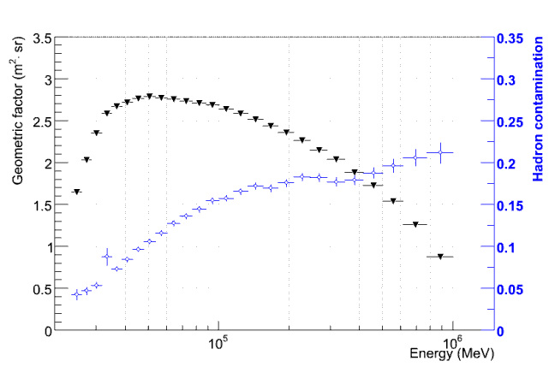
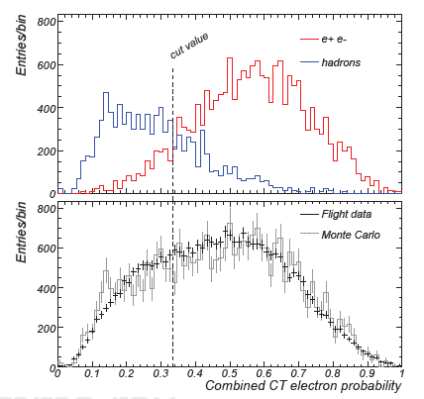
Why we need CALET ?
Proton rejection power depends fully on simulation by using different parameters
CALET is a dedicated detector for electrons and has a superior performance in the trans-TeV region as well as at the lower energies by using IMC and TASC
10⁴
FERMI Electron Analysis
Geometric Factor depends strongly on energy
Energy resolution becomes worse at high energies(~30 %@ 1 TeV)
Residual hadron contamination
Expected CALET Performance
Geometric Factor is constant up to 10 TeV
Energy resolution is nearly 2 %, and constant over 10 GeV
Proton rejection power at 4 TeV is better than 10⁵ with 95 % electron retained
Blue Mark
1.6 M protons

Slide 19
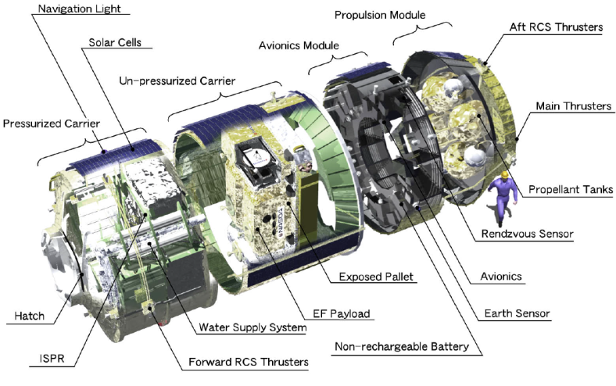
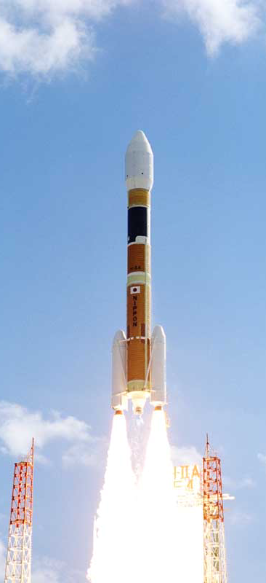
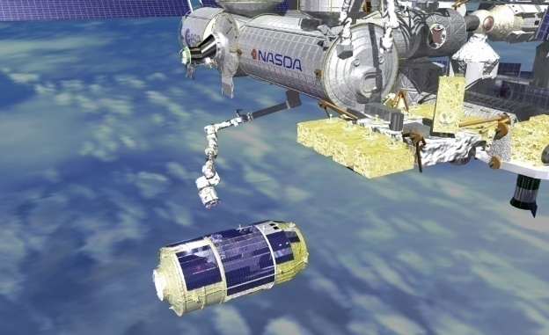
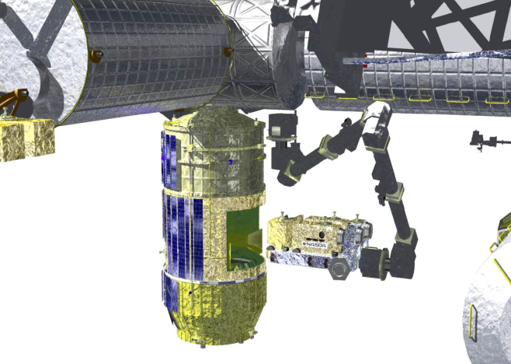
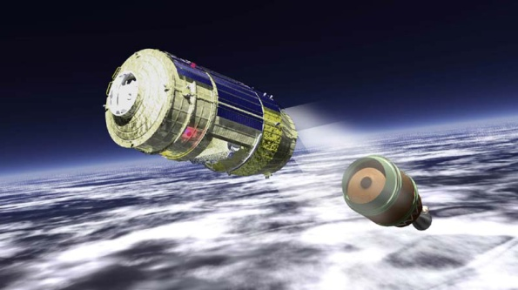
Launching Procedure of CALET
CALET
H2-B Transfer Vehicle（HTV)
ISS
Pickup of CALET
HTV
Approach to ISS
HTV
Launching by
H-IIB Rocket
Separation from H2-B
CALET

Slide 20
Concept of Data Downlink
NASA Link
Real-Time Connection
> 50 % (max. 17 hr/day)
NASA Data
Archive Center
Waseda Univ.
CALET Mission
Science Center
CALET
International
Collaboration
Organization
JAXA ICS Link
Real-Time Connection
~20 % (5 hr/day)

Slide 21
Summary and Future Prospect
The electron measurement over 1 TeV can bring us very important information of the origin and propagation of cosmic-rays and of the dark matter .
We have successfully been developing the CALET instrument for Japanese Experiment Module (Kibo) – Exposed Facility to extend the electron observation to the tans-TeV region.
The CALET has capabilities to observe the electrons up to 10 TeV , the gamma-rays in 10 GeV- 10TeV , the protons and heavy ions in several 10 GeV - 1000 TeV, for investigation of high energy phenomena in the Universe.
The CALET mission has been approved to proceed to the Phase B in target of launching schedule in summer, 2013.

