Slide 1
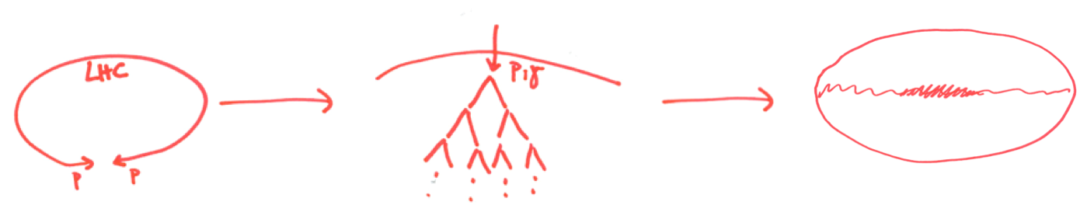

Air showers – from LHC to CTA
From the caverns of CERN to the top of the atmosphere and on to the Galactic plane
GRAPPA INSTITUTE
Gravitation AstroParticle Physics Amsterdam
David Berge
UvA / API / Nikhef
http://grappa.science.uva.nl

Slide 2
The air-shower connection

Slide 3
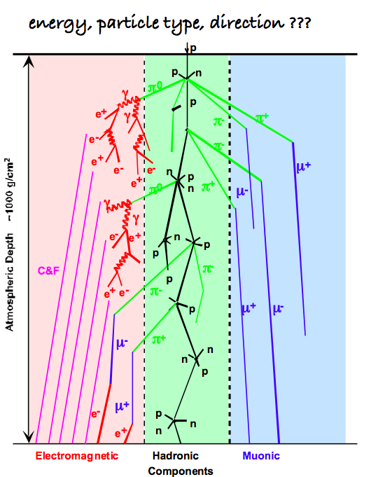
HESS
Auger
IceCube / Antares / KM3Net
LHC input to understand hadronic physics in air showers (as input to APP experiments): well known use case, yet without almost *ANY* effort.

Slide 4
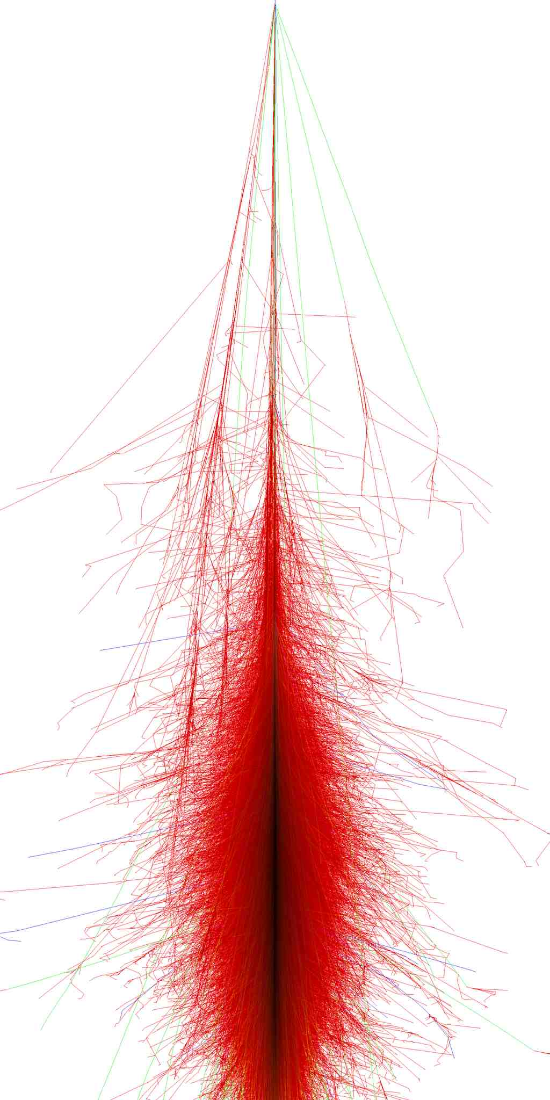
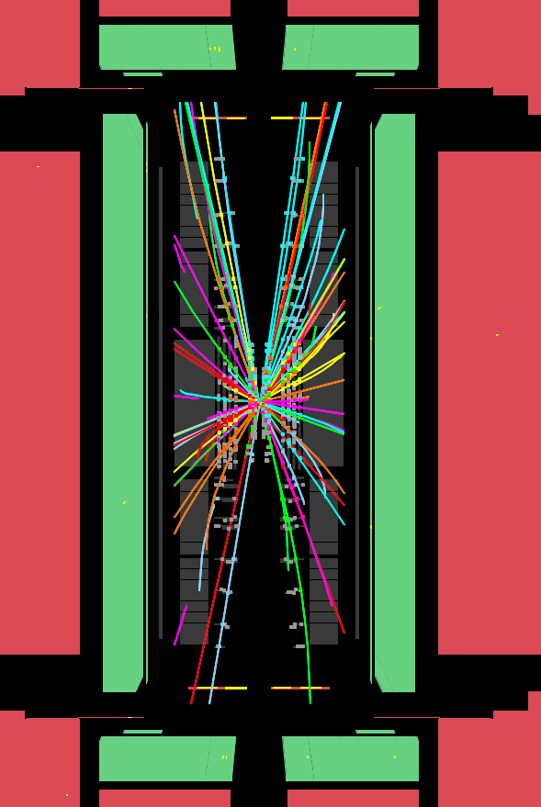
Probe energies beyond the CR knee at CERN
p
p
Measure at LHC
Extrapolate to very forward region and probe air-shower simulations

Slide 5
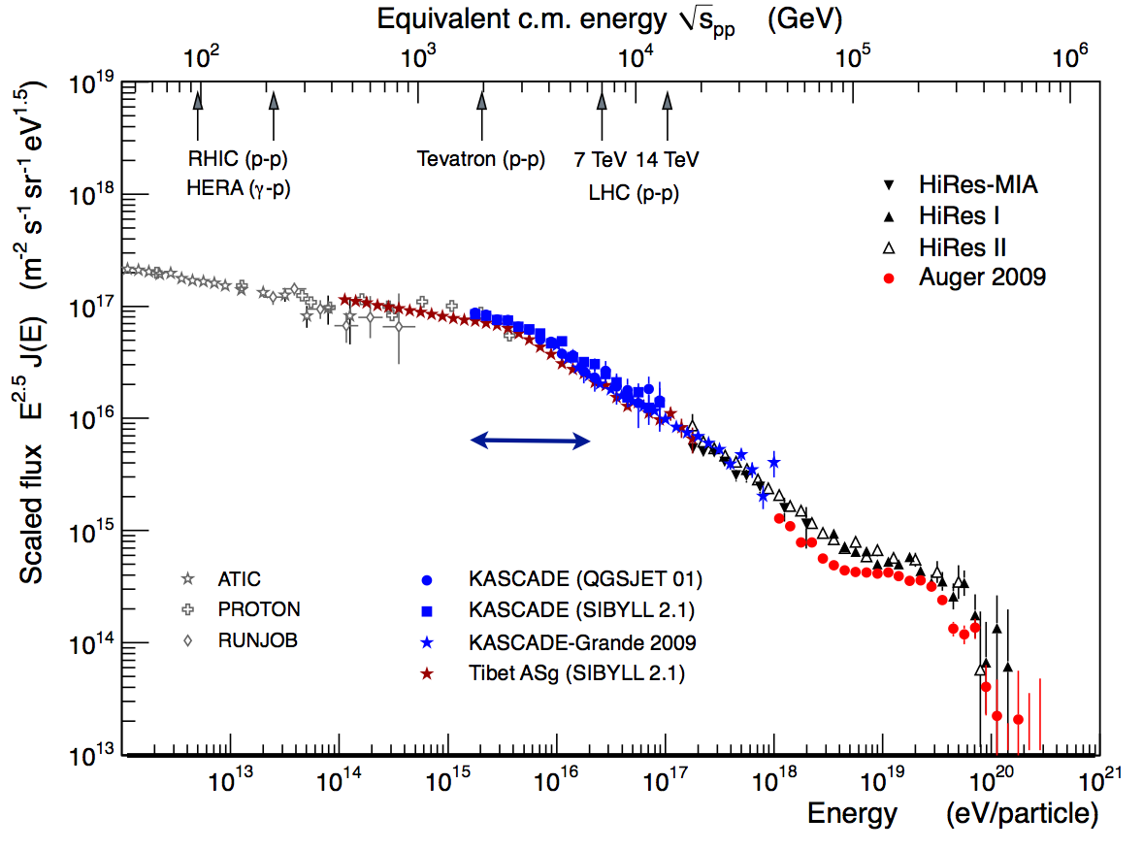

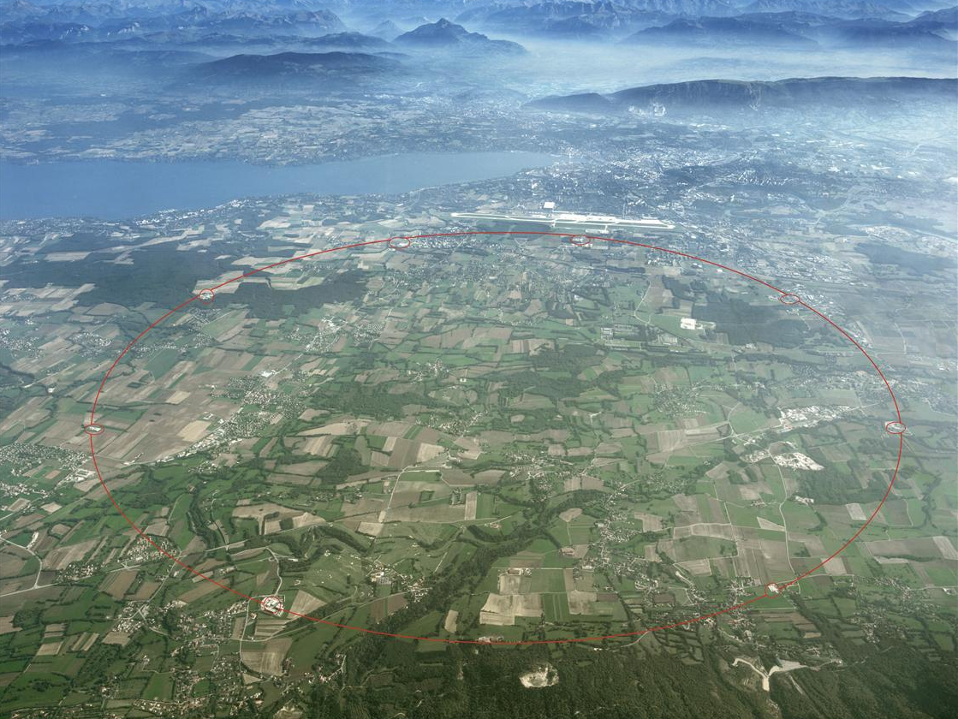
Probe energies beyond the CR knee at CERN
LHC
Charged cosmic rays

Slide 6
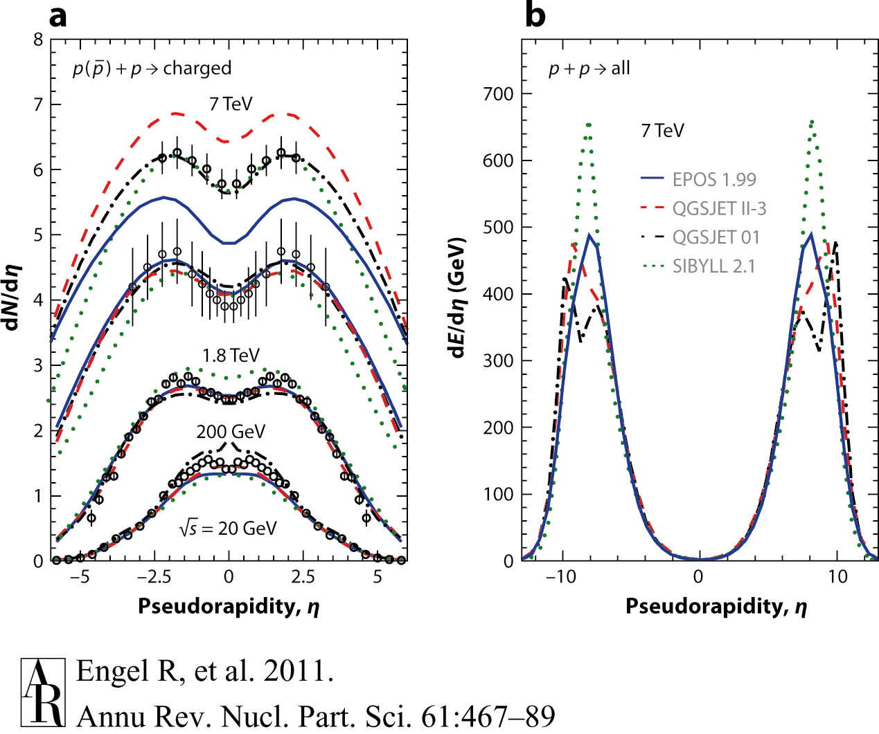
Probe energies beyond the CR knee at CERN
Extrapolations needed:
Energy
Central to very forward particle production
proton-proton to proton-Air

Slide 7
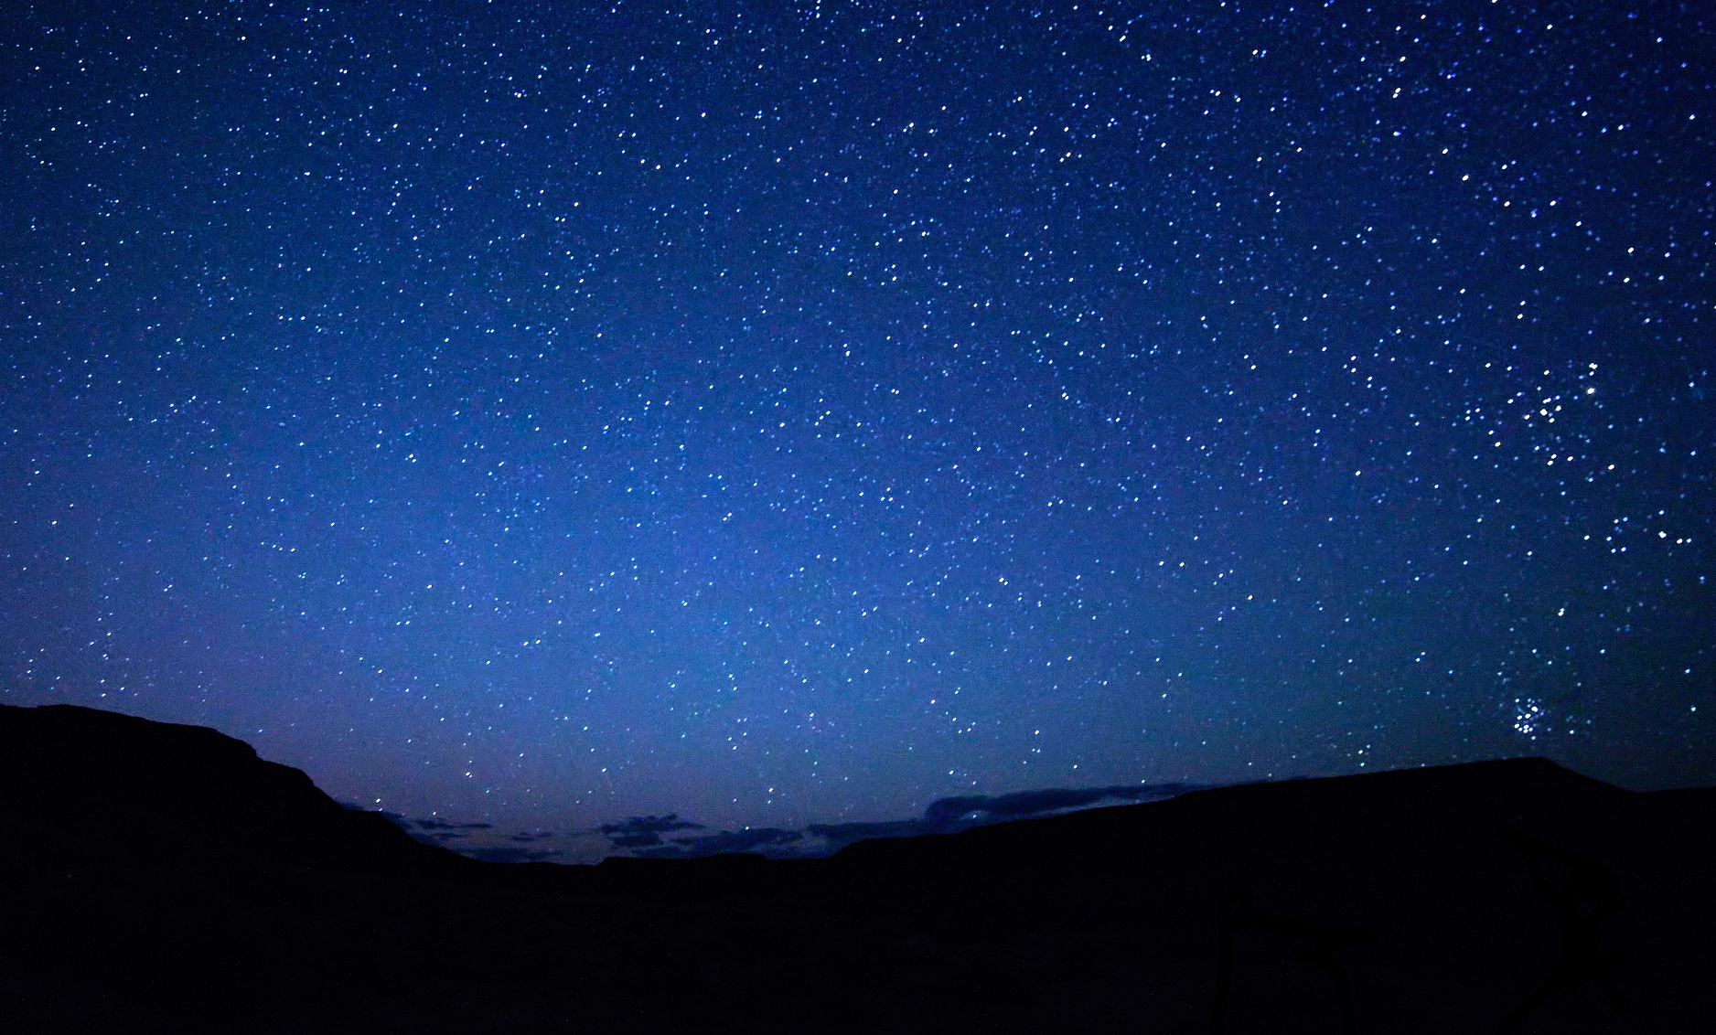

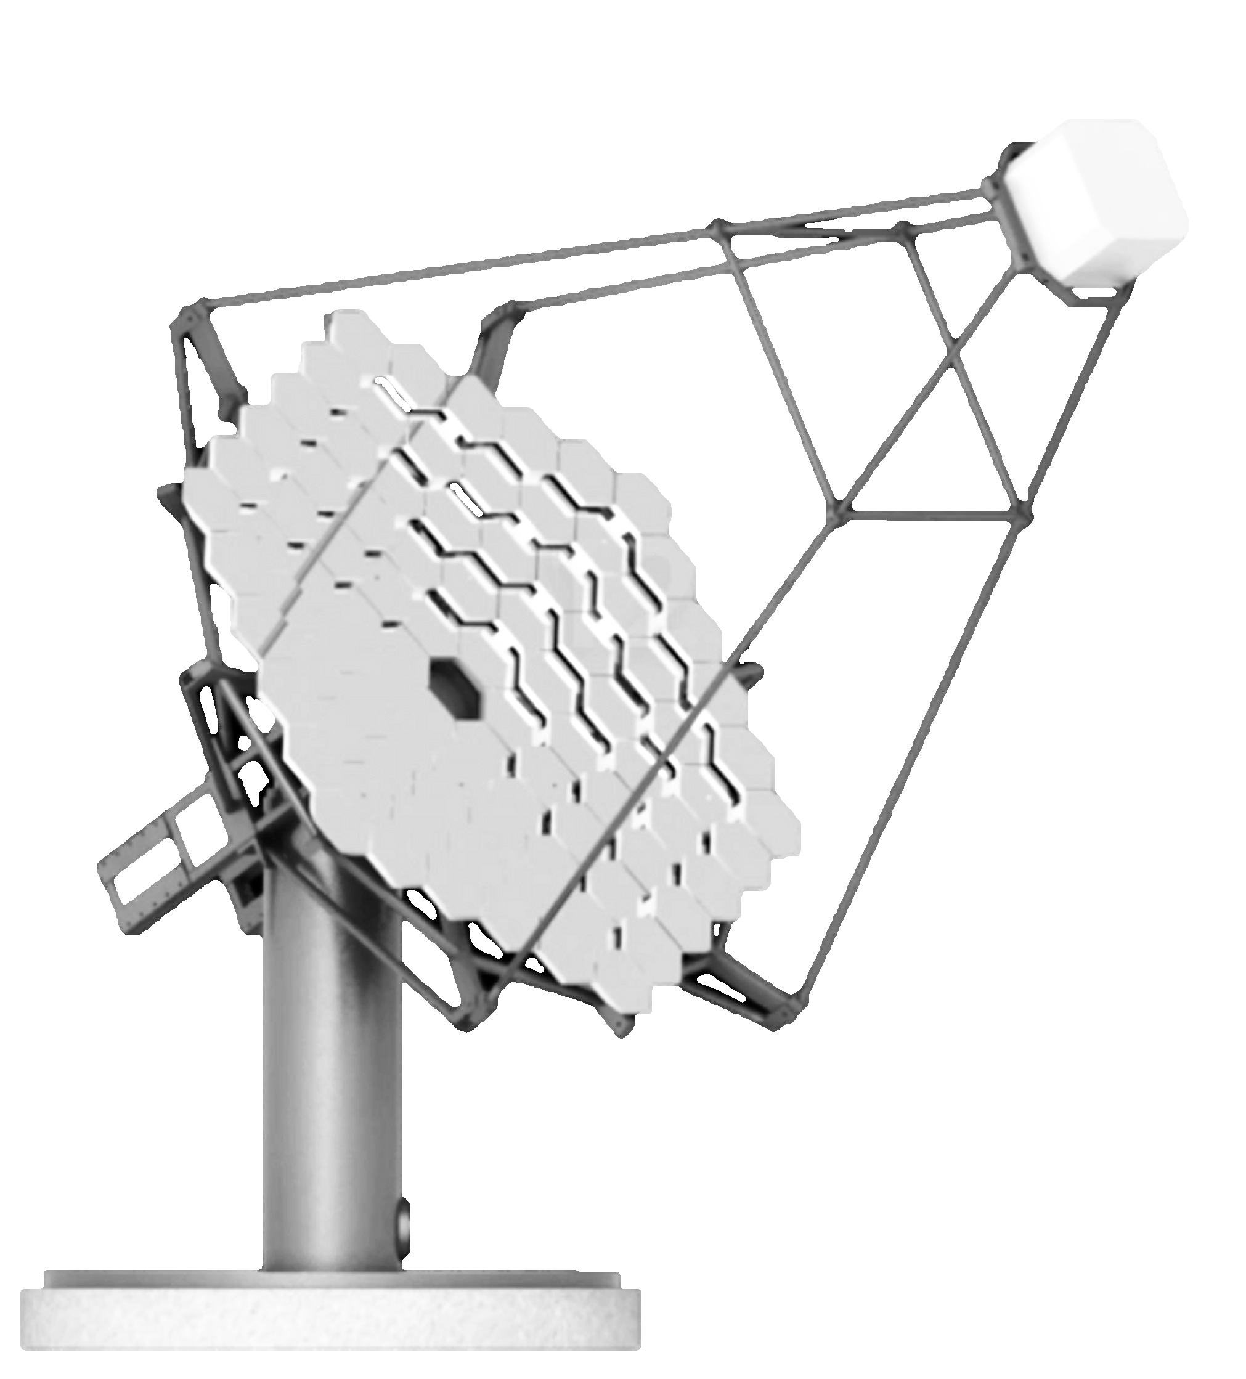
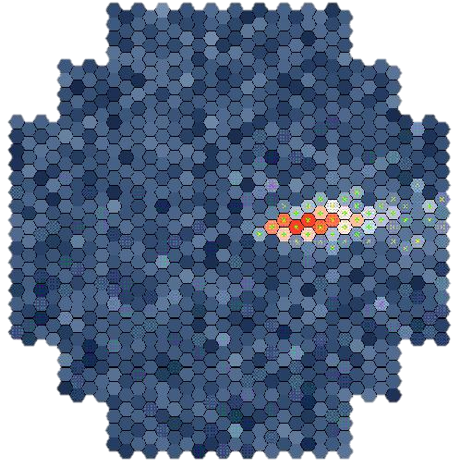
γ-ray enters the atmosphere
Electromagnetic cascade
10 nanosecond snapshot
0.1 km² “light pool”, a few photons per m².
~ 120 m

Slide 8
γ-ray enters the atmosphere
Electromagnetic cascade
10 nanosecond snapshot
0.1 km² “light pool”, a few photons per m².
~ 120 m

Slide 9
Background modeling for Cherenkov telescopes

Slide 10
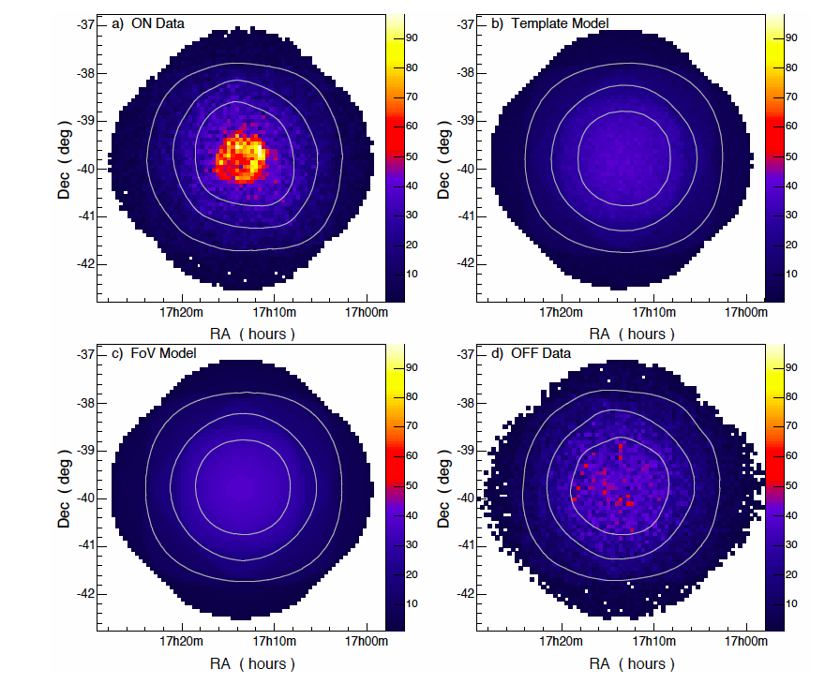
Irreducible background
Berge, Funk, Hinton (2006)
Ground-based γ-ray telescopes suffer from an irreducible and diffuse background, any “empty field” is not empty but rather a mix of:
charged hadronic cosmic rays
charged electrons
large scale (diffuse) γ-ray emission

Slide 11
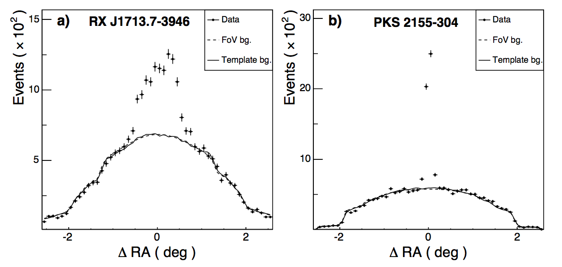
Irreducible background
Berge, Funk, Hinton (2006)
Ground-based γ-ray telescopes suffer from an irreducible and diffuse background, any “empty field” is not empty but rather a mix of:
charged hadronic cosmic rays
charged electrons
large scale (diffuse) γ-ray emission

Slide 12
Background modeling strategies
γ-ray-like background event rate =
CR flux ×
σ_{pAir→γ anything} ×
atmospheric transmission ×
detector response ×

Slide 13
Background modeling strategies
γ-ray-like background event rate =
CR flux ×
σ_{pAir→γ anything} ×
atmospheric transmission ×
detector response ×
Absolute
level
Shape

Slide 14
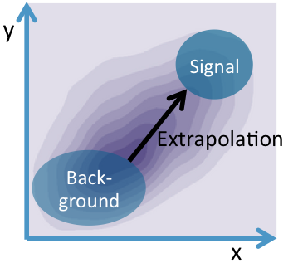
Background modeling strategies
Sideband techniques (γ-ray free region) to estimate shape and level

Slide 15
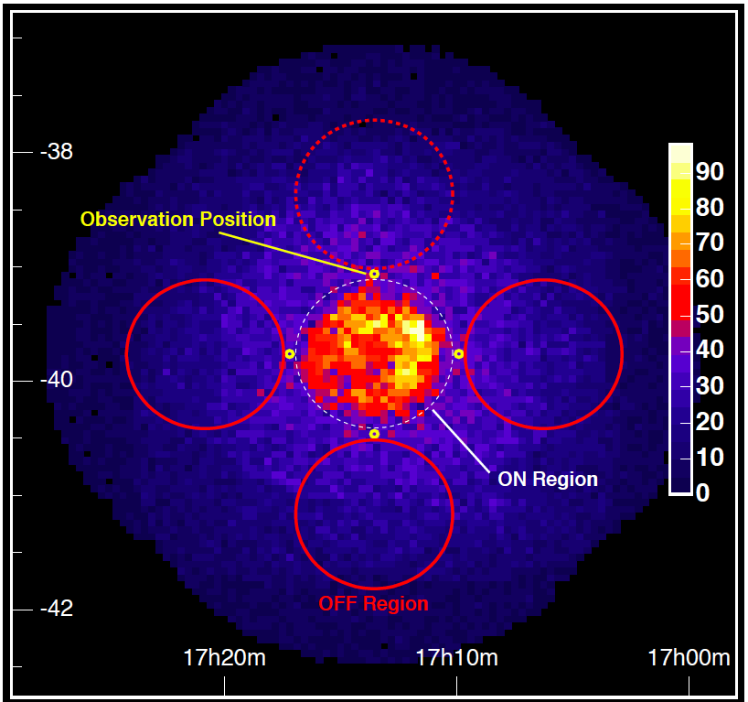
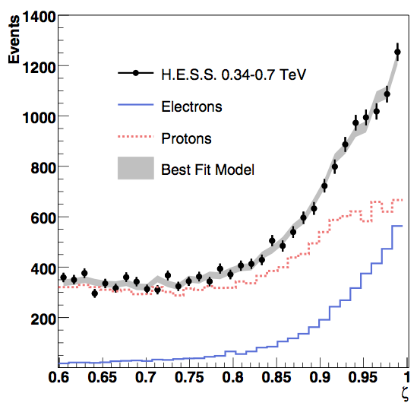
Background modeling strategies
Sideband techniques (γ-ray free region) to estimate shape and level
MVA

Slide 16
Background modeling strategies
Sideband techniques (γ-ray free region) to estimate shape and level
MVA
Background modeling challenging for large emission regions

Slide 17
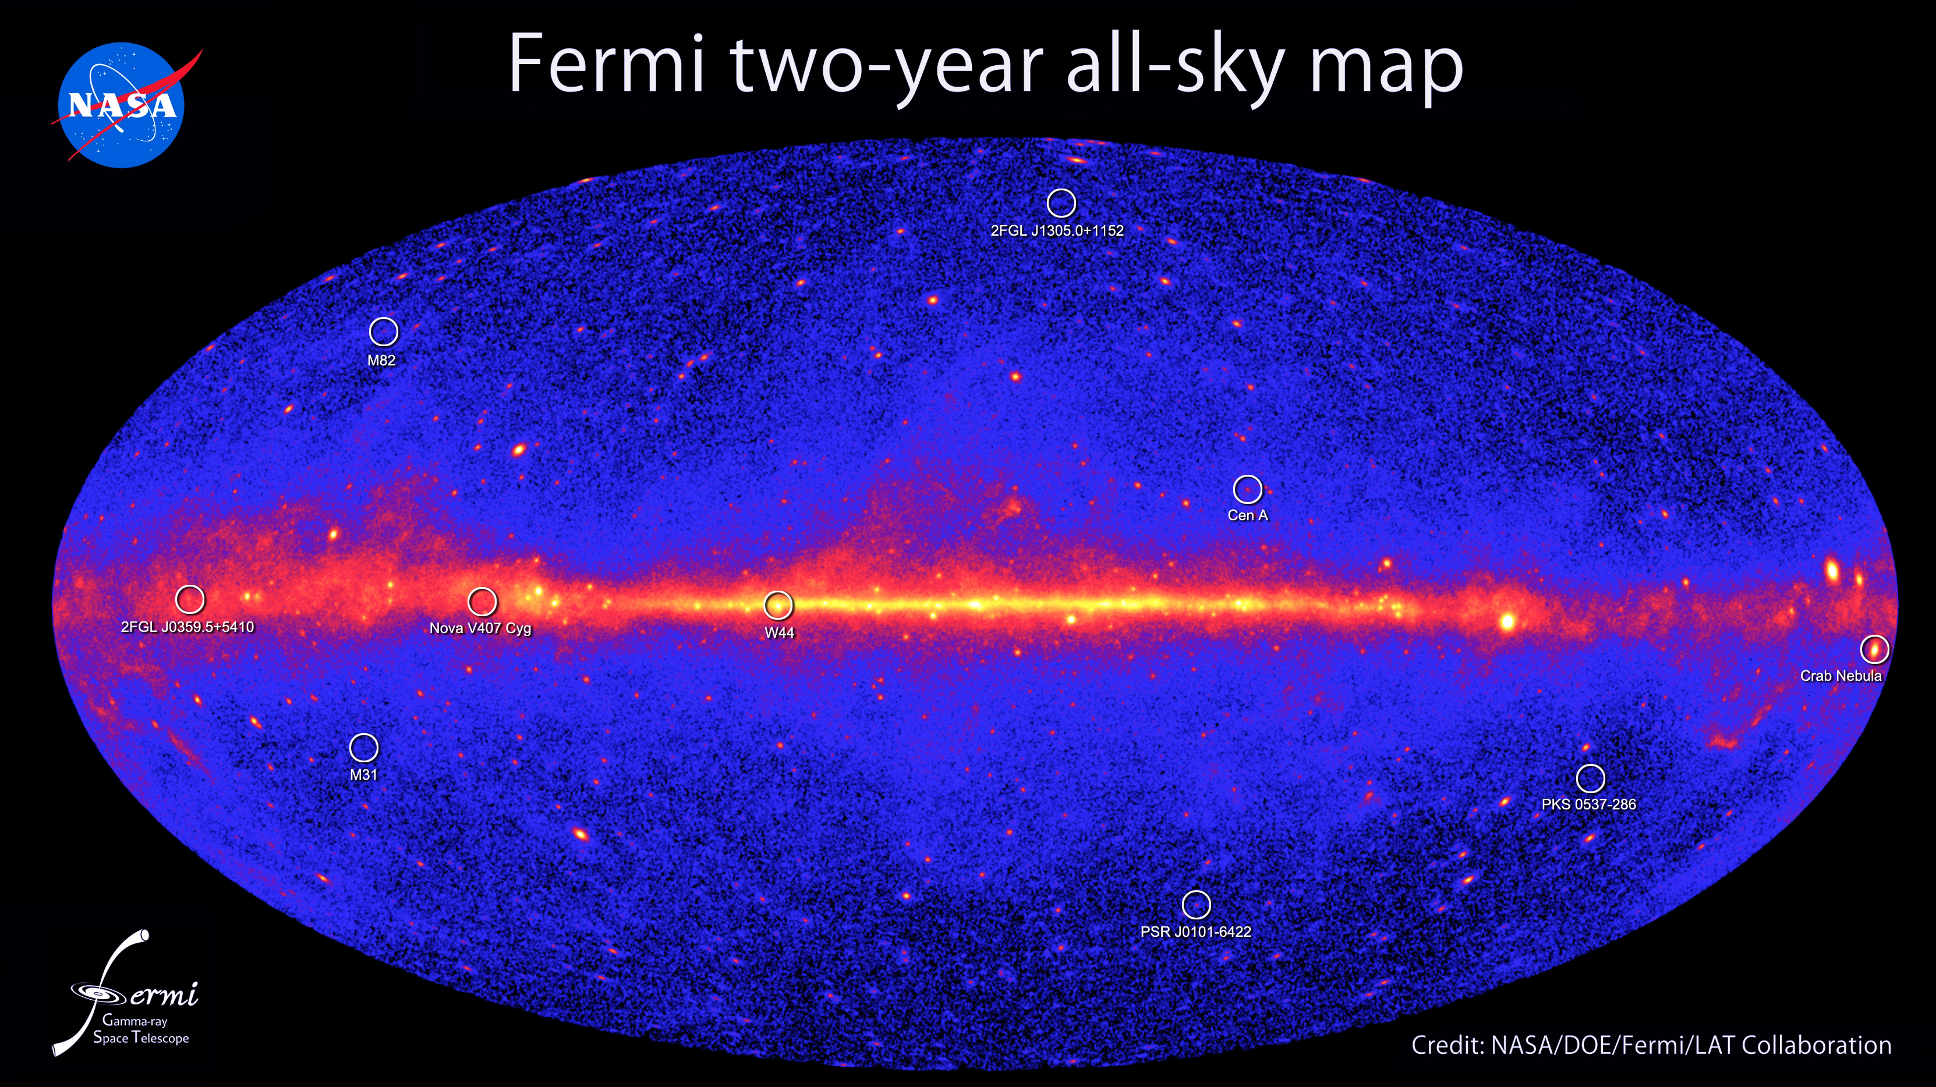
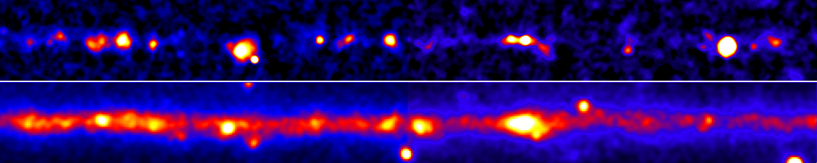
Fermi (GeV)
H.E.S.S. (TeV)

Slide 18
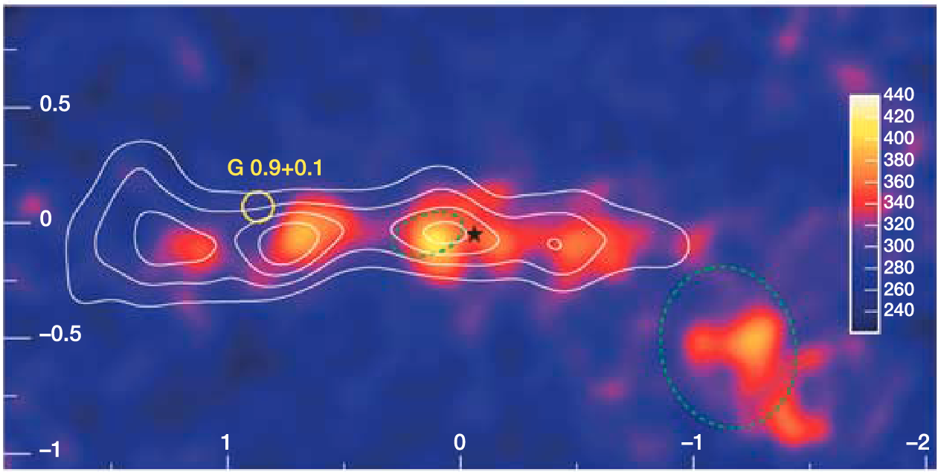
Fermi (GeV)
H.E.S.S. (TeV)

Slide 19
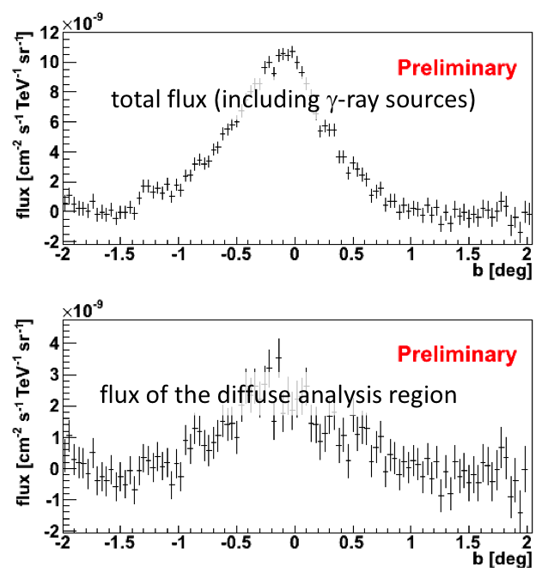
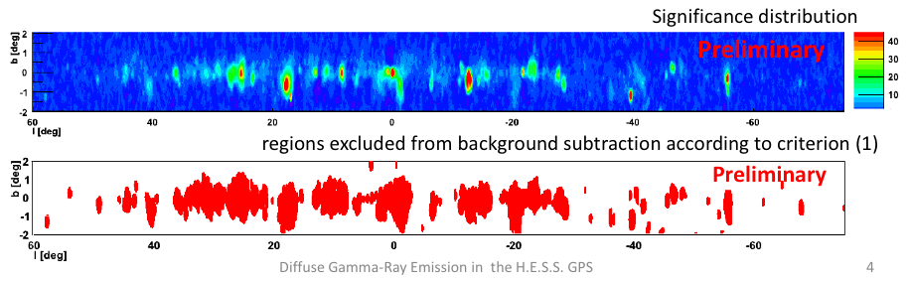
HESS at ICRC’13, diffuse TeV γ-ray flux starts to be accessible!
Fermi (GeV)
H.E.S.S. (TeV)

Slide 20
Opportunity: improve air-shower simulations with LHC data for γ-ray astronomy

Slide 21
Air-shower simulations for γ-ray astronomy
Pre-LHC tunes used everywhere (as far as I know)
But now for CTA, atmospheric and system monitoring will be MUCH better
A real use case for improving Monte Carlo simulations (and allow for background Monte Carlo modeling)!
Particularly interesting: LHCf measurements of forward photons

Slide 22
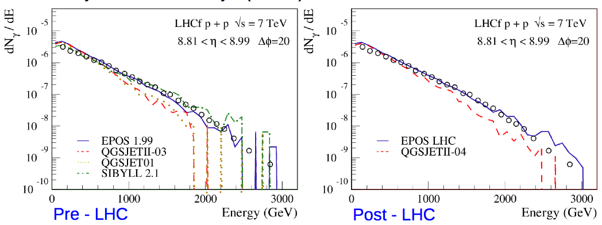
LHCf photon spectra
EPOS LHC tuned to multiplicity spectra with significantly improved data agreement

Slide 23
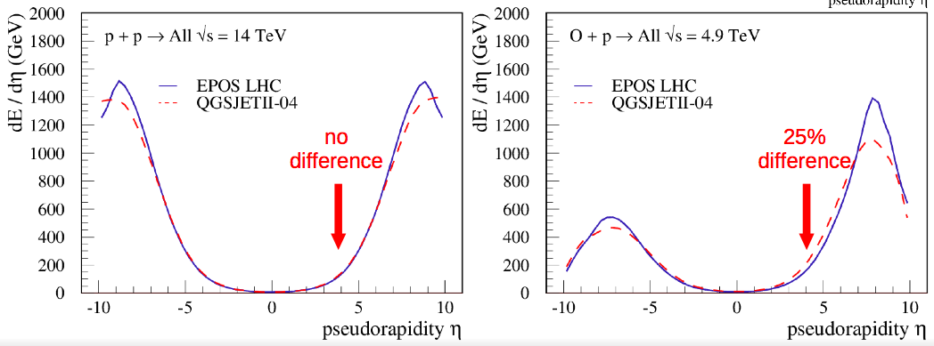
Future at LHC: p-Air…?
LHC currently upgrading from 8 to 13 (14) TeV
Will yield little improvement for air shower simulations
Much more useful would be to run proton-Oxygen collisions (discussions ongoing…)

Slide 24
Air showers – from LHC to CTA
Good opportunity in the NL with Nikhef / LHC groups
And MC simulations are of course even more important for Auger
Also relevant for neutrino telescopes (high-energy neutrino production in the atmosphere from charmed mesons…)

