Slide 1
Visit areas for CLIC during CERN open days
News: Both Sat 28 and Sun 29 Sep open for the public
~100.000 visitors expected!
Building 2010 CLEX area
Building 2008 CLIC showroom / CTF3 control room
Building 162 (Two Beam Module)

Slide 2
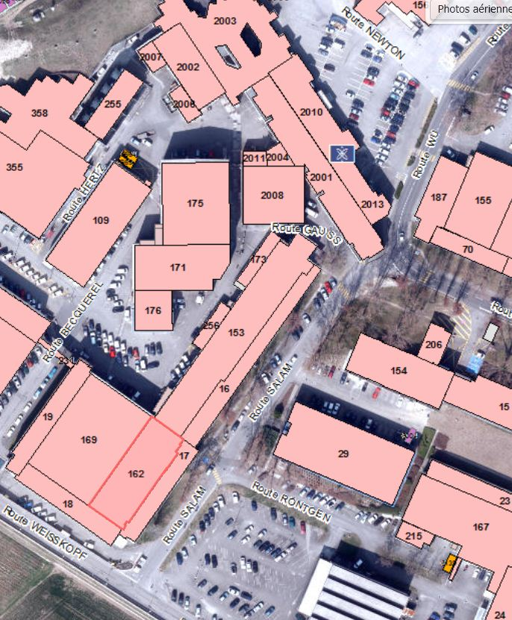
3 proposed areas in close proximity
CLEX
CLIC Show Room
and
CTF3 Control Room
Third Visit Area
(Two Beam Module)

Slide 3
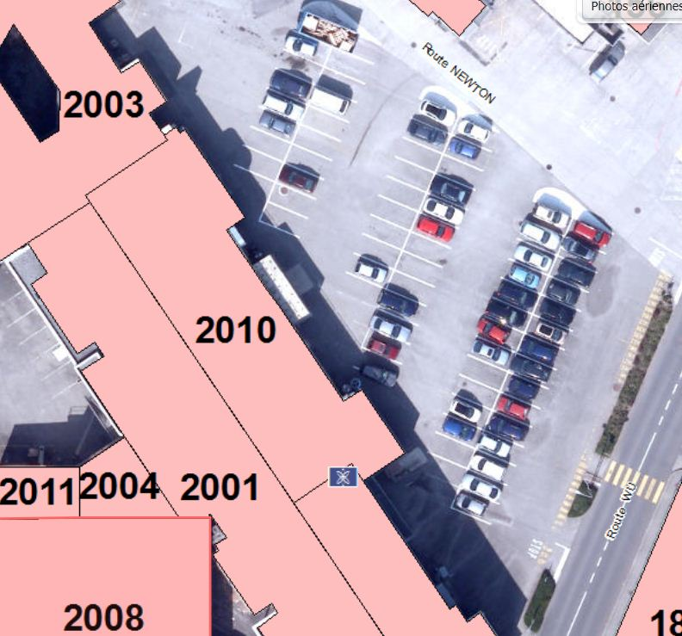
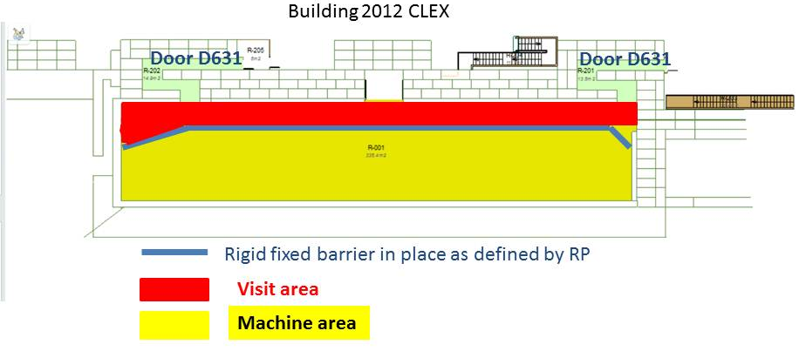
CLEX area Building 2010
Visits as procedure https://edms.cern.ch/document/1264066/1
but groups of 12, 3 groups at the time
Entrance
Exit
Tent 5mx5m
Entrance
Exit
Tented area outside with Posters

Slide 4
CLEX area Building 2010
Visitors:
12 years min
pregnant woman allowed
disabled access possible
<10 µSv but 1µSv goal
Waiting lines with barriers along
the chain towards building 2003
Tent 5mx5m
Entrance
Guides:
SIR course cern.ch/go/nN7v
CERN personal + operational dosimeter
dose recording (each visit - each group)
Exit

Slide 5
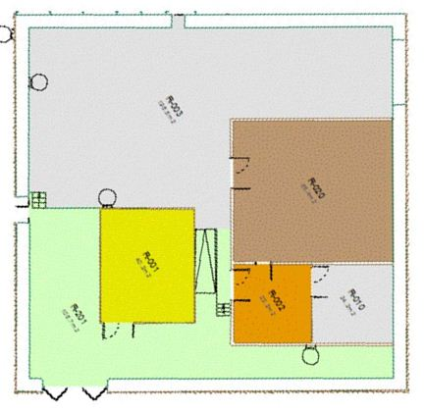
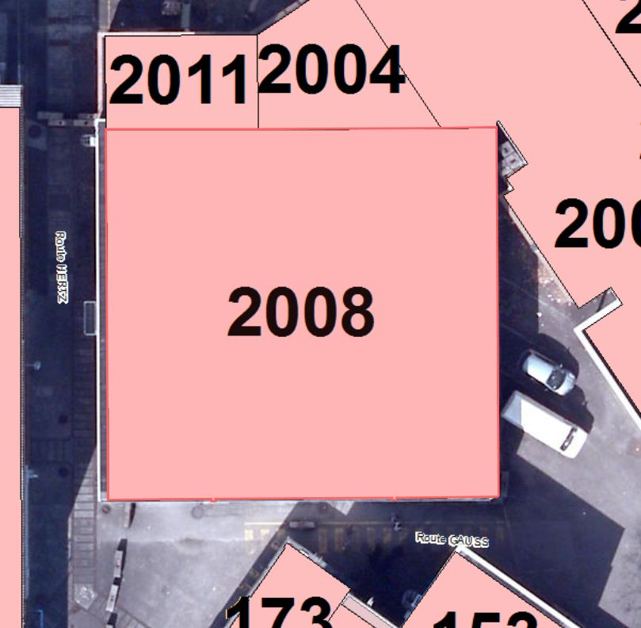
Building 2008
CLIC showroom and CTF3 Control room
Control room
Exit
Actual
showroom
New Showroom
area
Conference room
With projector
barriers
Visit itinerary
Entrance

Slide 6
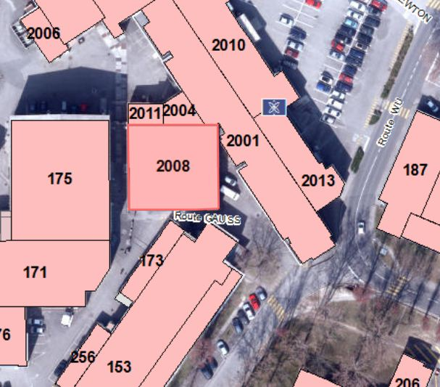
Waiting area
Exit
We have a small group to look at the content and logistics for the showroom
  Alexia Augier; Frank Tecker; Gerard Mcmonagle; Cristian Alejandro Fuentes Rojas; Sophie Redford; Rolf Landua; Andre-Pierre Olivier
Rearranging the show room with a big touch screen (84”), vitrines, detector model, posters, presentation + movie

Slide 7
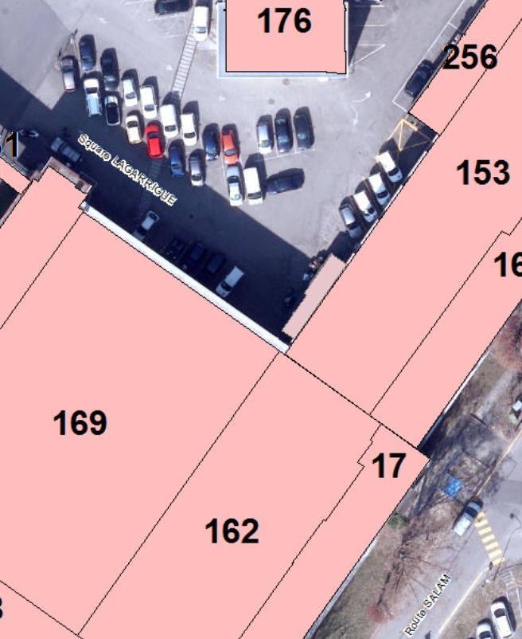
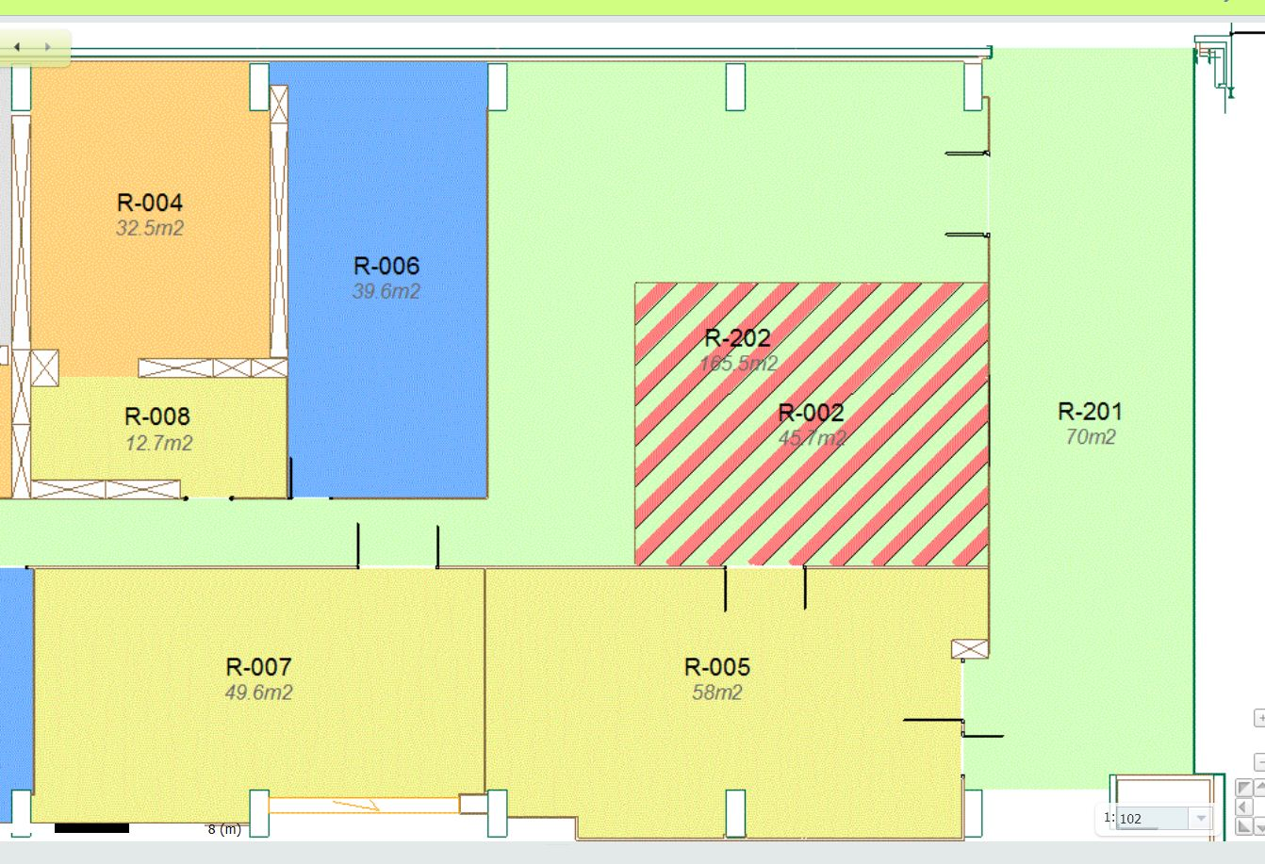
Third Visit Area (Two Beam Module) building 162
Entrance
Two Beam Module
Visit Area
Entrance
Exit
Exit
up to 10 3D-printouts of the two-beam module, large LCD screen, visit to the module

Slide 8
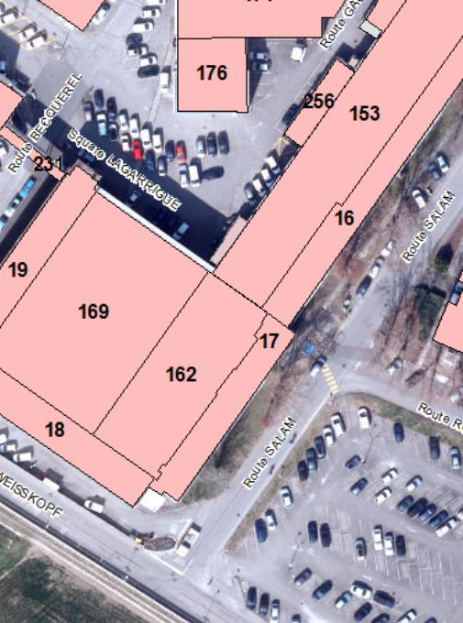
Waiting area
Exit

Slide 9
Very Important: We need guides
  Shifts last 6-7 hours,
  from 08:00 to 15:00 and from 14:00 to 21:00
    counted 3/4 guides per point simultaneously, 6/7 per shift
    2 crowd marshalls per point simultaneously, 3 per shift
  You can volunteer for one shift or a full day, on either Saturday and/or Sunday
  Please register if you would like to volunteer:
https://espace.cern.ch/OD2013/Volunteers/Pages/default.aspx

