Slide 1
Data Acquisition,
Trigger and
Control

Slide 2
Definitions
Trigger System
  Selects in Real Time “interesting” events from the bulk of collisions. - Decides if YES or NO the event should be read out of the detector and stored
Data Acquisition System
  Gathers the data produced by the detector and stores it (for positive trigger decisions)
Control System
  Performs the overall Configuration, Control and Monitoring

Slide 3
Trigger, DAQ & Control
Detector Channels
HwTrigger
Front End Electronics
Monitoring & Control
Event Building
High Level Trigger
Storage
DAQ

Slide 4
LEP & LHC in Numbers

Slide 5
Basic Concepts

Slide 6
Trivial DAQ
External View
sensor
Physical View
CPU
sensor
ADC Card
disk
Logical View
Proces-
sing
ADC
storage
Trigger (periodic)

Slide 7
Trivial DAQ with a real trigger
Sensor
Trigger
Delay
Discriminator
Start
ADC
Proces-
sing
Interrupt
What if a trigger is produced when the ADC or Processing is busy ?
storage

Slide 8
Trivial DAQ with a real trigger (2)
Sensor
Trigger
Discriminator
Delay
Start
Busy Logic
ADC
and
not
Proces-
sing
Interrupt
Set
Q
Ready
Clear
Deadtime (%) - the ratio between the time the DAQ is busy and the total time
storage

Slide 9
Trivial DAQ with a real trigger (3)
Sensor
Trigger
Discriminator
Delay
Start
Busy Logic
ADC
and
Full
FIFO
DataReady
Proces-
sing
Buffers: De-randomize data -> decouple data production from data consumption -> Better performance
storage

Slide 10
Trivial DAQ in collider mode
Sensor
Timing
Beam crossing
BX
Start
ADC
Abort
Trigger
Discriminator
FIFO
Full
Busy Logic
DataReady
Proces-
sing
We know when a collision happens the TRIGGER is used to “reject” the data
storage

Slide 11
LHC timing
p p crossing rate 40 MHz (L=10³³- 4⋅10³⁴cm⁻² s⁻¹)
25 ns
40 MHz
Level 1
≈ μs
100 kHz
Level 2
≈ ms
1 kHz
Level n
Level 1 trigger time exceeds bunch interval
Event overlap & signal pileup (multiple crossings since the detector cell memory greater than 25 ns)
Very high number of channels

Slide 12
Trivial DAQ in LHC
Timing
Sensor
Beam crossing
BX
Clock
Analog
Pipeline
Pipelined
Trigger
Accept/Reject
ADC
Busy Logic
FIFO
Full
DataReady
Proces-
sing
Front-end Pipelines: To wait for the trigger decision + transmission delays are longer than beam crossing period
storage

Slide 13
Less trivial DAQ
N channels
N channels
N channels
ADC
ADC
ADC
Trigger
Proces-
sing
Proces-
sing
Proces-
sing
Some processing
can proceed in parallel
Event
Building
Proces-
sing
storage

Slide 14
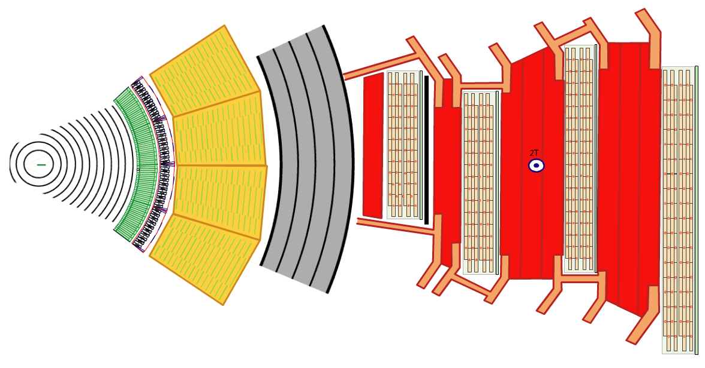
The Real Thing
15 million detector channels
@ 40 MHz
= ~15 * 1,000,000 * 40 * 1,000,000 bytes
= ~ 600 TB/sec
?

Slide 15
Trigger

Slide 16
Trigger System
The Trigger system detects whether an event is interesting or not
Typical ATLAS and CMS* event
20 collisions may overlap
This repeats every 25 ns
A Higgs event
^{*)}LHCb isn’t much nicer and in Alice (PbPb) it can be even worse

Slide 17
Trigger Levels
Since the detector data is not promptly available and the trigger function is highly complex, it is evaluated by successive approximations:
  Hardware trigger(s):
    Fast trigger, uses data only from few detectors
    has a limited time budget
    Level 1, Sometimes Level 2
  Software trigger(s):
    Refines the decisions of the hardware trigger by using more detailed data and more complex algorithms.
    It is usually implemented using processors running a program.
    High Level Triggers (HLT)

Slide 18
Hardware Trigger
Luckily pp collisions produce mainly particles with transverse momentum “p_{t} ” ~1 GeV
Interesting physics (old and new) has particles with large p_{t}
p
p_{t}
Conclusion: in the first trigger level we need to detect high transverse momentum particles
Notes:
18

Slide 19
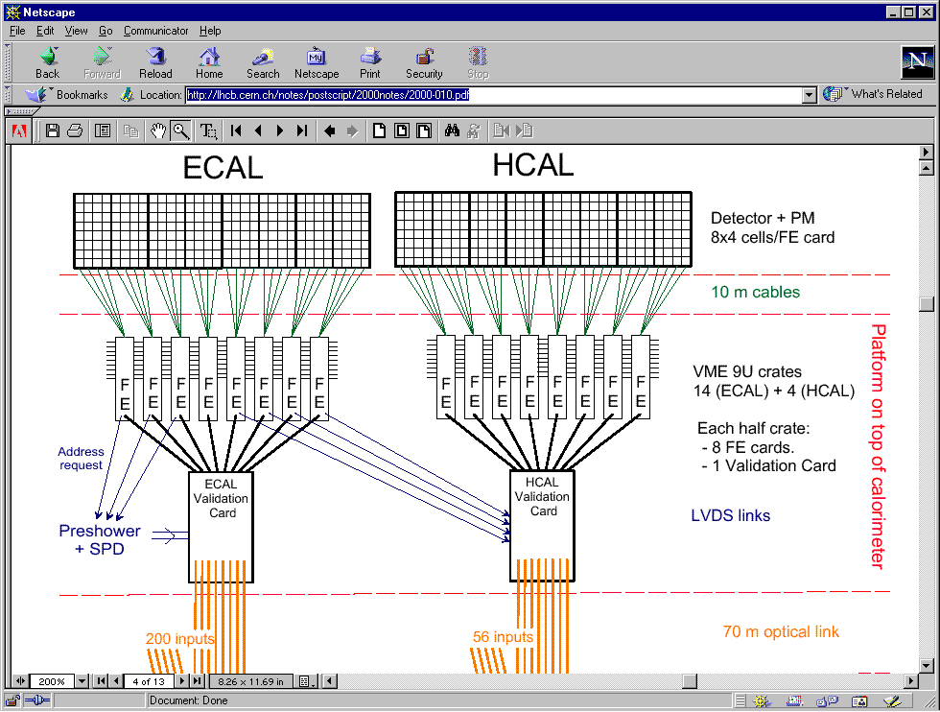
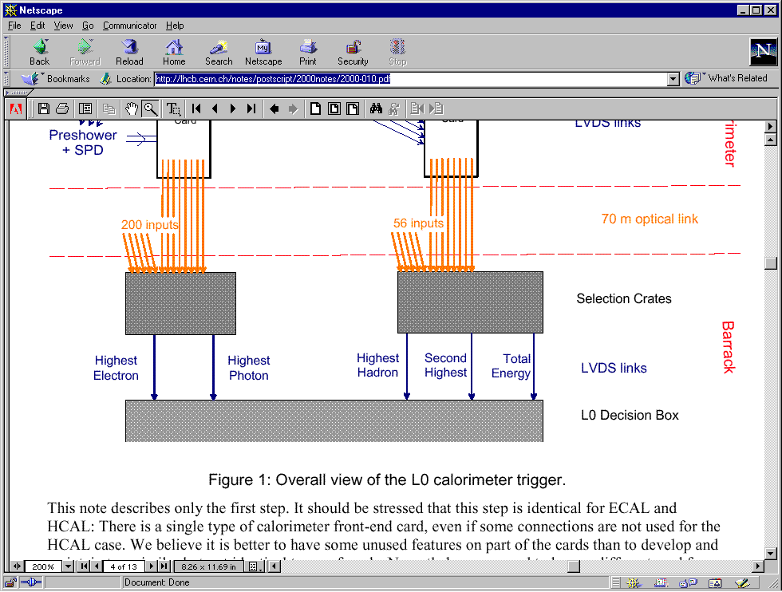
Example: LHCb Calorimeter Trigger
Detect a high energy in a small surface
Don’t forget the neighbors
Compare with threshold

Slide 20
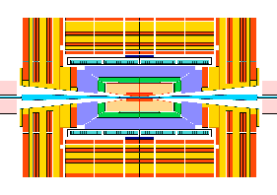
LHC: Trigger communication loop
Global Trigger
Local level-1
≈ 3 μs
latency
loop
Timing and trigger has to be distributed to ALL front-ends
Trigger
Primitive
Generator
Font-End
pipeline delay
≈ 3μs
accept/reject
40 MHz synchronous digital system
Synchronization at the exit of the pipeline non trivial. ⇒ Timing calibration

Slide 21
Trigger Levels in LHCb
Detectors
Level-0 (4 μs) (custom processors)
  High p_{T} for electrons, muons, hadrons
  Pile-up veto.
HLT (≈ms) (commercial processors)
  Refinement of the Level-1. Background
  rejection.
  Event reconstruction. Select physics
  channels.
  Needs the full event
40 MHz
Trigger
level 0
1 MHz
Readout
buffers
Event
building
Processor
Farms
High level
Trigger
2 KHz
Storage

Slide 22
Trigger Levels in ATLAS
Level-1 (3.5 μs) (custom processors)
  Energy clusters in calorimeters
  Muon trigger: tracking coincidence matrix.
Level-2 (100 μs) (specialized processors)
  Few Regions Of Interest relevant to trigger decisions
  Selected information (ROI) by routers and switches
  Feature extractors (DSP or specialized)
  Staged local and global processors
Level-3 (≈ms) (commercial processors)
  Reconstructs the event using all data
  Selection of interesting physics channels
Detectors
Front-end
Pipelines
Trigger
level 1
Region of
interest
RoI
Readout
buffers
Trigger
level 2
Event
building
Processor
Farms
Trigger
level 3
Storage

Slide 23
Data Acquisition

Slide 24
Data Acquisition System
Gathers the data produced by the detector and stores it (for positive trigger decisions)
  Front End Electronics:
    Receive detector, trigger and timing signals and produce digitized information
  Readout Network
    Reads front end data and forms complete events
    - Event building
  Processing & Storage
    Data processing or filtering
    Stores event data

Slide 25
Front-Ends
Detector dependent (Home made)
  On Detector
    Pre-amplification, Discrimination, Shaping amplification and Multiplexing of a few channels
    Problems: Radiation levels, power consumption
  Transmission
    Long Cables (50-100 m), electrical or fiber-optics
  In Counting Rooms
    Hundreds of FE crates : Reception, A/D conversion and Buffering

Slide 26
Front-end structure
Detector
Amplifier
Filter
Shaper
Range compression
clock
Sampling
Digital filter
Zero suppression
Pipeline
Feature extraction
Buffer
Format & Readout

Slide 27
DAQ Readout
Event-data are now digitized, pre-processed and tagged with a unique, monotonically increasing number
But distributed over many read-out boards (“sources”)
For the next stage of selection, or even simply to write it to tape we have to get the pieces together:
Event Building

Slide 28
Event Building
Data sources
Event Fragments
Event Building
Full Events
Data storage

Slide 29
Event Filters
Higher level triggers (3, 4, …)
Event
building
Event filter
Trigger
level 3,4
Storage
LHC experiments can not afford to write all acquired data into mass-storage. -> Only useful events should be written to the storage
The event filter function selects events that will be
used in the data analysis. Selected physics channels.
Uses commercially available processors (common PCs)
But needs thousands of them running in parallel.

Slide 30
Event Building to a CPU farm
Data sources
Event Fragments
Event Building
Full Events
Event filter CPUs
Data storage

Slide 31
Readout Networks
We can build networks using buses or switches.
data
sources
data
processors
Switches vs. Buses
  Total bandwidth of a Bus is shared among all the processors. Adding more processors degrades the performance of the others. In general, Buses do not scale very well.
  With switches, N simultaneous transfers can co-exists. Adding more processors does not degrade performance (bigger switch). Switches are scaleable.

Slide 32
LHC Readout Architecture
Detector Front Ends
...
Trigger Level 1/2
Readout Units
Event Manager
Event Builder (Network)
...
Event Filter Units
Storage

Slide 33
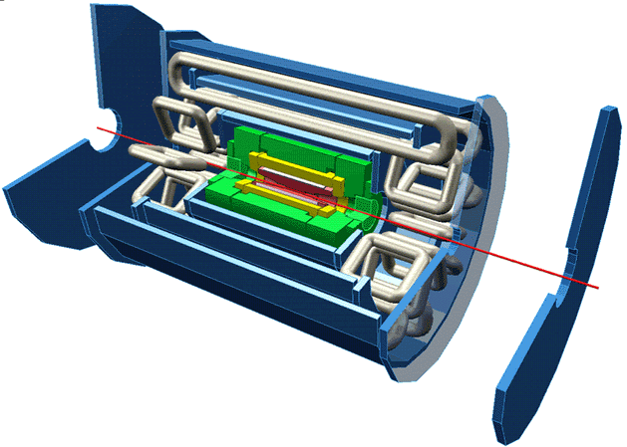
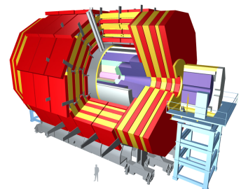
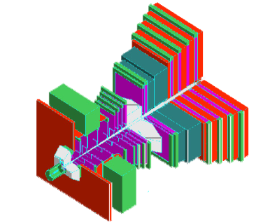
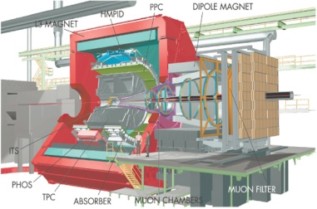
LHC Experiments DAQ
Level-1
Event
Storage
kHz
MByte
MByte/s
ATLAS
100
1
200
CMS
100
1
200
LHCb
1000
0.05
150
ALICE
1
25
1250
Notes:
33
33

Slide 34
LHCb DAQ
40 GB/s
80 MB/s
Average event size 50 kB
Average rate into farm 1 MHz
Average rate to tape 3 kHz

Slide 35
Configuration, Control and Monitoring

Slide 36
Experiment Control System
Detector Control System (HV, LV, GAS, Cooling, etc.)
Detector Channels
L0
TFC
Front End Electronics
Experiment Control System
Readout Network
HLT Farm
Storage
Monitoring Farm
DAQ
External Systems (LHC, Technical Services, Safety, etc)

Slide 37
Control System
Control System Tasks
  Configuration
    Loading of parameters
    (according to RUN type)
    Enabling/disabling parts of the experiment
  Partitioning
    Ability to run parts of the experiment in stand-alone mode simultaneously
  Monitoring, Error Reporting & Recovery
    Detect and recover problems as fast as possible
  User Interfacing

Slide 38
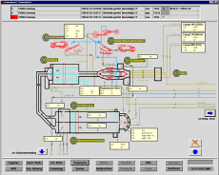
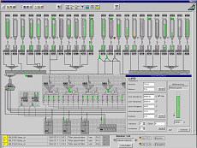
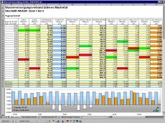
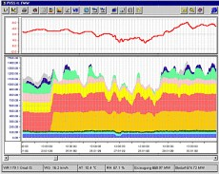
LHC Control Systems
Based on Commercial SCADA Systems (Supervisory Control and Data Acquisition)
  Commonly used for:
    Industrial Automation
    Control of Power Plants, etc.
  Providing:
    Configuration Database and Tools
    Run-time and Archiving of Monitoring Data including display and trending Tools.
    Alarm definition and reporting tools
    User Interface design tools

Slide 39
Control Automation
Experiment runs 24/24 7/7
Only 2 (non-expert) operators
Automation
  Avoids human mistakes and speeds up standard procedures
  What can be automated
    Standard Procedures (Start of fill, End of fill)
    Detection and Recovery from (known) error situations
  How
    Finite State Machine tools
    Expert System Type Tools (automated rules)

Slide 40
Monitoring
Two types of Monitoring
  Monitor Experiment’s Behaviour
    Automation tools whenever possible
    Good (homogeneous) User Interface
  Monitor the quality of the data
    Automatic histogram production and analysis
    User Interfaced histogram analysis
    Event displays (raw data)

Slide 41
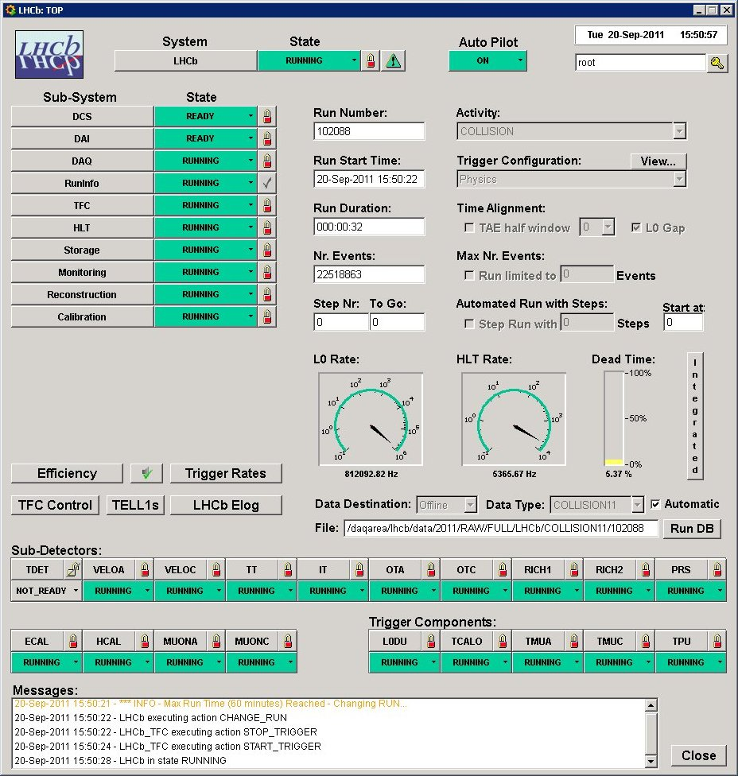
LHCb Run Control
  Homogeneous control of all parts of the experiment
  Stand alone operation (partitioning)
  Full Automation (Auto Pilot)

Slide 42
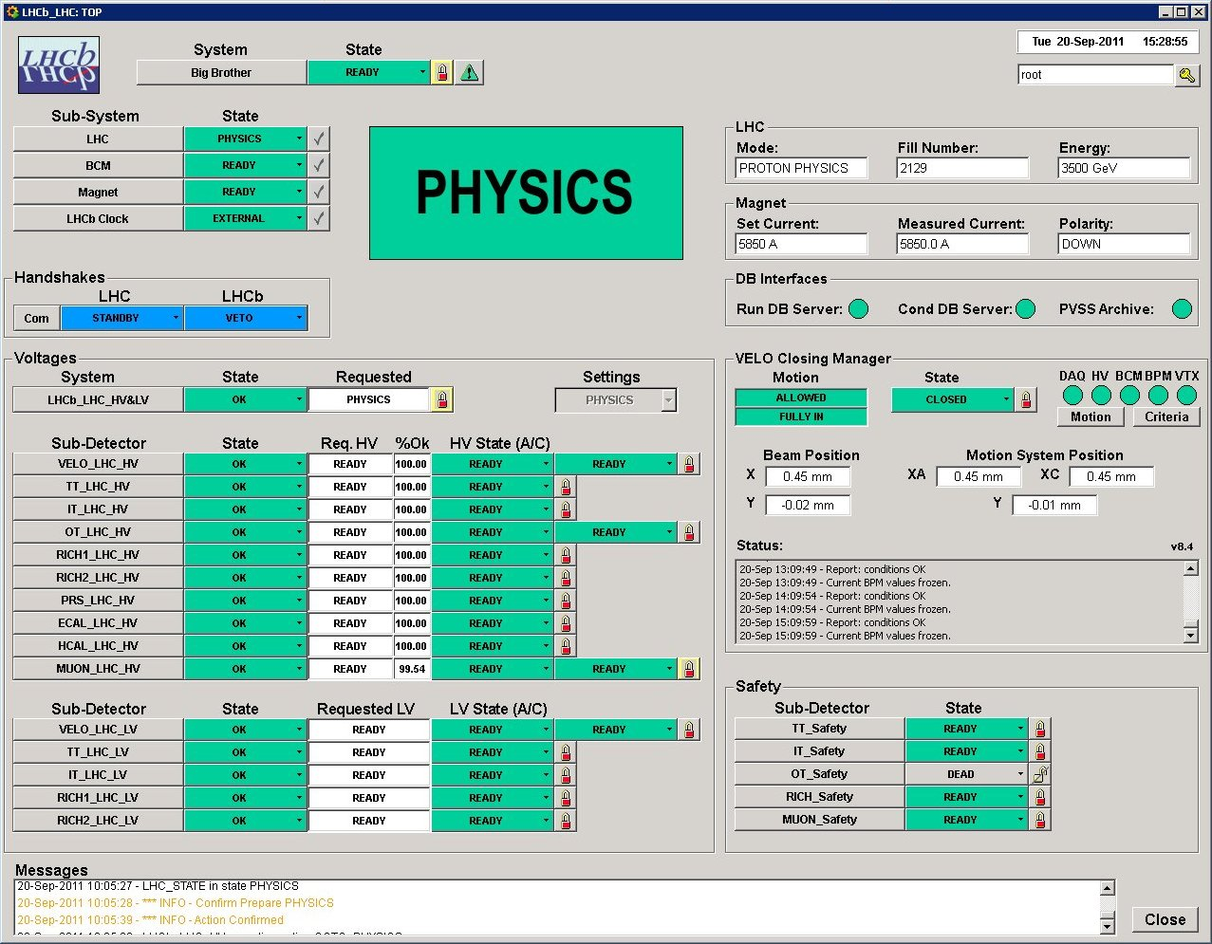
LHCb Big Brother
  DCS
  Overall
  Control

Slide 43
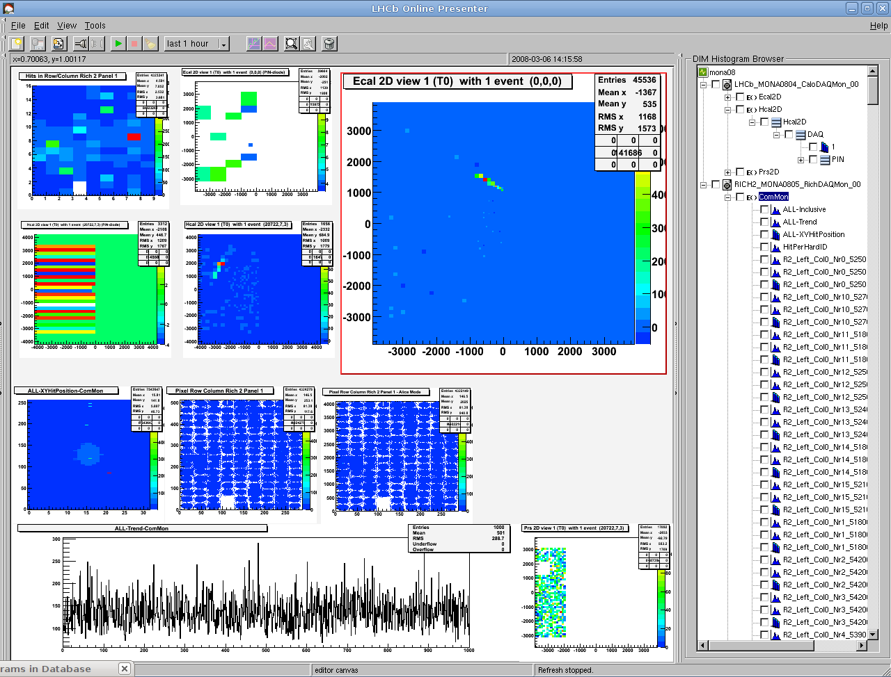
LHCb Histogram Presenter
  Monitor the quality of the data being acquired
  Compare with reference
  Automatic analyses

Slide 44
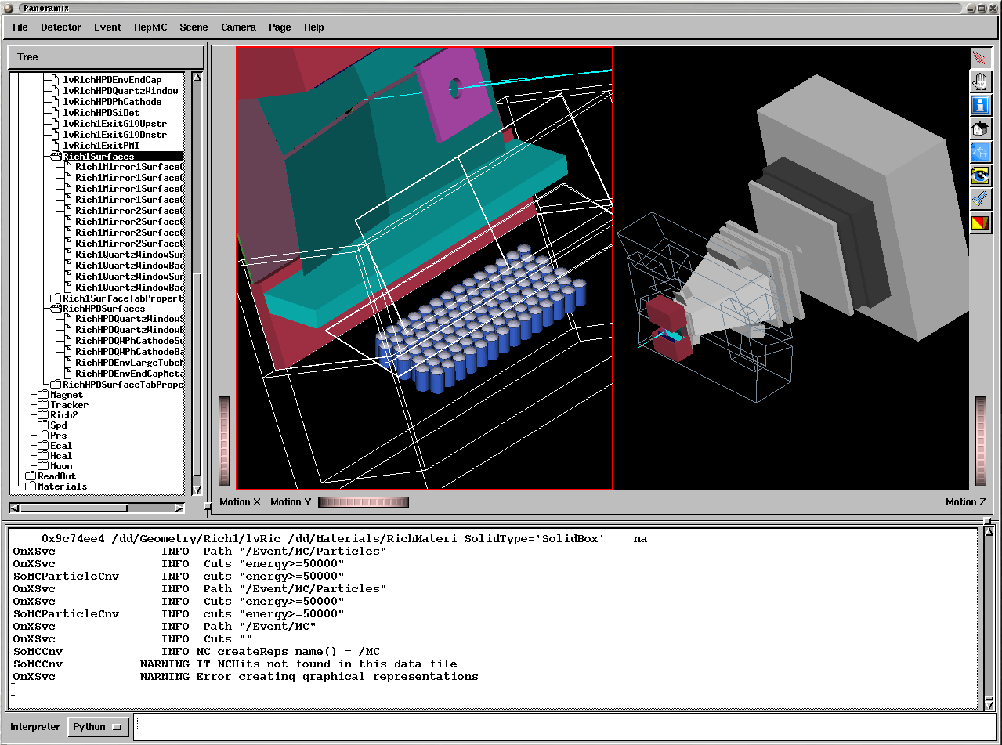
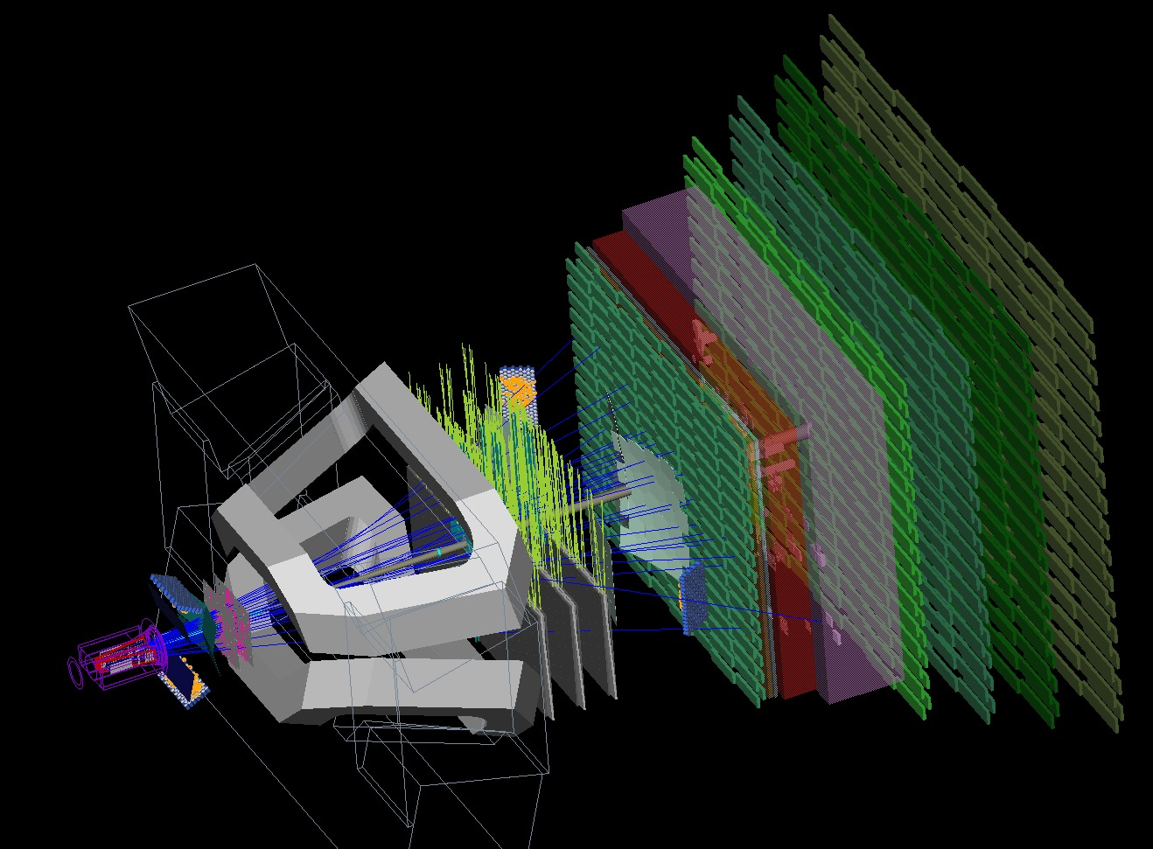
LHCb Online Event Display

Slide 45
Concluding Remarks
Trigger and Data Acquisition systems are becoming increasingly complex.
Luckily the requirements of telecommunications and computing in general have strongly contributed to the development of standard technologies:
  Hardware: Flash ADCs, Analog memories, PCs, Networks, Helical scan recording, Data compression, Image processing, ...
  Software: Distributed computing, Software development environments, Supervisory systems, ...
We can now build a large fraction of our systems using commercial components (customization will still be needed in the front-end).
It is essential that we keep up-to-date with the progress being made by industry.

