Slide 1
Superconducting links: PIC, US1, US2
A. Ballarino
3rd RLIUP Preparation Meeting
Wednesday, 11th of September

Slide 2
LHC Critical Areas
RR73
UJ76
RR77
Markus Brugger, R2E Study Group, 2010

Slide 3
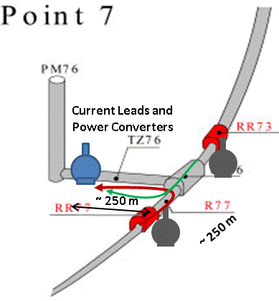
A summary of the needs at P7, P1 and P7
and proposals for discussion
Superconducting Links at P7
P7, replacement of today DFBA and DFBM
600 A circuits
2 Links, each with 48 cables and about 500 m long
New DFBs installed underground - TZ76. Links running underground in the tunnel
Reason for intervention: removal of PCs from radiation areas + ALARA + Reduced time for interventions
Power converters in UJs already moved to safe area (UJ 76). Still power converters in RR
Development of radiation hard power converters on-going
Link development well advanced. Detailed integration studies in the tunnel now required
Proposed installation of links during LS2
Classified as PIC
Shaft and lift access
LHC Tunnel

Slide 4
Superconducting Links at P1 and P5
P1 and P5 Hi-Luminosity Triplets+D1+CP, replacement of today DFBX in UJs.
20 kA, 4 kA, 0.4 kA and 0.12 kA circuits
2 Links, each with 32 cables and about 300 m long
New DFBs installed at the surface
Reason for intervention: High Luminosity Upgrade (PIC) + removal of PCs from radiation areas + ALARA + Reduced time for interventions
Installation during LS3
Classified as PIC
P1 and P5 MSs, replacement of today DFBLs in RRs.
6 kA, 0.12 kA circuits today – to be upgraded with higher currents for Q4
2 Links, each with 22 cables and about 300 m long
New DFBs installed at the surface
Reason for intervention: MS Upgrade (US1 ?) + removal of PCs from radiation areas (SC Links vs. Radiation hard PCs) + ALARA + Reduced time for interventions
Installation during LS3 ?
Classified as PIC for SEEs, US1 for upgrade of MSs

Slide 5
Superconducting Links at P1 and P5
P1 and P5 , replacement of today DFBAs in RRs
6 kA and 0.6 kA circuits
2 Links, each with 40 cables and about 300 m long
New DFBs installed at the surface
Reason for intervention: removal of PCs from radiation areas (SC Links vs. Radiation hard PCs) + ALARA + Reduced time for interventions
Installation during LS2 ?
Classified as PIC for SEEs

