Slide 1
MBW-MQW in the LHC
Considerations on expected life and available options
Presented by P. Fessia
Fluka analysis: Francesco Cerutti, Anton Lechner, Eleftherios Skordis
Collimation input: Rodrick Bruce, Stefano Redaelli , Belen Maria Salvachua Ferrando , Elena Quaranta
MNC team: Paolo Fessia, Pierre Alexandre Thonet, D. Tommasini
Power Converter: Hugues Thiesen
Optics: Massimo Giovannozzi
MME design office: L. Favre, T. Sahner
VSC: Eric Page, N. Zelko

Slide 2
Summary
The magnets
The expected dose
Evaluation of the magnet lifetime
Protective actions
  Shielding
  Optics changes
The present “final” picture
Actions, planning and risks

Slide 3
MQW point 7 and 3
Characteristics | RQ4.LR7 | RQ5.LR7 | RQT4.L7 | RQT5.L7 | RQT4.R7 | RQT5.R7 | RQ4.LR3 | RQ5.LR3 | RQT4.L3 | RQT5.L3 | RQT4.R3 |  | RQT5.R3
I ultimate (from layout database) [A] | 810 | 810 | 600 | 600 | 600 | 600 | 810 | 810 | 600 | 600 | 600 |  | 600
Voltage I ultimate [V] | 381 | 383 | 29 | 31 | 27 | 29 | 451 | 452 | 38 | 34 | 42 |  | 39
I 7 TeV (Fidel report) [A] | 598 | 610 | 151 | 17 | 151 | 17 | 561 | 593 | 313 | 441 | 313 |  | 441
Voltage I 7 TeV [V] | 282 | 289 | 8 | 2 | 8 | 2 | 313 | 331 | 20 | 31 | 22 |  | 29
Number magnet in series in circuit | 10 | 10 | 1 | 1 | 1 | 1 | 10 | 10 | 1 | 1 | 1 |  | 1
Turn/magnet | 171
Estimated ultimate inter-turn voltage [V] | 0.22 | 0.22 | 0.17 | 0.18 | 0.16 | 0.17 | 0.26 | 0.26 | 0.22 | 0.2 |  | 0.25 | 0.23
Estimated inter-turn voltage at 7 TeV [V] | 0.16 | 0.17 | 0.05 | 0.01 | 0.05 | 0.01 | 0.18 | 0.19 | 0.12 | 0.18 |  | 0.13 | 0.17
Estimated inter layer voltage | Same as inter turn
Insulation thickness inter turn | 2X(2X0.25) mm=1 mm glass tape
Circuit energy ultimate [Kj] | 154 | 164 | 9 | 9 | 9 | 9 | 154 | 164 | 9 | 9 |  | 9 | 9
Circuit energy 7 TeV [Kj] | 84 | 93 | 0.6 | 0.01 | 0.6 | 0.01 | 74 | 88 | 2.5 | 5 |  | 2.5 | 5
Ground insulation | 1X(2X0.25) mm+3X(2X0.25)=2 mm
Resin used | EPN1138 42%+ GY 6004 42% + CY 221 16% + HY 905 100 %+ 30ml DY 073
Dielectric resin | > 20 kV/mm

Slide 4
MBW point 7 and 3
Characteristics | RD34.LR7 | RD34.LR3
I ultimate [A] (layout database) | 810 | 810
Voltage I ultimate [V] | 440 | 700
I 7 TeV (Fidel report) | 643 | 643
Voltage I 7 TeV | 350 | 556
Number magnet in series in circuit | 8 | 12
Turn/magnet | 84
Estimated ultimate inter-turn voltage [V] | 0.65 | 0.7
Estimated inter-turn voltage 7 TeV [V] | 0.52 | 0.55
Estimated ultimate inter layer voltage [V] | 9.2 | 9.7
Estimated inter layer voltage 7 TeV [V] | 7.2 | 7.8
Circuit energy ultimate [Kj] | 472 | 793
Circuit energy 7 TeV [Kj] | 297 | 500
Insulation inter turn [mm] | 2X(2X0.15)=0.6 glass tape
Insulation inter layer [mm] | 2X(2X0.15)+2X(2X0.15)+1(glass cloth) =1.6 glass tape
Ground insulation | 2X(2X0.15)+1.5(0.15Xx)=1.8 glass tape
Resin used | EPC-1: resin ED-16 100 Hardener MA 2.28  K Plasticizer MGF-9 20 TEa accelerant 0.5
Dielectric resin | Unknwown (>>15kV/mm)

Slide 5
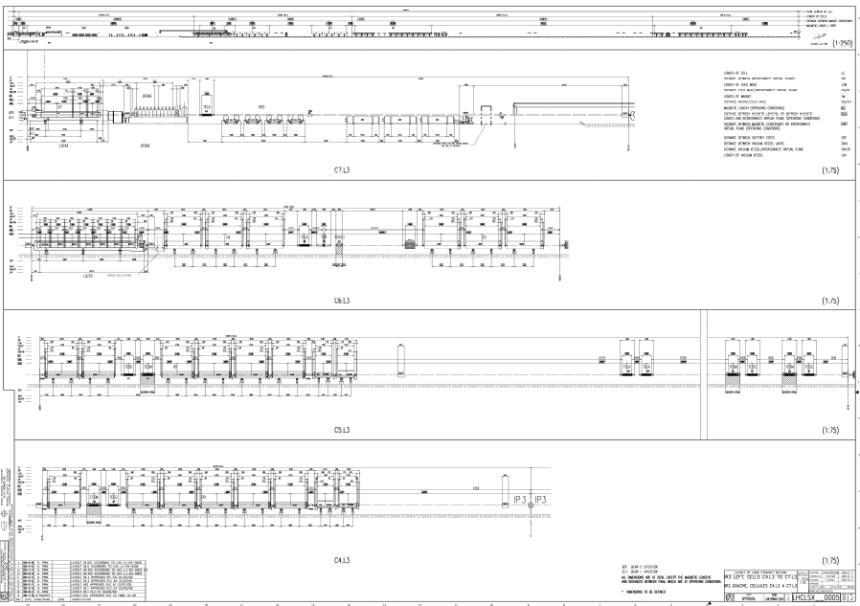

Slide 6
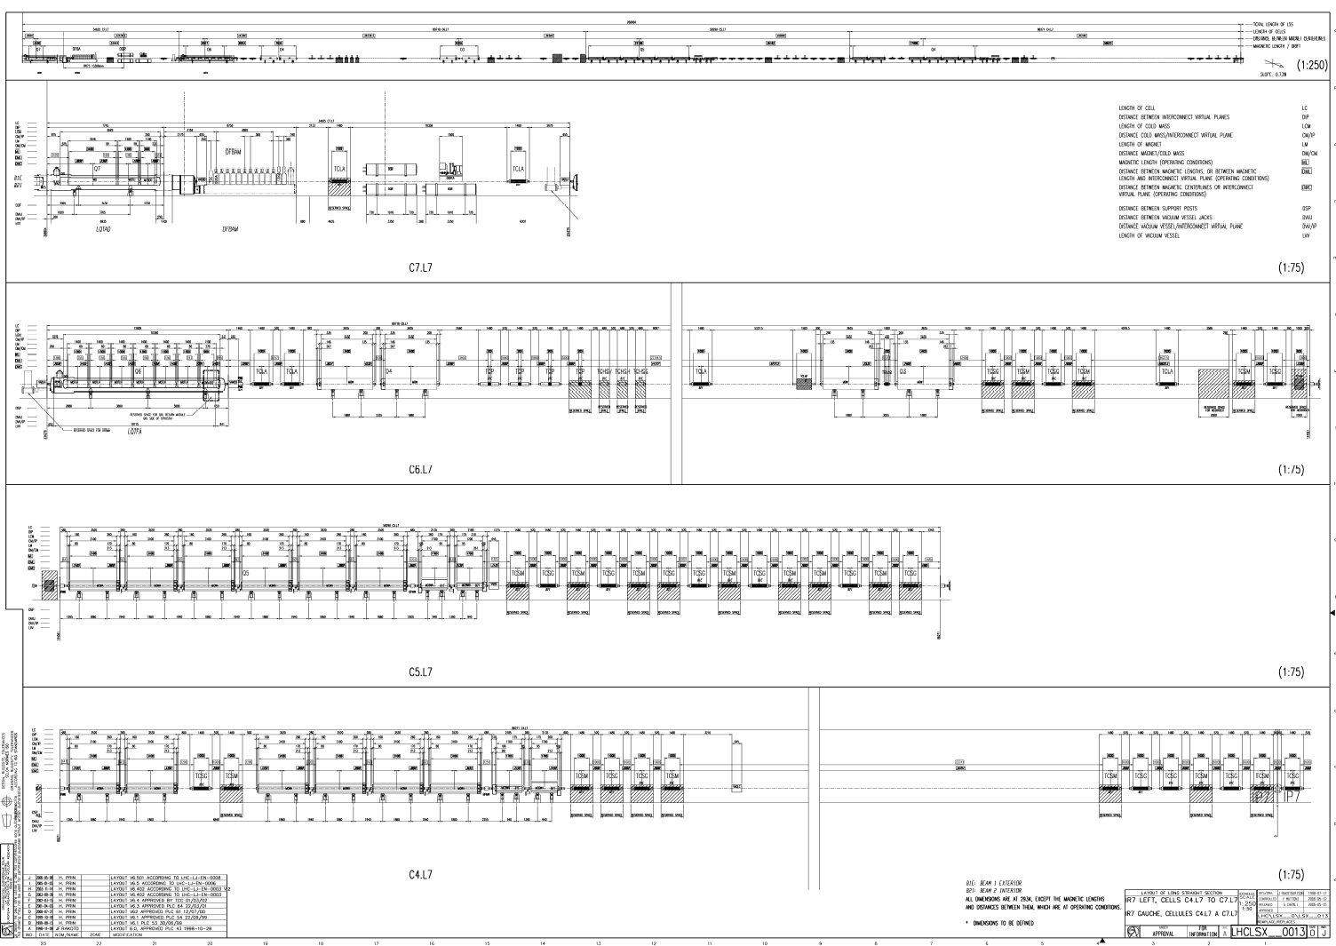

Slide 7
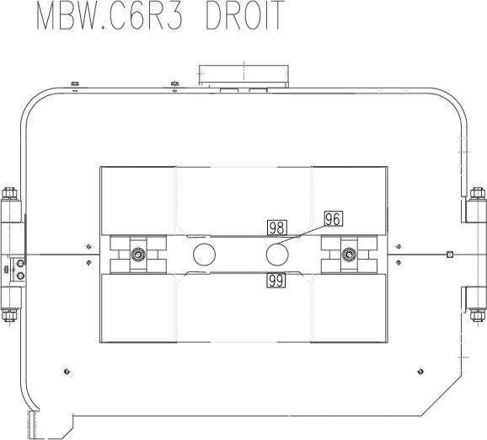
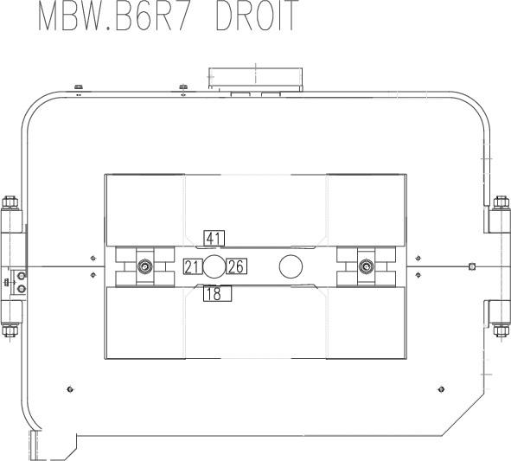
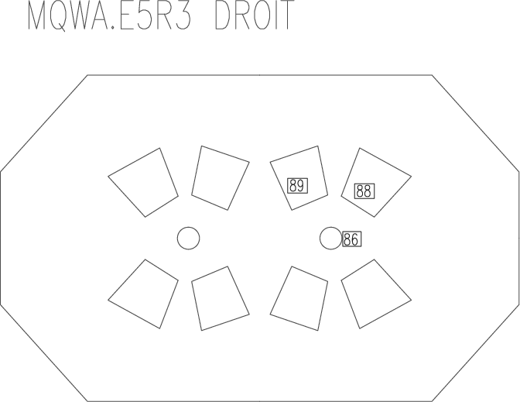
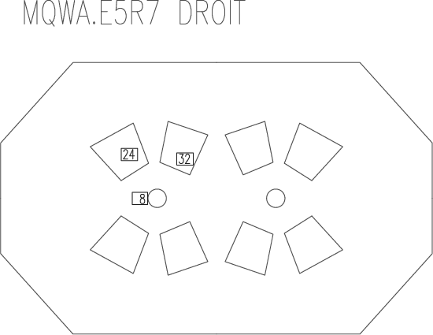
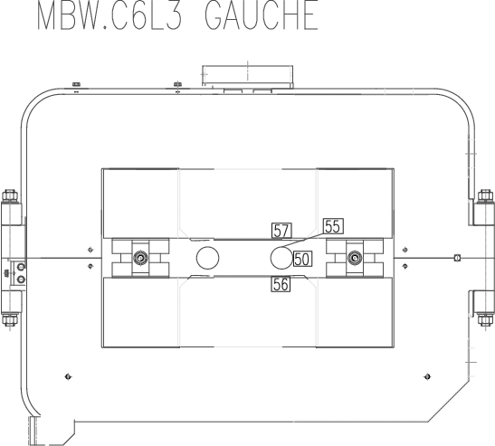
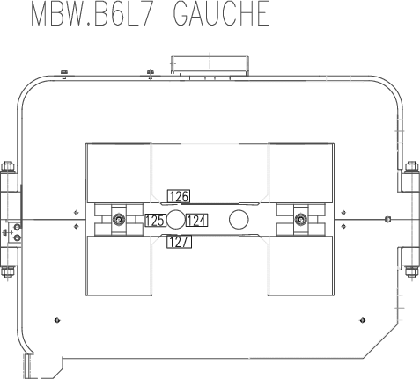
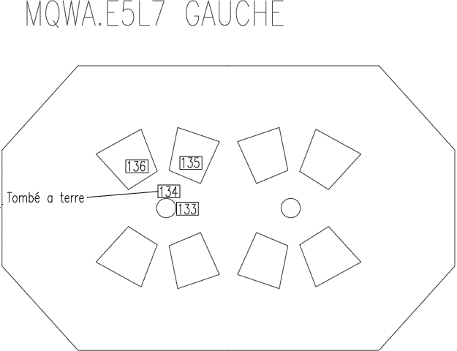
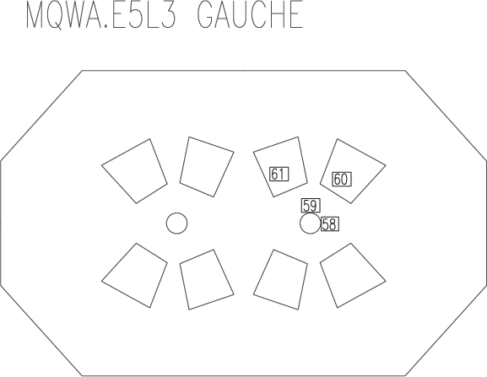
Analysis exp. data point 3 and point 7
2.3 kGy
5.5 kGy
1/100
487.3 kGy
1.3 kGy
43.7 kGy
19.1 kGy
469.1 kGy
297.4 kGy
2.3 kGy
1/6
> 500 kGy
4.4 kGy
329.4 kGy
81.7 kGy
1
1
1/3
1
15.7 kGy
18.0 kGy
1/20
397.5 kGy
1.6 kGy
59.6 kGy
25.7 kGy
119.8 kGy
> 500 kGy
6.7 kGy
1/10
9.2 kGy
6.3 kGy
106.3 kGy
8.0 kGy
297.4 kGy
fallen off
(487.3 kGy)
100.4 kGy
RP survey IP3
RP survey IP7
7R/7L=B2/B1
3R/3L=B2/B1

Slide 8
Point 3 and 7 coil magnet damage estimation
IP 3
IP 7
MQW | MBW
From 10 to 20 MGy | From 40 to 60 MGy
From 20 to 50 MGy | From 60 to 80 Mgy
Larger than 50 MGy | Larger than 80 MGy

Slide 9
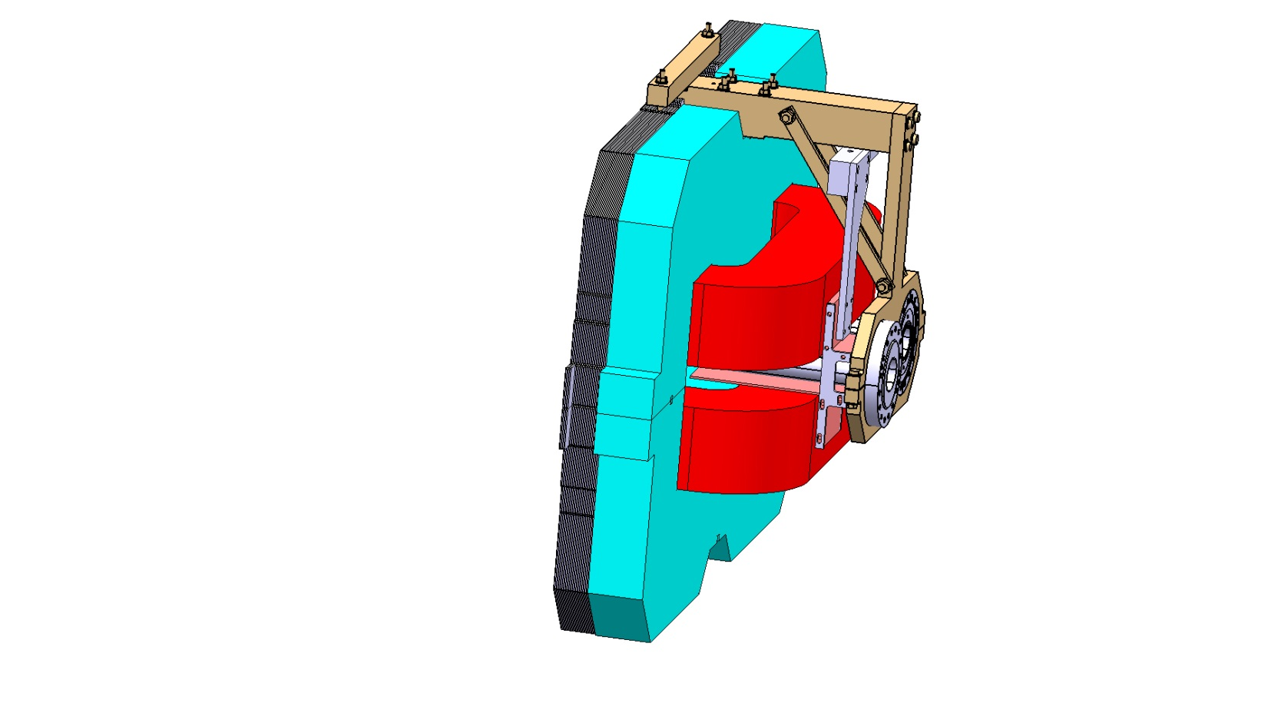
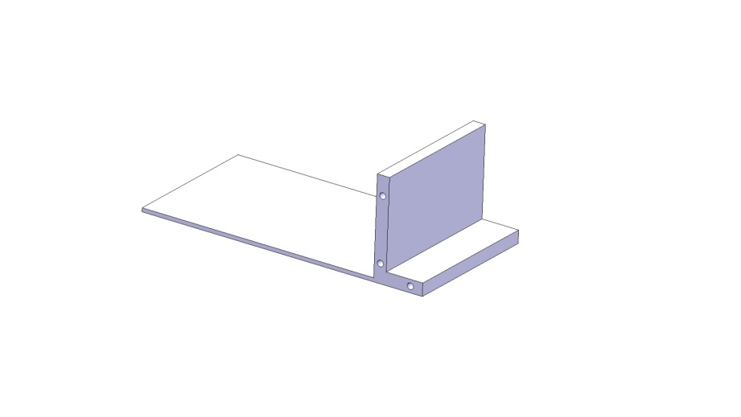
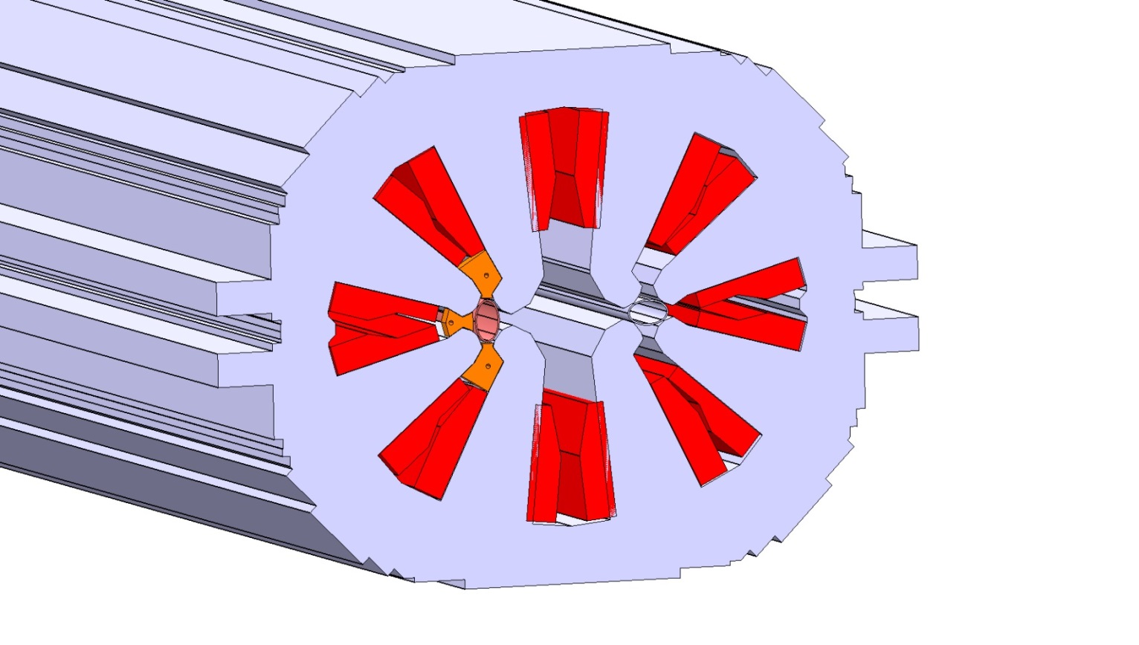
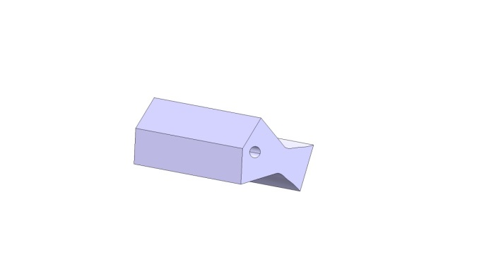
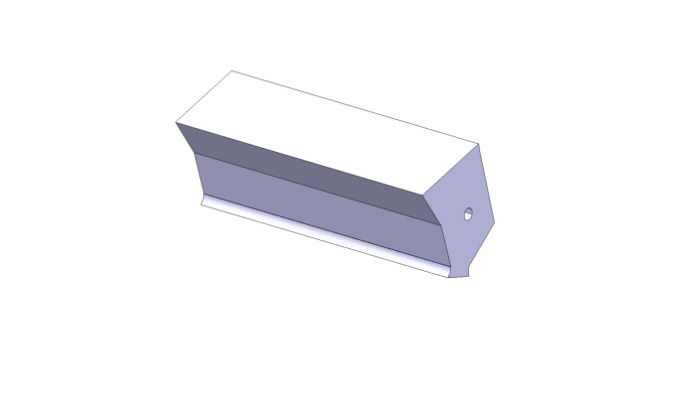
Screen design
- For max effectiveness we have to target the higher possible density candidate therefore W, or better the alloys for machining
- Magnetic properties can be an issue. Measurement being performed
- Possible material staging along the MQW magnet length under study
 | Inermet IT180
Nominal density | 18
W content % | 95
Balance | Ni,Cu
E-modulus | 360 GPa

Slide 10
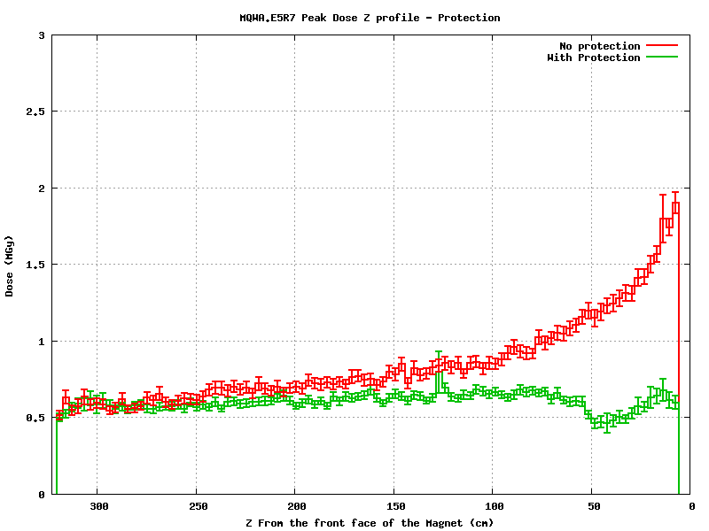
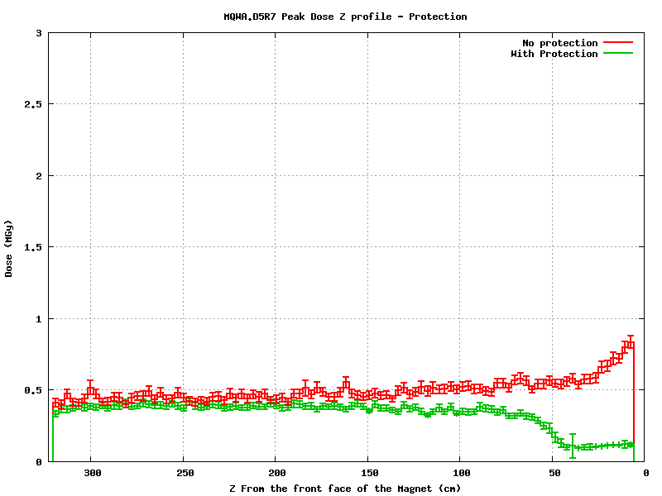
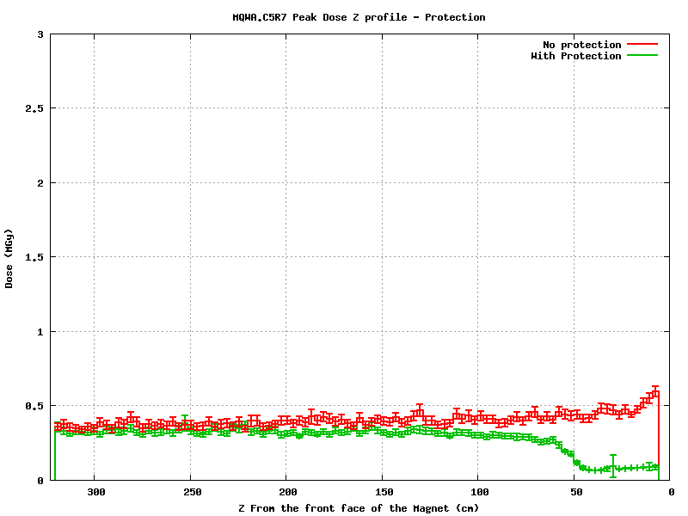
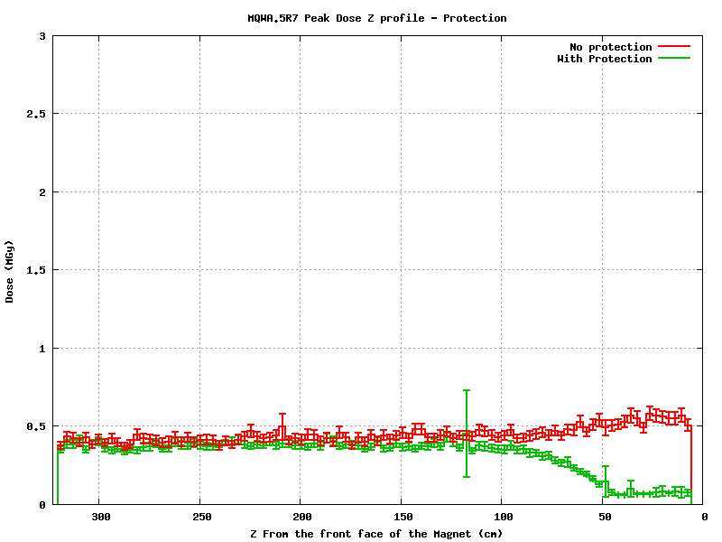
MQW shielding effect
Normalization: 1.15 10¹⁶ p (50 fb⁻¹ )
Beam 2
Beam 2
Beam 2
Beam 2

Slide 11
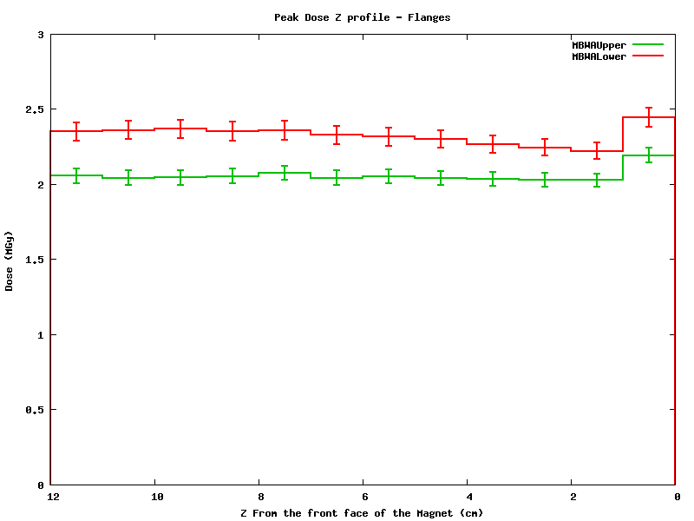
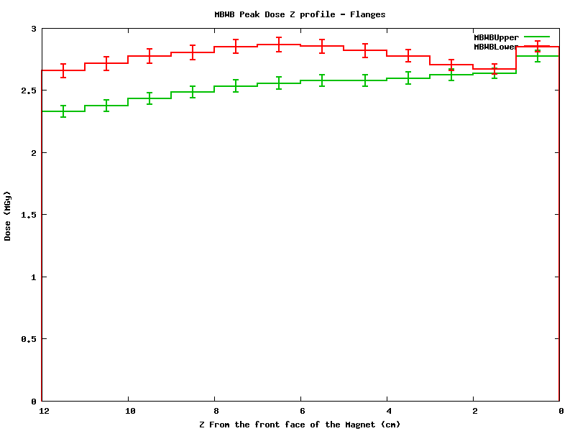
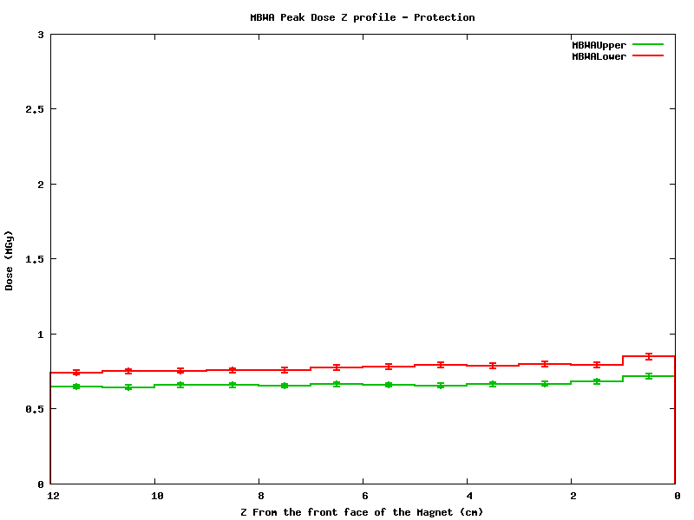
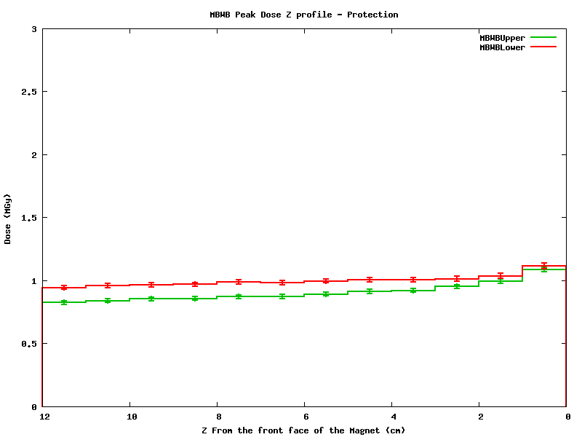
MBWA - MBWB Peak Dose profile
Beam 2
Beam 2
MBW.A6R7 with Flanges
MBW.B6R7
With Flanges
Normalization: 1.15 10¹⁶ p (50 fb⁻¹ )
Beam 2
Beam 2
MBW.A6R7
Flanges + Protection
MBW.B6R7 Flanges + Protection

Slide 12
Optic change proposal point 7 discussed and agreed as possible with M. Giovannozzi
(it needs verification)
ABS

Slide 13
Magnet damage with shielding point 3 and 7, W shielding peak dose scaling
 | Action LS1 |  | Dose [MGy] for integrated luminosity 150 fb^-1 |  | Action LS2 |  | Dose [MGy] for integrated luminosity 350 fb^-1 |  | Action LS3 |  | Dose [MGy] for integrated luminosity 3000 fb^-1 |  | Action during HL-LHC exploitation
 | R | L | R | L | R | L | R | L | R | L | R | L | R | L
MQWA.A4 |  |  | 0.0 | 0.1 |  |  | 0.1 | 0.2 |  |  | 1.0 | 1.9
MQWA.B4 |  |  | 0.1 | 0.1 |  |  | 0.1 | 0.2 |  |  | 1.0 | 2.1
MQWB.4 |  |  | 0.1 | 0.1 |  |  | 0.1 | 0.3 |  |  | 1.1 | 2.2
MQWA.C4 |  |  | 0.1 | 0.1 |  |  | 0.2 | 0.3 |  |  | 1.4 | 2.8
MQWA.D4 |  |  | 0.2 | 0.3 |  |  | 0.4 | 0.8 |  |  | 3.5 | 6.9
MQWA.E4 |  |  | 0.9 | 1.7 | S | S | 1.2 | 2.5 | S | S | 6.3 | 12
MQWA.A5 |  |  | 0.6 | 1.1 | S | S | 0.8 | 1.6 | S | S | 4.0 | 7.5
MQWA.B5 |  |  | 0.7 | 1.4 | S | S | 1.0 | 2.0 | S | S | 5.1 | 9.4
MQWB.5 |  |  | 1.7 | 3.3 | S | S | 2.4 | 4.8 | S | S | 12 | 23
MQWA.C5 |  |  | 3.9 | 7.7 | S | S | 5.6 | 11 | S | S | 29 | 53
MQWA.D5 |  |  | 0.9 | 1.9 | S | S | 1.3 | 2.7 | S | S | 6.8 | 13
MQWA.E5 |  |  | 1.7 | 3.5 | S | S | 2.5 | 5.0 | S | S | 13 | 24
MBW.A6 |  |  | 1.0 | 2.0 | S | S | 1.4 | 2.9 | S | S | 7.3 | 14
MBW.B6 |  |  | 1.2 | 2.3 | S | S | 1.7 | 3.3 | S | S | 8.4 | 16
MBW.C6 |  |  | 1.6 | 3.3 | S | S | 2.3 | 4.7 | S | S | 12 | 3
IP 3
 | Action LS1 |  | Dose [MGy] for integrated luminosity 150 fb^-1 |  | Action LS2 |  | Dose [MGy] for integrated luminosityy350 fb^-1 |  | Action LS3 |  | Dose [MGy] for integrated luminosity3000 fb^-1 |  | Action during HL-LHC exploitation
 | R | L | R | L | R | L | R | L | R | L | R | L | R | L
MQWA.A4 |  |  | 0.4 | 0.5 |  |  | 0.9 | 1.2 |  |  | 7.4 | 11
MQWA.B4 |  |  | 0.3 | 0.8 |  |  | 0.7 | 1.9 |  |  | 6.4 | 16
MQWB.4 |  |  | 0.5 | 1.3 |  | S | 1.2 | 1.8 |  | S | 10.1 | 9
MQWA.C4 |  |  | 4.0 | 4.0 | S | S | 5.8 | 5.8 | S | S | 30 | 30
MQWA.D4 |  |  | 2.7 | 2.7 | S | S | 3.8 | 3.8 | S | S | 20 | 20
MQWA.E4 |  |  | 5.0 | 10.0 | S | S | 7.2 | 14 | S | S | 37 | 73 |  | R
MQWA.A5 |  |  | 2.6 | 2.6 | S | S | 3.7 | 3.7 | S | S | 19 | 19
MQWA.B5 |  |  | 3.5 | 3.5 | S | S | 5.0 | 5.0 | S | S | 25 | 25
MQWB.5 |  |  | 4.1 | 4.1 | S | S | 5.9 | 5.9 | S | S | 30 | 30
MQWA.C5 |  |  | 1.9 | 4.9 | S | S | 2.8 | 7.0 | S | S | 14 | 36
MQWA.D5 | S | S | 1.4 | 2.0 | done | done | 3.3 | 4.7 | done | done | 27.9 | 39.9
MQWA.E5 | S | S | 12 | 4.1 | done | done | 29 | 10 | done | done | 246 | 82 | R | R
MBW.A6 | S | S | 7.8 | 5.5 | done | done | 18 | 13 | done | done | 155 | 111 | R | R
MBW.B6 | S | S | 12 | 6.2 | done | done | 30 | 14 | done | done | 248 | 124 | R | R
IP 7
Remove
Limit reached in | 7R | 7L
MQWA.E4 |  | 1500 fb^-1
MBW.B6 | 1500 fb^-1 | 2400 fb^-1
MBW.A6 | 1000 fb^-1 | 2000 fb^-1

Slide 14
Conclusions I
 |  | IP3 |  |  |  |  |  | IP7
 |  | L |  |  | R |  |  | L |  |  | R
 |  | Broken units no int | Units to be modified | Broken units | Broken units no int . | Units to be modified | Broken units | Broken units no int | Units to be modified | Broken units | Broken units no int . | Units to be modified | Broken units
LS1 | MQW | NA | 0 | NA | NA | 0 | NA | NA | 2 | NA | NA | 2 | NA
 | MBW | NA | 0 | NA | NA | 0 | NA | NA | 2 | NA | NA | 2 | NA
LS2 | MQW | 0 | 7 | 0 | 0 | 7 | 0 | 0 | 7 | 0 | 0 | 8 | 0
 | MBW | 0 | 3 | 0 | 0 | 3 | 0 | 0 | NA | 0 | 0 | NA | 0
LS3 | MQW | 0 | 0 | 0 | 0 | 0 | 0 | 1 | 0 | 0 | 0 | 0 | 0
 | MBW | 0 | 0 | 0 | 0 | 0 | 0 | 1 | 0 | 0 | 0 | 0 | 0
HL-LHC | MQW | 4 | 0 | 0 | 1 | 0 | 0 | 9 | 0 | 1 | 9 | 0 | 0
 | MBW | 0 | 0 | 0 | 0 | 0 | 0 | 2 | 0 | 2 | 2 | 0 | 2

Slide 15
Conclusion II
The proposed screen allow reducing of a factor 3 the dose and limit the number of magnet at risk or surely damaged, see previous slides. Hp. to achieve the same reduction factor on the spacers
The change of the optic in point 7 installing a long absorber is key to complete the protection
The lifetime of these units could be affected by the new environmental condition of point 7 not discussed here

Slide 16
Conclusion III: actions
The proposed shielding campaign should start in LS1 for effectiveness and ALARA
Very high dose dosimeter shall be installed systematically in point 3 and 7 to check better benchmark computations and symmetry effect
A campaign of irradiation of resins shall be performed with the real used resins and the relevant fillers in order to real know when the magnet will reach damage level
For HL LHC 4 MBW shall be reassembled with saddle type heads. This will solve the issue without needing special development
I suggest that we launch the program to build a NC magnet with extremely high radiation resistance (>300 MGy). It is and it will be more and more needed and today we do not have it in our capabilities and it will be key for future target areas development
We need to check
  For HL-LHC the MBW radiation dose along the straight part of the coil
  The level of accumulated dose of the MBXW units
  If any protecion can be added to on the beam line for the MQWA.E4 in point 7 R and 7 L

Slide 17
Long version

Slide 18
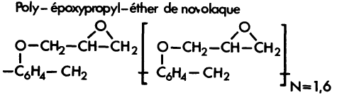
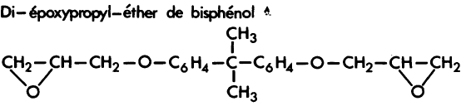

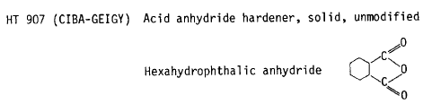
MQW coil resins
Resin used
component | EPN1138 | GY 6004 | CY 221 | HY 905 | 30ml DY 073
percentage | 50 % | 50 % | 20 % | 120 % | 0.03
EPN 1138 | Novolac
GY 6004 | DGEBA
CY 221 | DGEBA
HY 905 | HPA
DY 073 | flexibilizer

Slide 19
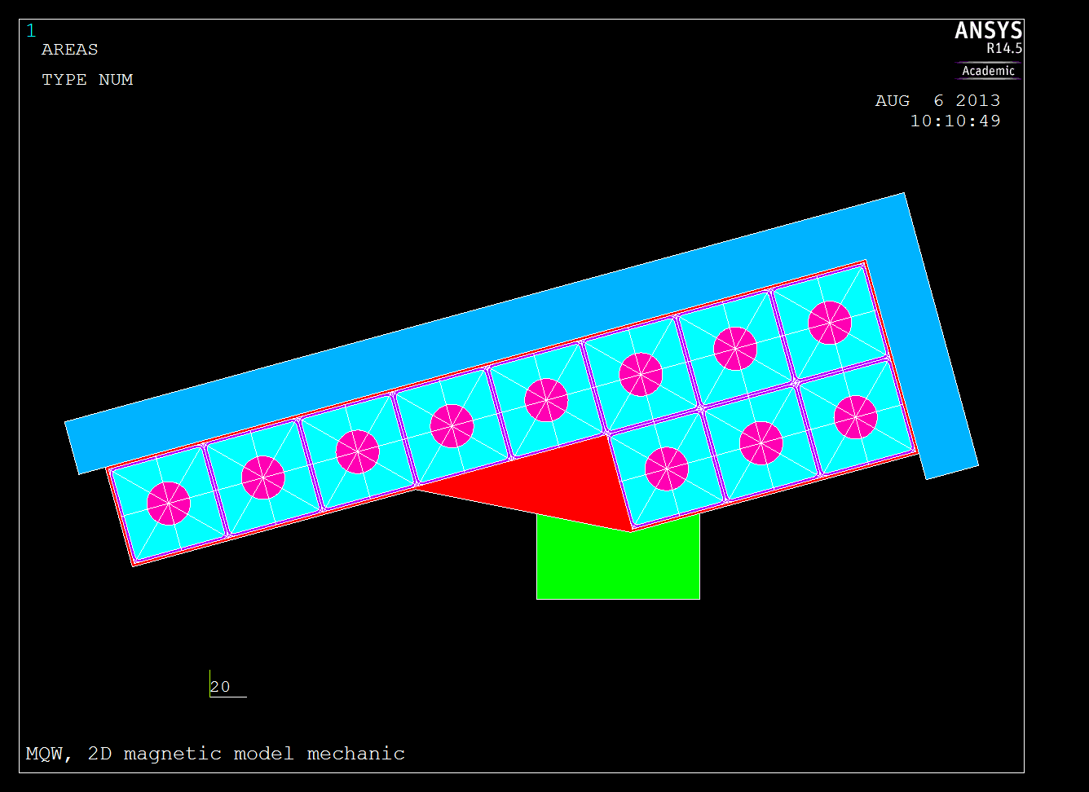
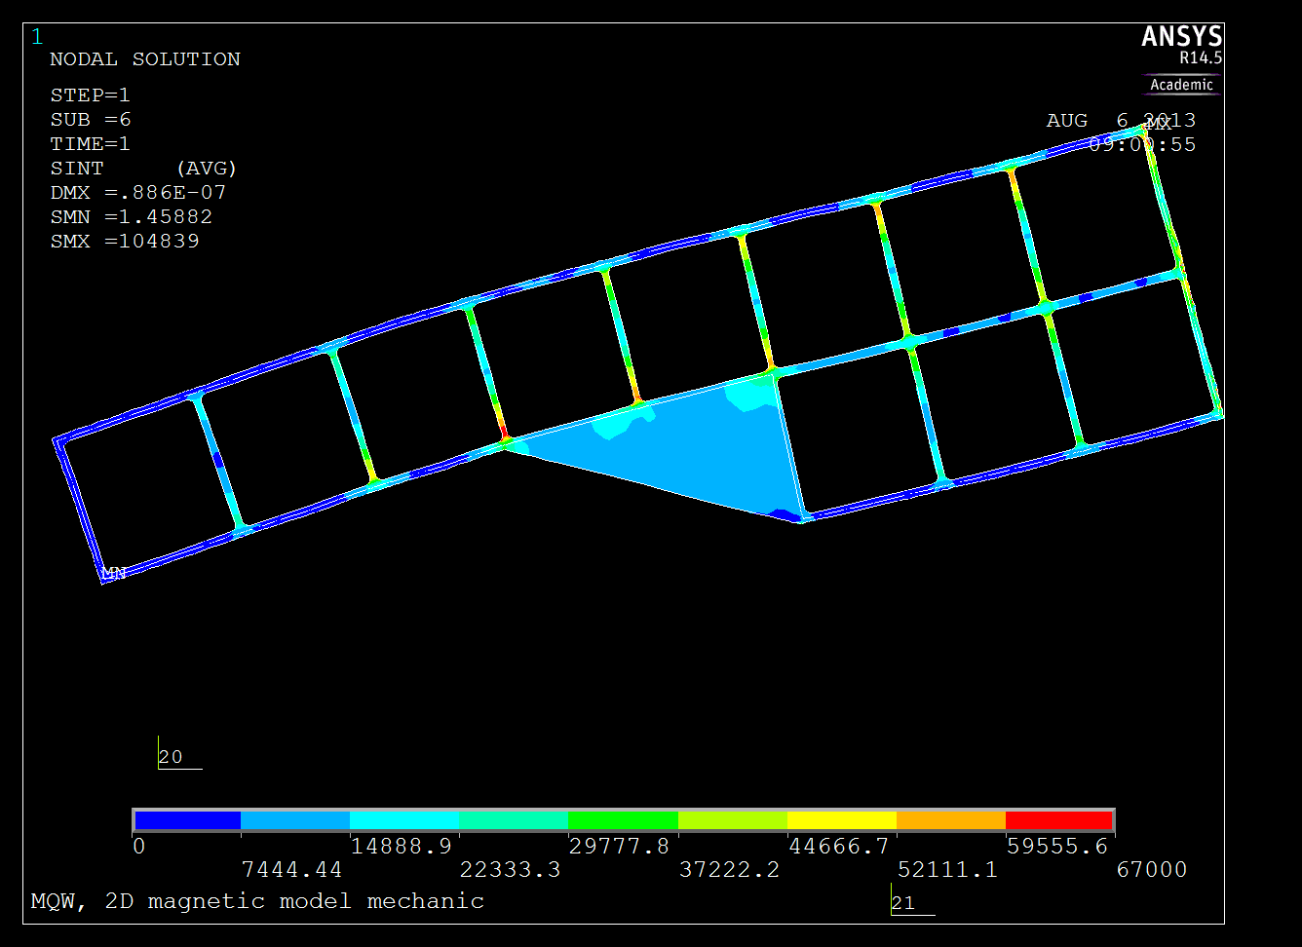
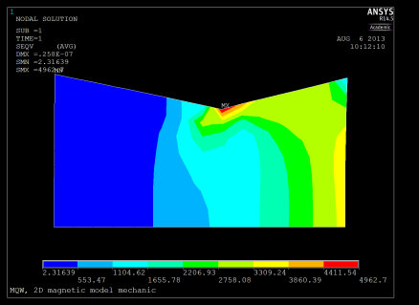
8
7
5
6
4
10
9
3
11
2
1

Slide 20
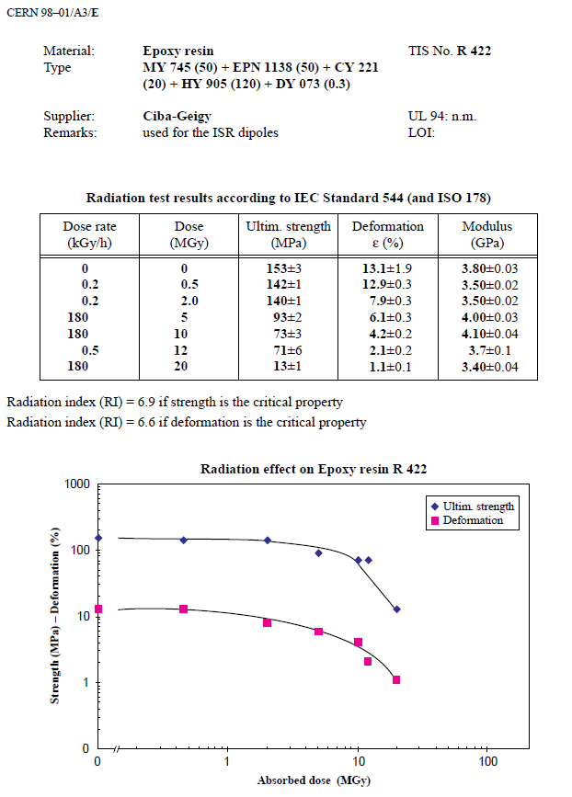
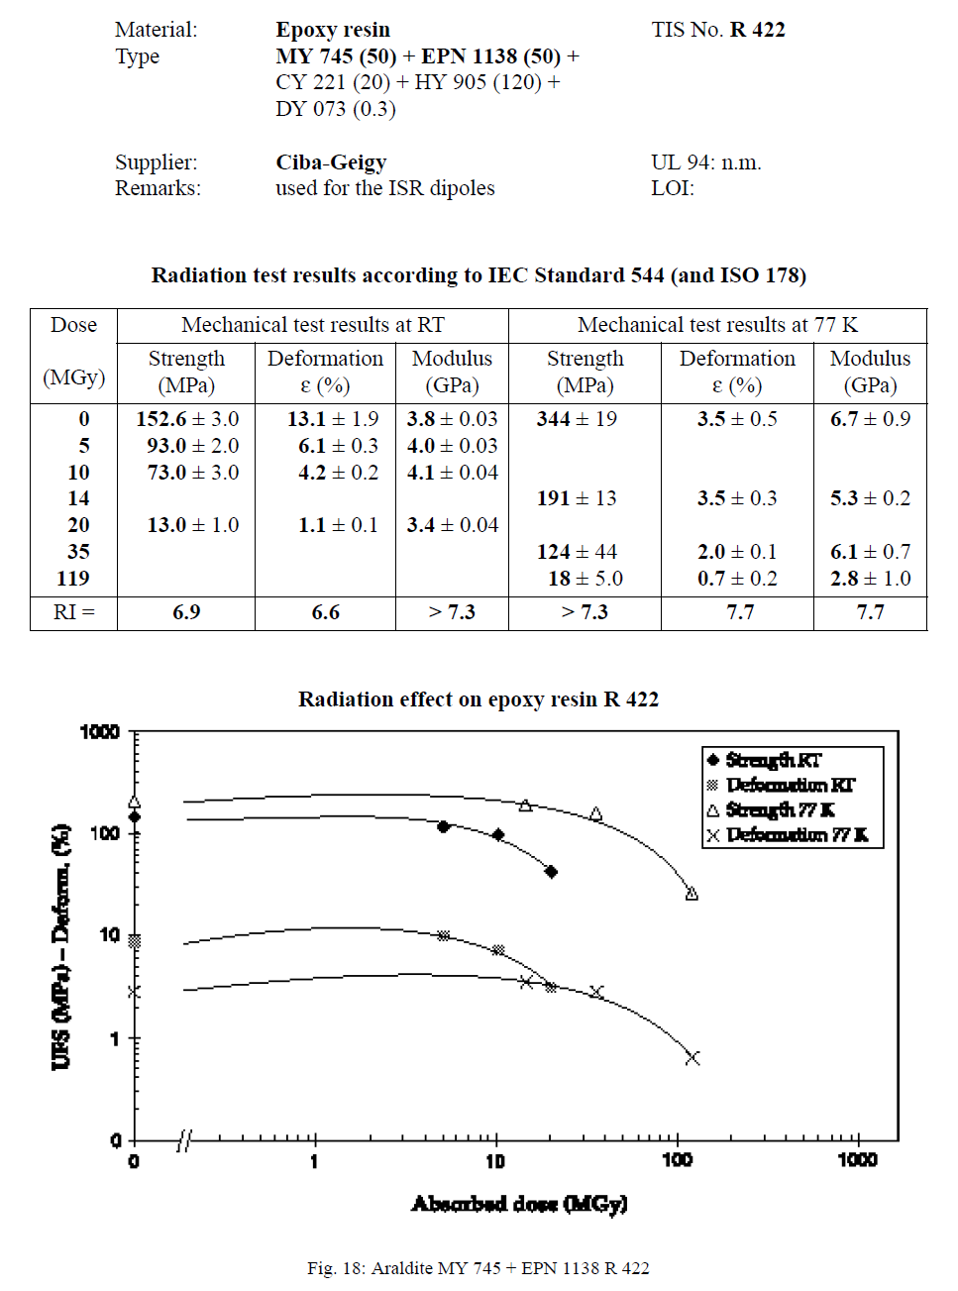

Slide 21
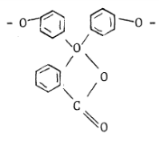
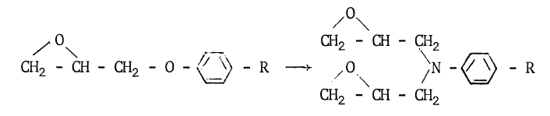
Different epoxy
Resins |  | Hardeners | Additives | Composition (p.p.) | Mix Temp (°C) | Viscosity (cPs) | Service life (mn) | Fig | Dose for 50% flex. (MGy) | Dose Range (MGy)
EDBAH |  | MA |  |  |  |  |  | 5.4 | 1.4 | 1 - 3
EDBAH |  | MA | BDMA | 100-105-0.2 | 80 | 45 | >180 | 5.1 | 1.6
BECP |  | MA |  |  |  |  |  | 5.4 | 2.5
BECP |  | MA | BDMA | 100-110-0.2 | 80 | 40 | >180 | 5.1 | 2.3
ECC |  | MA |  | 100-72 | 80 | 20 | >240 | 5.5 | 1.8 | 1 - 6
VCD |  | MA | BDMA | 100-160-05 | 60 | 20 | >180 | 5.4 | 3.7
DADD |  | MA |  | 100-65 | 80 | 180 | >240 | 5.4 | 5.5
DGEBA + | EDGDP | TETA |  | 100-20-12 | 25 |  |  | 5.21 | 1.3 | 1 - 2
DGEBA |  | TETA | DBP | 83-9-17 | 50 | 500 | few | 5.22 | 1.2
DGEBA |  | DADPS |  | 100-35 | 130 | 60 | 180 | 4.2 | 5.1 | 5 - 15
DGEBA + | EDGDP | MDA |  | 100-20-30 | 80 |  |  | 5.21 | 8.2
DGEBA |  | MDA |  | 100-27 | 80 | 100 | 50 | 5.9 | 13.0
DGEBA |  | MPDA |  | 100-14.5 | 65 | 200 | 30 | 5.7 | 23.5 | 23
DGEBA |  | AF |  | 100-40 | 100 | 150 | 30 | 5.26 | 45.2 | 45
DGEBA |  | DDSA | BDMA | 100-130-1 | 80 | 70 | 120 | 5.2 | 4.2 | 5 - 15
DGEBA |  | NMA | BDMA | 100-80-1 | 80 | 80 | 120 | 5.2 | 5.9
DGEBA |  | MA |  | 100-100 | 60 | 69 | >1440 | 5.23 | 7.1
DGEBA |  | MA | BDMA |  |  |  |  | 5.1 | 12.0
DGEBA |  | MA | BDMA + Po. Gl. | 100-100-0.1-10 | 60 | 65 | 300 | 5.23 | 12.1
DGEBA |  | AP |  | 100-70 | 120 | 26 | 180 | 5.2 | 13.0
DGPP |  | DADPS |  | 100-28 | 130 |  |  | 5.6 | 8.2 | 5 - 15
DGPP |  | MA |  | 100-135 | 120 |  |  | 5.3 | 13.0
EDTC |  | MDA |  | 100-20 | 80 |  | 40 | 5.9 | 10.0
TGTPE |  | DADPS |  | 100-34 | 125 | >20000 |  | 5.6 | 12.1
TGTPE |  | MA | BDMA | 100-100-0.2 | 125 | >15000 |  | 5.3 | 10.6
EPN |  | DADPS |  | 100-35 | 100 |  | 30 | 5.6 | 23.5 | 20 - 40
EPN |  | MDA |  | 100-29 | 100 |  | 35 | 5.10 | 37.2
EPN |  | HPA | BDMA | 100-76-1 | 80 |  | 40 | 5.10 | 13.0 | 10 - 20
EPN |  | MA | BDMA | 100-105-0.5 | 80 |  | 100 | 5.3+5.25 | 15.0
EPN |  | NMA | BDMA | 100-85-1 | 100 |  | 80 | 5.10 | 20.6
TGMD |  | DADPS |  | 100-40 | 80 |  | 50 | 5.6 | 20.6 | 10 - 25
TGMD |  | MA | BDMA | 100-136-0.5 | 60 |  | 30 | 5.3 | 11.4
TGMD |  | NMA | BDMA | 100-110-1 | 80 | 500 | 20 | 5.8 | 18.0
TGPAP |  | NMA |  | 100-137 | 80 | <20 |  | 5.8 | 23.5
DGA |  | MPDA |  | 100-20 | 25 |  | 120-420 | 5.7 | 23.5 | 20 - 30
DGA |  | NMA |  | 100-115 | 25 | 5 - 20 | 30-5760 | 5.8 | 28.6
Aromatic >
Cycloaliphatic >
Linear Aliphatic
Aliphatic amine harderner
→ poor radio-resistance
Aromatic amine hardener >
Anhydride hardener
H: Too high local concentration of benzene may induce steric hindrance disturbation
Good radio-resistance even if Cl (tendence to capture n_{th})
Novolac: HIGH Radio-resistance
Large nb of epoxy groups
→ Density + rigidity
Glycidyl-amine: HIGH R.-resistance
Quaternary carbon
→ weakness
Ether group (R – O – R’)
→ weakness
Legend
Resin
 | Linear aliphatic
 | Cycloaliphatic
 | Aromatic
Hardener
 | Aliphatic Amine
 | Aromatic Amine
 | Alicyclic Anhydride
 | Aromatic Anhydride
→ Repl. by amina

Slide 22
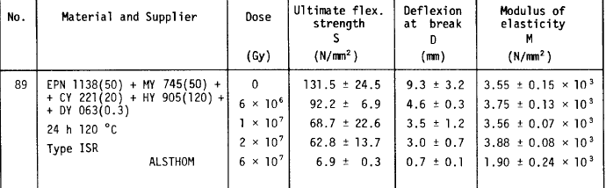
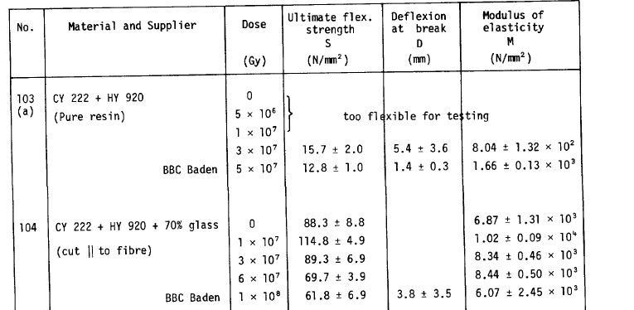

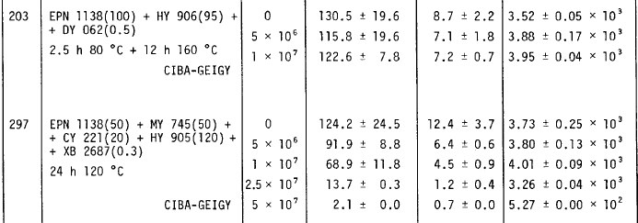
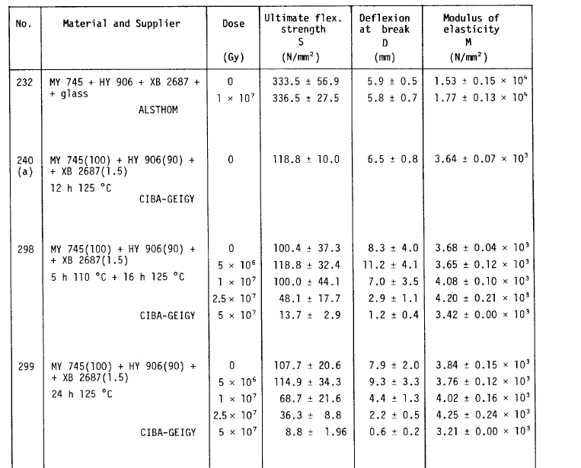
EPN 1138 | CY 222 (similar to CY221)
MY745 replaced by GY6004

Slide 23
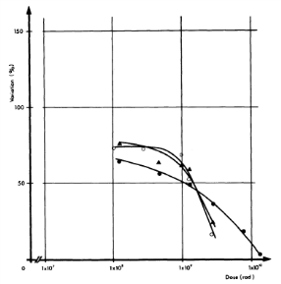

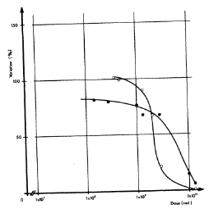

Filler contribution
2 Categories of fillers:
Powder fillers
Glass/Silice fibers
Resins | Hardeners | Additives | Filler | Composition (p.p.) | Fig | Dose for 50% flex. (MGy) | Dose Range (MGy)
DGEBA | MDA |  | Papier | 100-27-200 | 5.14 | 1.3 | 1 - 2
DGEBA | MDA |  | Silice | 100-27-200 | 5.14 | 10 | 10 - 15
DGEBA | MDA |  | Silice | 100-27-200 | 5.18 | 11.4
DGEBA | MDA |  | Silice (5 micron) | 100-27-20 | 5.16 | 14.8
DGEBA | MDA |  | Silice (20 micron) | 100-27-20 | 5.16 | 14.8
DGEBA | MDA |  | Silice (40 micron) | 100-27-20 | 5.16 | 14.6
DGEBA | MDA |  | Silice (40 micron) | 100-27-200 | 5.17 | 12.1
DGEBA | HPA | BDMA | Silice (40 micron) | 100-80-2-200 | 5.17 | <10 | <10
DGEBA | MDA |  | Aérosil + Sulphate de Barium | 100-27-2-150 | 5.14 | 15.8 | 15
DGEBA | MDA |  | Magnésie | 100-27-120 | 5.14 | 18 | 18
DGEBA | MDA |  | Graphite | 100-27-60 | 4.6 | 26.8 | 25 - 30
DGEBA | MDA |  | Graphite | 100-27-60 | 5.14 | 30.5
(DGEBA | MDA |  | Alumine | 100-27-220 | 4.7 | 23.5) | 20 - 50
DGEBA | MDA |  | Alumine | 100-27-220 | 5.14 | 51.7
DGEBA | MDA |  | Alumine | 100-27-100 | 5.15 | 20.6
DGEBA | MDA |  | Alumine | 100-27-220 | 5.15 | 42.5
DGEBA | MDA |  | Fibre de verre | 100-27-50 | 5.19 | 82 | 80 - 100
DGEBA | MDA |  | Fibre de verre | 100-27-60 | 5.18 | 100
EPN | MDA |  | Fibre de verre | 100-29-50 | 5.19 | >100 | >100
TGMD | MDA |  | Fibre de silice | 100-41-50 | 5.20 | >100 | >100
TGMD | DADPS |  | Fibre de silice | 100-40-50 | 5.20 | >100
Paper [cellulose (C₆H₁₀O₅)_{n}]
→ Strong decrease of radio-resistance
The bigger the powder, the more radio-resistant
Hardener choice not influenced by filler
High r.-resistance for Graphite and Alumina
The more fillers, the more radio-resistant
Best Radio-Resistant materials are obtain with Glass/Silice (influence of boron) fibers and aromatic resins (Novolac and glycidyl-amine)
Legend
Resin
 | Linear aliphatic
 | Cycloaliphatic
 | Aromatic
Hardener
 | Aliphatic Amine
 | Aromatic Amine
 | Alicyclic Anhydride
 | Aromatic Anhydride

Slide 24

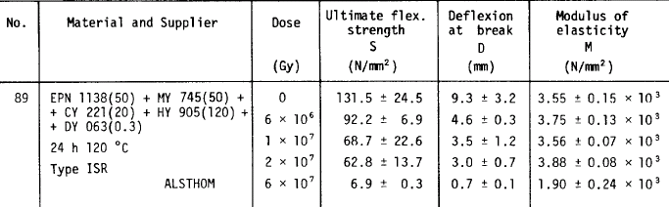
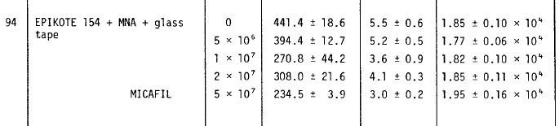
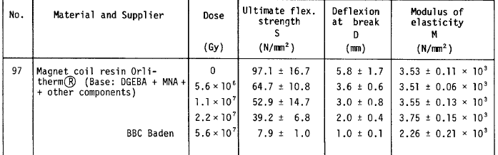
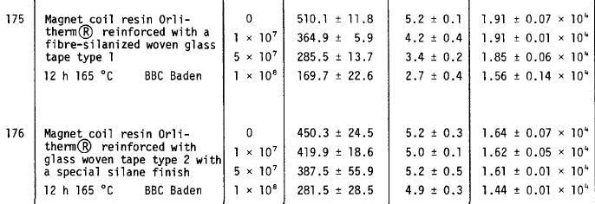
EPN 1138 with filler | CY 222 (similar to CY221) with filler
MY745 replaced by GY6004 with filler | Other DGBA with filler
MQW
The pure resin mix used shall keep substantial mechanical properties at least till 15-20 MGy
Presence of glass fibre shall increase the substantial mechanical properties at least to 40-50 MGy

Slide 25

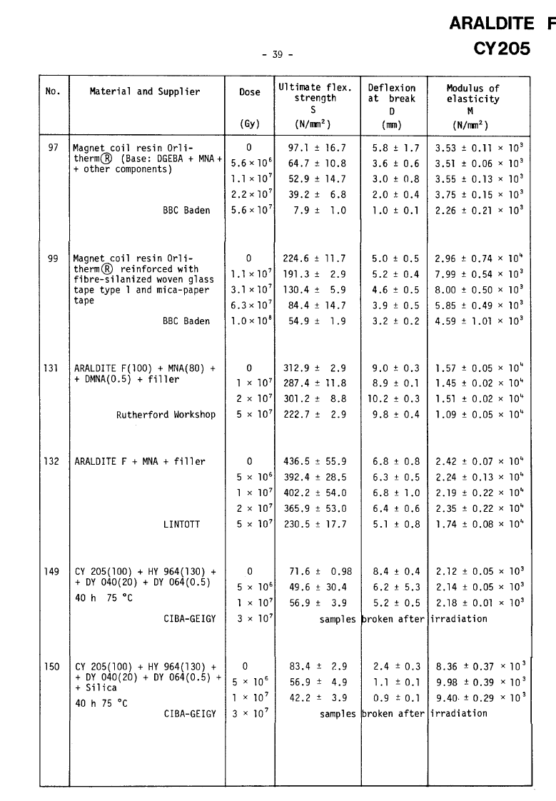
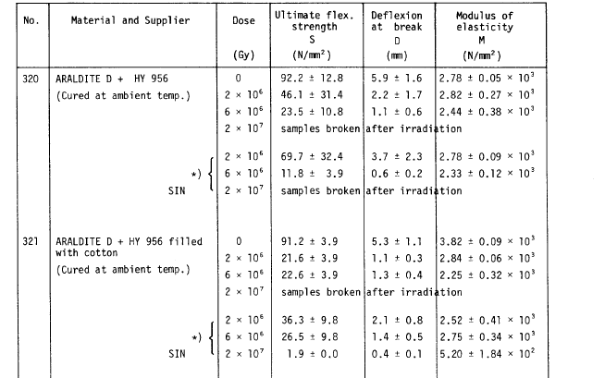
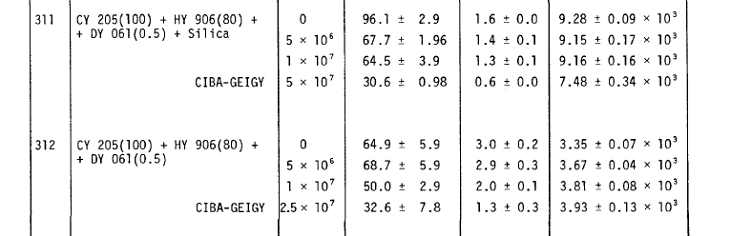
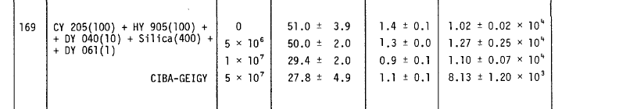
Spacers resins
Composition
  HD polyethylene pipes filled with
Ingredient | Quantity | Description
EPON 826 | 22 kg | Low viscosity, liquid bisphenol A based epoxy resin.
RP 1500 | 3kg | Tetramine hardener
MIN-SIL 120 F | 17 kg | Fused silica particles 50% diameter smaller than 0.044 mm
Assume a limit of
20 MGy

Slide 26
MBW BINP used resin.
We looked at molecule and there is good indication that it should radiation hard as witnessed by the tests and we assume stresses of the order of 10 MPa
MBW
The pure resin mix used shall keep substantial mechanical properties at least till 50-60 (10 MPa)
Presence of fibre glass should probably extend life till 70-80 MGy

Slide 27
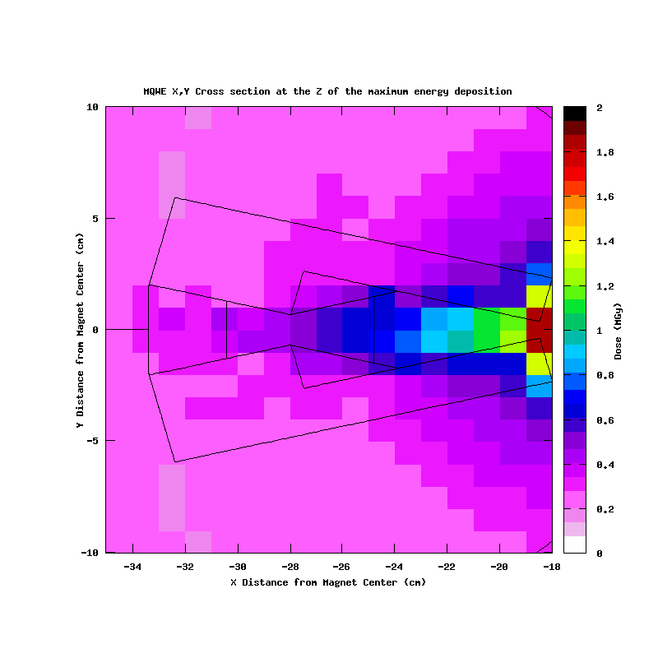
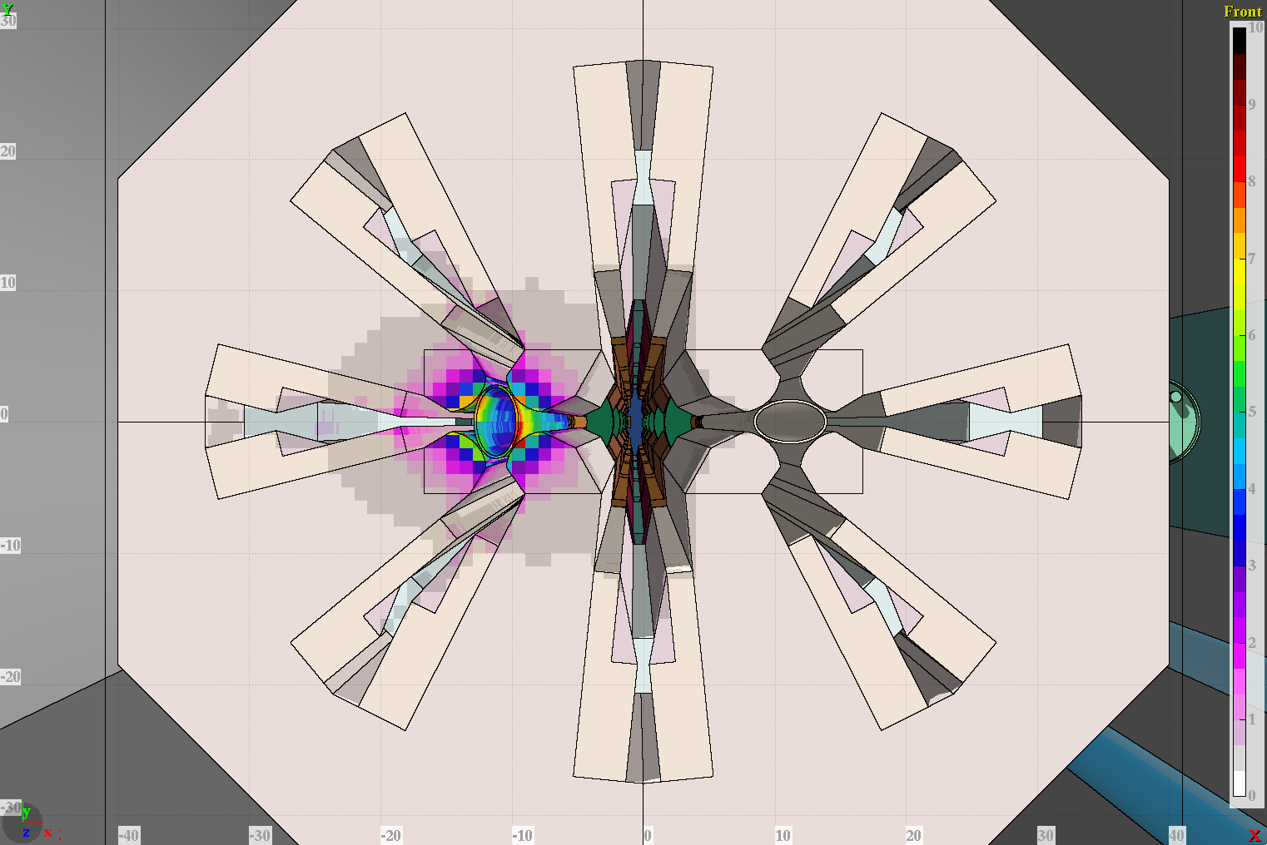
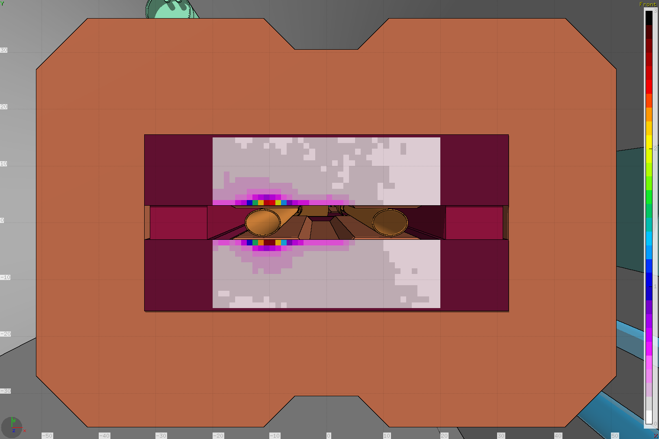
Type of deposition map
Dose (MGy)
Dose (MGy)
Normalization: 1.15 10¹⁶ p (30-50 fb⁻¹ ).
Computations with E 6.5 TeV relaxed collimator settings

Slide 28
Analysis exp. data point 3 and point 7
2.3 kGy
5.5 kGy
1/100
487.3 kGy
1.3 kGy
43.7 kGy
19.1 kGy
469.1 kGy
297.4 kGy
2.3 kGy
1/6
> 500 kGy
4.4 kGy
329.4 kGy
81.7 kGy
1
1
1/3
1
15.7 kGy
18.0 kGy
1/20
397.5 kGy
1.6 kGy
59.6 kGy
25.7 kGy
119.8 kGy
> 500 kGy
6.7 kGy
1/10
9.2 kGy
6.3 kGy
106.3 kGy
8.0 kGy
297.4 kGy
fallen off
(487.3 kGy)
100.4 kGy
RP survey IP3
RP survey IP7
7R/7L=B2/B1
3R/3L=B2/B1

Slide 29
Point 3 and 7 coil magnet damage estimation
IP 3
IP 7
MQW | MBW
From 10 to 20 MGy | From 40 to 60 MGy
From 20 to 50 MGy | From 60 to 80 Mgy
Larger than 50 MGy | Larger than 80 MGy

Slide 30
Screen design
- For max effectiveness we have to target the higher possible density candidate therefore W, or better the alloys for machining
- Magnetic properties can be an issue. Measurement being performed
- Possible material staging along the MQW magnet length under study
 | Inermet IT180
Nominal density | 18
W content % | 95
Balance | Ni,Cu
E-modulus | 360 GPa

Slide 31
MQW shielding effect
Normalization: 1.15 10¹⁶ p (50 fb⁻¹ )
Beam 2
Beam 2
Beam 2
Beam 2

Slide 32
MBWA - MBWB Peak Dose profile
Beam 2
Beam 2
MBW.A6R7 with Flanges
MBW.B6R7
With Flanges
Normalization: 1.15 10¹⁶ p (50 fb⁻¹ )
Beam 2
Beam 2
MBW.A6R7
Flanges + Protection
MBW.B6R7 Flanges + Protection

Slide 33
Optic change proposal point 7 discussed and agreed as possible with M. Giovannozzi
(it needs verification)
ABS

Slide 34
Magnet damage with shielding point 3 and 7, W shielding peak dose scaling
 | Action LS1 |  | Dose [MGy] for integrated luminosity 150 fb^-1 |  | Action LS2 |  | Dose [MGy] for integrated luminosity 350 fb^-1 |  | Action LS3 |  | Dose [MGy] for integrated luminosity 3000 fb^-1 |  | Action during HL-LHC exploitation
 | R | L | R | L | R | L | R | L | R | L | R | L | R | L
MQWA.A4 |  |  | 0.0 | 0.1 |  |  | 0.1 | 0.2 |  |  | 1.0 | 1.9
MQWA.B4 |  |  | 0.1 | 0.1 |  |  | 0.1 | 0.2 |  |  | 1.0 | 2.1
MQWB.4 |  |  | 0.1 | 0.1 |  |  | 0.1 | 0.3 |  |  | 1.1 | 2.2
MQWA.C4 |  |  | 0.1 | 0.1 |  |  | 0.2 | 0.3 |  |  | 1.4 | 2.8
MQWA.D4 |  |  | 0.2 | 0.3 |  |  | 0.4 | 0.8 |  |  | 3.5 | 6.9
MQWA.E4 |  |  | 0.9 | 1.7 | S | S | 1.2 | 2.5 | S | S | 6.3 | 12
MQWA.A5 |  |  | 0.6 | 1.1 | S | S | 0.8 | 1.6 | S | S | 4.0 | 7.5
MQWA.B5 |  |  | 0.7 | 1.4 | S | S | 1.0 | 2.0 | S | S | 5.1 | 9.4
MQWB.5 |  |  | 1.7 | 3.3 | S | S | 2.4 | 4.8 | S | S | 12 | 23
MQWA.C5 |  |  | 3.9 | 7.7 | S | S | 5.6 | 11 | S | S | 29 | 53
MQWA.D5 |  |  | 0.9 | 1.9 | S | S | 1.3 | 2.7 | S | S | 6.8 | 13
MQWA.E5 |  |  | 1.7 | 3.5 | S | S | 2.5 | 5.0 | S | S | 13 | 24
MBW.A6 |  |  | 1.0 | 2.0 | S | S | 1.4 | 2.9 | S | S | 7.3 | 14
MBW.B6 |  |  | 1.2 | 2.3 | S | S | 1.7 | 3.3 | S | S | 8.4 | 16
MBW.C6 |  |  | 1.6 | 3.3 | S | S | 2.3 | 4.7 | S | S | 12 | 3
IP 3
 | Action LS1 |  | Dose [MGy] for integrated luminosity 150 fb^-1 |  | Action LS2 |  | Dose [MGy] for integrated luminosityy350 fb^-1 |  | Action LS3 |  | Dose [MGy] for integrated luminosity3000 fb^-1 |  | Action during HL-LHC exploitation
 | R | L | R | L | R | L | R | L | R | L | R | L | R | L
MQWA.A4 |  |  | 0.4 | 0.5 |  |  | 0.9 | 1.2 |  |  | 7.4 | 11
MQWA.B4 |  |  | 0.3 | 0.8 |  |  | 0.7 | 1.9 |  |  | 6.4 | 16
MQWB.4 |  |  | 0.5 | 1.3 |  | S | 1.2 | 1.8 |  | S | 10.1 | 9
MQWA.C4 |  |  | 4.0 | 4.0 | S | S | 5.8 | 5.8 | S | S | 30 | 30
MQWA.D4 |  |  | 2.7 | 2.7 | S | S | 3.8 | 3.8 | S | S | 20 | 20
MQWA.E4 |  |  | 5.0 | 10.0 | S | S | 7.2 | 14 | S | S | 37 | 73 |  | R
MQWA.A5 |  |  | 2.6 | 2.6 | S | S | 3.7 | 3.7 | S | S | 19 | 19
MQWA.B5 |  |  | 3.5 | 3.5 | S | S | 5.0 | 5.0 | S | S | 25 | 25
MQWB.5 |  |  | 4.1 | 4.1 | S | S | 5.9 | 5.9 | S | S | 30 | 30
MQWA.C5 |  |  | 1.9 | 4.9 | S | S | 2.8 | 7.0 | S | S | 14 | 36
MQWA.D5 | S | S | 1.4 | 2.0 | done | done | 3.3 | 4.7 | done | done | 27.9 | 39.9
MQWA.E5 | S | S | 12 | 4.1 | done | done | 29 | 10 | done | done | 246 | 82 | R | R
MBW.A6 | S | S | 7.8 | 5.5 | done | done | 18 | 13 | done | done | 155 | 111 | R | R
MBW.B6 | S | S | 12 | 6.2 | done | done | 30 | 14 | done | done | 248 | 124 | R | R
IP 7
Remove
Limit reached in | 7R | 7L
MQWA.E4 |  | 1500 fb^-1
MBW.B6 | 1500 fb^-1 | 2400 fb^-1
MBW.A6 | 1000 fb^-1 | 2000 fb^-1

Slide 35
MQW Shielding strategy
Bring the coil below 50 MGy, trying to get uniform and below that level (useless to have points at 10 MGy if your peak is at 50 MGy)
IP 3
 | Peak dose reduction factor to reach 3000 fb^-1 |  | Shielding strategy
 | R | L | W | Steel/Copper/Bronze
MQWA.A4
MQWA.B4
MQWB.4
MQWA.C4
MQWA.D4
MQWA.E4 | Not needed | Not needed |  | 50 cm
MQWA.A5 | Not needed | Not needed |  | 50 cm
MQWA.B5 | Not needed | Not needed |  | 50 cm
MQWB.5 | Not needed | 1.4 | 50 cm | rest of length
MQWA.C5 | 1.7 | 3.3 | 100 cm | rest of length
MQWA.D5 | Not needed | Not needed |  | 50 cm
MQWA.E5 | Not needed | 1.5 | 50 cm | rest of length
 | Peak dose reduction factor to reach 3000 fb^-1 |  | Shielding strategy
 | R | L | W | Steel/Copper/Bronze
MQWA.A4 | Not needed | Not needed
MQWA.B4 | Not needed | Not needed
MQWB.4 | Not needed | Not needed | none | full length
MQWA.C4 | 1.6 | 1.6 | 50 cm | rest of length
MQWA.D4 | 1.1 | 1.1 | none | full length
MQWA.E4 | 2.0 | 4.0 | 100 cm | rest of length
MQWA.A5 | 1.0 | 1.0 | none | full length
MQWA.B5 | 1.4 | 1.4 | none | full length
MQWB.5 | 1.6 | 1.6 | 50 cm | rest of length
MQWA.C5 | Not needed | 1.9 | 50 cm | rest of length
MQWA.D5 | 1.7 | 2.4 | 100 cm | rest of length
MQWA.E5 | 14.8 | 4.9 | 100 cm | rest of length
IP 7

Slide 37
Optic change proposal point 7 discussed and agreed as possible with M. Giovannozzi
(it needs verification)
ABS

Slide 38


Estimated MQW spacer damage with screens
(extrapolated red. factor 3)
IP 7
IP 7
Need to modify screen design

Slide 39
Conclusions I
 |  | IP3 |  |  |  |  |  | IP7
 |  | L |  |  | R |  |  | L |  |  | R
 |  | Broken units no int | Units to be modified | Broken units | Broken units no int . | Units to be modified | Broken units | Broken units no int | Units to be modified | Broken units | Broken units no int . | Units to be modified | Broken units
LS1 | MQW | NA | 0 | NA | NA | 0 | NA | NA | 2 | NA | NA | 2 | NA
 | MBW | NA | 0 | NA | NA | 0 | NA | NA | 2 | NA | NA | 2 | NA
LS2 | MQW | 0 | 7 | 0 | 0 | 7 | 0 | 0 | 7 | 0 | 0 | 8 | 0
 | MBW | 0 | 3 | 0 | 0 | 3 | 0 | 0 | NA | 0 | 0 | NA | 0
LS3 | MQW | 0 | 0 | 0 | 0 | 0 | 0 | 1 | 0 | 0 | 0 | 0 | 0
 | MBW | 0 | 0 | 0 | 0 | 0 | 0 | 1 | 0 | 0 | 0 | 0 | 0
HL-LHC | MQW | 4 | 0 | 0 | 1 | 0 | 0 | 9 | 0 | 1 | 9 | 0 | 0
 | MBW | 0 | 0 | 0 | 0 | 0 | 0 | 2 | 0 | 2 | 2 | 0 | 2

Slide 40
Conclusion II
The proposed screen allow reducing of a factor 3 the dose and limit the number of magnet at risk or surely damaged, see previous slides. Hp. to achieve the same reduction factor on the spacers
The change of the optic in point 7 installing a long absorber is key to complete the protection
The lifetime of these units could be affected by the new environmental condition of point 7 not discussed here

Slide 41
Conclusion III: actions
The proposed shielding campaign should start in LS1 for effectiveness and ALARA
Very high dose dosimeter shall be installed systematically in point 3 and 7 to check better benchmark computations and symmetry effect
A campaign of irradiation of resins shall be performed with the real used resins and the relevant fillers in order to real know when the magnet will reach damage level
For HL LHC 4 MBW shall be reassembled with saddle type heads. This will solve the issue without needing special development
I suggest that we launch the program to build a NC magnet with extremely high radiation resistance (>300 MGy). It is and it will be more and more needed and today we do not have it in our capabilities and it will be key for future target areas development
We need to check
  For HL-LHC the MBW radiation dose along the straight part of the coil
  The level of accumulated dose of the MBXW units
  If any protecion can be added to on the beam line for the MQWA.E4 in point 7 R and 7 L

Slide 42
Long version

Slide 43
The doses

Slide 44
Dose evaluation process for each point
IP 3
Fluka model results with 1.15 10¹⁶ p lost per interaction point E 6.5 TeV.
IP 7
1
(Fluka esti. already 7 TeV)
Scale to 7 TeV (linearly)
1.077
1
Scale to the dosimeter readings as benchmark (TS2)
1
150 fb⁻¹ ->3
350 fb⁻¹ -> 7
3000 fb⁻¹ ->60
Scale to the LS1, LS2 LS3 and HL-LHC integrated luminosity
150 fb⁻¹ ->3
350 fb⁻¹ -> 7
3000 fb⁻¹ ->60
2
Scale to the increase slope dose/luminosity after TS2
2
Normalise to a total losses (adding the 2 points) of 1.15 10¹⁶
0.23
0.98->1
L=1
R=0.5
Scale to the Left and Right using RP survey
L=1
R= (0.4->2)

Slide 45



Relationship dose vs. luminosity and point 7 vs. point 3
2
196.7/(697+196.7)=0.23
1357/(1357+30)

Slide 46


MEASUREMENTS VS EXPECTATIONS
(different collimation settings and before change of slope losses vs. luminosity )
MBW
TCAP
MQW
v
h
s
s
beam 1
IP7
TCP.D C B 6L7.B1
assuming a horizontal halo
taking for 4 TeV
with tight settings
2 250kGy
0.5 60 kGy
peak dose
for intermediate
collimator settings
100-400 kGy
60 kGy
one would get
by normalizing to
1.4 10¹⁵ beam 1 protons lost in P7
measured
for 1.15 10¹⁶ lost protons per beam
F. Cerutti 03/09/2012

Slide 47
Point 3 vs. point 7
2.3 kGy
5.5 kGy
487.3 kGy
469.1 kGy
297.4 kGy
4.4 kGy
329.4 kGy
15.7 kGy
18.0 kGy
397.5 kGy
119.8 kGy
> 500 kGy
9.2 kGy
6.3 kGy
106.3 kGy

Slide 48
Point 3 vs. point 7
43.7 kGy
1.3 kGy
19.1 kGy
2.3 kGy
81.7 kGy
> 500 kGy
1.6 kGy
59.6 kGy
25.7 kGy
6.7 kGy
8.0 kGy
fallen off
(487.3 kGy)
100.4 kGy
297.4 kGy

Slide 49
Estimated dose point 3 and point 7
IP 3
IP 7

Slide 50
Magnet lifetime

Slide 51


Slide 52
Different scenarios agreed with M. Giovannozzi
    In IR3 no MQWB can be removed without changing the optical conditions at the collimators.
    In IR7 the MQWB modules in the two Q5 may be removed without changing the optical conditions at the collimators (2 spare magnets
Other operating scenario
Reconfigure the MQWA in pos. C5 as MQWB
Remove MQWA.E5
Connect new MQWB.C5 in the circuit RQ5.LR7
Substitute MQWA.E5 with an absorber at least effective as previous MQWA.E5

Slide 53
Power deposition

Slide 54
Power deposition
 | MQW |  | MBW
Ultimate current | 810 | A | 820 | A
Electrical dissipated power ultimate current | 25 | kW | 41 | kW
Delta T measured ultimate current on cooling water | 16 | C | 30 | C
New operational current | 620 | A | 650 | A
New dissipated electrical power operational current | 15 | kW | 26 | kW
Worst dissipated power due to radiation losses (including dissimetry and new loss rate) | 3 | kW | 4 | kW
New total power to be dissipated (Pel+Prad+Pconv) | 19 | kW | 30 | kW
New Delta T necessary to evacuate the power | 12 | C | 22 | C
New magnet working temperature | 38 | C | 48 | C
Remark
Due to small lifetime (load case 1h) we do not take into account the coefficient 2linked to the ratio losses/luminosity nor the discrepancy B1/B2 (L/R)

Slide 55

MQWA.E Energy Deposition on various elements
5770
1780
570
1290
290
With Protection over 50 c m
2030
2130
50
110
60
50
4550
640
210
2020
1670
90
70
1950
2230
500
110
1250
370
720
5670
2310
Values are in pJoule/proton lost in the collimators

Slide 56
Peak power adiabatic (wrong) approximation in shielding
 | MQW shielding |  | MQW beam pipe |  | MBW shielding
Env Temp | 50 | C | 50 | C | 50 | C
Integral proton energy lost | 1012 | pJ/proton | 4550 | pJ/proton | 256 | pJ/proton
symmetry, loss rate and 7 TeV factor | 1.0775 |  | 1.0775 |  | 1.0775
Proton losses | 9.00E+10 | proton/s | 9.00E+10 | proton/s | 9.00E+10 | proton/s
Loss time | 3600 | s | 3600 | s | 3600 | s
Total integral power | 98 | W | 441 | W | 25 | W
Assumed ratio Pmax/Pmin along magnet | 4 |  | 4 |  | 1
Adiabatic Delta T Pmax | 170 | C | 750 | C | 224 | C
Adiabatic Delta T Pmin | 43 | C | 190 | C
Baking vacuum chamber
T->230 C
Necessary 4 KW to get to the temperature along several hours

Slide 57
Installation issues and planning

Slide 58
Installation/planning/risks
To reduce radiation aging intervention on most exposed magnets shall performed in LS1 (also for ALARA reasons ). The initial foreseen modus operandi directly on the magnet in the tunnel is not feasible because of the interference with the backing equipment. Due to the limited number of vacuum chambers available and also field quality sorting it is better to modify the magnets presently installed in LHC and replace them in the same slot. It will help in saving non radioactive spares.
The backing strips power wiring and the related thermocouples need to be rewired. VSC (N. Zelko) performed test and it looks feasible. Possible back up strategy with screen modification is available
Possible planning sequence
  From 18/11/2013 till 30/11/2013 removal of 8 magnets and transport to point 6
  From 20/11/2013 modification of 1st unit in 867 workshop
  From 01/02/2014 start re-installation
  01/03/2014 complete re-installation
Risks | Solutions/Consequences
Screens not available on time | Install steel screen or re-install without screen
W-Ni-Cu alloy cause no acceptable field distortion | Install reduce effectiveness copper or steel screens
Difficult installation on MBW | Possibility to machine the shielding to ease installation and close the hole with W tap
Damage of backing strip | One magnet not backed out

Slide 59




MBW

Slide 60



MQW

Slide 61




LHC Point 7
Ambient dose equivalent rates in µSv/h at 40cm
measured on Dec 20, 2012
(last “good” fill on Dec 5, i.e. cooling time >1week)
Scaling factors
based on generic
Studies for IR7:
t_{cool} | Scaling factor
One hour | 1.4
One day | 1.0
One week | 0.73
One month | 0.45
4 months | 0.20

Slide 62


Slide 63

SPS
ISR~MQW

Slide 65


Slide 66


Slide 67

Electrical Properties Changes 2
10¹⁷
○ DGEBA + MDA
x EPN + MDA
∆ TGMD +MDA
_______ Non irradié
_ _ _ _ _ 2.7x10⁹ rad
10¹⁶
Volumetric Resistivity ρ (Ω·cm)
10¹⁵
10¹⁴
10¹³
10¹²
10¹¹
10¹⁰
0
20
40
60
80 100 120 140 160 180 200 Temp. (°C)
ρ = ~10¹⁶ Ω·cm @RT
High mechanical radio-resistance → High electrical resistance (mechanical degradation occurs first)
T ↑ => ρ ↓
Example of low mechanical-resistance system:
DGEBA-DBP-TETA → ρ = ~10¹³ Ω·cm @RT for 6.8x10⁸ rad

Slide 68


DGEBA considerations

Slide 69
PROPOSALS I
 | Traction test | Flexural test | Leakage current in air humid | Dielectric in air humid | Leakage current in air humid after 1 month in water | Dielectric in air humid after 1 month in water
0 MGy | Y | Y | (Y) | Y | (Y) | Y
10 Mgy |  | Y | (Y) | Y | (Y) | Y
20 Mgy | Y | Y | (Y) | Y | (Y) | Y
40 Mgy | Y | Y | (Y) | Y | (Y) | Y
50 MGy |  |  | (Y) | Y | (Y) | Y
60 MGy | Y | Y | (Y) | Y | (Y) | Y
70 MGy | Y | Y | (Y) | Y | (Y) | Y
Wafer 1 and 2 mm thickness resin and glass fibre

Slide 70
PROPOSALS II
 | Shear test | Leakage current in air humid | Dielectric in air humid | Leakage current in air humid after 1 month in water | Dielectric in air humid after 1 month in water
0 MGy | Y | (Y) | Y | (Y) | Y
10 Mgy |  | (Y) | Y | (Y) | Y
20 Mgy | Y | (Y) | Y | (Y) | Y
40 Mgy | Y | (Y) | Y | (Y) | Y
50 MGy |  | (Y) | Y | (Y) | Y
60 MGy | Y | (Y) | Y | (Y) | Y
70 MGy | Y | (Y) | Y | (Y) | Y
Insulated cables, 2 resins, 3 samples

