Slide 1
CMS Pixels: Status @ Fermilab
Farah Fahim, Gregory Deptuch, Jim Hoff, Alpana Shenai, Marcel Trimpl

Slide 2
Update
Radiation tolerance tests of 130nm & 65nm are ongoing with U. Colorado using Sandia National Lab "Gamma Irradiation Facility" (Colbolt-60 source array).
Design a CMS_pixel_testChip130 for 4.8mm x 4.8mm detector with an array of 30µm x 100µm on SINTEF "Phase-2" wafers recently delivered (to Purdue)
Goal
  1. Demonstrate low (<1000e-) threshold operation in a moderate-sized array.
  Test analog circuit ideas including self-trimming discriminators
  Begin to understand how small a pixel is possible in 130nm
  We also hope that the test chip will be useful for other prototype sensors such as diamond sensors that require low threshold operation for good performance

Slide 3
ASIC: CMS_pixel_testChip
Technology platform: GF130nm
ASIC size: 5.5mm x 8.5mm
Pixel size: 30µm x 100µm
Analog part: 20µm x 100µm
Digital Part: 10µm x 100µm
Rows x Columns: 48 x 160
Column pattern: A D D A A D D A
4 columns are grouped together to create a superColumn (192 pixels)
Each ASIC has 40 super columns.
Analog Pixel to include Preamplifier + 3bit Flash ADC + Hit Comparator (independent of ADC)

Slide 4
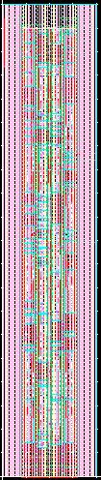
Digital Pixel
Thermometric encoder
Fischer tree sparsification
Hit processor
Mask/demask capability
Functionality finalized. Simulations confirm performance
Double pixel layout (20µm x 100µm)

Slide 5
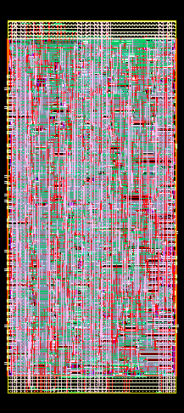
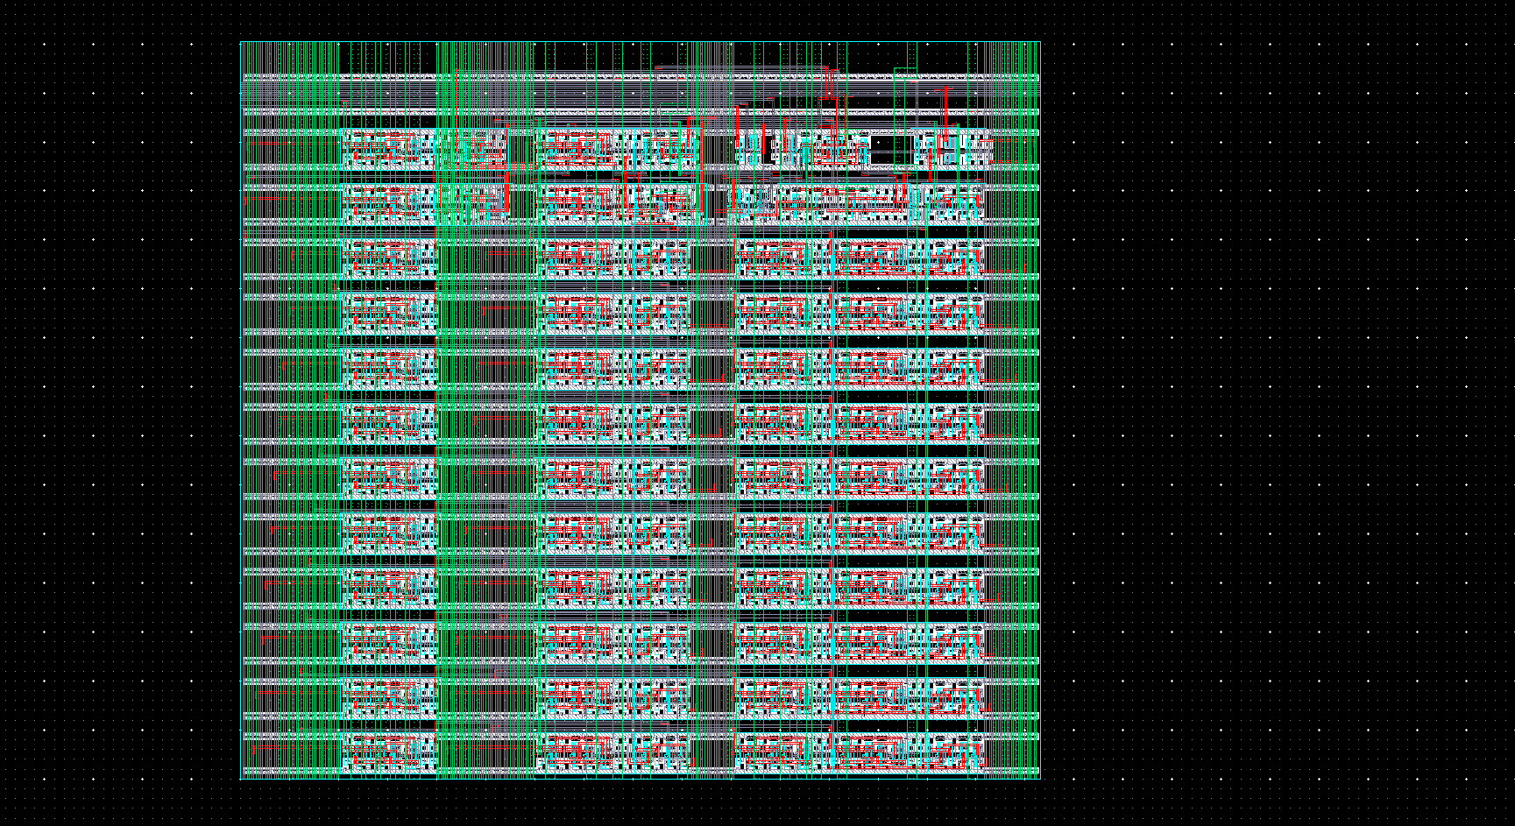
Readout Electronics
Conflux: Asynchronous data readout scheme with implicit multiplexing of data
Uses a 4 phase handshaking protocol
FIFO2 daisy: enables daisy chaining of data from every pixel to the output.
Also used to communicate between the fischer tree and Conflux

Slide 6
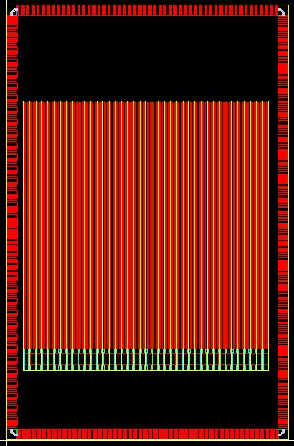
Top Level view- pad layout
51 analog PADS on top (100µm pitch)
51 digital PADS at the bottom (100µm pitch)
34 spy PADS on the right for analog and digital superColumn outputs (240µm pitch)
34 PADS on left for testing chip-to-chip Conflux performance (240µm pitch)
Basic Floorplan. Missing a lot of components

Slide 7
CMS_testPixel to detector bump bonding:
Results of investigating single ASIC to detector bump bonding using CVI
Results from other work at Fermi

Slide 8

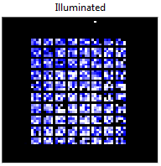
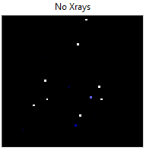
3D VIPIC1 - first X-rays seen with the chip bonded to a 32x38 pixels sensor
VIPIC1 – bonded to 100x100 μm² 32x38 pixels baby sensor
Every 5th channel skipped because of pixel pitch mismatch: VIPIC1-80um, sensor-100μm
Sensor bonded to VIPIC using Sn-Pb bump bonding with underfill by CvInc. Bumps deposited on dies
Wire bonded by Albert last Friday night
Detector still not biased (backplane left floating)
¹⁰⁹Cd 22keV source used
threshold ~200 (40mV) causes noise hits disappear (right reference sample plot) and only X-rays are visible; threshold ~1200 (240mV) no more signal visible; gain estimation ~40uV/e- (22keV –> 6100e/h)

Slide 9
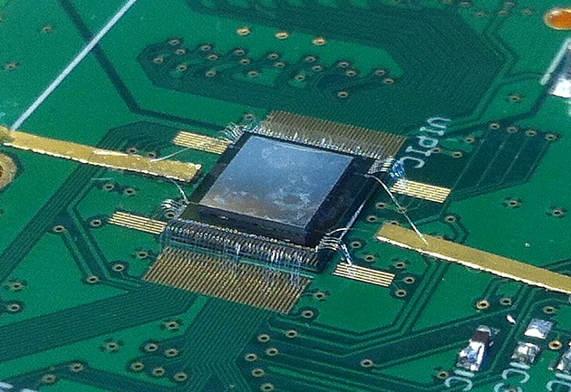
3D VIPIC1 – more detailed results
Skipped pixels removed
Detector biased at 120V (mask not shown)
Detector tested using sources
¹⁰⁹Cd 22keV and ⁵⁵Fe 5.9keV
Transmission radiogram of a small W mask (2.5x2.5 mm²) put on top of the sensor; back-side illumination of the fully depleted sensor using ⁵⁵Fe source, all signals integrated above noise, mask has features smaller than the sensor pitch, e.g. φ=75μm in the middle
Full sparsified readout from all 16 groups of 4x64 pixels used in the acquisition

