Slide 1
Simulations for Hadron Irradiated n⁺p⁻ Si Strip Sensors Incorporating Bulk and Surface Damage
Ranjeet* , A. Bhardwaj, K. Ranjan, M. Moll & A. Peisert , Kavita, Geetika
for
Uni. of Delhi & CERN
Work performed with CERN PH-DT-DD
under ISJRP and RD-50

Slide 2
Contents of presentation
Simulation approaches for irradiated sensors : up to now!
Some puzzling observations!
Simulation framework
Simulation of Cint & Rint and E field for n+p- strip sensor
Simulations of E field for different p-stop designs
Summary

Slide 3
Simulation approaches for irradiated sensors :
Up to now !
Either considered surface damage only or considered bulk damage only
No simulation study which incorporate both of these effects
simultaneously !
Simulation using Surface damage only | Simulations using Bulk damage only
G. Verzellesi & G.F. Dalla Betta Nucl. Sci. Symp., 2000 IEEE (Vol.-1) Compact modeling of n-side interstrip resistance in p-stop and p-spray isolated double-sided silicon microstrip detectors | 1. V. Eremin et al. NIM A 476 (2002) 556–564 The origin of double peak electric field distribution in heavily irradiated silicon detectors
2. P. Claudio (2006) IEEE Trans. ON Nucl. Sci., VOL. 53, NO. 3 Device Simulations of Isolation Techniques for Silicon Microstrip Detectors Made on p-Type Substrates | 2. M. Petasecca et al. NIM A 563 (2006) 192–195 Numerical simulation of radiation damage effects in p-type silicon detectors
3. Y Unno et al. NIM A 636 (2011) S118–S124 Optimization of surface structures in n-in- p silicon sensors using TCAD simulation | 3. V. Chiochia et al., IEEE Trans. Nucl. Sci. NS-52 (2005) 1067 Simulation of Heavily Irradiated Silicon Pixel Sensors and Comparison With Test Beam

Slide 4
Some puzzling observations !
Previous simulation studies indicates that to ensure strip isolation (in case of high surface oxide charge density ~ 1-2x10¹²cm⁻²) between n+ strips, Pstop/Pspray peak doping densities should be ~ 1x10¹⁷cm⁻³ (P. Claudio, IEEE 2006).
It is common practice in sensor studies (till now) to use
Pspray ~ few times 1x10¹⁶ cm⁻³ (above it breakdown voltage will be very low)
Pstop ~ 1x10¹⁷cm⁻³
So in case of Si sensors irradiated with very high fluence of ionizing radiation (proton or pion) there must not be strip insulation for very low p-stop/p-spray doping densities.
But contrary to this experience :
Strip Insulation is not a problem for Si sensor with very low p-stop ( ~ 5x10¹⁵cm⁻³) and p-spray doping densities (~1x10¹⁵cm⁻²) and irradiated with high fluence of protons (~1x10¹⁵cm⁻²neq)
(CMS-HPK tracker phase-II upgrade study)
Observations of other parameters like Cint, also do not follow the expected trends for oxide charge density build up with irradiation.
Oxide charge density (Q_{F}) appears to be suppressed in the HPK sensors!
Further, for irradiated n-in-p type sensors, it was expected that maximum E field would be near p-stop curvature. But microdischarge have been observed near n+ strips (Atlas tracker upgrade work)

Slide 5
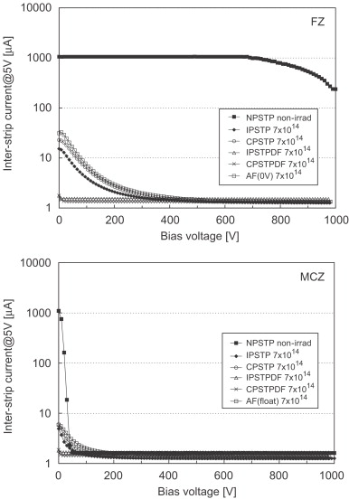
Another experimental evidence …..
Y. Unno et. Al. (NIM A 579 (2007))
Strip isolation was observed for n+p- sensors without isolation structure after proton irradiation
  Clear signature of proposed mechanism !
No Isolation Structure
unirradiated
No Isolation Structure
unirradiated
No Isolation Structure
Irradiated
No Isolation Structure
Irradiated
Plot of Interstrip current vs. applied reverse bias.
  NPSTP – No Isolation structure (non-irradiated).
  AF – No isolation structure (irradiated by flux = 7x10¹⁴cm⁻²).
  All other structures are with different layouts of Pstops (Irradiated)
  Voltage difference between two neighboring strips = 5V

Slide 6
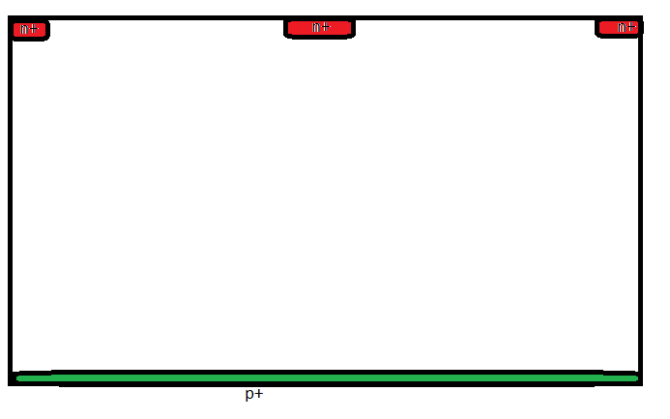
How these observations can be explained !
₊ ₊ ₊ ₊ ₊ ₊ ₊
₊ ₊ ₊ ₊ ₊ ₊ ₊
₊ ₊ ₊ ₊ ₊ ₊ ₊
₊ ₊ ₊ ₊ ₊ ₊ ₊
- - - - - - - - - - - - - - - - - -
- - - - - - - - - - - - - - - - - -
- - - - - - - - - - - - - - - - - -
- - - - - - - - - - - - - - - - - -
- - - - - - - - - - - - - - - - - -
- - - - - - - - - - - - - - - - - -
Accumulation e- layer
Shorting n+ strips
Mobile e-s due to Q_{F} - - - (Red color)
X-ray and Gamma irradiation case
For X-ray and γ ray irradiation, low leakage current and no/or very low bulk damage results
in absence of space charge
Accumulation e- layer will result in shorting of n+ strips unless sufficient pspray/pstop doping
is used.

Slide 7
Very high –ve space charge density near n+ strips. Moreover, this space charge will be even more higher near the both ends of n+ strip (curved) because this area is collecting current from a large volume between the strips (leading to higher e- current density).
This -ve space charge will act like a Pspray whose density increases with irradiation flux !
No need for formation of accumulation layer due to +ve Oxide charge density !
₊ ₊ ₊ ₊ ₊ ₊ ₊
₊ ₊ ₊ ₊ ₊ ₊ ₊
₊ ₊ ₊ ₊ ₊ ₊ ₊
₊ ₊ ₊ ₊ ₊ ₊ ₊
Very high
-ve space charge
near n+,
(Very high E field near n+)
Hadron Irradiation case
Static –ve space charge.
No need for e- accumulation layer formation !
+ + + + + +
₊ ₊ ₊ ₊
₊ ₊ ₊ ₊
₊ ₊ ₊ ₊
₊ ₊ ₊ ₊
₊ ₊ ₊ ₊
₊ ₊ ₊ ₊
₊ ₊ ₊ ₊
₊ ₊ ₊ ₊
₊ ₊ ₊ ₊
-ve bias
Fixed -ve space charge - - - (Blue color) – due to filling of Acceptor traps

Slide 8
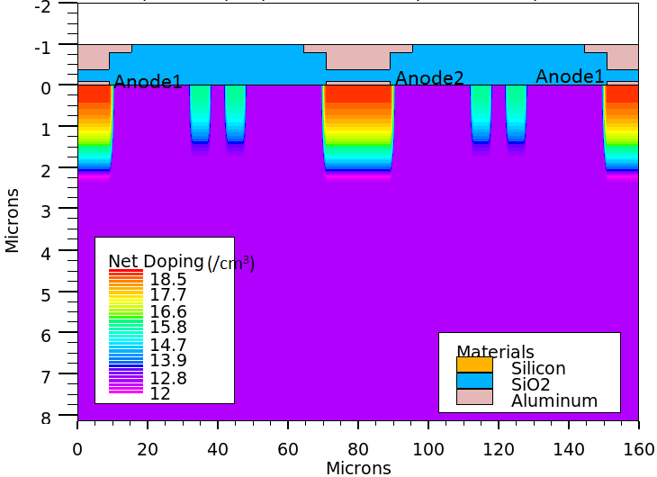
Simulation structure
Bulk doping = 3e12cm-3
2-D simulations
Double p-stops
Each 4µm wide separated by 6µm
P-stop doping = 5e15cm-2
P-stop doping depth = 1.6um
CMS HPK tracker upgrade campaign
parameters [1]
Three strips structure was used for R_{int} simulations in which bias of 0.2V is given to Central DC Anode while two neighboring Anodes are shorted together. Reverse bias is provided from cathode (not shown), below while a very low DC external resistance of 1Ω is used to avoid scaling confusion.
Simulations are carried out using Silvaco TCAD tool.
A . Deirlamm, 2012 JINST 7 C01110 ,
THE 9th INTERNATIONAL CONFERENCE ON POSITION SENSITIVE DETECTORS, 12–16 SEPTEMBER 2011,

Slide 9

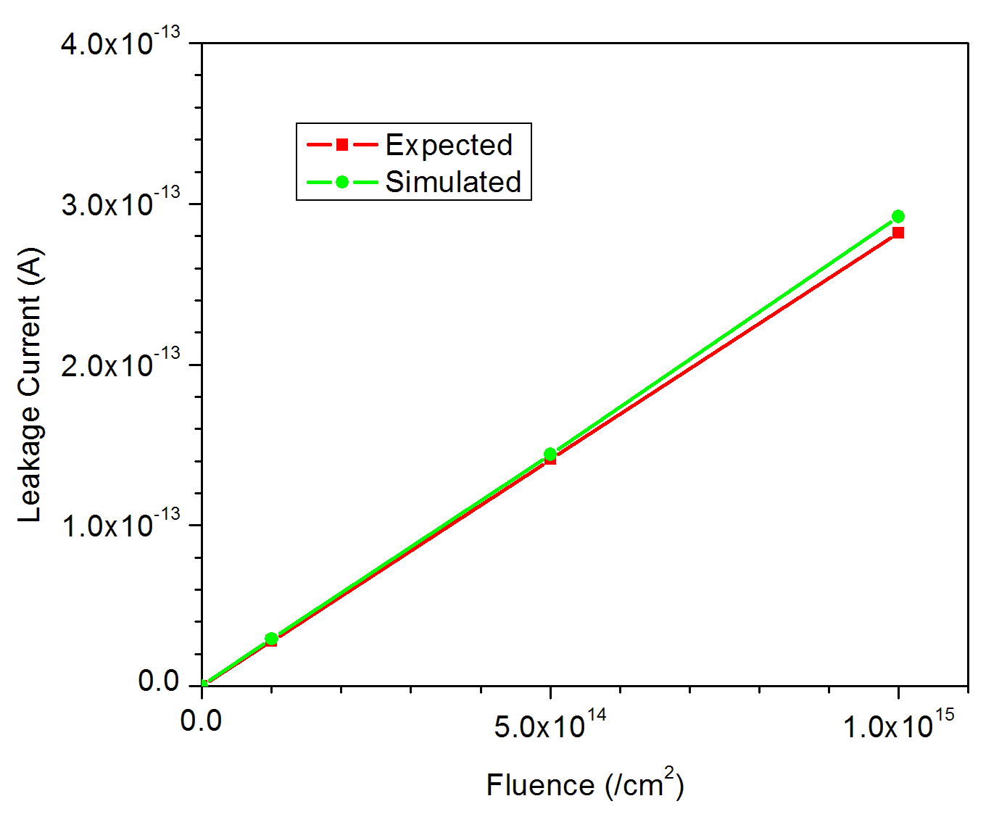
Bulk damage model
Trap | Energy Level | Intro. | σ_{e} (cm⁻²) | σ_{h} (cm⁻²)
Acceptor | 0.525eV | 3.0 | 1x10⁻¹⁴ | 1.4x10⁻¹⁴
Acceptor | 0.45eV | 40 | 8x10⁻¹⁵ | 2x10⁻¹⁴
Acceptor | 0.40eV | 40 | 8x10⁻¹⁵ | 2x10⁻¹⁴
Donor | 0.50eV | 0.6 | 4x10⁻¹⁴ | 4x10⁻¹⁴
Donor | 0.45eV | 20 | 4x10⁻¹⁴ | 4x10⁻¹⁴
Two more acceptors & one donor in addition to two deep levels
Able to remove accumulation e-
Produce very high E field near n+
Reproduce experimental observed good
Rint and Cint
(Rough calculation (Thomas Poehlsen):
For Oxide charge density ~ 1x10¹²cm⁻²; assume accumulation e- layer width of ~ 1µm is created. So, accumulation e⁻ density of ~ 1x10¹⁶cm⁻³.
To neutralize this: trap density (or p-stop/p-spray) should be much larger then that.

Slide 10
Surface damage
Along with radiation damage, oxide charge density is a complex function of fabrication process, annealing steps, humidity, radiation particle type etc.
Hence, instead of taking one value of Q_{F}, for a given flux of hadron irradiation, surface damage is incorporated in simulation by considering range of Q_{F} for a given fluence.
Ranges of Oxide charge density (Q_{F}) used :
Irradiation fluence (neq/cm²) | Range of Q_{F} (cm⁻²)
0 | 5e10 to 5e11
1x10¹⁴ | 1e11 to 8e11cm-2
5x10¹⁴ | 5e11 to 1.2e12
1x10¹⁵ | 8e11 to 2e12

Slide 11
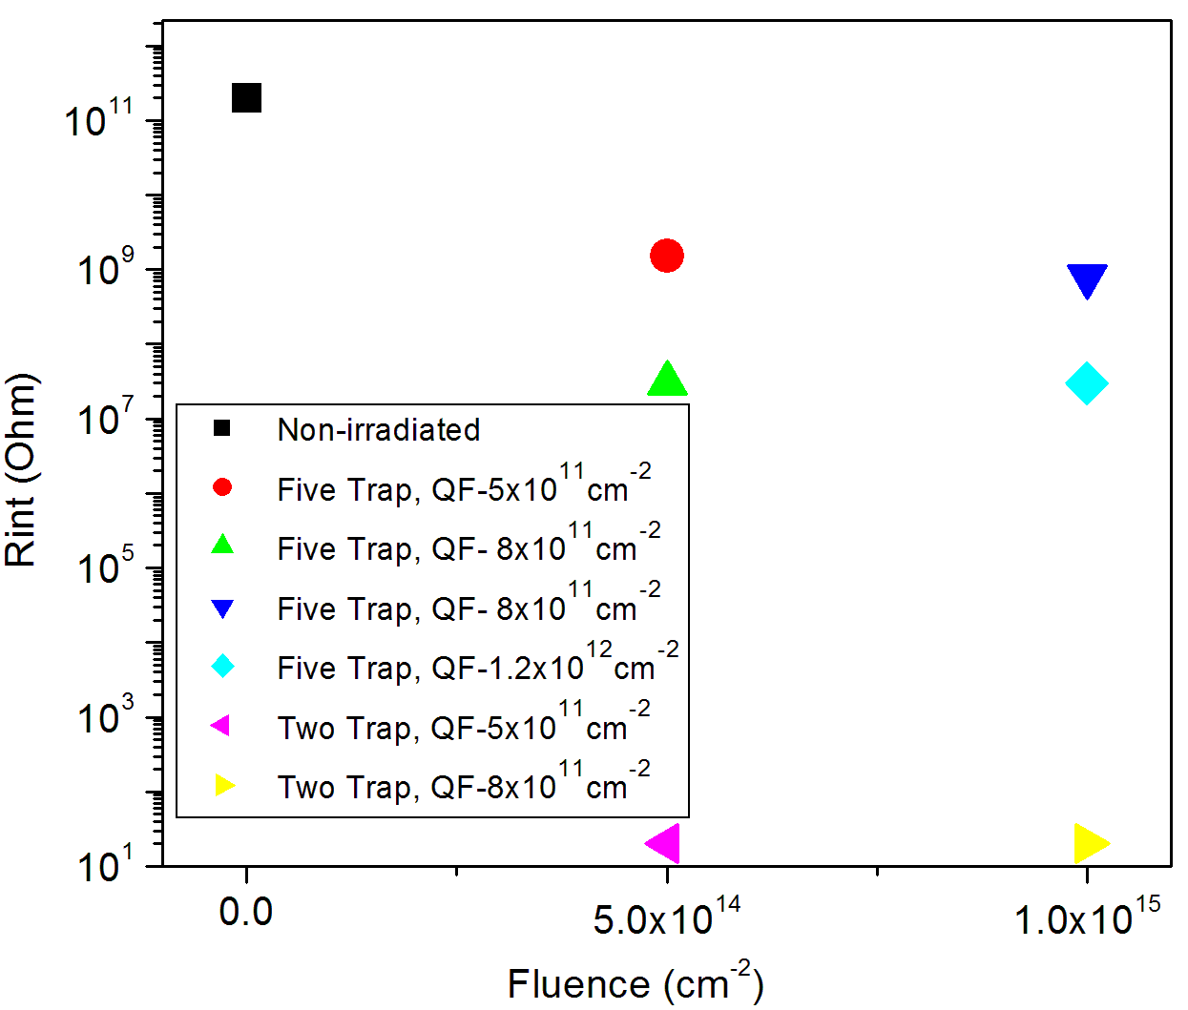
Two vs. Five trap model : Rint simulations
Two trap models (in Silvaco [2] as well as in Synopsis [proton model of KIT] also) are not
able to account the good Rint for irradiated sensors
[2] Thomas Eichhorn, 2012 IEEE Nucl. Science Symp. and Medical Imaging Conf.(NSS/MIC) N2S-S

Slide 12
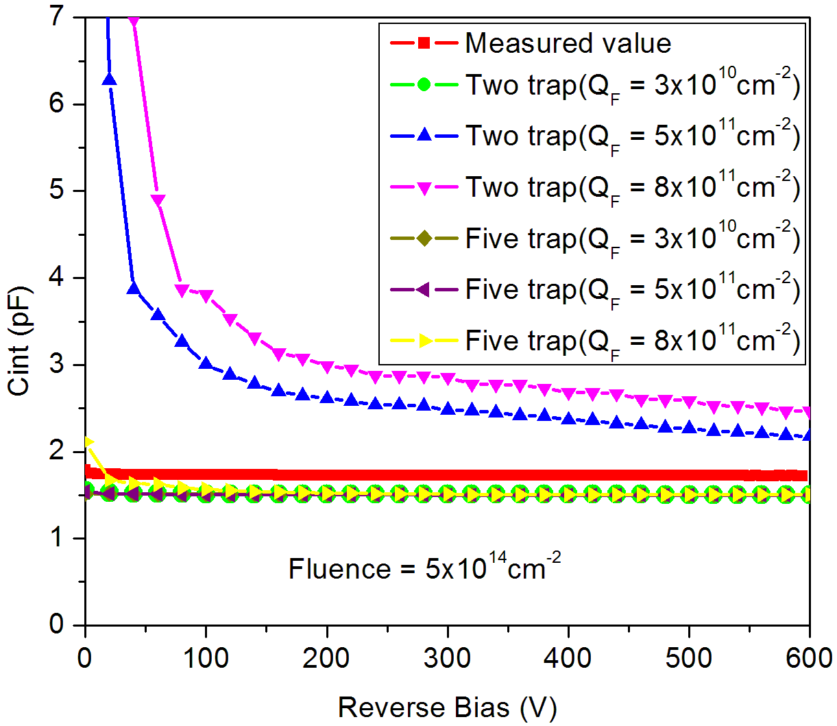
Two vs. Five trap model : Cint simulations
For two trap model, Cint increases sharply with Q_{F}
Five trap model is able to reproduce Cint for realistic Q_{F} values

Slide 13
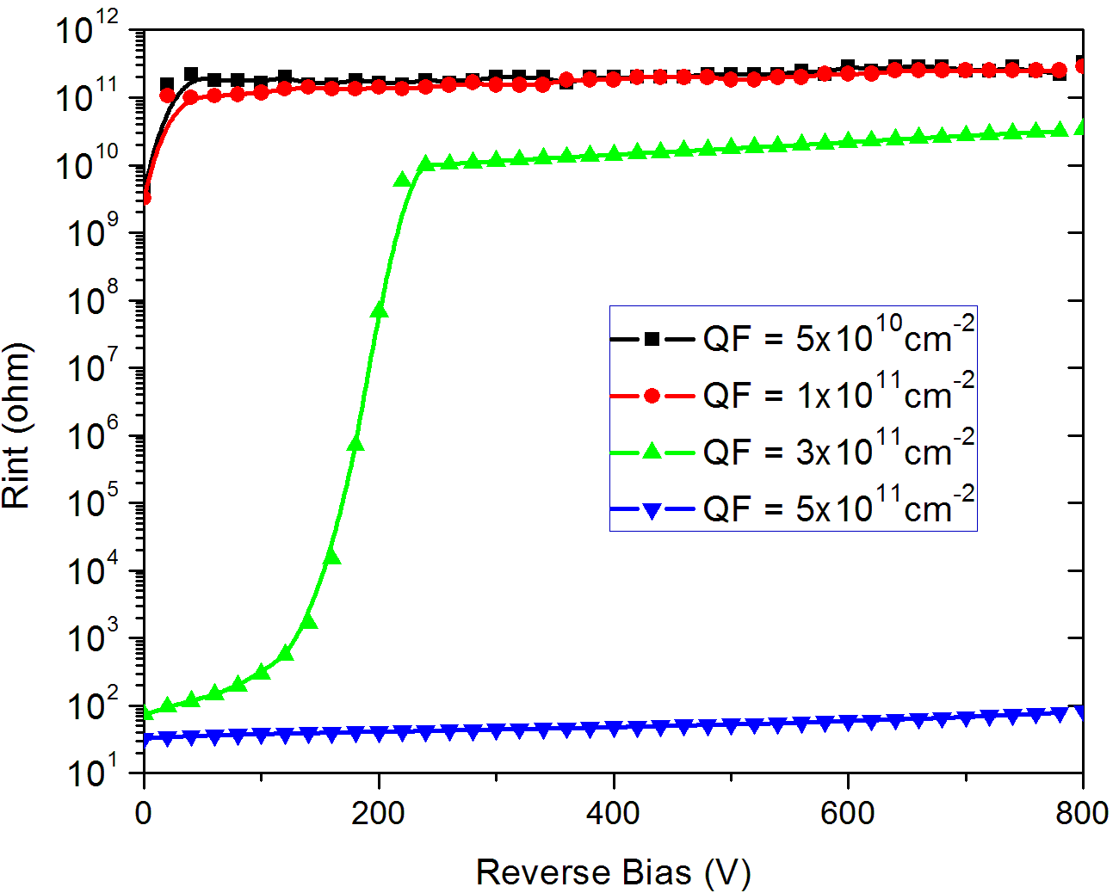
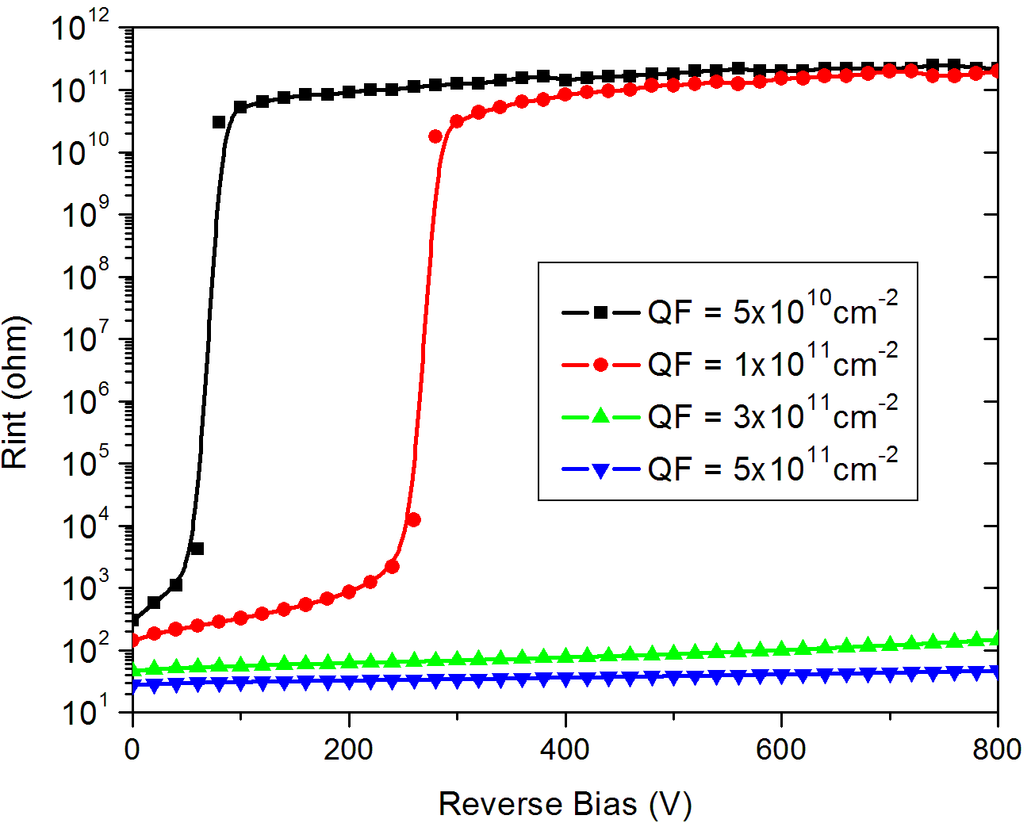
Simulation of Rint without bulk damage
Structure with p-stop
Structure without p-stop
Three different Rint curves
For low values of Q_{F}, good strip insulation is obtained even for low bias voltages.
For intermediate values of Q_{F}, strip insulation is very poor for low voltages, but improves with higher reverse biases, as the electrons from accumulation layer are progressively removed, resulting in a higher R_{int}.
But for higher values of Q_{F}, R_{int} remains very low up to 800 V.

Slide 14
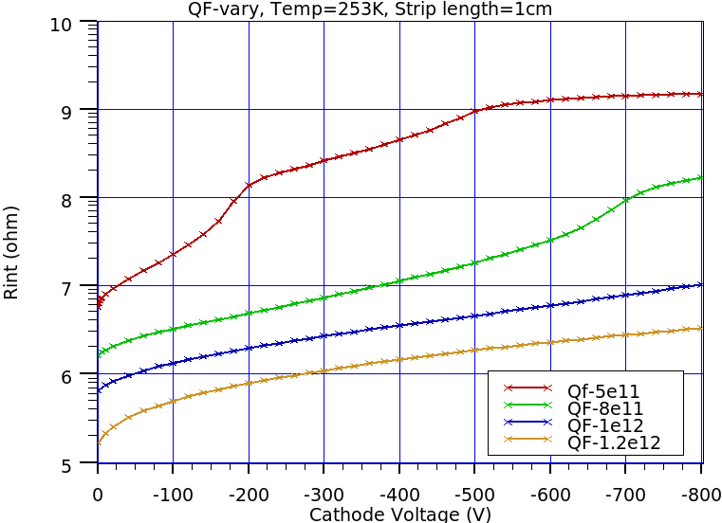
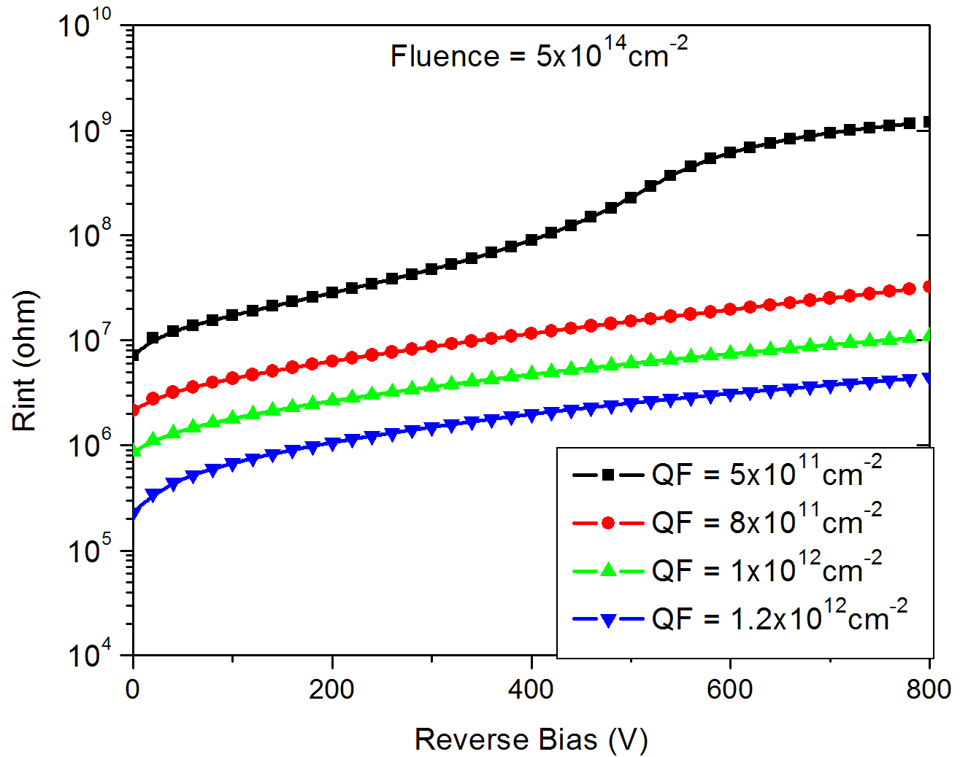
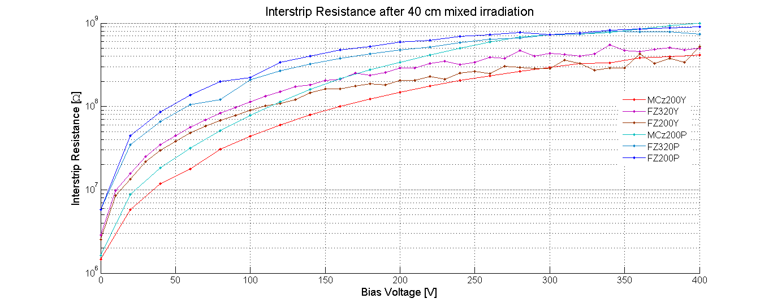
Simulations of Rint for Fluence = 5x10¹⁴neq/cm²
Str. with double p-stop
Str. without p-stop
10⁹
Rint values of more then 100MOhm is possible for QF = 8e11cm-2
Significant improvement in Rint values for higher values of Q_{F}
Good strip insulation is possible even without any isolation structure!
One of the Experimental result
- Thanks to Wolfgang Treberspurg
10⁶

Slide 15
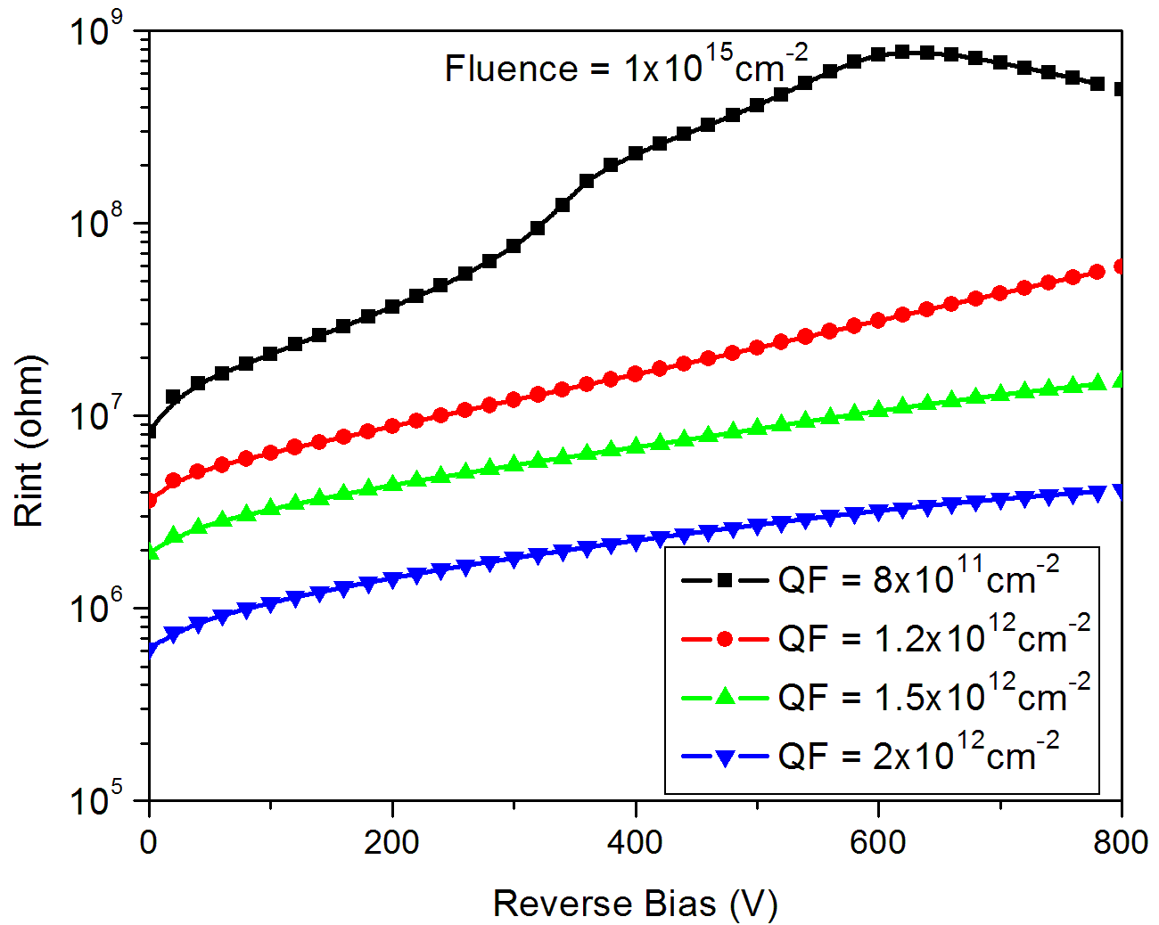
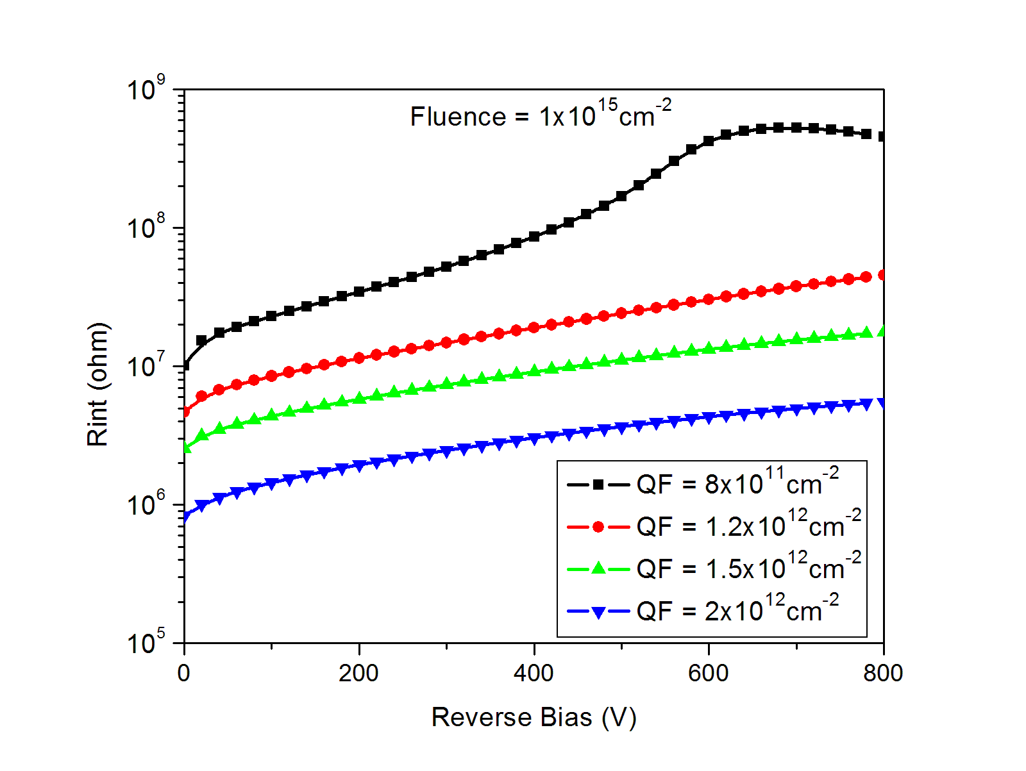
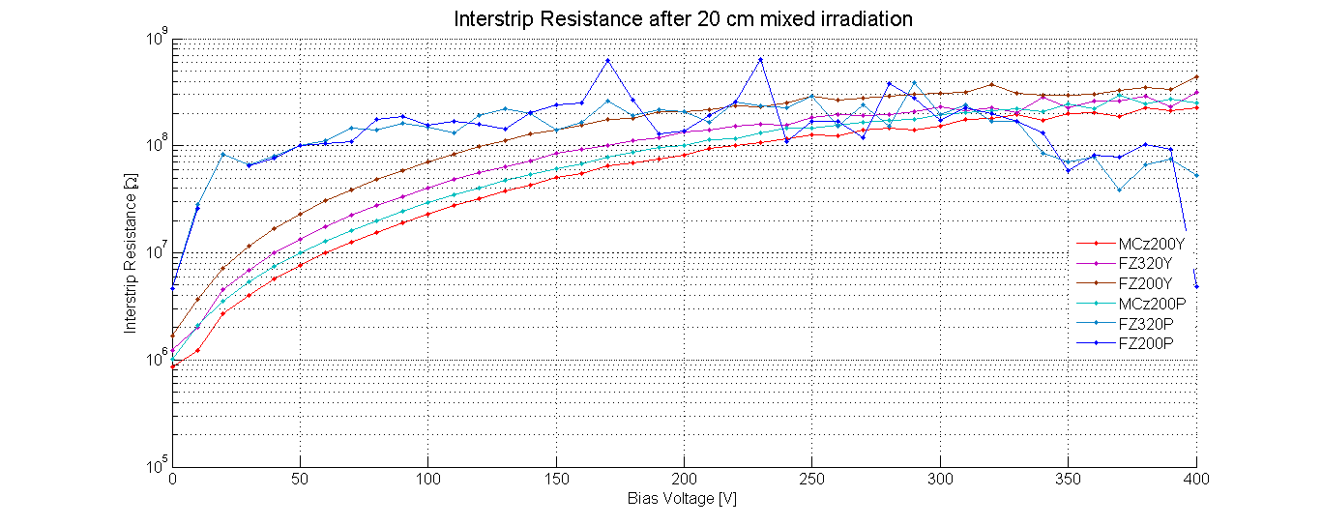
Simulations of Rint for Fluence = 1x10¹⁵neq/cm²
Str. with p-stop
Str. without p-stop
10⁹
Rint values of more then 100MOhm is possible for QF = 8e11cm-2
Significant improvement in Rint values for higher values of Q_{F}
Good strip insulation is possible even without any isolation structure!
One of the Experimental result
- Thanks to Wolfgang Treberspurg
10⁵

Slide 16
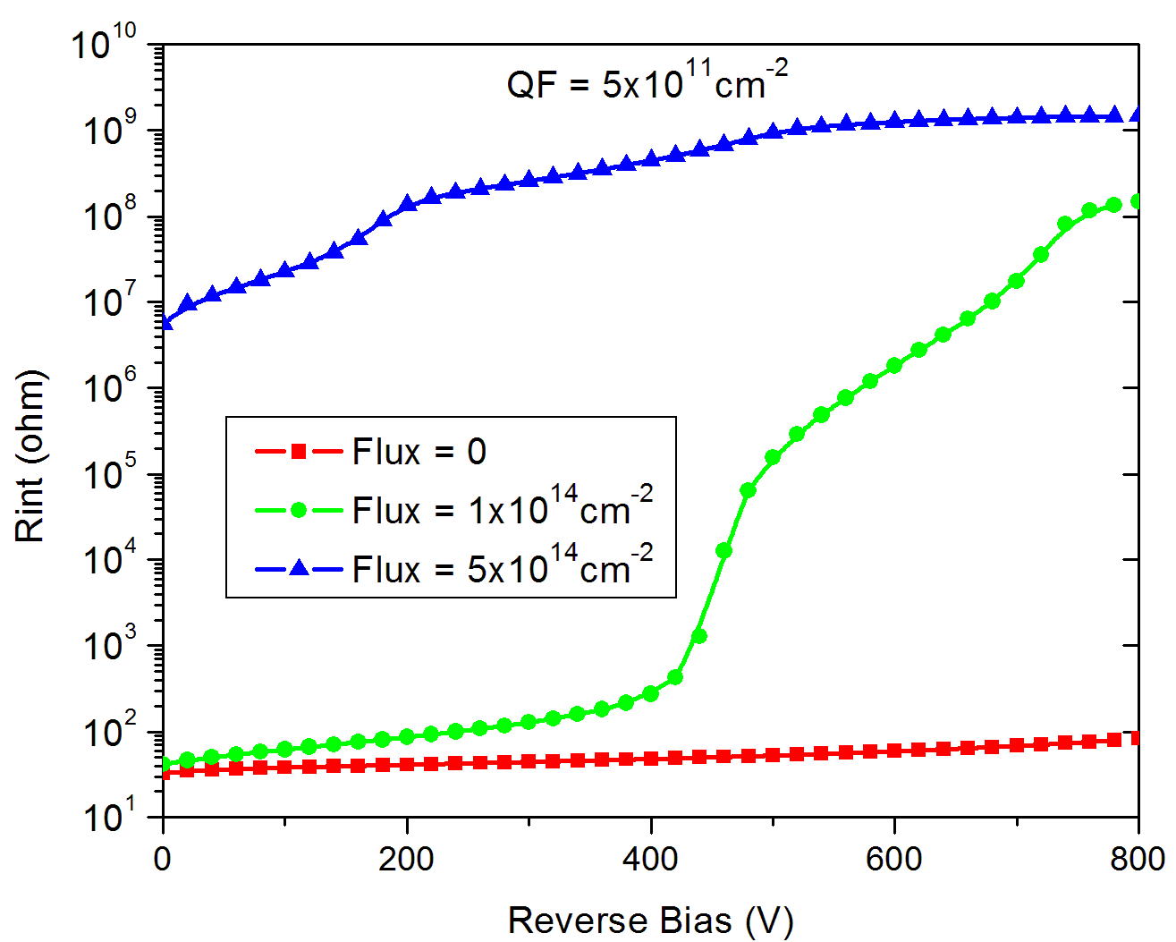
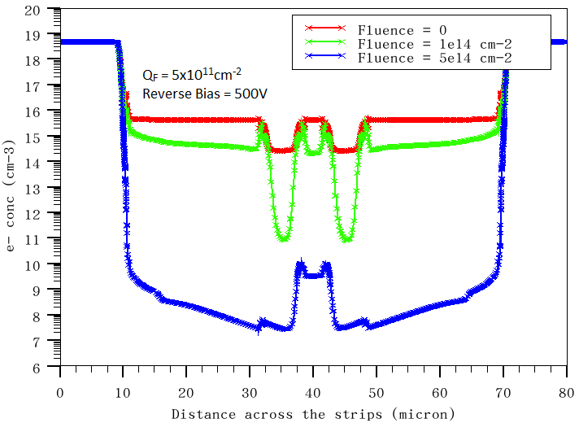
Effect of bulk damage on electron accumulation layer
5e14cm⁻²
1e14cm⁻²
1e14cm⁻²
5e14cm⁻²
Fluence=0
For a given Oxide charge density value, Rint increases with bulk damage
- Bulk damage suppress the electron accumulation layer

Slide 17
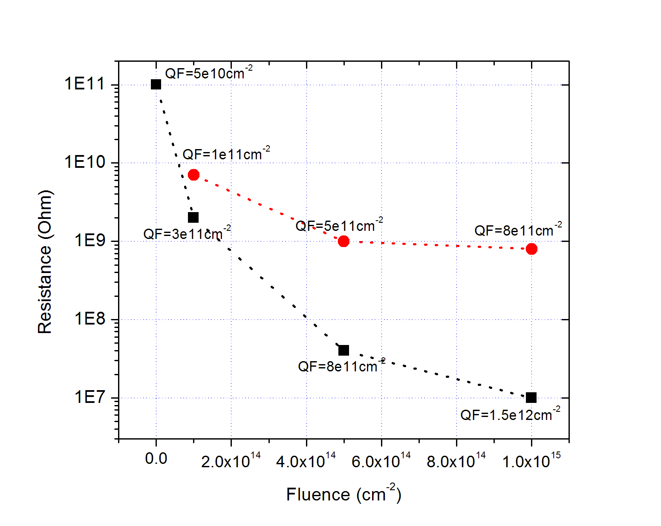
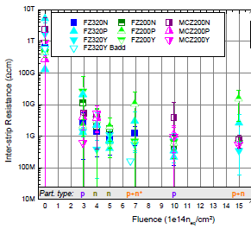
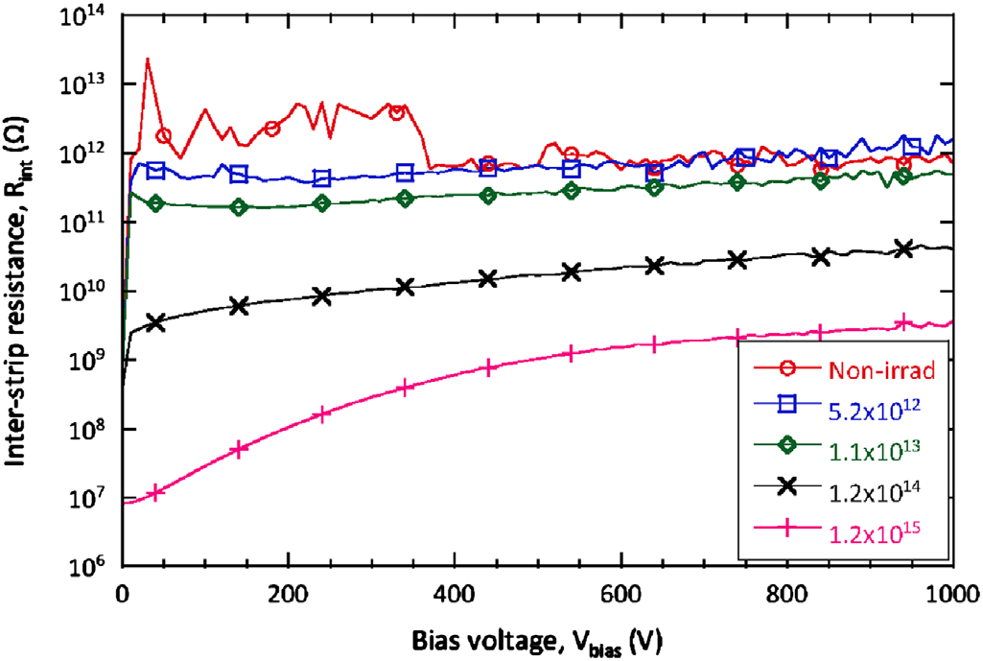
R_{int} variation with Irradiation flux
600V
600V
Simulations
CMS measurements
Rint decreases with increase in fluence
Similar trends in CMS tracker upgrade measurements (A. Dierlamm, PoS paper, Vertex 2012, 016)
Similar trends observed in Atlas measurements (Y. Unno et al., NIMA, 2013), http://dx.doi.org/10.1016/j. nima.2013.04.075)
with different p-stop parameters
- Can not be explained by increase in leakage current
Atlas measurements

Slide 18
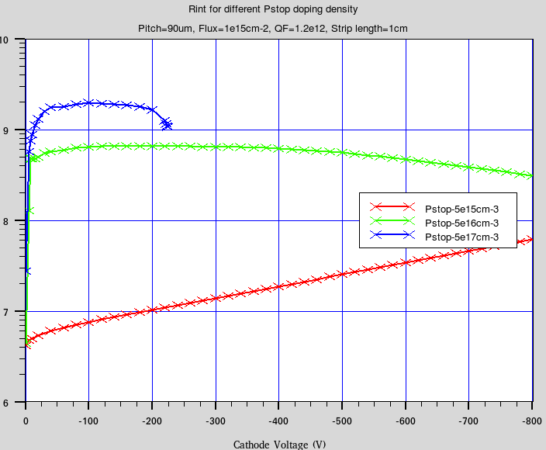
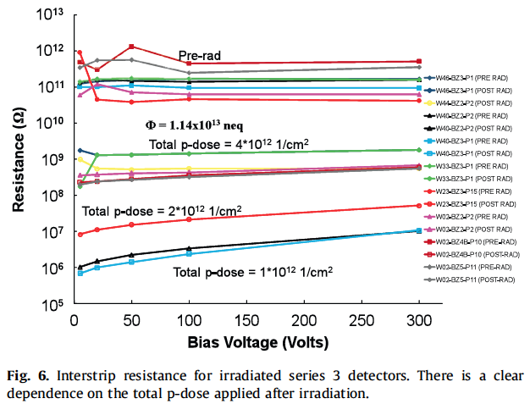
Rint variation for different p-stop doping
Pstop-5e17cm⁻³
Pstop-5e16cm⁻³
QF =1.2e12cm⁻²
Pstop-5e15cm⁻³
Fluence = 1e15cm-2
S. Lingren et al., Nucl. Instr. Meth. A636 (2011) S111
Higher Pstop doping density leads to better Rint
similar trends seen in measurements also
But very high p-stop doping density may leads to breakdown near p-stop curvature region

Slide 19
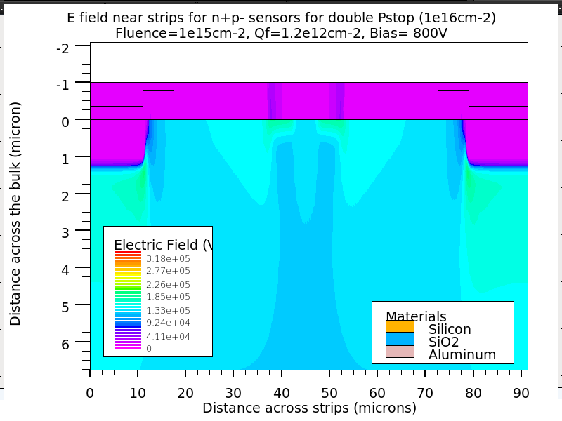
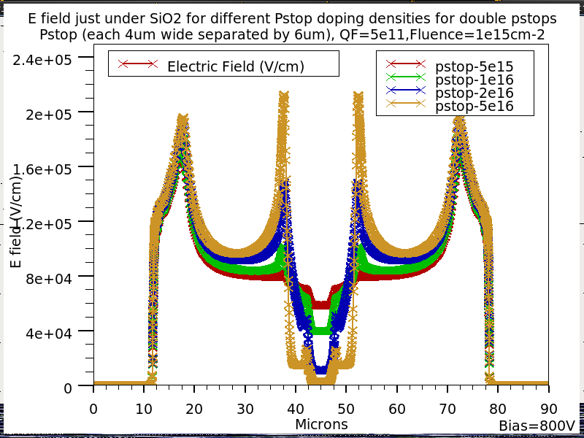
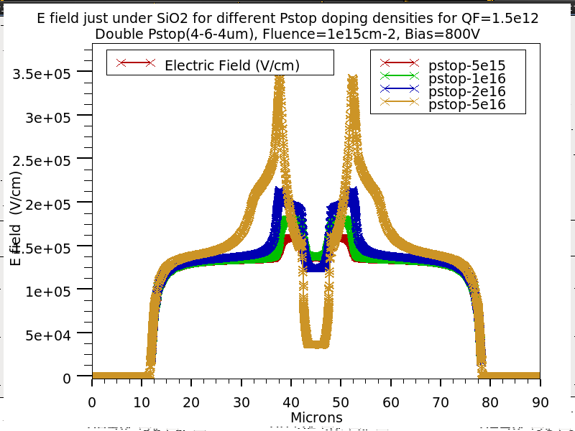
E field 0.1µm below SiO2/Si interface for different p-stop doping
n+
n+
QF = 5e11cm⁻²
Max. E field for n+p- MSSD is near the curvature region
of n+ strip Or near p-stop, just below SiO2/Si interface
- Need two cutlines : 0.1µm and 1.4µm below interface
For Pstop upto 2e16cm⁻³, highest E field is near n+ strip curvature (next slide)
For higher Pstop concentration (5e16cm⁻³), maximum E field is near p-stop
QF = 1.5e12cm⁻²

Slide 20
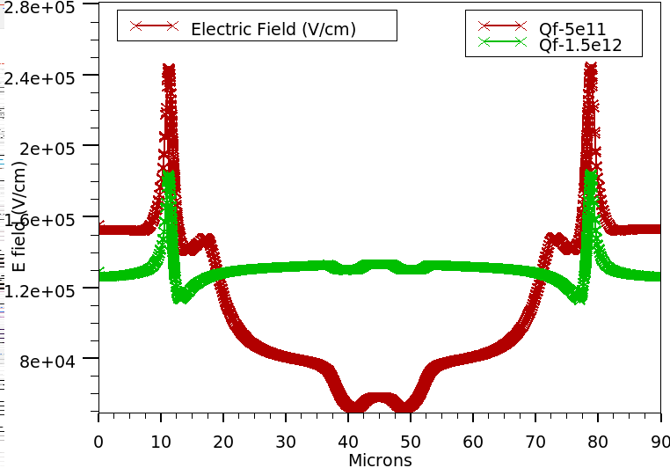
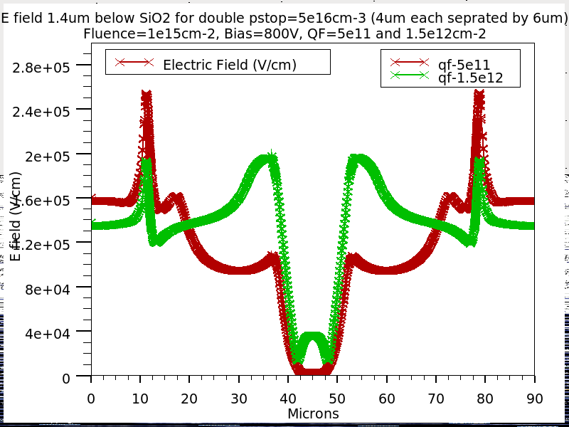
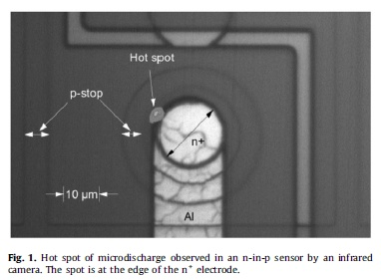
E field 1.4µm below SiO2/Si interface for diff. p-stop dopings
P-stop = 5e16cm⁻³
P-stop = 5e15cm⁻³
Bias=800V, Fluence=1e15cm-2
QF = 1.5e12cm⁻²
For p-stop (at least) up to 2e16cm-3, highest E field is near n+ strip curvature
For low and intermediate p-stops, it is quite possible, that microdischarges are taking place at n+ curvature.
Y. Unno et al.
NIMA 636 (2011)

Slide 21
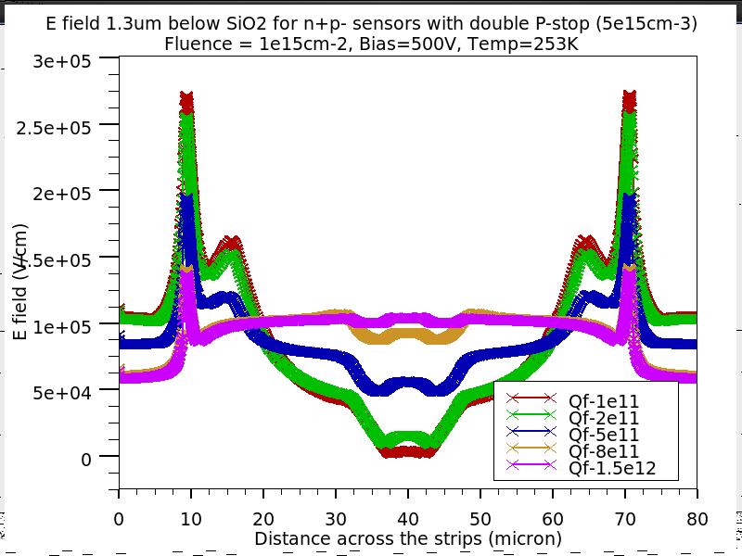
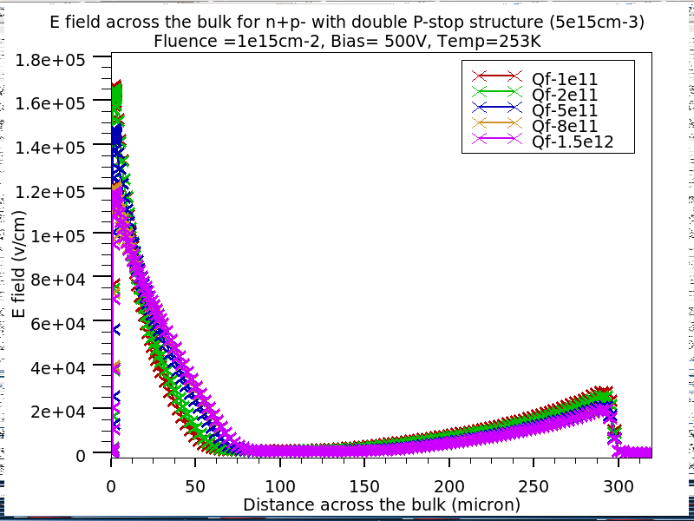
E field 1.3µm below SiO2/Si interface for n+p- strip sensor
E field along the strips
- Q_{F} vary
E field across the bulk
- Q_{F} vary
Flux=1x10¹⁵cm⁻² Bias = 500 V
E field near n+ strips strongly decrease with increase in Oxide charge density
Higher E field near strips, for neutron irradiation compare to proton irradiation
More charge multiplication for neutron irradiation then proton irradiation !
(See C. Betancourt`s Yeasterday talk)
Different amount of surface damage can be very useful in understanding different effects of n & p irradiations

Slide 22
Summary and future directions
Measurements clearly indicate good Rint values for low very p-stop/p-spray isolation
structure or even without any isolation structure, after hadron irradiation
Similarly, other observables like Cint, Rint trends & position of microdischarge for
p-type sensor etc., indicate the combined effects of surface and bulk damage.
Bulk damage appear to suppress the electron accumulation layer due to surface
damage
Surface + Bulk damage considered simultaneously in simulations
Good agreements between Rint , Cint trends were obtained
Rint increases with p-stop doping but very high value of p-stop doping can lead to
low value of breakdown
Position of critical field for hadron irradiated sensors can be understood
Electric field near the strips for n+p- sensors strongly decrease with increase in oxide
charge density. This indicate that charge multiplication may be more for neutron
irradiated sensors
No. of traps in the bulk damage model
Interface traps incorporation into simulations
Comparison of E field in the bulk with results of eTCT (Marcos, Kramberger )
Simulation study of E field difference for proton and neutron irradiation

Slide 23
Thanks for your attention!

Slide 24
E field contours for double p-stops doping = 1e16cm⁻³

Slide 25
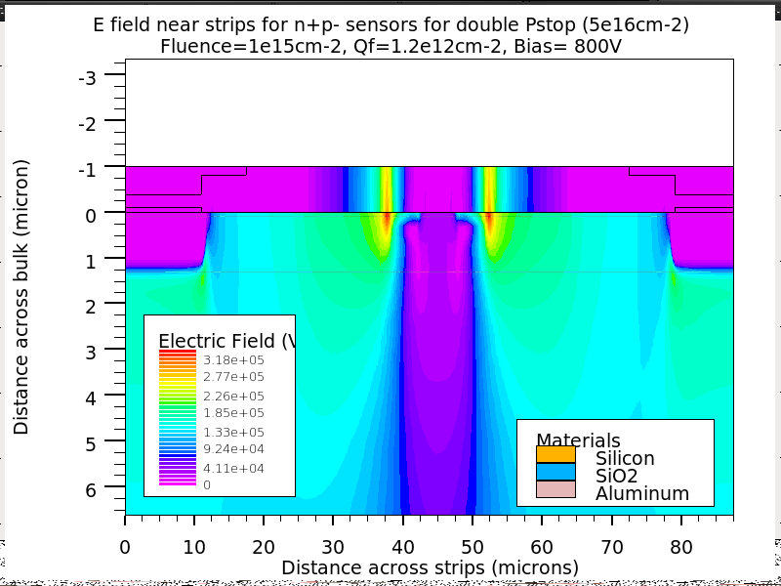
E field contours for double p-stops doping = 5e16cm⁻³

Slide 26
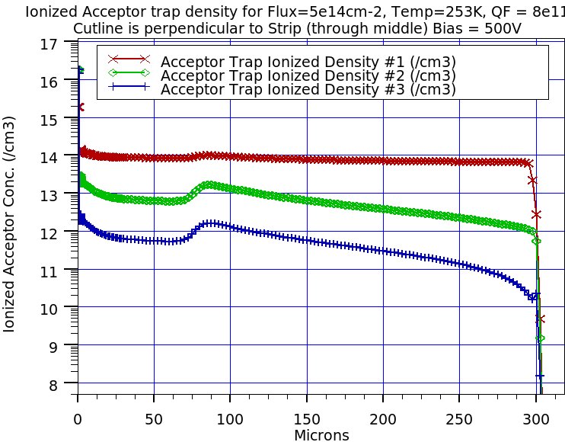
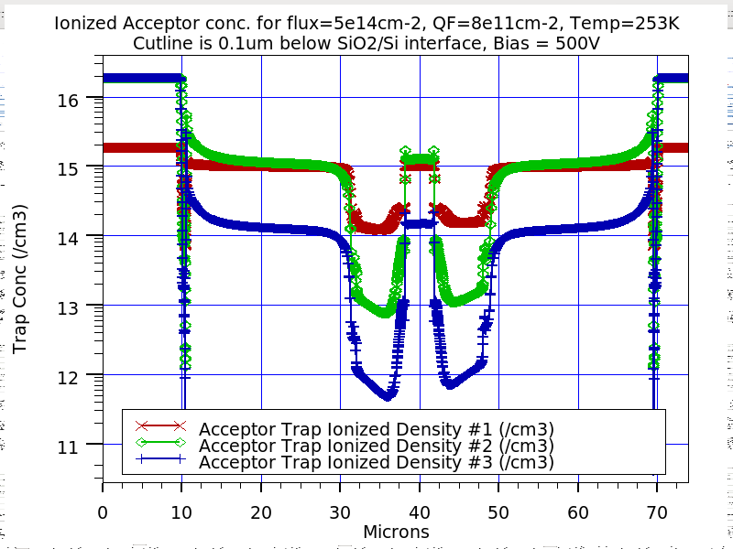
Why two more acceptors with higher introduction rates ? – continue…
Ionized Acceptor trap density inside Si sensor
Ionized Shallow levels (green and blue) are much less compare to deep levels (Red color).
Ionized Acceptors just below SiO2/Si
Interface
In some of the region, Ionized shallow
traps (green and blue) are much more
compare to deep one
Cutline is 0.1 um below SiO2
Cutline is perpendicular to n+ strip
(Through middle)

Slide 27
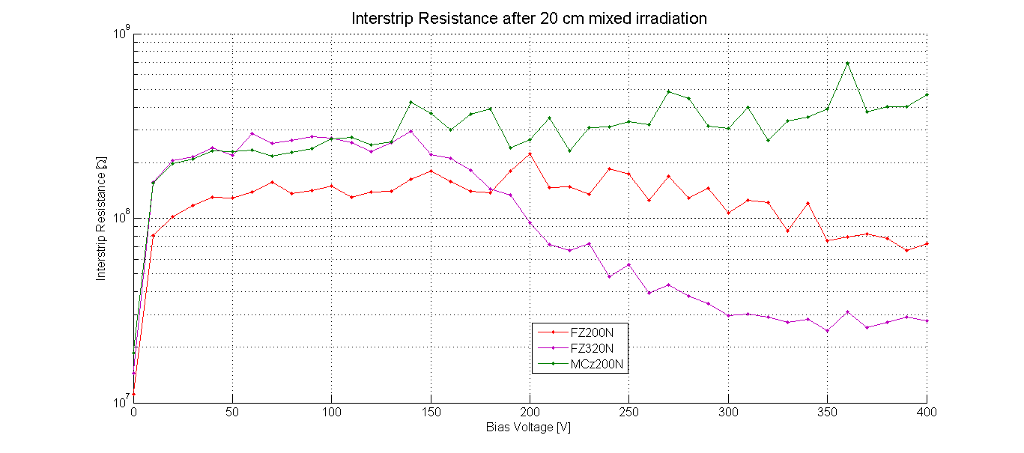
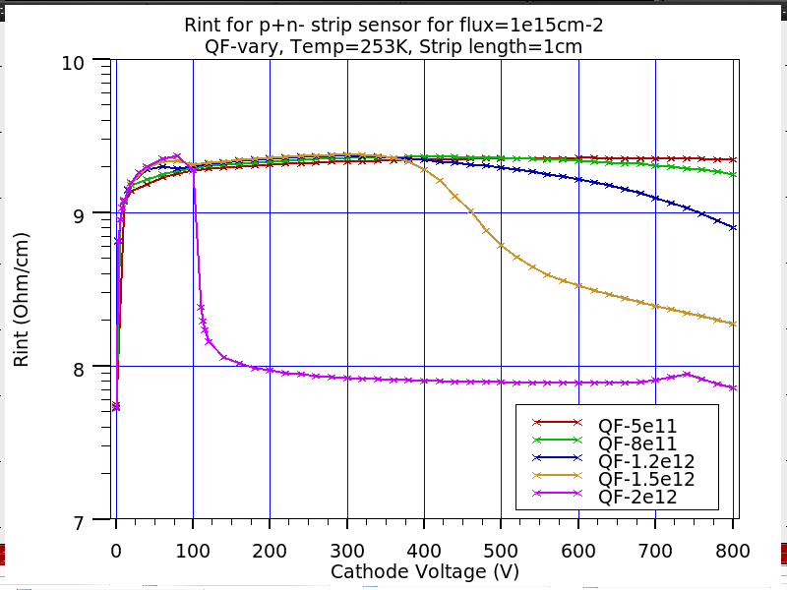
R_{int} vs. V_{bias} (Irradiated) : p+n- strip sensor
Measurement (Wolfgang)
DC-CAP
Simulation (F= 1x10¹⁵ cm⁻²)
Different Structures
N-Type: Different Q_{F}
Isolation remains good for all values of Q_{F}.
  Simulation shows decrease in R_{int} for high values of Q_{F} at high Bias values. Experimentally different structures show similar behavior.
  Electric field near the curvature of p+ strip is quite high & increases with Q_{F} . This high E field can initiate a localized avalanche & can decrease R_{int}

Slide 28
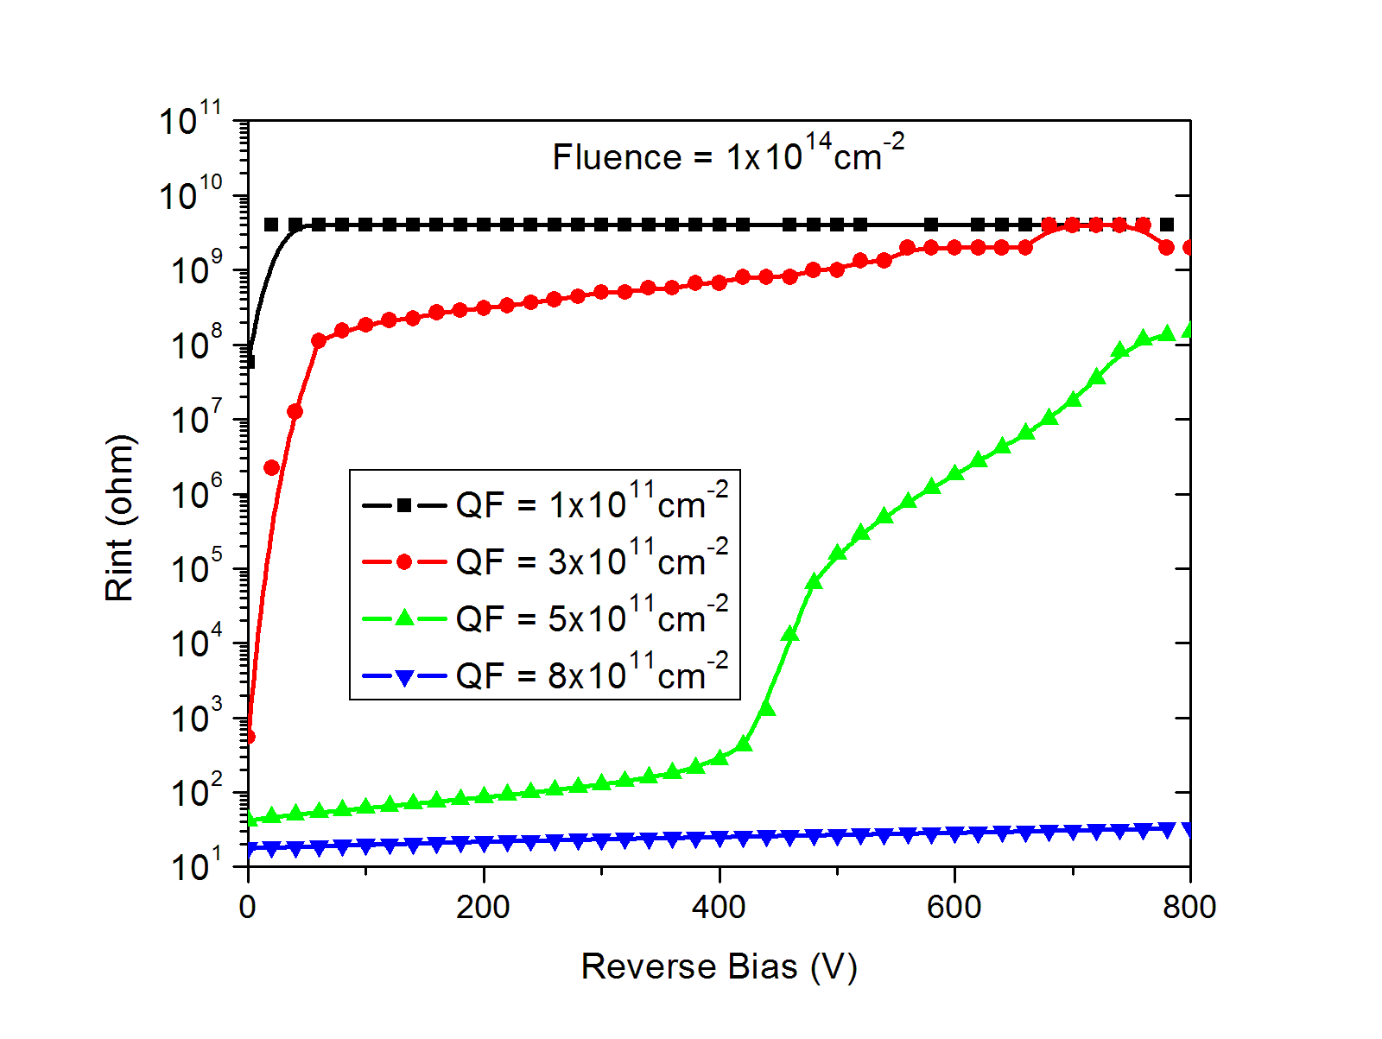
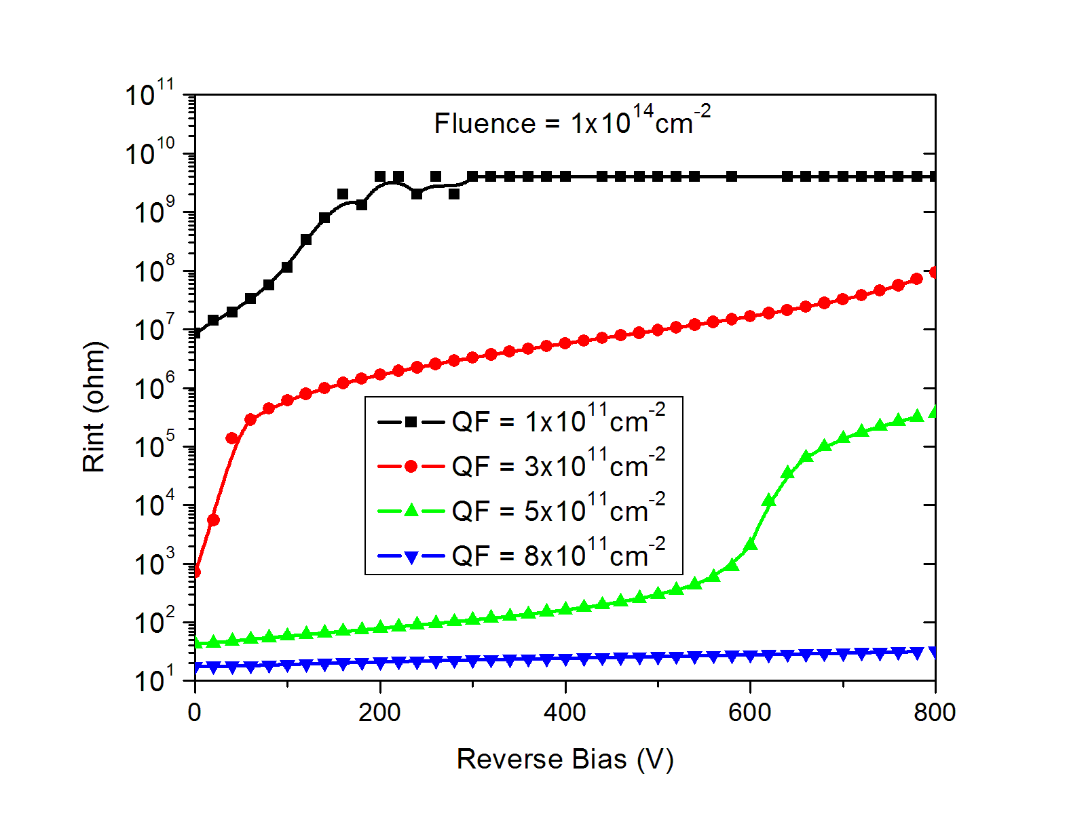
Simulations of Rint for Fluence = 1x10¹⁴neq/cm²
Str. without p-stop
Str. with p-stop
Saturation value of Rint decreases (compare to unirradiated case) with irradiation
Significant improvement in Rint values for higher values of Q_{F}

Slide 29
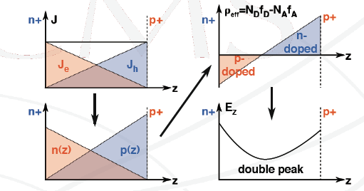
What is going inside hadron irradiated sensors !
Irradiation of n+p-p+ Si sensor by hadrons :
  Acceptor and Donor traps are created
  Deep traps leads to quite higher leakage current
  Electrons move toward n+ strips while holes move toward p+ backside
  Electron density near n+ is very high leading to filling of Acceptor traps and thus creating negative space charge near n+ strip.
  Similarly, positive space charge is created near p+ by filling of Donor traps by holes
High negative space charge near n+ strips result in high E-fields near strips (similar for pixel)
Can we see this….?
Yes by eTCT

Slide 30
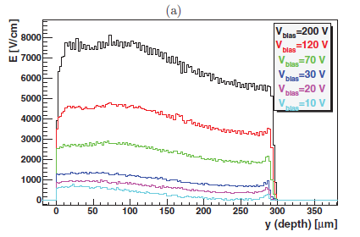
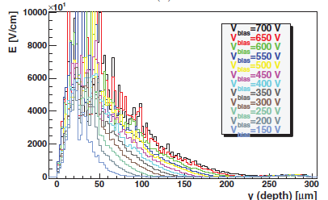
Measurement of E-field in a irradiated Si strip sensor (n+p-)
G. Kramberger et all , 2009, IEEE conference
E field profile for a non-irradiated sensors
<8000V/cm for reverse bias = 200V
E field profile for a irradiated sensors
Can be as high as 80000V/cm, near the strips for reverse bias = 200V !
- Formation of high density negative space charge near n+ strips
(flux=5e14cm⁻²)
- The negative space charge will act as Pspray and increases with irradiation !
Hence, we never had much problem of strip isolations in hadron irradiation expt!

Slide 31
Two type of irradiation
Irradiation with Photons (x-ray and γ-ray irradiation)
- Only surface damage is significant, resulting in very high Q_{F} (see backup slides)
- Leakage current is very low, α is at least three orders lower than hadron irradiation and no effect of annealing (very low bulk damage, M.Moll thesis)
For this type irradiation : No High electric field near strips
- Oxide charge density ~ 2-3x10¹² cm⁻² after irradiation ~ 1MGy (in MOS as well as in strips and pixel sensors), leading to very serious problems for isolation, Cint & breakdown.
Irradiations with Hadrons (p,n or pions irradiations)
- Along with surface damage, significant bulk damage very high leakage current
- This leads to high Electric field or high density of negative space charge near the n+ strips.
- No e⁻ accumulation layer formation ….. No problems for strip isolation, C_{int} etc.
- Measurements using MOS will show expected high Q_{F} as there is no high leakage current, so, no negative space charge near Si/SiO₂ junction (no suppression of Q_{F}).

Slide 32
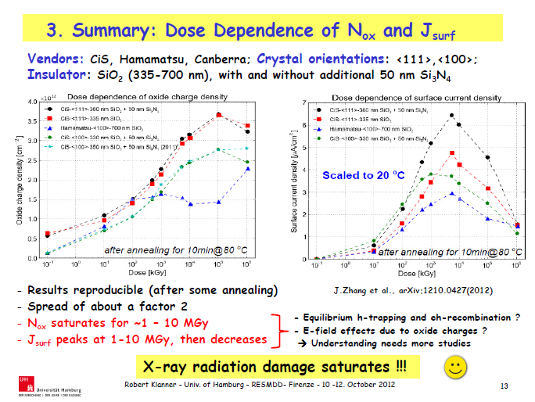

Slide 33
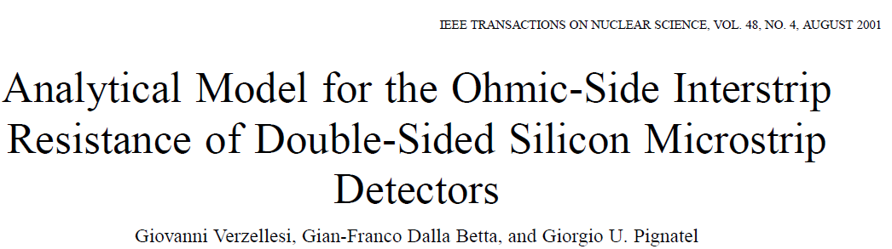
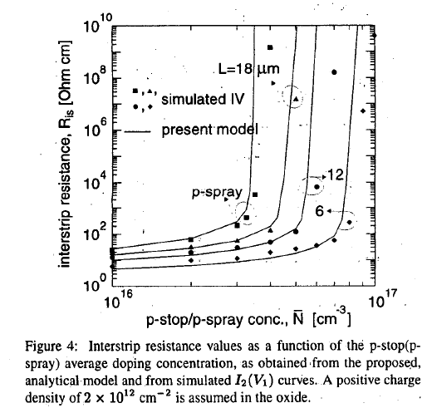
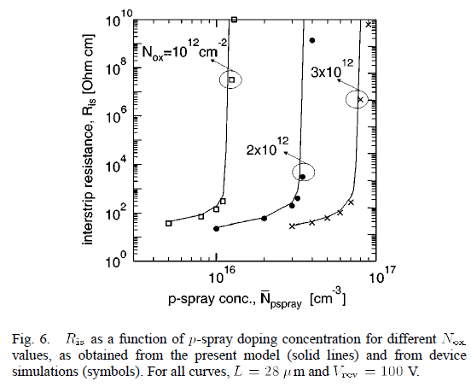

Slide 34
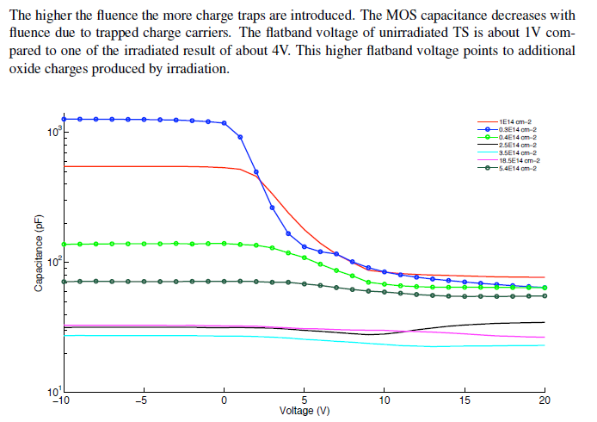
From Maria thesis, MOS measurement

Slide 35
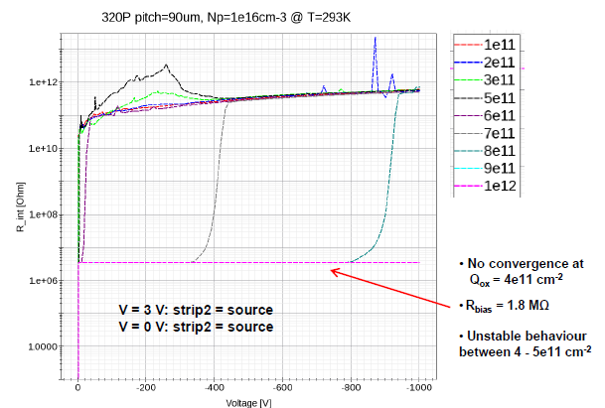
Rint simulations (Timo Peltola)
Pspray doping (1e16cm⁻³) is one
order of magnitude higher then HPK
For QF = 5e11cm⁻², Strip isolation
Was not possible (upto reverse bias
= 400V)
For QF = 1e12 cm⁻², No strip isolation
Even upto 1000V (Though pspray is
10 times denser then HPK pspray)
QF =5e11cm⁻²
QF =1e12cm⁻²

Slide 36
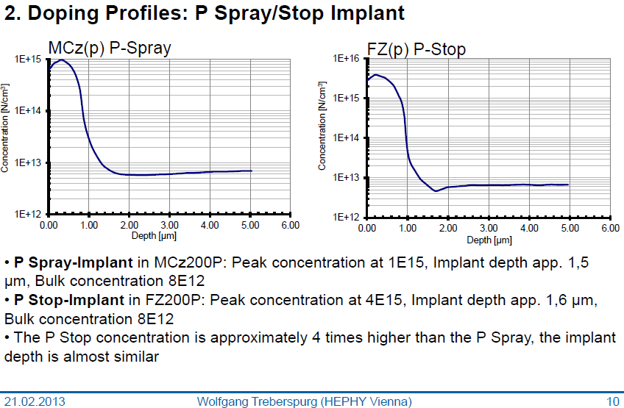
Pspray/Pstop doping profile measurement

Slide 37
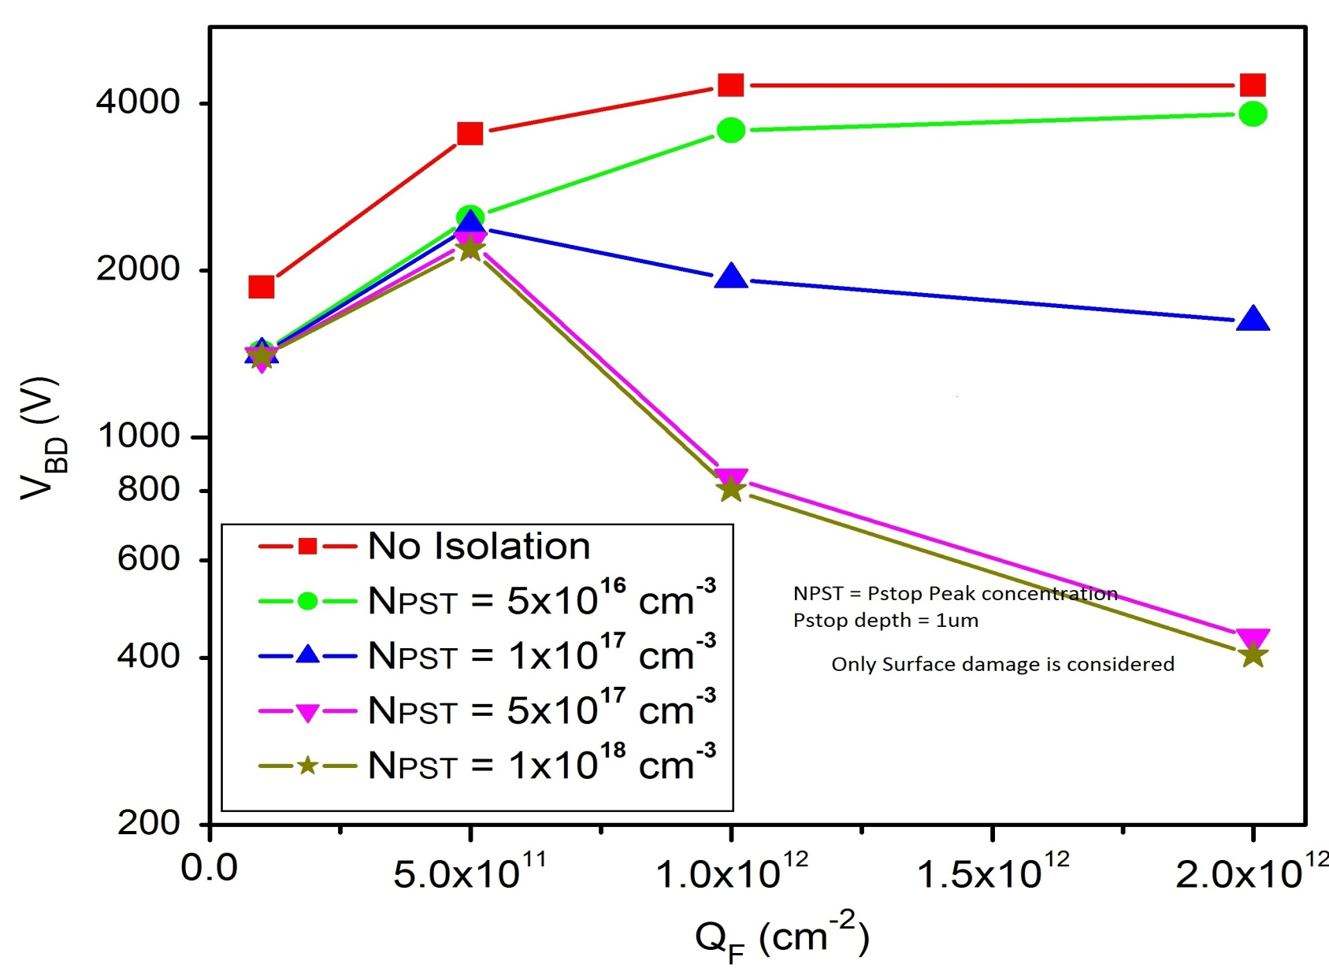
Trend for Vbd for different P-stop doping density
For slightly different n⁺ p⁻ structure

