Slide 1

3D Silicon and 3D Diamond Detectors for Future Upgrades of LHC Experiments
..
Presented by Iain Haughton
Particle Physics
IOP 2014
7-9.04.14

Slide 2
Overview
Motivation
Material Properties
Geometry
Silicon
Diamond
Conclusion

Slide 3
Motivation
LHC Increasing Luminosity
2 x target luminosity
LHC equivalent to 6000 fb^-1
Jose Bernabeu, “Silicon Strip Detectors for the ATLAS HL-LHC Upgrade”.
Expected fluence @ HL-LHC innermost layer: 2E16 1MeV neq/cm^2

Slide 4
Material Properties
Property | Silicon | Diamond
Band Gap (eV) | 1.12 | 5.5
Dielectric Constant | 11.9 | 5.7
Breakdown Field (V/m) | 10⁷ | 10⁷
Thermal Conductivity (Wcm⁻¹k⁻¹) | 1 | 22
Displacement Energy (eV) | 20 | 43

Slide 5
Charge Collection
Silicon
Diamond
p⁺
MIP
p⁺
MIP
h
h
e
e
n⁺

Slide 6
Charge Collection
Radiation Damage
MIP
+
-
+
+
-
+
+
-
-
-
+
+
+
-
+

Slide 7
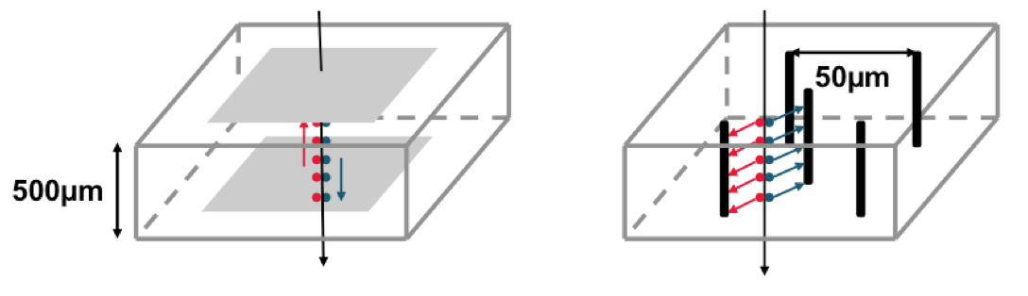
Geometry
Planar
3D
p⁺
MIP
p⁺
n⁺
MIP
p⁺
n⁺
e
h
L
Δ
Δ
e
h
n⁺
L

Slide 8
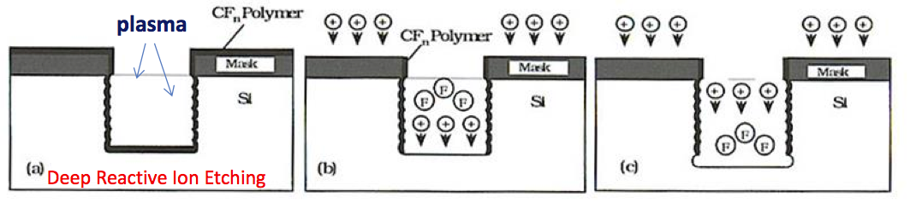
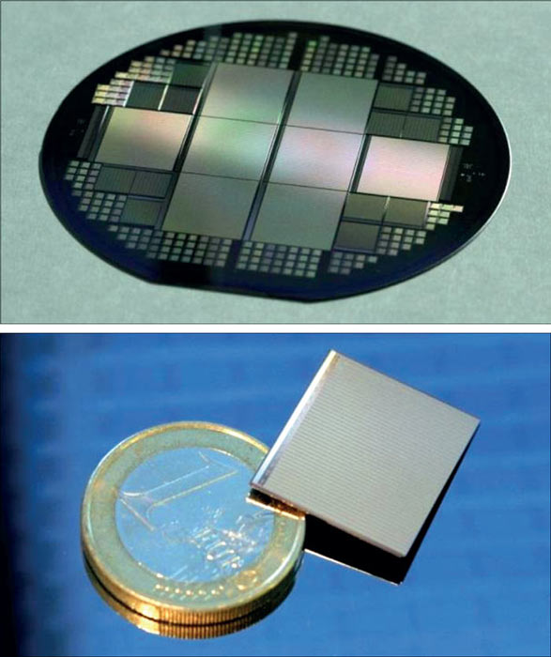
Silicon
3D Silicon Fabrication
1
Wafer cleaning.
Mask production.
Deep Reactive Ion Etching of column holes.
column hole filling with poly silicon.
Introduction n+ and p+ dopants.
Addition of metallisation layer.
2
3
4
5
6

Slide 9
Silicon
3D Silicon for the HL LHC
100μm
p⁺
p⁺
n⁺
50μm
p⁺
p⁺
IES = 56μm
50% signal efficiency
after 2×10¹⁶ 1MeV n_{eq}/cm²

Slide 10

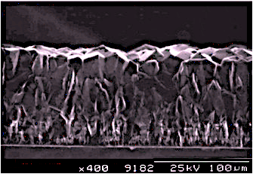
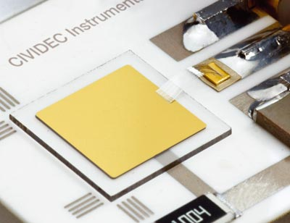
Diamond
Planar Diamond
Single Crystal Diamond
Polycrystalline Diamond
Planar Diamond Detector
ATLAS Diamond Beam Monitor.
To be installed in Phase 0 upgrade.

Slide 11
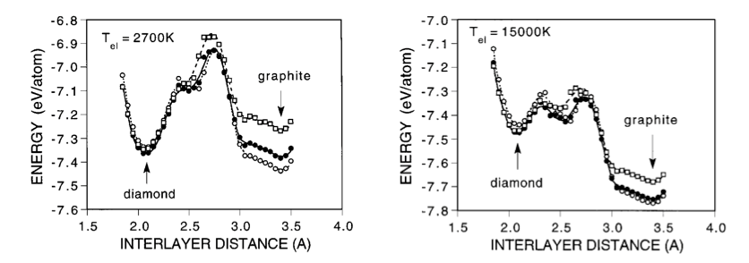
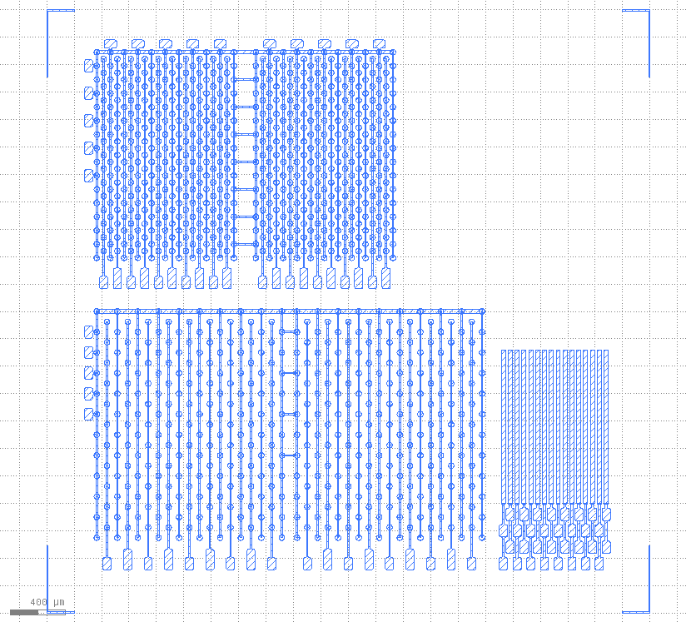
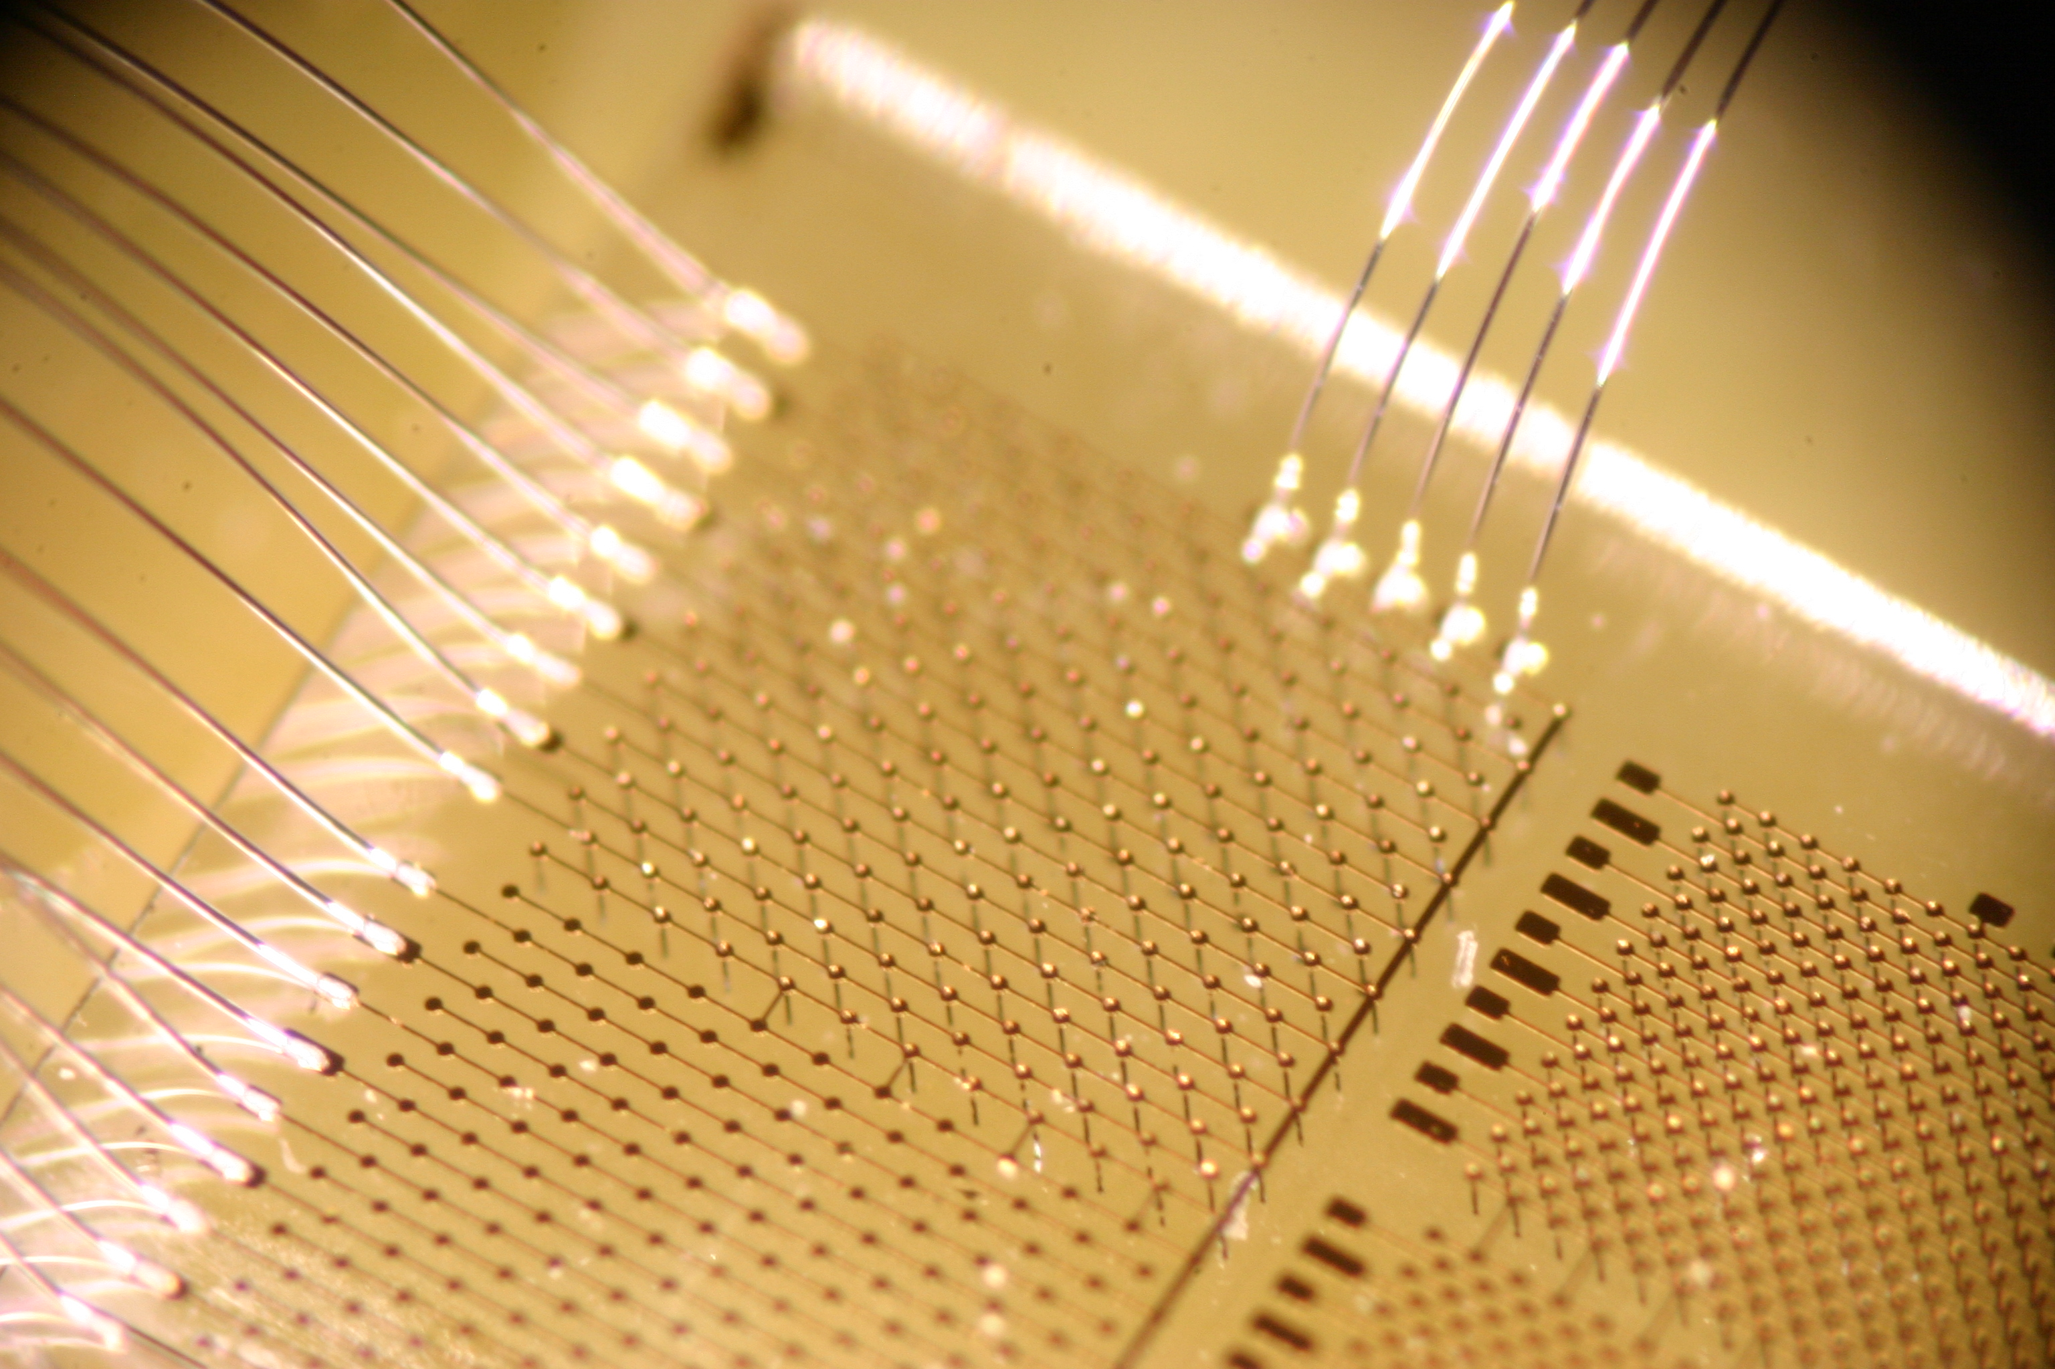
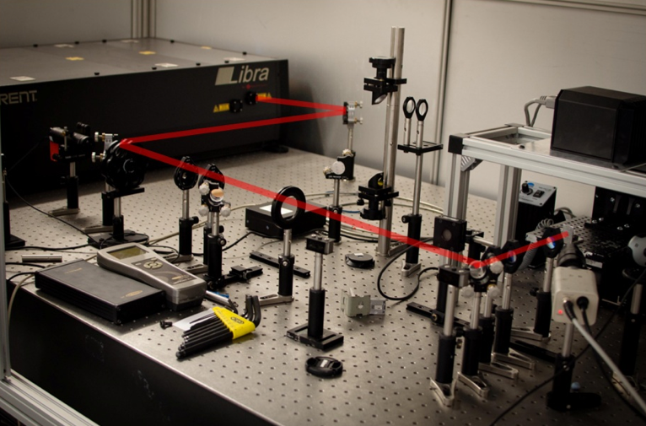
Diamond
3D Diamond Fabrication
1
Wafer cleaning.
Laser drilling of columns.
Addition of metallisation layer.
2
3
fs Laser
2
1
Diamond

Slide 12
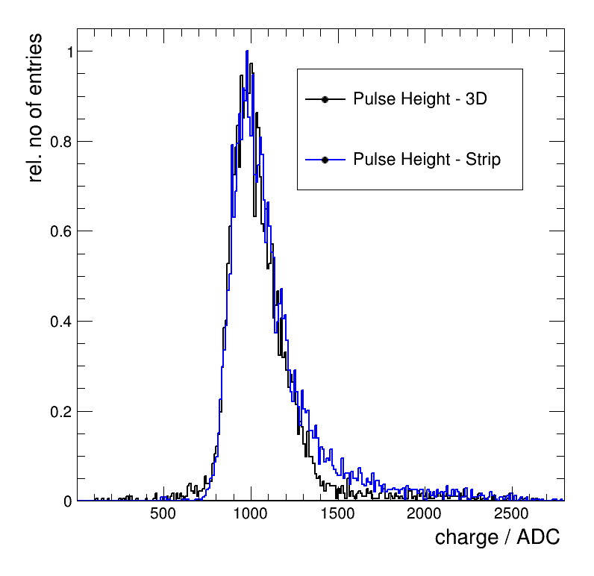
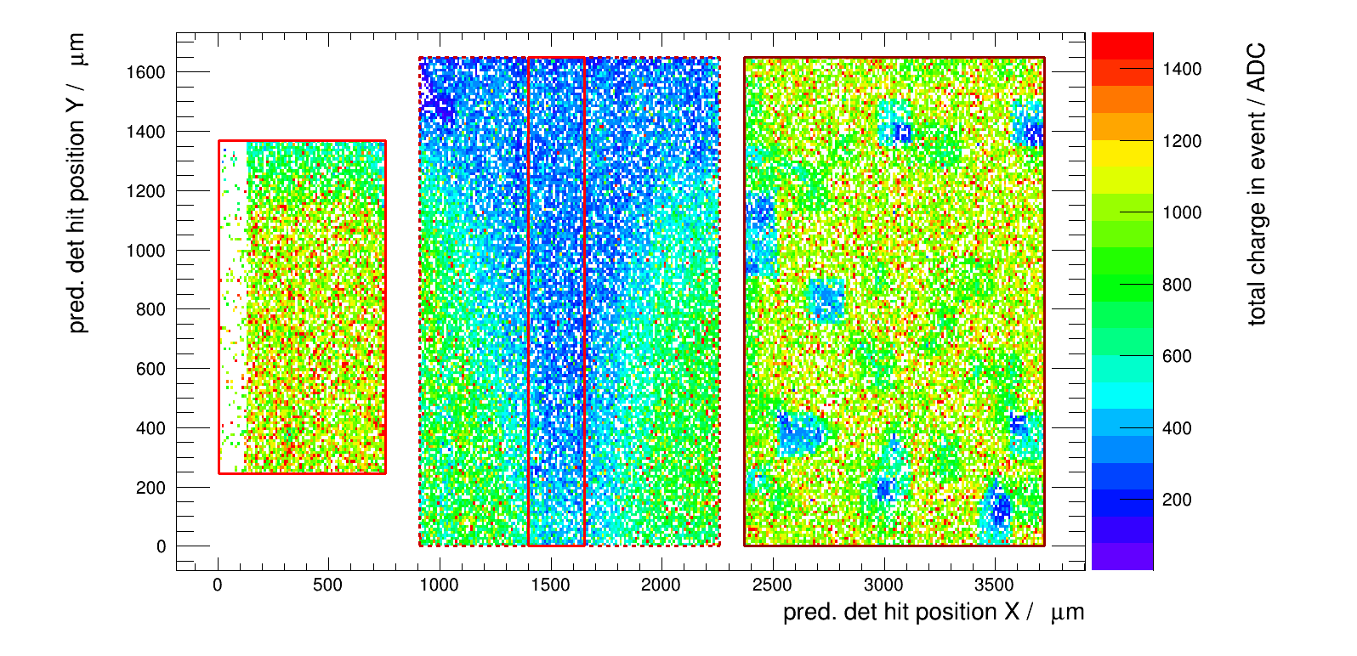
Diamond
Planar versus 3D Diamond

Slide 13
Conclusion
Aim to produce innermost layer detectors → perform after a radiation fluence of 2×10¹⁶ 1MeV n_{eq}/cm², as expected at the HL LHC.
3D Silicon, having been proven for the IBL ATLAS project, is a good candidate.
Trying to apply 3D geometry to other semiconductors, specifically diamond.
Generation of first 3D Diamond prototype using a laser for fabrication. Results are promising.

