Slide 1
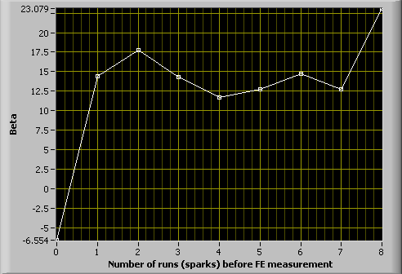
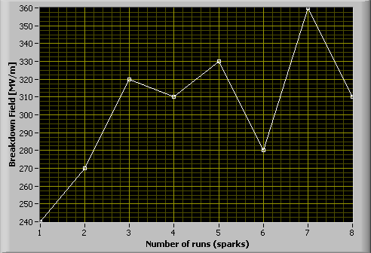
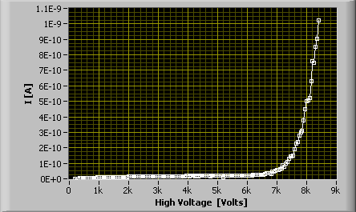
Iridium cathode + copper anode
20um gap (0.75pF)
Beta Evolution measurement
Beta evolution
Field emission (8th run)
Breakdown field evolution

Slide 2
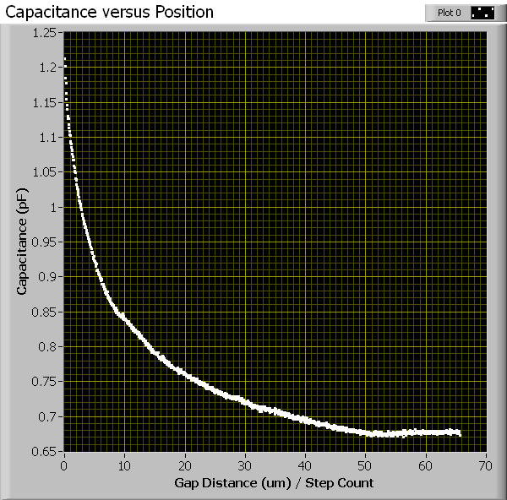
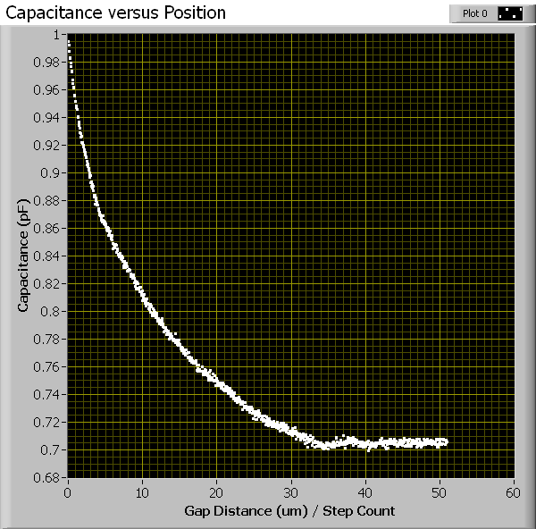
Before breakdowns
After breakdowns

