Slide 1




Sources of « high energy » particles obtained with UHI lasers for nuclear physics applications
Excitations Nucléaires par Laser Group:
M.M. Aléonard, M. Gerbaux, F. Gobet, F. Hannachi, G. Malka, C. Plaisir, J.N. Scheurer, M. Tarisien.
CERN, CLIC meeting - October, 3rd 2008

Slide 2

WARNING
In all the slides to come :
« High energy » is to be understood in the context of plasma and nuclear physics.
As a consequence, this means :
above 10 MeV for electrons or photons
above a few MeV for protons
(you are allowed to smile)

Slide 3
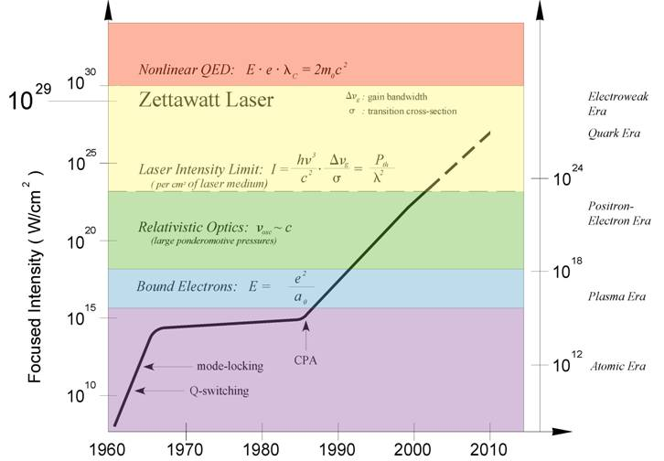
Introduction
Introduction
Accélération de particules
Particle acceleration
Dispositifs expérimentaux (e⁻)
Electron beam characterization
Résultats électrons
Proton beam characterization
Résultats protons
Application to nuclear physics
Application à la physique nucléaire
Conclusion and outlook
Conclusion et perspectives
A brief history…
1960 : laser
1979 : principle of the laser-plasma accelerator
1985 : Chirped Pulse Amplification (CPA)
e⁻ (quelques 10 MeV)
1990’s : Particle acceleration with laser
LASER
p (quelques MeV)
2001 : first experiments of the ENL group at the LOA
γ
2004 :
Creation of particle beams by laser-plasma interaction = well established experimental fact…
…but with an incomplete knowledge, especially in the case of solid targets and at high energies (> a few MeV).

Slide 4
Introduction
Introduction
Accélération de particules
Particle acceleration
Dispositifs expérimentaux (e⁻)
Electron beam characterization
Résultats électrons
Proton beam characterization
Résultats protons
Application to nuclear physics
Application à la physique nucléaire
Conclusion and outlook
Conclusion et perspectives
Outline of the talk
Particle acceleration by laser-plasma interaction and interest for nuclear physics
Electron beam characterization experiments
Proton beam characterization experiments
Application to nuclear physics
Conclusion & outlook

Slide 5
Introduction
Introduction
Accélération de particules
Particle acceleration
Dispositifs expérimentaux (e⁻)
Electron beam characterization
Résultats électrons
Proton beam characterization
Résultats protons
Application to nuclear physics
Application à la physique nucléaire
Conclusion and outlook
Conclusion et perspectives
I
Particle acceleration by laser-plasma interaction and interest for nuclear physics

Slide 6
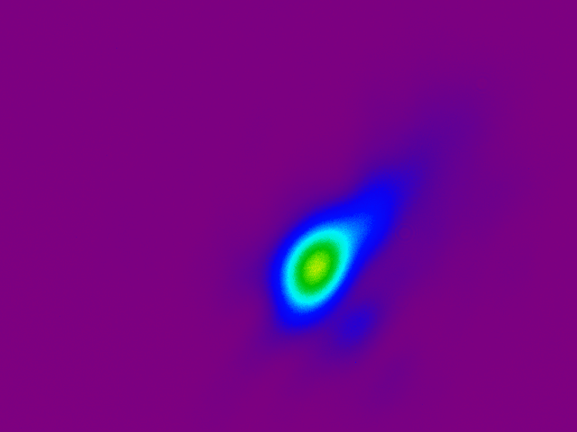
Introduction
Introduction
Accélération de particules
Particle acceleration
Dispositifs expérimentaux (e⁻)
Electron beam characterization
Résultats électrons
Proton beam characterization
Résultats protons
Application to nuclear physics
Application à la physique nucléaire
Conclusion and outlook
Conclusion et perspectives
τ
P
P
To obtain more power high energy and/or short pulses are used.
τ
E : energy in the pulse
τ : pulse duration
0
t
0
t
laser « continu »
laser pulsé
…and to obtain a maximal intensity, the laser beam is focused on the smallest possible surface.
w₀ ∼ μm
w₀ : focal spot radius
Orders of magnitude for the used facilities
Energy | ~ 1 J to ~ 30 J
Duration | a few 10 fs to a few100 fs
Power | a few 10 TW
Intensity | ~ 10¹⁹ W.cm⁻²
Delay between 2 shots | 1 s to 20 min

Slide 7
Introduction
Introduction
Accélération de particules
Particle acceleration
Dispositifs expérimentaux (e⁻)
Electron beam characterization
Résultats électrons
Proton beam characterization
Résultats protons
Application to nuclear physics
Application à la physique nucléaire
Conclusion and outlook
Conclusion et perspectives
I/I_{max}
Pulse
1
I/I_{max}
1
10⁻²
10⁻²
contrast
10⁻⁴
t
-1 ps
0
10⁻⁴
10⁻⁶
Pedestal
Ionization threshold
~10¹² W.cm⁻²
t
-1 ns
0
target
pulse
t = -2 ns
t = -1 ns
t = 0

Slide 8
Introduction
Introduction
Accélération de particules
Particle acceleration
Dispositifs expérimentaux (e⁻)
Electron beam characterization
Résultats électrons
Proton beam characterization
Résultats protons
Application to nuclear physics
Application à la physique nucléaire
Conclusion and outlook
Conclusion et perspectives
The intensity gradient push e⁻ away from the high field zones
⇒ electronic density perturbation
⇒ plasma wave
Intensity
Laser pulse
Amplitude
δn_{e}/n_{e}
Plasma wave
- -
-
- -
-
- -
-
- -
+ + +
+ +
+ + +
+ +
+ + +
+ +
+ + +
- - - -
- - -
- - - -
- - -
- - - -
- - -
- - - -
+ + +
+ +
+ + +
+ +
+ + +
+ +
+ + +
- - - -
- - -
- - - -
- - -
- - - -
- - -
- - - -
+ + +
+ +
+ + +
+ +
+ + +
+ +
+ + +
- - - -
- - -
- - - -
- - -
- - - -
- - -
- - - -
+ + +
+ +
+ + +
+ +
+ + +
+ +
+ + +
- -
-
- -
-
- -
-
- -
z
Plasma wave ⇒ possibility to trap and accelerate electrons

Slide 9
Introduction
Introduction
Accélération de particules
Particle acceleration
Dispositifs expérimentaux (e⁻)
Electron beam characterization
Résultats électrons
Proton beam characterization
Résultats protons
Application to nuclear physics
Application à la physique nucléaire
Conclusion and outlook
Conclusion et perspectives
Electron acceleration
- -
- -
- -
- -
- -
- -
++++
++++
++++
++++
++++
++++
- -
- -
- -
- -
- -
- -
Possibility to accelerate charged particles
in the direction of the laser propagation (up to a few 100 MeV)
In the general case, continuous and decreasing energy distribution
In 3D, diverging beam with ~ gaussienne angular distribution

Slide 10

Introduction
Introduction
Accélération de particules
Particle acceleration
Dispositifs expérimentaux (e⁻)
Electron beam characterization
Résultats électrons
Proton beam characterization
Résultats protons
Application to nuclear physics
Application à la physique nucléaire
Conclusion and outlook
Conclusion et perspectives
Proton and/or ion acceleration
Hydrogen-rich deposit
plasma
Solid target
+
-
e⁻
+
-
+
-
p
+
-
Protons acceleration by the electric field created by the electron sheath
Continuous and decreasing energy distribution

Slide 11
Introduction
Introduction
Accélération de particules
Particle acceleration
Dispositifs expérimentaux (e⁻)
Electron beam characterization
Résultats électrons
Proton beam characterization
Résultats protons
Application to nuclear physics
Application à la physique nucléaire
Conclusion and outlook
Conclusion et perspectives
Specific features of these beams :
Short duration (bunch duration ~ pulse duration ~ ps )
Source size : a few µm²
Large number of particles / pulse (~ 10⁹ electrons above 10 MeV at LOA in 2004)
High current density (~ 10¹³ A.cm⁻²)
Possibility to synchronise several beams (laser and particles)
Experimental difficulties:
Large number of particules in a short time (+ continuous energy distribution)
Shot to shot reproducibility (duration, contrast, energy, focal spot, target surface and position…)
High flux of photons ⇒ no prompt measurement in the target chamber.

Slide 12
Introduction
Introduction
Accélération de particules
Particle acceleration
Dispositifs expérimentaux (e⁻)
Electron beam characterization
Résultats électrons
Proton beam characterization
Résultats protons
Application to nuclear physics
Application à la physique nucléaire
Conclusion and outlook
Conclusion et perspectives
Examples of nuclear physics themes that can make use of laser-plasma interaction :
Nuclear reaction rates in plasmas as a function of their density.
Effect of the atom ionization on nuclear states (cf ¹²⁵Te).
Effect of a strong electromagnetic field on the coupling between the nucleus and the electronic shells (ex : modification of the internal conversion).
…
Electrons
γ
(γ,n) reactions…
(e,e’) scattering
Need metrology of these beams
Protons
(p,γ), (p,n) reactions…
Heavier ions

Slide 13
Introduction
Introduction
Accélération de particules
Particle acceleration
Dispositifs expérimentaux (e⁻)
Electron beam characterization
Résultats électrons
Proton beam characterization
Résultats protons
Application to nuclear physics
Application à la physique nucléaire
Conclusion and outlook
Conclusion et perspectives
II
Electron beam characterization in laser-solid target experiments

Slide 14
Introduction
Introduction
Accélération de particules
Particle acceleration
Dispositifs expérimentaux (e⁻)
Electron beam characterization
Résultats électrons
Proton beam characterization
Résultats protons
Application to nuclear physics
Application à la physique nucléaire
Conclusion and outlook
Conclusion et perspectives
Experimental setup at LOA
Laser characteristics :
Energy on target ~ 1 J
Duration ~ 40 fs
w₀ ~ 3 µm (fwhm)
Number of shots : 10 à 60
Repetition rate ~ 0,5 Hz
Contrast ~10⁻⁶
10 µm thick target
Activation sample(s)
Magnetic dipole
~ 5 m
e⁻
γ
Monitor (= scintillator + PM)
Shielded and collimated
Si diodes
Pb wall
Off-axis
parabola
Laser
Collimator
(Ω = 8.10⁻⁵ sr)
Observables :
Energy deposited by the electrons in the diodes
Number of nuclear reactions in the activation samples
Energy deposited by the γ-rays in the monitor

Slide 15
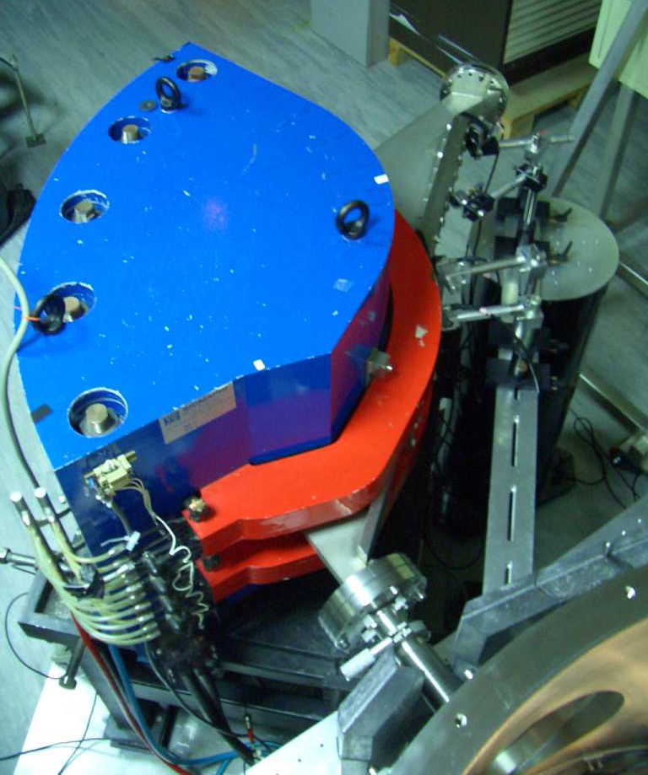
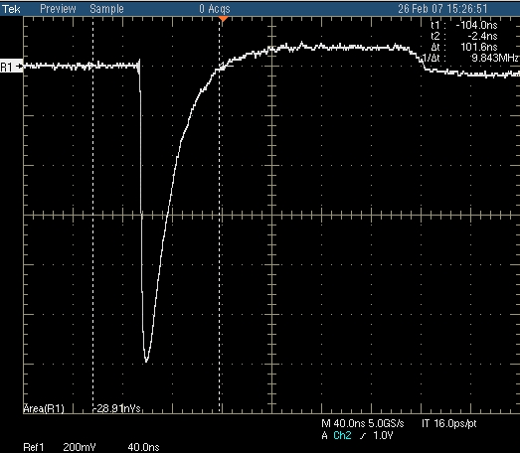
Introduction
Introduction
Accélération de particules
Particle acceleration
Dispositifs expérimentaux (e⁻)
Electron beam characterization
Résultats électrons
Proton beam characterization
Résultats protons
Application to nuclear physics
Application à la physique nucléaire
Conclusion and outlook
Conclusion et perspectives
Spectrometer ⇒ energy distribution on the laser beam axis
Energy deposited in 1 mm of Si (shielded by 0.5 mm of Cu)
Diodes
e⁻ - hole pair creation
+ polarisation of the diode
Electro-
magnet
Collection of a current on an oscilloscope
Photo : thèse de Y. Glinec
Chamber
To trace back to the electron energy distribution, one need to :
know the response of each diode
compute the energy deposited by an electron as a function of its initial energy

Slide 16

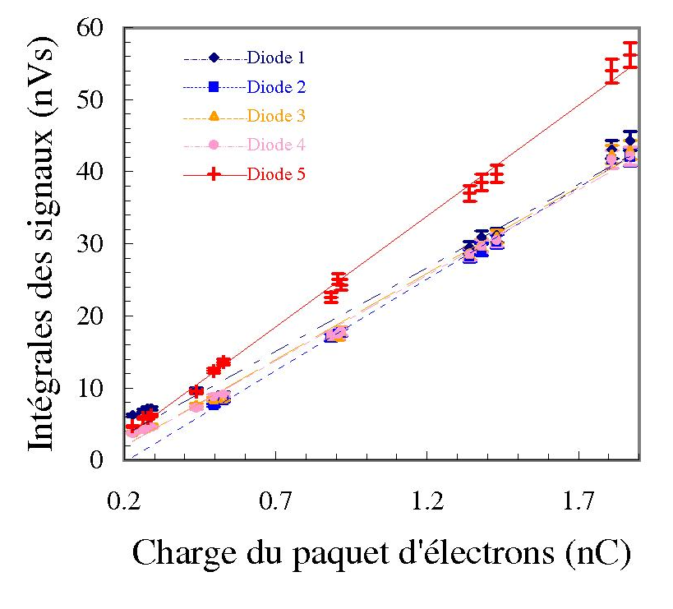
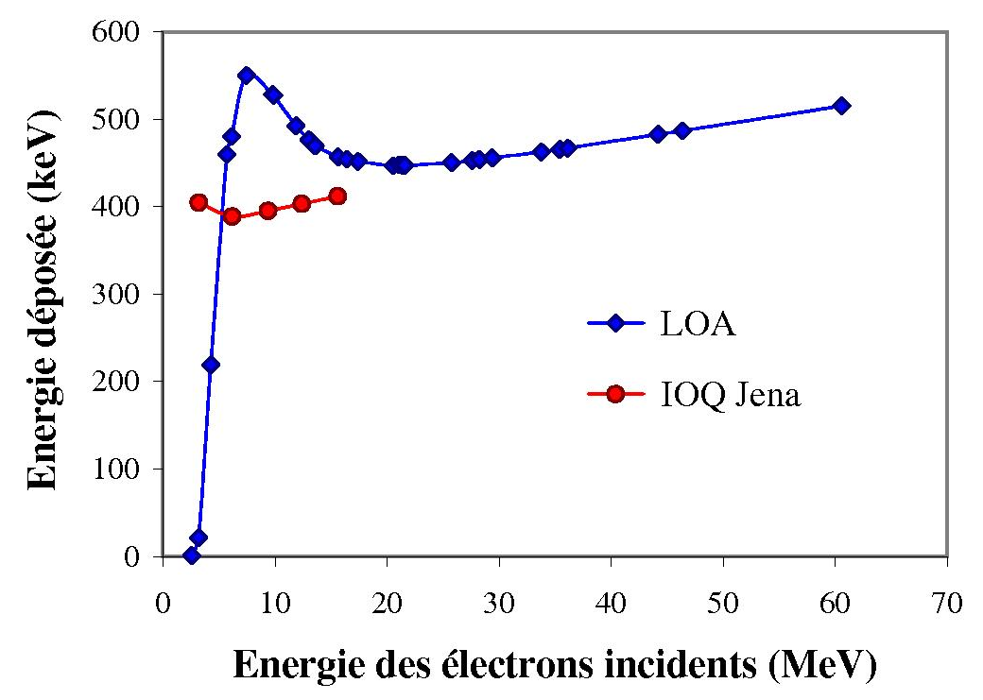
Introduction
Introduction
Accélération de particules
Particle acceleration
Dispositifs expérimentaux (e⁻)
Electron beam characterization
Résultats électrons
Proton beam characterization
Résultats protons
Application to nuclear physics
Application à la physique nucléaire
Conclusion and outlook
Conclusion et perspectives
Response function of the diode
simulations of the deposited energy δE_{Si} in the diodes
Relative calibration of the diodes at ELSA
500 µm Cu
50 µm Al
E(e⁻)=10 MeV
C : integral of the diode signal measured with the oscilloscope
G (=3,66 eV) : mean energy to create an e– hole pair in Si
R : oscilloscope impedance
e (=1,6.10⁻¹⁹ C) : elementary charge

Slide 17
Introduction
Introduction
Accélération de particules
Particle acceleration
Dispositifs expérimentaux (e⁻)
Electron beam characterization
Résultats électrons
Proton beam characterization
Résultats protons
Application to nuclear physics
Application à la physique nucléaire
Conclusion and outlook
Conclusion et perspectives
Electron energy distribution on the laser beam axis
Targets : Al 10 µm
T_{LOA}≈7 MeV
T_{IOQ}≈2,5 MeV
High energy component approximated by a Boltzmann law :
N(E)=N₀e^{-E/T}
with T : « electronic temperature»
(≡ mean energy of the electrons)

Slide 18
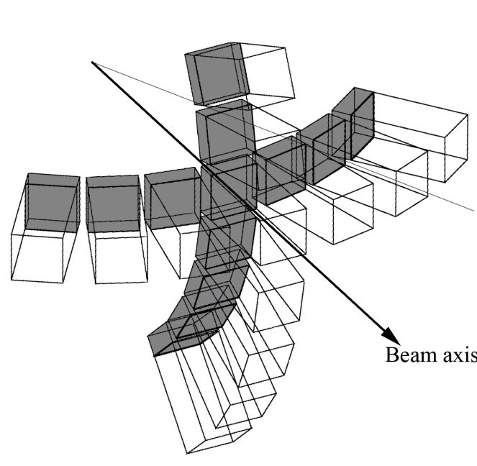
Introduction
Introduction
Accélération de particules
Particle acceleration
Dispositifs expérimentaux (e⁻)
Electron beam characterization
Résultats électrons
Proton beam characterization
Résultats protons
Application to nuclear physics
Application à la physique nucléaire
Conclusion and outlook
Conclusion et perspectives
Ta converter
Activation
sample
Practically, we used natural Cu samples :
⁶³Cu + γ → ⁶²Cu + n and ⁶²Cu → ⁶²Ni + e⁺ + ν_{e}
with T_{1/2}(⁶²Cu) = 9.73 min and E_{threshold} = 9.8 MeV
γ (511 keV)
e⁻
γ
n
Scintillator
Scintillator
γ (511 keV)
β⁺ emitter
Low-background coincidence measurement
(0,9 events / 3 min, without source)
Experimental decay curve of the ⁶²Cu nuclei created by (γ,n) reactions
x
Number of ⁶²Cu decays detected
φ = 0°
Activation sample
+
Simulations of the detection efficiency for a spread ⁶²Cu source
φ = 270°
Nombre de décroissances (en 3 min)
2 mm
≈ 7 mm
φ = 90°
10 mm
1,8 cm
y
5 mm
φ = 180°
⇓
Total number of reactions induced in each sample (sum of all shots)
laser
target
4 mm
2 mm
θ
Temps après le dernier tir laser (min)
+
Monitor data (reproducibility)
Ta converter
Beam axis
⇓
Number of reactions induced in each sample per shot
« Integral activation »
« Angular distribution »

Slide 19
Introduction
Introduction
Accélération de particules
Particle acceleration
Dispositifs expérimentaux (e⁻)
Electron beam characterization
Résultats électrons
Proton beam characterization
Résultats protons
Application to nuclear physics
Application à la physique nucléaire
Conclusion and outlook
Conclusion et perspectives
Number of electrons with an energy above 10 MeV
(activation + spectrometer + )
10
10
?
LOA
10
9
IOQ
10
8
Complex evolution with Z
Disagreement between measurements for the Al targets
Total number of electrons (E>10 MeV)
10
7
10
6
No obvious dependence on Z
10
5
0
10
20
30
40
50
60
70
80
Z
Strong dependence on the laser characteristics
Characteristics | Salle jaune (LOA) | JETI (IOQ)
Energy on target | ~ 1 J | ~ 0,8 J
Pulse duration (FWHM) | 40 fs | 80 fs
Intensity on target | ~ 4.10¹⁹ W.cm⁻² | ~ 2.10¹⁹ W.cm⁻²
Contrast (ns scale) | ~ 10⁻⁶ | ~ 10⁻⁷

Slide 20
Introduction
Introduction
Accélération de particules
Particle acceleration
Dispositifs expérimentaux (e⁻)
Electron beam characterization
Résultats électrons
Proton beam characterization
Résultats protons
Application to nuclear physics
Application à la physique nucléaire
Conclusion and outlook
Conclusion et perspectives
Divergence of the distribution
(activation + spectrometer + )
The width increases together with Z
(to be interpreted)
Full width at half maximum (°)
Measurements with
Radiochromic films (IOQ Jena)
Open question : do the width of the beam depend mainly on…
… the average of fluctuations in the direction of the beam
… the transport of the electrons inside the target
… the generation of the electron beam in the plasma ?
+
+
+
…

Slide 21
Introduction
Introduction
Accélération de particules
Particle acceleration
Dispositifs expérimentaux (e⁻)
Electron beam characterization
Résultats électrons
Proton beam characterization
Résultats protons
Application to nuclear physics
Application à la physique nucléaire
Conclusion and outlook
Conclusion et perspectives
To sum up…
A priori similar laser conditions, very different results
Clear evolution of the beam width with Z
Strong dependence of the number of (γ,n) reactions on the electronic temperature and unpredictable reproducibility.
⇒ Not easy to use for nuclear physics experiments but…
Possible applications :
Nuclear isomeric states excitation by inelastic scattering (e,e’)
Ultrafast radiography using Bremsstrahlung γ-rays
And other applications out of the ENL group activities…

Slide 22
Introduction
Introduction
Accélération de particules
Particle acceleration
Dispositifs expérimentaux (e⁻)
Electron beam characterization
Résultats électrons
Proton beam characterization
Résultats protons
Application to nuclear physics
Application à la physique nucléaire
Conclusion and outlook
Conclusion et perspectives
III
Proton beam characterization experiments (LULI)

Slide 23
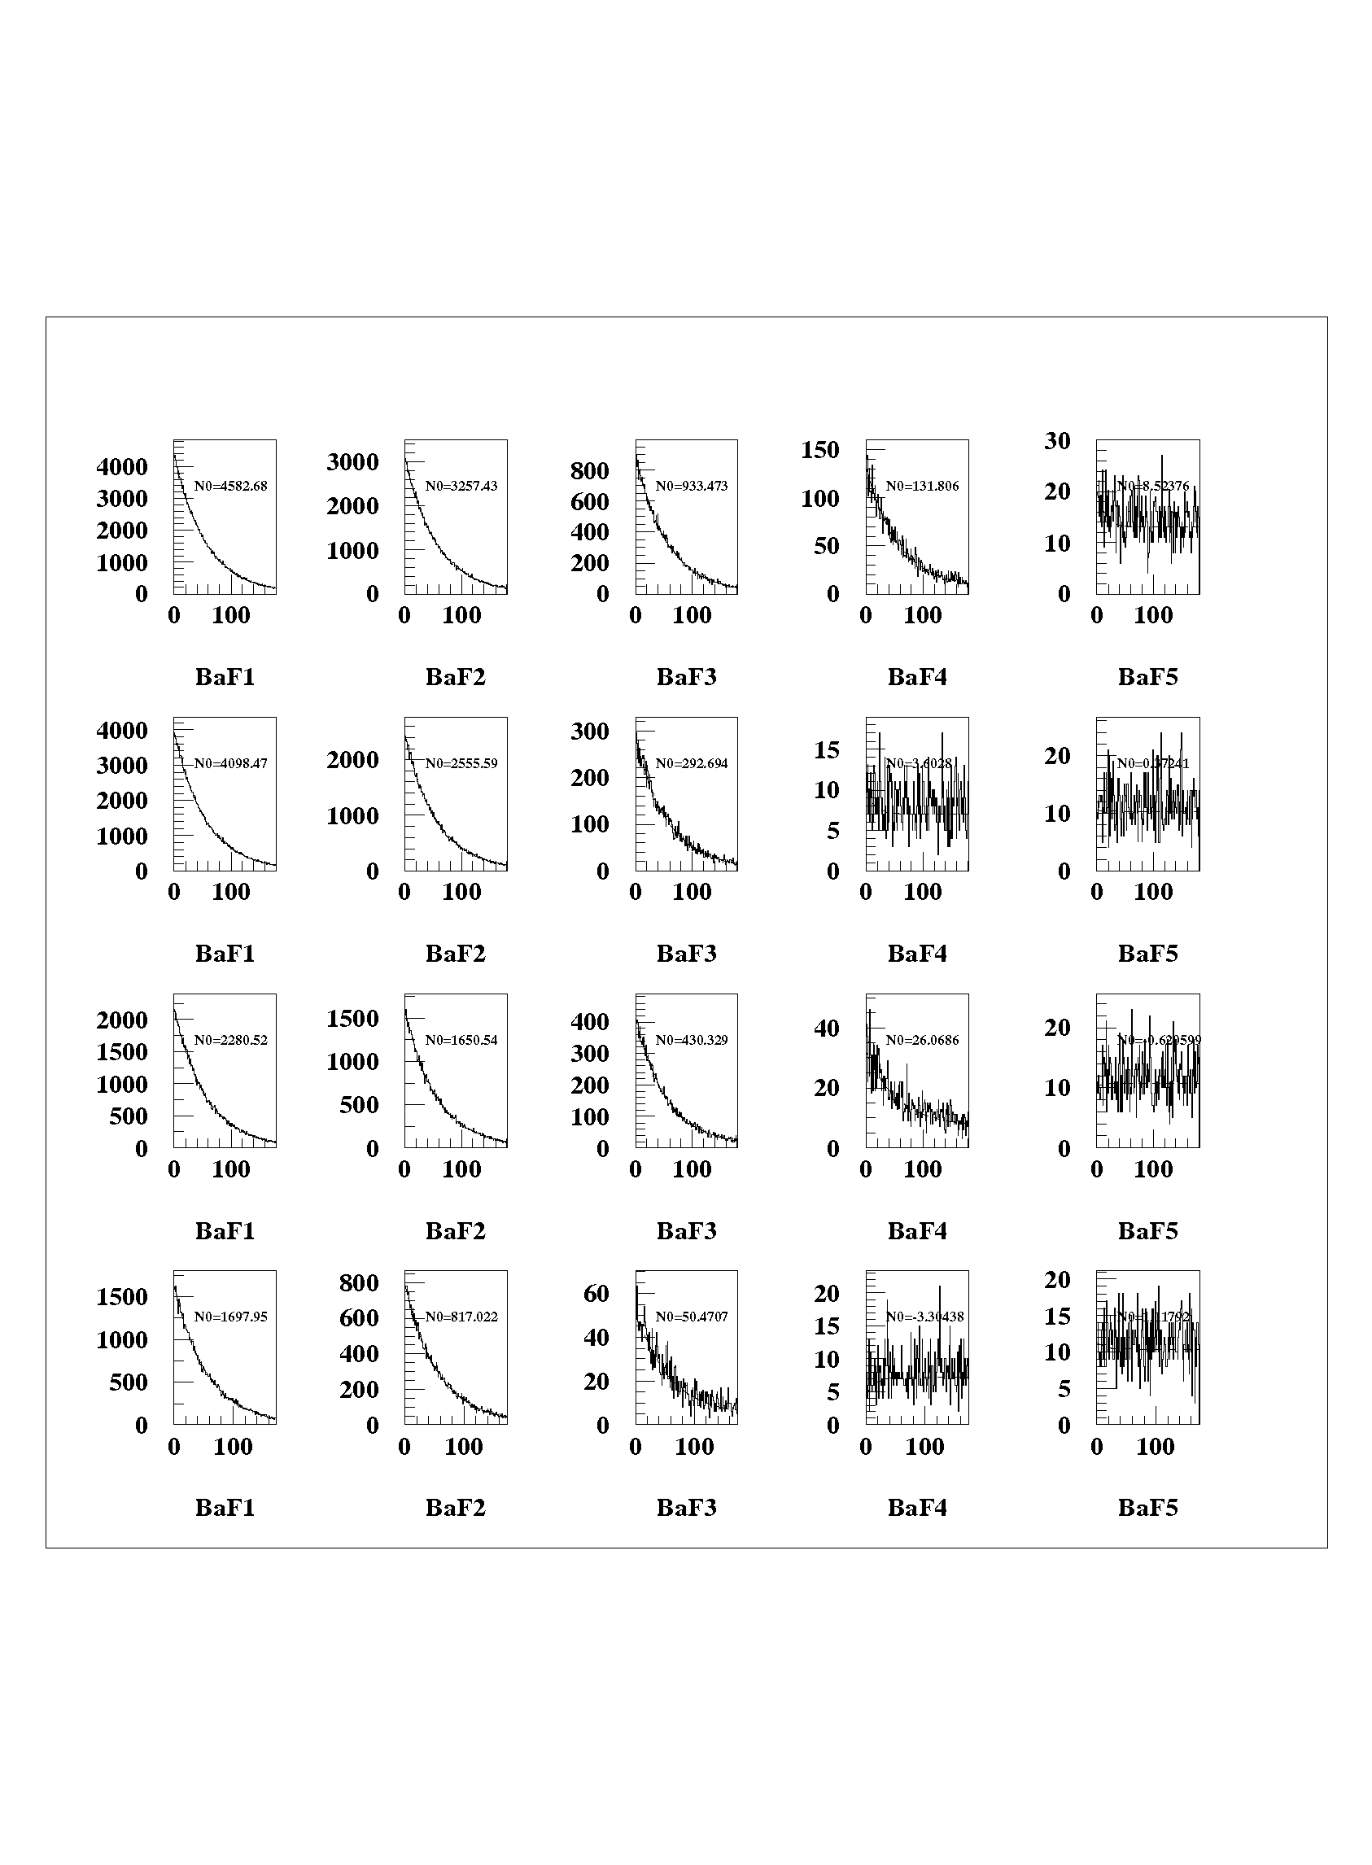
Introduction
Introduction
Accélération de particules
Particle acceleration
Dispositifs expérimentaux (e⁻)
Electron beam characterization
Résultats électrons
Proton beam characterization
Résultats protons
Application to nuclear physics
Application à la physique nucléaire
Conclusion and outlook
Conclusion et perspectives
Cu stack
⁶³Cu + p → ⁶³Zn + n
⁶³Zn → ⁶³Cu + e⁺ + ν_{e}
T_{1/2}(⁶³Zn) = 38.5 min
E_{seuil} = 4 MeV
n
n
Laser
Protons
n
Target
(9 µm thick Al)
50 µm
75 µm
100 µm
100 µm
100 µm
Number of decays
per min
Time (min)

Slide 24
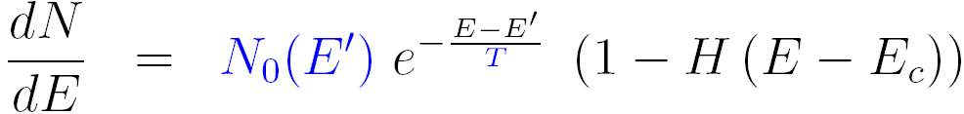
Introduction
Introduction
Accélération de particules
Particle acceleration
Dispositifs expérimentaux (e⁻)
Electron beam characterization
Résultats électrons
Proton beam characterization
Résultats protons
Application to nuclear physics
Application à la physique nucléaire
Conclusion and outlook
Conclusion et perspectives
Simulations (TRIM) of the range of monoenergetic protons in the stack layers
+
Hypothese on the shape of the distribution
+
Number of reactions in each layer of the stack
⇓
Proton distribution
LULI 100 TW
Cible Al 9 µm
Agreement between simulation and experiment tested with the Tandem accelerator at Bruyères le Châtel (protons of 8 and 10 MeV)
Methode usable at high particle flux (no saturation)

Slide 25
Introduction
Introduction
Accélération de particules
Particle acceleration
Dispositifs expérimentaux (e⁻)
Electron beam characterization
Résultats électrons
Proton beam characterization
Résultats protons
Application to nuclear physics
Application à la physique nucléaire
Conclusion and outlook
Conclusion et perspectives
IV
Application to nuclear physics :
blocking of the internal conversion

Slide 26
Introduction
Introduction
Accélération de particules
Particle acceleration
Dispositifs expérimentaux (e⁻)
Electron beam characterization
Résultats électrons
Proton beam characterization
Résultats protons
Application to nuclear physics
Application à la physique nucléaire
Conclusion and outlook
Conclusion et perspectives
Internal conversion (without laser)
Energy
continuum
E_{I}
Photon virtuel
E_{F}
E_{i}
0
0
Nuclear
states
Atomic
states

Slide 27
Introduction
Introduction
Accélération de particules
Particle acceleration
Dispositifs expérimentaux (e⁻)
Electron beam characterization
Résultats électrons
Proton beam characterization
Résultats protons
Application to nuclear physics
Application à la physique nucléaire
Conclusion and outlook
Conclusion et perspectives
Blocking of the internal conversion (with laser)
Energy
continuum
E_{I}
U
Photon virtuel
E_{F}
E_{i}
0
0
Nuclear
states
Atomic
states

Slide 28
Introduction
Introduction
Accélération de particules
Particle acceleration
Dispositifs expérimentaux (e⁻)
Electron beam characterization
Résultats électrons
Proton beam characterization
Résultats protons
Application to nuclear physics
Application à la physique nucléaire
Conclusion and outlook
Conclusion et perspectives
Experimental constraints :
Duration of the laser pulse (to get 10¹⁸ W.cm⁻² with E = 10 J and w₀ = 10 µm) : τ ~ 1 ps
Half-life T_{1/2} of the state to perturb < or ~ τ
Synchronism of the laser and exciter particle beams ~ T_{1/2}
Laser – « classical » accelerator coupling
⇒ « All laser » experiment
Plasma cible
"Plasma" laser
"Particles" target
"Particles“
laser
Exciter particle beam
"strong field" laser
Overlap zone
=
Excited nuclei undergoing a strong field

Slide 29
Introduction
Introduction
Accélération de particules
Particle acceleration
Dispositifs expérimentaux (e⁻)
Electron beam characterization
Résultats électrons
Proton beam characterization
Résultats protons
Application to nuclear physics
Application à la physique nucléaire
Conclusion and outlook
Conclusion et perspectives
Cu stack
300 µm
3 cm
Laser « plasma »
Laser « protons »
Protons
Target 1
(Al 9 µm)
Collector Al 13 µm
Target 2
(Al 13 µm + Cu 210 nm)
The collector is radioactive !
Evidence of nuclear reactions in the plasma
(10700 ± 1800 in this case)

Slide 30
Introduction
Introduction
Accélération de particules
Particle acceleration
Dispositifs expérimentaux (e⁻)
Electron beam characterization
Résultats électrons
Proton beam characterization
Résultats protons
Application to nuclear physics
Application à la physique nucléaire
Conclusion and outlook
Conclusion et perspectives
Next step : add the « strong field »
Cu stack
300 µm
3 cm
« plasma » laser
« protons »
laser
Protons
« strong field»
laser
1st attempt in september 2007 (no blasting of the plasma)
Quantitative measurements to be done with an appropriate target-element (copper is easy to use for the proof of principle but has not the proper nuclear level scheme)

Slide 31
Introduction
Introduction
Accélération de particules
Particle acceleration
Dispositifs expérimentaux (e⁻)
Electron beam characterization
Résultats électrons
Proton beam characterization
Résultats protons
Application to nuclear physics
Application à la physique nucléaire
Conclusion and outlook
Conclusion et perspectives
Conclusion

Slide 32
Introduction
Introduction
Accélération de particules
Particle acceleration
Dispositifs expérimentaux (e⁻)
Electron beam characterization
Résultats électrons
Proton beam characterization
Résultats protons
Application to nuclear physics
Application à la physique nucléaire
Conclusion and outlook
Conclusion et perspectives
Development of a method to characterize electron and/or proton beams based on nuclear activation (efficient at high energy, no saturation problem, transportable from a facility to another)
Complete characterization of the electron beam (above 10 MeV) as a function of the target material.
Important variations in the number of high energy electrons as a function of the laser facility, proton beam easier to use for nuclear physics purposes.
Nuclear reactions induced in the plasma

Slide 33
Introduction
Introduction
Accélération de particules
Particle acceleration
Dispositifs expérimentaux (e⁻)
Electron beam characterization
Résultats électrons
Proton beam characterization
Résultats protons
Application to nuclear physics
Application à la physique nucléaire
Conclusion and outlook
Conclusion et perspectives
Outlook

Slide 34
Introduction
Introduction
Accélération de particules
Particle acceleration
Dispositifs expérimentaux (e⁻)
Electron beam characterization
Résultats électrons
Proton beam characterization
Résultats protons
Application to nuclear physics
Application à la physique nucléaire
Conclusion and outlook
Conclusion et perspectives
Detection method coupling activation and radiochromic films(obtention in one measure of the angular and energy distributions) under way, LULI 100 TW – C. Plaisir PhD thesis
Uncertainty reduction (laser – target interaction reproducibility improvement, target, more realistic modelling …)
Computation of the electron acceleration and transport stages (understanding of the mechanisms governing the beam characteristics as a function of Z)
Modification of the half-life of a nuclear state

Slide 35




Introduction
Introduction
Accélération de particules
Particle acceleration
Dispositifs expérimentaux (e⁻)
Electron beam characterization
Résultats électrons
Proton beam characterization
Résultats protons
Application to nuclear physics
Application à la physique nucléaire
Conclusion and outlook
Conclusion et perspectives
Collaborators
C. Courtois
V. Méot
P. Morel
F. Dorchies
C. Fourment
P. Nicolaï
J. J. Santos
V. Tikhonchuk
K.-U. Amthor
O. Jäckel
J. Polz
S. Pfotenhauer
H. Schwoerer
J. Faure
A. Guemnie Tafo
Y. Glinec
V. Malka
M. Manclossi
P. Audebert
E. Brambrink

Slide 36
Additional slides (just in case)

Slide 37
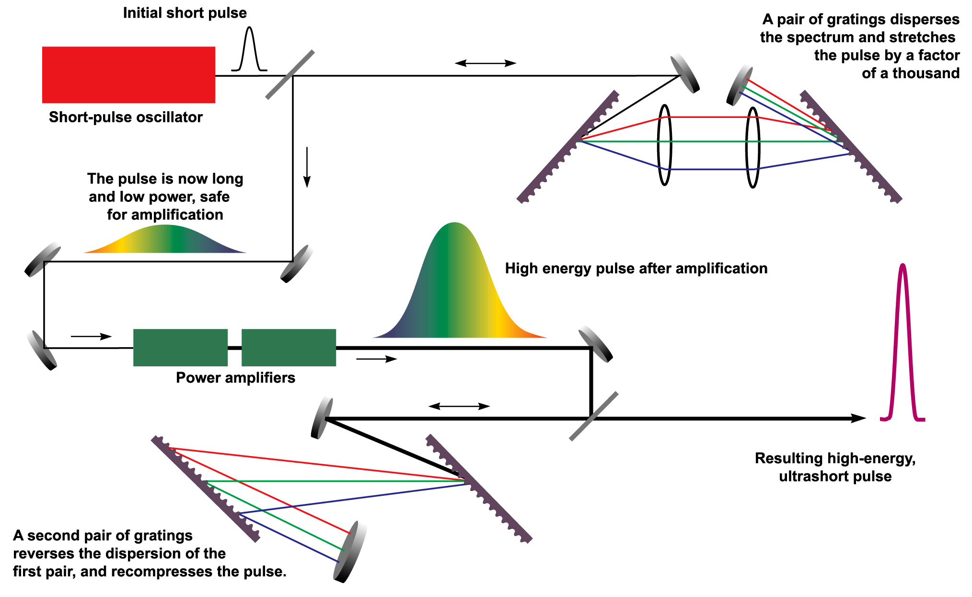
Amplification à dérive de fréquence (CPA)
source : http://en.wikipedia.org/wiki/Chirped_pulse_amplification
Retour

Slide 38
Introduction
Introduction
Accélération de particules
Particle acceleration
Dispositifs expérimentaux (e⁻)
Electron beam characterization
Résultats électrons
Proton beam characterization
Résultats protons
Application to nuclear physics
Application à la physique nucléaire
Conclusion and outlook
Conclusion et perspectives
Which nuclear physics with laser-induced plasmas ?
Warm and dense PLASMA
Strong electric and magnetic fields: >10¹¹ V/cm, 1000 T
Free electrons
Bound electrons
Modification of the…
binding energies
nucleus – electronic shells coupling
Charged particles aceleration
High energy photons production
Ultra-short particle sources
Nuclear Excitation by Electron Transition (NEET) ?
Nuclear excitation and reaction rates modification
in the plasma ?
Modification of the nucleus decay modes ?
38

Slide 39
Interactions du noyau avec son cortège électronique

Slide 40
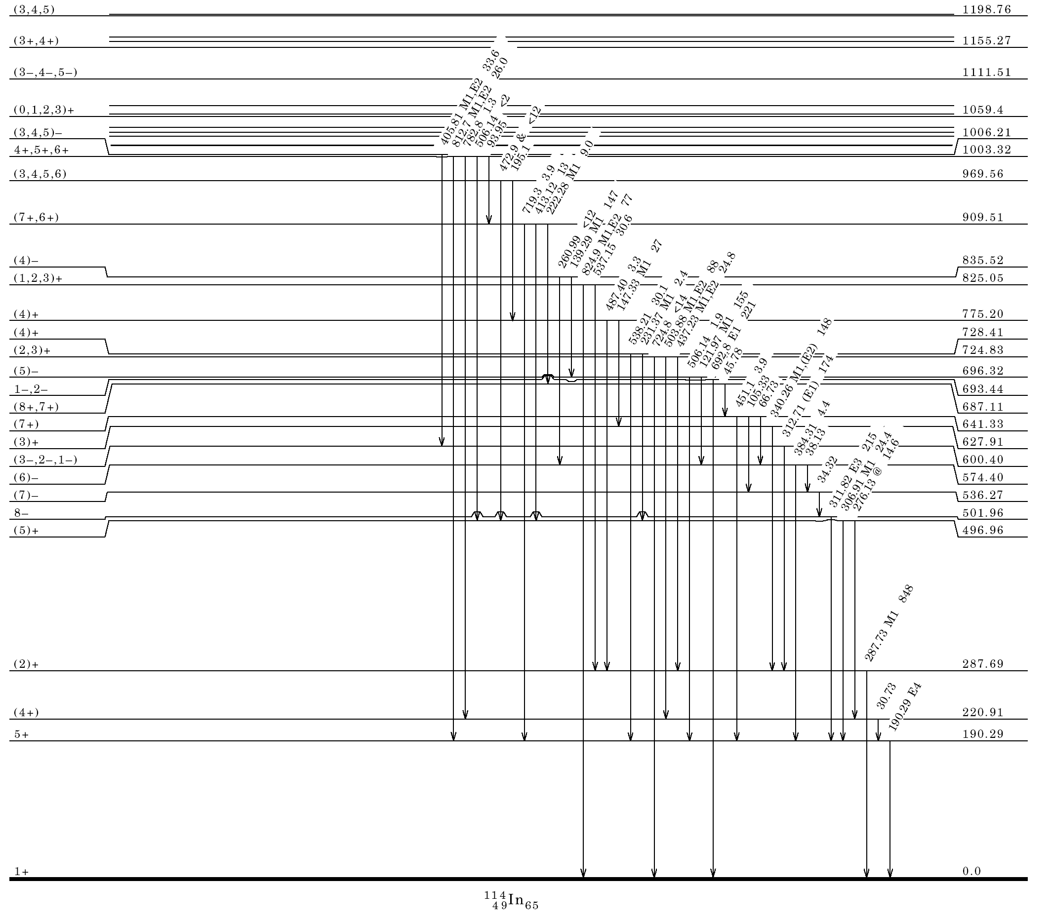
Effet sur le peuplement du niveau isomérique T = 43,1 ms de ¹¹⁴In, produit par ¹¹⁴Cd(p,n)
Transition radiative
Conversion interne
(+ transition radiative)
43,1 ms
Eγ=311,8 keV
49,51 j
71,9 s
¹¹⁴In
Q_{β‾} = 1,89 MeV
¹¹⁴Sn

Slide 41
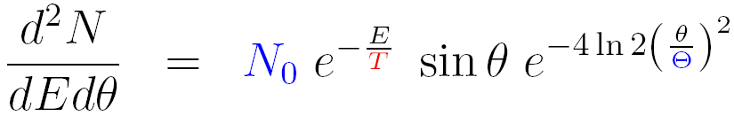


Introduction
Introduction
Accélération de particules
Particle acceleration
Dispositifs expérimentaux (e⁻)
Electron beam characterization
Résultats électrons
Proton beam characterization
Résultats protons
Application to nuclear physics
Application à la physique nucléaire
Conclusion and outlook
Conclusion et perspectives
Analysis hypothesis :
Gaussian angular distribution
Energy distribution independent from the emission angle θ
Relative number of (γ,n) reactions in each sample
(angular distribution)
Temperature T
(electron spectrometer)
γ
θ
Hypothesis
(tracking of the electrons in the angular distribution geometry)
χ² minimization
FWHM Θ (electrons)

Slide 42
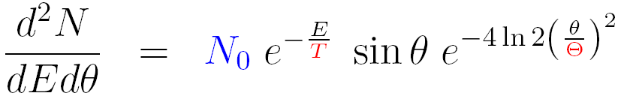
Introduction
Introduction
Accélération de particules
Particle acceleration
Dispositifs expérimentaux (e⁻)
Electron beam characterization
Résultats électrons
Proton beam characterization
Résultats protons
Application to nuclear physics
Application à la physique nucléaire
Conclusion and outlook
Conclusion et perspectives
Temperature T
+
FWHM Θ
Absolute number of (γ,n) reactions in the sample
(integral activation)
(tracking of the electrons in the integral geometry)
Total number of electrons above 10 MeV
⇒ Complete knowledge of the electron beam above 10 MeV

Slide 43
Introduction
Introduction
Accélération de particules
Particle acceleration
Dispositifs expérimentaux (e⁻)
Electron beam characterization
Résultats électrons
Proton beam characterization
Résultats protons
Application to nuclear physics
Application à la physique nucléaire
Conclusion and outlook
Conclusion et perspectives
What about reproducibility (example of the LOA) ?
10
CH
10
Cu
9
9
8
8
7
7
6
6
Nombre d'occurences
Nombre d'occurences
5
5
4
4
3
3
2
2
1
1
0
0
0
0.4
0.8
1.2
1.6
2
2.4
2.8
3.2
3.6
4
4.4
4.8
5.2
5.6
6
0
0.4
0.8
1.2
1.6
2
2.4
2.8
3.2
3.6
4
4.4
4.8
5.2
5.6
6
Amplitude du signal NaI (V)
Amplitude du signal NaI (V)
30
Good reproducibility
Al
18
Poor reproducibility
Au
25
16
14
20
12
10
Nombre d'occurences
Nombre d'occurences
15
8
10
6
5
4
2
0
0
0.4
0.8
1.2
1.6
2
2.4
2.8
3.2
3.6
4
4.4
4.8
5.2
5.6
6
0
0
0.4
0.8
1.2
1.6
2
2.4
2.8
3.2
3.6
4
4.4
4.8
5.2
5.6
6
Amplitude du signal NaI (V)
Amplitude du signal NaI (V)
The interaction is not always reproducible, depending on criteria difficult to control…
This is taken into account in the error bars calculation
→
Number of reactions induced in each sample per shot

Slide 44
Mesure de température à 0° (cibles de 10 µm)
20
)
IOQ
MeV
LOA
Les barres d’erreur dépendent de l’accord entre l’ajustement et les données expérimentales
15
Batani et al.
(
?
10
Température
5
Grande différence de températures entre le LOA et l’IOQ
0
0
20
40
60
80
Z
Caractéristiques | Salle jaune (LOA) | JETI (IOQ)
Energie sur cible | ~ 1 J | ~ 0,8 J
Durée de l’impulsion (FWHM) | 40 fs | 80 fs
Intensité sur cible | ~ 4.10¹⁹ W.cm⁻² | ~ 2.10¹⁹ W.cm⁻²
Contraste (ns) | ~ 10⁻⁶ | ~ 10⁻⁷

Slide 45
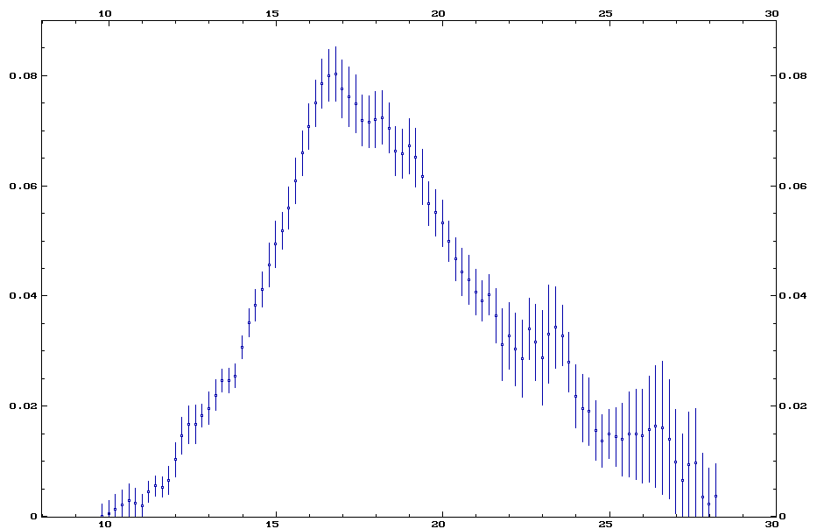
Section efficace (γ,n)
Section efficace (barns)
Energie (MeV)

Slide 46
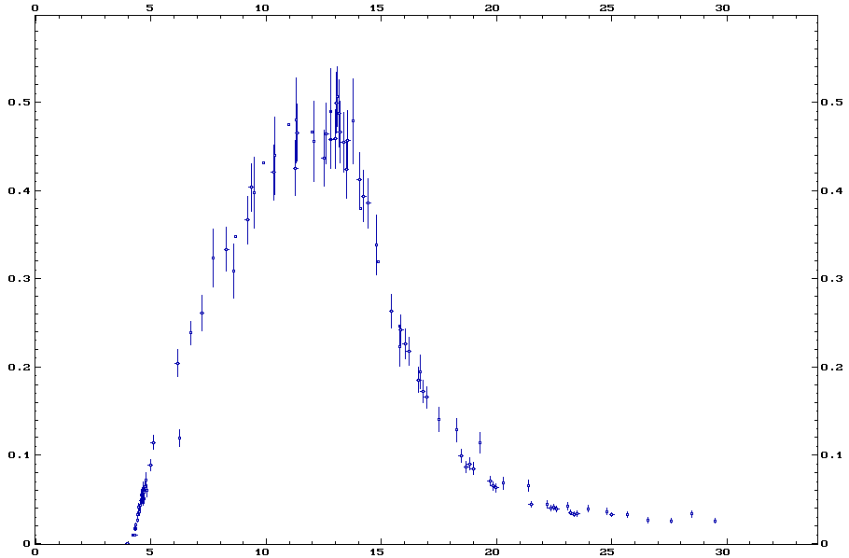
Section efficace (p,n)
Section efficace (barns)
Energie (MeV)

Slide 47
Schéma du dispositif expérimental à l’IOQ
Caractéristiques laser :
Energie sur cible ~ 0,8 J
Durée ~ 80 fs
w₀ ~ 2 µm (fwhm)
Nombre de tirs : 10 à 300
Cadence ~ 0,4 Hz
Contraste ~ 10⁷
Parabole
hors -axe
Laser
Cible 10 µm
Potence
de rotation
Murs de Pb
Empilement RCF
(ou échantillons d’activation)
Collimateur
Al 20 µm
→
Cu 2 mm
B
Cu 2 mm
Spectromètre à
champ permanent
Cu 1 mm
Cu 1 mm
Cu 1 mm
Al 20 µm
MD-55
MD-55
Moniteur
HD-810
Observable supplémentaire :
Densité optique des films
MD-55
e⁻
HD-810
HD-810

Slide 48
Distributions en énergie IOQ
)
)
)
)
-1
-1
-1
10
-1
10
10
10
.sr
10
.sr
10
.sr
10
CH 10 µm
.sr
10
Al 10 µm
-1
Ag 10 µm
-1
Au 10 µm
-1
-1
9
9
9
9
10
10
10
10
Nombre d'électrons (MeV
Nombre d'électrons (MeV
Nombre d'électrons (MeV
Nombre d'électrons (MeV
8
8
8
8
10
10
10
10
7
7
7
7
10
10
10
10
0
5
10
15
20
0
5
10
15
20
0
5
10
15
20
0
5
10
15
20
Energie (MeV)
Energie (MeV)
Energie (MeV)
Energie (MeV)
-1
)
10
10
-1
)
10
10
-1
)
10
10
.sr
Ti 10 µm
.sr
Ti 10 µm
.sr
Au 10 µm
-1
-1
-1
10
9
10
9
10
9
Nombre d'électrons (MeV
Nombre d'électrons (MeV
Nombre d'électrons (MeV
10
8
10
8
10
8
10
7
10
7
10
7
0
5
10
15
20
0
5
10
15
20
0
5
10
15
20
Energie (MeV)
Energie (MeV)
Energie (MeV)

Slide 49
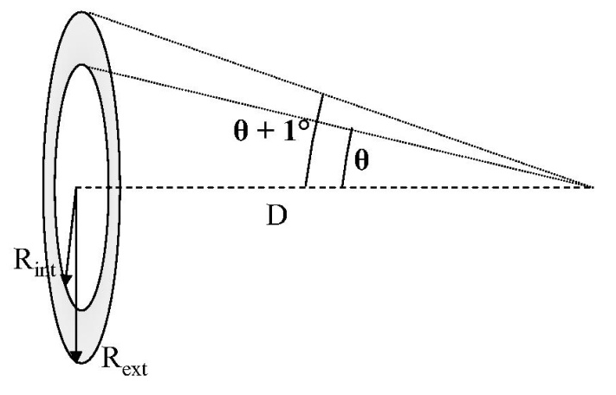
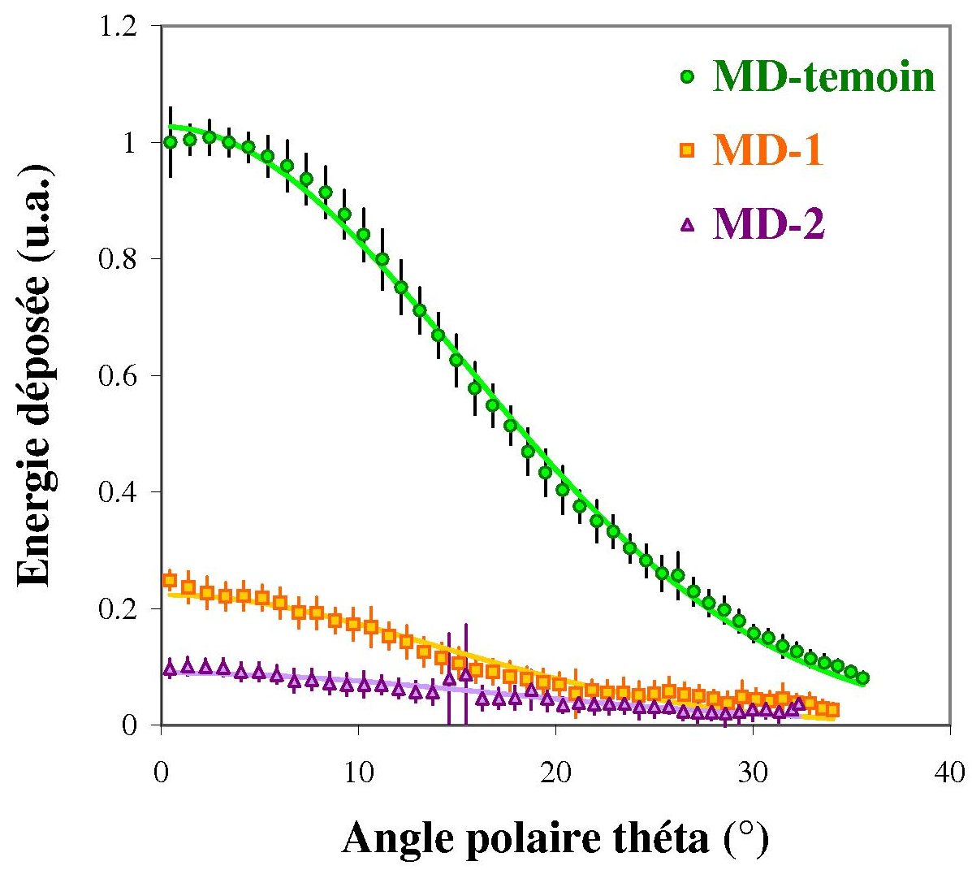
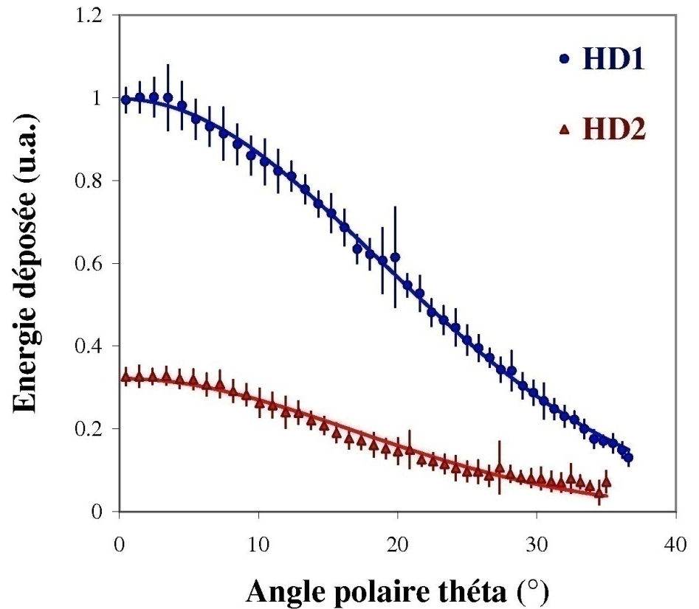
Energie déposée dans les RCF (IOQ)
Ajustements gaussiens

Slide 50
Analyse des RCF (IOQ)
1re étape : dépendance de T avec θ à א₀ constant
2ème étape : dépendance de א₀ avec θ
⇒

Slide 51
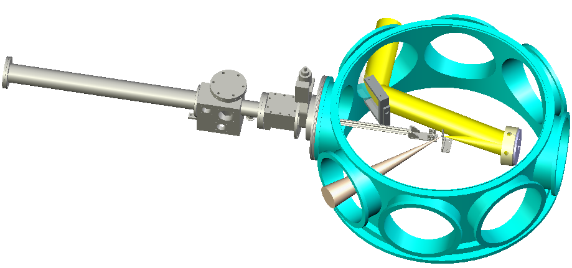
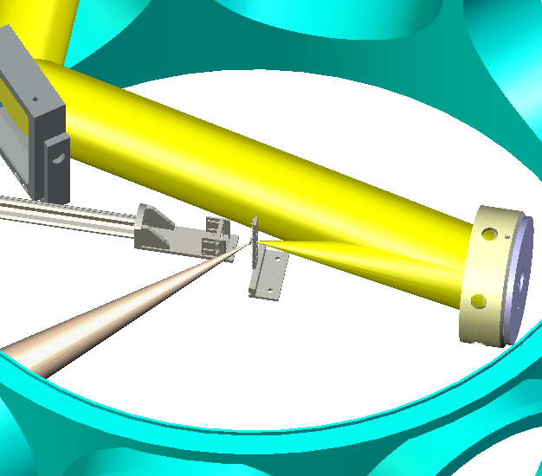
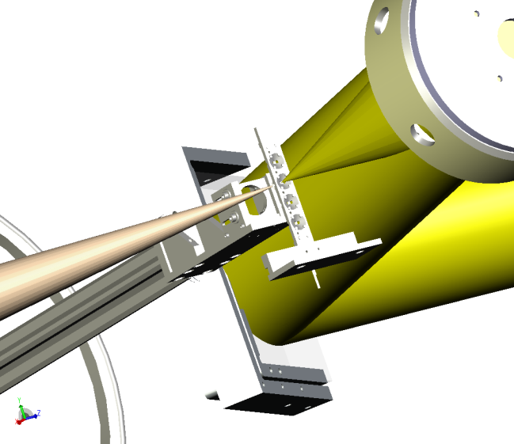
Expérience LULI
Enceinte du bras motorisé
Parabole de
focalisation
Porte-cible
Faisceau « protons »
Faisceau
« plasma »
Support de l’empilement

Slide 52
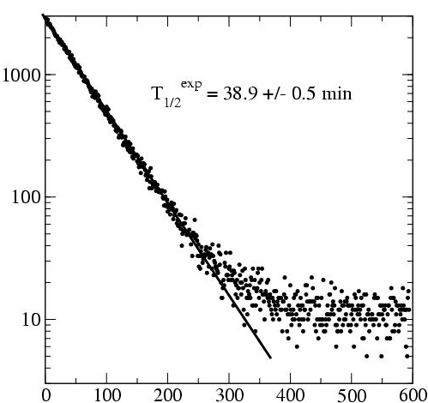
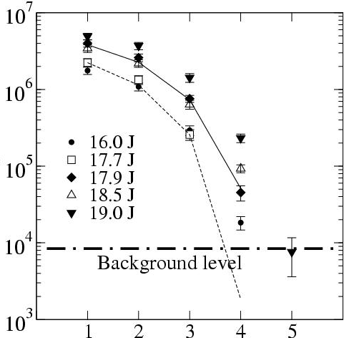
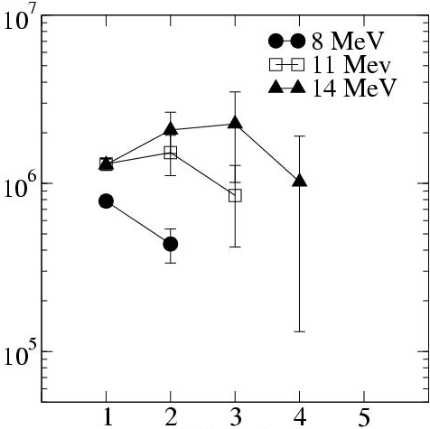
Evolution du nombre de réaction dans les couches de l’empilement
(pour plusieurs énergies laser)
Comptage d’une feuille de l’empilement utilisé au LULI
Nombre de coïncidences (min⁻¹)
Nombre de réactions ⁶³Cu(p,n)⁶³Zn
Temps après l’irradiation (min)
Numéro de la feuille
Nombre de réactions (p,n) calculés dans chacune des feuilles de l’empilement (50+75+2×100 µm) pour 10¹⁰ protons monoénergétiques
Nombre de réactions (p,n) par 10¹⁰ protons
Numéro de la feuille

Slide 53
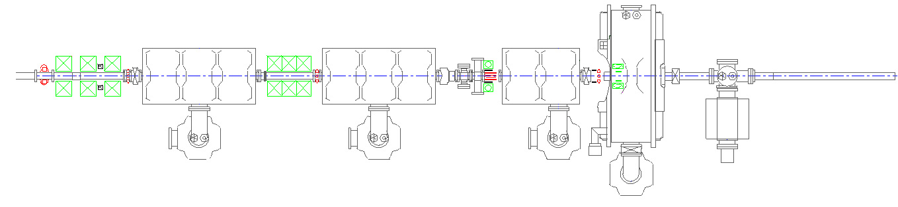
Expérience ELSA
Photoinjecteur
(144 MHz)
Cavités radiofréquence (433 MHz)
Chambre
Système de transfert de la photocathode
Cible
Cage de Faraday
Quadrupoles
laser Nd:YAG
Support des diodes
Al 50 µm + diodes
Suppresseur d’électron
90°
50 Ω
e⁻
Cible (Au 10 µm)
inclinée à 45° / faisceau
Cage de Faraday

Slide 54
Comparaison
accélérateur conventionnel / accélérateur laser-plasma
 | ELSA | LOA Salle Jaune (cible solide) | LOA Salle Jaune (cible jet de gaz)
Charge (E>10 MeV) | 50 nC / 20 µC | <1 nC | <10 pC / <70 pC
ΔE/E | 0,2 % | 100 % | ~10 % / ~30%
Durée du paquet d’e⁻ | 10 ps / 140 µs | < 100 fs | < 100 fs
Taux de répétition max | 72 MHz / 10 Hz | 10 Hz | 10 Hz
 | Tandem BIII | LULI 100 TW
Charge (E>4 MeV) | 1 µA × temps d’irradiation | ~10 nC
ΔE/E | 1 % | 100 %
Durée du paquet de protons | Faisceau continu | < ps
Taux de répétition max |  | ~10⁻³ Hz

