Slide 1


Size Matters :
Non-Destructive Bunch Length Measurements in CTF3
The OFFICIAL Status Report
Julian Jacobson
Northwestern University
under the tutelage of
Anne Dabrowski and Thibaut Lefevre

Slide 2
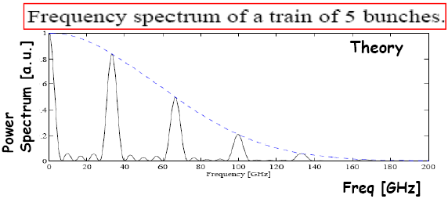
What are we doing?
Measuring electron bunch lengths non-invasively
Can extract bunch lengths from power measurements of the EM field emitted by the particles
The field is “picked up” by the waveguide and guided to the gallery to be measured using our detection setup.
The signals are filtered into different frequency intervals → down-mixed → digitized by a fast PCI card → spit into our code → some magic happens → out comes information on the noise, signal, frequency spectrum, beam position and current, and other assorted data.

Slide 3
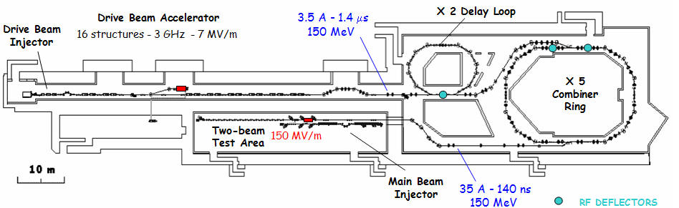
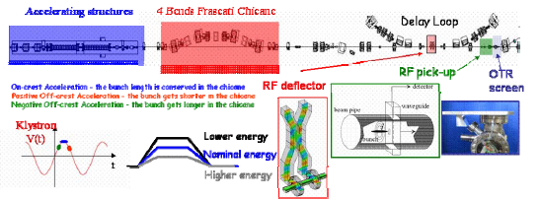
Location
site of the fabled RF pick-up
Notes:
Lengthen = stretch, shorten = compresses
Energy/path length correlation through chicane – all focusing magnets were off (natural chicane)

Slide 4
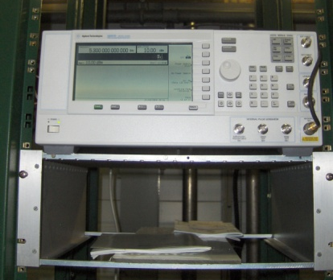
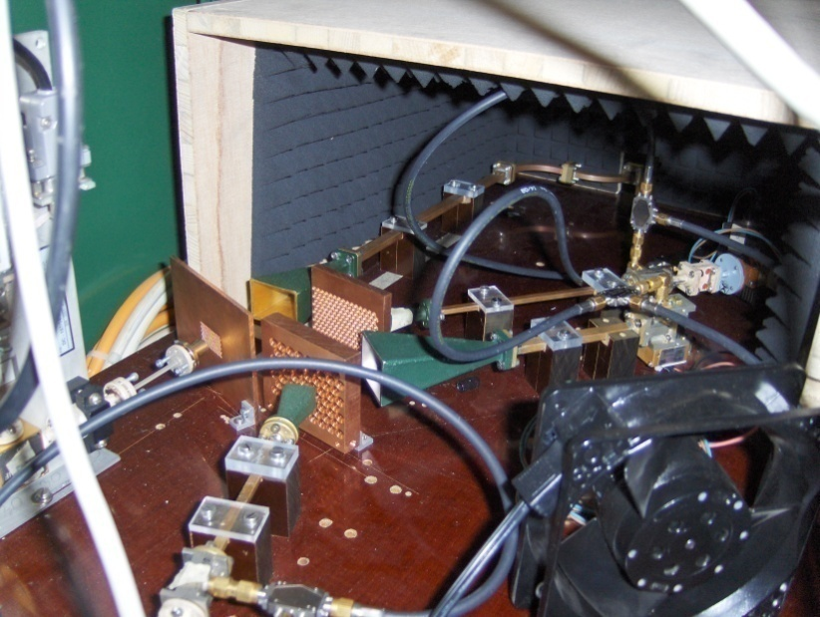
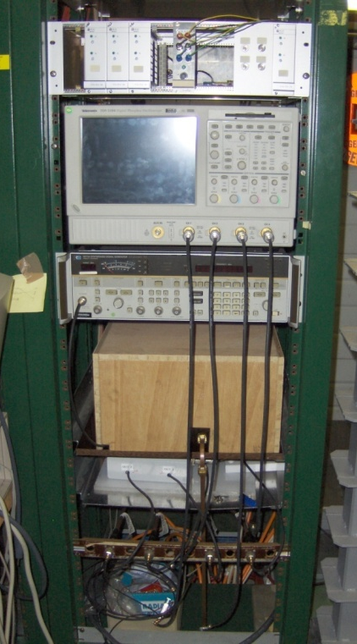
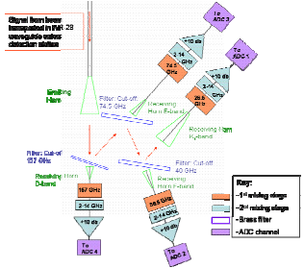
Detection System
The signal arrives to a series of 4 mixing stages with the signal filtered by frequency
The 4 mixers down-mix the signal twice so it can be read by a digitizing scope
Notes:
2 local oscillators for the 2nd down mixing stage - - NEW AND AWESOME (northwestern)
High powered synthesizers (14 and 20dbm max)

Slide 5
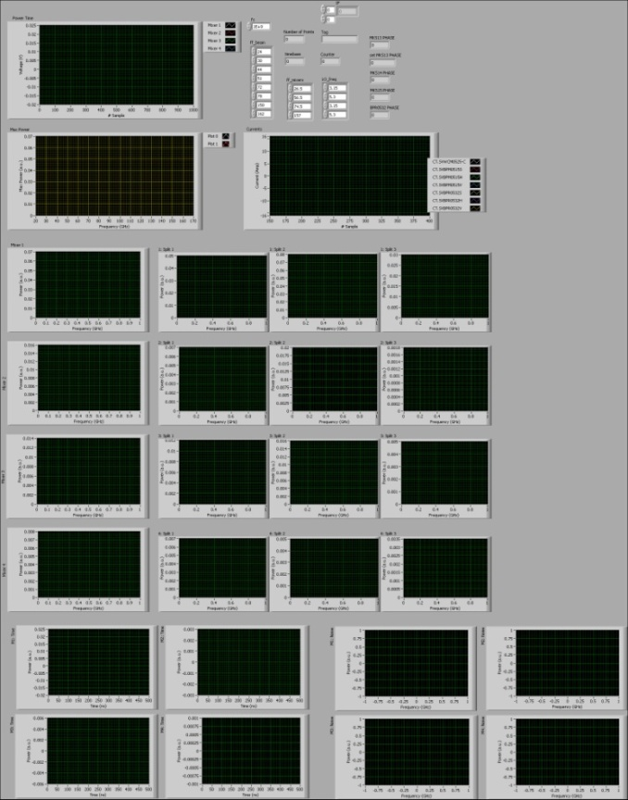
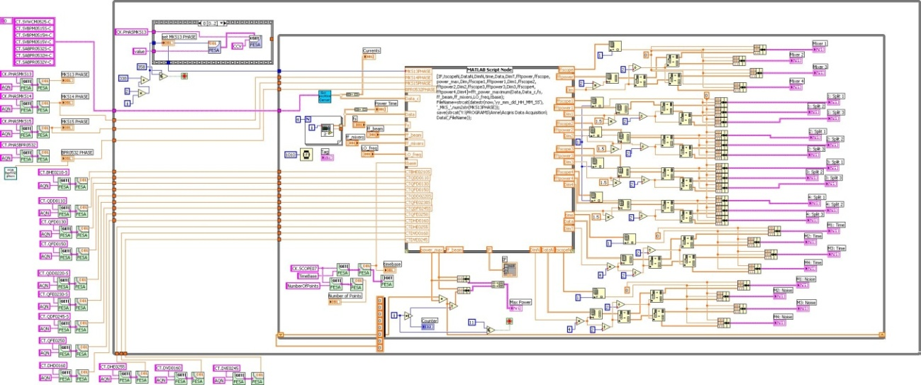
Online Code
Display and Save:
Signals outputted by the 4 mixers
Max power plotted over the range of beam frequencies
Beam position and current of BPM0515 and BPR0532
FFTs of the signals as well as their splits over three time windows
FFTs of the noise
Scans:
BPR0532 phases to find the max amplitude for the 3GHz signal
MKS13 phases and stores the data
Saves magnet settings so we can later calculate the expected bunch lengths
Notes:
Time windowing is new: both for us and controls peeps – because we have the capability to take many many samples we can do this

Slide 6
Offline Code
Calculates the bunch lengths at FWHM and RMS as a function of the MKS13 klystron phase as well as errors
Allows us to do further analysis and look at pulse to pulse variation
Notes:
Peak variation

Slide 7
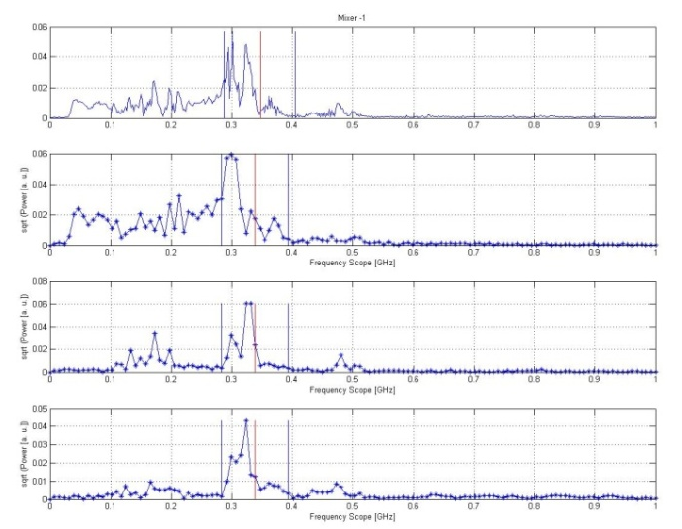
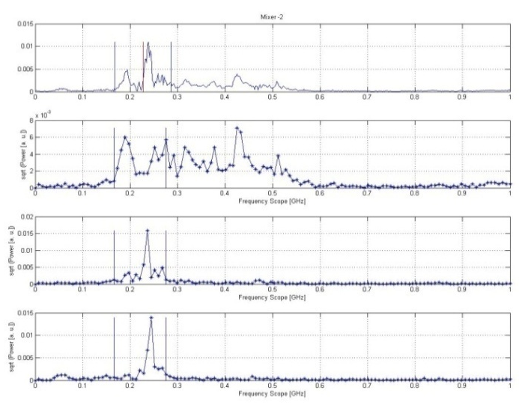
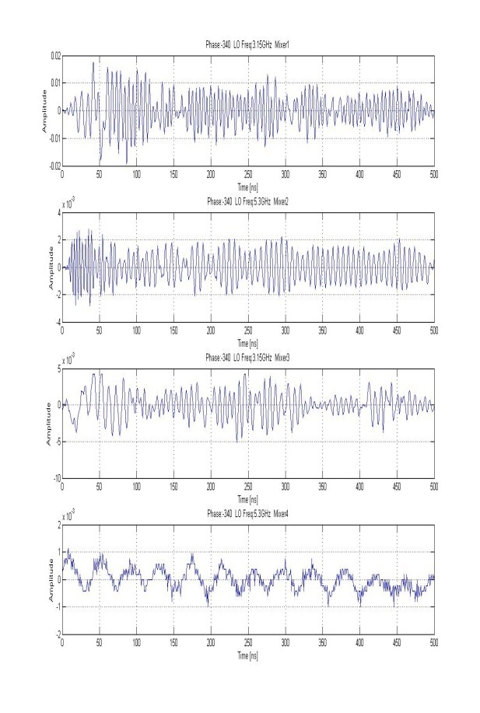
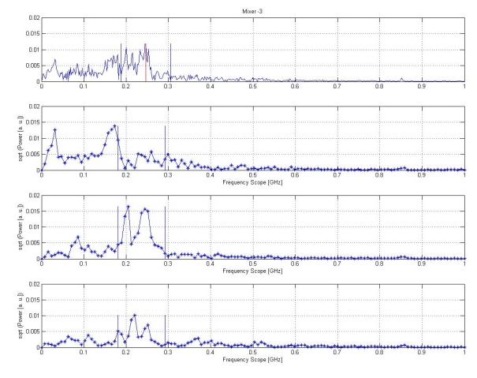
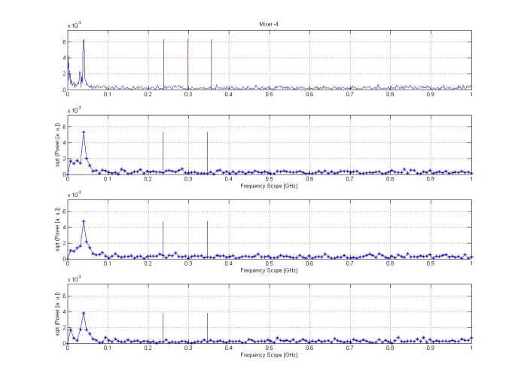
FFT Time FFT
Mixer 1
Mixer 3
Power
Power
Mixer 2
Mixer 4
Power
Power
|-------400ns-----------|
|-----------1 GHz------------|
|-----------1 GHz-------------|

Slide 8
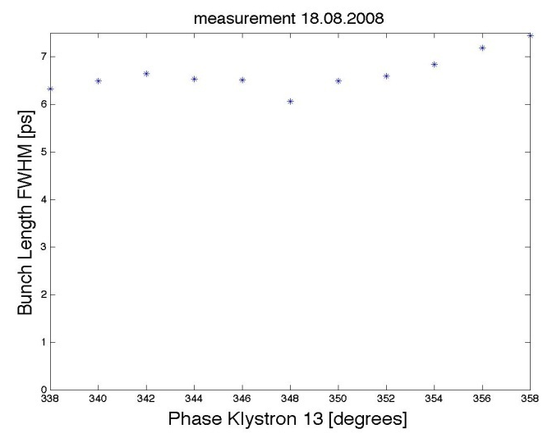
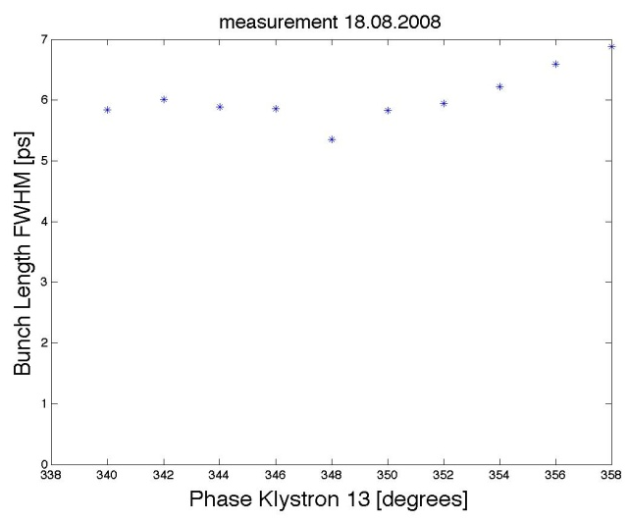
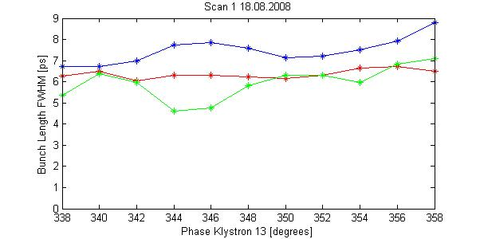
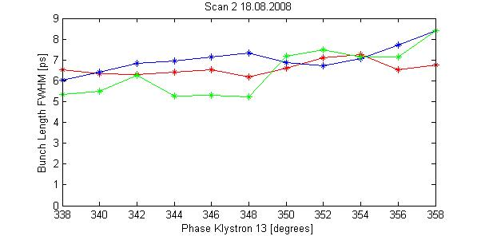
Measured Bunch Lengths
Displayed are the bunch length measurements of two MKS13 phase scans and the time windowing results for both scans
The lengths were determined by assuming a Gaussian bunch distribution
Fit result between 5 and 7ps FWHM
Bunch Length FWHM (ps)
Bunch Length FWHM (ps)
Blue- Time Interval 1
Red – Time Interval 2
Green – Time Interval 3
Klystron Phase (338°-358°)
Klystron Phase (338°-358°)

Slide 9
Future Work
Next time, we’d like a beam with shorter bunches so we can have a response in Mixer 4
Detailed calibration with the RF Deflector
Add remote control of the synthesizer so we are more flexible and can gather more data points directly from the control room
Add the bunch length measurements to the end of the scan

Slide 10
Merci Beaucoup
Mayda Velasco for giving me the opportunity to be here
Anne Dabrowski and Thibaut Lefevre for putting up with me for 9 weeks
And of course all the folks who contributed to getting a nice beam to pass by our detector

Slide 11
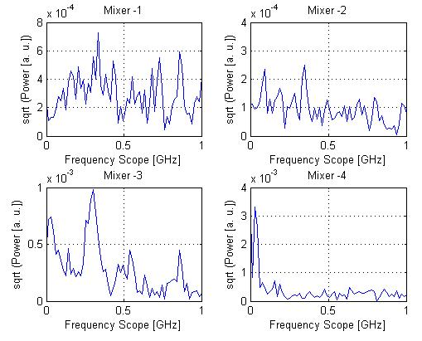
Noise
If we compare the FFTs of the noise in the four mixers to the FFTs of the signals (slide 7) we see that there is no serious interference with our peaks

Slide 12
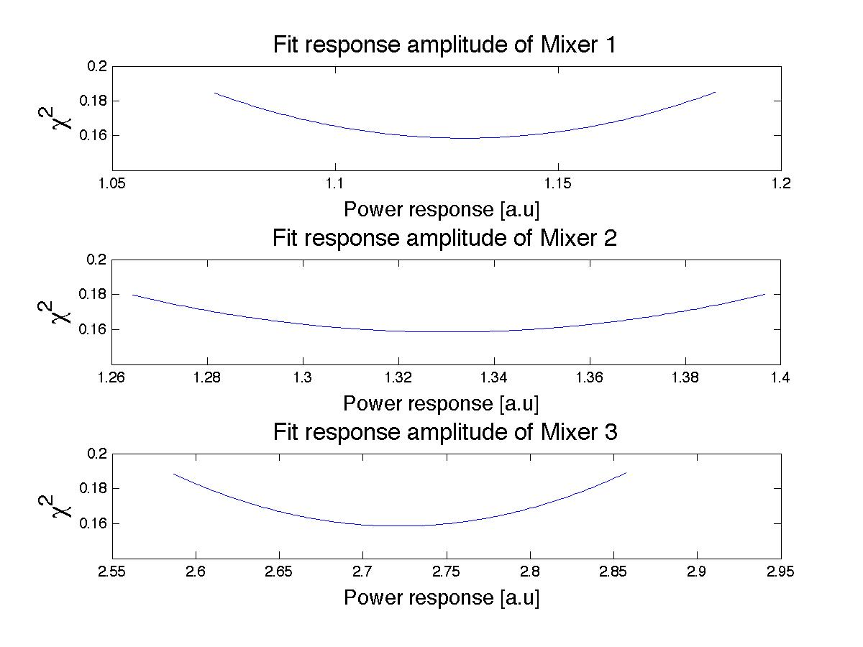
Chi-Squared Fits
The chi-squared fit response is obviously not perfect, but it tells us that we aren’t grossly mis-analysing the data
One potential pitfall could be the error estimation. We need to look at our methods closer to see if that’s causing the low χ² values

Slide 13
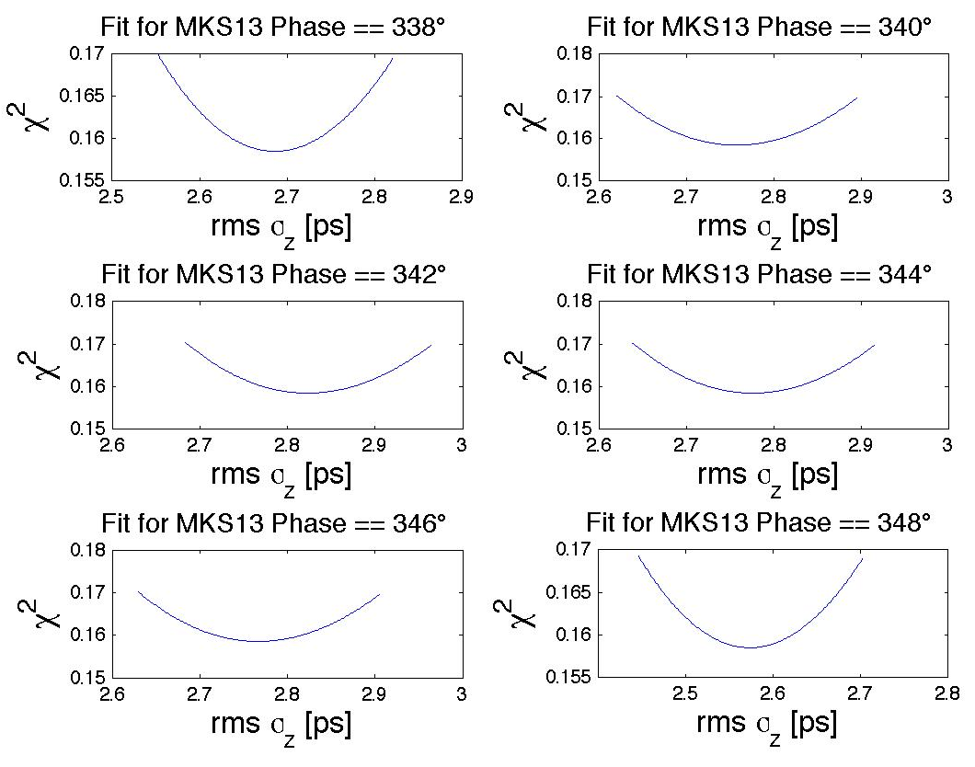
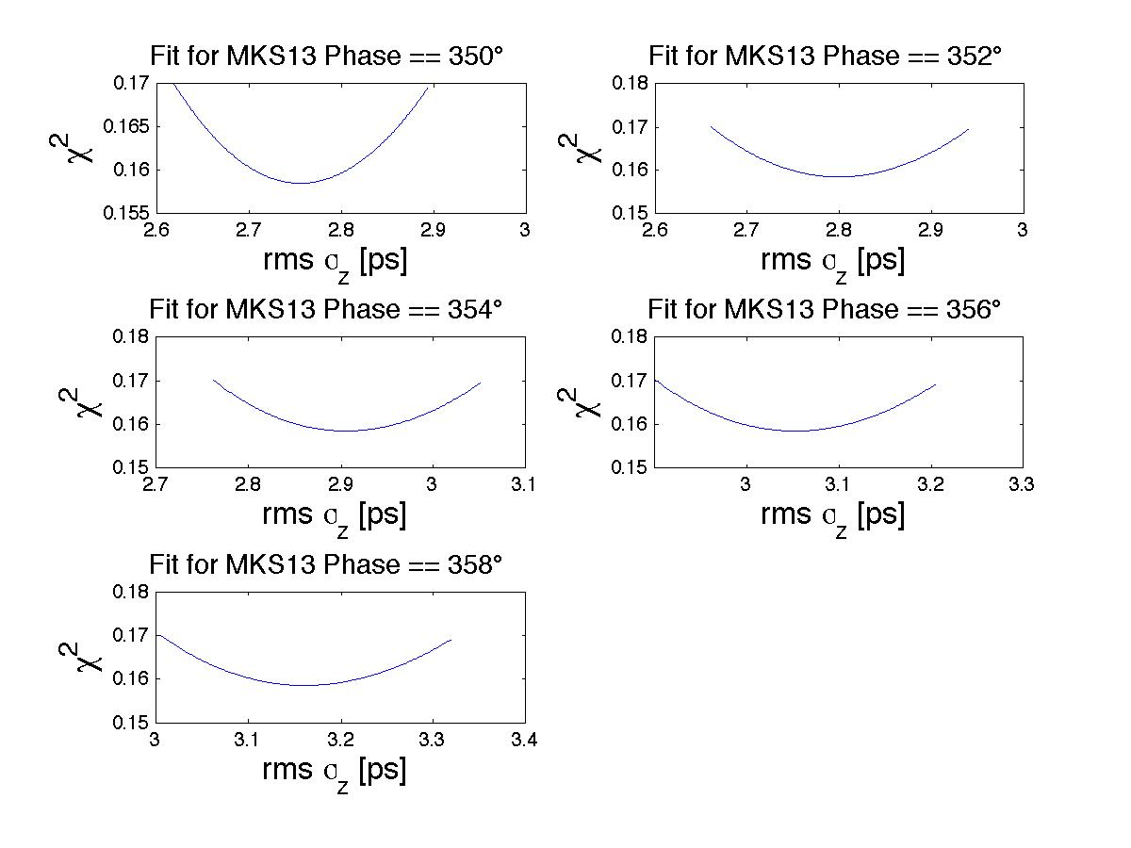
Chi-Squared Fits

Slide 14
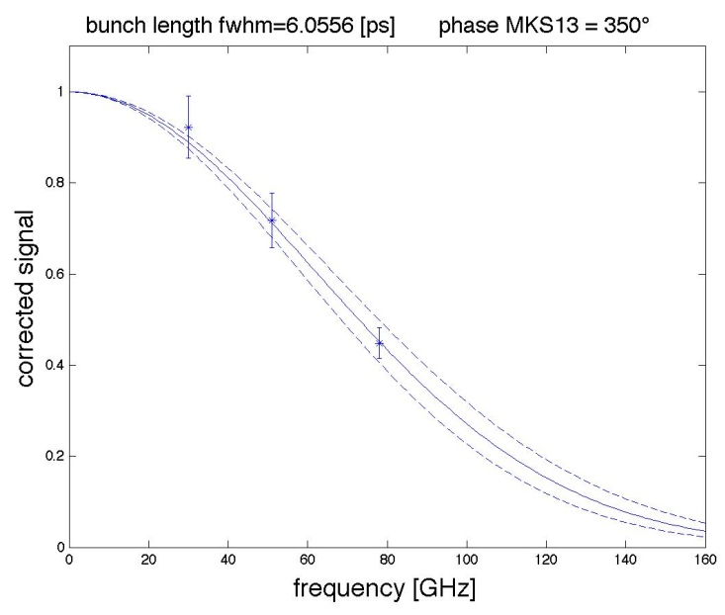
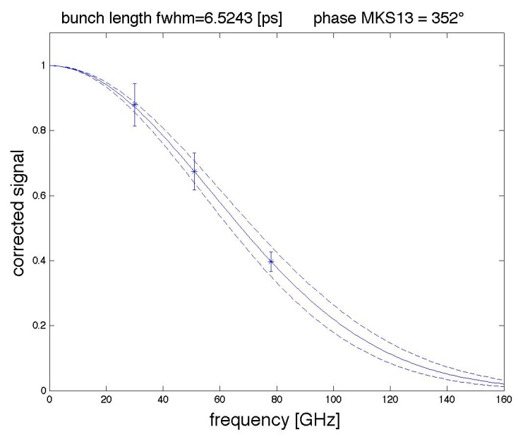
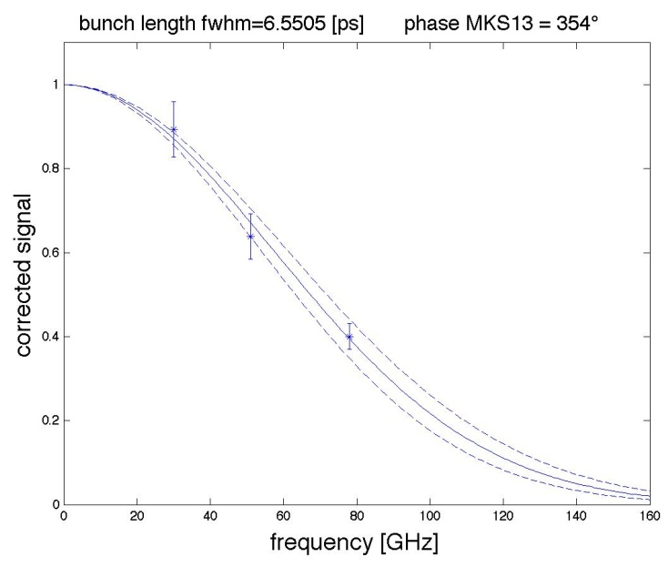
Examples of Bunch Frequency

