Slide 1
CTF3 in 2007
Optics Measurements
Caterina Biscari, Yu-Chiu Chao, Roberto Corsini,
Anne Dabrowski, Steffen Doebert, Andrea Ghigo,
Seyd Hamed Shaker, Piotr Skowroński, Frank Tecker
CLIC Meeting
CERN 29 February 2008
1

Slide 2
2007 Run
Planned for 22 weeks
  Excluding PETS only running
Very uneasy run due to
  Large number of hardware failures
    For most of the time mal behaving gun
      Periods of large current variation from shot to shot, sudden jumps of the average current, large current change along the pulse
    Total 6 weeks of down-time
      The run extended for additional 4 weeks because of that
      3 vacuum leaks
      2 klystrons out due to failures of parts we didn’t have in spare
      Gun cathode exchanged
      And many, many, many more!
  Instability induced by the wake in the Combiner Ring RF deflectors
  Bugs in the machine
    Swapped cables between devices
  Bugs in the online model
    Wrong calibration factors for some magnets

Slide 3
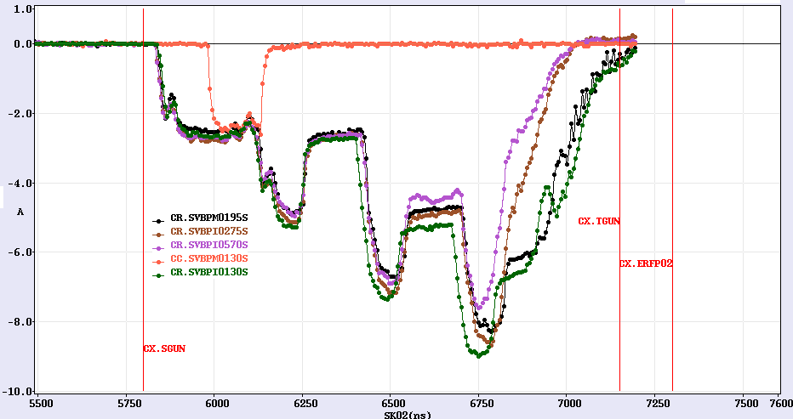
Achievements
We have achieved the main goal: the recombination
  To reduce the effect of the instability cut a gap within the trains with the extraction kicker

Slide 4
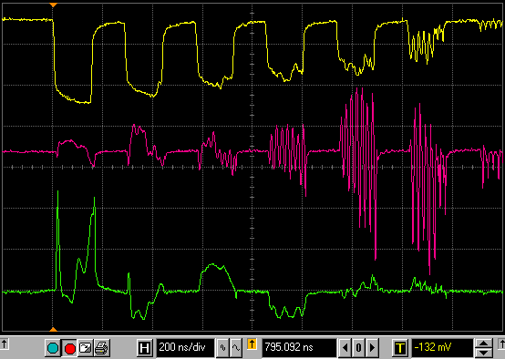
Achievements
Finally we have understood what prevented the beam from staying in the Combiner Ring for more than 2 turns: Instability
current
Vpos
Hpos

Slide 5
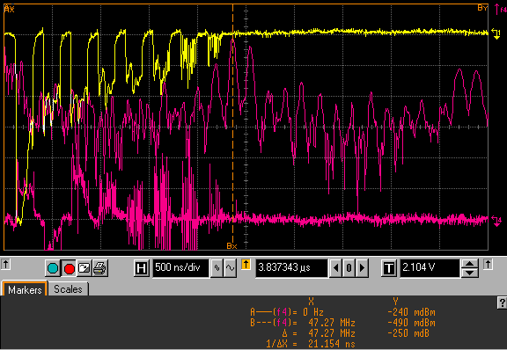
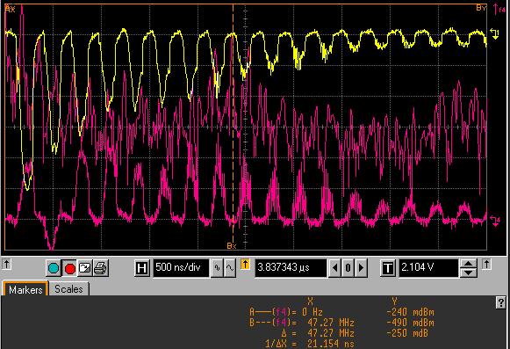
It is not fast ion instability
RF deflector in DL set up to kick out every second bunch from the train
    Same charge per bunch
    Twice smaller current
    Twice bigger spacing between bunches
If it is fast ion instability then the frequency should change
  It is not
3GHz
1.5GHz
5
CLIC Meeting, CERN
29 Feb 2008

Slide 6
The Optics Studies
All along the Run 2 we were performing the machine measurements
  Dispersion
  Tunes
  Response Matrix
  Combiner Ring Length
  Bunch length
They allowed us to discover many discrepancies in the machine and in the model
  Of course, that is why we do them

Slide 7
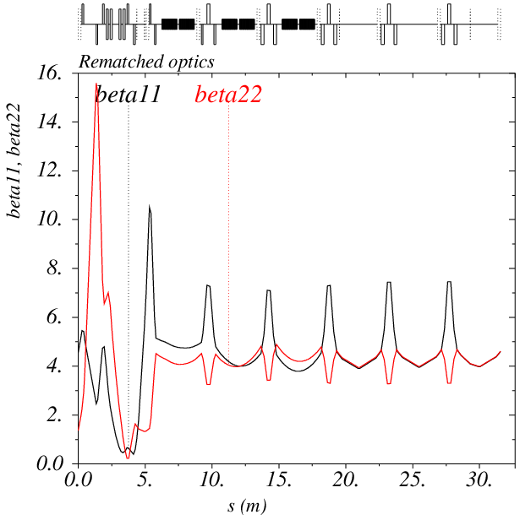
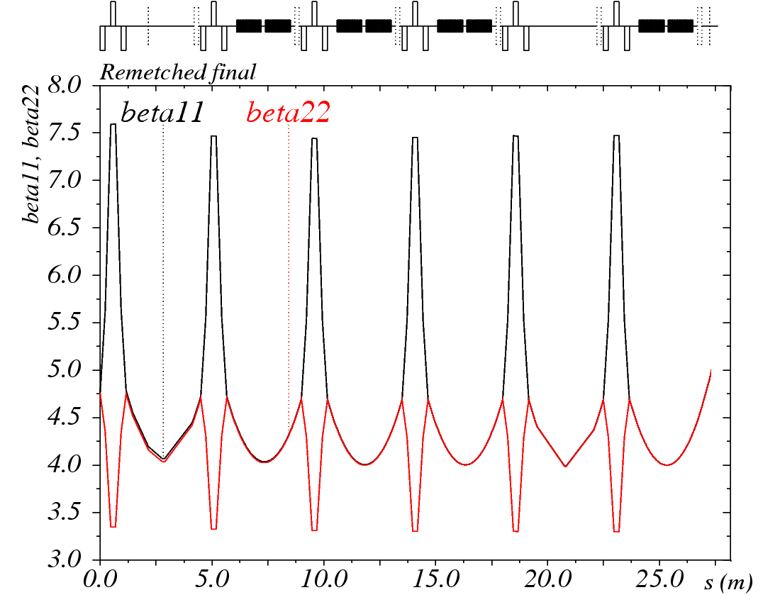
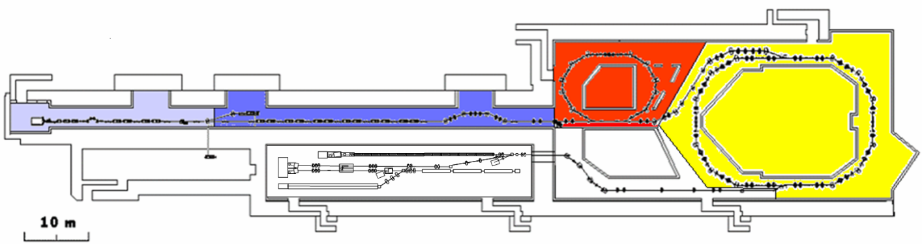
Nominal Optics
Linac
We measure what comes out of the buncher and rematch linac to regular optics
7

Slide 8
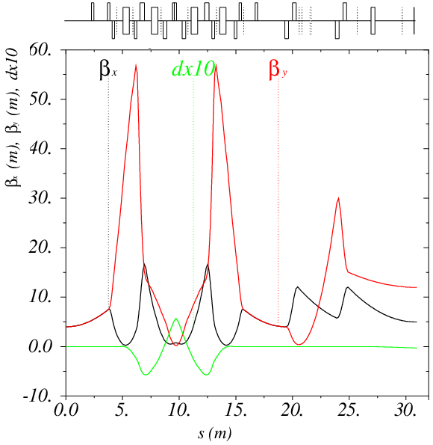
Nominal Optics
CT Line
Optics in the Stretcher Chicane is adjusted to the required R₅₆
8
CTF3 Collaboration Meeting, CERN
20 Jan 2008

Slide 9
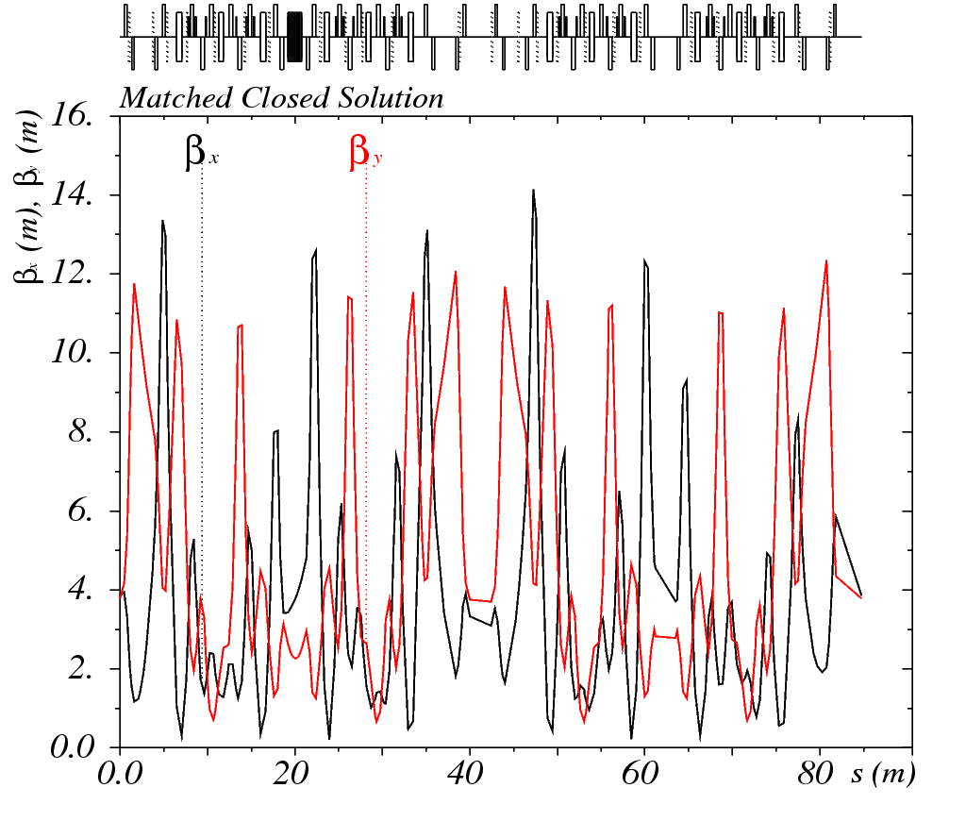
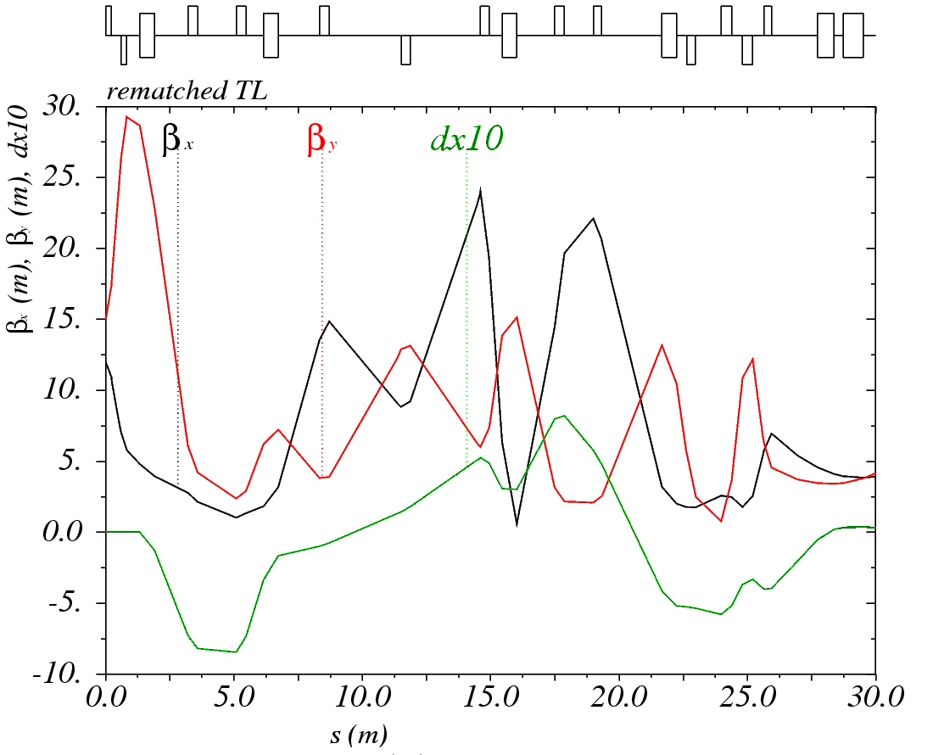
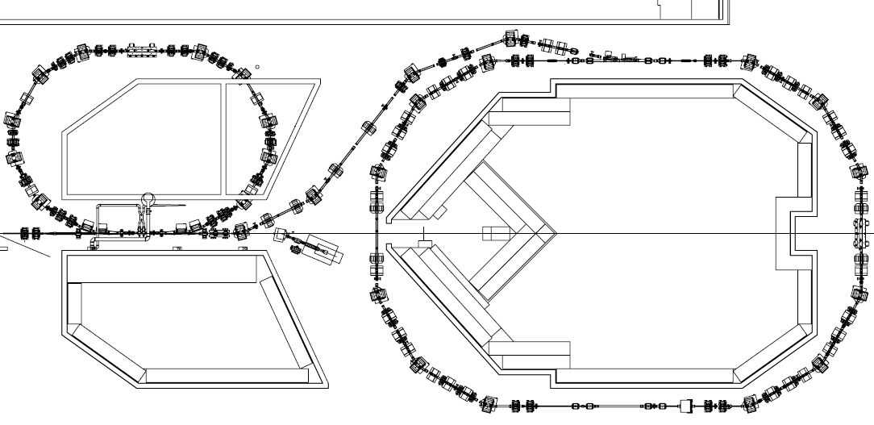
TL1 and CR optics
The optics in the Combiner Ring is adjusted to
  The beam energy
  Wiggler current
In TL1 the isochronous optics is matched to the CR optics

Slide 10
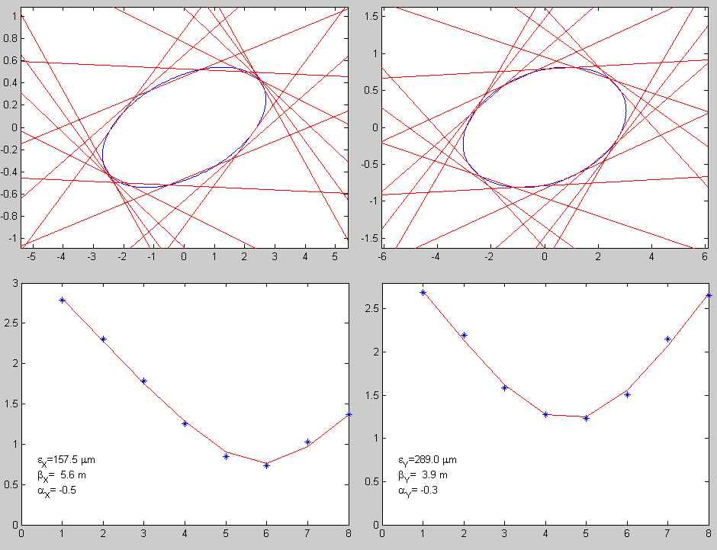
Quad Scans
We measure beam parameters with quad scans
  Measure beam profile for different settings of
  the upstream quad(s)
  Beam size depends
  quadratically with quad
  strength
  Parabola parameters
  are linked to the Twiss
  parameters just before the
  quad

Slide 11
Quad Scans
We can do quad scans at few locations
  Girder 4 of the Linac
  Girder 10 of the Linac
  Girder 4 of CT line
  Beginning of TL1 in CTS
  After injection in Combiner Ring
    Sending the beam to the screen in CRM
      Tricky since dipole can not be demagnetized
Routinely the beam parameters are measured at 2 and 3 or 4 during beam setup

Slide 12
Emittances
We have made a lot of quad scans during the last year, however, we never performed detailed study of the emittances
  The data points we have are taken
    With completely different conditions
    Sometimes with wrongly calibrated screens
    Almost never at a couple of locations the same day

Slide 13
Dispersion
Dispersion is measured in two ways
  By observing the orbit change while setting all elements strengths proportionally higher or lower
    The lattice becomes mismatched to the beam energy
    Specialized MatLAB script doing the job
      Read the current setting of the magnets
      Get the reference orbit over several shots
      Scale all the elements in the specified range about desired value(s)
      Get the orbit over several shots
      Return to the original setting
      Prepare the input for MADX and run the model
      Plot the measured and the model dispersions together
  Measuring the position jitter from pulse to pulse
    RMS of a pickup position reading is proportional to the dispersion
    The pattern is normalized so the dispersion in the Stretcher chicane agrees with the model
      It is well controlled there
    It is much less precise method comparing to the former one, however, it allows to monitor dispersion on-line
      Facilitates the beam setup

Slide 14
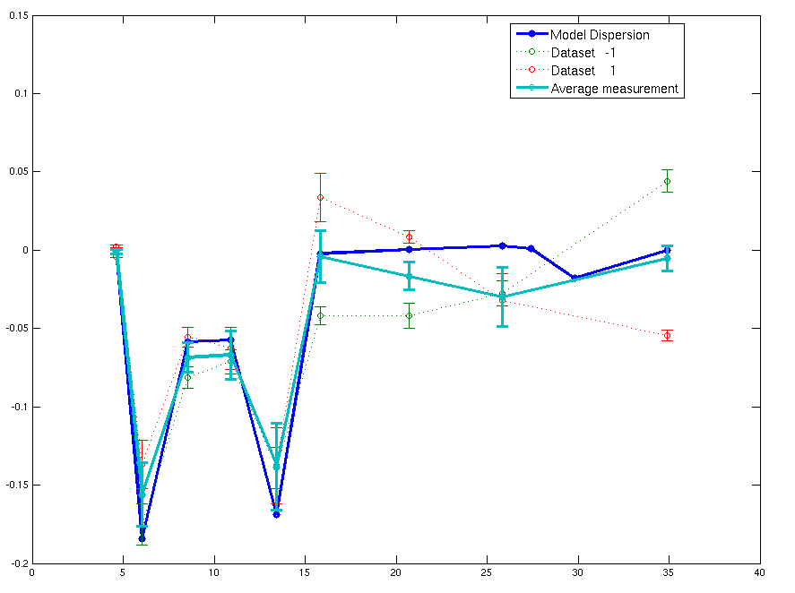
Dispersion in the CT line
Measured dispersion in the Stretcher Chicane does not agree with the model
  Discrepancy tracked to the quadrupole CT.QFE 0250
  Fudge factor 0.86 applied in the model
Measured and corrected model dispersion

Slide 15
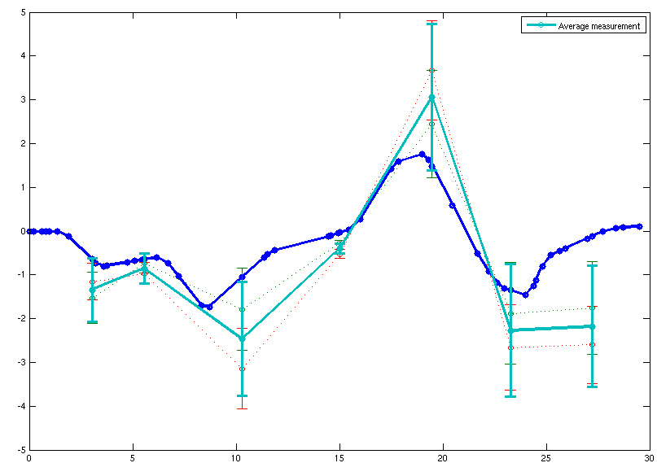
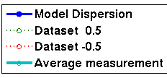
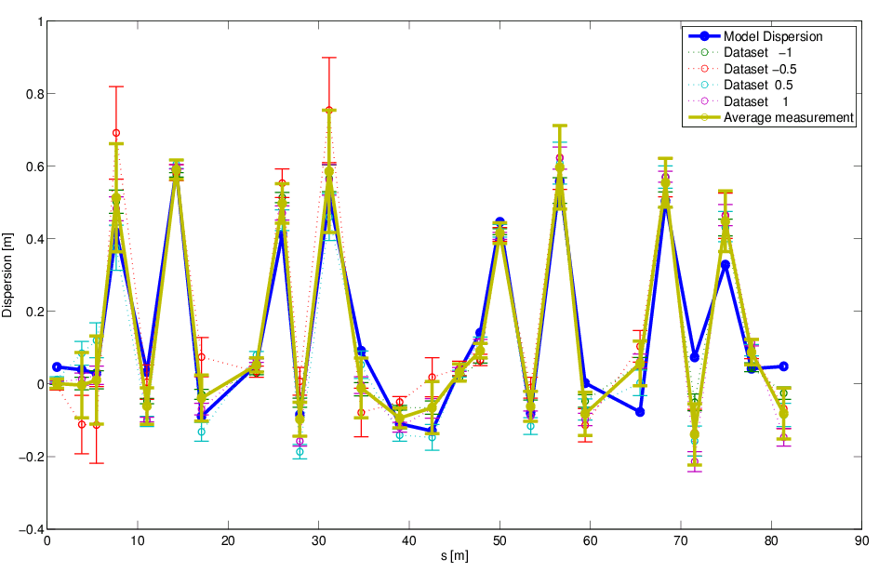
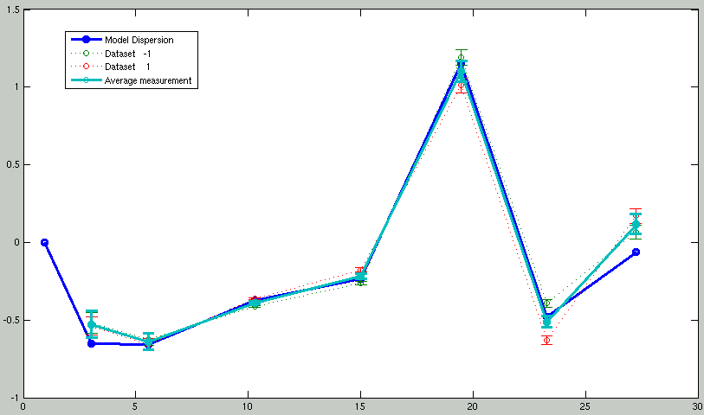

Dispersion in TL1 and CR
Dispersions agrees with the model within the error-bars
TL1
CR
TL1

Slide 16
Response Matrix
Register the orbit position in all BPMs
Change setting of one (or more) corrector
Look into orbit position change (difference)
Compare with the model predicted change
If they do not agree, the model does not describe the machine correctly
  It is easy to localize the region where the error occures
    Between the element the discrepancy occurs first and the previous one or two
  Even if there are more errors we still can find them
    If the kick is applied after the first error the pattern should agree
The measurements were automatized with a MatLAB script

Slide 17
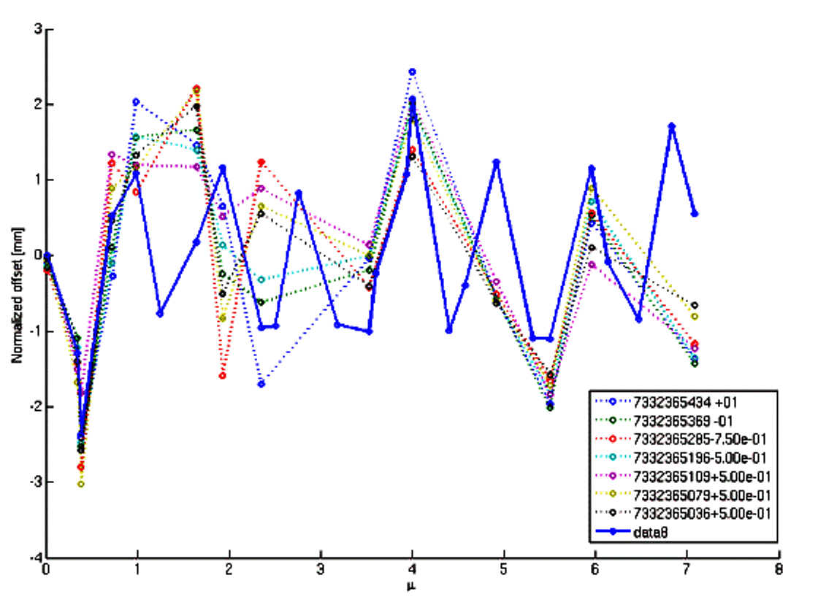
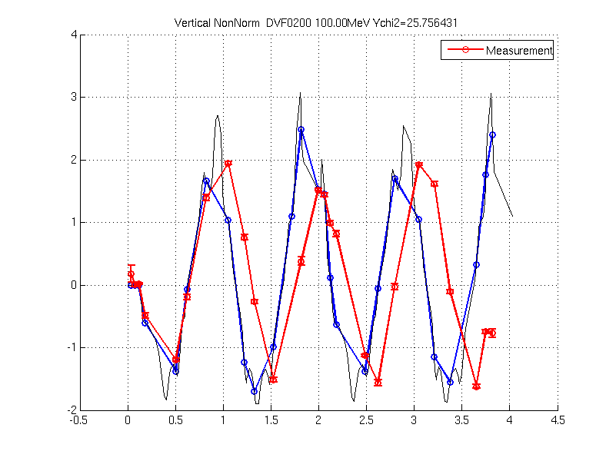
The Response Matrix Study
The measurements made during Run 1 traced us to
  Wrong calibration of the J type quads about 6%
  A few correctors with wrong polarities
Corrected J type
The first data
Problem in the wiggler area

Slide 18
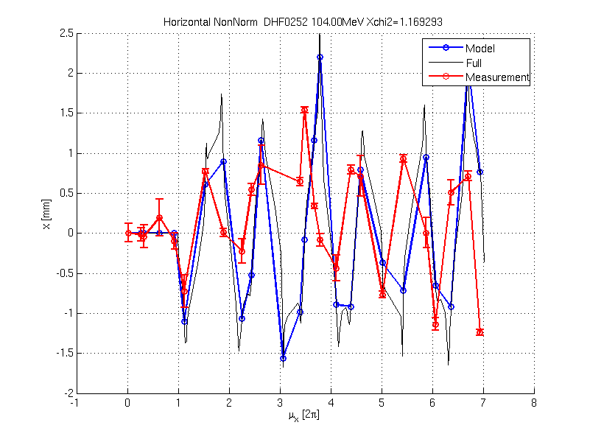
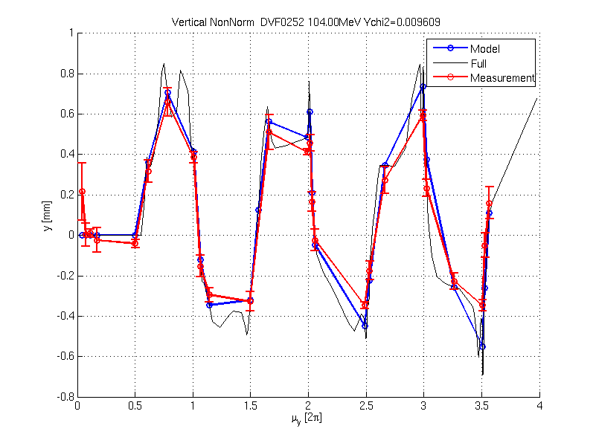
The new wiggler model
Caterina Biscari has prepared detailed wiggler model based on the magnetic measurements of the device
  It describes more correctly the wiggler vertical focusing
  Still there is not understood discrepancy in horizontal
  Need more detailed measurements for different wiggler currents
    The most importantly with wiggler off

Slide 19
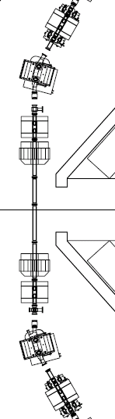
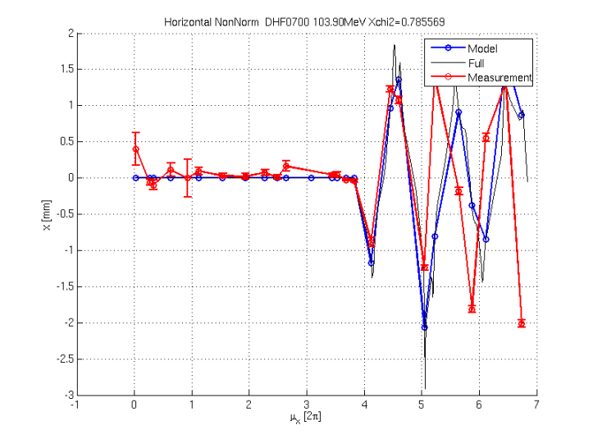
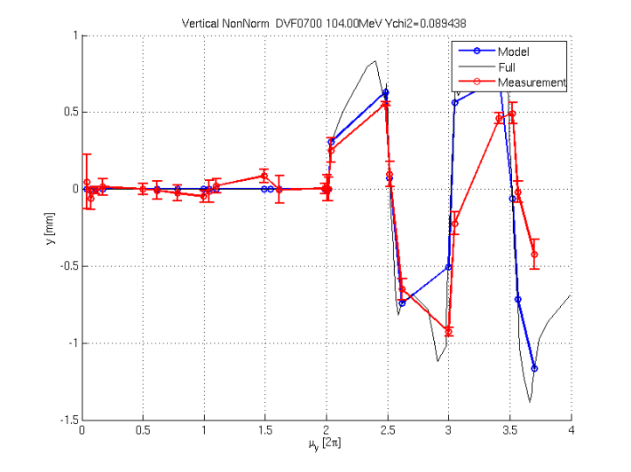
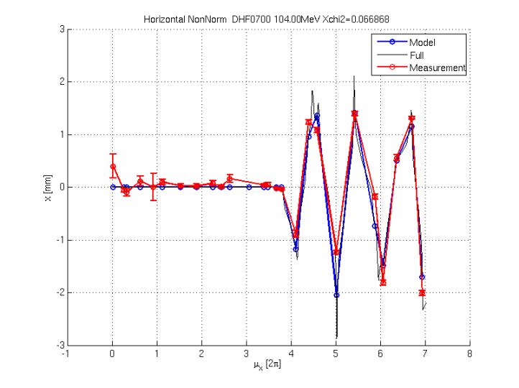
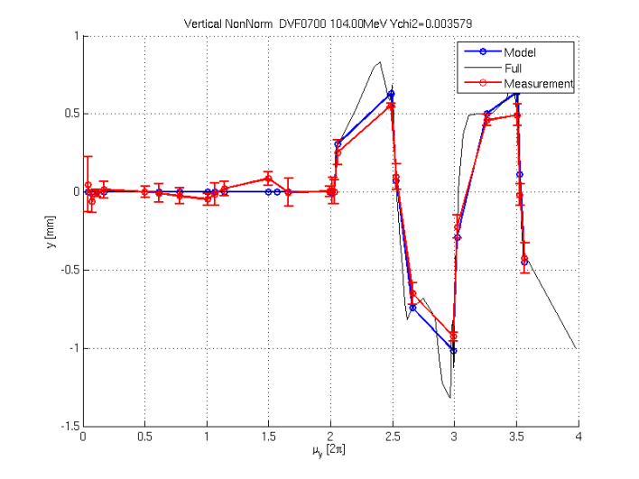
Discrepancy in 2nd short section
Increasing 820-880 doublet by 15% gives good agreement between the data and the model
CR.QFJ0880
CR.QFJ0820

Slide 20
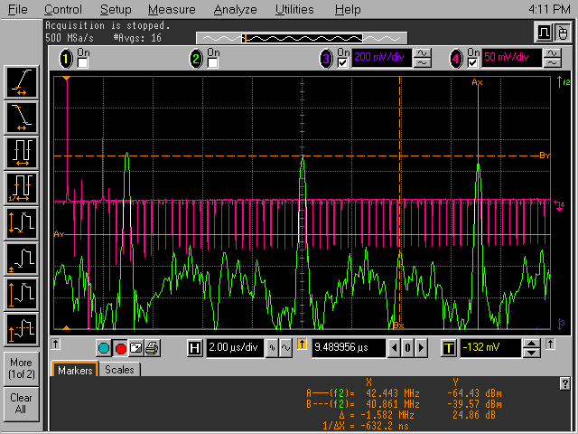
Tunes
We measure tunes doing FFT of a pickup analog signal
  Using a scope
Measure distance between the main frequency peak f_{rev} and the second highest f_{Q}
Q = N ± (f_{rev}- f_{Q})/f_{rev}
N is an integer that is
obtained as the number
of the orbit oscillations
around the ring
To distinguish the sign
observe how f_{rev}- f_{Q}
changes while changing
a quad strength

Slide 21
Combiner Ring Tunes
The measured tunes does not agree with the model
  What only confirms the observations from the response matrix measurements

Slide 22
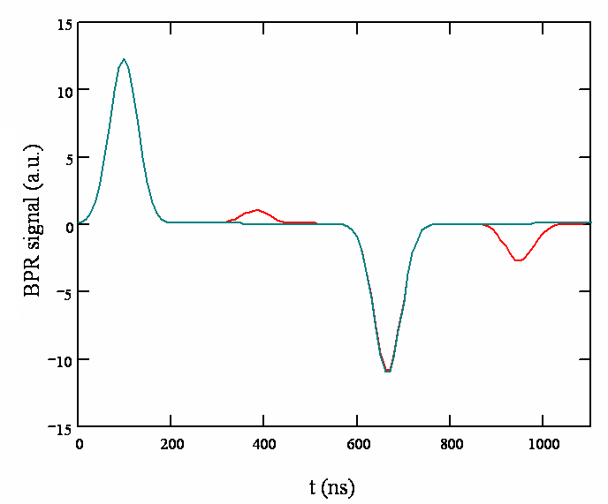
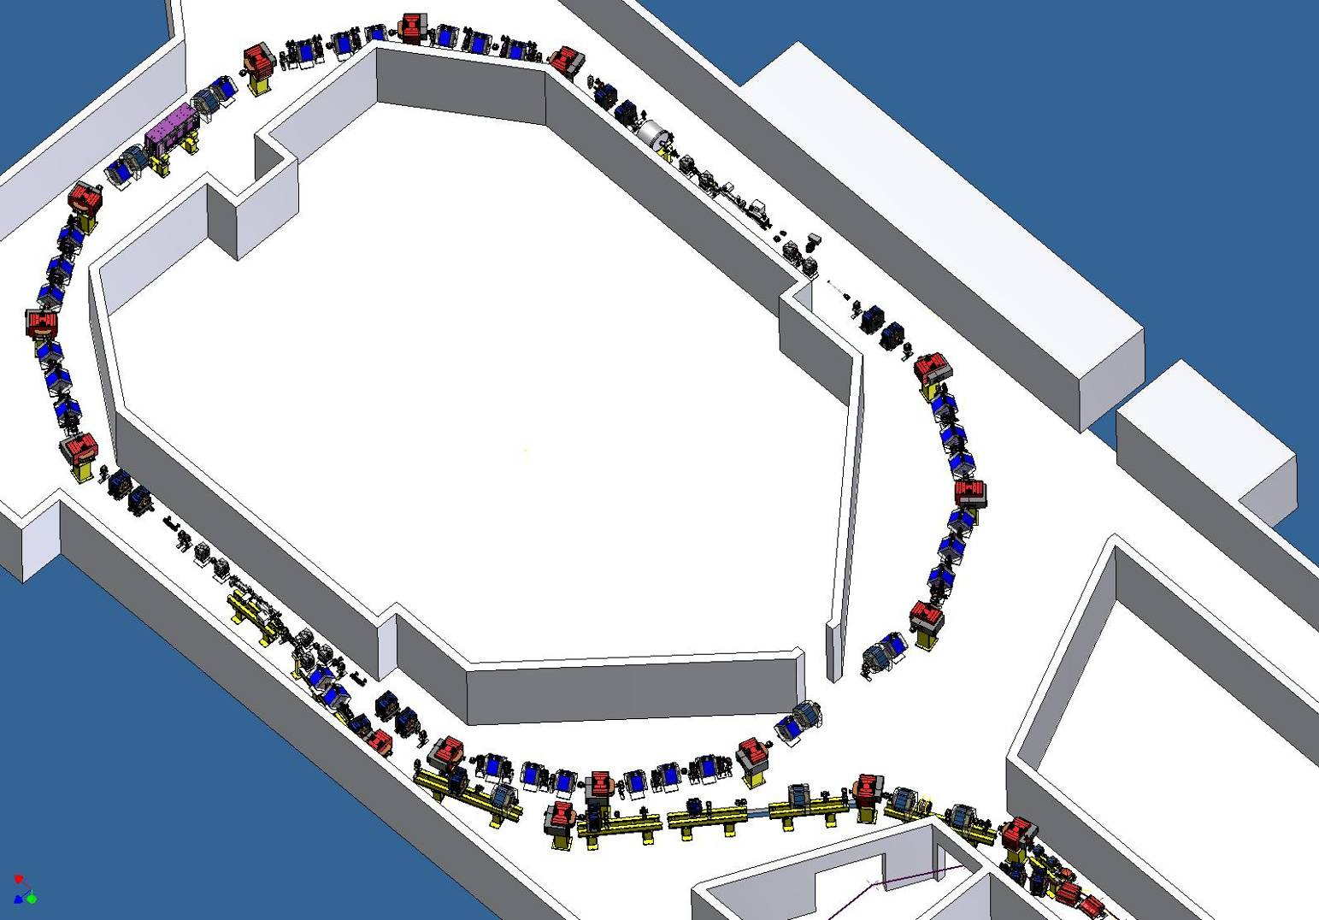
Measurement of the ring length
BPR: RF Phase Monitor
Gives sum of the beam induced signal and internal frequency (3GHz)
If beam has also 3GHz it measures phase offset between the two signals
1st turn
2nd turn
3rd turn
4th turn
Simulated signal
Combination factor 4
Combination factor 4 with + 5° error

Slide 23
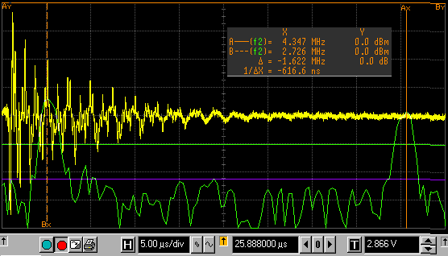
BPR measurement
Short pulse for many turns
FFT of the BPR signal gives the ring length
  f_{rev} gives total ring length L_{R}= (N – 1/CF) λ_{RF}
  Δf gives fractional part of ring length 1/CF λ_{RF}
B
Δf = (A - B) / 2
A
BPR signal
Suppressed revolution frequency
f_{REV} =(A + B) / 2
FFT

Slide 24
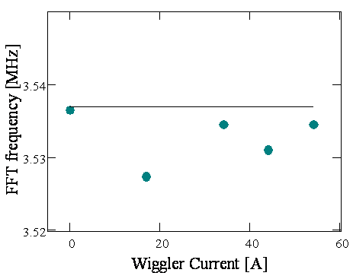
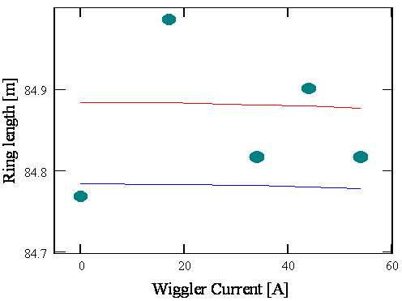
BPR measurement: f_{rev}
Measure for different values of
the wiggler current
Theoretical f_{REV}
f_{REV} =(A + B) / 2
A
f_{REV} =(A + B) / 2
Measured LR = c β / f_{REV}
Theoretical f_{REV}
B
LR = (849 - 0.225) λ_{RF}
Theoretical LR = (848 - 0.225) λ_{RF}
21 Jan 2008

Slide 25
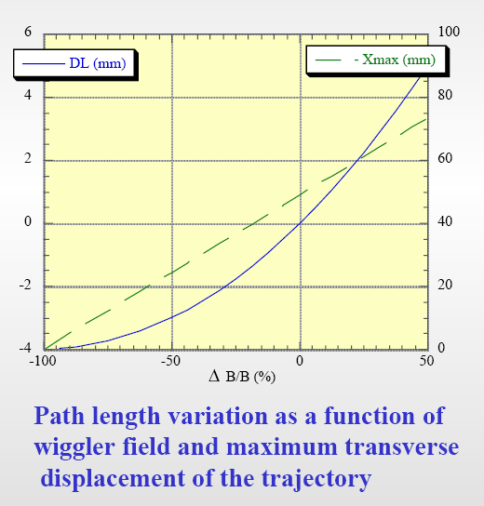
BPR measurement: Δf
expected
measured
CF 5, - 1/5 λ_{RF}
About 1.5 mm
Expected ring length for nominal wiggler current
Measured Lfrac = - 1/CF λ_{RF}
CF 4, - 1/4 λ_{RF}
C. Biscari

Slide 26
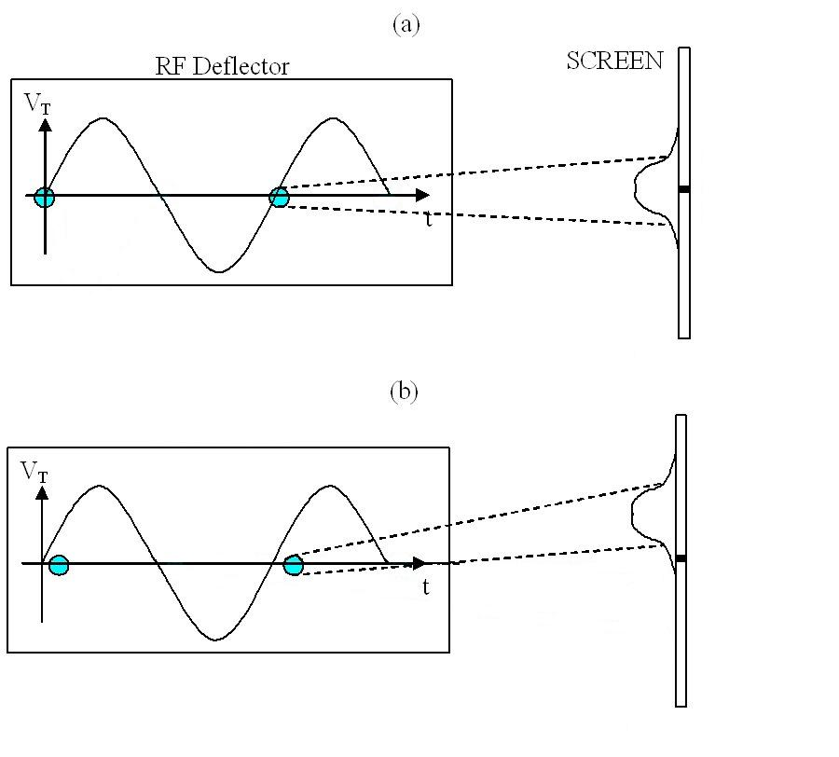
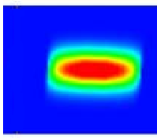
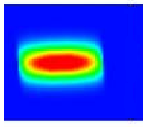
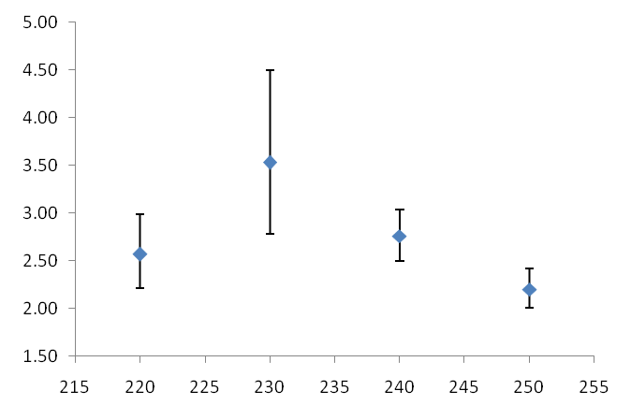
Bunch length
l_{b}= 2.68±0.60 mm
Intensity
RF Deflector Phase(degree)
The bunch length achieved by measuring the intensity of a thin band at middle of screen for each RF deflector phase and fitting a Gaussian distribution. The standard deviation of this chart is related to bunch length by c/f constant. c is speed of light and f=1.5 GHz is frequency of RFD. The errors are large due to the beam jitter but is good for first measurement by this method
Bunch length(mm)
Klystron 13 Phase(degree)

Slide 27
Conclusions
The optics tests are indispensable for
  A good control over the machine
  Fishing out all the machine and the model errors
The measurements we did helped to solve a number of problems and show that there are still more
We were not given a chance to perform enough measurements up to now and to gather enough high quality data for offline analysis
  Instability of the machine
  A bounty of hardware failures
  The instability in Combiner Ring
During the beginning of the next run we plan a campaign for systematic optics measurements which would hopefully let us find all the remaining optics errors

Slide 28
Conclusions - Online Tools
Already during the last run we developed set of software tools that allow to test quickly the optics and compare immediately the results with the model
  Dispersion measurements
    Magnet scaling
    Using position jitter from shot to shot
      Online dispersion monitoring
  Response Matrix measurements
We need set of more robust tools
  Which would speed up the measurements and analysis
  They are currently under development

Slide 29
Outlook- New Tools
Quad scans
  Precise fit is obtained only if the shape around the parabola minimum is measured
    Often, it is difficult to find a good range for quad strengths
    In consequence we do not do them sufficiently often because it takes too much time
      Currently it is at least one hour exercise
  We want to make a new tool which would find a range itself and eventually obtain Twiss parameters in a range of quads

Slide 30
Outlook- New Tools
“Orthogonal” response matrix
    In preparation by Chao (JefLAB)
    Complete & even coverage of phase space what would help to isolate the sources of errors
    See Chao’s talk from CTF3 technical meeting in January for more details
X’
X’
Global transfer matrix determination
Orbits on both ends determined on equal footing → Rigorous error analysis
Orthogonal phase space coverage
Large signal-to-noise ratio
Symplectification
Diagonally reflected scan pattern to combat pulse-to-pulse jitter, and increase signal amplitude.
X
X
Correctors
BPMs
M

Slide 31
Outlook- New Tools
Codes for measurement automatization of
  Bunch length with RF deflector – Hamed
  Bunch length with RF pick-up – Anne
  Energy and energy spread with the new segmented dump – Anne
Code for Combiner Ring orbit correction – Caterina and Simona

