Slide 1
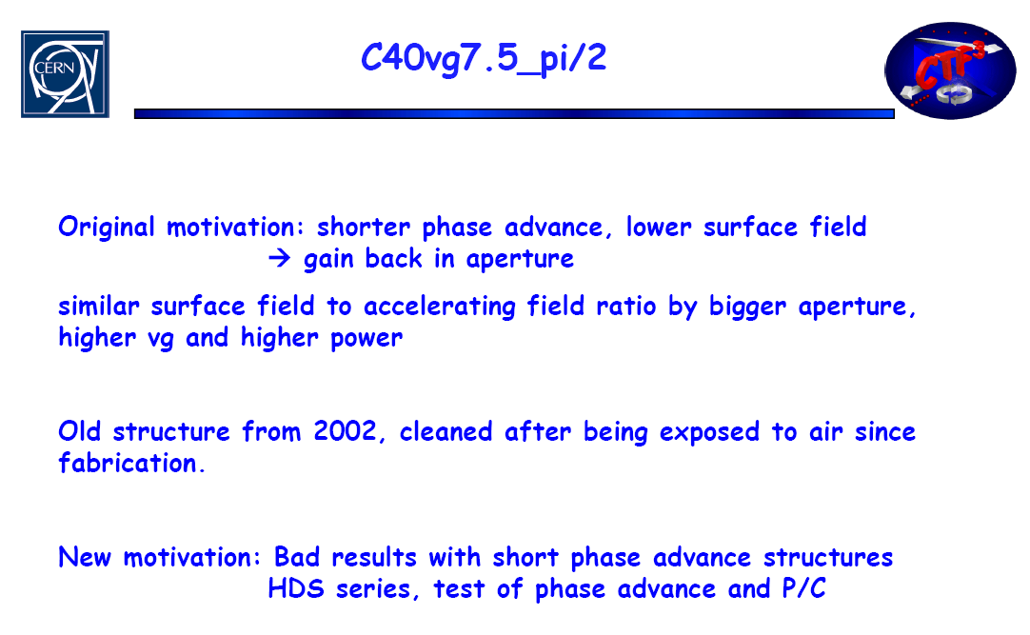
π/2 brazed Cu disc structure
Steffen, CLIC meeting, 14.3.2008

Slide 2
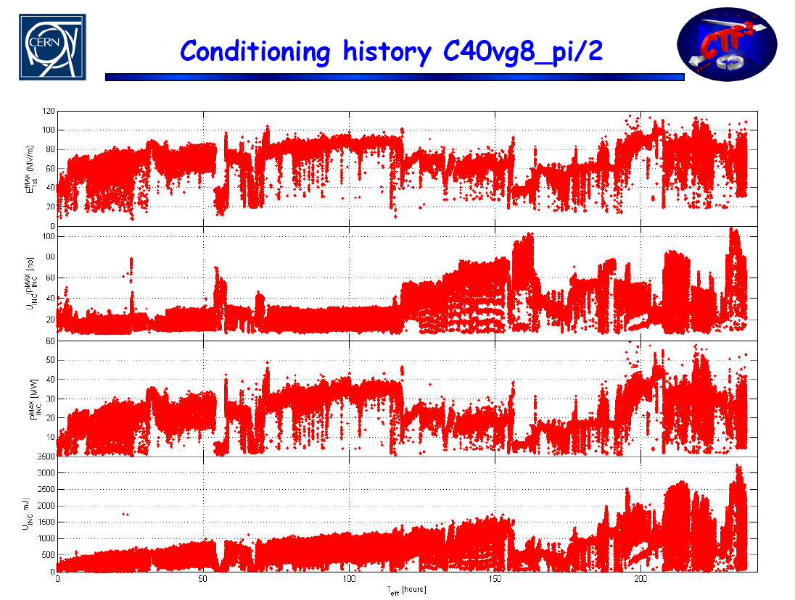
π/2 brazed Cu disc structure
Steffen, CLIC meeting, 14.3.2008

Slide 3
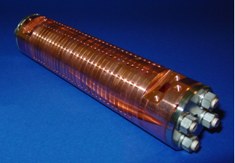
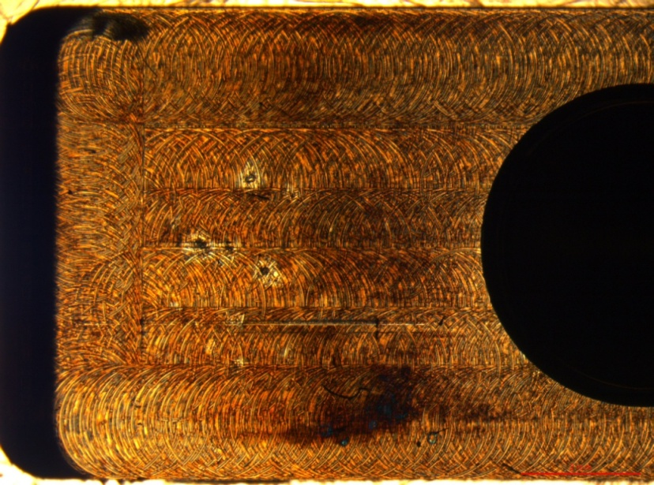
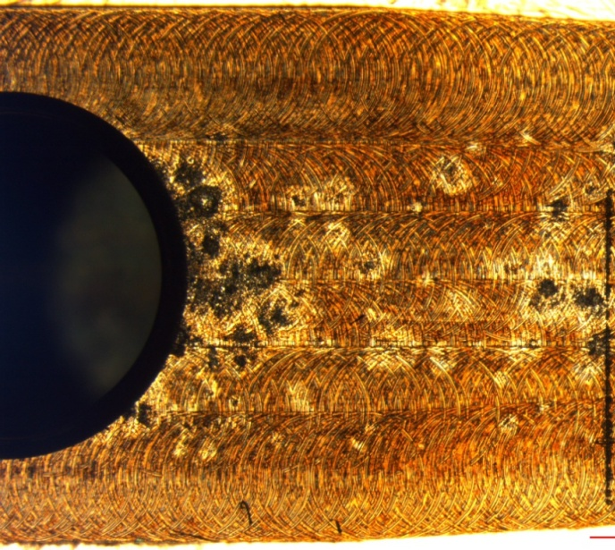
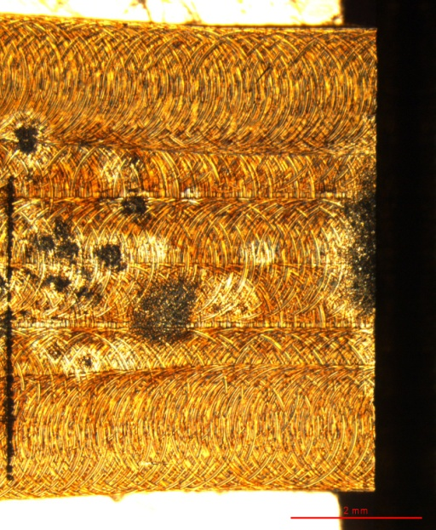
π/2 brazed Cu disc structure
Power in
Waveguide wall of the input coupler
Power in

Slide 4
π/2 brazed Cu disc structure
Damage decreases slightly but does not vanish away completely
Only the last matching iris is significantly less damaged
More melting on the downstream side of the irises
“Pitting” present, possibly due to wire cutting
Input

Slide 5
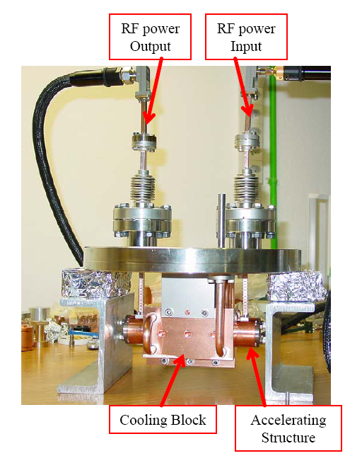
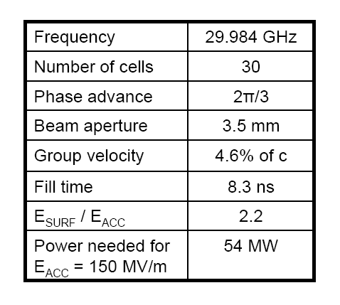
2π/3 brazed Cu disc structure
Alberto, CLIC meeting 30.6.2006

Slide 6
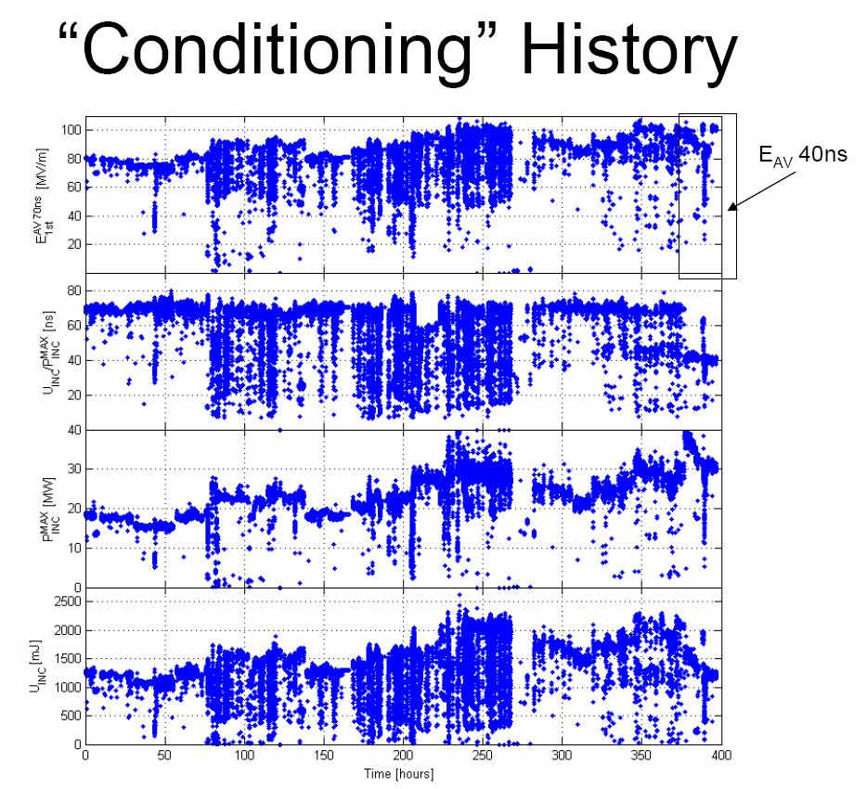
2π/3 brazed Cu disc structure
Alberto, CLIC meeting 30.6.2006

Slide 7
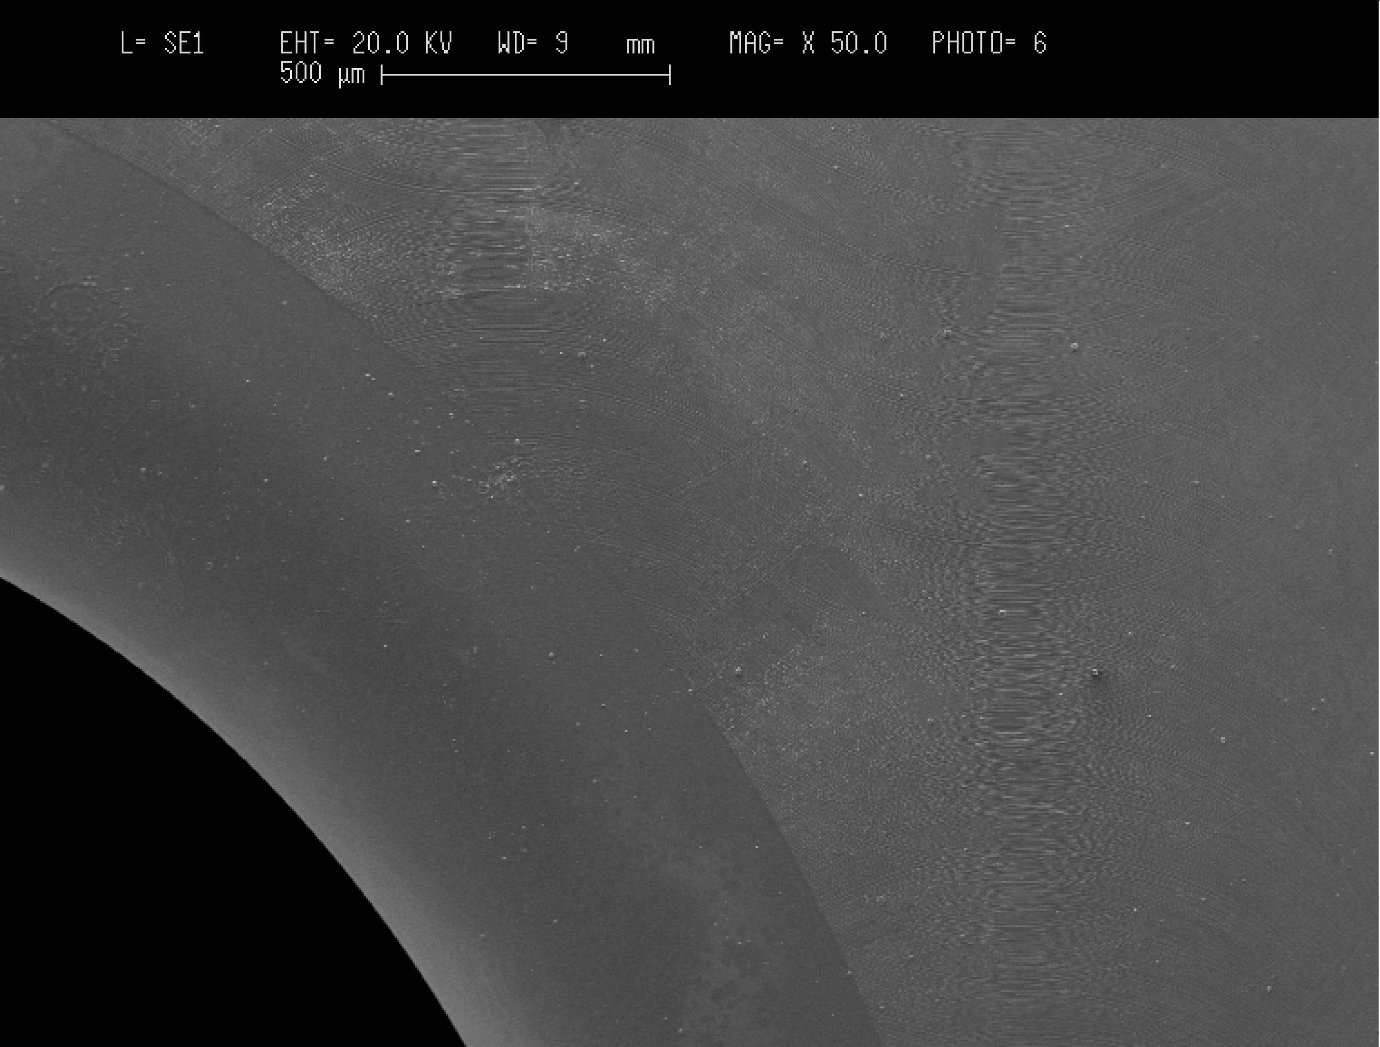
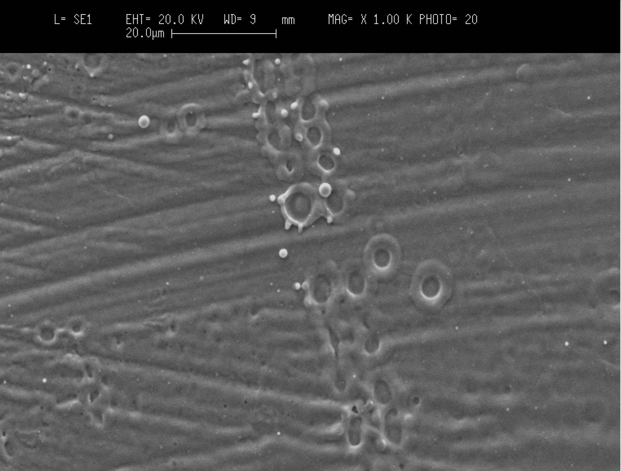
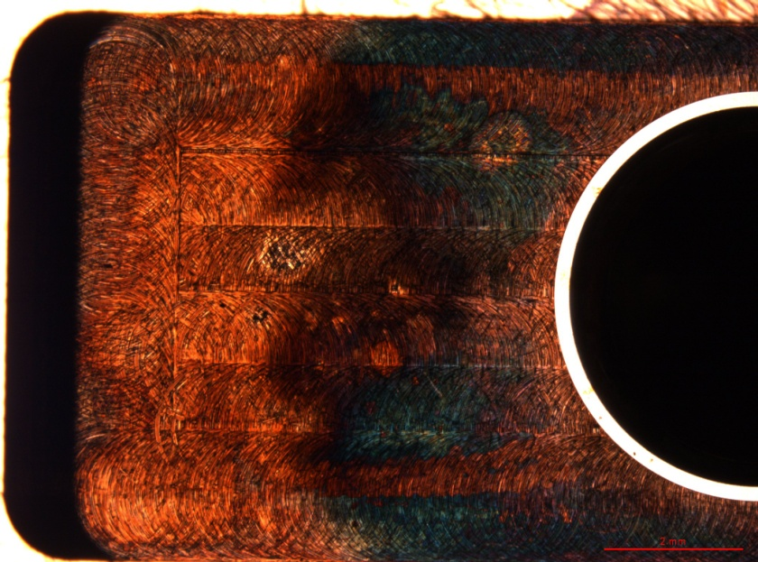
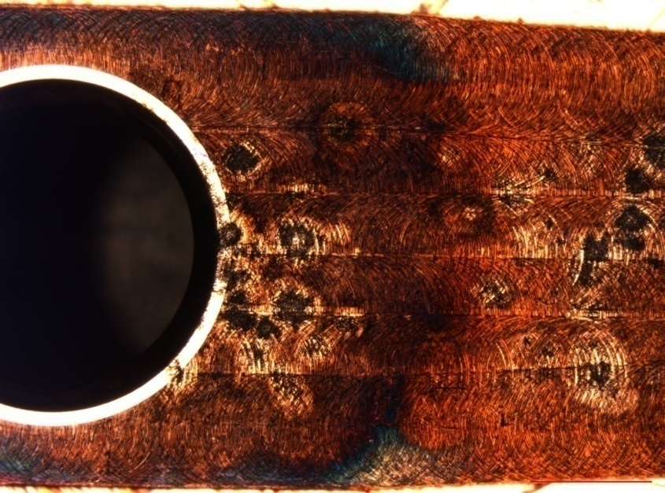
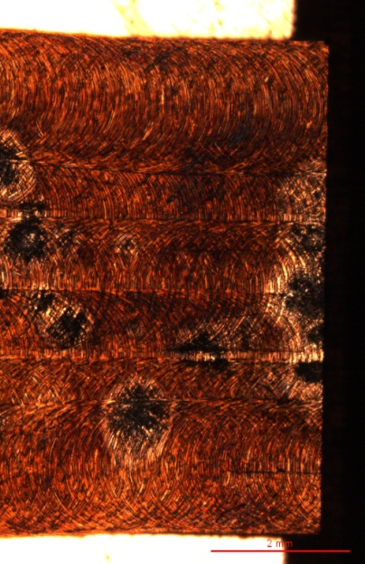
2π/3 brazed Cu disc structure
Power in
Waveguide wall of the input coupler
π/2 Cu
π/2 Cu
π/2 Cu
Power in

Slide 8
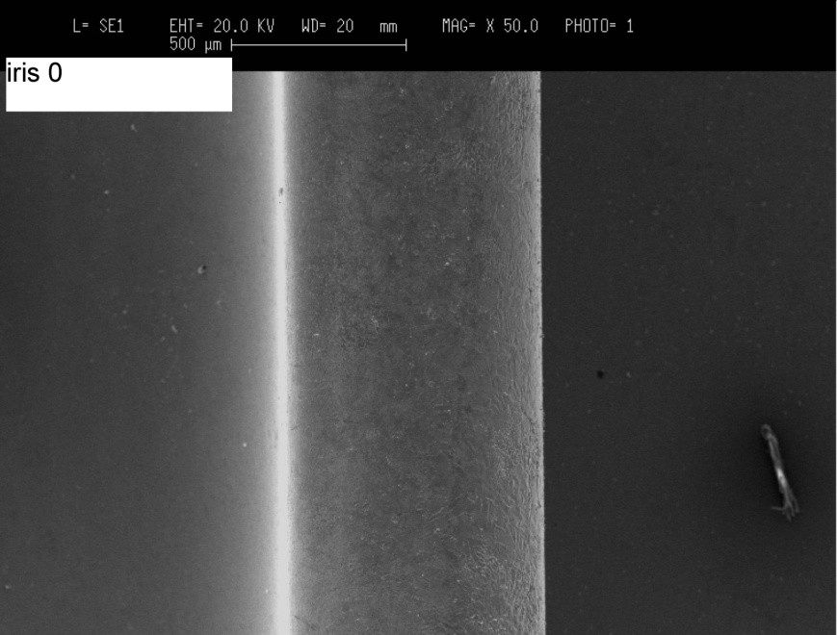
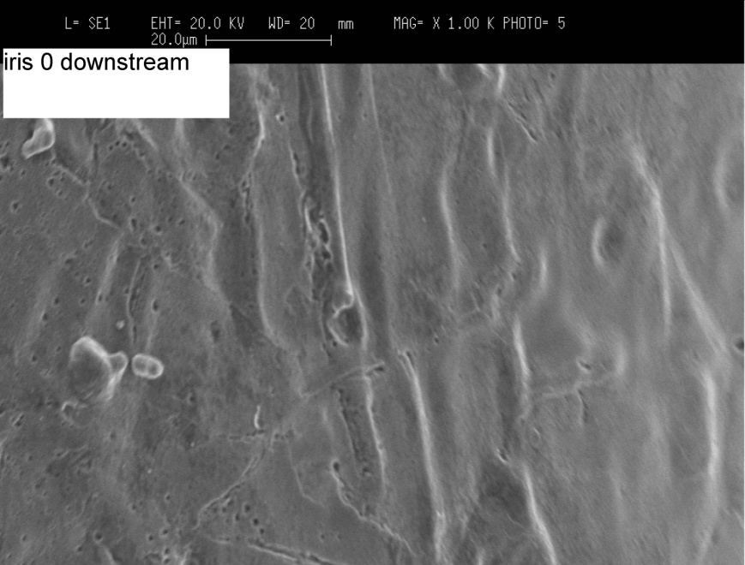
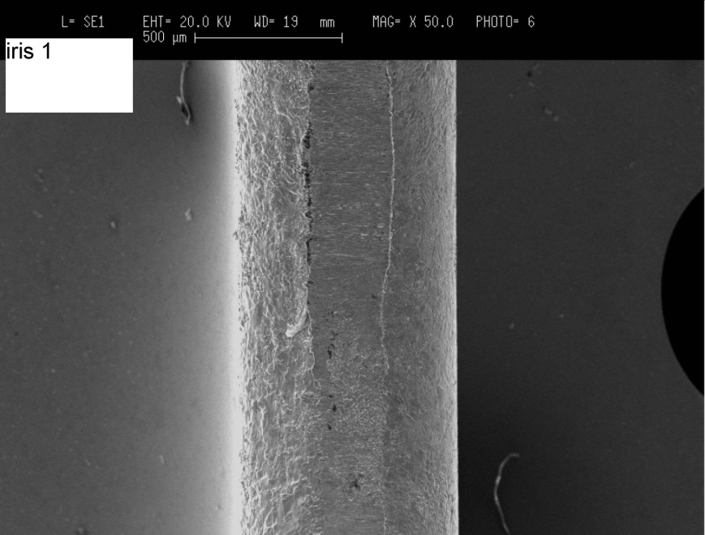
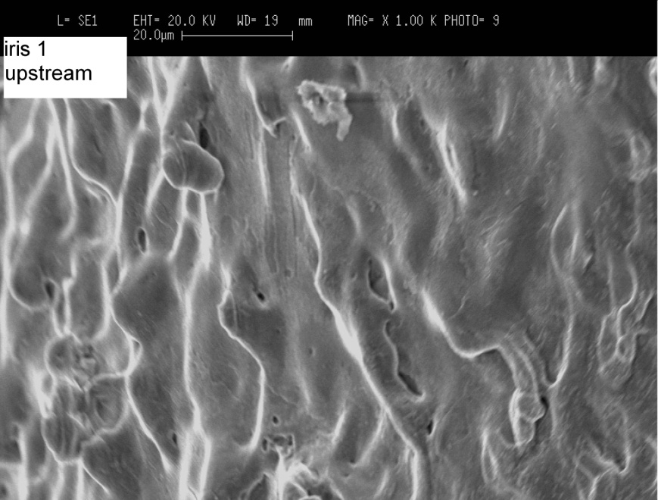
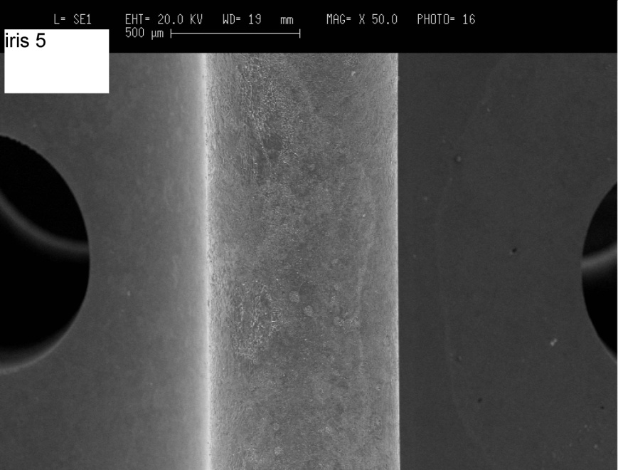
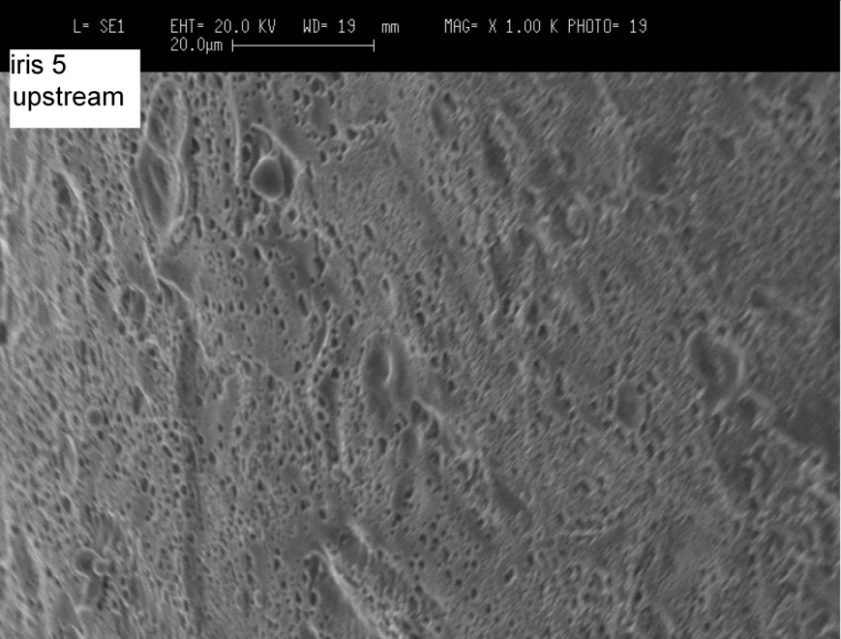
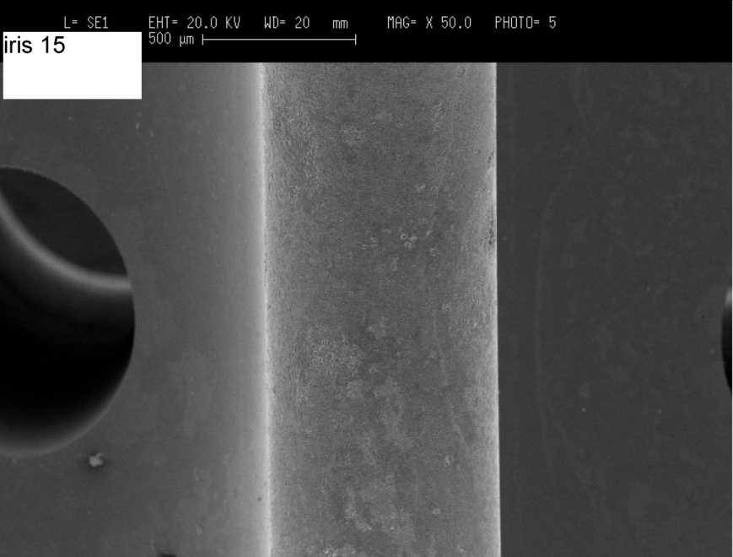
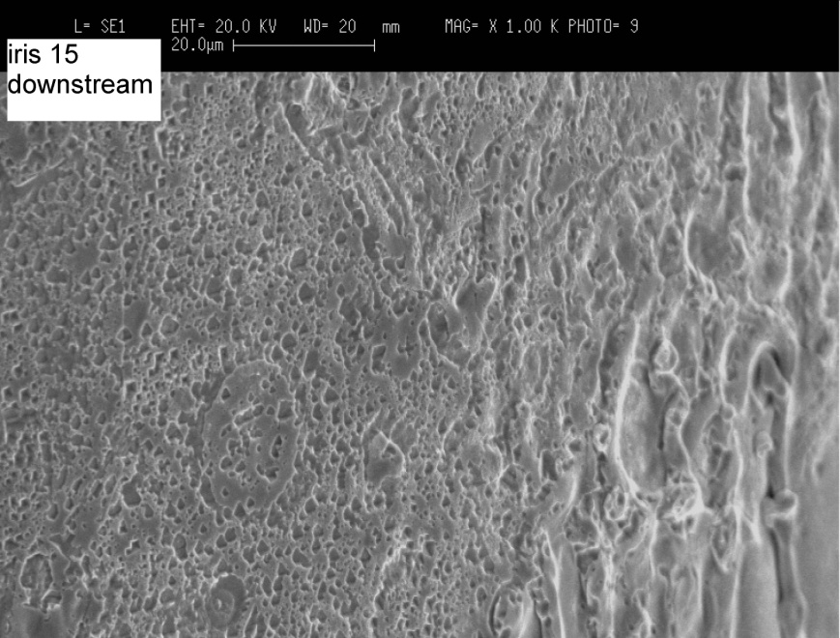
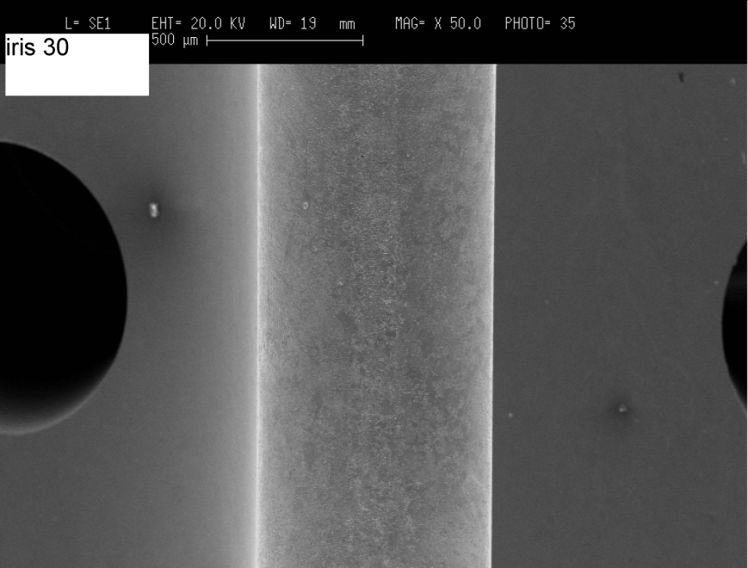
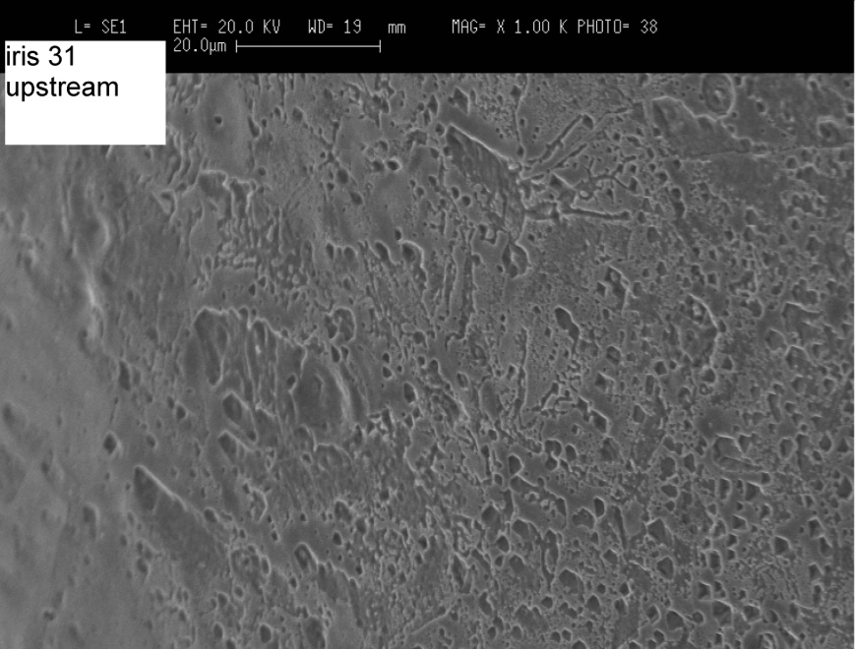
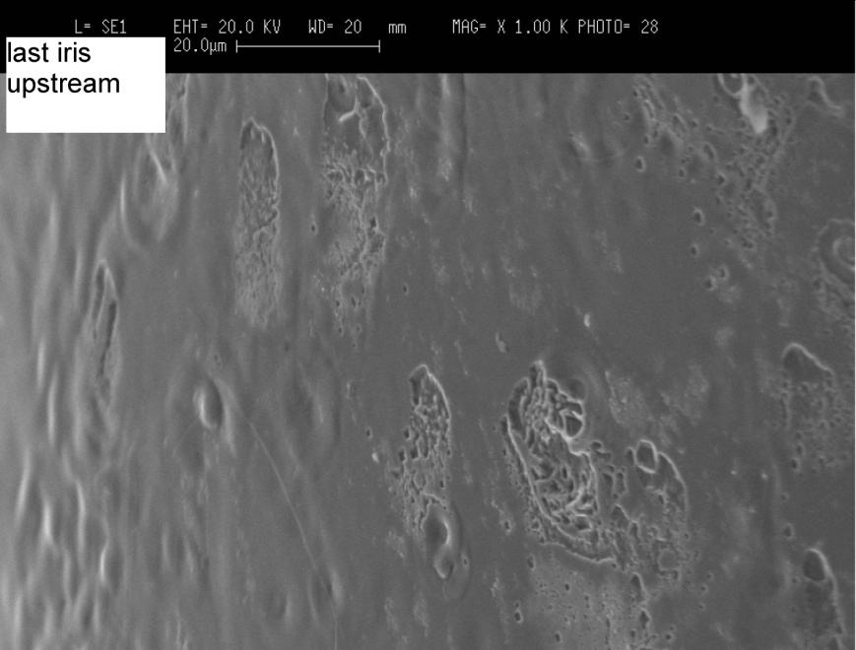
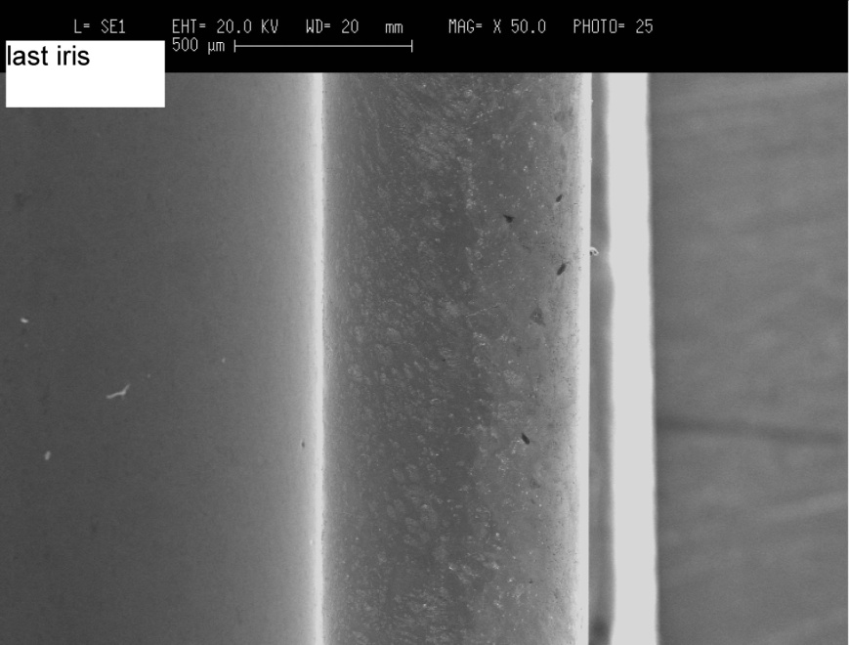
2π/3 brazed Cu disc structure
Damage decreases but does not vanish away completely
  The decrease is stronger than for π/2 Cu
Less damaged than the π/2 Cu
More melting (perhaps) on the upstream side of the irises
“Pitting” heavily present, possibly due to wire cutting
Input

Slide 9
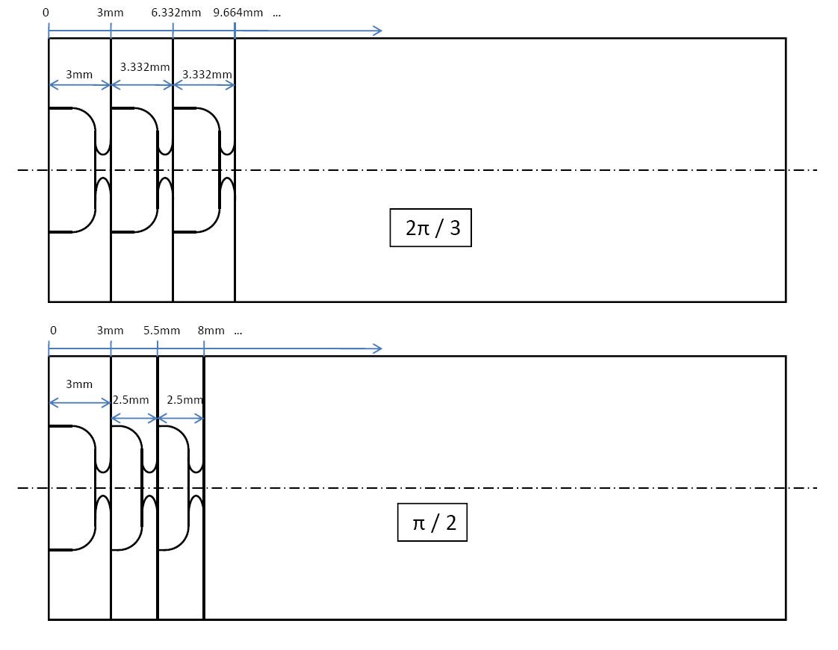
π /2 and 2π/3 compared side by side

Slide 10
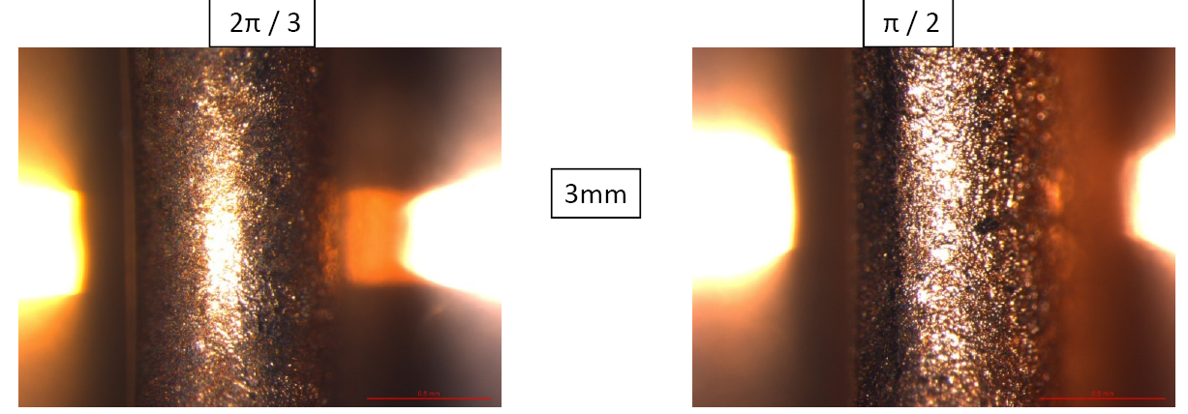
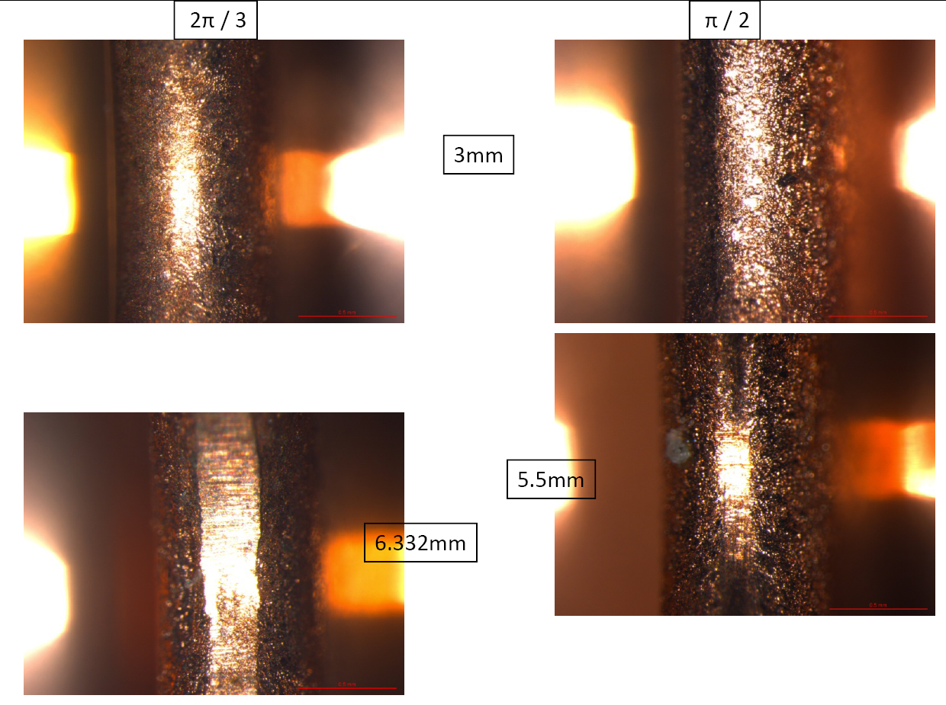
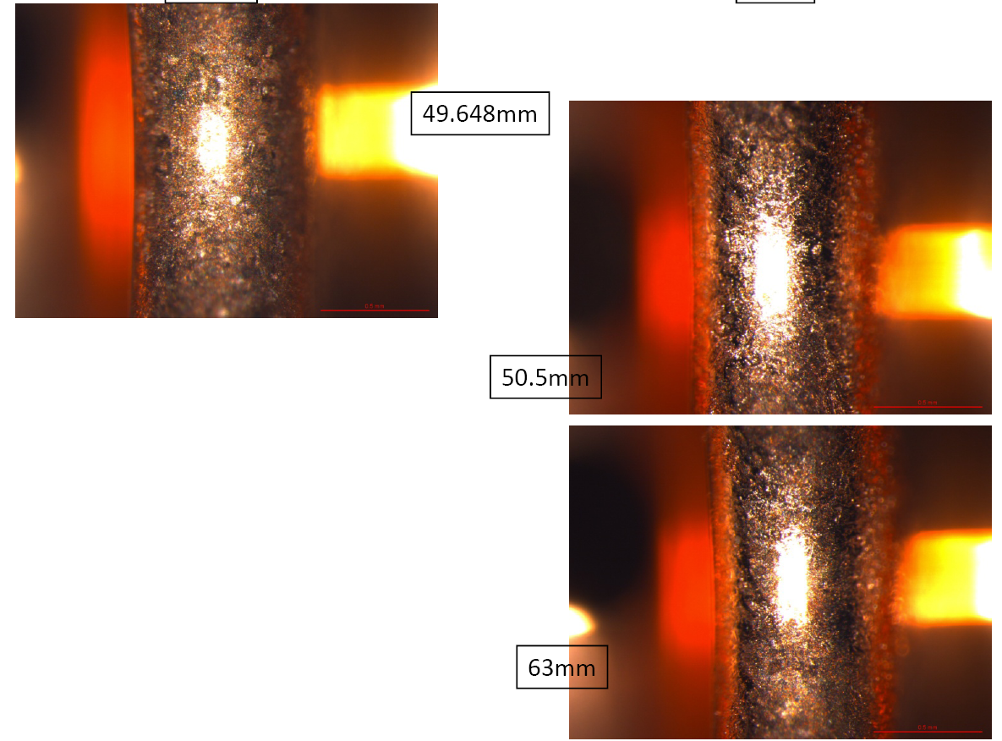
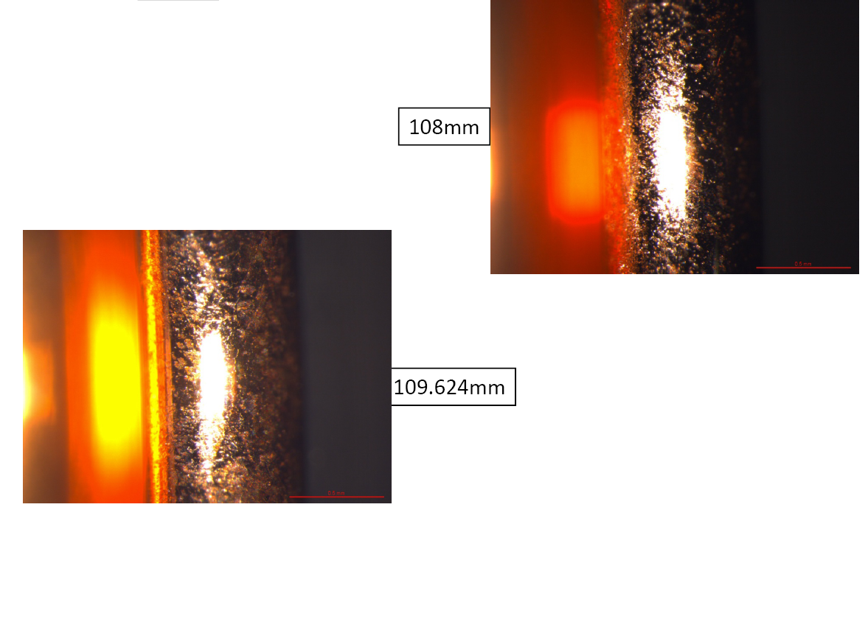
π /2 and 2π/3 compared side by side
Input matching irises
Output matching irises

Slide 11
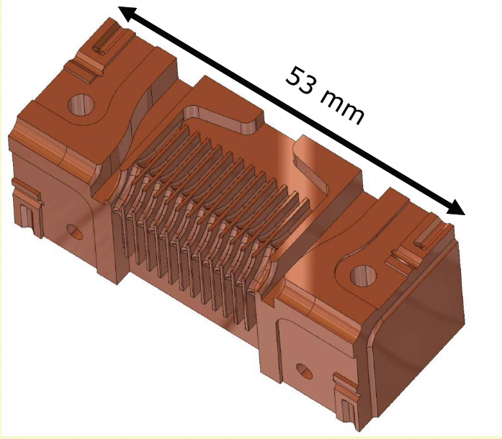
30HDS11 Small Cu
IMTEC - Cu HDS11 small, 30HDSQ11S.Cu
  Received at CERN in CW44
  RF check in CW45 (they are OK)
  Metrology: CW51 OK
  Burr removal: CW3 (add. step)
  Cleaning: CW04
  SEM: CW05
  Heat treatment: CW06
  SEM: CW08

Slide 12
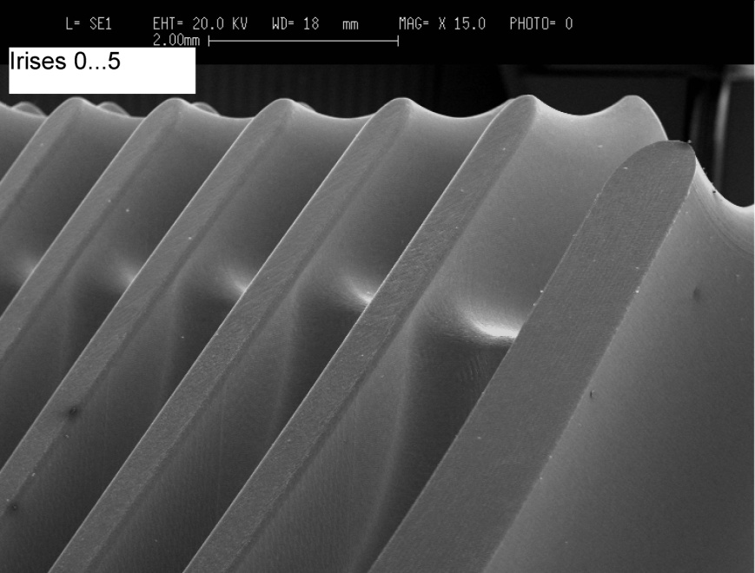
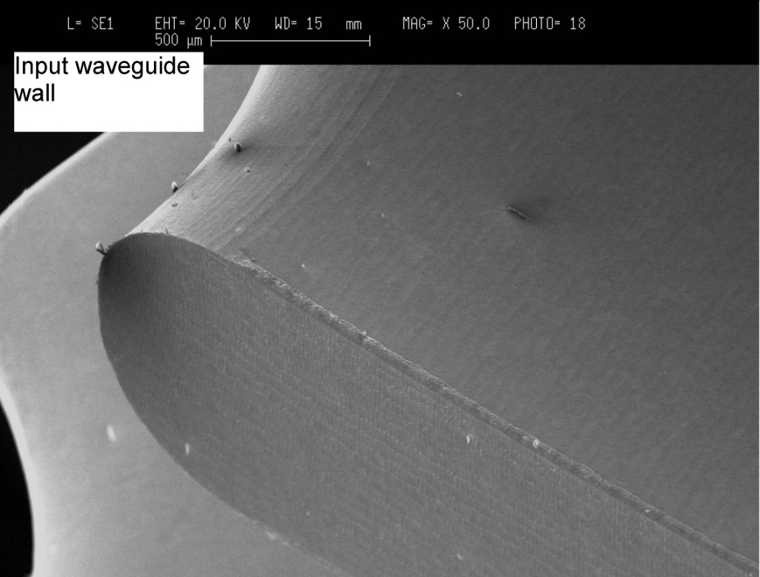
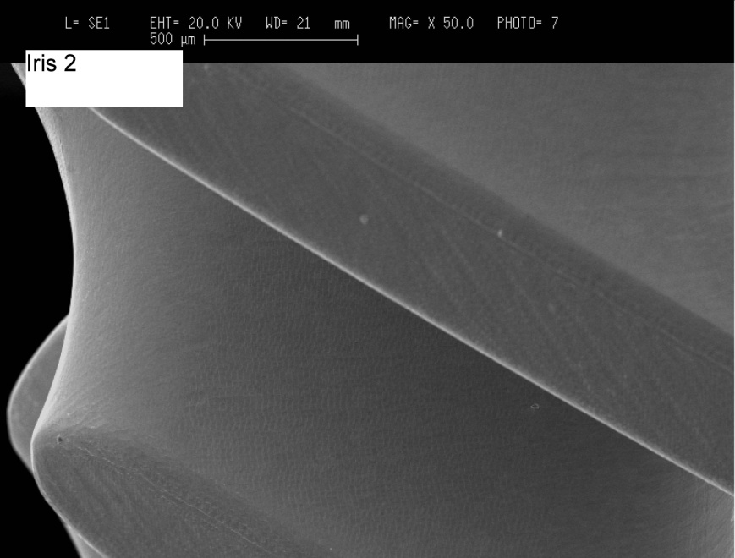
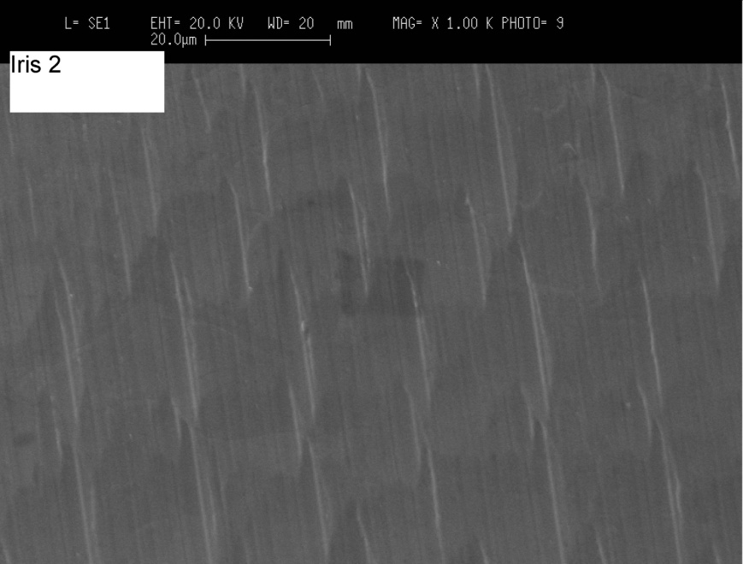
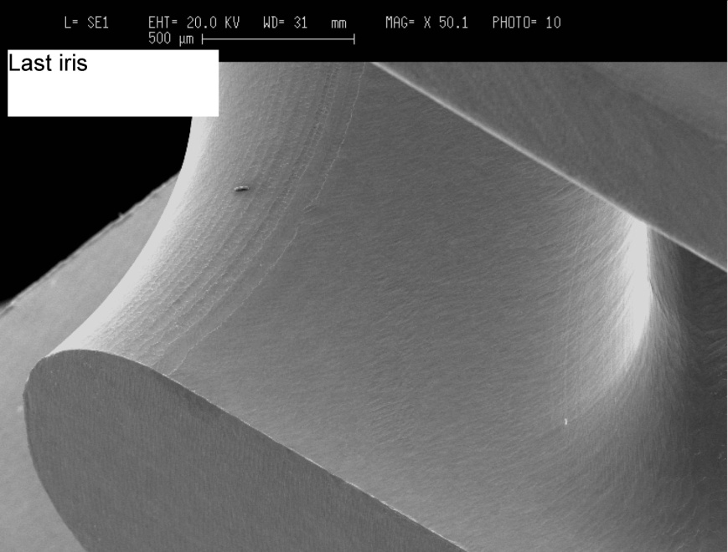
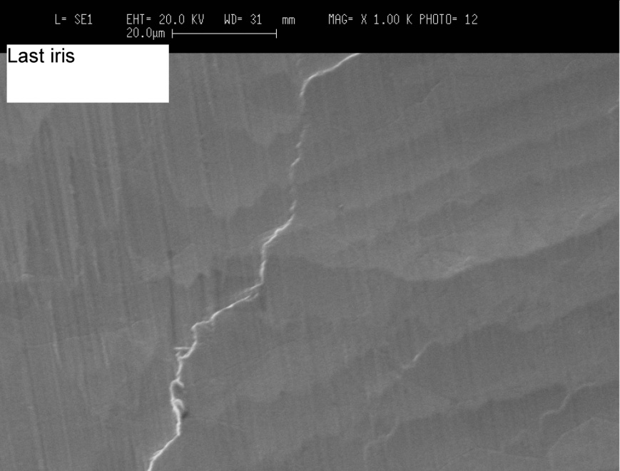
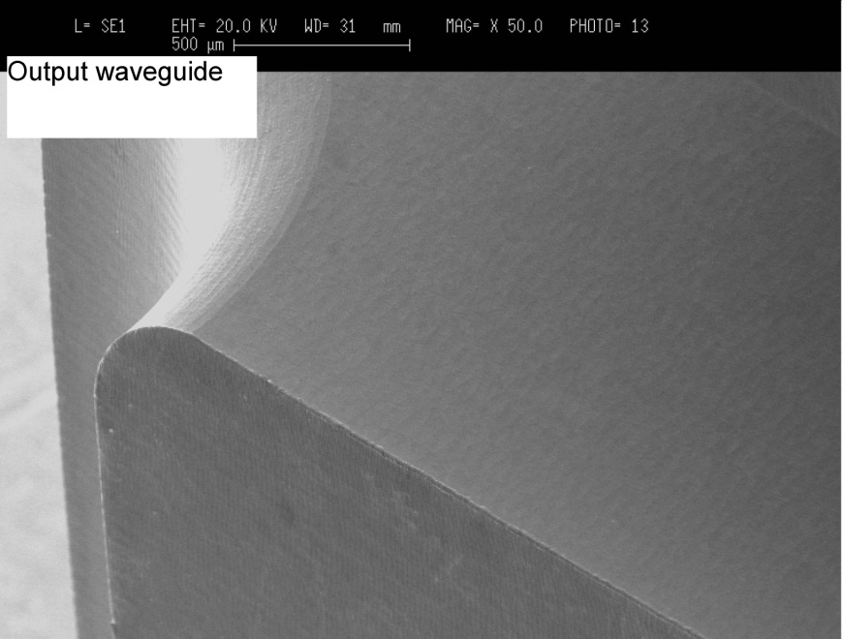
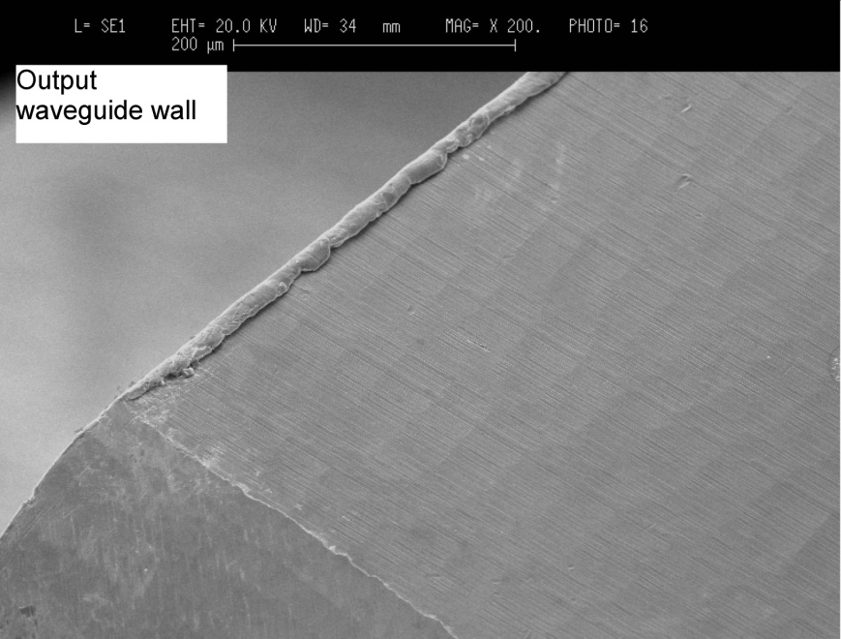
30HDS11 Small Cu
As received
After deburring, cleaning and heat treatment
Machining marks “softened” after heat treatment
Machining traces look very smooth
Chip-like burrs are removed
Thick burrs remain (possibly in the high field regions? Input waveguide wall)

