Slide 1
https://wiki.lepp.cornell.edu/ilc/bin/view/Public/DampingRings/ILCDR08/WebHome

Slide 2
Participants
Dr. DOWD, Rohan | Australian Synchrotron | AUSTRALIA
FISCHER, Wolfram | BNL | UNITED STATES OF AMERICA
GUO, Weiming | Brookhaven National Laboratory | UNITED STATES OF AMERICA
Dr. CALATRONI, Sergio | CERN | SWITZERLAND
Dr. RUMOLO, Giovanni | CERN | SWITZERLAND
Mr. BILLING, Michael | CLASSE, Cornell University | UNITED STATES OF AMERICA
CALVEY, Joseph | Cornell | UNITED STATES OF AMERICA
Dr. GREENWALD, Shlomo | Cornell | UNITED STATES OF AMERICA
LIVEZEY, Jesse | Cornell | UNITED STATES OF AMERICA
Mr. SIKORA, John | Cornell | UNITED STATES OF AMERICA
Dr. CRITTENDEN, James | Cornell University | UNITED STATES OF AMERICA
DUGAN, Gerald | Cornell University | UNITED STATES OF AMERICA
FORSTER, Michael | Cornell University | UNITED STATES OF AMERICA
Dr. GRAY, Stephen W. | Cornell University | UNITED STATES OF AMERICA
Prof. HARTILL, Don | Cornell University | UNITED STATES OF AMERICA
RENDINA, Matt | Cornell University | UNITED STATES OF AMERICA
RICE, David | Cornell University | UNITED STATES OF AMERICA
Prof. RUBIN, David | Cornell University | UNITED STATES OF AMERICA
Mr. SAGAN, David | Cornell University | UNITED STATES OF AMERICA
Mr. SHANKS, James | Cornell University | UNITED STATES OF AMERICA
WHITNEY, Will | Cornell University | UNITED STATES OF AMERICA
Dr. PALMER, Mark | Cornell University LEPP | UNITED STATES OF AMERICA
ROSS, Marc | Fermilab | UNITED STATES OF AMERICA
Dr. ZWASKA, Robert | Fermilab | UNITED STATES OF AMERICA
Dr. GUIDUCCI, Susanna | INFN-LNF | ITALY
Dr. FLANAGAN, John | KEK | JAPAN
KANAZAWA, Ken-ichi | KEK | JAPAN
KUBO, Kiyoshi | KEK | JAPAN
Dr. OIDE, Katsunobu | KEK | JAPAN
Dr. SUETSUGU, Yusuke | KEK | JAPAN
Prof. URAKAWA, Junji | KEK | JAPAN
YAMAMOTO, Akira | KEK | JAPAN
Dr. CELATA, Christine | Lawrence Berkeley National Laboratory | UNITED STATES OF AMERICA
Mr. FURMAN, Miguel | LBNL | UNITED STATES OF AMERICA
MELLER, Robert | LEPP Cornell University | UNITED STATES OF AMERICA
Dr. PIVI, Mauro | SLAC | UNITED STATES OF AMERICA
Dr. YAN, Yiton | SLAC | UNITED STATES OF AMERICA
Dr. WOLSKI, Andy | U Liverpool/Cockcroft Institute | UNITED KINGDOM

Slide 3
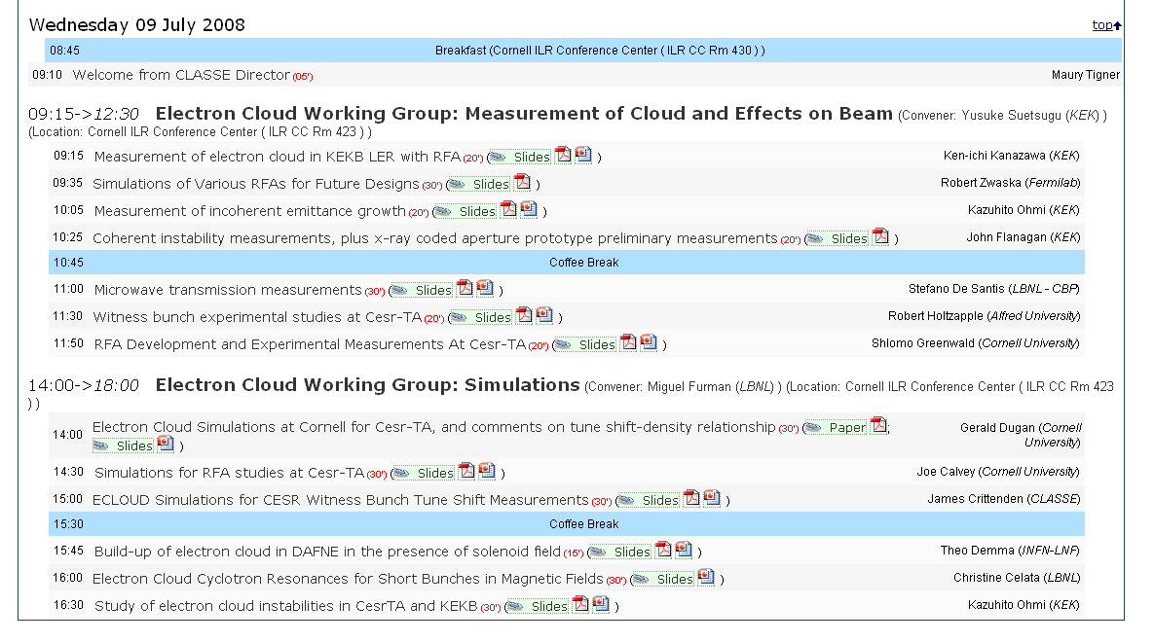

Slide 4
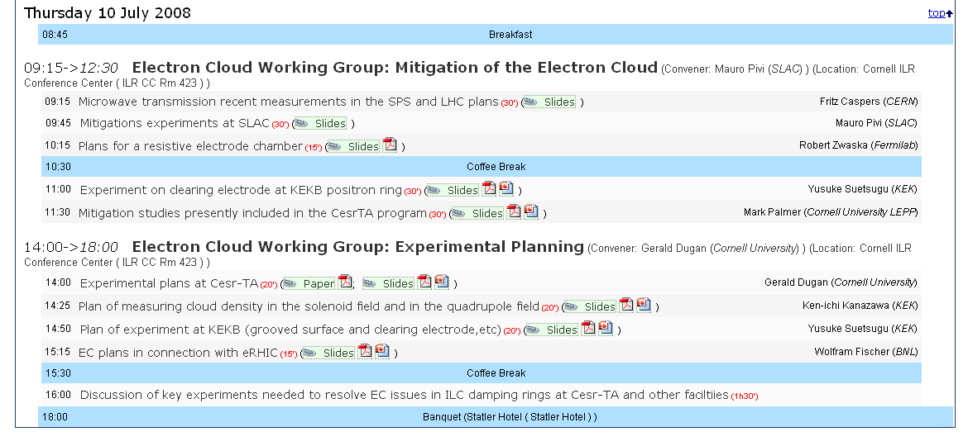

Slide 5
Electron cloud working group:
Mitigation of the electron cloud
    Coatings
    Grooves
    Clearing electrodes

Slide 6
Mauro Pivi, SLAC

Slide 7
Mauro Pivi, SLAC

Slide 8
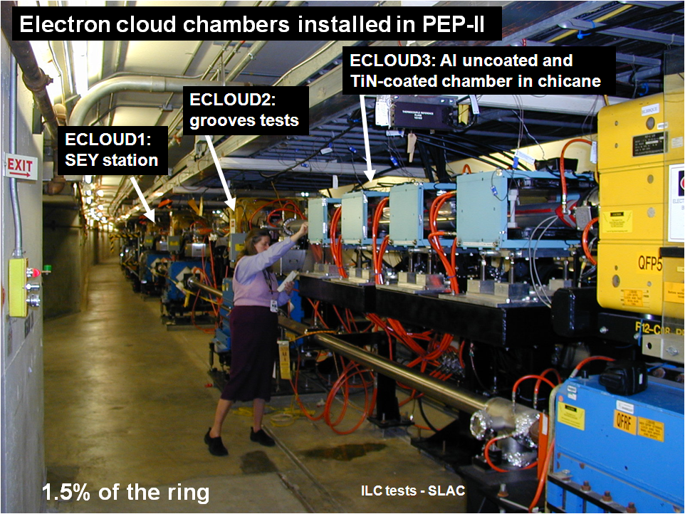
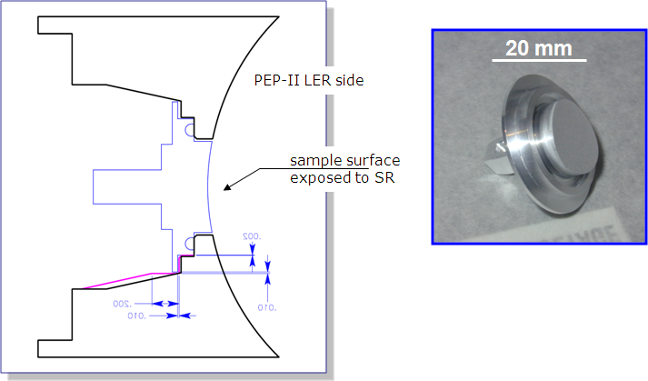
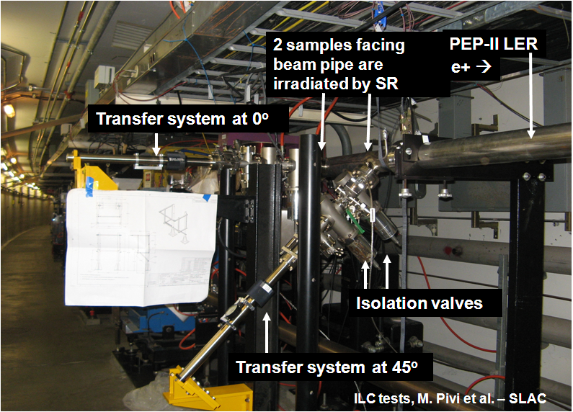

Slide 9
Mauro Pivi, SLAC

Slide 10
Mauro Pivi, SLAC

Slide 11
Mauro Pivi, SLAC

Slide 12
Mauro Pivi, SLAC

Slide 13
Mauro Pivi, SLAC

Slide 14
Mauro Pivi, SLAC

Slide 15
Mauro Pivi, SLAC

Slide 16
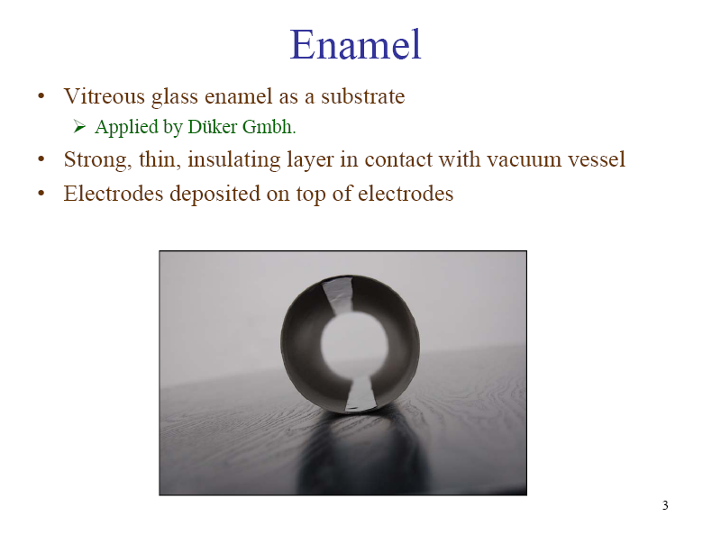
Robert Zwaska, Fermilab

Slide 17
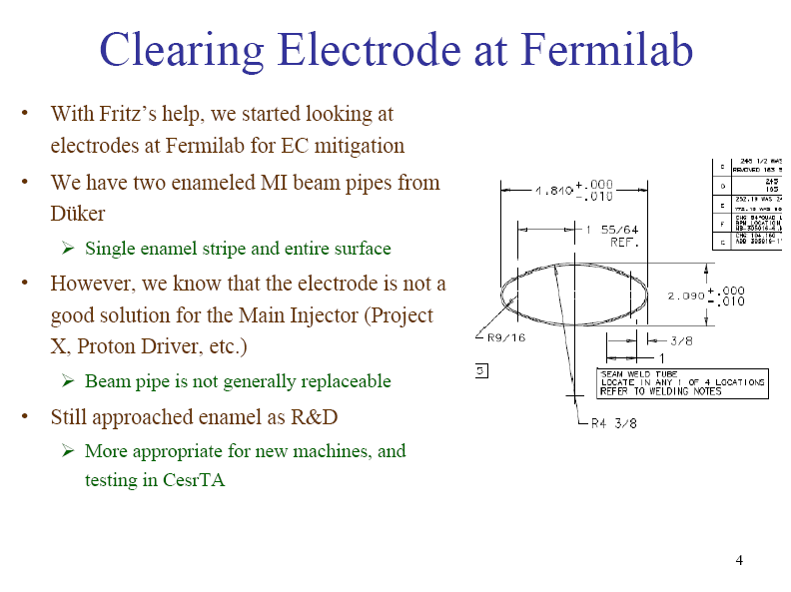
Robert Zwaska, Fermilab

Slide 18
Yusuke Suetsugu, KEK

Slide 19
Yusuke Suetsugu, KEK

Slide 20
Yusuke Suetsugu, KEK

Slide 21
Mauro Pivi, SLAC

Slide 22
Electron cloud working group:
Experimental planning

Slide 23
Mark Palmer, Cornell

Slide 24
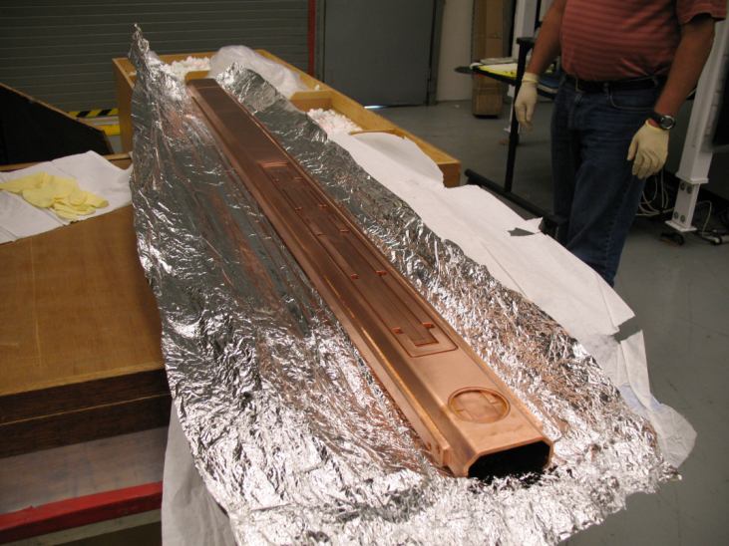
Mark Palmer, Cornell

Slide 25
Mark Palmer, Cornell

Slide 26
Mark Palmer, Cornell

Slide 27
Mark Palmer, Cornell

Slide 28
Mark Palmer, Cornell

Slide 29
Mark Palmer, Cornell

Slide 30
Mark Palmer, Cornell

Slide 31
Mark Palmer, Cornell

Slide 32
Key questions for experimental planning
Mitigation Techniques
  What additional experiments are needed to establish high confidence in the proposed mitigation techniques to be used in the ILC damping ring?
    Repeat measurement of EC cloud suppression for TiN and NEG.
    Investigate chamber exposure to gases such as SF6, N2, O2.
    Try carbon coating proposed for SPS-durability under SR radiation
    Long term lifetime of TiN-PEP II and KEK can provide data.
    Clearing electrodes in wiggler and dipole, and grooves in dipole. Grooves for wiggler chamber should continue to be studied.
    Investigate feasibility of measuring transverse wake from single grooved chamber (and electrodes) using local field probes.
  What types of RFA, beam, or bench measurements are needed to fully characterize the proposed mitigation techniques?
    Depending on the type of mitigation (e.g., electrodes), there may be some additional code validation required.
Gerald Dugan, Cornell

