Slide 1
Markus Aicheler, Ruhr-University Bochum
CLIC Material Fatigue Study:
A summary of results of recent observations and test campaigns

Slide 2
Outline of the talk
Motivation / Aims
Observed material and tempers
The 4 fatigue experiments
Results and Discussion EBSD-Observation
Results and Discussion Hardness-Observation

Slide 3
Motivation
Aims:
Observe influence of crystallographic orientation on fatigue behavior
Observe influence of fatigue / machining on mechanical properties
Show similarities between the different fatigue tests
=> Show that the fatigue tests are coherent and relevant for CLIC structure!
Means:
EBSD on samples with big grains laser fatigued with constant parameters
Nano-Indentation in fatigued and non-fatigued areas of machined and non-machined samples
Interpret the results and review results of other researchers on related topics

Slide 4
Observation material
C10100 (OFE Copper)
Reference material
Well known
Results comparable to other researchers
Supplementary fatigue data needed (CuZr already well tested by Samuli)
40% cold worked
as received
Round bar cold rolled Ø 40 mm and Ø 100 mm
Yield Strength: R_{p0.2} = 316 MPa
Ultimate tensile strength: R_{m} = 323 MPa
Average grain size: Ø 110 um
Brazed
Heat treatment in vacuum furnace:
300 K/h -> 795 °C; 60 min hold
100 K/h -> 825 °C; 6 min hold
Natural cooling in vacuum
- Yield Strength: R_{p0.2} ≈ 72 MPa
Ultimate tensile strength: R_{m} = 270 MPa
Average grain size: Ø 400 um
2h@1000 °C
Heat treatment in vacuum furnace:
300 K/h -> 1000 °C; 120 min hold
Natural cooling in vacuum
- Yield Strength: R_{p0.2} ≈ 72 MPa
Ultimate tensile strength: R_{m} = 257 MPa
Average grain size: Ø 1400 um

Slide 5
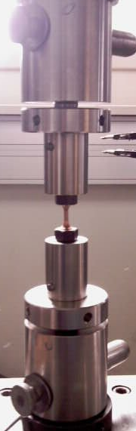
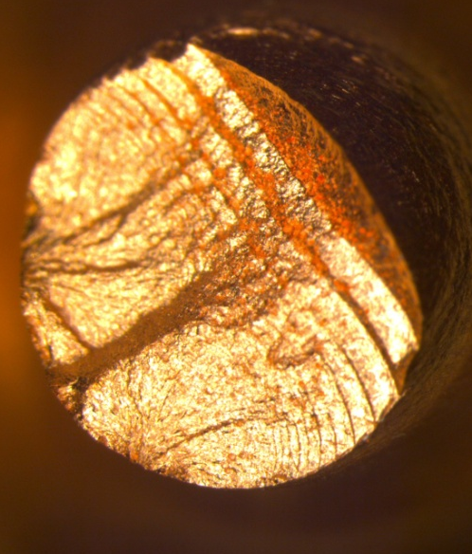
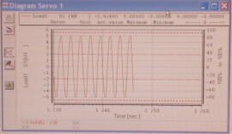
Conventional fatigue test
- Mechanical fatigue; R = -1 (R = σ_{max}/ σ_{min})
UTS electro-mechanical universal-test machine
Repetition rate 0.5 Hz
Load +/-220 MPa; stress controlled
Sample shape conform ISO 12106
3-5 samples for one data point
Damage criterion: rupture
2 mm

Slide 6
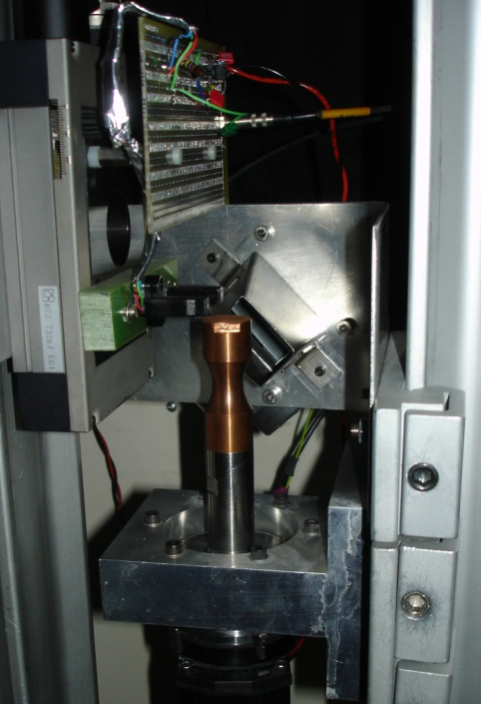
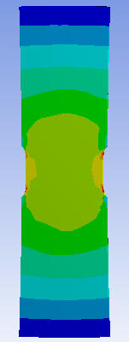
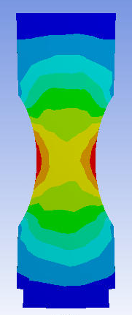
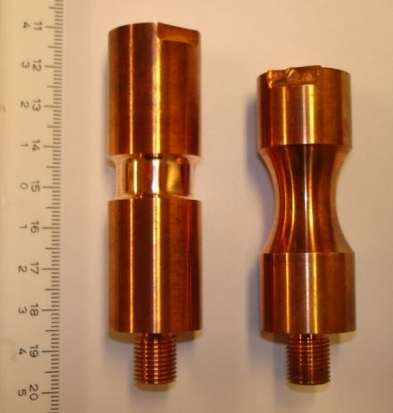
Ultrasound swinger test
- Mechanical fatigue; R = -1 (R = σ_{max}/ σ_{min})
Piezo electric resonant attenuator
Repetition rate 24 kHz
Load +/-70 MPa; strain controlled
3-5 samples for one data point
Damage criterion: roughness or crack
New sample shape:
easier surface observation & replica
one defined gage length
easier to machine & electro polish
comparison to results of other researchers
Former shape
New shape

Slide 7
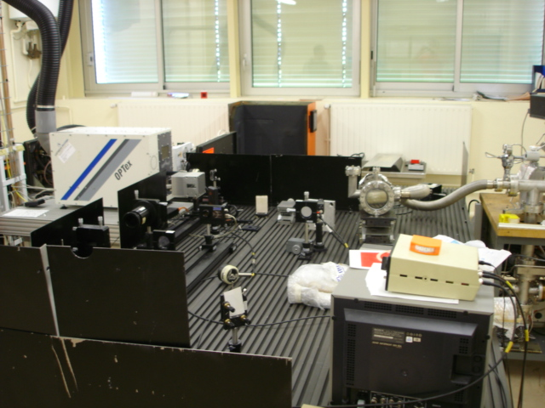
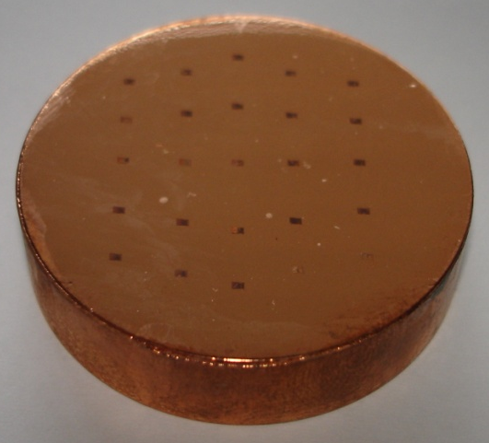
Laser fatigue test
- Thermal fatigue in vacuum
OPTEX Excimer Laser; λ = 248 nm
Repetition rate 200 Hz
5 x 10⁴ shots @ 0.3 J/cm² ≈ ΔT 250 °C
Round disc diameter 40 mm
25 discrete spots per disc
Damage criterion: Roughness

Slide 8
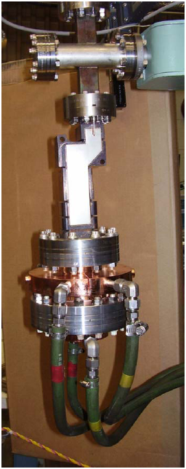
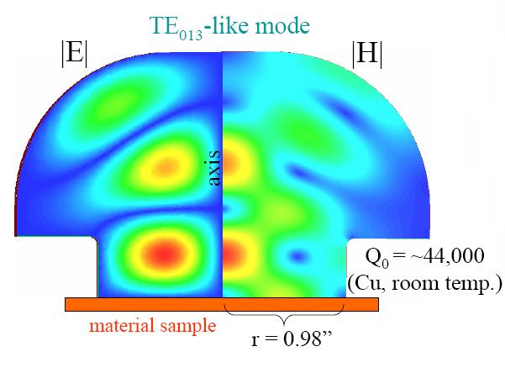
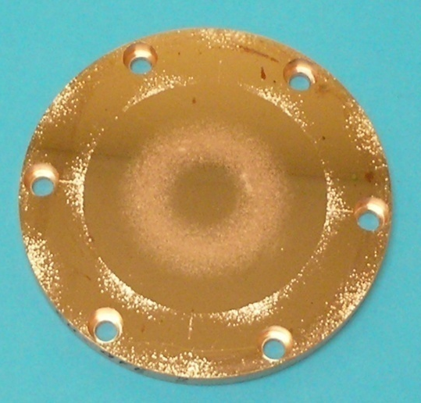
SLAC RF heating (Stanford)
- Thermal fatigue due to RF heating
Mushroom cavity @ 11,4 GHz
Repetition rate 50 Hz
2 x 10⁶ Pulses; ΔT_{max} 110 °C
Round disc diameter 100 mm
Continuous radial distribution of ΔT
Damage criterion ?
Photos: Sami Tantawi
Presentation 23 Jan. 2008

Slide 9
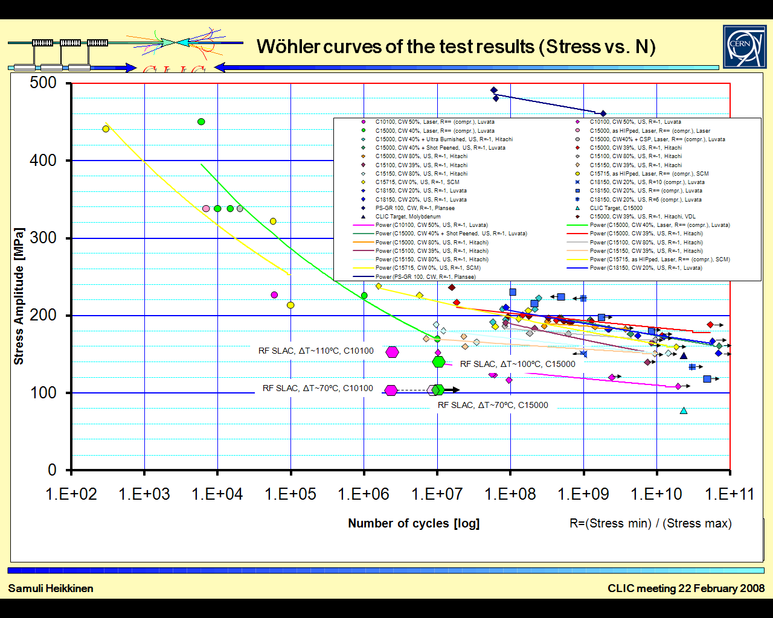

Slide 10
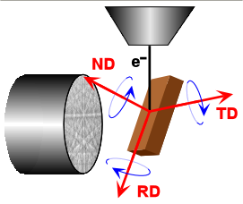
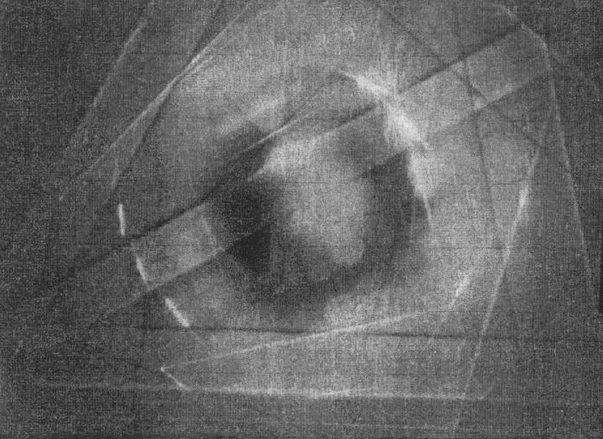
Observation techniques used: EBSD
Electron Back Scattered Diffraction
Electron Microscope column
SEM: Leo 1530 VP
EBSD unit: EDAX TSL
Phosphoric screen and digital camera
Kikuchi pattern
70°
“Bragg Reflection”

Slide 11
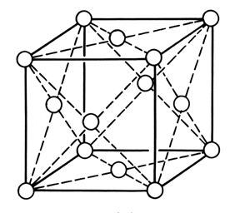
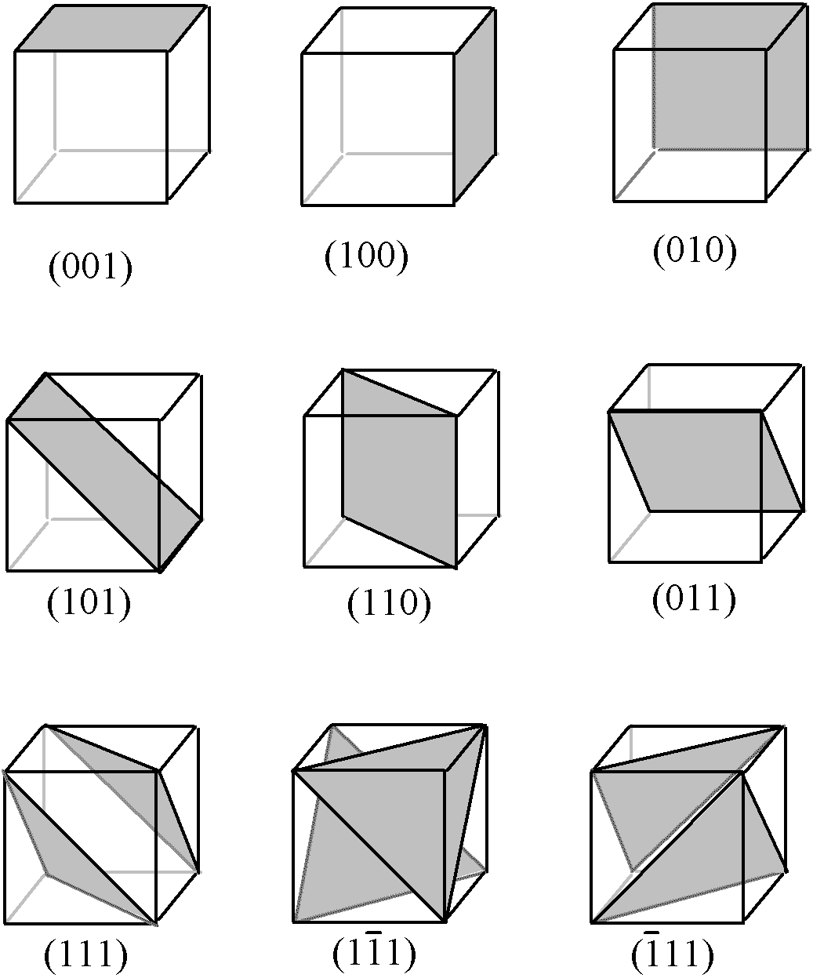
Crystallography
A cube with atoms on its corners and its faces (so called face centered cubic FCC)
Plenty of these elementary cells
(elementary cell)
Crystallographic description of directions:
Crystallographic description of planes: Normal vector of planes!
z
[1 1 1]
x
[1 0 0]
y
[1 1 0]

Slide 12
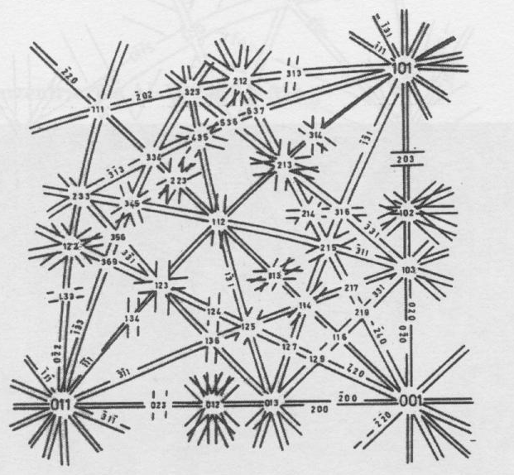
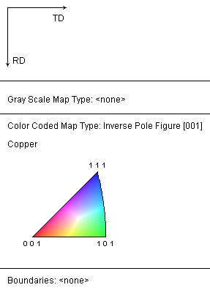
Kikuchi line indexing
(1 3 1)
(2 2 0)
(3 1 1)
(1 3 1)
(2 2 0)
(1 3 1)
(2 2 0)
(3 1 1)
(3 1 1)

Slide 13
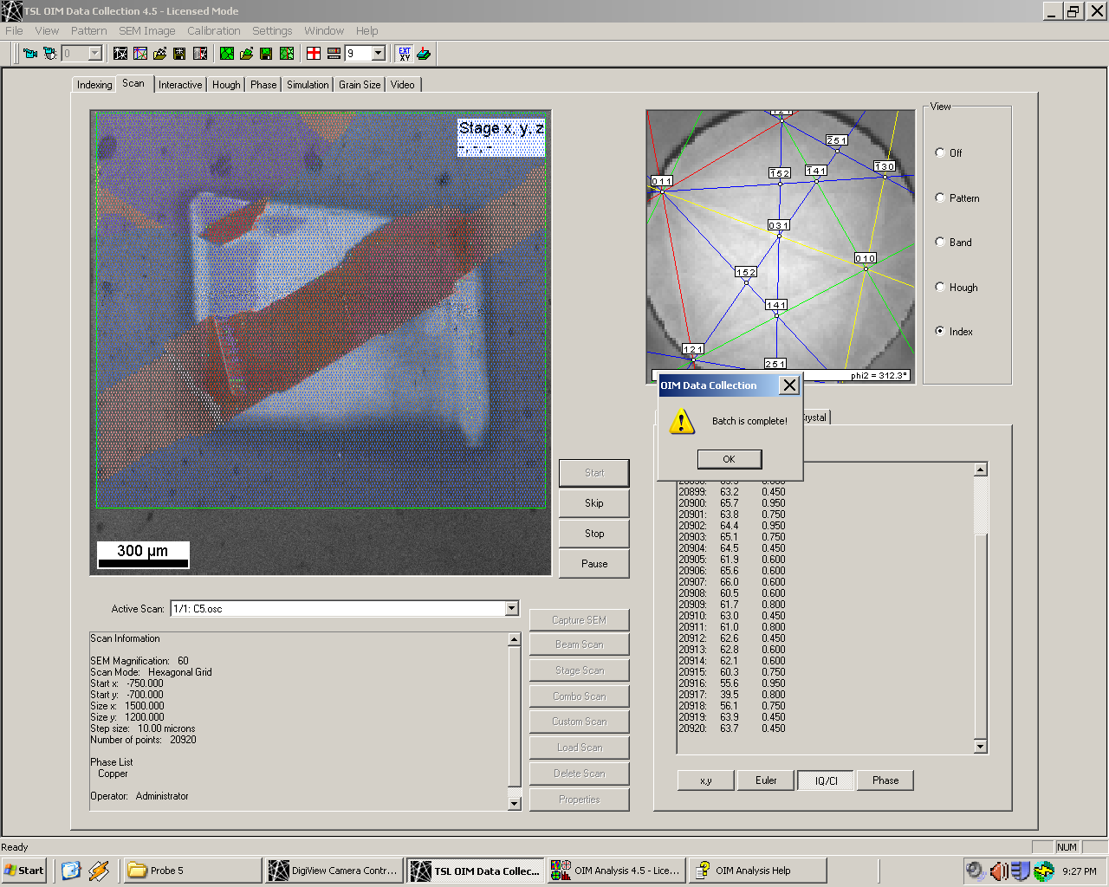
EBSD
Scan:
Each point one Kikuchi pattern
-> each point complete orientation information
=> Mapping of orientations
Scan rate: 75 points/s
Ordinary used for:
- Texture analysis
Orientation of samples (like X-Ray diffraction but faster)
Identification of different phases (like TEM but lower resolution/magnification)
Possibility to connect with quantitative EDX scans

Slide 14
SLAC Virgin Surface

Slide 15
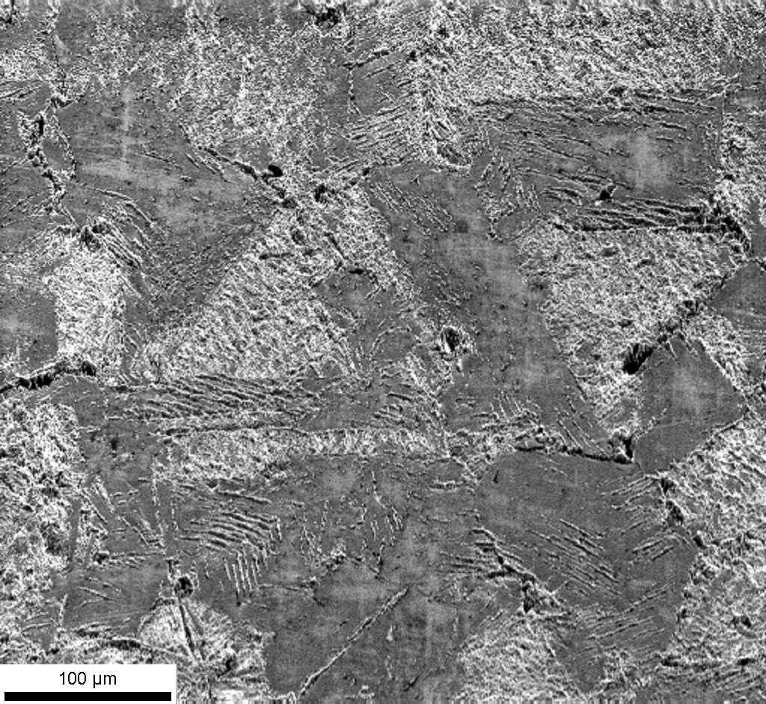
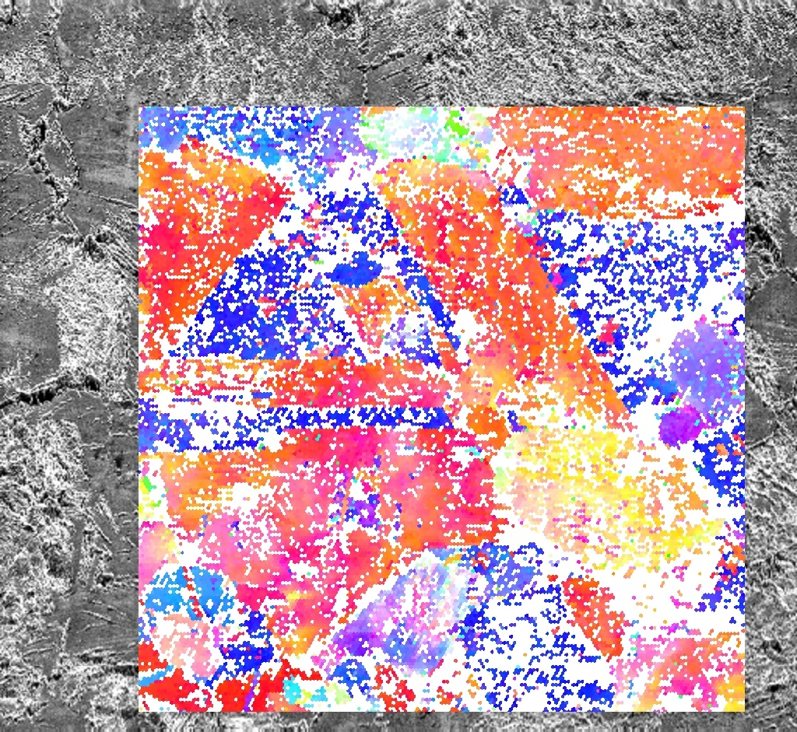
SLAC_Slash5

Slide 16
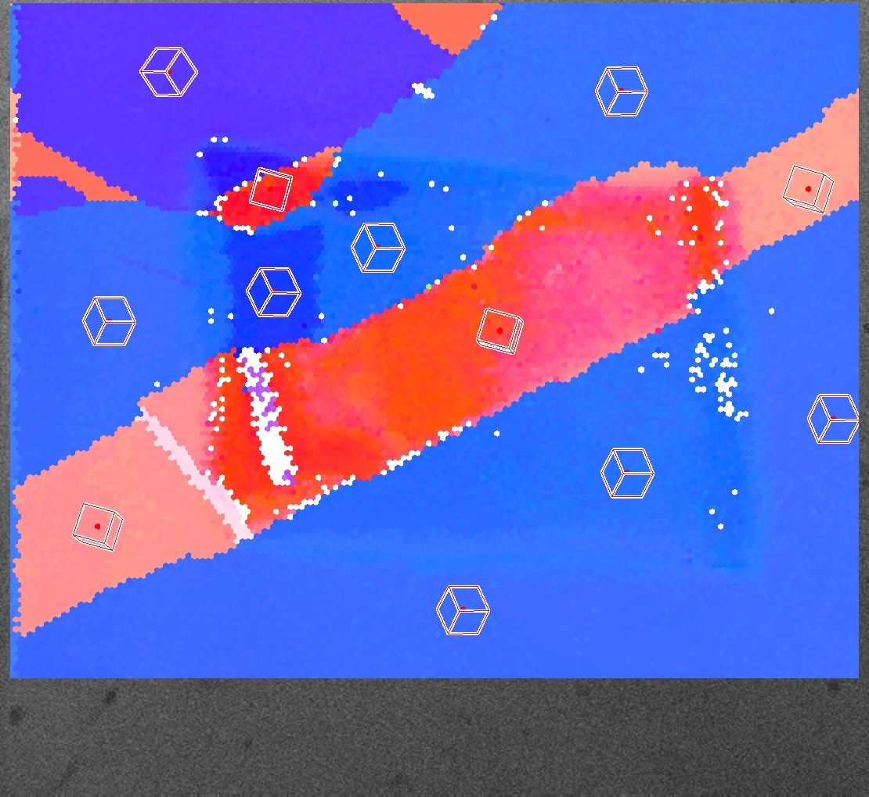
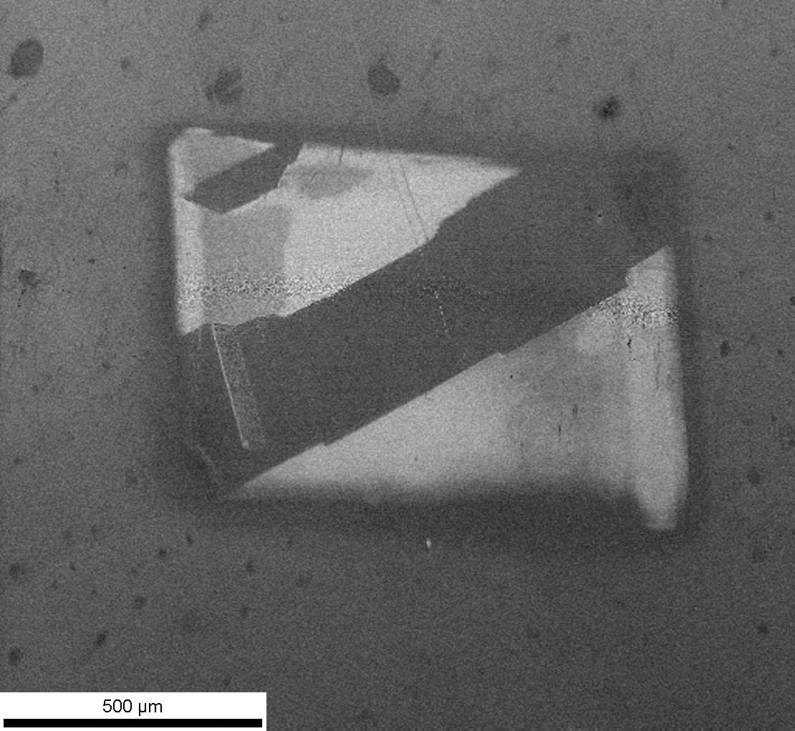
C10100_2h@1000_EP_Probe5_C5

Slide 17
C10100_2h@1000_EP_Probe5_C5

Slide 18
C10100_2h@1000_EP_Probe5_C5

Slide 19
C10100_2h@1000_EP_Probe5_C5

Slide 20
C10100_2h@1000_EP_Probe5_C5

Slide 21
C10100_2h@1000_EP_Probe5_C5 Virgin Surface

Slide 22
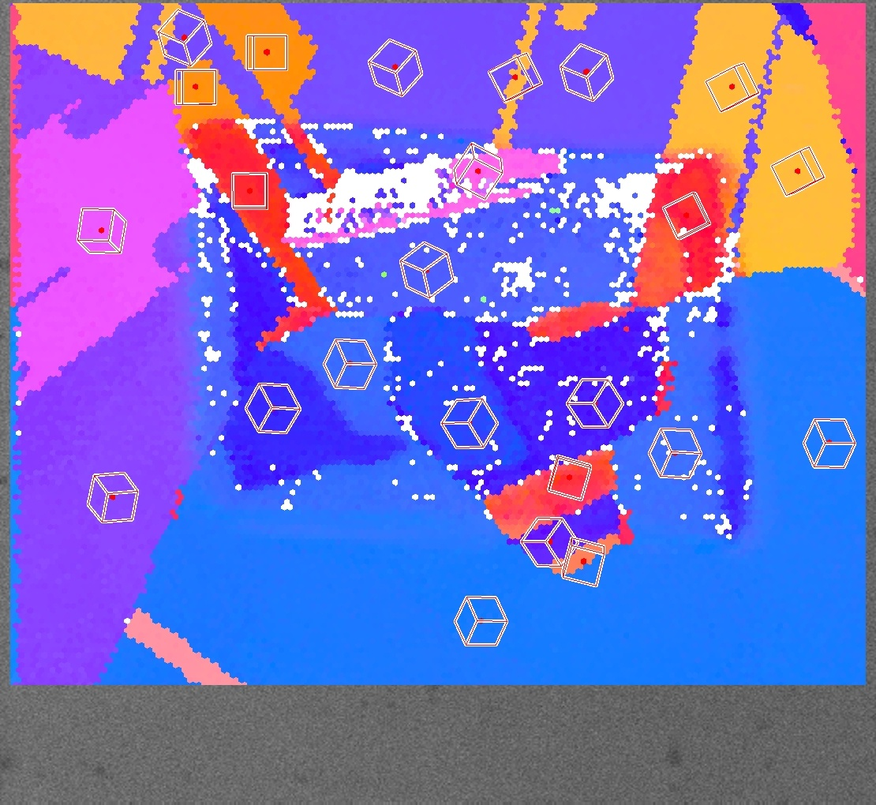
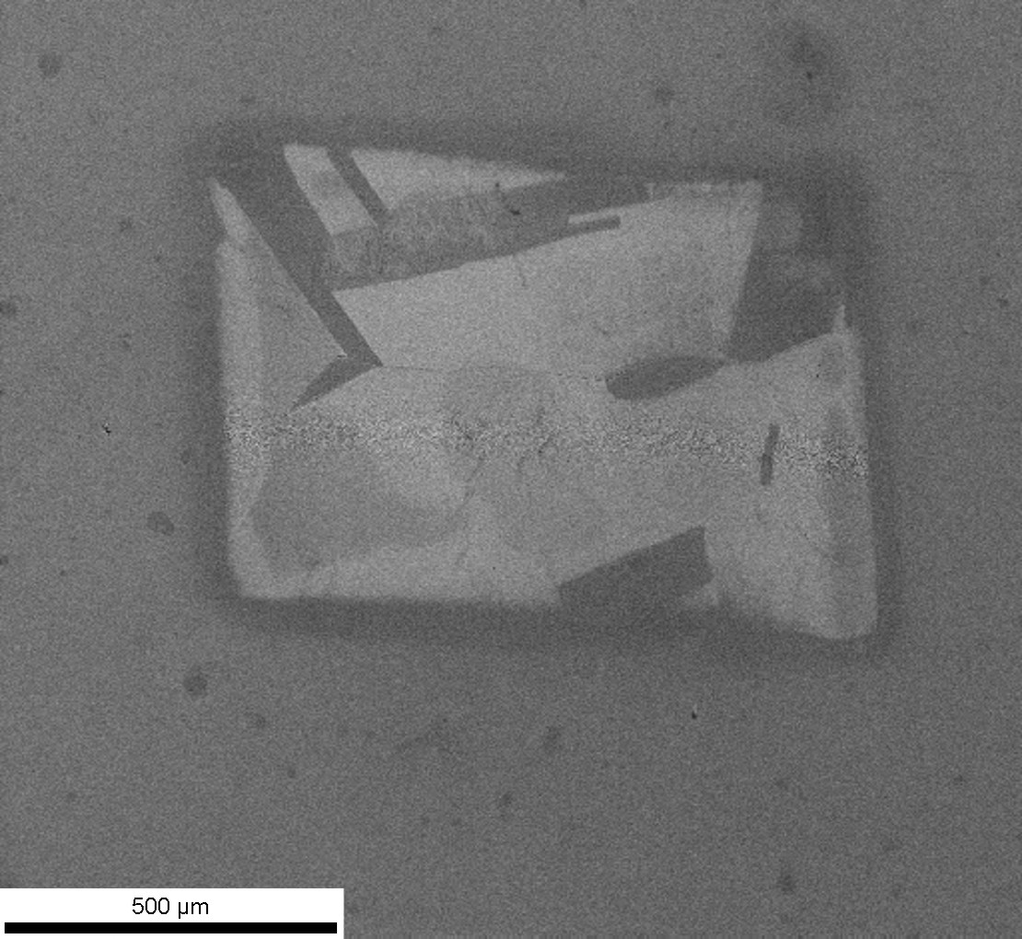
C10100_2h@1000_EP_Probe5_D4

Slide 23
C10100_2h@1000_EP_Probe5_D4

Slide 24
C10100_2h@1000_EP_Probe5_D4

Slide 25
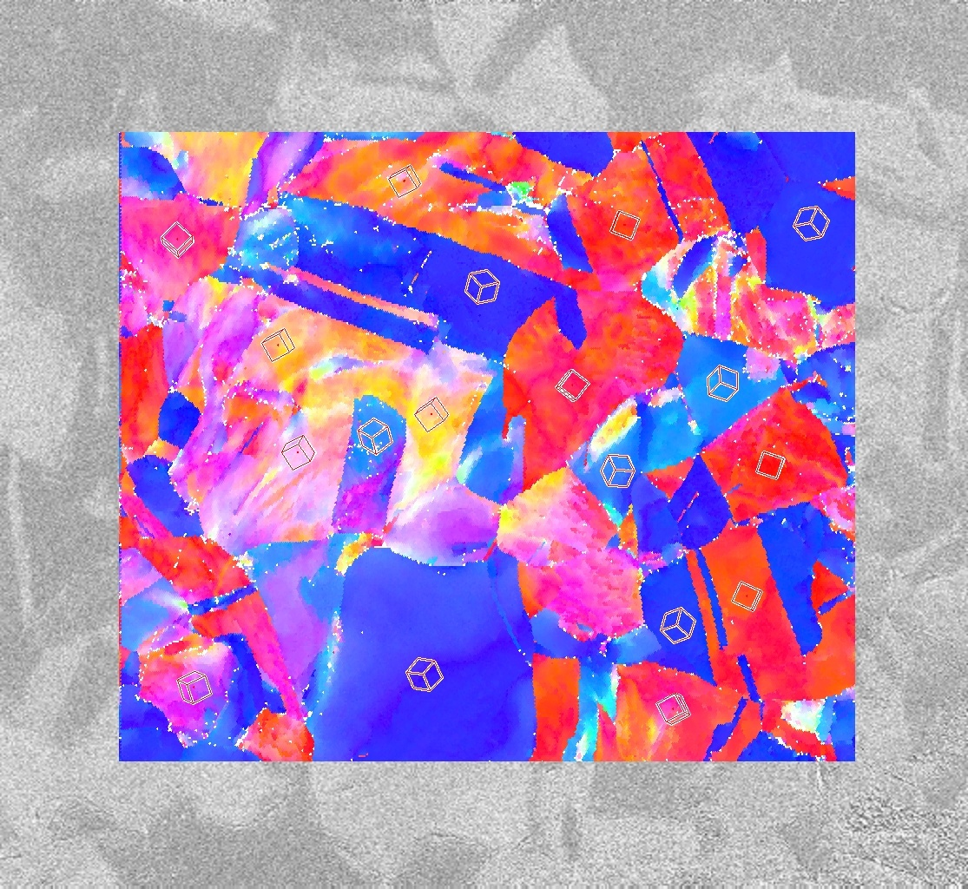
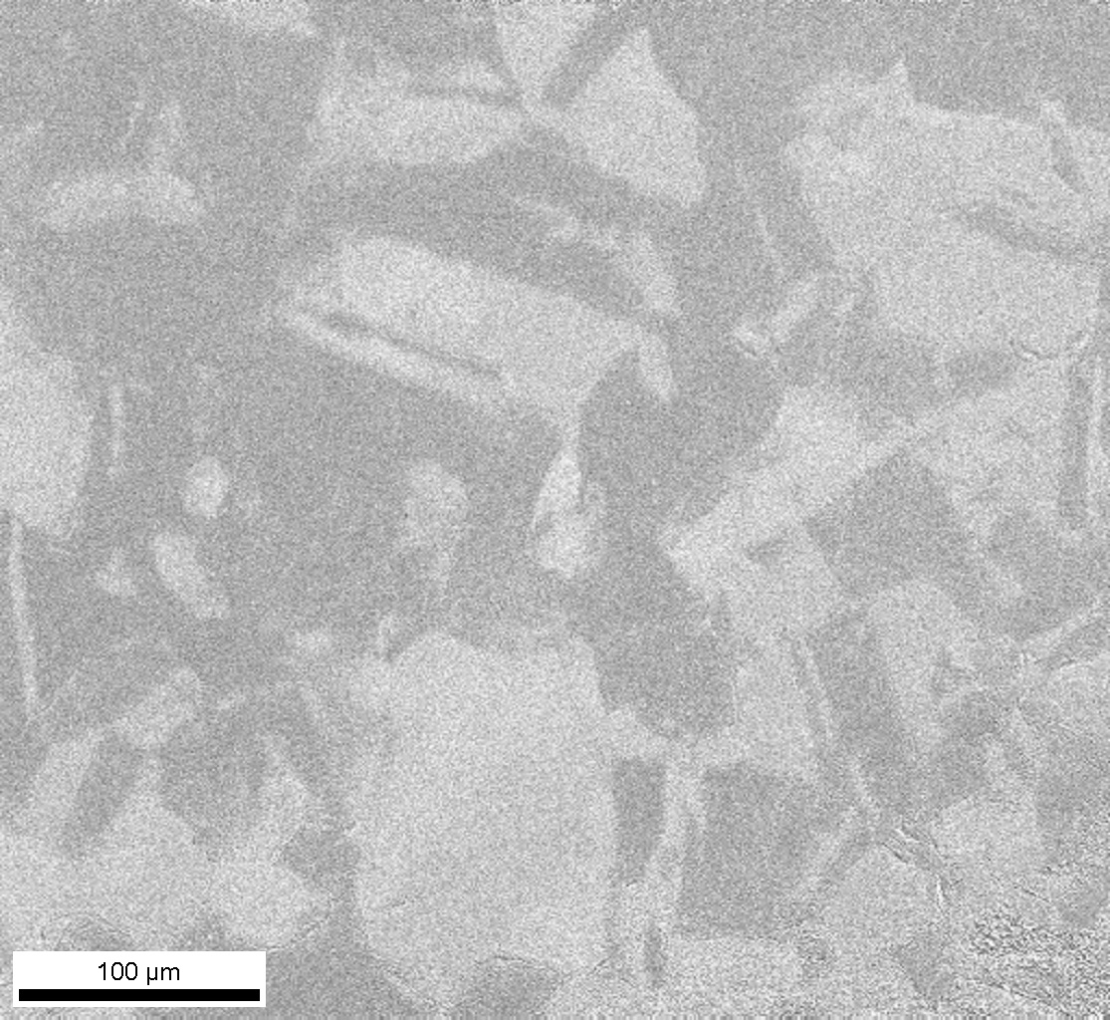
C10100-40%CW-EP_A1

Slide 26
C10100-40%CW-EP

Slide 27
C10100-40%CW-EP

Slide 28
C10100-40%CW-EP Virgin Surface

Slide 29
Discussion EBSD-Observation Results
(1 1 1) (blue) direction high developed and (1 0 0) (red) direction less developed fatigue features
-> evidence of influence of orientation on fatigue behaviour
-> crystallographic explanation still unknown
=> fatigue samples of different orientation
=> quantify surface fatigue damage <-> orientation
Orientation <–> fatigue behaviour same trend in RF-fatigue as well as in Laser fatigue!
-> hint for equality of fatigue techniques
=> proof the same behaviour for the ultrasound-device
(1 1 1) (blue) direction dominating after extreme heat treatment
-> preferred and less preferred orientations
-> texture already exists in raw material
-> further texture development through thermal treatment
=> Need for further observation upon the influence of textures

Slide 30
Recent Picture: SLAC sample

Slide 31
Recent Picture: Ultra sound sample

Slide 32
Recent Picture: Ultra sound sample

Slide 33
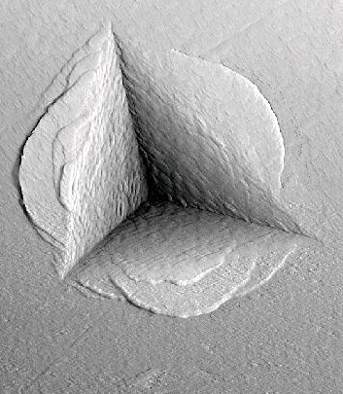
Observation techniques used: Nano-Indentation
Classical Hardness: Loads between 10 – 300 N
MTS Nano indenter XP: Loads of several mN
Indentation depth: 30 – 2000 nm; instrumented
4 um

Slide 34
Results and Discussion Hardness-Observation
ASTM standard
(=> Cu intrinsic dependency!)
Working range: 500 nm indentation depth
compromise between low indent size (high resolution) and sensitivity

Slide 35
Sample origin
First indents not valid (too close to surface)
=> no information about the first 7 um!
Treated surface
embedded sample
Cross section preparation:
Cut with liquid cooled cutting machine
hot embedded in epoxy resin
grinding and mechanical polishing to 1 um
Metallurgical cut
50 um

Slide 36
Results and Discussion Hardness-Observation
If work hardening through machining this slight raise would be coherent

Slide 37
Discussion Hardness-Observation
slight increase of hardness in superficial layer only in 40%CW DiaCut
-> effects of machining not measurable anymore after brazing
-> possibility of thin work hardened layer without brazing due to machining
=> micro indentation with different loads in the treated surface could give information about the first 10 um
=> fatigue of machined samples
Hardness observations on cross sections of fatigued areas revealed no coherent information
=> Indentations in fatigued surfaces could give information about work hardening due to thermal fatigue
=> Interesting point for understanding fatigue and RF-conditioning phenomena

Slide 39

Thanks for the attention!

Slide 40
Observation techniques used: EBSD
Electron Back Scattered Diffraction
Electron Microscope column
SEM: Leo 1530 VP
EBSD unit: EDAX TSL
Phosphoric screen and digital camera
Kikuchi pattern
70°
“Bragg Reflection”

Slide 41
Basics for EBSD: Crystallography
A cube with atoms on is corners and his faces (so called face centered cubic FCC)
Plenty of these elementary cells
Crystallographic description of directions:
Crystallographic description of planes: Normal of planes!
z
[1 1 1]
x
[1 0 0]
y
[1 1 0]

Slide 42
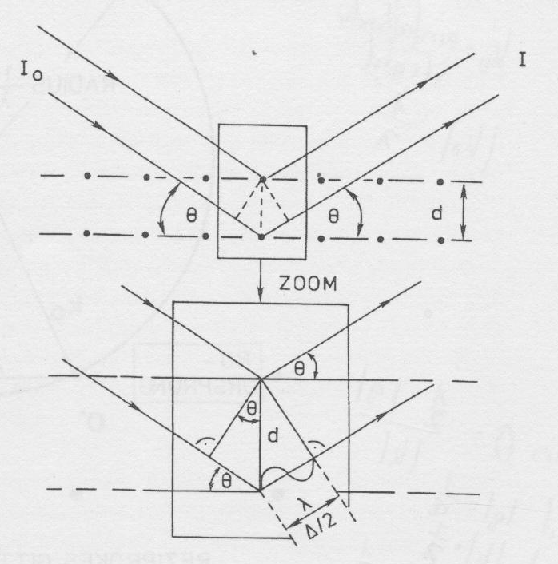
Basics for EBSD: Bragg Reflection
I₀: intensity of initial ray
I: intensity of outgoing ray
Face centered cubic (FCC) crystal
d: distance between crystal planes
Atomic planes of crystal
Only constructive interference if path difference equals wavelength! => intensity maximum.
Each Atom radiates as a “point like” source
(“Elastic Scatter”)
n · λ = 2 · d · sinΘ
Bragg equation
Θ: “Bragg angle”
λ: Wavelength
=> For known n, λ and θ one can calculate d

Slide 43
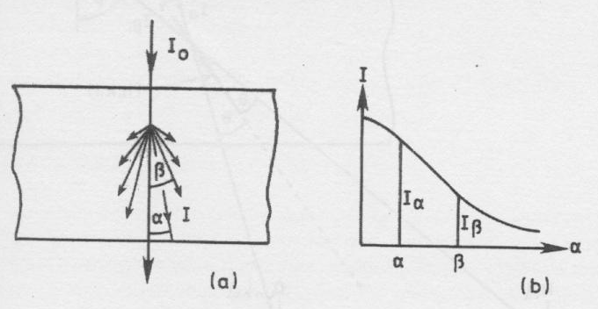
Basics for EBSD: Inelastic scatter in thick crystal
I₀: intensity of initial ray
Maximum intensity in initial direction (α = 0°, decreasing with increasing angle
Thick crystal: => more and more inelastic scatter in every direction!
α, β: diffraction angles
I: intensity of outgoing ray
Changes in λ due to energy dissipation negligible
=> new I₀ ray with initial λ but different direction!

Slide 44
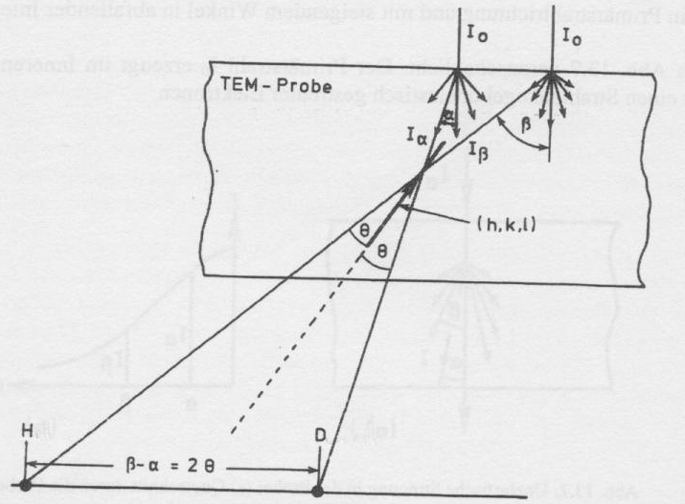
Basics for EBSD: Kikuchi line construction
Θ: “Bragg angle”
I_{α} ; I_{β}: intensities of new initial rays
Facts:
1) I_{α} > I_{β}
2) Every crystal plane produces interference line (perpendicular to drawing plane) due to ray cones of I_{α} and I_{β}
3) crystal plane (almost perpendicular in the crystal) gets hit from both sides
f =
scattered intensity primary intensity
> 0
In H: Background + (f·I_{α} - f·I_{β}) => brighter
Screen
(h,k,l): crystal plane
In D: Background + (f·I_{β} - f·I_{α}) => darker
< 0

Slide 45

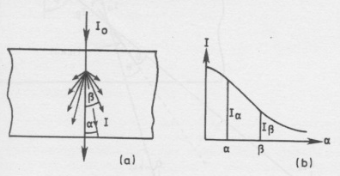
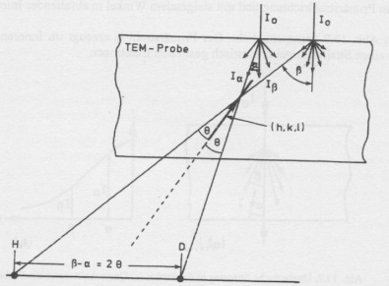
Basics for EBSD: Kikuchi line
(1 3 1)
(2 2 0)
(3 1 1)
Zone axis [-1 1 -2]
Distance => Bragg equation => planes space d! => plane identification

Slide 46
Basics for EBSD: Kikuchi line indexing
(1 3 1)
(2 2 0)
(3 1 1)
(1 3 1)
(2 2 0)
(1 3 1)
(2 2 0)
(3 1 1)
(3 1 1)

Slide 47
Basics for EBSD: EBSD-Software
Scan:
Each point one Kikuchi pattern
-> each point complete orientation information
=> Mapping of orientations
Scan rate: 75 points/s
Ordinary used for:
- Texture analysis
Orientation of samples (like X-Ray diffraction but faster)
Identification of different phases (like TEM but lower resolution/magnification)
Possibility to connect with quantitative EDX scans

Slide 48
Observation techniques used: Nano-Indentation
Classical Hardness: Loads between 10 – 300 N
MTS Nano indenter XP: Loads of several mN
Indentation depth: 30 – 2000 nm; instrumented
4 um

Slide 49
Complete Calculation for Nano-Hardness
Hardness H:
(1) in GPa! A(h_{c}): projected contact area
(2)
Youngs Modulus E:
(3)
(4) β: constant: 1.034 for Berkovich
(5) ν: Poisson`s ratio
ν_{i}; E_{i}: indenter parameters

