Slide 1
gLExec and OS compatibility
David Groep
Nikhef

Slide 2
Outline
What is glExec-on-WN (again)
OS and Batch System Interoperability
  Starting and killing jobs
  Cleaning up files
  Pruning stray processes

Slide 3
Use Case for ‘gLExec on the WN’
Make pilot job subject to normal site policies for jobs
VO submits a pilot job to the batch system
  the VO ‘pilot job’ submitter is responsible for the pilot behaviour
this might be a specific role in the VO, or a locally registered ‘special’ user at each site
  Pilot job obtains the true user job,
  and presents the user credentials and the job
  (executable name) to the site (gLExec) to request a
  decision on a cooperative basis
Preventing ‘back-manipulation’ of the pilot job
  make sure user workload cannot manipulate the pilot
  project sensitive data in the pilot environment (proxy!)
  by changing uid for target workload away from the pilot

Slide 4
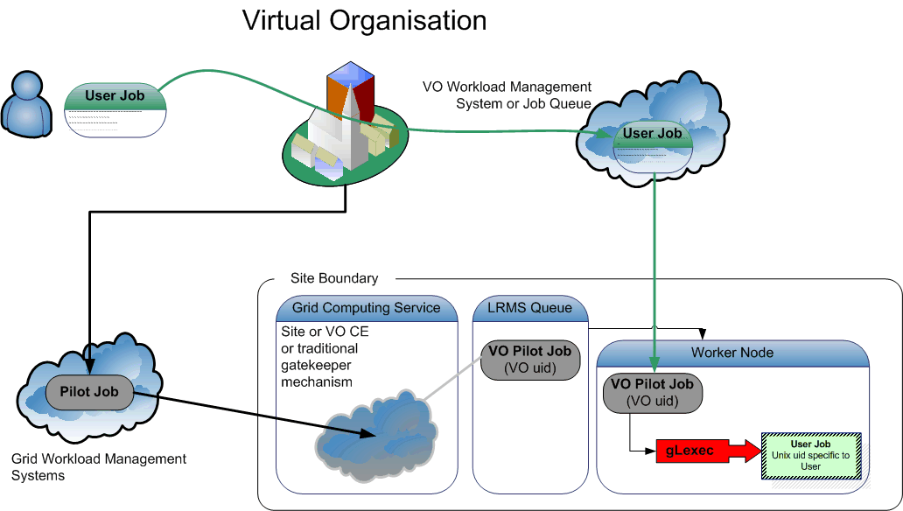
Pilot Jobs and gLExec
On success: the site will set the uid/gid to the new user’s job
On failure gLExec will return with an error, and pilot job can terminate or obtain other user’s job

Slide 5
gLExec deployment modes
Identity Mapping Mode – ‘just like on the CE’
  have the VO query (and by policy honour) all site policies
  actually change uid based on the true user’s grid identity
  enforce per-user isolation and auditing using uids and gids
  requires gLExec to have setuid capability
Non-Privileged Mode – declare only
  have the VO query (and by policy honour) all site policies
  do not actually change uid: no isolation or auditing per user
  the gLExec invocation will be logged, with the user identity
  does not require setuid powers – job keeps running in pilot space
‘Empty Shell’ – do nothing but execute the command…

Slide 6
Identity change
Let’s assume you make it setuid. Fine. Where to map to:
To a shared set of common pool accounts
  Uid and gid mapping on CE corresponds to the WN
  Requires SCAS or shared state (gridmapdir) directory
  Clear view on who-does-what
To a per-WN set of pool accounts
  No site-wide configuration needed
  Only limited (and generic) set of pool uids on the WN
  Need only as many pool accounts as you have job slots
  Makes cleanup easier, ‘local’ to the node
Or something in between ... e.g. 1 pool for CE other for WN

Slide 7
Starting and Killing Jobs
The batch system performs the following basic functions
Job Submission
Job Suspend/Resume
Job Kill
CPU time accounting
does not yet address enforcing sanity and user compliance
from the test description of Ulrich Schwickerath

Slide 8
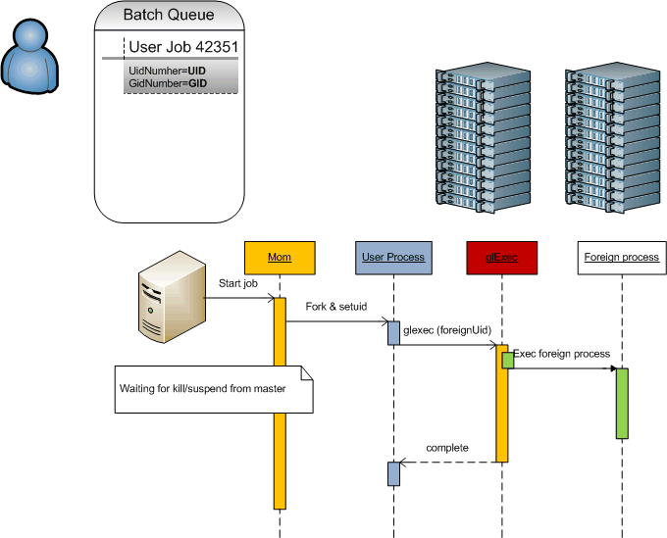
Starting and Killing Jobs

Slide 9
Testing it
Can batch system suspend/kill the gLExec’ed processes?
Test using gLExec itself
  Most ‘true’ tests
  Requires installation of gLExec and all dependencies
Test using the sutest mini programme
  Same logic, but a stand-alone small (50-line) C programme
  No dependencies
  A few hard-coded constants to be set before compilation
  Trivial to test

Slide 10
Session Preservation
$ date && ps --forest -eo pid,ppid,sess,user,uid,euid,cmd
Fri Feb 8 14:02:41 CET 2008
PID PPID SESS USER UID UID CMD
3294 1 3294 root 0 0 /usr/sbin/pbs_mom
18668 3294 18668 davidg 502 502 \_ -bash
18713 18668 18668 davidg 502 502 \_ /bin/sh …/jobs/33.tbn05.ni.SC
18715 18713 18668 nobody 99 99 \_ /project/sutest /bin/sleep 120
18716 18715 18668 nobody 99 99 \_ /bin/sleep 120
...
... and Torque will kill all processes in the tree:
$ date && qsub -q test tmp/tt.pbs
Fri Feb 8 14:02:21 CET 2008
33.tbn05.nikhef.nl
tbn05:~:1018$ cat tmp/tt.pbs
#! /bin/sh
date
/project/sutest /bin/sleep 120
date
All vanishes after a ‘qdel 33’ …

Slide 11
CPU accounting
No change with respect to current behaviour of jobs
Times are accumulated on wait and collated with the gLExec usage

Slide 12
Forcing havoc on yourself
$ ( date && ./sutest /bin/sleep 60 && date )
Fri Feb 8 16:41:24 CET 2008
Notice: identity changed to uid 99
...
7508 1 7508 root 0 /usr/sbin/sshd
32122 7508 32122 root 0 \_ sshd: davidg [priv]
32124 32122 32122 davidg 502 | \_ sshd: davidg@pts/0
32126 32124 32126 davidg 502 | \_ -bash
17001 32126 32126 davidg 502 | \_ -bash
17003 17001 32126 nobody 99 | \_ ./sutest /bin/sleep 60
17004 17003 32126 nobody 99 | \_ /bin/sleep 60
# kill -9 17001
Killed
17003 1 32126 nobody 99 99 ./sutest /bin/sleep 60
17004 17003 32126 nobody 99 99 \_ /bin/sleep 60

Slide 13
Cleaning up files
File cleanup: what do sites use today?
Check for files owner by users not currently running a job?
  Who ‘is running’ becomes ill defined
  Need a ‘back-mapping’ tool that can trawl log files or a state dir
tmpwatch(8) for old files?
  Change of uid does in influence this solution
Transient TMPDIR facilities (PBSPro, Torque 2+)?
  Runs with root privileges anyway
  TMPDIR is inherited by the gLExec’ed child
  And is thus unaffected by gLExec

Slide 14
Pruning stray processes
Killing stray user processes
‘not owned by a user with a currently running process’
  E.g. used at CERN/LSF
  Need a ‘back-mapping’ tool that can trawl log files or a state dir
  But: is not trustworthy to begin with on multi-job-slot machines!
Kill processes that are ‘too old’
  Will run as root anyway
  Unaffected, but is not trustworthy either
Kill processes not ‘parented’ in a batch job
  gLExec will preserve the process tree, and thus this will work
  Will also slaughter daemonizing jobs today
  … which is a Good Thing™

Slide 15
Pruning User Processes
https://www.nikhef.nl/grid/sysutils/prune_users/
For Torque in perl (simple migration to other systems)
Kill processes that are not a child of a registered pbs_mom
Uses the momctl command on the node
Caveats
  Will usually not kill processes with a uid < 99
  May optionally preserve top-level sshd sessions (beware of MPI)
  Does not protect against fork bombs

Slide 16
Where are we now?
You can deploy today if
You run LSF or Torque and
don’t manage disk or processes
You run LSF or Torque and
use TMPDIR and prone_userproc style job slaughtering
You should wait for back-mapping tool (+update your script) if
You use LSF or Torque and use uid recognition for pruning stray processes (but you ought to change this anyway)
You use uid recognition for file cleaning
Back-mapping tool is expected to be out of development
in XXX weeks

Slide 17
Summary and References
References
https://www.nikhef.nl/grid/lcaslcmaps/glexec
  sutest program: https://www.nikhef.nl/grid/lcaslcmaps/glexec/osinterop
https://twiki.cern.ch/twiki/bin/view/FIOgroup/FsLSFGridglExec

