Slide 1
LHC operations past and future: part 2
RF – briefly
Instrumentation – even more briefly
The nominal cycle
  Injection
  Ramp
  Squeeze
Machine protection
  Beam interlock system
  Beam dump
  Collimation
Plus 3 visits to the tunnel
Mike Lamont
with acknowledgements to all the people whose material I’ve used
(including Ralph Assmann, Luca Bottura, Heiko Damerau, Bernhard Holzer, Rende Steerenberg, Ralph Steinhagen, Jorg Wenninger...)

Slide 2
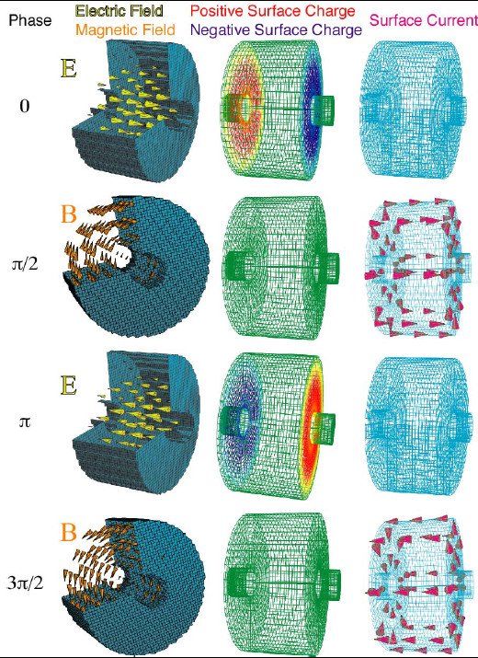
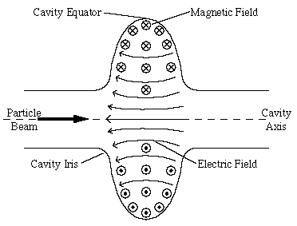
Radio
Frequency
Briefly!
Bunch the beams (longitudinal focussing)
Accelerate particles during the ramp

Slide 3
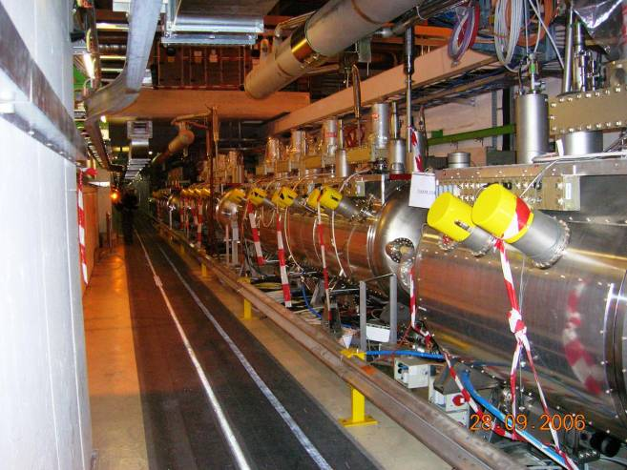
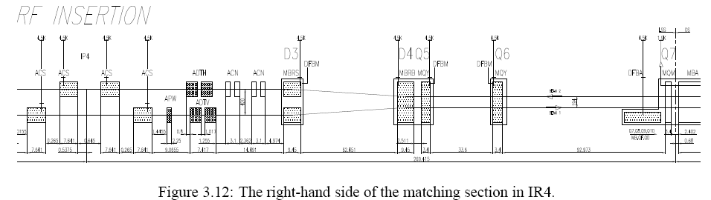
2 x four cavity cryo module per beam
400 MHz
16 MV/beam (7 TeV design)
Nb on Cu cavities @4.5 K
Beam pipe diam.=300 mm
S34
S45
ADT
D3
D4
Q5
Q6
Q7
ACS
ACS
B2
420 mm
194 mm
B1
ACS
ACS

Slide 4
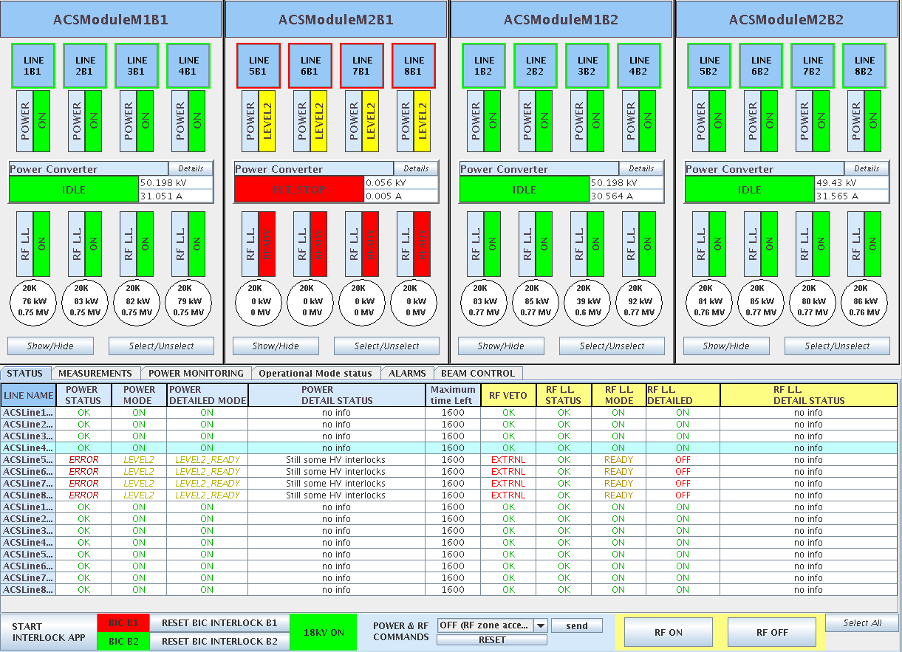

Slide 5
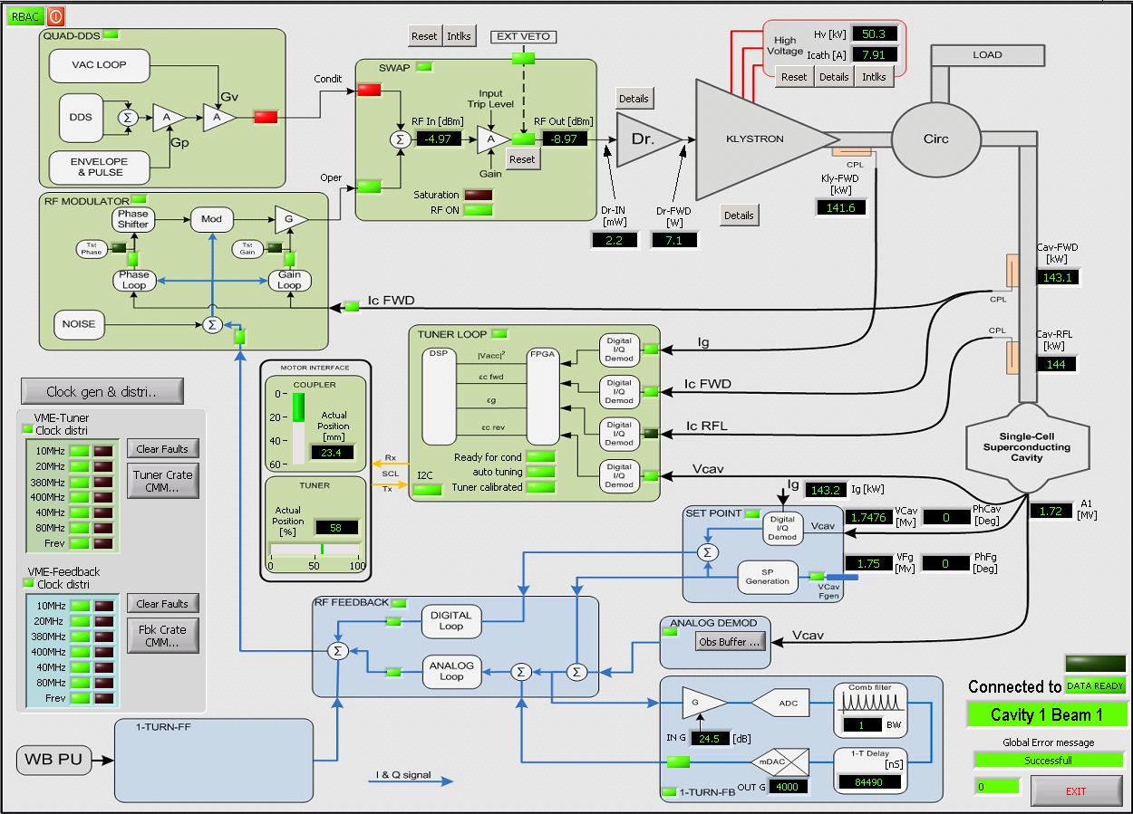
Courtesy Andy Butterworth

Slide 6
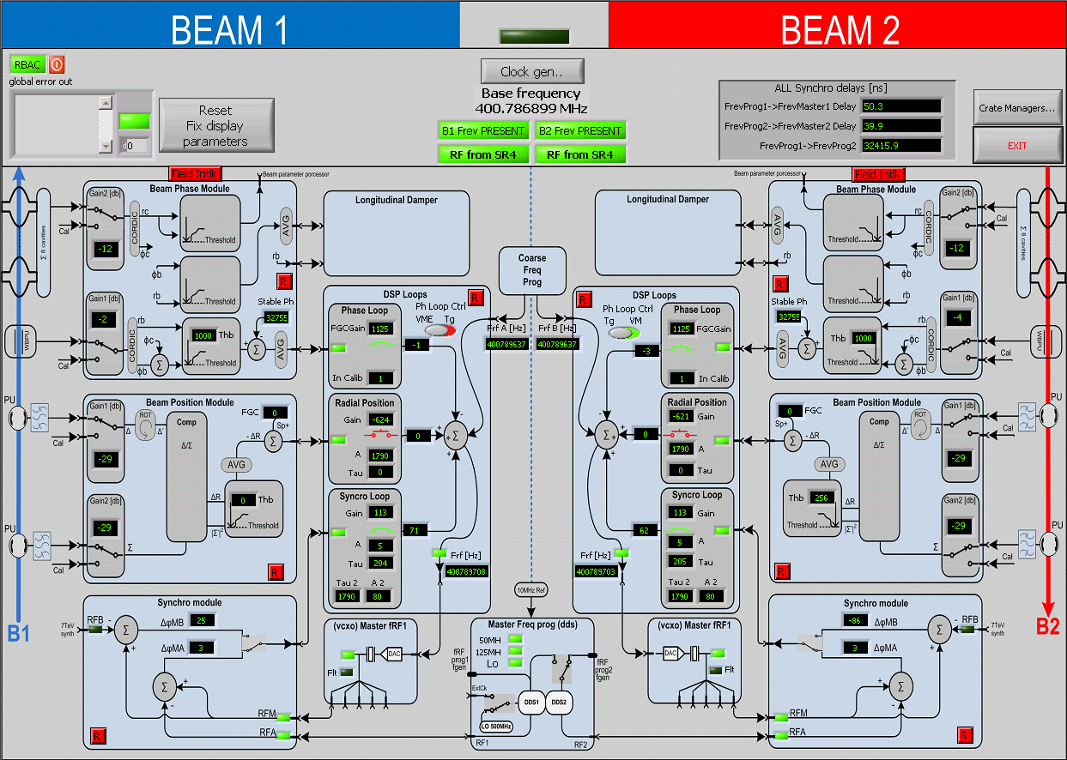
Courtesy Andy Butterworth

Slide 7
Synchronous particle
V
Δt (or φ)
Lower energy particles – bent more – shorter revolution time
Higher energy particles – bent less – longer revolution time
ΔE
RF Bucket
Δt (or φ)
Bunch

Slide 8
The motion in the bucket (2)
V
ΔE
Δt (or φ)
Rende Steerenberg

Slide 9
The motion in the bucket (3)
V
ΔE
Δt (or φ)

Slide 10
The motion in the bucket (4)
V
ΔE
Δt (or φ)

Slide 11
The motion in the bucket (5)
V
ΔE
Δt (or φ)

Slide 12
The motion in the bucket (6)
V
ΔE
Δt (or φ)

Slide 13
The motion in the bucket (7)
V
ΔE
Δt (or φ)

Slide 14
The motion in the bucket (8)
V
ΔE
Δt (or φ)

Slide 15
The motion in the bucket (9)
Phase focussing - important!!!
Synchrotron oscillations
V
ΔE
Δt (or φ)
(In the LHC when dp/dt=0, the stable phase is 180 degrees. During the ramp it reaches 176.5 degrees)

Slide 16
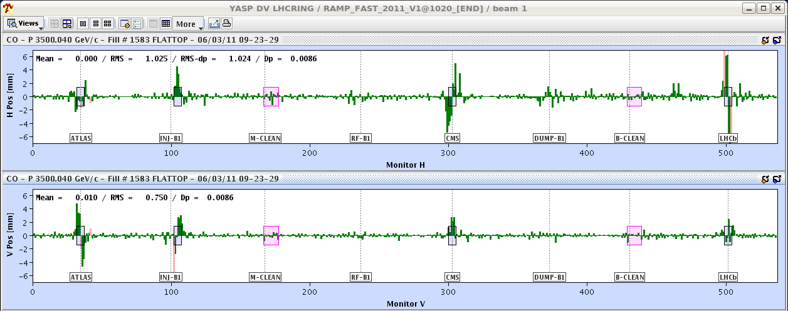
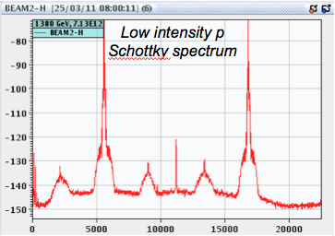
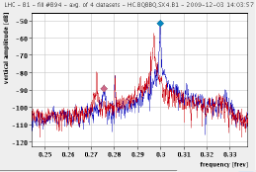
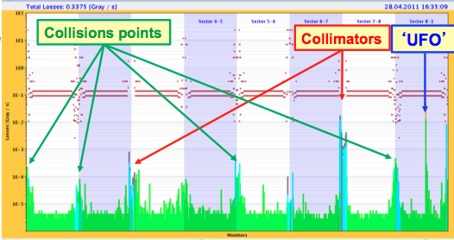
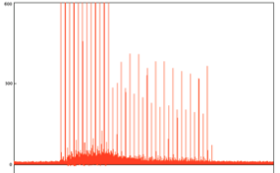
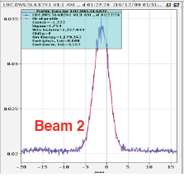
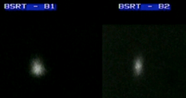
Beam Instrumentation – our eyes
Beam Position Monitors
Beam loss monitors
Base-Band-Tune (BBQ)
Wire scanner
Longitudinal density monitor
Synchrotron light

Slide 17
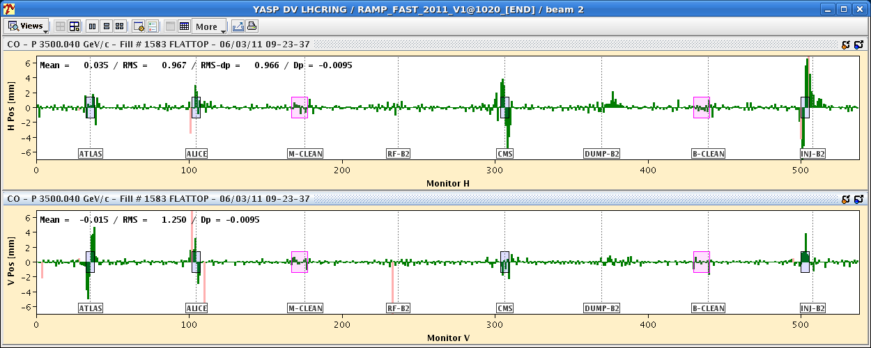
The LHC BPM system
1088 button and coupler monitors – 2176 position readings.
Excellent availability
±7 mm
Typical orbits

Slide 18
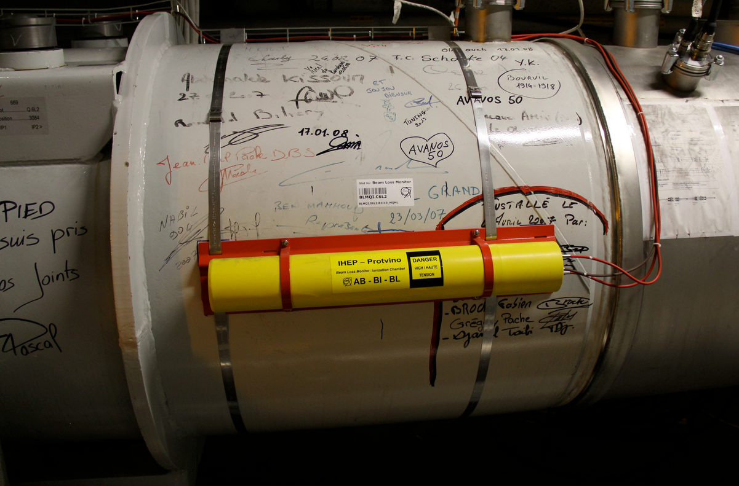
Beam loss monitors
Around 4000 ionization chambers protect the LHC superconducting magnets against quenches and damage from beam loss.
The system has been designed with high safety standard (SIL3) and is an essential component of the LHC Machine Protection System.
  Smallest loss integration interval is 40 microsecond ~½ LHC turn.
  The BLM system will dump if a SINGLE monitor goes above threshold.
A large fraction of the BLMs are installed on super-conducting magnets with dump thresholds set to some fraction of the estimated quench level loss.

Slide 19
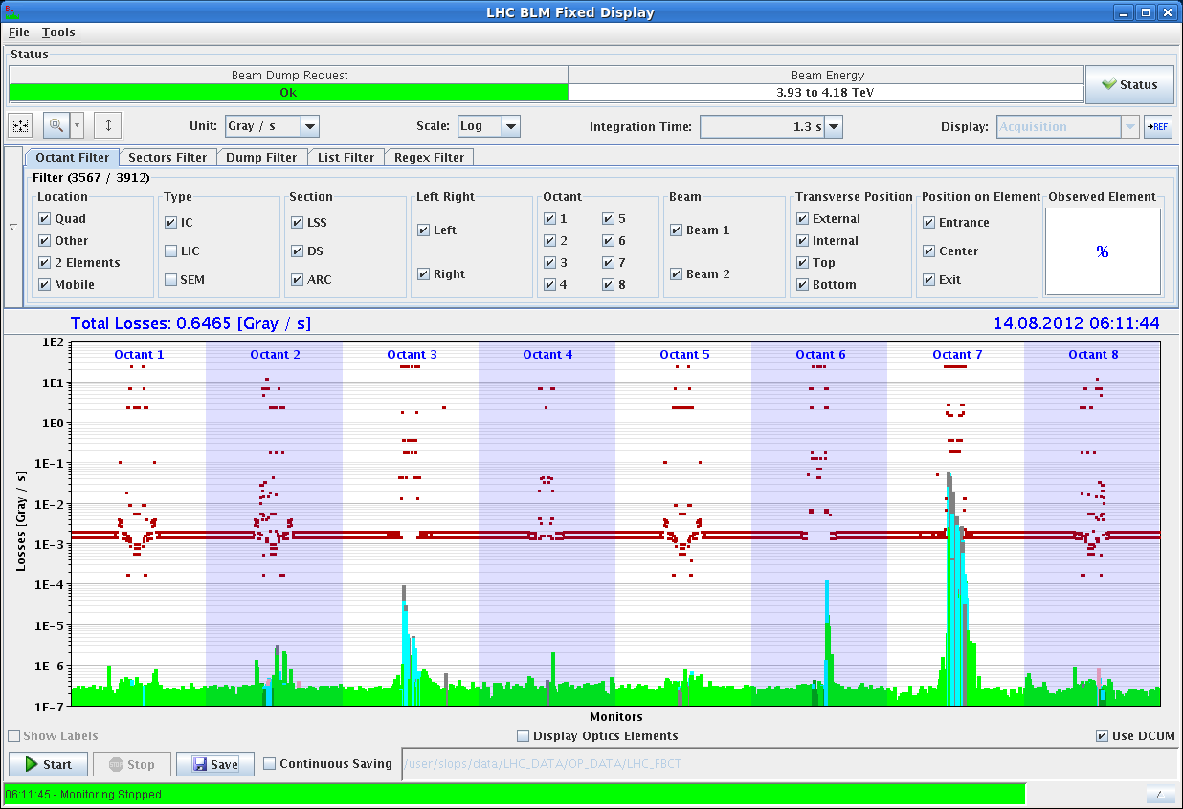

Slide 20
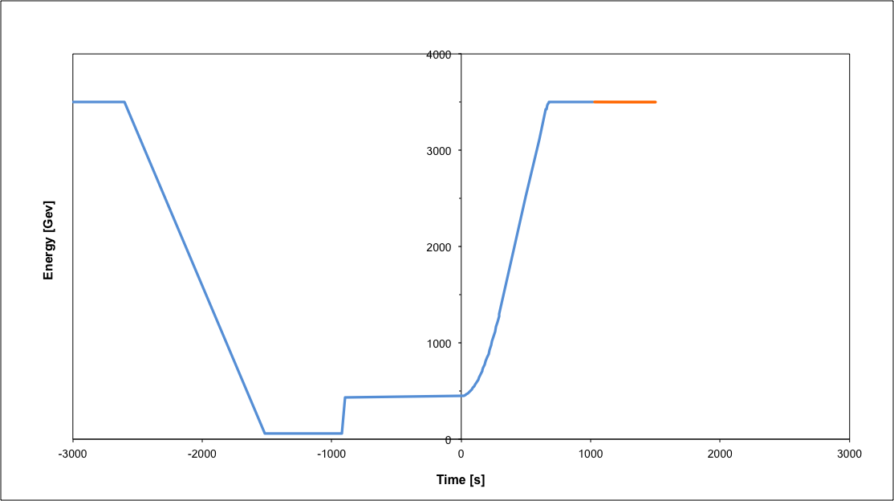
Operational cycle
Beam dump
Squeeze
Stable beams
Collide
Ramp
Ramp down/precycle
Ramp down | 35 mins
Injection | ~30 mins
Ramp | 12 mins
Squeeze | 15 mins
Collide | 5 mins
Stable beams | 0 – 30 hours
Injection
Turn around from stable beams to stable beams - 2 to 3 hours on a good day

Slide 21
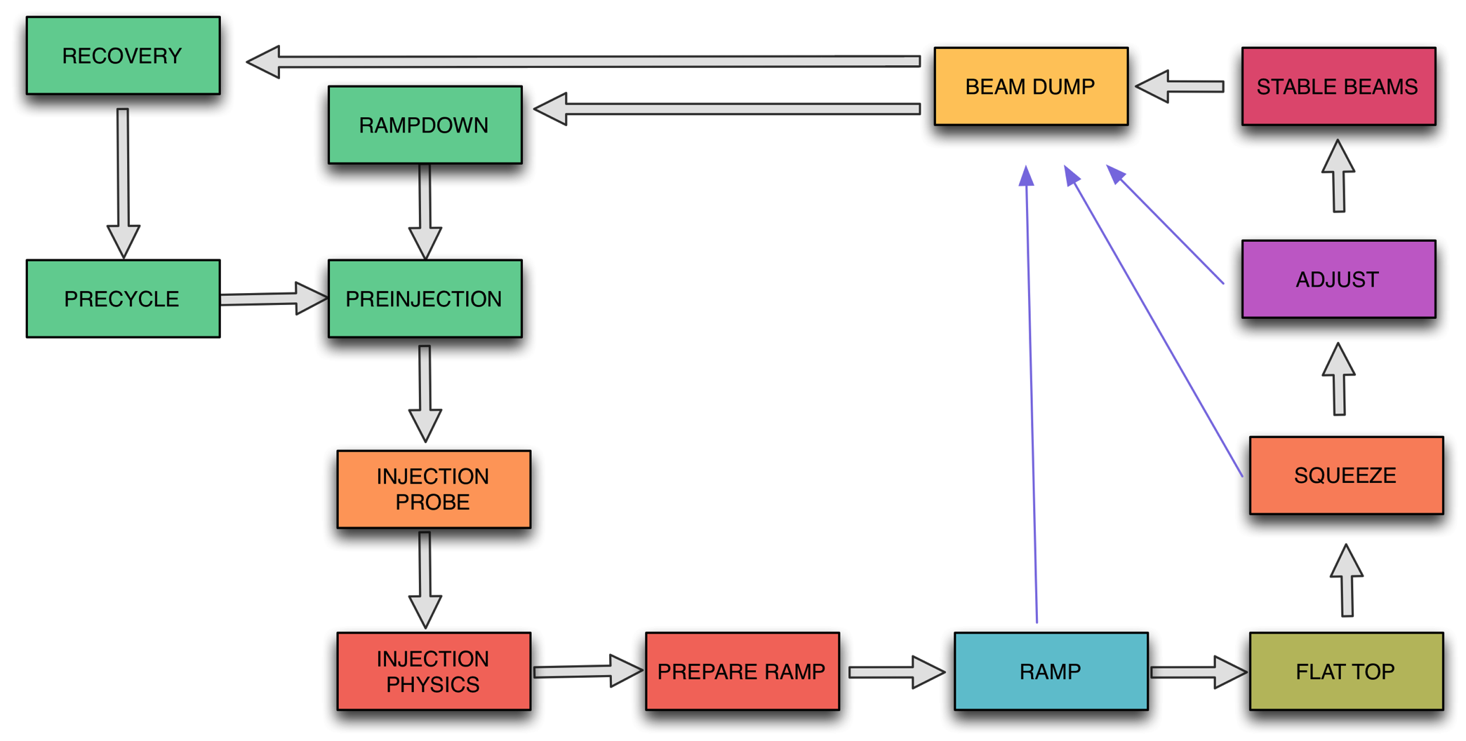
Nominal cycle
Globally the machine state is fairly well described by machine mode/beam mode combination

Slide 22
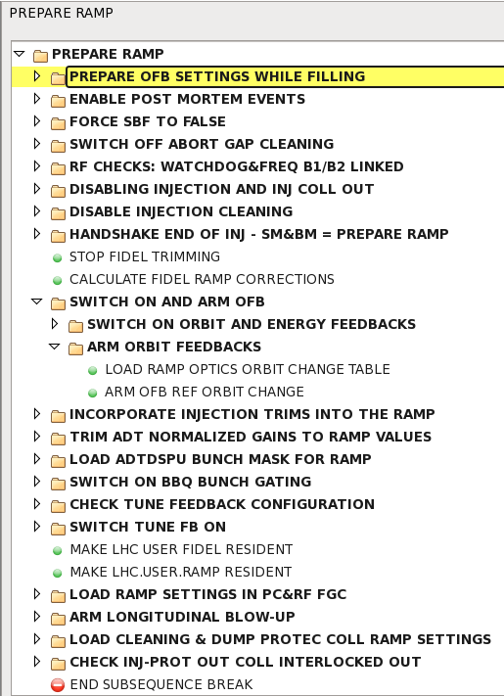
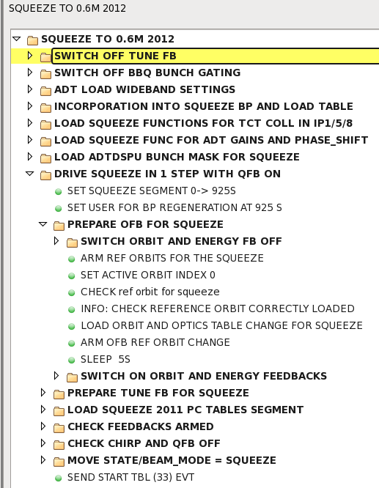
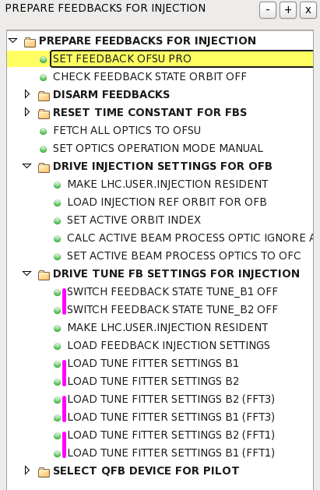
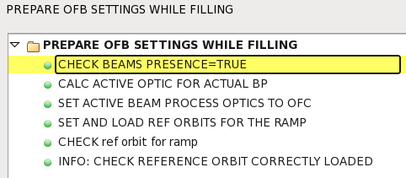
Sequencer tasks
  Task by task breakdown of everything that needs to be done to drive LHC through the nominal operational cycle – semi-automatic

Slide 23
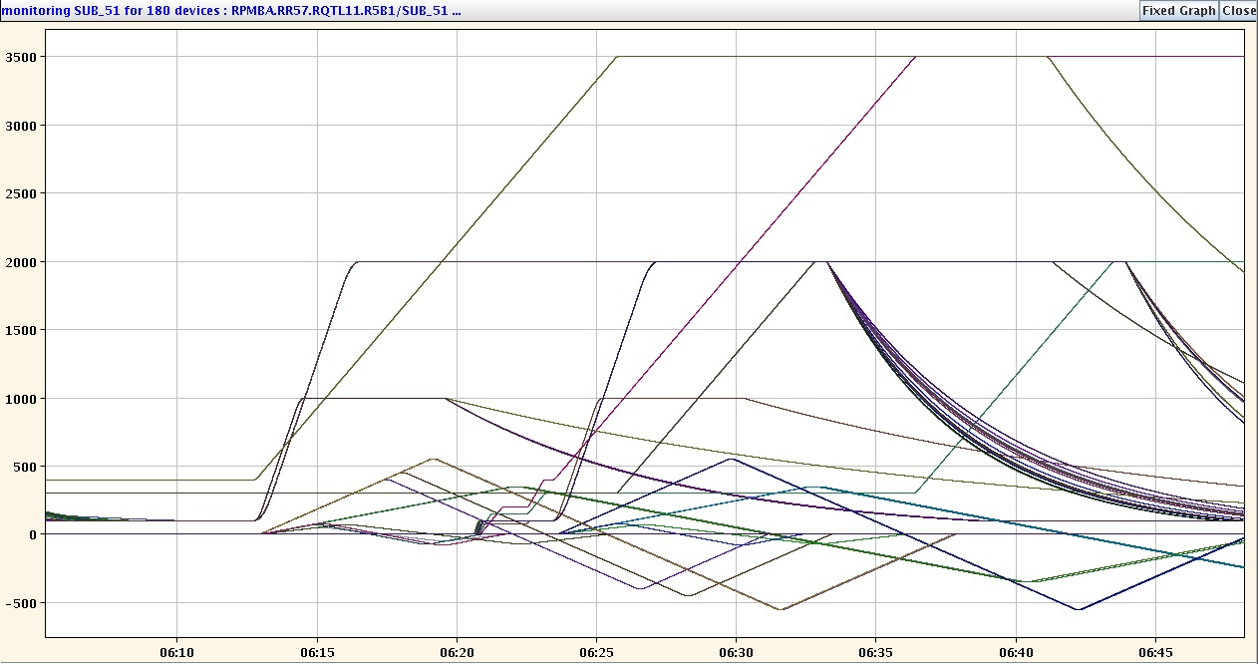
Precycle/rampdown
Coming back from access
  Full pre-cycle of all magnetic circuits
After stable beams
  Ramp-down/precycle combination
Aim: reproducible magnetic machine

Slide 24
Transfer & injection
2012: 144 bunches of 1.7e11 ppb - 1.8 MJ
One SPS batch: 2.2 km long (7 microseconds)
IR8
Injection kicker
Switching magnet
CNGS Target
Fast extraction kicker
SPS
6911 m
450 GeV / 400 GeV
Transfer line
LHC
Injection kicker
IR2
Fast extraction kicker
1 km
Transfer line
HiRadMat

Slide 25
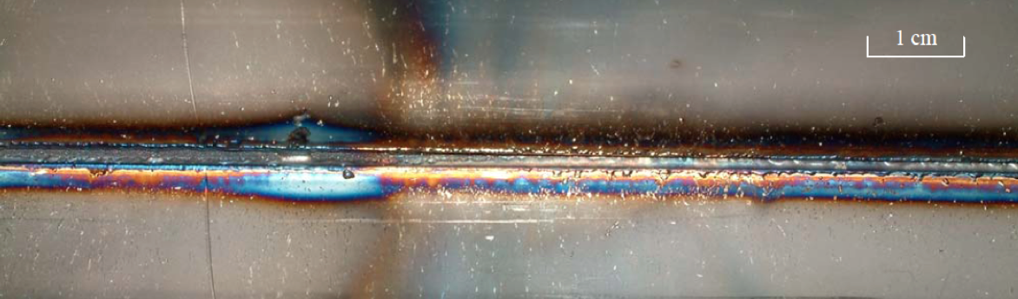
Reasons to be careful
During an SPS extraction test in 2005…
The beam was a 450 GeV full LHC injection batch of 3.4 10¹³ p⁺ in 288 bunches [2.5 MJ]

Slide 26
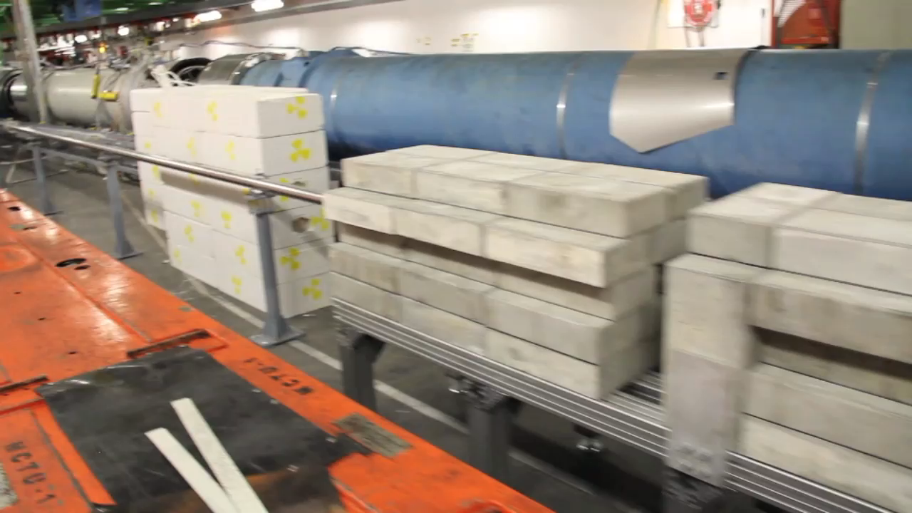
End of TI2
Video 2’29’’

Slide 27
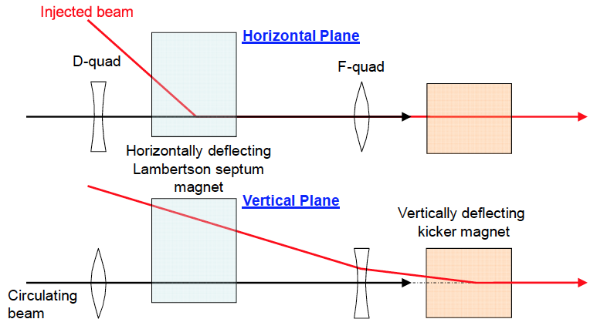
Injection
Require from the injection kickers:
< 1μs rise time (gap between SPS injections),
<3 μs fall time (abort gap),
8 μs flat-top length (1 SPS batch)

Slide 28
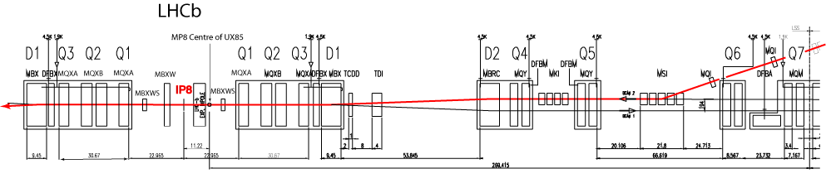
Layout (point 8)
4 injector kickers
(MKI)
5 septum magnets
(MSI)
TDI collimator
TCDD absorber

Slide 29
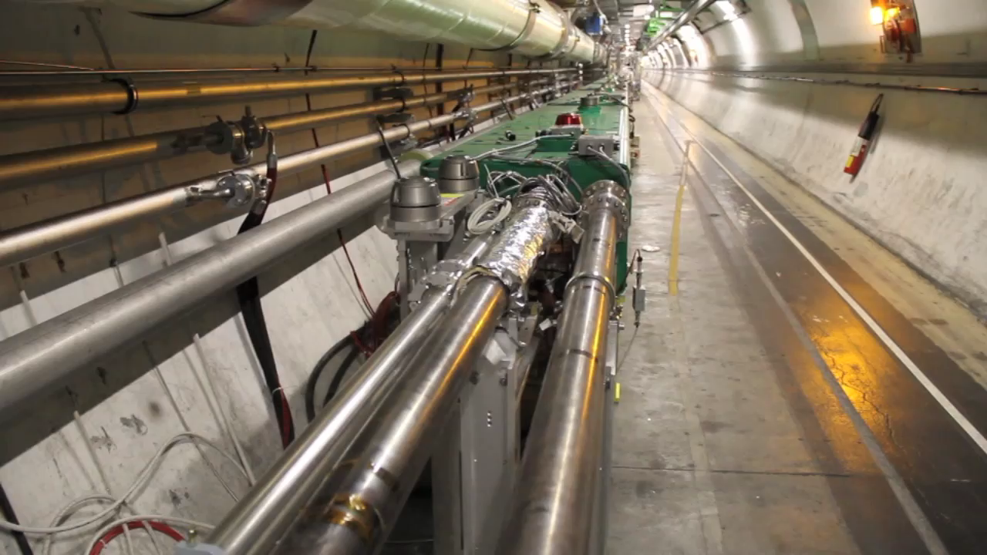
Septa and beyond
Video – 2’26’’

Slide 30
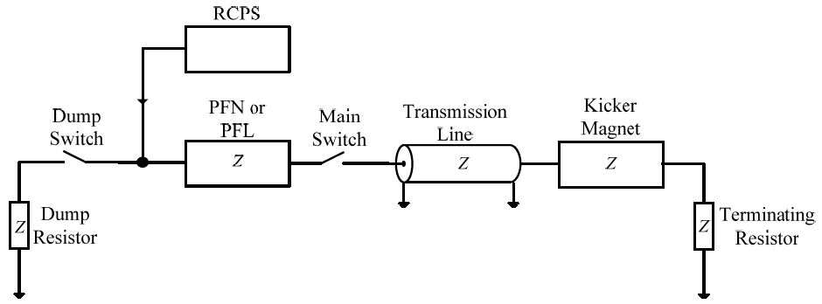
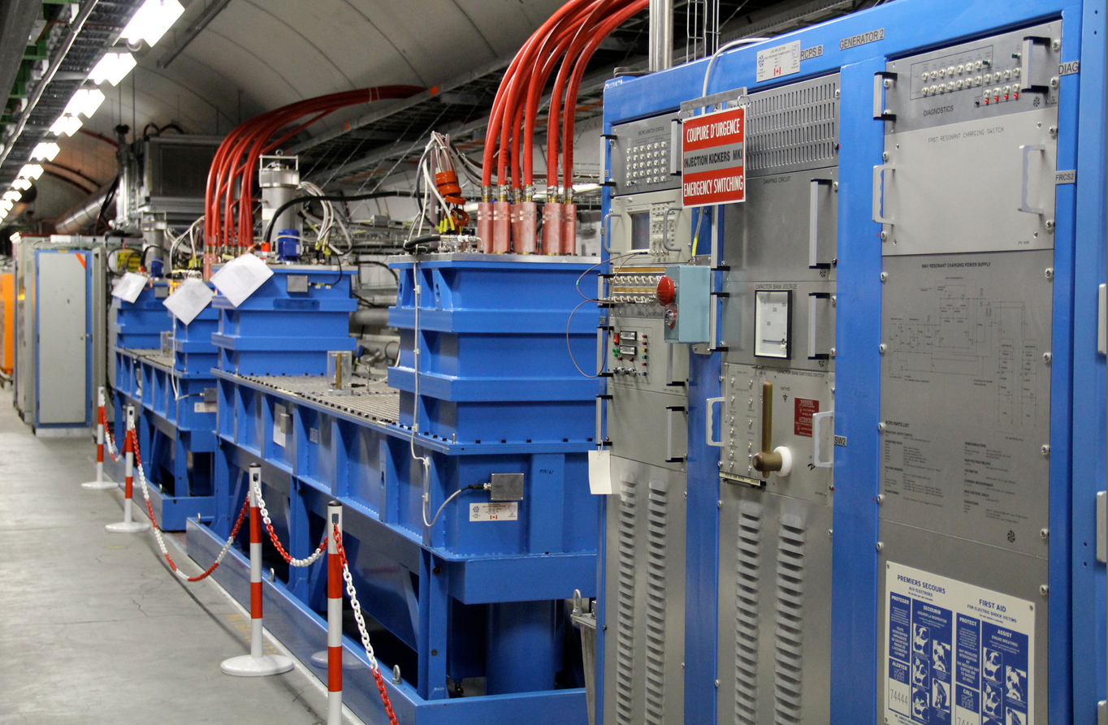
Injection kickers
PFN - pulse forming network
Fast resonant charging systems (RCS) are used to charge the PFNs within 1 ms to 60 kV

Slide 31
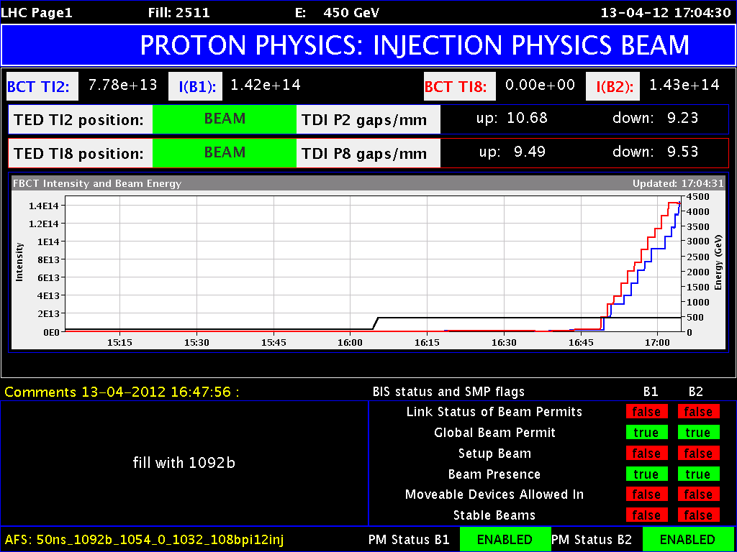
Injection of beam from SPS

Slide 32
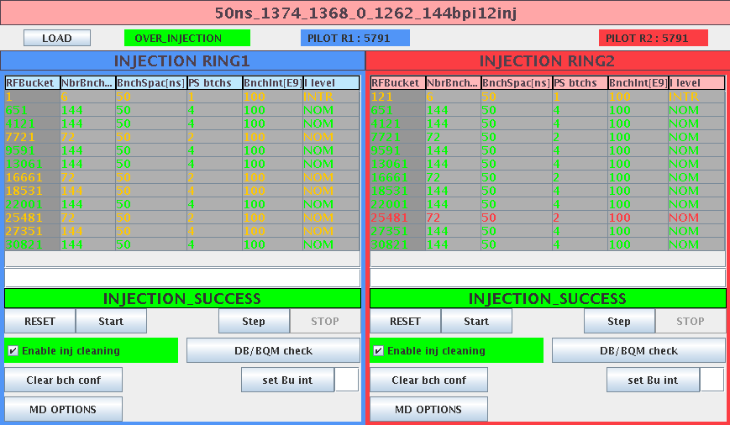
Filling
LHC makes requests to the Central Beam and Cycle Manager (CBCM) which takes care of sorting things out in the injectors
  Ring, number of batches, bucket number
Injection process controlled semi-automatically by injection sequencer

Slide 33
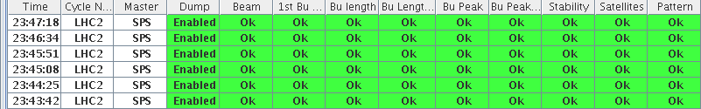
Injection – general
Worry a lot about losses and beam quality
Transfer lines steering
RF: phasing, synchronization
Beam Quality Check in SPS
  Bucket, bunch length…
Injection Quality Check in LHC
  inhibits further injection if issues

Slide 34
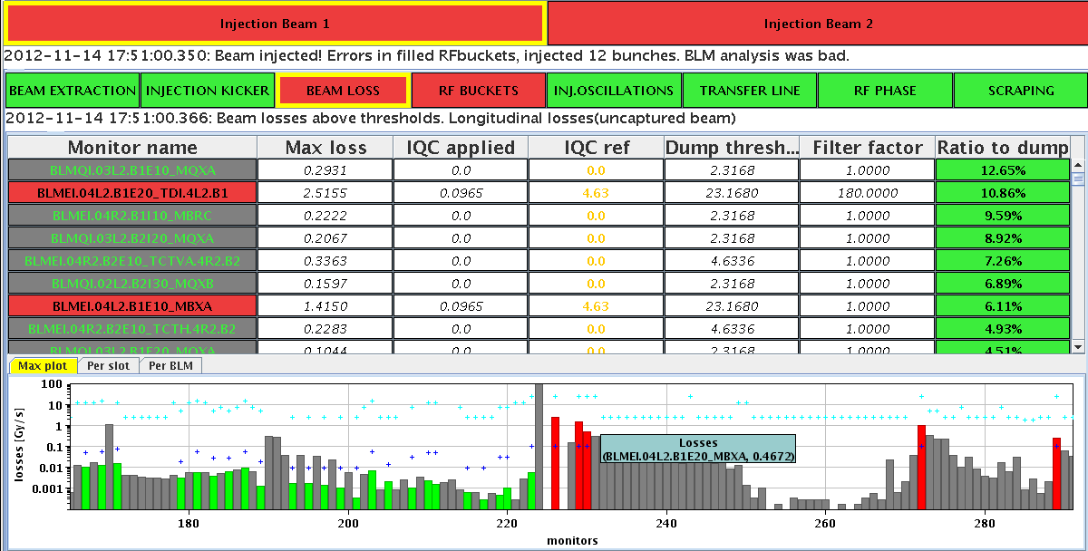
Injection Quality Checks
Beam loss

Slide 35
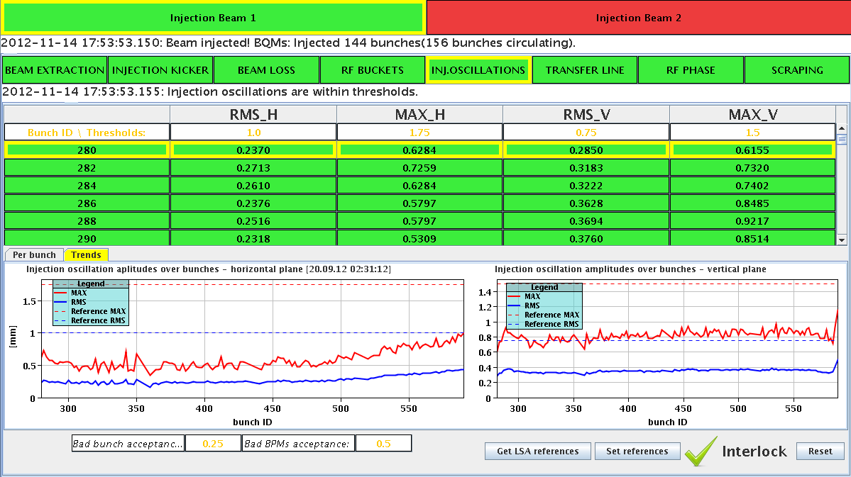
Injection Quality Checks
Trajectory

Slide 36
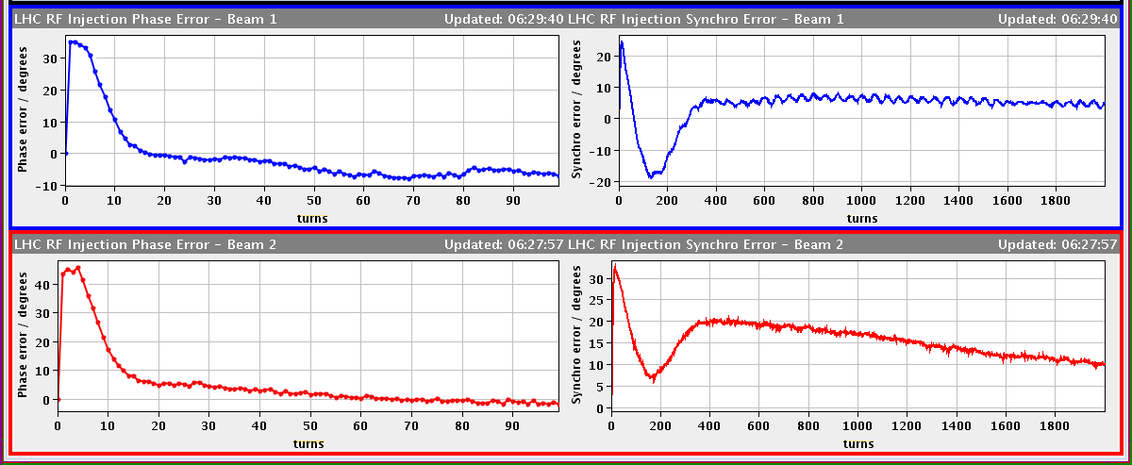
LHC Capture Transients
-30 deg in 60 turns -> -15 Hz @ 400 MHz
Δp/p ~ 10⁻⁴
Phase loop is fast: “jumps” the RF on the beam at injection
Synchro loop is slow. No reaction in first 100 turns. Slope gives frequency (energy) error at injection
Inj Phase Error 35 deg/45 deg
Synchro loop brings RF (and beam) back to Freq Prgm reference
Cavity field “jumps” on the beam in ~ 10 turns
Phase Loop Error: Beam PU-Cav Sum
Synchro Loop Error: VCXO-Freq Prgm
-15 deg in 80 turns -> -6 Hz @ 400 MHz
Very slow (seconds) time constant. Boosts DC gain to minimize thermal drifts
Philippe Baudrenghien

Slide 37
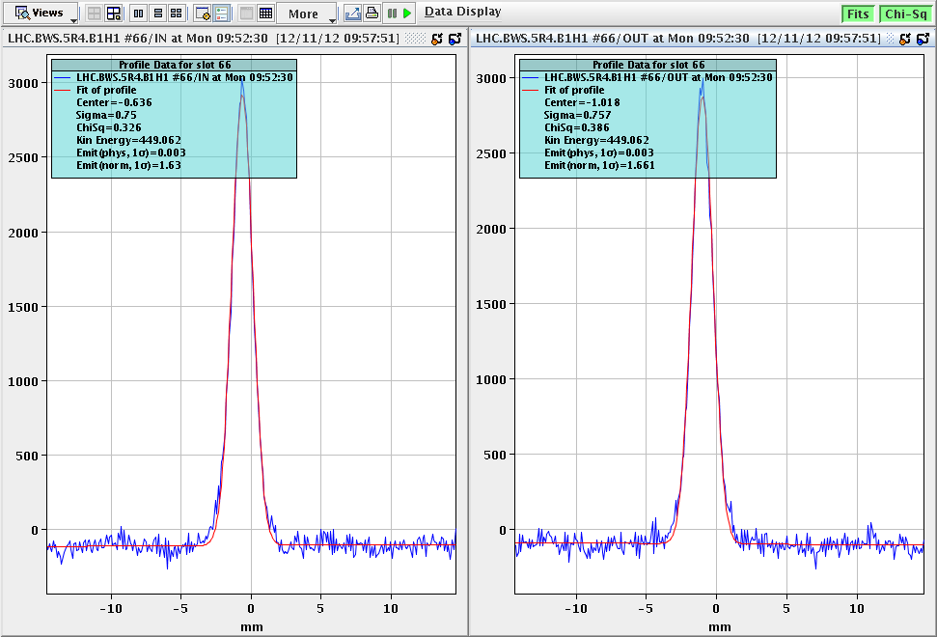
Emittance measurement
Wire scanners

Slide 38
Prepare ramp
Load power converters (1700+)
Load collimators
Load RF
Load transverse feedback
Get orbit and tune feedback on
Send timing event
Get a cup of coffee

Slide 39
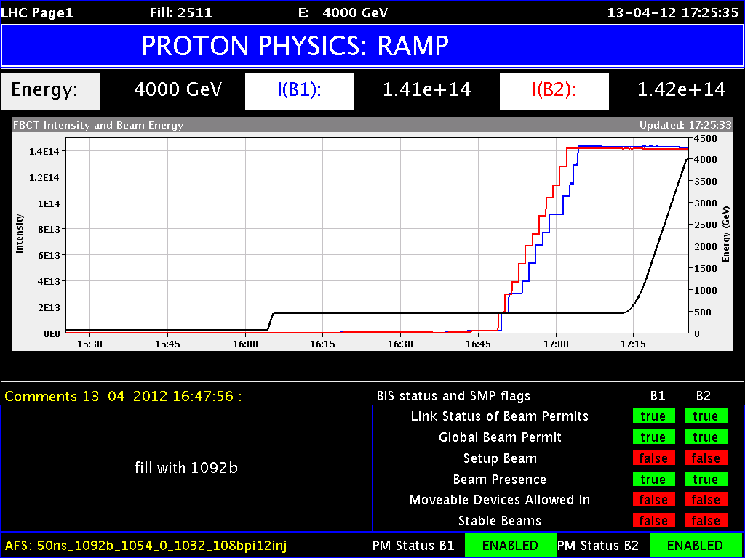

Slide 40
Ramp
450 GeV – 4000 GeV
  13 minutes
  Parabolic – exponential – linear – parabolic to minimize effects of snapback and duration
  Snapback correction for b2, b3, b5 calculated just before ramp start and incorporated into settings
I ≈ t
injection
I ≈ e^{t}
pre-injection
I ≈ t²

Slide 41
Persistent currents
Field change ΔB
Eddy currents J_{c} with τ=∞ ⇒ persistent
Diamagnetic moment at each filament: M_{DC}≈J_{c}*Dfil
-J_{c}
+J_{c}
M_{DC}
This really messes with the field quality of the main dipoles. Large field errors, in particular, sextupole, are introduced.
Exacerbated by the fact the effects are dynamic…
ΔB

Slide 42
Decay and Snap-back
LHC operation cycle
decay
snap-back
Luca Bottura

Slide 43
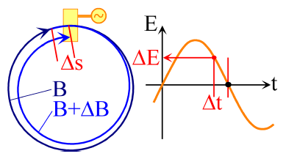
Increasing the momentum
Momentum follows magnet field variation due to RF phase focussing:
inject beam into ring at B₀ with momentum p₀ = qRB₀
increase B-field → B + ΔB
bending radius shrinks
path becomes shorter by 2πΔR
particles arrive earlier by Δt = (2πΔR)/βc
RF cavity: U(Δt) = U₀ sin(ωΔt + φ) > 0
Acceleration by Δp = βqU(Δt)
⇒ self-synchronization of p(t) with B(t)

Slide 44
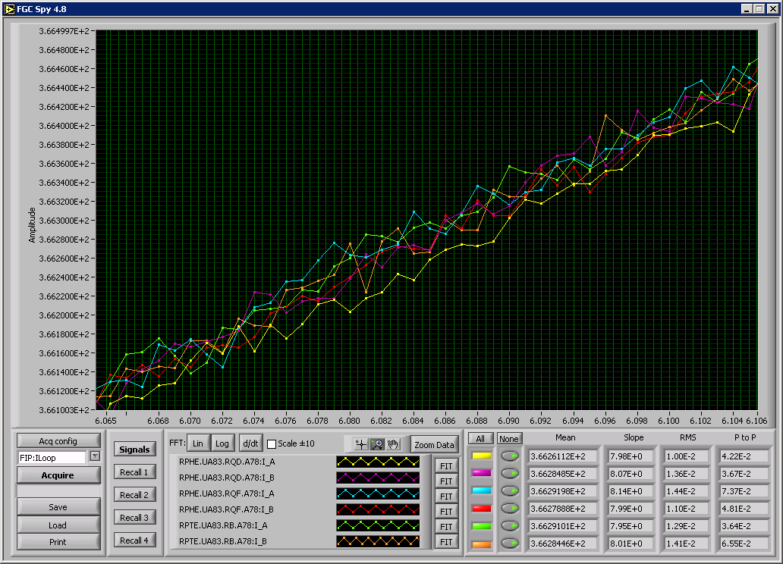
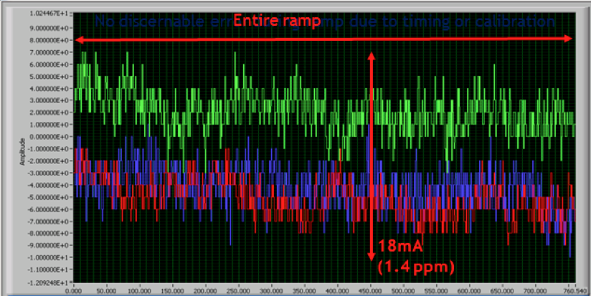
Tracking between the three main circuits of sector 78
2ppm
Main bend power converters: tracking error between sector 12 & 23 in ramp to 1.1 TeV
Phenomenal performance from the power converters
Courtesy Freddy Bordry & Dave Nisbet

Slide 45
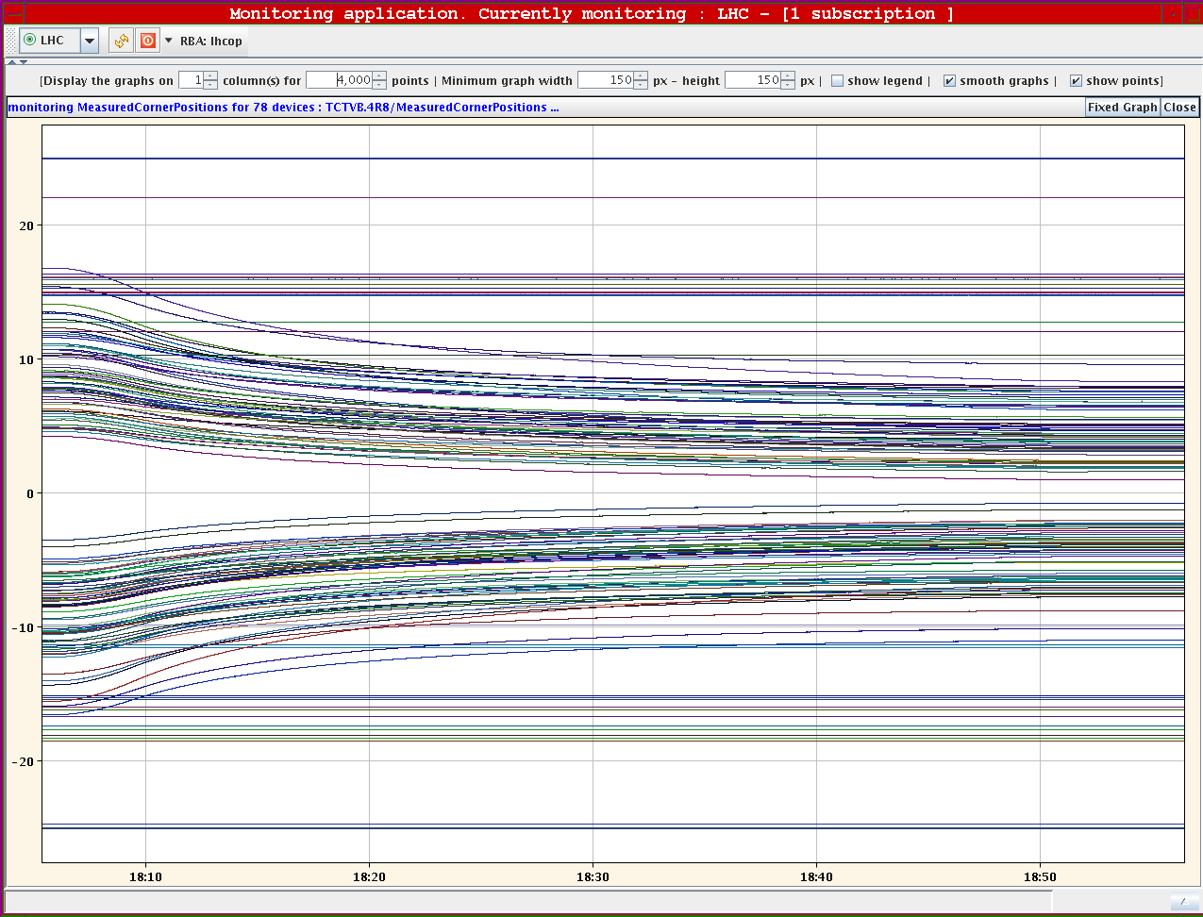
Ramp - collimators
Jaw positions in ramp

Slide 46
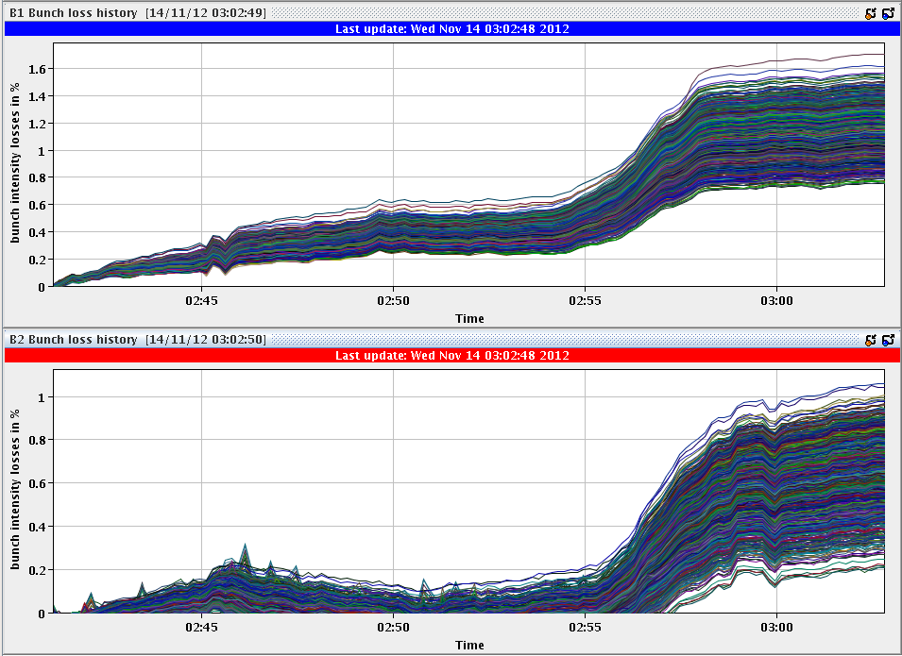
Losses per bunch in ramp

Slide 47
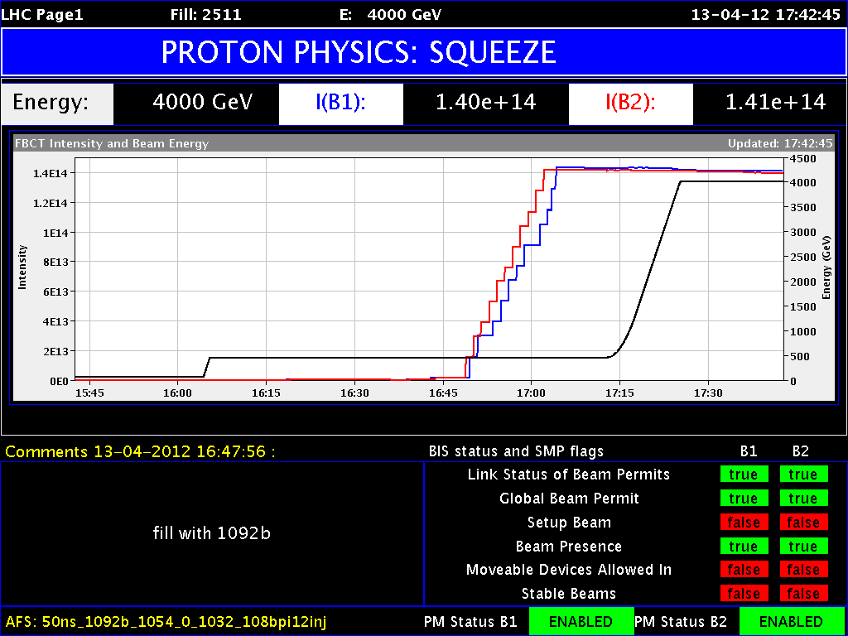
Reduction of beam size at interaction points
(beams still separated)

Slide 48
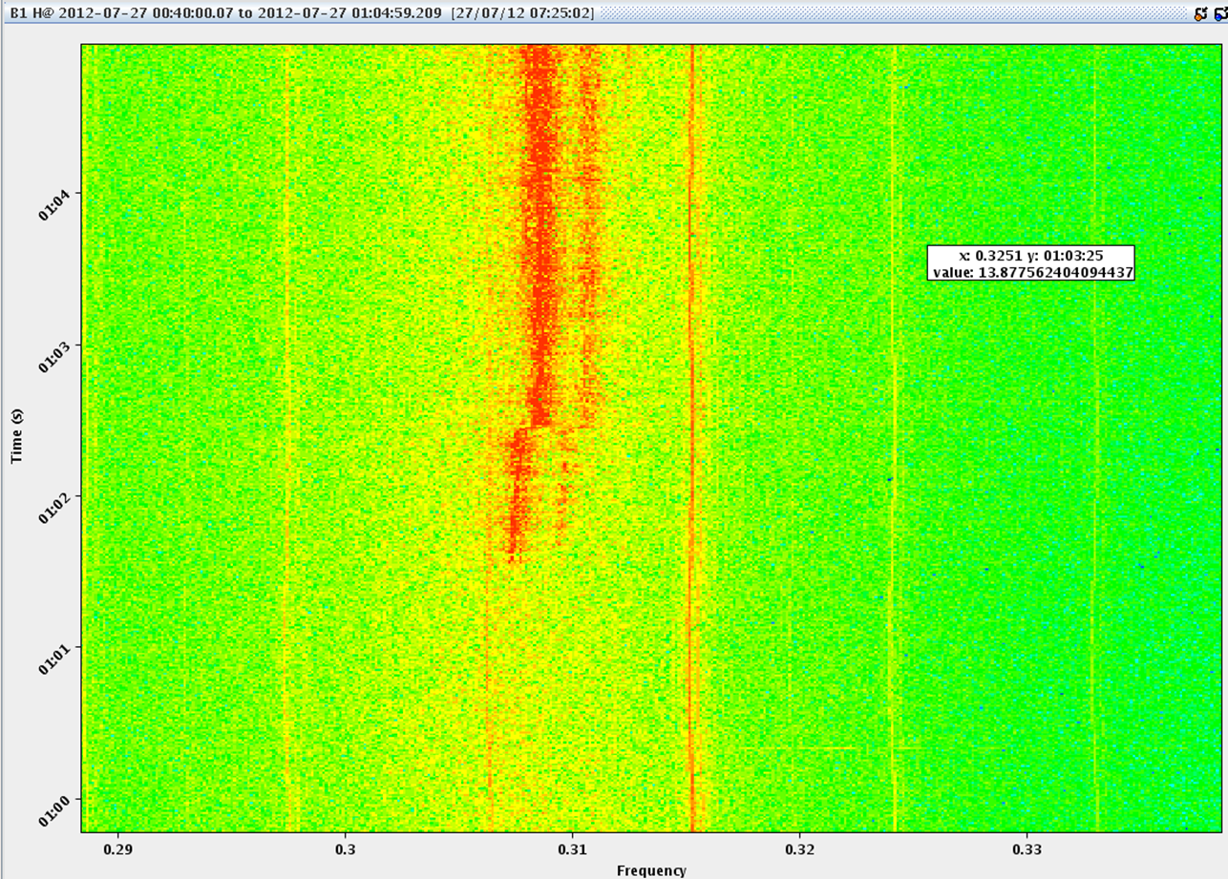
Squeeze 2012
From 11-10-11-10 to 0.6-3.0-0.6-3.0 m
Collisions tunes (.31/.32)
Orbit feedback - obligatory
Worry about:
  tune, chromaticity, coupling, orbit, optics corrections
  beam loss and instabilities… (tight collimator settings)
Activity kicks off on beam 1 – end of squeeze
Sustained beam loss both beams – finally dumping on collimator temperature interlock

Slide 49
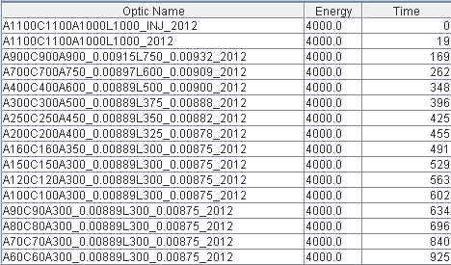
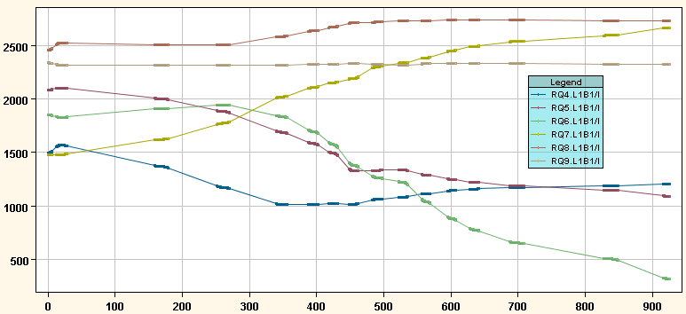
Squeeze in practice
Time in seconds
Matched optics
Beta* - 11 m ATLAS, CMS; 10 m in ALICE, LHCb
Beta* - 0.6 m ATLAS, CMS; 3 m in ALICE, LHCb
Current during the squeeze in a few quads at point 1

Slide 50
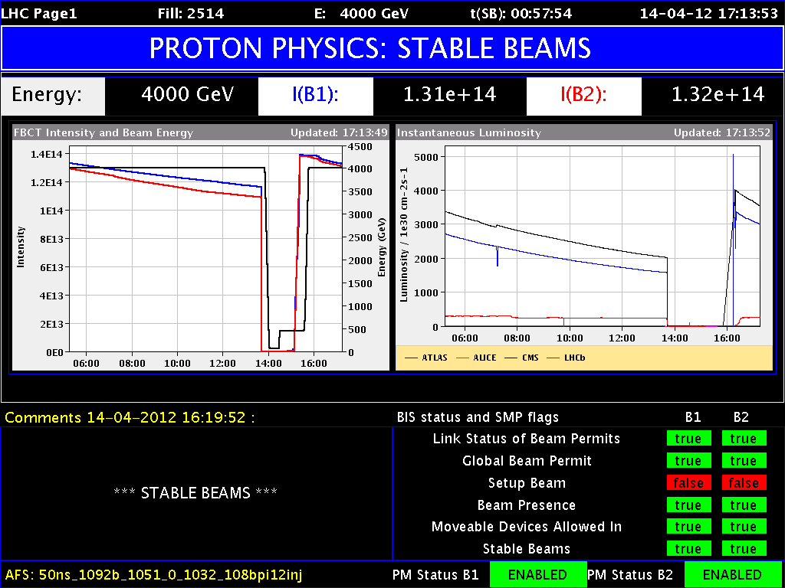
Luminosity
Beam intensity

Slide 51
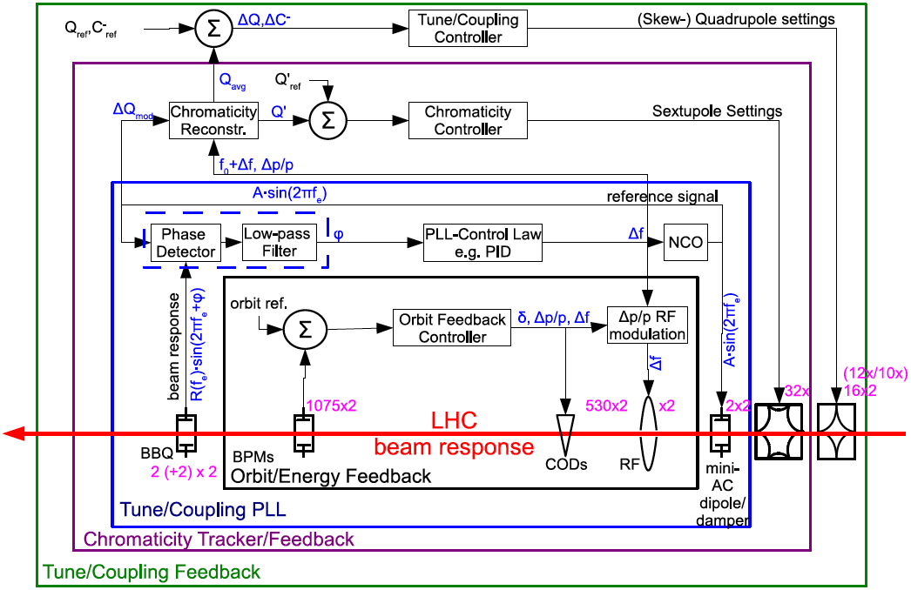
Beam based feedbacks
Courtesy Ralph Steinhagen

Slide 52


Orbit feedback
Orbit-Feedback is the largest and most complex LHC feedback:
  1088 BPMs → 2176+ readings @ 25 Hz from 68 front-end computers
  530 correction dipole magnets/plane, distributed over ~50 front-end computers
Total >3500 devices involved
Mandatory in ramp and squeeze
Stability in ramp and squeeze of ~ 50 micron rms or better

Slide 53


Tune feedback in ramp
Without
With
Courtesy Ralph Steinhagen

Slide 54


The transverse damper in general
The transverse damper is a feedback system: it measures the bunch oscillations and damps them by fast electrostatic kickers
OFF
Transverse position
Turn number
ON
Injection oscillations
Courtesy Wolfgang Hofle & Daniel Valuch

Slide 55
ADT as seen from the CCC
Daniel Valuch: Transverse damper system, Evian 2012

Slide 56
ADT as really seen from the CCC
ON
OFF
WHY ISN’T IT WORKING?
Phone Wolfgang or Daniel

Slide 57
Transverse feedback

Slide 58
Operations’ 7 pillars of wisdom
Given an impeccably debugged, optically good machine with an excellent magnet model, operations then rely on:
Availability
Reproducibility
Control
Instrumentation
Optimization and stability
Understanding
Safety systems

Slide 59
Machine protection
4 TeV with 1380 bunches – 2012
~3.6 GJ of energy stored in the main dipoles
140 MJ stored in each beam ~21 kg of TNT.

Slide 60
Beam Interlock system
Beam Current
Current
Safe LHC
Monitors
Parameters
Energy
Energy
DCCT Dipole
Current 1
Beam Energy
Injection
Energy
SPS Extraction
Tracking
Kickers
SafeBeam
Interlocks
DCCT Dipole
Flag
Current 2
TL collimators
RF turn clock
Beam Dumping
BLMs aperture
System
BLMs arc
Beam Dump
Collimators / Absorbers
Access Safety
Trigger
BPMs for Beam Dump
System
Discharge
NC Magnet Interlocks
Switches
LHC
BPMs for dx/dt + dy/dt
Beam
dI/dt beam current
Interlock
Cryogenics
System
dI/dt magnet current
essential
RF + Damper
Quench
circuits
Protection
Powering
LHC Experiments
Interlock
auxiliary
Vacuum System
Power Converters
System
circuits
Screens
Operators
AUG
Software Interlocks
UPS
Timing
Software Interlocks
Over 10’000 signals enter the beam interlock system (BIS).
The BIS will trigger a beam dump if any input signals a fault.

Slide 61

Beam Interlock System (BIS)
The communications from one point to another is carried out over four dedicated fibre optic channels. A clockwise and anticlockwise link exists for each beam to be interlocked by the Beam Interlock System. This means that the request for a Beam Dump always takes the shortest path from one BIC to LBDS.
Ben Todd

Slide 62
LHC beam dump
TDE
MKBH
(4x)
MKBV
(6x)
Beam 1
Q5L
MKB
Q4L
TCDQ
MSD
(3x5)
MSDA
MSDC
TCDS
Q4R
Q5R
MKD
(14x)
Beam 2

Slide 63

Beam dump system – point 6
Video 2’10”

Slide 64
Abort Gap
dump trigger
Extraction kicker MKD deflection
LHC
Beam
3.0 μs
particle-free
abort gap

Slide 65

Asynchronous Beam Dump
TCDQ + TCSG to protect downstream superconducting magnets (Q4)
TCSG
TCDQ = 6 m long CFC* one-sided collimator
TCSG = 1 m long CFC* two-sided collimator
*CFC = carbon fibre compound
Estimated occurrence : at least once per year, 1 events up to now!

Slide 66


Slide 67


Slide 68
Pedagogical collimation 1
Collimation is set up with multi-stage logic for cleaning and protection
Let’s look in normalized phase space, talking in nominal sigmas:
Tertiary
+Triplet
Tertiary
+Triplet
Secondary
Dump Protection
Primary
Dump Kicker
Closed orbit
“The hierarchy”
Ralph Assmann

Slide 69
Pedagogical collimation II
Collimation is set up with multi-stage logic for cleaning and protection
Let’s look in normalized phase space, talking in nominal sigmas:
Tertiary
+Triplet
Tertiary
+Triplet
Secondary
Dump Protection
Primary
Primary beam and primary halo
Dump Kicker

Slide 70
Pedagogical collimation III
Collimation is set up with multi-stage logic for cleaning and protection
Let’s look in normalized phase space, talking in nominal sigmas:
Tertiary
+Triplet
Tertiary
+Triplet
Secondary
Dump Protection
Primary
Beam dump envelope
Dump Kicker

Slide 71
Pedagogical collimation IV
Collimation is set up with multi-stage logic for cleaning and protection
Let’s look in normalized phase space, talking in nominal sigmas:
Tertiary
+Triplet
Tertiary
+Triplet
Secondary
Dump Protection
Primary
Not robust
ROBUST
Beam dump envelope
Not robust
Dump Kicker
… but efficient …

Slide 72
Pedagogical collimation V
Collimation is set up with multi-stage logic for cleaning and protection
Let’s look in normalized phase space, talking in nominal sigmas:
Tertiary
+Triplet
Tertiary
+Triplet
Secondary
Dump Protection
Primary
Not robust
ROBUST
MARGIN
Beam dump envelope
Not robust
Dump Kicker
… but efficient …

Slide 73
Collimator hierarchy
The hierarchy must be respected at all times.
The collimators and protection devices are positioned with respect to the closed orbit
Therefore the closed orbit must be in tolerance at all times.
This includes the ramp and squeeze.
  Orbit feedback becomes mandatory
  Interlocks on orbit position become mandatory

Slide 74


Collimation/reproducibility
.
Orbit at primary
IR7 collimators – beam 1
ORBIT FEEDBACK
2011-2012: only ONE full alignment in IR3/IR7
Orbit at Primary collimator (TCP) in ramp
J. Wenninger

Slide 75

Collimation
Generate higher loss rates: excite beam with transverse dampers
Beam 1
Betatron
Off-momentum
0.00001
Dump
TCTs
TCTs
TCTs
TCTs
Legend:
Collimators
Cold losses
Warm losses
0.000001
Routine collimation of 140 MJ beams without a single quench from stored beam
Stefano Redaelli

Slide 76
RESERVE

Slide 77
Correcting the closed orbit
Represent beam position by M-dimensional vector
Represent the corrector kicks by an N-dimensional vector
M is the number of BPMs and N is the number of correctors.
Now
Where A is the linear response matrix (N x M) which describes the relation between corrector kicks and beam position changes at the BPMs.
A_{ij} corresponds to the orbit change at the i^{th} monitor due to a kick from the j^{th} corrector

Slide 78
Orbit correction
Variety of methods MICADO, SVD designed to deal with this problem
e.g. minimising
Just need to invert this
Poorly positioned correctors, errors in measurements means the matrix is often ill conditioned
A lot of options and facilities provided on-line at the LHC by YASP

Slide 79
The extraction process
0.06 mrad
H
LHC orbit
0.33 mrad
Q4
Kickers (H)
Septum (V)
2.4 mrad
V
LHC orbit
From the kickers require:
<3 μs extraction kicker rise time (abort gap),
>89 μs extraction kicker flat-top length (full LHC turn)

