Slide 1

An (Early) Experimental Profile of the Higgs Boson
The Higgs Particle
CERN Academic Training
Lecture II
Marumi Kado
Laboratoire de l’Accélérateur Linéaire (LAL)
and CERN

Slide 2
Outline
I.- The roadmap to the discovery (Lecture I)
From theoretical foundations to the discovery
II.- An (early) experimental profile of the Higgs boson (Lecture II)
  1.- Comments on Statistical Methods (Part II)
  2.- Overview of the analyses
  3.- Measurements of coupling properties of the Higgs boson
  4.- Measurement of spin/CP properties of the discovered state
III.- Implications and future projects (Lecture III)
- Rare and invisible decays
- Implications of the discovered state
- Search for BSM Higgs and extended sectors
- Future Higgs programs

Slide 3

Picking up where we left yesterday…
Discovery of a narrow bosonic Higgs-like resonnance
Compatible in all investigated aspects with the Higgs boson of the Standard Model
Today: How the « Like » was removed… and…

Slide 4
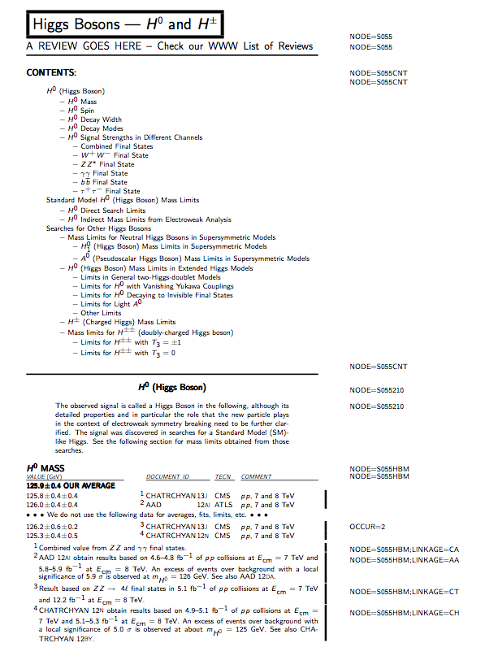
… in 2013
Entrance of the H⁰ in the PDG!
Inaugural entrance of the Higgs boson in the PDG particle listing !
(not anymore as an hypothetical particle)

Slide 5
Comment on Statistical Methods
(Part II)

Slide 6
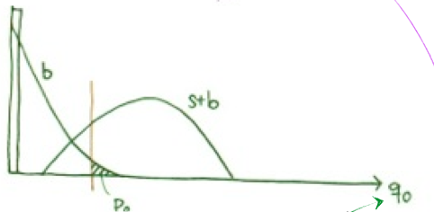
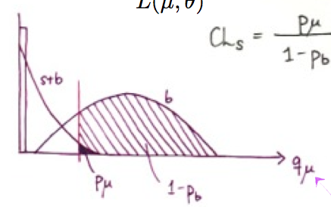
The Profiling Paradigm
Background likeliness
Signal likeliness

Slide 7
The Profiling Paradigm

Slide 8
Simple Example
SR

Slide 9
Simple example with control region
SR
BR

Slide 10
Simple example with control region
SR
BR

Slide 11
Simple example with control region
SR
BR

Slide 12
Simple example with control region
Do we know that constraint term should be a Gaussian?
Needs caution as in this case ε can change from its initial value and its post-fit variance can be smaller than δ₀ resulting from the data constraint
Potentially dangerous (if not modeled correctly) when the parameter is correlated between background and signal

Slide 13
The Profiling Paradigm
Allowed to take into account systematic uncertainties in our statistical methods (p₀ and limits).
It now serves as paradigm to model systematic uncertainties also in our measurements.
Relies on modeling of prior probability of the systematic uncertainty (in many cases unknown).
Often implies a re-measurement of model physical observable which should be handled with great care.

Slide 14
Overview of Main Current Analyses

Slide 15
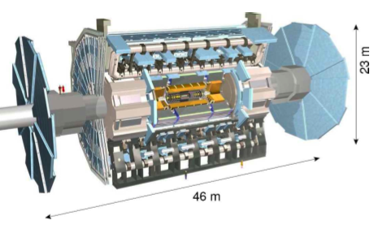
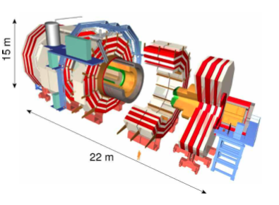








Preamble I: The ATLAS and CMS Detectors In a Nutshell
Sub System | ATLAS | CMS
Design
Magnet(s) | Solenoid (within EM Calo) 2T 3 Air-core Toroids | Solenoid 3.8T Calorimeters Inside
Inner Tracking | Pixels, Si-strips, TRT PID w/ TRT and dE/dx | Pixels and Si-strips PID w/ dE/dx
EM Calorimeter | Lead-Larg Sampling w/ longitudinal segmentation | Lead-Tungstate Crys. Homogeneous w/o longitudinal segmentation
Hadronic Calorimeter | Fe-Scint. & Cu-Larg (fwd) | Brass-scint. & Tail Catcher
Muon Spectrometer System Acc. ATLAS 2.7 & CMS 2.4 | Instrumented Air Core (std. alone) | Instrumented Iron return yoke
4
11

Slide 16
Preamble II : Theoretical Breakthroughs
Several breakthroughs in the past decade have drastically changed the theory prospective to the hadron collider processes.
  The “Next-to…” revolution :
    Breakthrough ideas in computation of loops (sewing together tree level amplitudes).
    NLO generators, blackhat, NLOjet++, Phox, MCFM, etc…
    NLO generators w/ PS, MC@NLO, aMC@NLO and POWHEG.
    NLO+NLL or NNLL, CAESAR, ResBos, HqT
    NNLO, FEHIP, FEWZ, HNNLO, DYNNLO
    …
  NNLO PDFs sets
  Parton Shower (and Matrix Element matching) improvements :
    Pythia (8.1), Herwig++, Sherpa and CKKW (1.3) and MadGraph (5.0)
    MEPS@NLO, etc…
  The Jet revolution (Fast Jet) : Allowing to compute in reasonable time infra-red safe k_{T} jets.

Slide 17
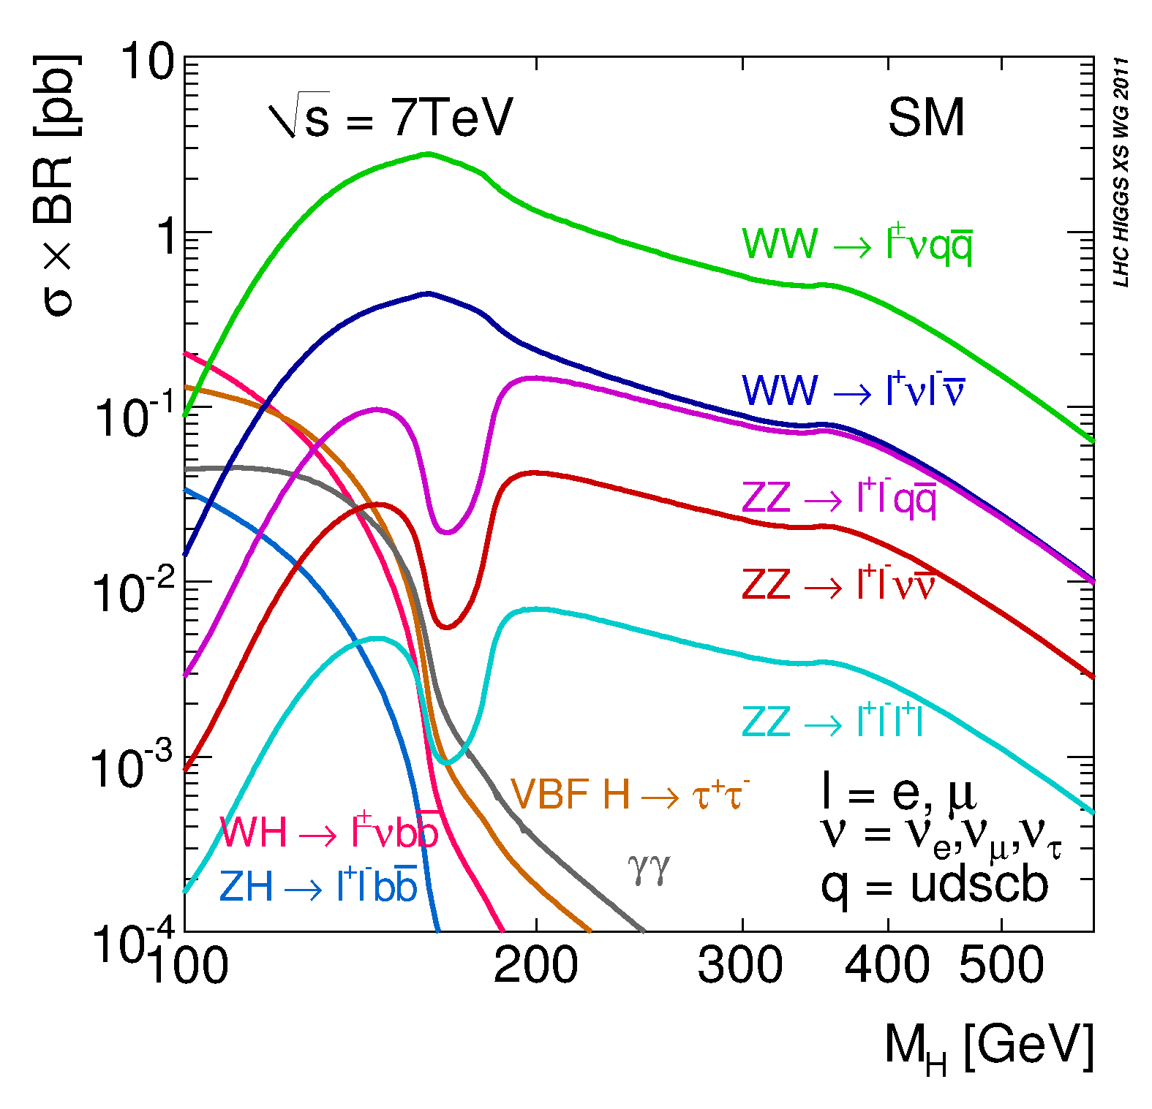
Decay Modes
- Dominant decay mode b (57%)
Very large backgrounds, associated production W,Z H and Boost!
- The ττ channel (6.3%)
VBF, VH, but also ggF with new mass reconstruction techniques
H → WW→ lvlv
VBF(H → ττ)
W(H → bb)
- The γγ channel (0.2%)
H → γγ
Discovery channel, high mass resolution (High stat, and backgrounds)
Z(H → bb)
- The ZZ Channel (3%)
- Subsequent all leptons decays (low statistics): golden channel
- llqq and llvv sensitive mostly at high mass
H → ZZ → llll
- The WW Channel (22%)
- Subsequent lvlv very sensitive channel
- lvqq sensitive mostly at high mass
- The μμ channel (0.02%) and Zγ (0.2%)
Low statistics from the low branching in μμ or both the low branching and subsequent decay in leptons (Zγ)
- The cc channel (3%)
Very difficult

Slide 18
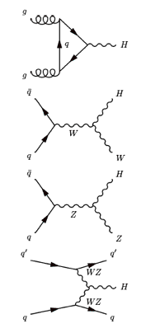
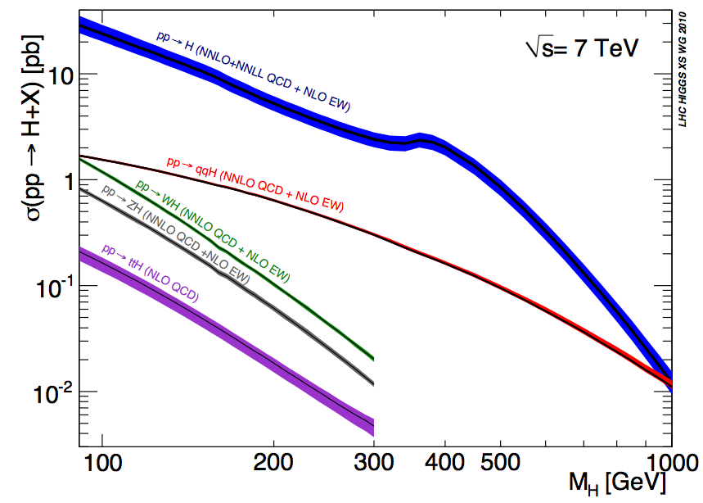
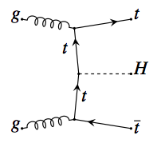
The Main Production Modes at the LHC
- Gluon fusion process :
Dominant process known at NNnLO
TH uncertainty ~O(10%)
~0.5 M events produced!
- Vector Boson Fusion :
known at NLO TH uncertainty ~O(5%)
Distinctive features with two forward jets and a large rapidity gap
~40 k events produced!
- W and Z Associated Production :
known at NNLO TH uncertainty ~O(5%)
Very distinctive feature with a Z or W decaying leptonically
~20 k events produced!
- Top Associated Production :
~3 k events produced!
known at NLO TH uncertainty ~O(15%)
Quite distinctive but also quite crowded
* TH uncertainty mostly from scale variation and PDFs, δσ _{PDF-αs}~8-10% and δσ _{Scale~} 7-8%

Slide 19
Channels investigated
Channel categories | ATLAS |  |  |  | CMS |  |  |  | TeVatron
 | ggF | VBF | VH | ttH | ggF | VBF | VH | ttH | VH | ggF
γγ | ✓ | ✓ | ✓ | ✓ | ✓ | ✓ | ✓ | ✓ | (inclusive) ✓
ZZ (llll) | ✓ | ✓ |  |  | ✓ | ✓ |  |  | ✓
WW (lνlν) | ✓ | ✓ | ✓ |  | ✓ | ✓ | ✓ |  | ✓ | ✓
ττ | ✓ | ✓ | ✓ |  | ✓ | ✓ | ✓ | ✓ | ✓
H (bb) |  |  | ✓ | ✓ |  | ✓ | ✓ | ✓ | ✓
Zγ | (inclusive) ✓ |  |  |  | ✓ | ✓
μμ | (inclusive) ✓
Invisible | (✓) |  | ✓ |  |  | ✓ | ✓

Slide 20
Overview of Current Main Analyses
Highlighting one example

Slide 21
Somewhat detailing one example
(rather important one)

Slide 22
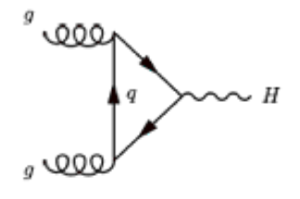
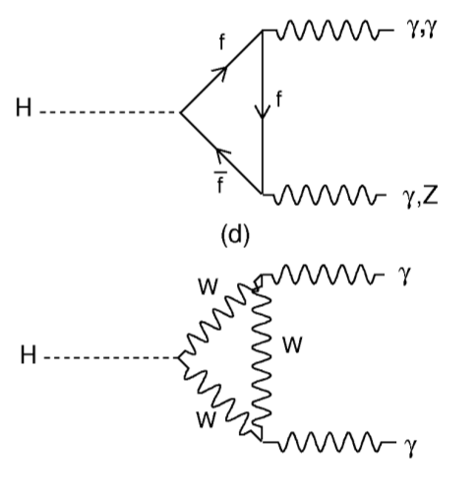
Interesting Facts about the γγ Channel
- Main production and decay processes occur through loops :
Excellent probe for new physics !
known at NNnLO, still rather large uncertainty O(10%)
A priori potentially large possible enhancement…
… Not so obviously enhanced (e.g. SM4)
Seldom larger yields : e.g. NMSSM (U. Ellwanger et al.) up to x6, large stau mixing (M. Carena et al.), Fermiophobia…
- High mass resolution channel
- If observed implies that it does not originate from spin 1 : Landau-Yang theorem
- If observed implies that its Charge Conjugation is +1

Slide 23
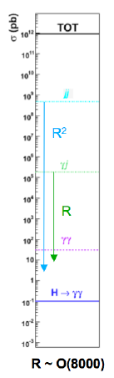
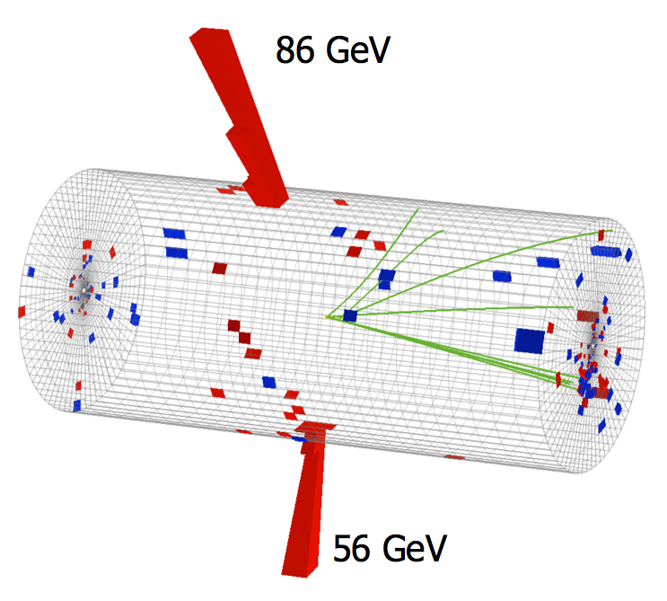
Backgrounds
Photon or jet fragmenting into leading π⁰ ?
23

Slide 24
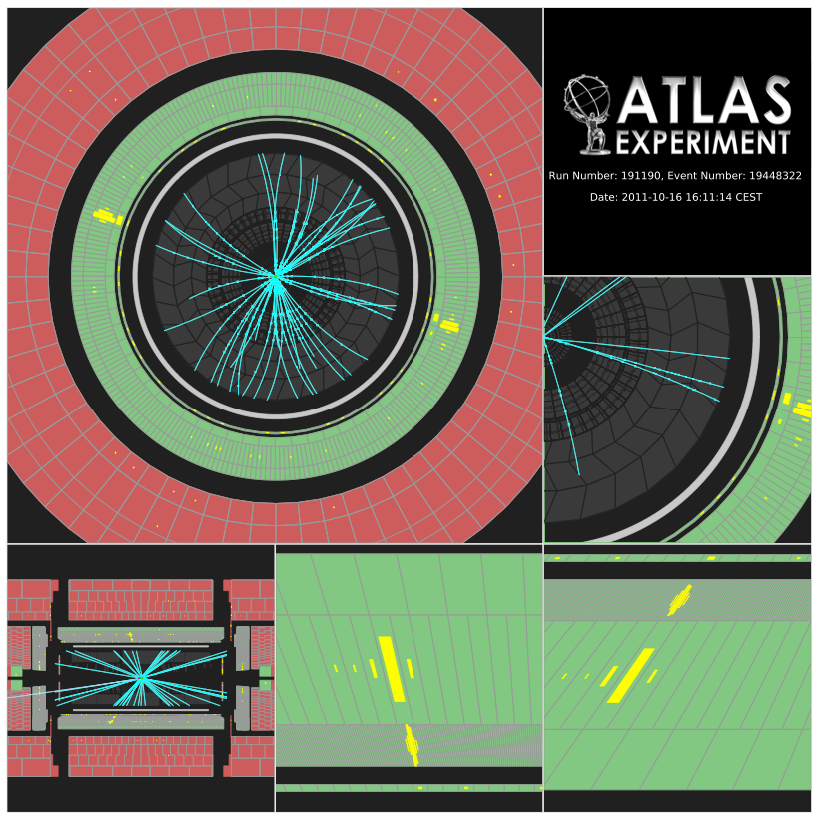
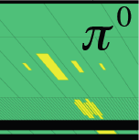
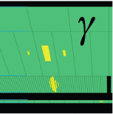
Background
From jets
Signal

Slide 25
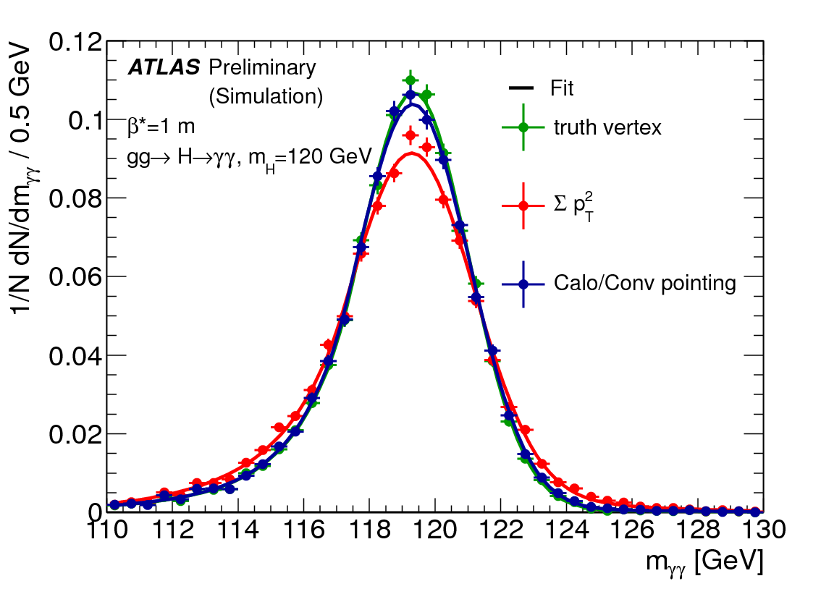
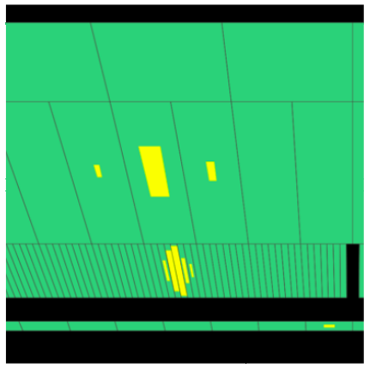
Reconstruction of the Angle in Space
IP spread of 5.6 cm : assuming (0,0,0) adds ~1.4 GeV in mass resolution
(equiv. to the calo. M_{γγ} resolution itself).
Can use conversion as well
Recoil tracks (less effective with large PU)
1.- Measure photon direction
2.- Deduce z of PV
Resolution with pointing ~1.6 cm
Effective gain with O(10) PU events ~10%

Slide 26
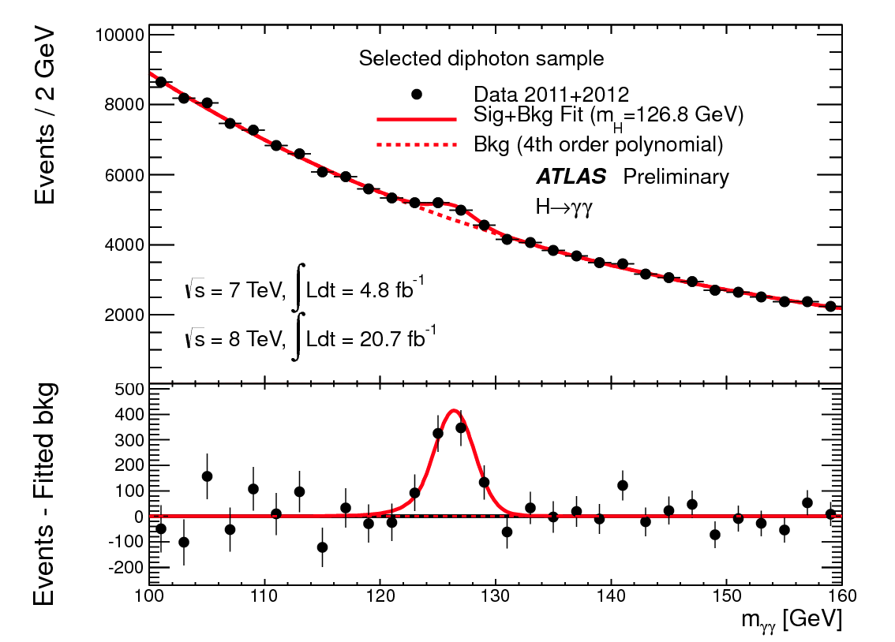
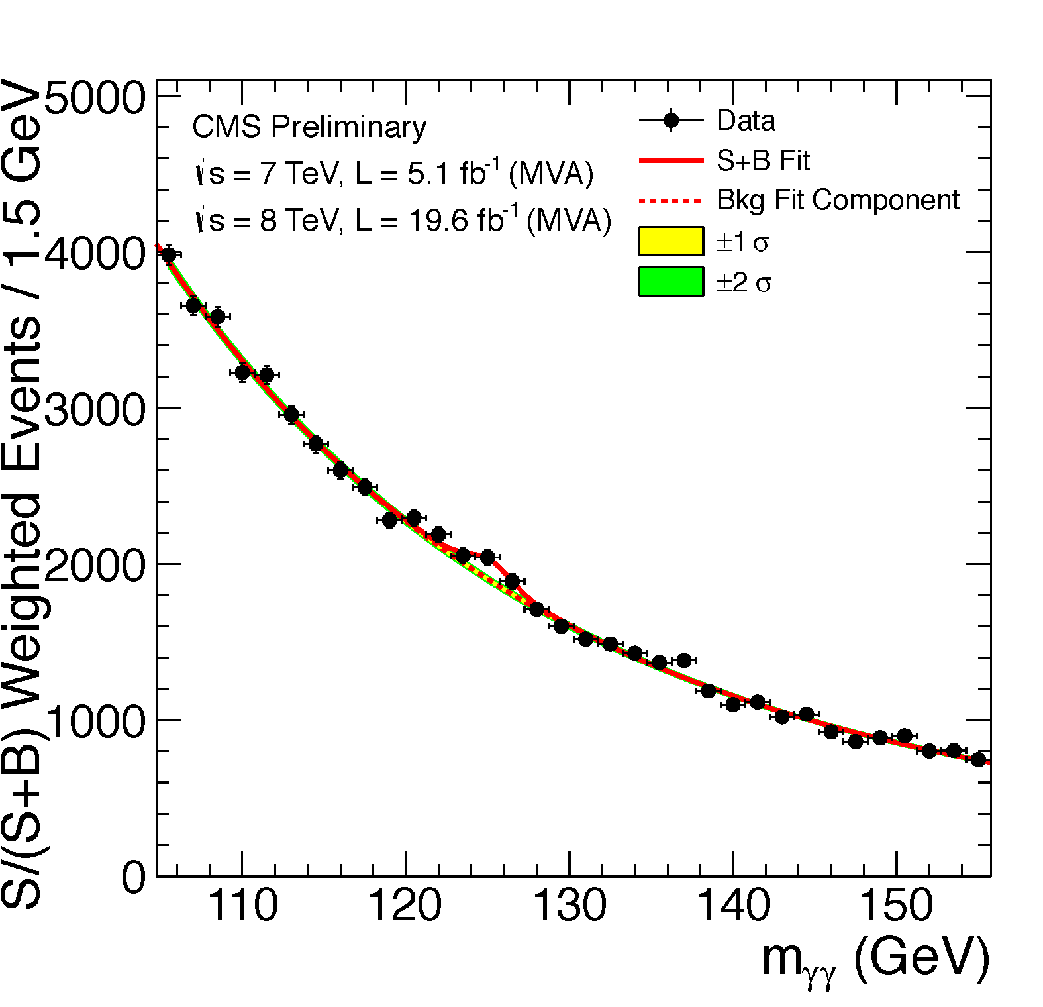
Analysis strategy:
  - Di-photon mass is the key observable
  - two isolated high-p_{T} photons
  - vertex
    CMS: from recoiling charged particles
    ATLAS: from photon pointing (longitudinal ECAL segmentation)
  - split events into exclusive categories:
    untagged, and further divided into 4/9 classes based on
      expected mass resolution
      expected S/B-ratio
    di-jet tagged (VBF), and further divided into 2 classes based on
      expected S/B-ratio
    ATLAS: low mass di-jet tag (VH)
    MET-tagged (VH)
    lepton-tagged (VH)
  - background: from m_{γγ} distribution (in the sidebands)
Key Analysis Features to note:
  - Small S/B-ratio,
  High event yield
  di-photon mass resolution = 1-2%

Slide 27
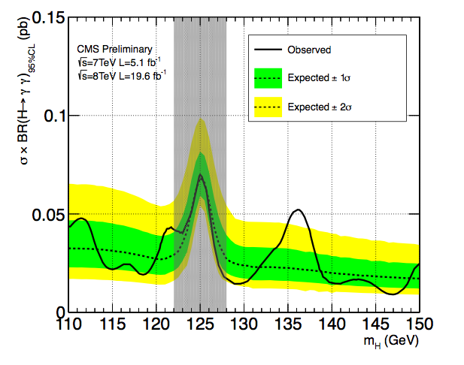
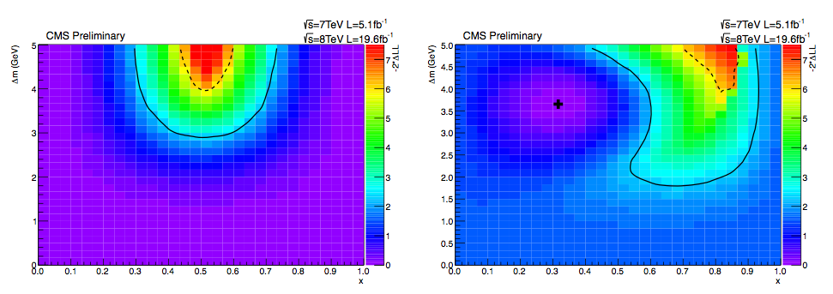
  - CMS estimate of the potential presence of two nearly degenerate states (CMS-PAS-HIG-13-016)
  - CMS obs. (exp.) limit on natural width 6.9 (5.9) GeV
  - CMS limit on higher mass states (an excess at around 136 GeV <2 s.d. with LEE)

Slide 28
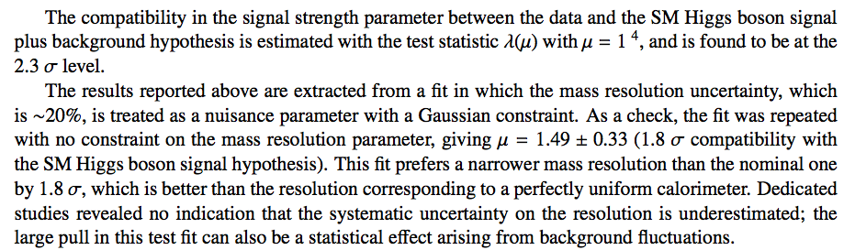
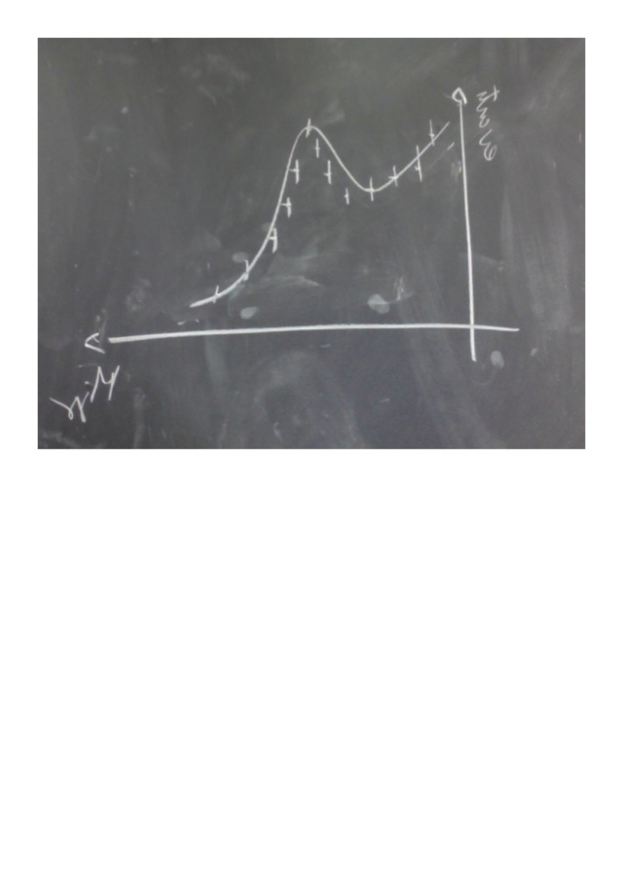
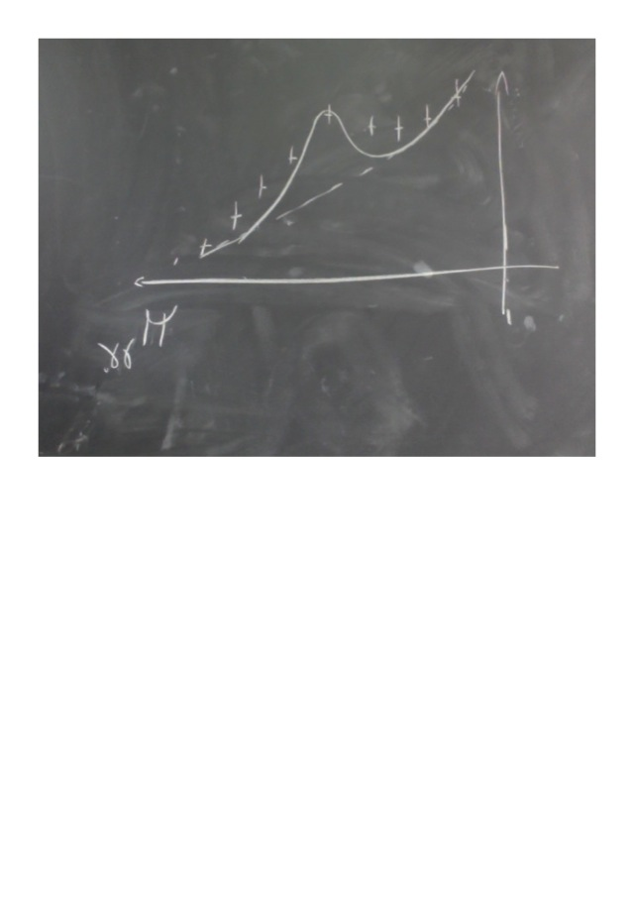
Data larger than typical resolution
The long standing ATLAS “excess” in diphoton rate
Higher prob. to overestimate μ
Higher prob. To underestimate μ
ATLAS case
Typical resolution larger than data
(Conditionnal) Probability for a fluctuation in the mass also higher

Slide 29
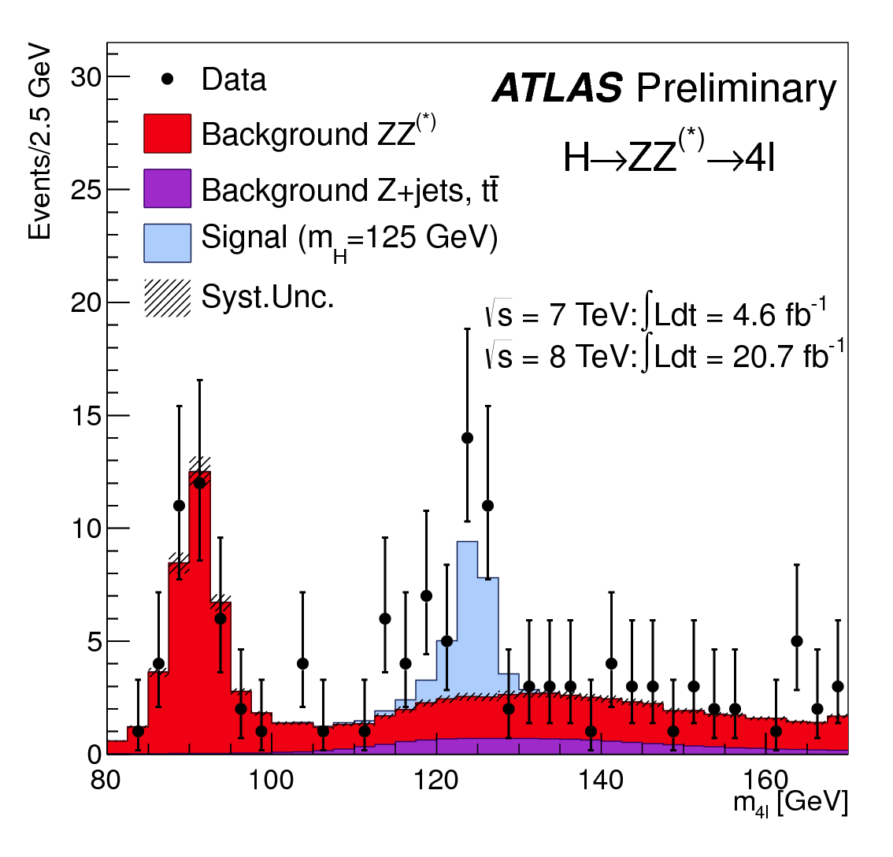
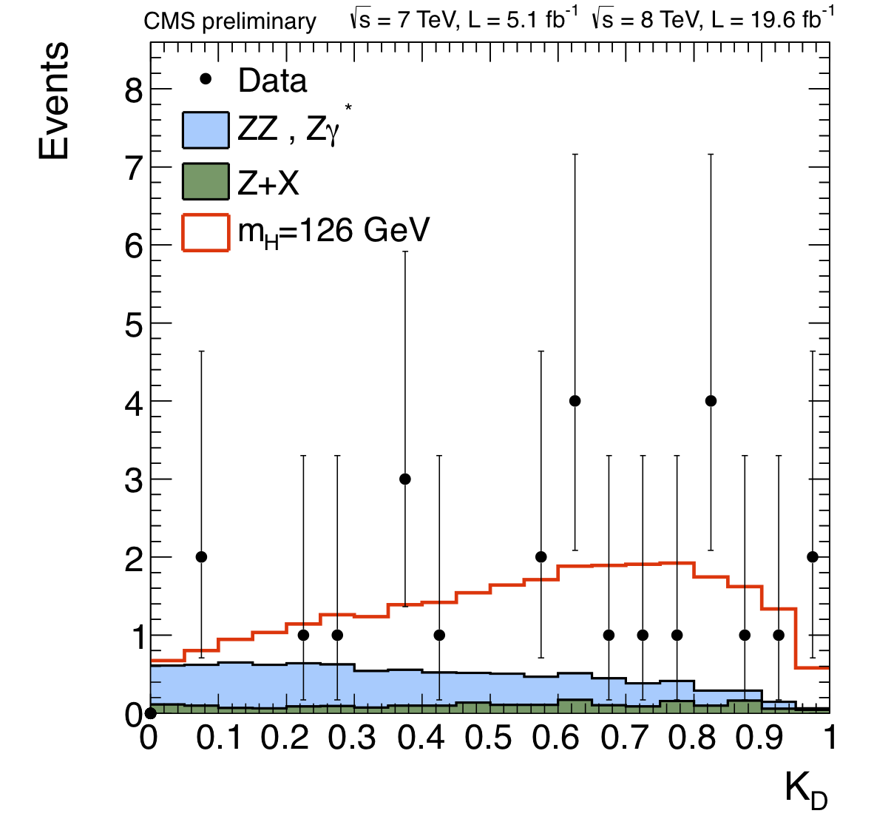
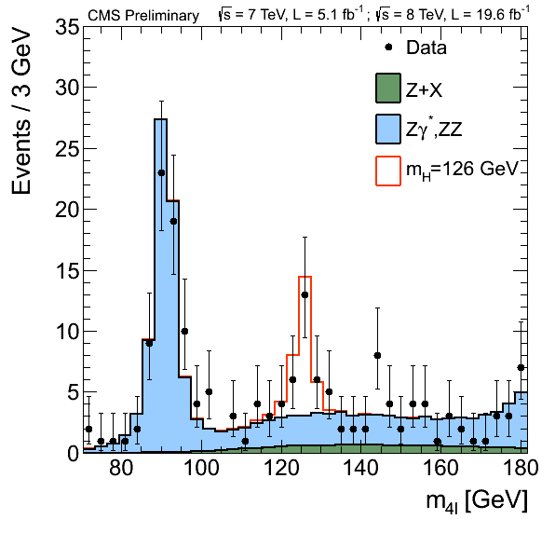
Analysis strategy:
  four prompt leptons (low p_{T} is important!)
  four-lepton mass is the key observable
  split events into 4e, 4μ, 2e2μ channels:
    Different resolutions and S/B rates
  CMS specificities:
  - ME-based discriminant K_{D}
  - Per event (mass) errors
  split events further into exclusive categories:
    untagged (CMS: add a 3rd observable: four-lepton p_{T}/m )
    di-jet tagged (CMS: add a 3rd observable: V_{D}(m_{jj}, Δη_{jj}) )
Analysis key features:
  High S/B-ratio,
  But small event yield
  mass resolution = 1-2%

Slide 30
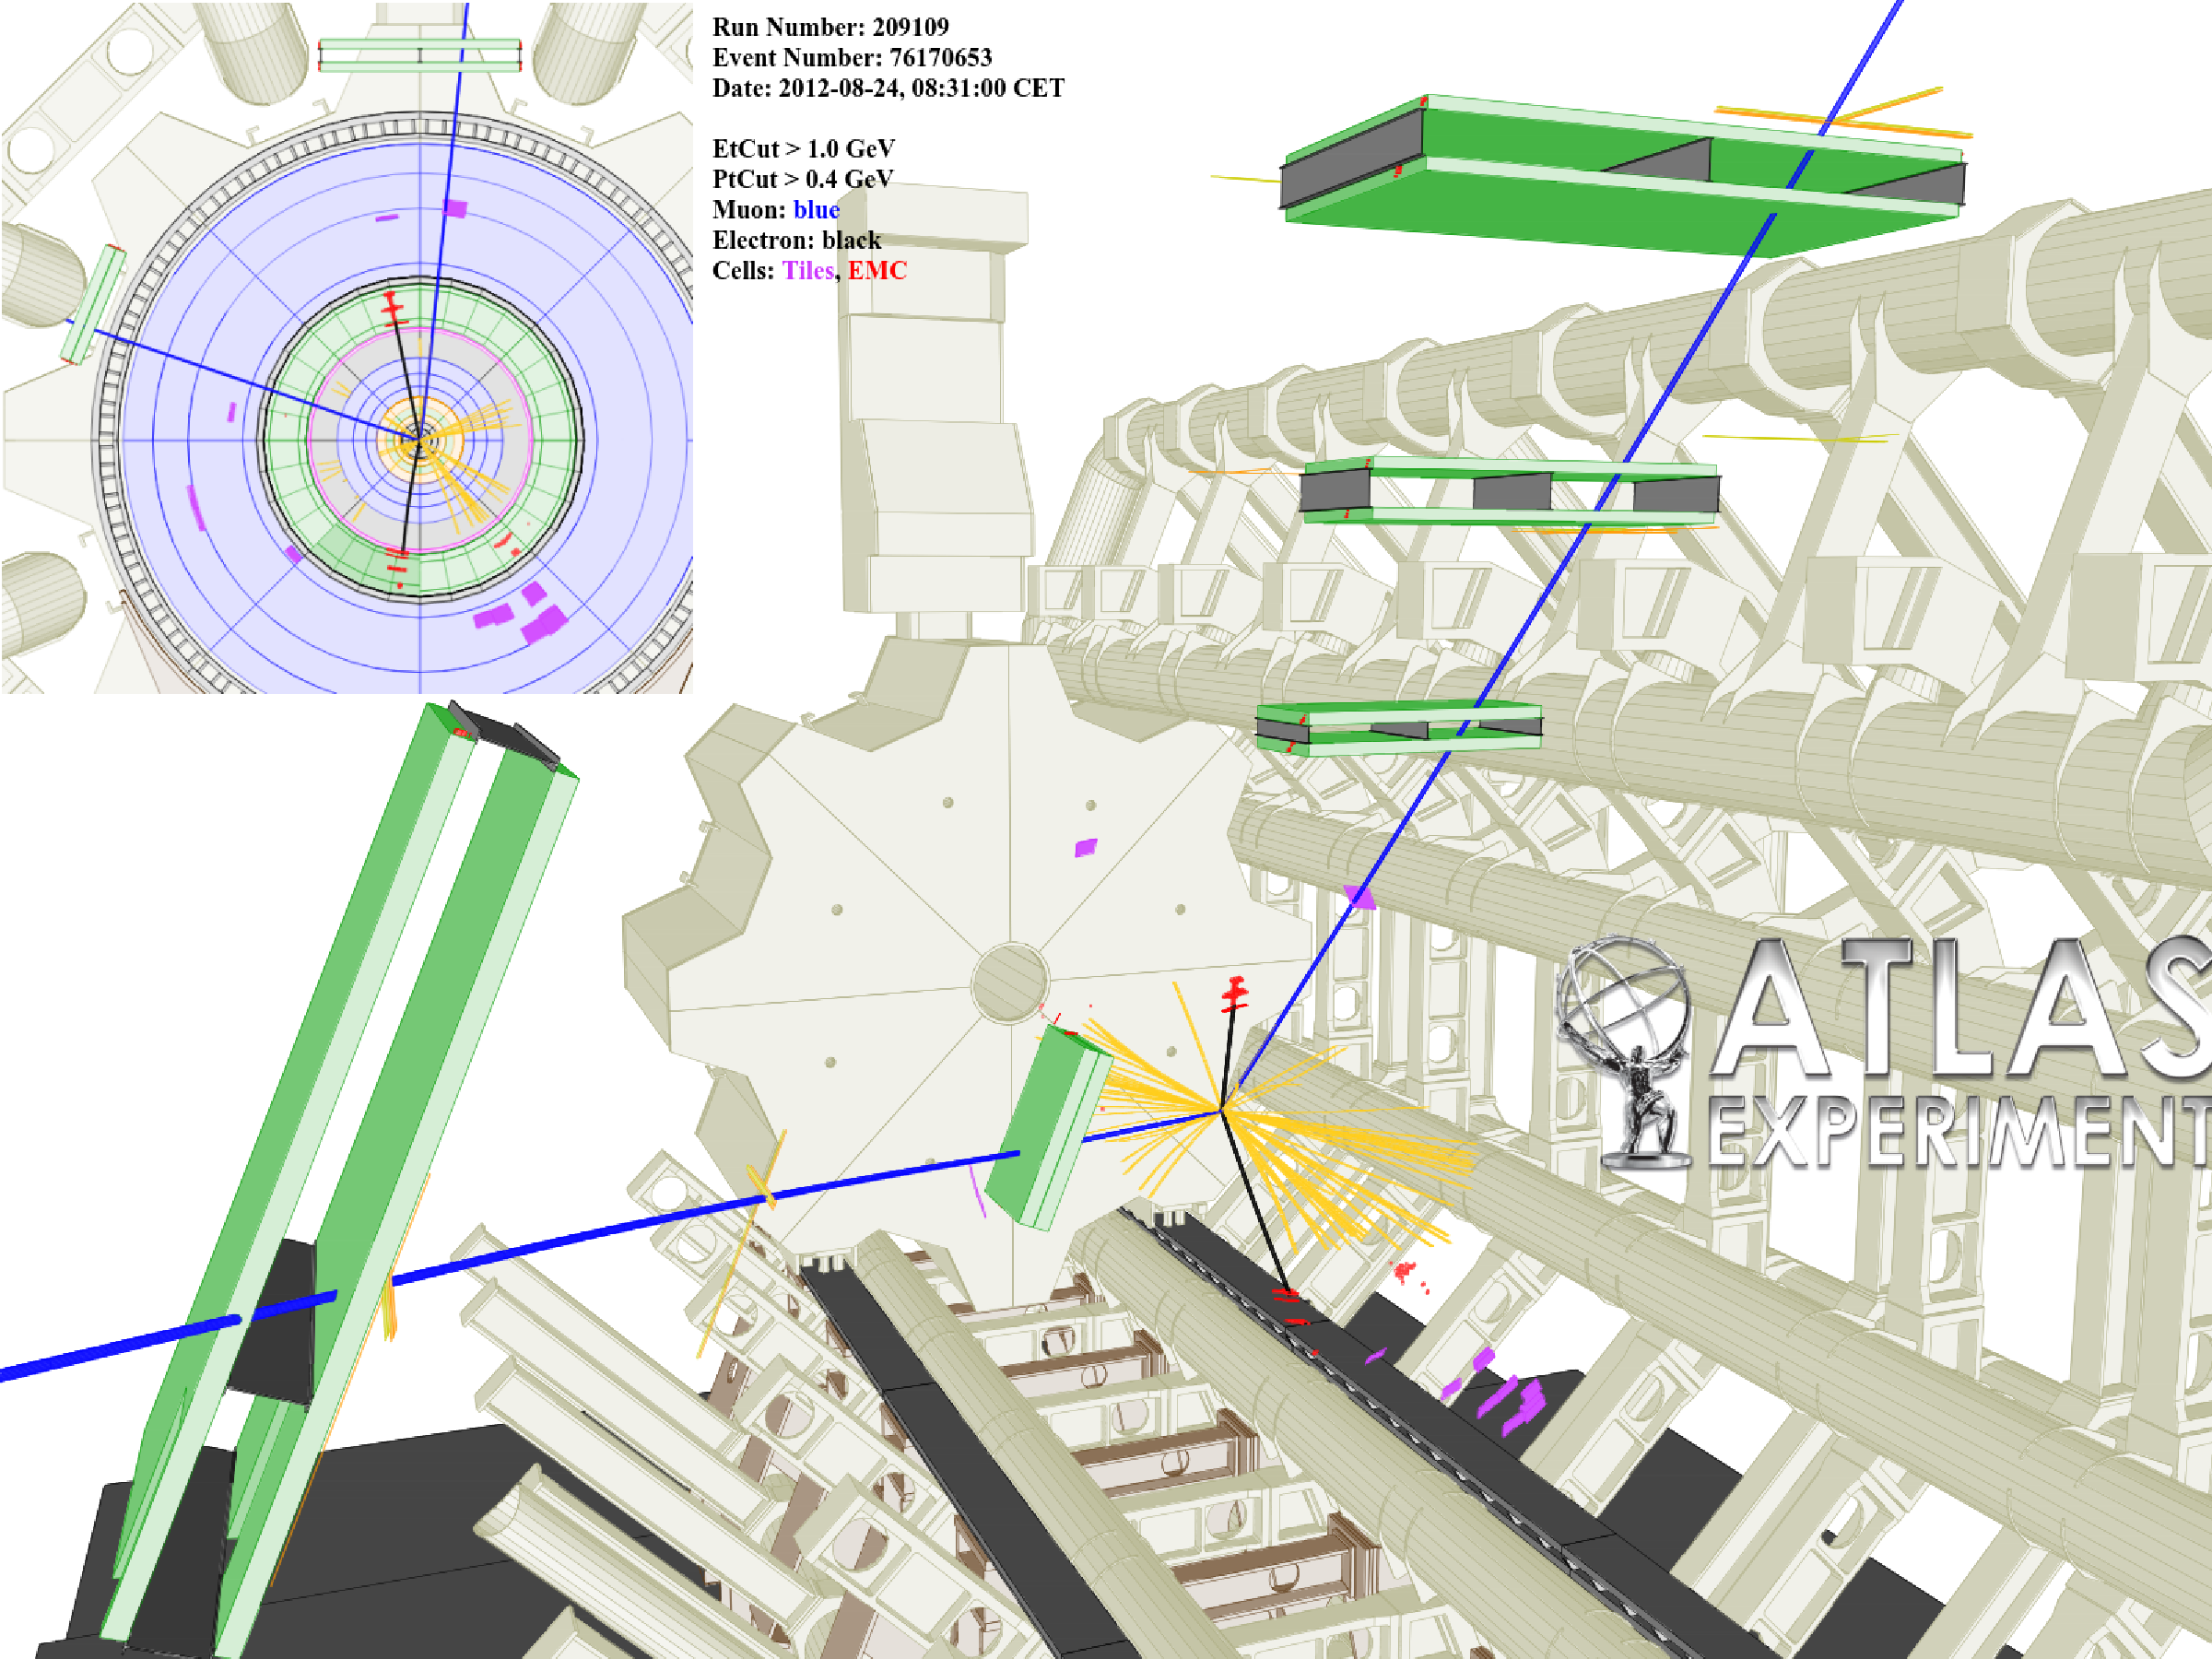
H → 4l Single Highest Purity Candidate Event (2e2μ)
H → 4l Update

Slide 31
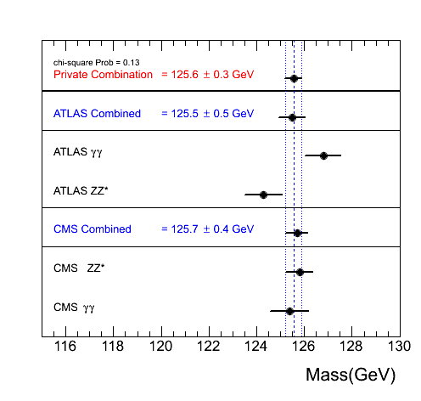
H → 4l Update
The Mass of the Higgs Particle
Review of mass measurements across channels and experiments
Unofficial combination
χ² Probability of 13%
Final word on mass and μ from both ATLAS and CMS will require final Run I calibration

Slide 32
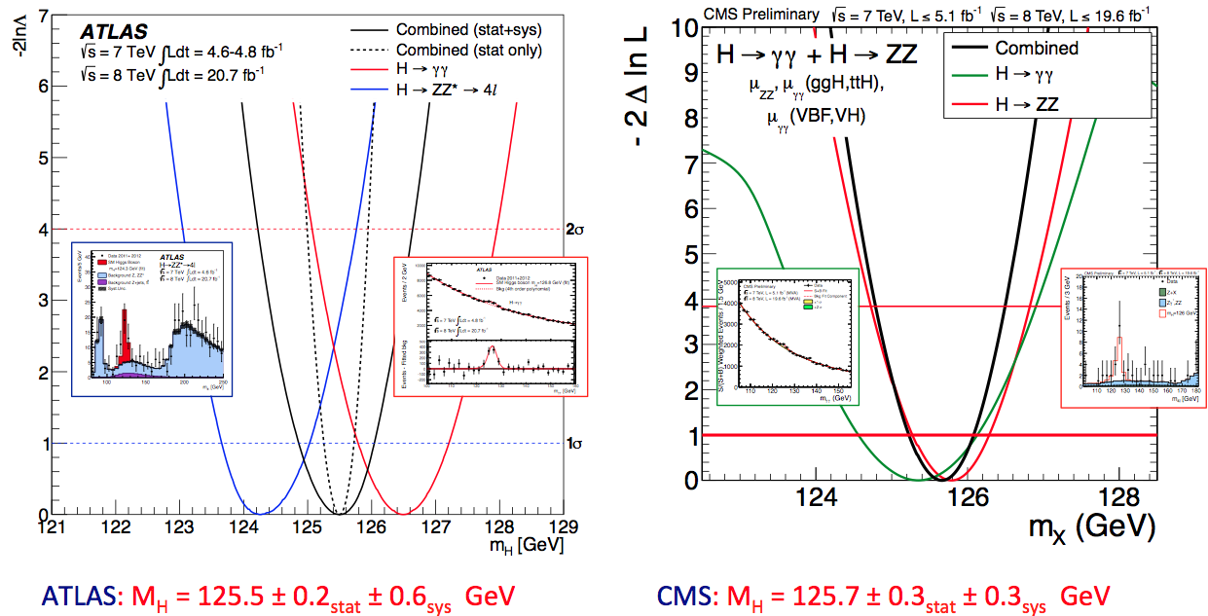
H → 4l Update
The Mass of the Higgs Particle
(F. Cerutti @ EPS 2013)
Diphoton : 126.8±0.2±0.7
Four leptons : 124.3±0.5±0.5

Slide 33
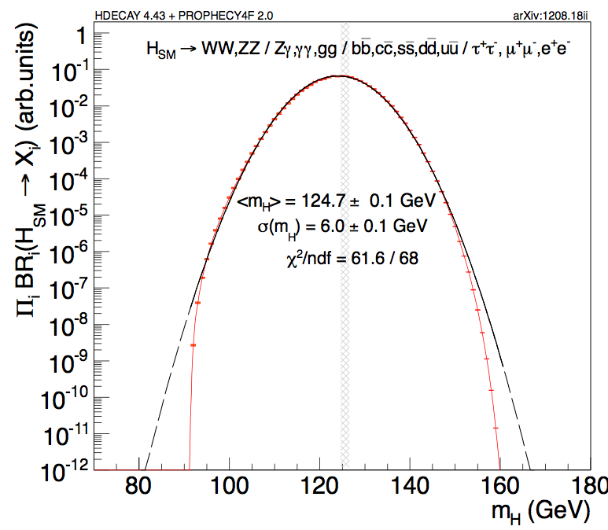
Intriguing/Amusing Coincidences (?)
- m_{H}= (m_{W}+m_{W}+m_{Z})/2 = 126.0 GeV (http://arxiv.org/abs/0912.5189)
- m_{H}² = m_{Z} x m_{t} => m_{H} = 125.8 GeV (http://arxiv.org/pdf/1209.0474.pdf)
- Π BR peak at mH =124.7 GeV (http://arxiv.org/pdf/1208.1993.pdf)

Slide 34
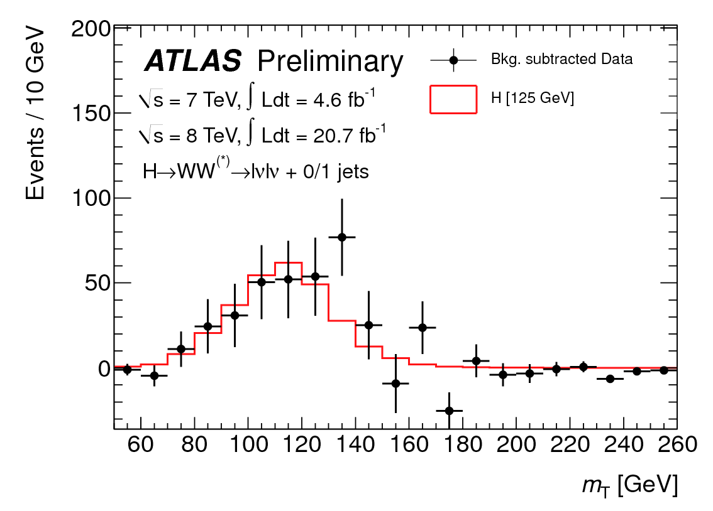
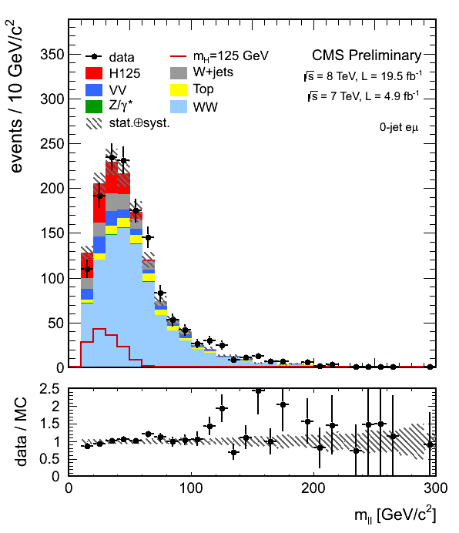
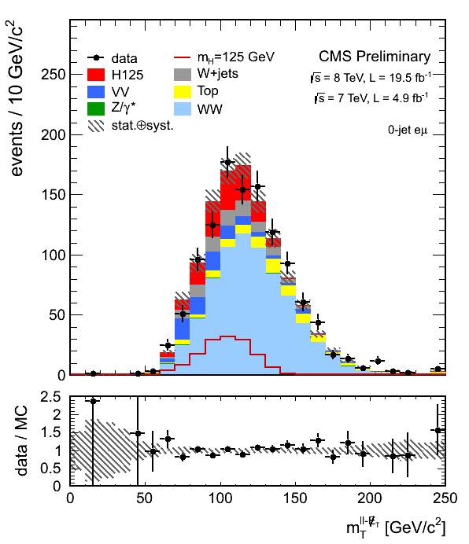
Analysis strategy:
  two prompt high-p_{T} leptons
  Use spin-0 and V-A structure of W decay
  MET
  split events into ee, μμ, eμ channels:
    different S/B rates: Drell-Yan in ee/μμ !
  split events further into 0/1-jet:
    different S/B rates: ttbar in 1-jet !
  ATLAS: m_{T}-distribution
  CMS:
    Different-flavor: 2D distribution N(m_{ll},m_{T})
    Same-flavor dileptons: cut-based analysis
  Backgrounds (for low mass Higgs):
    WW, tt, W+jets, DY+jets, Wγ: from control regions
    ZW, ZZ: from MC (very small contribution)
Analysis features to note (m_{H}=125):
  Fair S/B
  Fair signal event yield (200 events)
  Poor mass resolution ≈20%

Slide 35
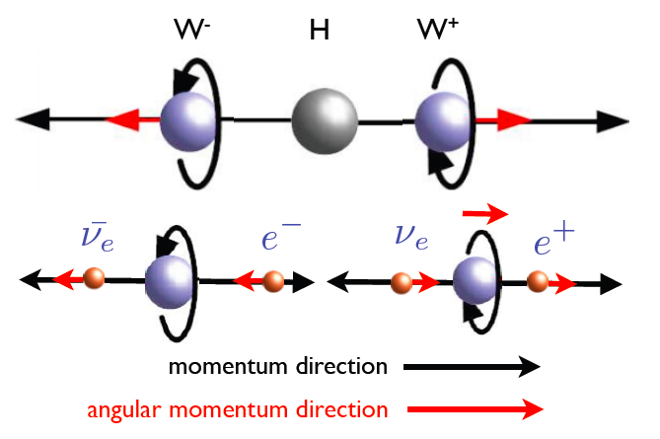
Analysis strategy:
  two prompt high-p_{T} leptons
  Use spin-0 and V-A structure of W decay
  MET
  split events into ee, μμ, eμ channels:
    different S/B rates: Drell-Yan in ee/μμ !
  split events further into 0/1-jet:
    different S/B rates: ttbar in 1-jet !
  ATLAS: m_{T}-distribution
  CMS:
    Different-flavor: 2D distribution N(m_{ll},m_{T})
    Same-flavor dileptons: cut-based analysis
  Backgrounds (for low mass Higgs):
    WW, tt, W+jets, DY+jets, Wγ: from control regions
    ZW, ZZ: from MC (very small contribution)
Analysis features to note (m_{H}=125):
  Fair S/B
  Fair signal event yield (200 events)
  Poor mass resolution ≈20%

Slide 36

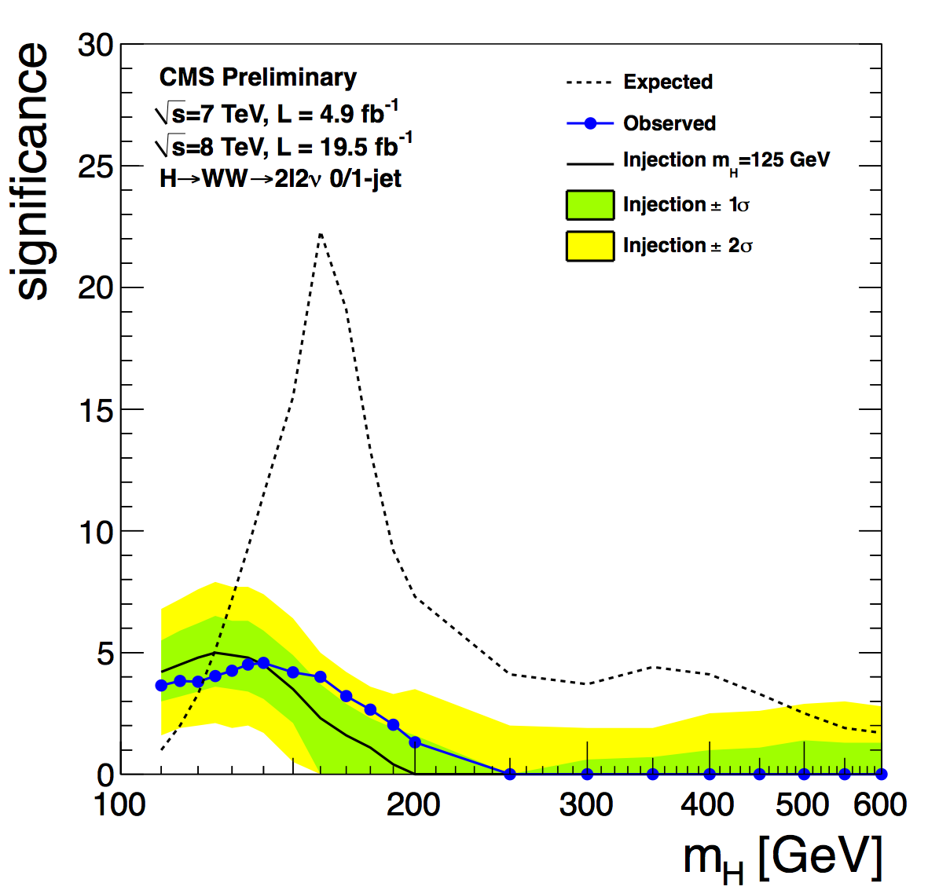
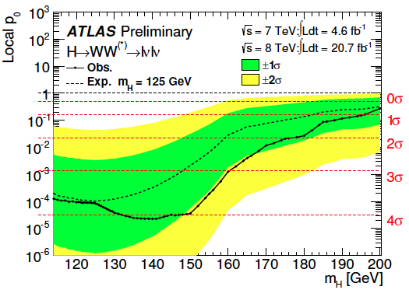
Background Uncertainties
TH uncertainty on the WW kinematics
NNLO calculation underway!!!
(m = 125) Z_{obs} = 4.0 σ
Z_{exp} = 5.0 σ
(m = 125) Z_{obs} = 3.8 σ
Z_{exp} = 3.7 σ

Slide 37
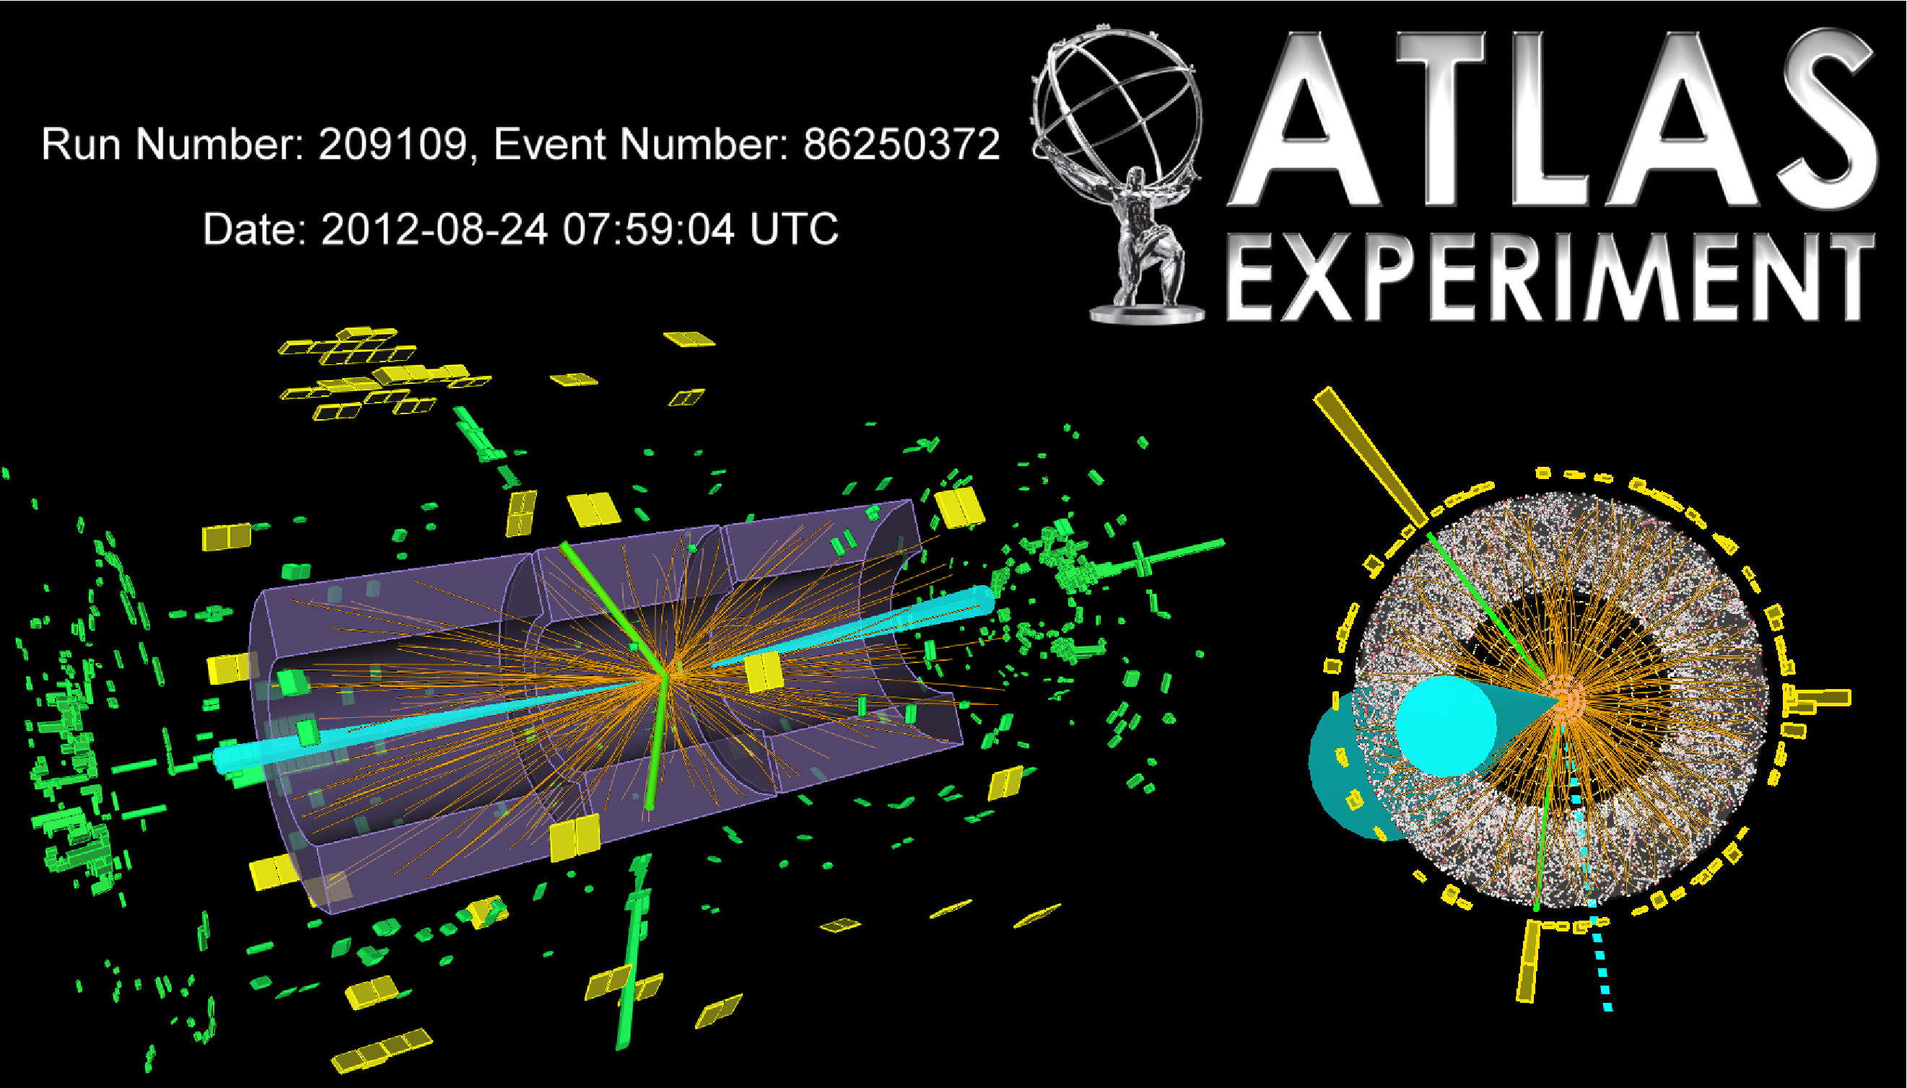
H → ττ
Reoptimised 7+8 TeV analysis
ATLAS-CONF-2012-160
H → τ_{had}τ_{had} candidate in VBF channel (m_{MMC} = 131 GeV)
ττ channel basic facts sheet :
Ns ~ O(500) per experiment
ττ channel basic facts :
Signal purity ~ 0.3% - ~O(50%)

Slide 38
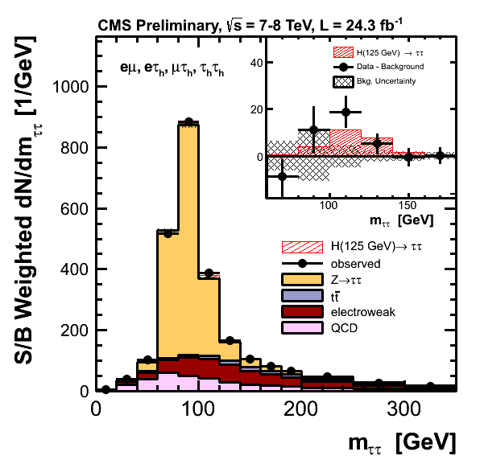
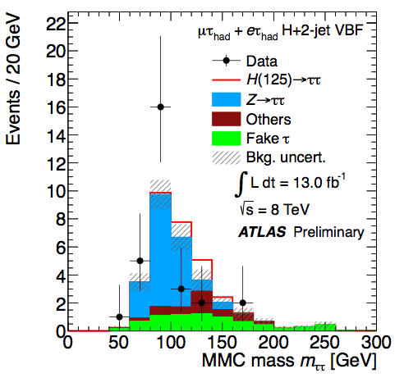
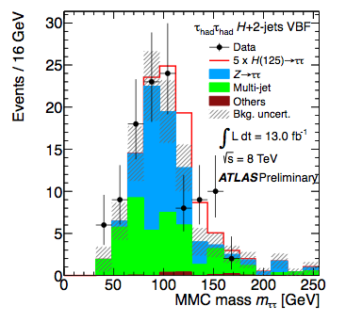
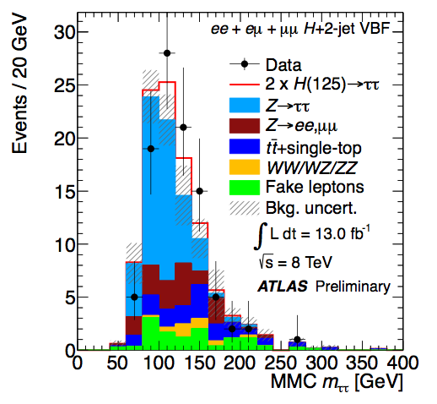
Analysis strategy:
- di-tau candidates: eτ_{h}, μτ_{h}, eμ, μμ, τ_{h}τ_{h}
- MET
  - DiTau mass (including MET): key distribution split events into jet categories:
    2-jets (VBF-tag): best S/B-ratio
    2-jets (VH-tag): best S/B-ratio
    VH Lepton tag
    1-jet (ggF, VH): acceptable S/B-ratio
    untagged: control region (S/B≅0)
  - Split 1-jet events further high/low p_{T} tau
    different S/B rates
  - Backgrounds:
    Z→ττ: Z→μμ (data) with embedding
    Z→ee, W+jets, ttbar: MC for shapes, data for normalization
    QCD: from control regions
Key Analysis features:
  Decent S/B-ratio
  Relatively small signal event yield
  Higgs is on falling slope of Z-decays
  poor mass resolution ≈15%

Slide 39

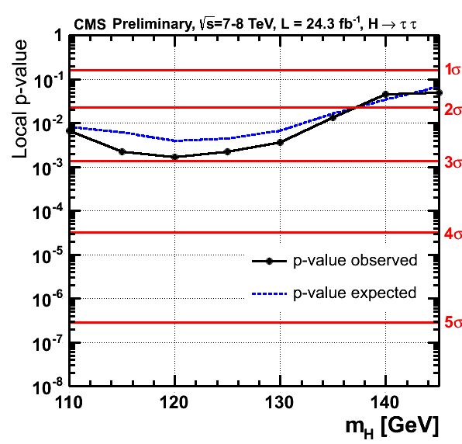
Excess with a significance of 2.8σ observed and 2.6σ expected

Slide 40
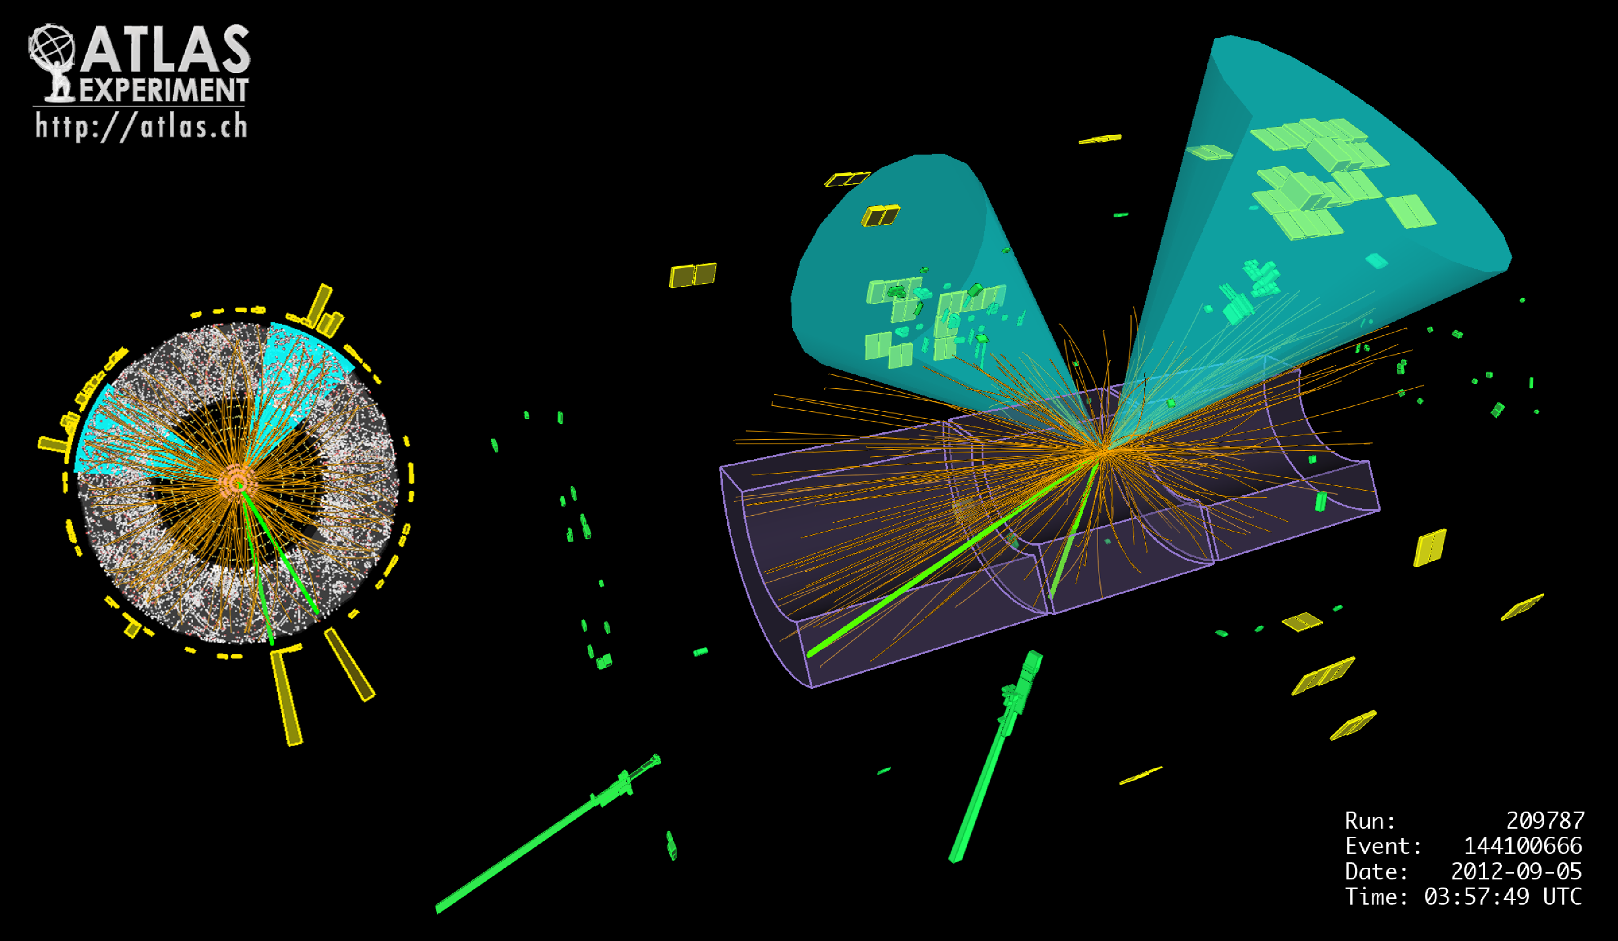
VH production with H → bb
Combined and reoptimised 7+8 TeV analysis
VH(bb) channel basic facts sheet :
Ns ~ O(100) per experiment
VH(bb) channel basic facts :
Signal purity ~ 1% - 15%

Slide 41
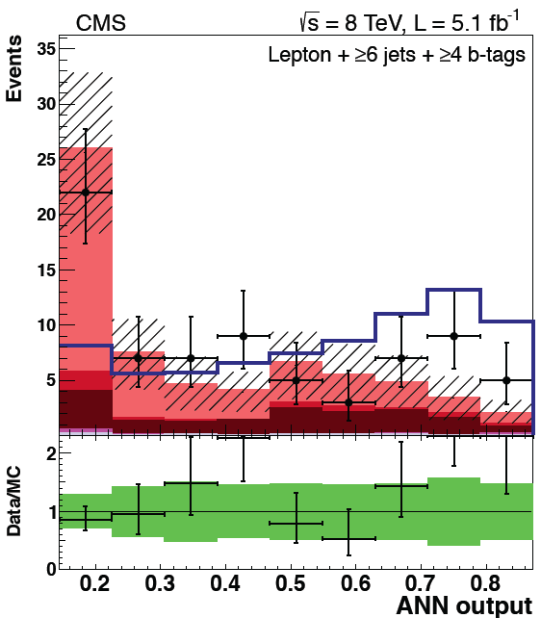
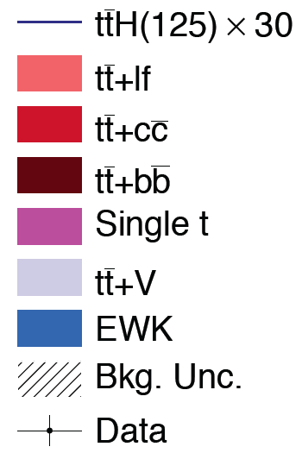
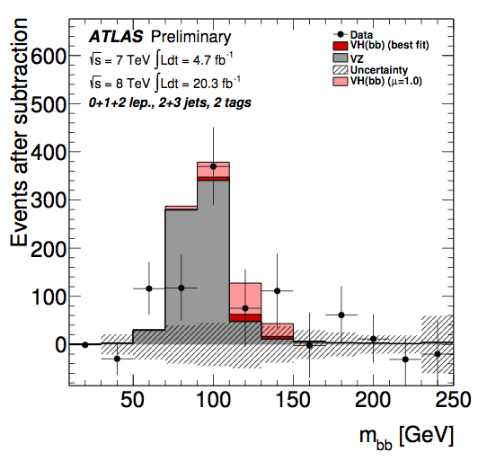
Analysis strategy:
  Channels separated in 0 (MET), 1 (MET) and 2 leptons
  With two b-tagged jets (using 0 and 1 for control)
  Further categorize in pT of the V
  Mass reconstruction is Key
  Simulation ISR and gluon splitting is also Key
  Diboson reconstruction also important element
  - Main Backgrounds:
    V+bb and top
    Uses mainly control regions except
Key Analysis features:
  Low S/B-ratio
  small signal event yield
  Higgs is on falling slope of Z-decays
  poor mass resolution ≈15%

Slide 42
VH(bb) at the Tevatron

Slide 43
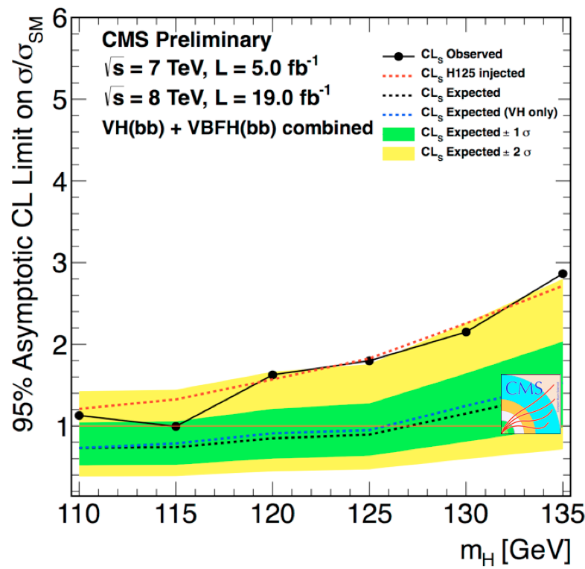
CMS with VBF analysis combined

Slide 44
H₁₂₅ Summary
Channel categories | ATLAS |  |  |  | CMS
 | μ ( at 125.5 GeV) | Z exp | Z obs | M (GeV) | μ | Z exp | Z obs | M (GeV)
γγ | 1.5±0.4 | 4.1 | 7.4 | 126.8±0.2±0.7 | 0.8±0.3 | 3.9 | 3.2 | 125.4±0.5±0.4
ZZ (llll) | 1.6±0.3 | 4.4 | 6.6 | 124.3±0.5±0.5 | 0.9±0.3 | 7.1 | 6.7 | 125.8±0.5±0.2
WW (lnln) | 1.0±0.3 | 3.8 | 3.8 | - | 0.7±0.2 | 5.3 | 3.9 | -
ττ | 0.8±0.7 | 1.6 | 1.1 | - | 1.1±0.4 | 2.6 | 2.8 | 120 ⁺⁹₋₇
W,Z H (bb) | 0.2±0.7 | 1.4 | 0.3 | - | 1.1±0.6 | 2.2 | 2.0 | -
Combination | 1.30±0.20 | 7.3 | 10 | 125.5±0.2±0.6 | 0.80±0.14 | - | - | 125.7±0.3±0.3
Channel categories | Tevatron
 | μ ( at 125 GeV)
γγ | 6.0^{+3.4}_{-3.1}
ZZ (llll) | -
WW (lnln) | 1.6±1.2
ττ | 1.7^{+2.3}_{-1.7}
W,Z H (bb) | 1.6±0.7
Combination | 1.4±0.6

Slide 45
Measurement of Coupling Properties

Slide 46
The Complete Model*
Measures the agreement between an hypothesis and the value most favored by the data
* O(500) Nuisance Parameters to describe systematic uncertainties and background models

Slide 47
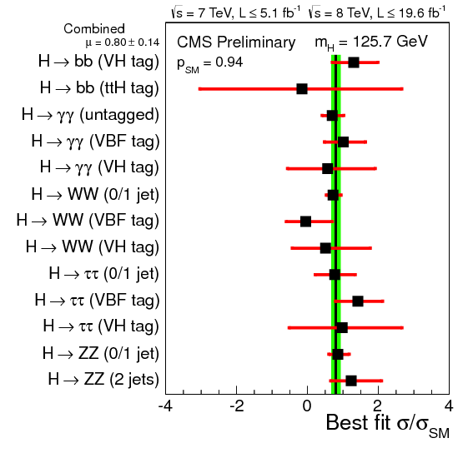

How the fit works
Sub-channel signal strengths
Production mode signal strengths
(per channel)
μ=0
μ=1
μ=0
μ=1

Slide 48

Production Signal Strengths
For individual channels

Slide 49

Evidence for VBF production
From the ratio of individual production signal strengths
Evidence for VBF(,VH) production

Slide 50

Measuring the Coupling Properties of the Observed State
For the time being only test the bosonic and fermionic sector

Slide 51


Coupling Properties (Deviations) Measuremens
Further re-parameterization of the n_{s}^{c} yields per categories
Assuming narrow width approximation
Assume the same tensor structure of the SM Higgs boson : J^{CP} = 0⁺⁺
Link to an effective Lagrangian and use scale factors
Parametrize μ_{i} and μ_{f} as a function of κ’s
For example, the main contribution (ggF) to the gg channel can be written as:

Slide 52





Relating Couplings and Event Yields
(I) Tree Level Couplings scale factors w.r.t. SM
Affecting decay and production modes

Slide 53




Relating Couplings and Event Yields
(II) Scale factors of loop induced couplings w.r.t. SM
Loop expression ambiguity :
  Can be expressed in terms of k_{F} and k_{V} (Assuming the SM field content)
  Or treated effectively (Allowing for possible additional particles)

Slide 54

Model I : Couplings to Fermions and Vector Bosons
Single scale factor for all fermion couplings and vector boson couplings

Slide 55



Main results I : Probing the coupling to SM particles
By convention sign on the fermion yukawa strength multiplier (relying on the γγ strength primarily)… ambiguity inspired tH analyses
Checking the direct and indirect couplings to fermions
Checks of specific composite models

Slide 56




Main results II : Probing the W to Z ratio (custodial symmetry)

Slide 57






Main results III : Probing physics beyond the Standard Model
(In the decays and/or in the loops)
Also direct invisible only search
(Tomorrow)

Slide 58



Main results IV : Other Relevant Models
Test of the predicted Yukawa structure of the couplings
3 coupling strength parameter fits κu, κd and κV for MSSM and 2HDM limits

Slide 59



Key Features:
Robust channel
Will require (very) large statistics
Key Features:
Will it ever be possible be sensitive?
Relies on the control of the tt+HF background
Key Features:
  Inclusive multi-signatures

Slide 60

Summary and combination :

Slide 61
Beyond any reasonable doubt…
The consistency of rates of the three discovery channels and the supporting evidence from the additional channels leaves little doubt about the nature of the particle.
For it NOT to be a Higgs boson would require a very savvy conspiring impostor
- Observation in the diphoton channel implies C = 1
- Observation in the diphoton channel (Landau-Yang theorem) implies J≠1
- Observation in WW channel favors J=0
- Observation in the ZZ and WW channels disfavors P=-1
This being said we still perform analyses to test the main quantum numbers directly from model independent observables.

Slide 62
Measurement of Differential Cross Sections

Slide 63


Differential Cross Sections
(Differential and fiducial cross sections in the Diphoton channel)
Possibly learn about the loop content of gluon fusion

Slide 64


Differential Cross Sections
(Differential and fiducial cross sections in dijet - Diphoton channel)

