Slide 1
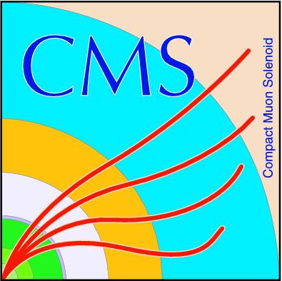

Emulator System for OTMB Firmware Development for Post-LS1 and Beyond
Aysen Tatarinov
Texas A&M University
US CMS Endcap Muon
Collaboration Meeting
October 1, 2013

Slide 2
Outline
OTMB firmware development for post-LS1
  Emulator system
  Setup & data formats
OTMB firmware development for beyond LS1
  GEM detectors
  Additional data formats
Tasks and milestones
Conclusions

Slide 3
Emulator of CSC Data
Emulator system for OTMB firmware development:
  Dedicated emulator board to emulate data coming from CSC to OTMB
    Start with emulation of DCFEB comparator data
    Later add emulation of ALCT data (several options being considered)
CSC
DCFEB
OTMB
L1 Muon Trigger
ALCT
Emulator
Board
DCFEB
OTMB
ALCT

Slide 4
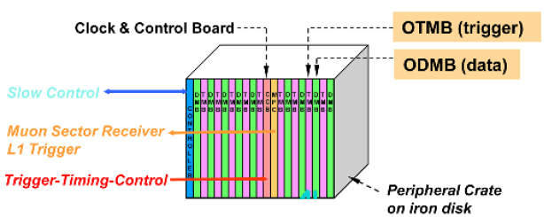
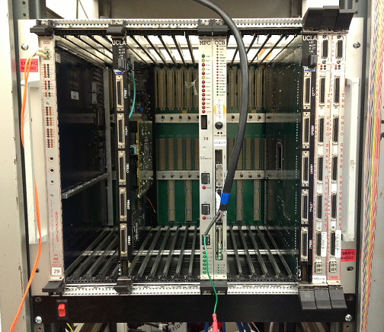
Test Stand @ TAMU
Emulator board to be used at current ME1/1 electronics test stand at TAMU
VME peripheral crate with
  OTMB
  CCB (provides clocking for all boards)
  VME Controller

Slide 5
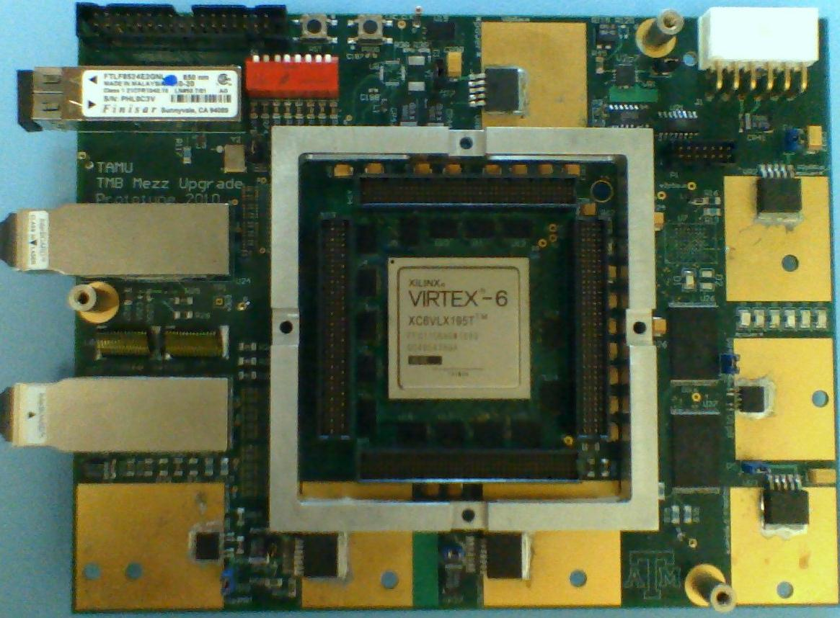
Where do we get the Emulator Board?
TAMU responsibility: R&D of new TMB Mezzanine Boards
TMB Mezz Board Prototype is a good candidate for the emulator board! (use Snap12 Fiber Transmitter to send CSC data)
Prototype TMB Mezzanine Board
Gigabit Ethernet Link
(communication with PC)
Snap12 Fiber Transmitter
Snap 12 Fiber Receiver
VIRTEX-6 FPGA

Slide 6
Test Stand Setup
PC with software which controls the test stand:
  Data generation and loading into the emulator board:
  Data transmission from the emulator board to OTMB
  Readout of trigger results from OTMB
PC with test stand control software
Gigabit
Ethernet
Data & Control
Readout
& Control
Emulator Board
OTMB
Fiber links

Slide 7
Test Stand Setup
Data generation and loading into the emulator board:
  PC generates data to be transmitted to OTMB according to CSC data formats
  PC uploads the data to memory units on the emulator board
PC with test stand control software
Gigabit
Ethernet
Data & Control
Readout
& Control
Emulator Board
OTMB
Fiber links

Slide 8
Test Stand Setup
Data transmission from the emulator board to OTMB:
  A command from PC initiates data transmission
  Emulator transmits data from specified memory units to OTMB through particular fiber links
PC with test stand control software
Gigabit
Ethernet
Data & Control
Readout
& Control
Emulator Board
OTMB
Fiber links

Slide 9
Test Stand Setup
Readout of trigger results from OTMB:
  PC communicates with OTMB to readout information about triggered events
PC with test stand control software
Gigabit
Ethernet
Data & Control
Readout
& Control
Emulator Board
OTMB
Fiber links

Slide 10
Trigger Algorithm in Hardware vs Software
Control and understand OTMB trigger algorithm both in hardware and software by comparing trigger decisions in:
  OTMB firmware
  CMSSW trigger stubs emulator
It should be possible to implement the readout of trigger results through ODMB in a format that could be used as input to CMSSW

Slide 11
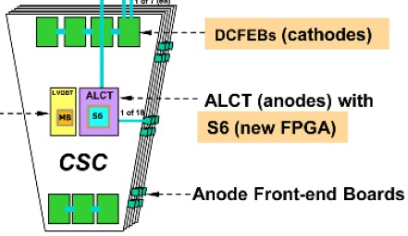
DCFEB Data Format
7 DCFEBs
(Digital Cathode
Front End Boards)
Each DCFEB:
6 layers * 8 di-strips =
= 48 signals (bits) per BX
Di-strips with no hits: all zero bits
Di-strip with hit: hit location with half-strip precision encoded in “triads “ — 3 bits transmitted over 3 BXs
  1st bit — tells there is a hit in this di-strip
  2nd bit — tells in which strip there is a hit
  3rd bit — tells in which half-strip there is a hit

Slide 12
How much DCFEB data can we emulate?
Emulator board FPGA: 256 memory pages (4KB each)
  Group them into 7 memory units (36*4 = 144 KB each)
  One memory unit represents one specific DCFEB
  Emulate data stream from 7 DCFEBs = transmit data from memory units through 7 fiber links
Each DCFEB: 48 bits per BX
Single memory unit can store 144*1024*8/48 ~ 25000 BXs of data (well enough for any tests!)
DCFEB1
DCFEB2
DCFEB3
DCFEB4
DCFEB5
DCFEB6
DCFEB7

Slide 13
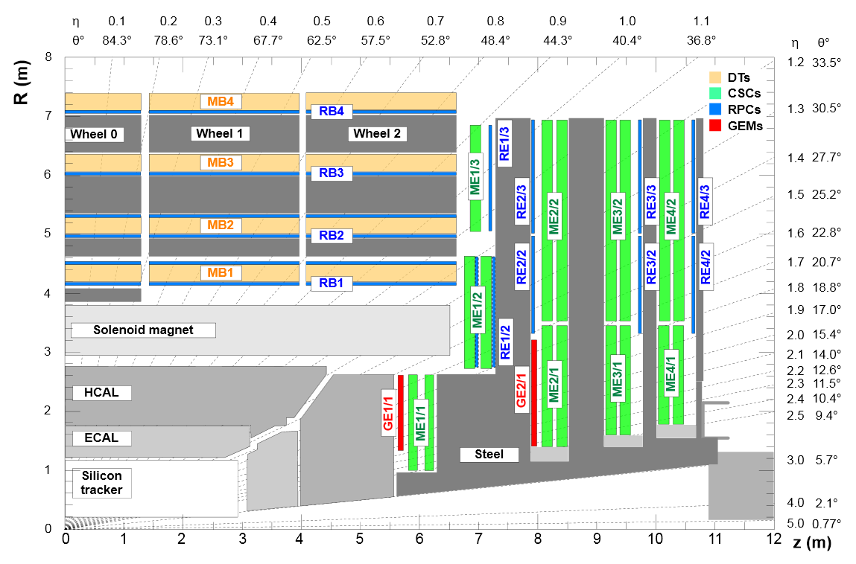
Beyond LS1: GEM detectors
GEMs to be installed during LS2 (and possibly LS3)
  Redundancy to CSC in the very forward region , where especially high trigger rates expected in the near future
GE1/1
GEM GE1/1
detector planned
for LS2 CMS
upgrade period
(2018)
GE2/1
Possible
installation of a
second GEM
station (GE2/1)
for LS3 CMS
upgrade period

Slide 14
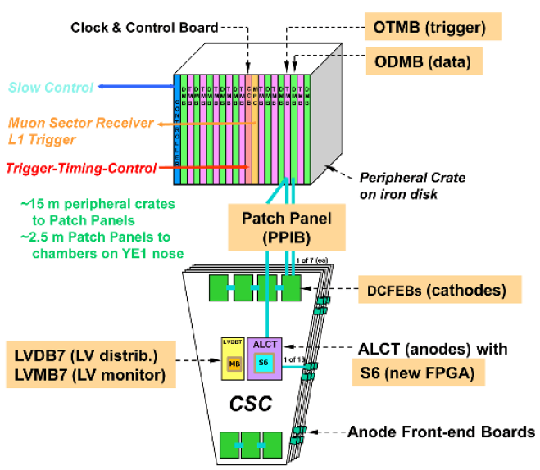
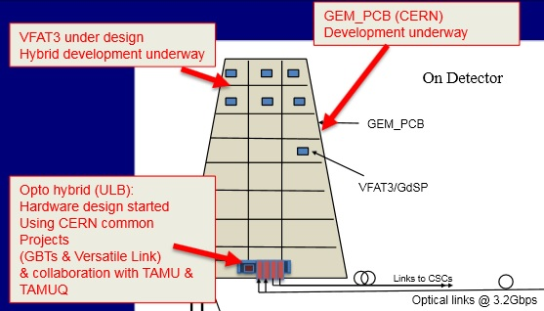
Combined GEM-CSC Trigger
Redundancy to CSC through combined GEM-CSC trigger
    Transmit GEM data to CSC OTMB through optohybrid board (provide data properly formatted for CSC TMB)
  No changes in CSC scheme needed
  Requires implementation of GEM-CSC trigger algorithm in OTMB firmware
14

Slide 15
Emulator of CSC and GEM Data
Add emulation of GEM data from optohybrid board
CSC
DCFEB
ALCT
OTMB
L1 Muon Trigger
GEM
Optohybrid Board
Emulator
Board
DCFEB
Optohybrid Board
OTMB
ALCT

Slide 16
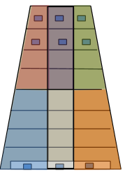
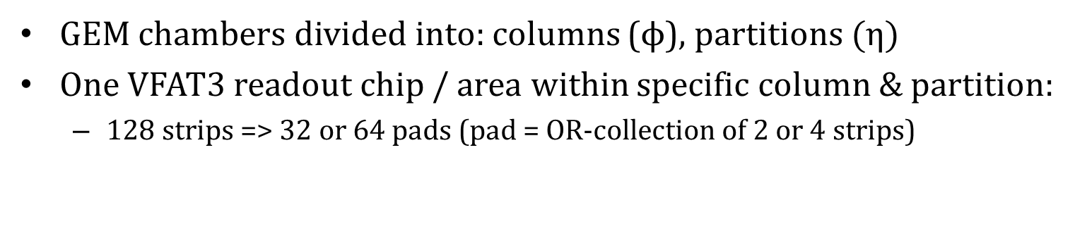
GEM Data Format
GEM chambers divided into: columns ($ϕ$), partitions$(η)$
One VFAT3 readout chip / area within specific column & partition:
  128 strips => 32 or 64 pads (pad = OR-collection of 2 or 4 strips)
VFAT3 chips
GEM hit location encoding:
  Column (2 bits)
  Partition (3-4 bits)
  Pad (5-6 bits)
Total: 10-12 bits (most likely 10 bits)
6, 8, 10 partitions
GEM data to OTMB over 2 fiber links:
  96 bits / BX
  Encode up to 9 GEM pad hits
  Negligible probability to have more than 9 hits per GEM chamber
3 columns

Slide 17
Tasks and Milestones
Three main task groups:
Development of test stand control software
Development of emulator board firmware
Development of OTMB firmware

Slide 18
Tasks and Milestones
1. Development of test stand control software
1.1. Data loading into emulator board memory pages
1.1.1. Standalone program for generating and uploading arbitrary data DONE
1.1.1.1. Add XDAQ interface
1.1.2. Generate data according to CSC and GEM data formats
1.1.2.1 Generation of simple stub patterns (straight stub pattern, etc.)
1.1.2.2 Using data from simulation/real data that includes background as input
1.2. “Go” command initiating data transmission
1.3. Readout from OTMB
1.3.1. Readout last trigger results via VME
1.3.2. Readout trigger results via ODMB

Slide 19
Tasks and Milestones
2. Development of emulator board firmware
2.1. Data transmission from specific memory units to OTMB through specific fibers
2.1.1. Verify the fact of data transmission
2.1.1.1. LEDs and test signals on emulator board
2.1.1.2. Verify if memory units are empty after data transmission
2.1.2. Verify correctness of data transmission
2.1.2.1. Basic readout of last trigger from OTMB via VME
3. Development of OTMB firmware
3.1. Take over current OTMB firmware (UCLA firmware)
3.2. Implement ODMB readout
3.3. Implement post LS1 changes in CSC trigger
3.4. Implement GEM-CSC algorithm

Slide 20
Short Term Plans
Short-term plan: proof the concept with simple options:
  Software to generate CSC data describing one straight stub
    DCFEB data only, no ALCT and GEM data yet
  Use standalone program to load into the emulator board
    Already implemented
  Assign specific memory pages to specific fiber links, transmit the data to OTMB
  Basic readout from OTMB to see if we can trigger the same stub
    Last trigger stub is already available with VME tools

Slide 21
Conclusions
Emulator system for OTMB development:
  Mezz board prototype as emulator board
  ME1/1 electronics test stand at TAMU
  Test stand control software
Start with emulation of DCBEF data, later add emulation of ALCT and GEM data
Emulator board has enough memory to store muon data of any arbitrary complexity
Important tool for development and validation, study of efficiency and performance of both post-LS1 and beyond changes to OTMB firmware

Slide 22
BACKUP SLIDES

Slide 23
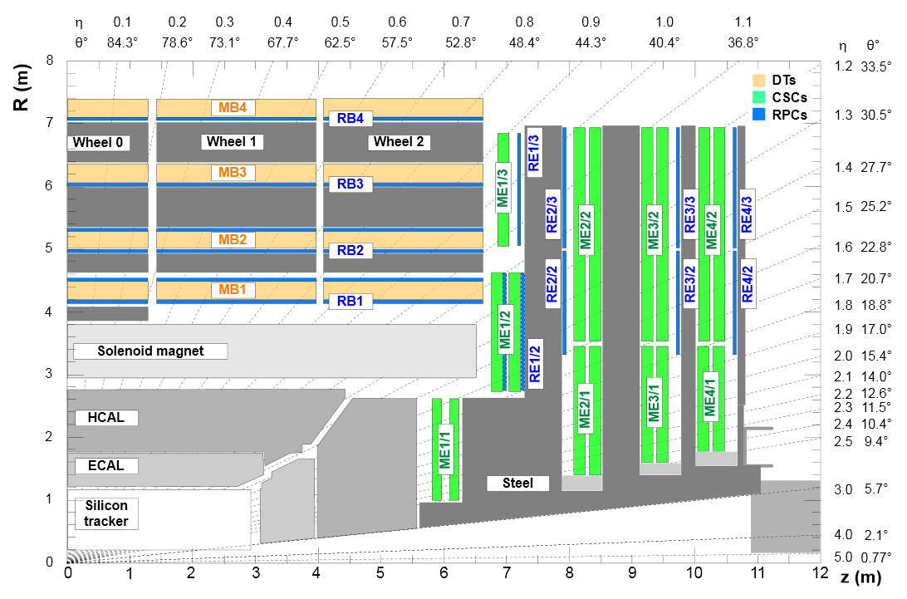
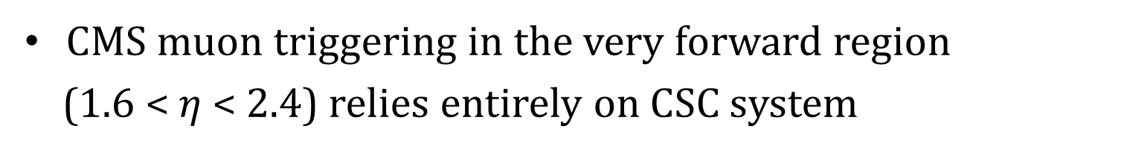
Muon Triggering in Forward Region
Higher trigger rates and more hostile conditions expected in near future, especially in the forward region (PU ~20 in 2012, PU ~200 after LS2)
CMS muon triggering in the very forward region
(1.6 < $η$ < 2.4) relies entirely on CSC system
No redundancy in the very forward region!

Slide 24
GEM Detectors
GEM (Gaseous Electron Multiplication) detectors
  Excellent spatial resolution and good timing at high rates
Proposed installation: redundancy to CSC in the very forward region
GE1/1
GEM GE1/1
detector planned
for LS2 CMS
upgrade period
(2018)
GE2/1
Possible
installation of a
second GEM
station (GE2/1)
for LS3 CMS
upgrade period

Slide 25
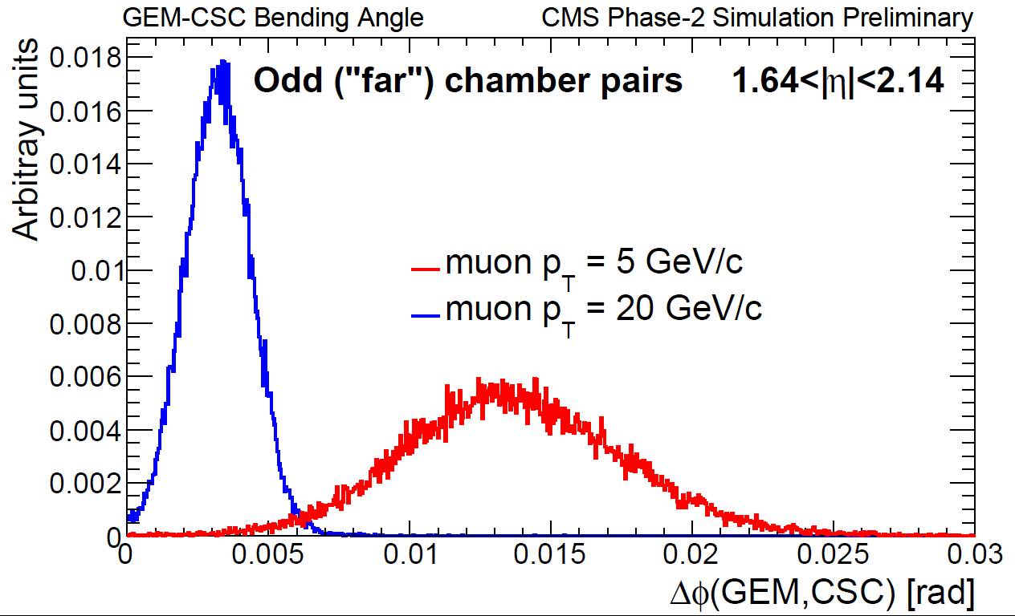
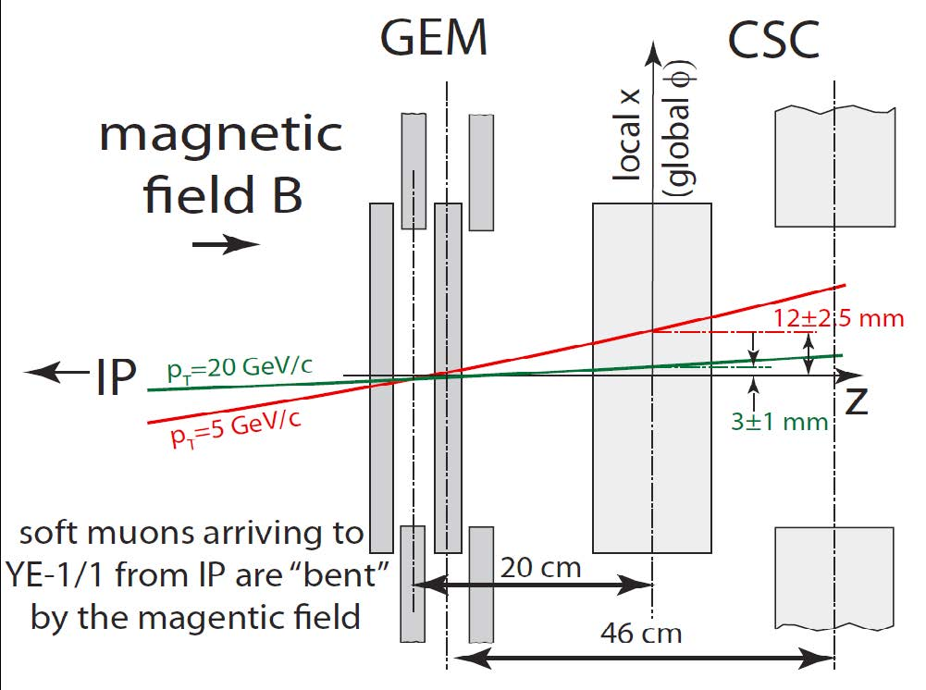
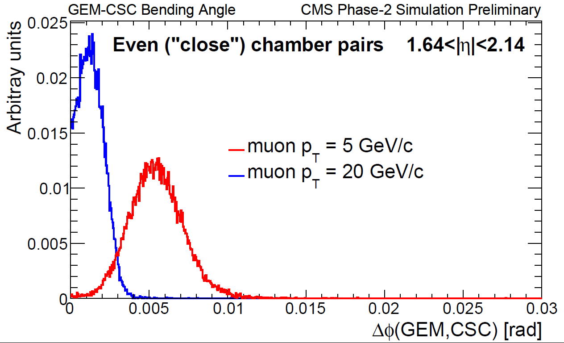
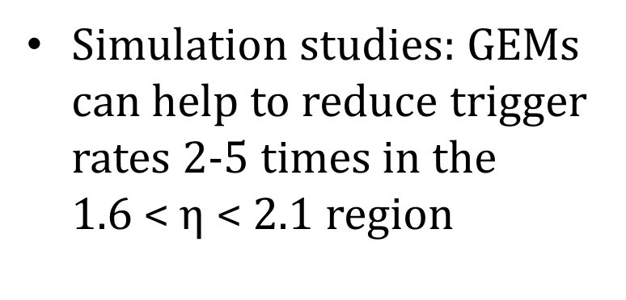
Muon Bending Angle
View down from the top of the CMS
Odd chambers
Even chambers
GEM detectors to improve momentum resolution by measuring muon “bending angle” (CSC are too thin for it)
Simulation studies: GEMs can help to reduce trigger rates 2-5 times in the 1.6 < $η$ < 2.1 region

Slide 26
Realistic Emulation in Test Stand
Realistic emulation of CSC (GEM) electronics configuration and operating conditions during actual data taking
  Same data formats and similar rates as in real operations
  CSC and GEM hits:
    correlations in the locations
    differences in time arrival
The stand will provide:
  Test-bed for design and development, debugging and validation of the OTMB firmware (both for standalone CSC and GEM-CSC regimes)
    Important tool in developing firmware for the OTMB

