Slide 1
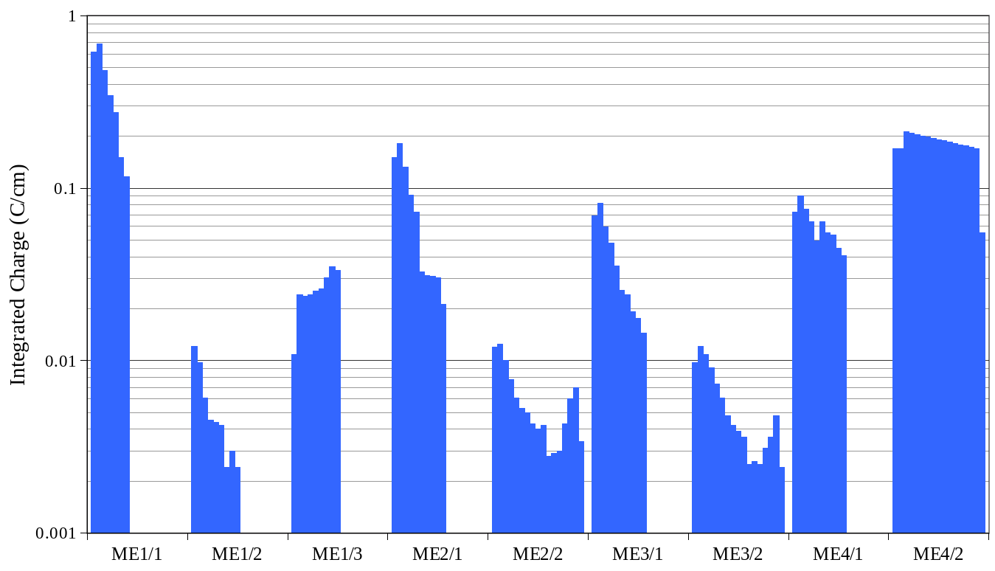
CSC longevity
Expected wire accumulated charge at 3000 fb-1 for various chamber types (and wire group):
Dubna ME1/1 chambers
Production ME1/2 tested safe to 0.35 C/cm
Original 500 fb⁻¹ limit
Andrew Peck

Slide 2
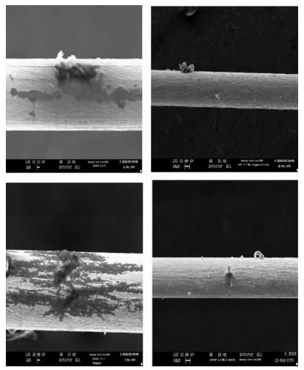
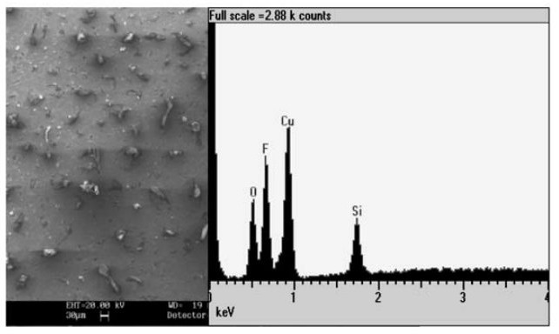
CSC aging test results at the GIF
Two production ME2/1 chambers were tested to 0.3-0.4 C/cm over a 5 month period
  Silicon-containing deposits were formed on wires and strips
  Aging effects were measurable, but not found to inhibit chamber performance
D. Acosta et al. / Nuclear Instruments and Methods in Physics Research
A 515 (2003) 226-233

Slide 3
(1) CSC longevity studies
CSC are obvious users of GIF and GIF++ facilities
GIF: where ME2/1 studies were done
GIF++: allows ~10x larger exposure/time
  Can do HL-LHC tests in reasonable amount of time
Makes sense to do combined GE1/1-ME1/1 tests
  Put together a system at GIF in 2014, partial irradiation
  Move the system to GIF++ in 2015-6, full irradiation studies, beam
What is needed?
  Infrastructure for test site with ME1/1 chamber, electronics
    NB partial synergy with the SX5 test facility for ME1/1 refurbishment
  Commitment of physicists to carry out the studies
  Travel support

Slide 4
Proponents for aging studies
Wisconsin (Armando - put together a draft proposal)
Riverside (Bob Clare, new PD, students)
  Participation in test beam
Florida (Gena, Andrey, Lesya)
  Precision aging monitor, highly segmented HV, gas mixture R&D
Fermilab (Oleg)
  Also gas monitor system for current CSCs
UCLA (Jay, student)
With respect to electronics: Ohio State (rate, latency effects), NEU (radiation aging)
Discuss…

Slide 5
Armando draft proposal
A new series of studies on CSC performance, particularly ME1/1, (detection efficiency, pattern recognition, resolution) and stability (radiation tolerance, aging of components, long term behaviour) are proposed in order to understand whether new operating conditions or improved detector-technologies are required at the several kHz/cm^2 rates expected at the HL-LHC.
The aim is to test a production ME1/1 chamber and accumulate a charge at least as high as 1.5 C/cm, which ensures a safety margin equal to 2-3. Irradiation tests carried out at the old GIF facility, at a nominal gamma rate of ~20 kHz/cm^2, would require extremely long exposure (~3 years). Perhaps even longer if one takes into account some ageing effects which have decreased the source original 740 GBq intensity to about 518 GBq.
At the new GIF++ facility, scheduled to come into operation in the spring of 2015, the expected gamma flux could be as high as 100 kHz/cm^2/s yielding an equivalent charge of 2.4 C/cm collected in 1 year.

Slide 6
draft…
We foresee a two-years duration for the project. A possible starting time would be during the fall of 2014. The initial phase (~3 months) would be devoted to the preparation of the detector to be irradiated and its services. The following phase (~3 months) would focus on the preparation of the user infrastructures at the GIF++: gas, cooling and the DAQ system, and the installation of the detector. The third phase (~15 months) would be devoted to the irradiation campaign and the last phase (~3 months) to the analysis of irradiated components and delivery of final results.
To cover the full costing of the project we would like to request a research fund of 250 k$. A fraction (~70%) of the grant would serve to support technical personnel (1 FTE) and to cover the cost of leaving adjustment (cola) for pre and post-graduates involved in the project. The rest would be used to purchase experimental equipment (electronics, power units), technical material (mechanical supports, installation and infrastructure components) and to cover the project running expenses, the consumables and the facility sharing costs. In terms of resources a team of 2-3 physicists (including at least one graduate student or post-graduate) and one support technician is considered adequate during all phases of the project. Overall 3 FTEs could be effectively employed.

Slide 7
Total project cost (for 2 years)
 |  |  | Cost (k$) | Total (k$)
Material | LV power | Maraton – OPFC- cables | 15
 | HV power | Caen + cables | 10
 |  |  |  | 25
Infrastructures | Cooling | Chiller | 1.5
 | Gas | Per-mixed bottles (*) | 20 (*)
 | Mechanics | Chamber support | 5
 |  |  |  | 26.5
Personnel | Technician | 1 FTE (80 k$/year) | 160
 | Students | (Cola) (12 k$/year) | 24
 |  |  |  | 184
Contingency | Inc. consumables |  | 20
 |  |  |  | 20
 |  |  |  | 255.5
(*) Cost reduces to 10 k$ of gas consumption if can reuse existing gas mixer rack now operating in B904 ME4/2 muon chamber factory
54.5K request in 2014 for Sep-Dec “Detector and services preparation”
2015 Jan-Mar “Installation and setup at GIF++. Apr 15-Jun 16 “Irradiation measurements”, 2016 Jul-Sep “Analysis of irradiated components”

Slide 8
Additional suggestion (Oleg)
(6) Gas monitor for current CSC system
  We have no performance-based monitor – use prop. tube and radioactive source?
  DTs have something like this
  Good idea to have this with start of use of recirculated CF4?

