Slide 1
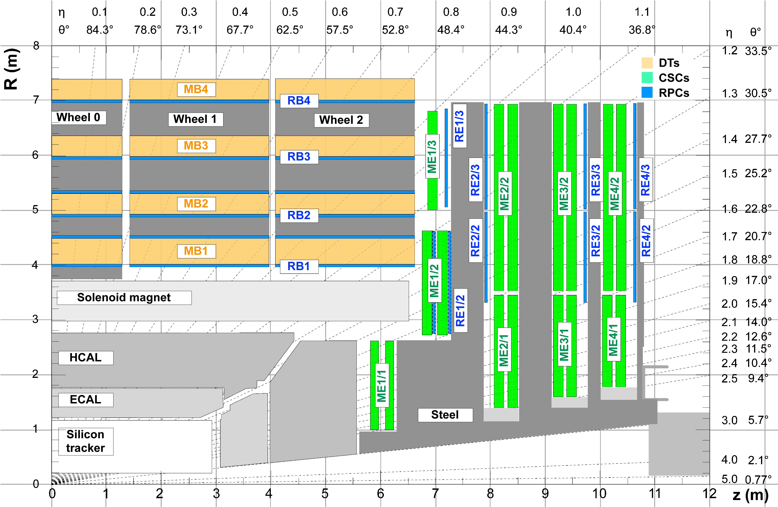
GE1/1 and GE2/1
Add redundancy (power) to trigger where most needed
  First and innermost stations: highest rates, highest backgrounds, yet least redundancy!

Slide 2
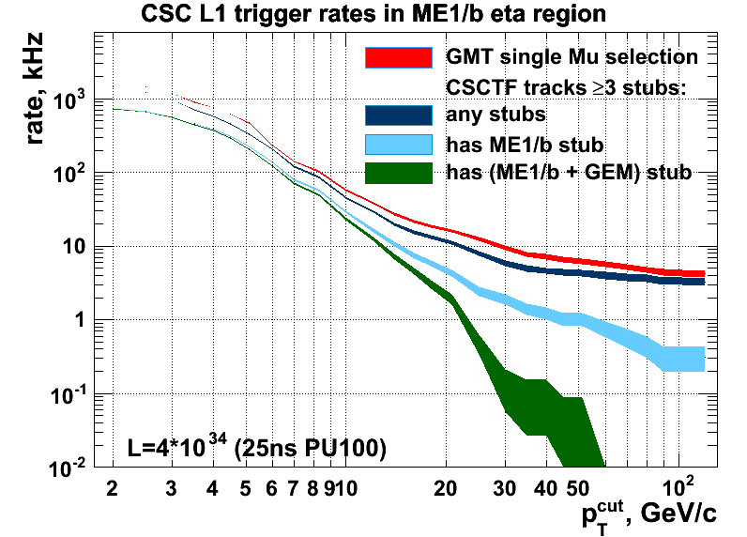
CSC-GEM trigger
The GE1/1 addition greatly improves triggering for muons in 1.55 < |η| < 2.16
  An “early Phase 2” project
42
13
U.S. should continue to define and implement the CSC-GEM combined algorithms
  Much to be done by physicists, simulation tools
  Testing to be done with emulators in 2014

Slide 3
(2) CSC-GEM trigger development
Proposed timeline:
Jan. 2015 (1 year devel.) Run cosmic ray tests on preliminary prototypes at B904
  Initial firmware written and running
  Demonstrate the ability to trigger on CSC * GEM as well as CSC ! GEM
  Demonstrate good efficiency
Jan. 2016 (+1 year) Run cosmic ray tests on final prototypes at B904
  Optimized algorithms, measure performance (verify spatial , time resolution)
  Demonstrate with a full set of online DQM plots
Jan. 2017 (+1 year) Cosmic ray tests on the installed demonstrator in advance of collisions

Slide 4
(2) CSC-GEM trigger development effort
Groups interested:
  Florida (Acosta), Rice (Padley), TAMU (Safonov), UCLA (Hauser), WSU (Karchin)
What is needed?
  Implementation in hardware and firmware to be done by engineers (currently supported by M&O)
  Travel to combined test stand at B904
Paul K proposed 25% of an engineer in 2014 plus 2 trips

Slide 5
(3) Commercialization of GEMs
Thus far, large GEM foils built by CERN
Commercialization is beginning now
  Needed for GE1/1 (25% could be built in U.S., e.g. Tech-Etch company in Boston)
  Especially needed if GE2/1, ME0 and/or endcap calorimeter to be built with GEM technology
U.S. physicist role:
  Provide liason and QC of foils, chamber assembly
  M. Hohlmann (FIT) working together with BNL, Stony Brook, Yale, and Virginia

Slide 6
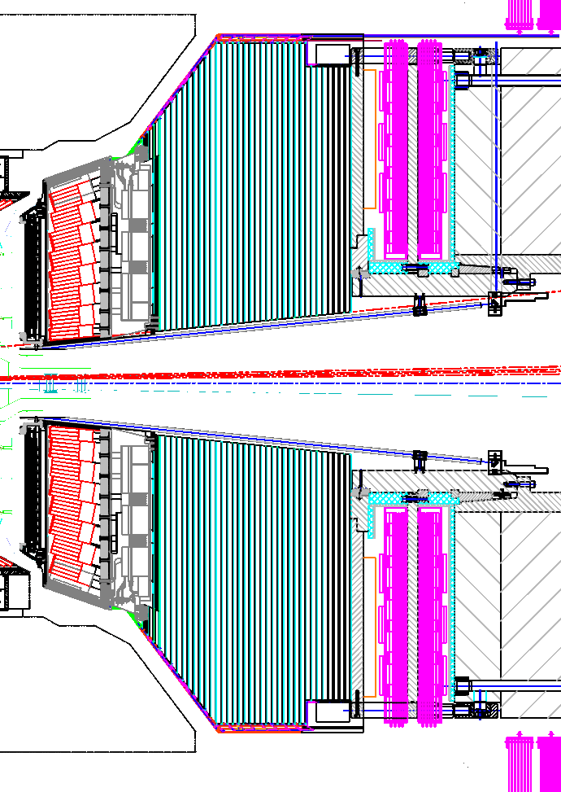
Small ME0 muon tagger at back of a new HE
2.2 < |η| < 4.0 or so
  Best region for muon ID (more bending and less multiple scattering)
  Goes along with forward pixel upgrade and HE replacement
“Integrated” option
  Build all of HE with GEM technology, for example
New
HE
μ
ΜΕ0
Additional EE/HE coverage
μ
ΜΕ0

Slide 7
Details of ME0 front tagger
Covers eta 2.2-4.0 (or 1.6-4.0 if choose large version)
  On the low side, dovetails with GE1/1 and overlaps aligned ME1/1
  On the high side, match forward pixel coverage (depends on shielding)
Costing assumes 6 layers of GEM technology
  Standalone, so need excellent rejection of neutrons, etc.
  Cost to be dominated by electronics: assume extremely high granularity (very skinny strips)
  For this high rapidity assume twice as many channels as GE1/1 (1106K, 0.48 cm²/channel)
Chance for novel particle-flow combined calorimetry/muon ID
  Could be a new U.S. flagship project: chambers, electronics
  Would need serious planning and validation in test beams

Slide 8
(4) ME0 front tagger R&D
Detailed simulation studies needed
  How many layers, how fine granularity, background rejection
  Largely physicist-driven
Short-term:
  Simulation studies, design work (physicists)
  Anticipate to be a special part of a HE “stack” in a beam test
Needs:
  Unclear for 2014 - obviously related to the details of whatever endcap calorimeter efforts are launched
    CSC and GEM institutions would be quite interested
  Could become much larger, e.g. build the first ME0 muon prototype?
    Readout leveraging the electronics effort for GE1/1
    ~6 layers, very fine granularity
    Study muon spatial resolution and background suppression

Slide 9
Additional possibility since Snowmass
(5) HV for GEMs:
  UF/PNPI system considerably less expensive, better than CAEN
  Adds homogeneity with CSCs
  GE1/1 only, or also in Particle Flow calorimeter?
  Different set of voltages, currents applied? TBD
  (What about ME1/1?)

