Slide 1
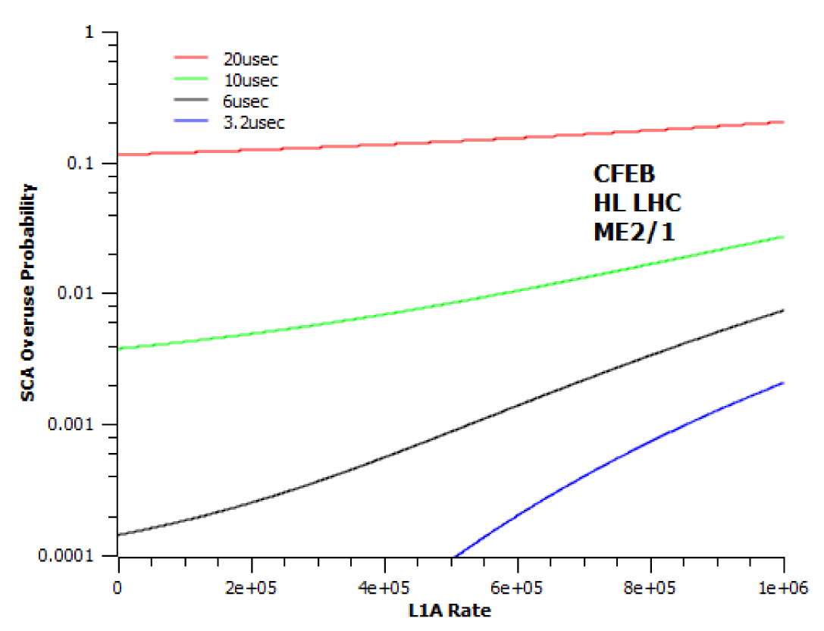
Not baseline: ASIC, DCFEB R&D if L1A latency > 10 μs
At Phase 2 baseline 10 μs and 500 kHz lose ~1% of cathode data, beyond that need to replace DCFEBs
13.8 MChF, 8 months steady crane use
  See JH talk at 12-Mar-2013 Trigger TPSG meeting: https://indico.cern.ch/conferenceDisplay.py?confId=239752
4.5x as many parts as for ME1/1 refurbishment
  A good part of cost is for re-engineering
    ASICs: “Buckeye” low-noise preamps, comparators for trigger
    Power: re-engineer the DCFEB design
Significant engineering needs to start ASAP if LS2 installation
  3 x 5 or 5 x 3 FTE-years ~$x.x M?
S. Durkin

Slide 2
Summary
Longevity of CSC test beam studies at GIF, GIF++
  Need some infrastructure & travel support during 2014 and 2015
  Add a CSC gas monitor?
Local triggering development with GE1/1
  Need engineering (currently on M&O) and travel support during 2014-2017
Develop commercialized GEM chambers
  More discussion needed to define the scope and short-term needs
Test beam studies of ME0 and possible construction role
  Scope could be modest in 2014, but much larger later if U.S. to lead this project: needs coordination with endcap calor R&D plan, overall CMS plan
HV mods for GEMs
ASIC, DCFEB development for CSCs
  Contingent on L1A latency to be extended beyond 10 μs
  Serious engineering required depending on install. schedule

Slide 3
List of muon R&D proponents
Paul Karchin (WSU)
Alexei Safonov (TAMU)
Bob Clare (UCR)
Jay Hauser (UCLA)
Stan Durkin (tHE Ohio State U.)
Ela Barberis (NEU)
Armando Lanaro (UW)
Gena Mitselmakher (UF)
Marcus Hohlmann (FIT)
Oleg Prokofiev (Fermilab)

Slide 4
Backup slides

Slide 5
References
Discussion forums:
  General Muon Meetings (GMM) on Mondays at 5 p.m. in 40-R-B10
  Forward detector working group (FDWG), Rusack and Mannelli
  Upgrade Project Office (UPO) meetings biweekly Friday afternoons
  Building on DESY Upgrades Week, June 3-7 https://indico.cern.ch/conferenceOtherViews.py?confId=236161&view=standard
Upgrade ideas were summarized 19-June in the weekly CSC meeting: https://indico.cern.ch/conferenceDisplay.py?confId=258486
Muon upgrades: a first costing exercise for UPO on 28-June:
  See https://indico.cern.ch/conferenceDisplay.py?confId=259774 but costing slides removed due to “sensitivity” (have not been reviewed)

Slide 6
Text description of forward muon upgrade costing
Baseline forward muon upgrades:
GE1/1: 2 layers of GEMs in the eta range 1.55-2.2; most salient motivation is for the muon trigger: lower muon Pt threshold from ~25 to ~15 GeV. Obviously well costed & reviewed already.
GE2/1: 2 layers of GEMs in the eta range 1.65-2.4, adds redundancy to 2nd station, most salient motivation is to provide acceptable single muon trigger rate in rapidity region 2.1-2.4 with threshold of ~25 GeV. Base the cost estimate on having similar segmentation to GE1/1, extrapolate production (not R&D) costs from GE1/1.
RE3/1 and/or RE4/1: 1 layer of multi-gap GRPCs covering eta 1.8-2.4, motivated primarily by fine timing to identify muon vertex and to provide a good handle on slow particles. The proponents claim this technology is inexpensive, and these would be single chambers, so 1 or two stations could optimistically be 0.5x or 1.0x the cost of GE1/1, respectively (some R&D for TDCs and CMS compatible readout probably required). Imad Laktineh has cost estimates in his DESY Upgrades Week talk.
ME0 small front tagger: covers rapidity 2.2-4.0, to be costed assuming 6 layers of GEMs, 2x finer segmentation than GE1/1. Note that it is possible to reduce cost per area for chambers and cost per channel electronics up to a factor of 3 over GE1/1 if HE is rebuilt with this basic technology, since economies of scale that are thought to be possible will be needed for that. We may need to add some cost item that represents additional shielding and iron to improve field strength within the space of the present eta=3 cone.
Iron toroids option: motivation is triggering capability at high rapidity (assume coverage 2.4-4.0), overlap with rapidity range of LHCb, ability to capture a large rate of dimuons from e.g. B⁰_{s}→μμ. Currently thought unlikely, since HF needs to be relocated and the current HF may withstand 3000 fb⁻¹. Also forward tracker needs to achieve decent (<4%) momentum resolution to resolve B⁰_{s} and B⁰_{d} peaks. Very well costed already for the basic iron, magnet, support structure, and need to add cost of 3 or 4 stations of double-layer detectors, by scaling up from the GE1/1 cost estimate.
Other options that have been discussed but not to be costed now:
Large ME0: diminishes the case for GE1/1, only possible if calorimeter rebuilt, and requires negative arguments that CSC station ME1/1 is insufficient for rapidity 1.5-2.1.
Back tagger: thought far inferior to front tagger: long lever arm for matching with forward pixel upgrade, much iron contributing multiple scattering, and larger so more costly.

Slide 7
Elements of the Phase 2 muon upgrade costing
GE1/1 and GE2/1 for trigger, covering eta 1.55-2.4
  Assume 2 layers of GEM detectors
RE3/1 and RE4/1 for fine timing, covering eta 1.8-2.4
  Assume 1 layer each of GRPC multigap detectors
Small ME0 front tagger, part of new HE, cover eta 2.2-4.0
  Assume 6 layers of GEM technology assumed
Iron toroids option covering eta 2.3-4.0
  Assume 3 iron disks, 4 station each of GEM detectors

Slide 8
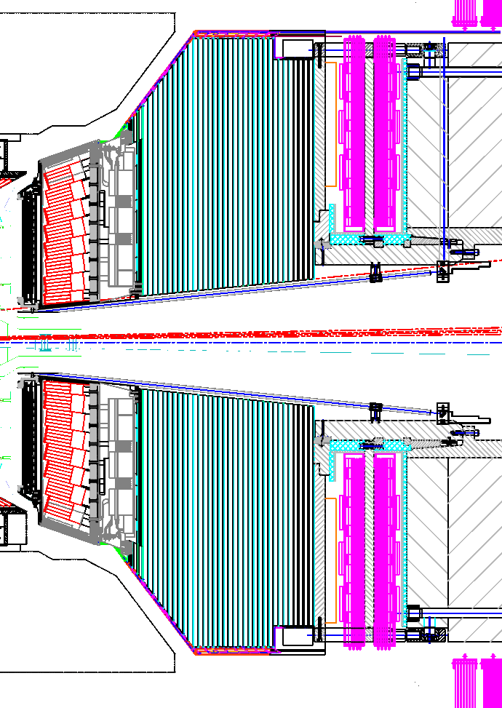
ME0 muon tagger at back of a new HE
Coverage options:
  In red: small ME0 ring (top), large ME0 ring (bottom)
  {1.5, 2.4} < |η| < 3.5 or so
  Best region for muons (more bending and less multiple scattering)
Inner radius shielding needed
  Will limit maximum η
  New technology allows >>1 MHz/cm²
“Integrated” option
  Build all of HE with GEM technology, for example
New
HE
μ
ΜΕ0
Additional EE/HE coverage
μ
ΜΕ0

