Slide 1
Improvements to ME1/1 TMB Algorithm from Simulation Studies
Vadim Khotilovich,
Texas A&M University
US CMS EMU Workshop
2013-10-01

Slide 2
Outline
About ME1/1
Algorithm changes in a nutshell
CLCT reconstruction changes
ALCT handling and ALCT to CLCT matching
LCT sorting
Twiki page https://twiki.cern.ch/twiki/bin/view/Main/TMBAlgorithmDescription

Slide 3
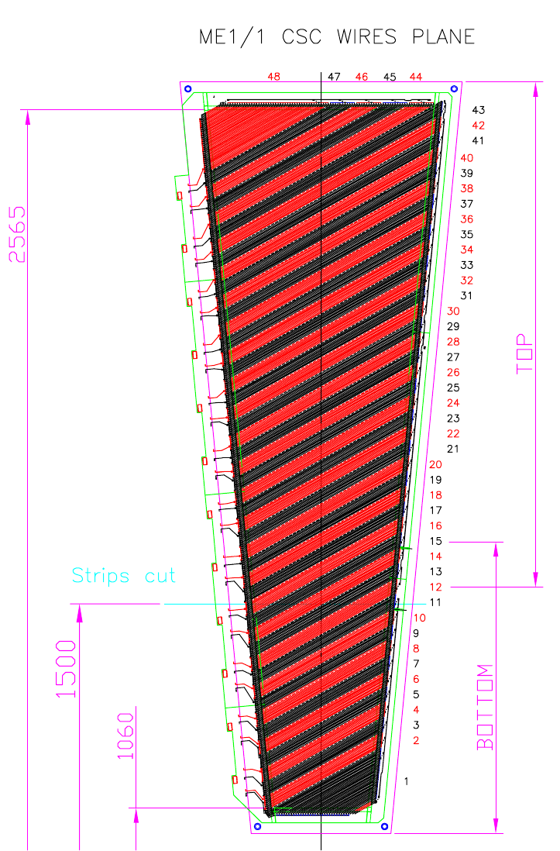
About ME1/1
ME1/1
Good quality stubs in ME1/1 are crucial for trigger rate suppression at high eta
  Closer to IP, less scattering
  Provides large lever arm
  More B-field bending then other endcap stations
By construction, it is different to other chambers:
  48 anode wire groups, inclined at 29º
  Physically separated cathode strip detectors in ME1/a and ME1/b
    1/b has 64 strips read out by 4 CFEBs
    1/a has 48 strips
      Before: triple-ganged, read out by 1 CFEB
      Upgrade: un-ganged , read out by 3 DCFEBs
487
η=1.55
ME1/b
1505
ME1/a
η=2.10
η=2.44

Slide 4
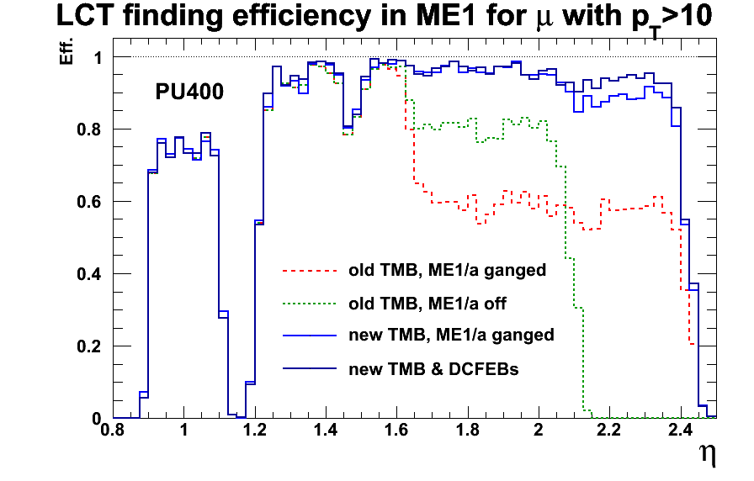
ME1/1 High Luminosity Trouble
With no change, ME1/1 would be a big trouble maker at SLHC luminosities (L up to x10 of nominal design)
  The highest BG rates of all chambers
    Occupancy-related timing effects would increase significantly in high PU and would lead to degradation of stub finding efficiency
  No hope of triggering in ganged ME1/a @high L
  Current TMB FPGA is full to its capacity
  CFEB chips rate capacities become a bottleneck
  Extended years of running in high radiation environment – increasing likelihood of failure
  Strong motivation for ME1/1 electronics upgrades
Note:
PU25 is average @design L & 25ns BX
PU400 possible @ SLHC peak inst. L
if no luminosity leveling or 50ns BX
Most of efficiency plots are PU400
unless noted otherwise

Slide 5
Algorithm Changes in a Nutshell
Find CLCTs separately in ME1/a and ME1/b, minimize/localize electronics dead-time due to out-of-time pileup
Find ALCTs in ME1/1
  Assign them to ME1/a and ME1/b (with some overlap region due to the slant)
Match ALCTs to CLCTs separately in ME1/a and ME1/b
  Properly handle a possibility that ALCT and CLCT might not be able to physically cross
  Better cross-BX matching of ALCT to CLCT
Choose the best two LCTs in each, ME1/a and ME1/b
  One more sorting step is necessary if we are allowed max 2 per whole ME1/1

Slide 6
CLCT reco: ME1/a & ME1/b separation
Old TMB algo: 1/b + 1/a strip signals are treated as in a single continuous chamber
  Works ok for low lumi, but becomes increasingly harmful as L increases
Larger FPGA would allow to treat 1/a and 1/b as two separate chambers for finding CLCT
  With max 2 CLCTs/BX per each 1/a and 1/b parts
  Thus, up to 4 CLCTs per whole ME1/1 would be available for further matching to ALCTs (which would also be done separately in 1/a and 1/b)

Slide 7
CLCT reco: dead-time localization
Old TMB algo: state-machine freezes whole chamber after a CLCT trigger is found until # of coincidence layers falls under trigger threshold
  If anywhere in a chamber there was a CLCT from PU a few BX earlier before a signal muon, signal would be lost – major source of inefficiency
Possible solution: localization of dead-time
  After CLCT triggers, mark as busy only strips covered by the CLCT pattern envelope and remember CLCT half-strip
    during the following BXs, check if # of coincidence layers drops under the trigger threshold for the signal half-strip
    if it does, remove the "busy" mark from the marked strips
  Only strips marked as busy in specific BX are excluded from pattern recognition

Slide 8
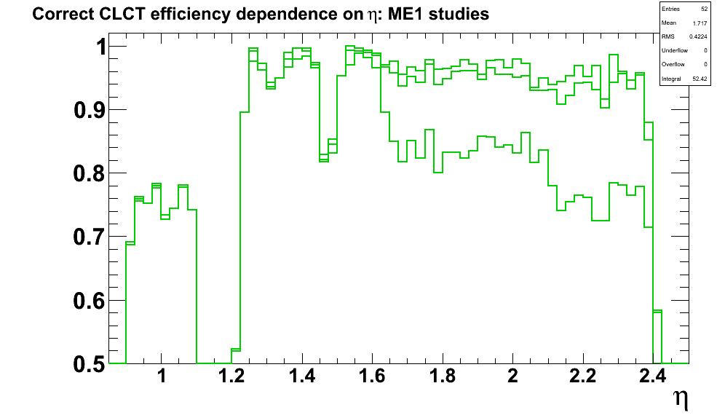
CLCT reco: dead-time localization
CLCT efficiency improvement:
  Lower line – before dead-time localization
  Upper line – localized dead-time as described in previous slide

Slide 9
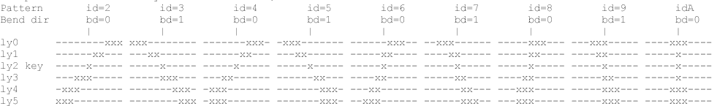
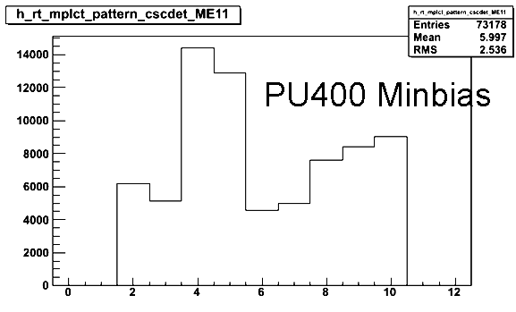
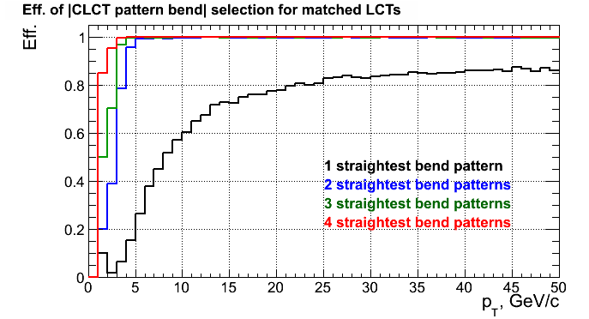
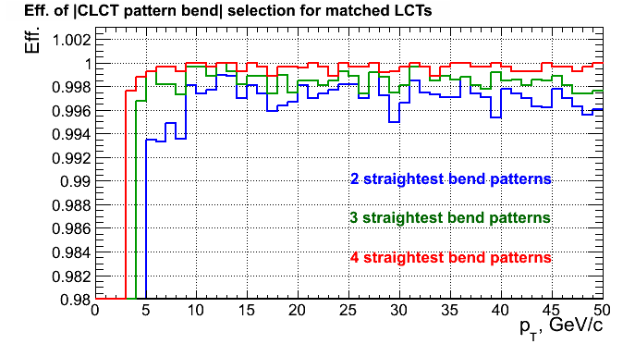
On CLCT Patterns
Only these
patterns are
relevant for
PT>10 GeV/c
Bend:
4
3
2
1
0
Occupancy:
Efficiency:
PU0
4
3
2
1
0
9
Zoom onto efficiency close to 1:
3 of the highest bend patterns contribute
  0.3% to efficiency for pt>8
  A lot to occupancies from pt<5 stubs
PU0

Slide 10
On CLCT Patterns
It would be beneficial to limit the set of CLCT patterns used for triggering
  Would help with rate, ghosting, dead-time and corresponding loss of efficiency (while we loose a little of efficiency in low PU case, we would gain a bit in high PU)
But we still would like to read out data from low pt muons
  For that we would still need to keep the full set of CLCT patterns for DAQ
  Data is only read-out from those chambers that have a CLCT pre-trigger (3 layers coincidence)
    Thus, high-bend patterns might only need to be used for pre-triggering, but not for triggering
10

Slide 11
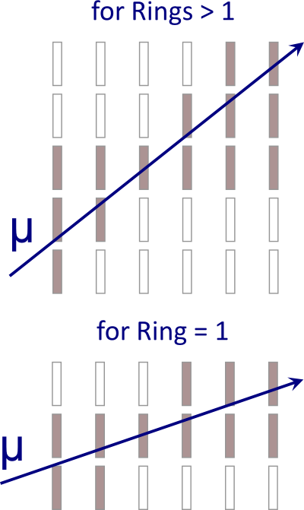
On ALCT Patterns
Problem:
  ALCT time resolution in ME1/a becomes worse then that of CLCTs
  The reason is that the single “wide” ALCT pattern envelope that we currently have for all chambers, picks up too much of BG from neighboring wiregroups
Solution:
  Use “wide” ALCT pattern for chambers in Ring > 1
  Use a new “narrow“ ALCT pattern for Ring 1 chambers
11

Slide 12
On Stub Timing (relevant to CLCT and ALCT)
Current stub timing measure is not robust enough:
  Defined by BX of pre-trigger
    First BX when at least 3 layers with signal start fitting into a stub pattern envelope
  Could be influenced by outlier signal channels from early BG
  Check for trigger condition happens 2BX after pre-trigger
    For CLCT, trigger pattern could even be different then pre-trigger pattern
Possible improvement: median stub timing
  Defined by median time of signal channels that fit into stub’s trigger envelope
    Median is a measure that is the most robust to outliers
  In firmware it would require extra memory to maintain FIFOs to calculate running medians
  If that would be taking too much resources, some sort of truncated averages might be attempted instead
12

Slide 13
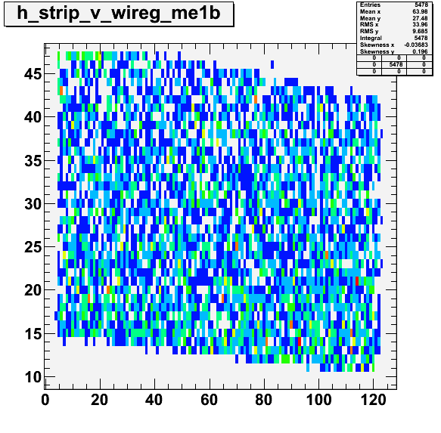
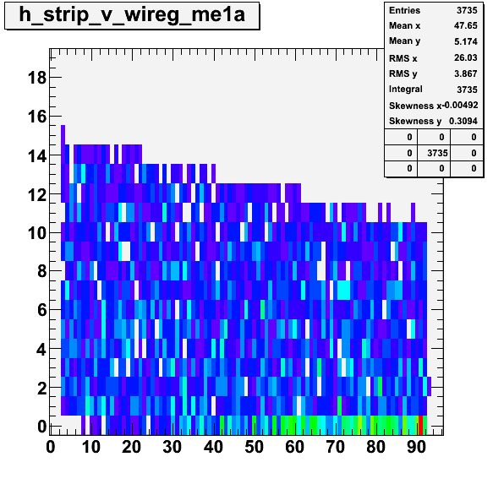
ALCT Handling in ME1/1
ME1/b
For the ALCTs received by TMB we propose to assign them either to 1/a or to 1/b if they could cross either of them
Match ALCTs to CLCTs independently in 1/a and 1/b
  A complication: 29º slant
    some wiregroups cross both 1/a and 1/b
    ALCTs in these WGs would be assigned to the both
  Use LUTs to check for a physical possibility of a half-strip and a wire groups to cross
WG
Half-strip
ME1/a
WG
13
Half-strip

Slide 14
Improving Stub Time-Matching Logic
A problem in old TMB: CLCTs are “leading” the matching
  When it finds CLCT, it looks for 1st BX in the matching window (in arrival time order) that has ALCTs
  Problem: when ALCT is matched, it is taken away from the queue together with the matched CLCT
    Even if there might be a better match later –> inefficiency!
    Advantage: simple, no latency loss
Solution: ALCT-centric cross-BX approach
  For a BX with ALCT (which determines BX of LCT), TMB would wait for CLCTs to be reconstructed
    Look for a match in the same central BX first
    If less then 2 LCTs are matched yet, look for CLCTs in BX -1, then BX+1 …
  That would require some small additional latency
14

Slide 15
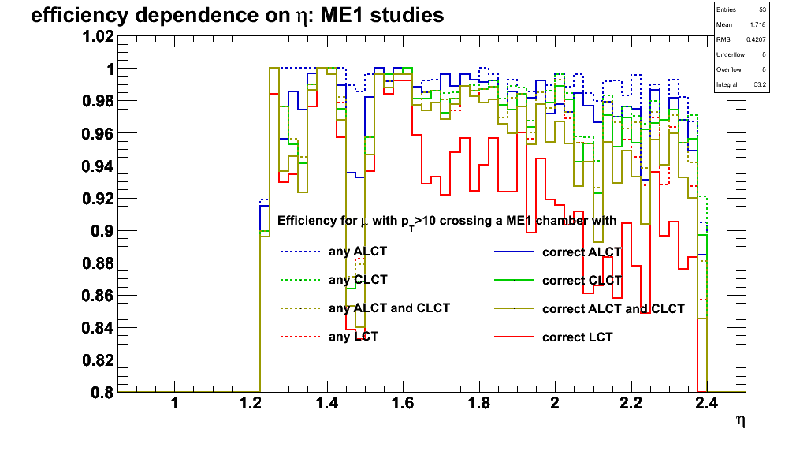
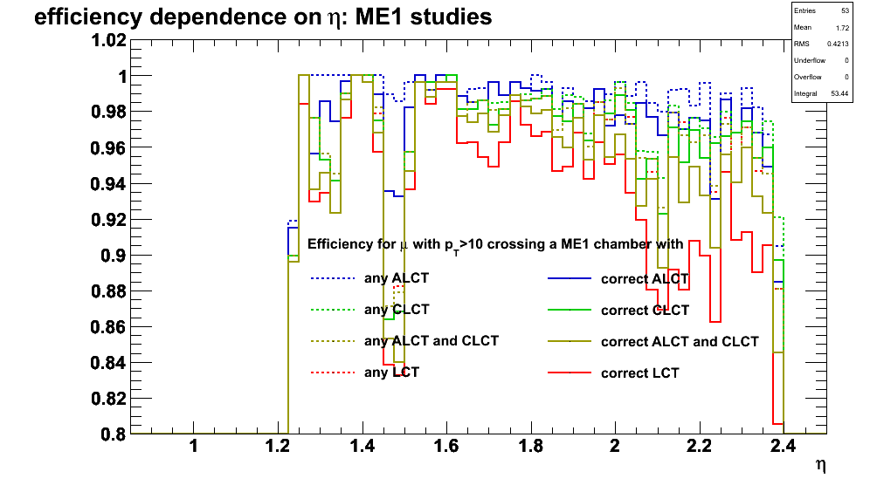
Improving Stub Time-Matching Logic
Example of efficiency improvement
  Note the red “correct LCT” efficiency histogram
Before:
After:
15

Slide 16
On LCT Sorting
Since we can have max 2 + 2 = 4 LCTs/BX from 1/a + 1/b, we need some LCT sorting procedure to select max 2 LCTs/BX from the whole ME1/1
  The limit comes from the backplane limitation
The simplest solution:
  Rank by eta: drop the highest eta ones until we have just two
A bit better:
  Rank stubs by “special quality” value which is the same as stub quality for 1/b and is stub quality - 1 for 1/a stubs
  Rank by eta, if special quality is the same
A more complex way to work around the limitation of max 2 LCTs/BX
  Serialize extra stubs into the following BX if it would be empty
  However, it’s unclear if it would actually be worth doing
16

Slide 17
Conclusion
A number of ways to improve local triggering in ME1/1 at high luminosity was identified from simulation studies in high pileup
The plan is to start implementation in firmware
  Step-by-step improvements of the existing TMB firmware with 7DCFEB handling (Yuriy’s talk yesterday)
  Having a versatile test-bed for firmware development is important
    Aysen will be talking about the electronic emulation system for the TMB input signals
17

Slide 18
Backup
18

Slide 19
Potential ALCT Efficiency Improvements
Current ALCT “ghost cancellation” algorithm:
If( WG-1 has ALCT of higher Quality in the same BX ||
WG+1 has ALCT of at least the same Q in the same BX )
ALCT on wire group WG is canceled
else (if WG+1 or WG-1 have ALCT from 1 to 4 BX ago)
ALCT on wire group WG is canceled
Is run in parallel for all Wire Groups
Has little effect at low PU
At high PU and high eta efficiency suffers because of
the strict requirements in the ‘else’
  “from 1 to 4 BX ago” is a large range for time-precise ALCTs
  No requirement on Quality of WG+1 or WG-1
    Fairly often can lead to killing of a good signal ALCT by some low quality neighboring ALCT from early PU
19

Slide 20
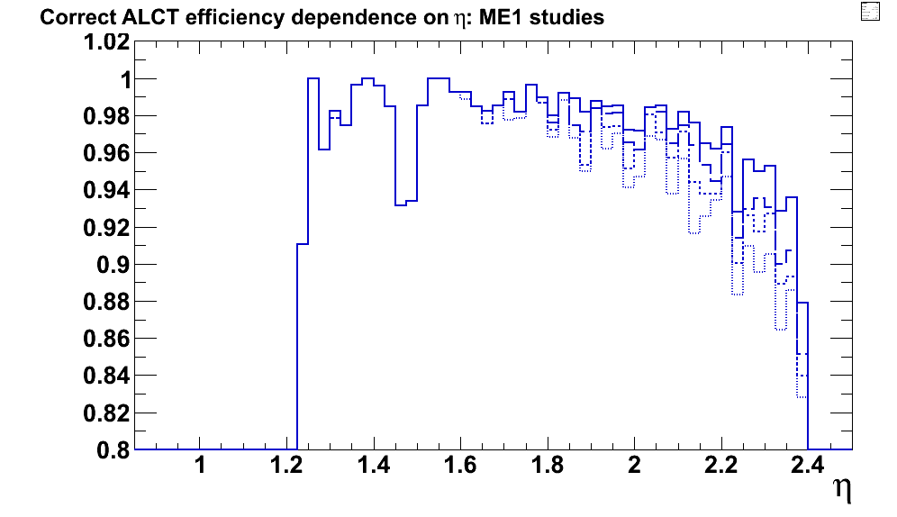
Potential ALCT Efficiency Improvements
Ghost Cancellation:
  Changing the WG±1 look-back DBX from 4 to 1 (dotted line)
  Adding higher quality requirement for past BXs (dashed)
before
The highest eff. is after removing pre-trigger dead-time:
  Currently, if pre-trigger happens on some WG but no trigger 2BX later, ALCT stops this WG for total 6 BX after pre-trigger
  No reason not to reduce it to 2 BX (drift time only)
20

Slide 21
Note on ALCT Emulator
Current ALCT emulator in CMSSW has a limitation:
  It does not allow simulation of multiple ALCT trigger stubs in a BX train happening on the same wire-group
  It means that only the first ALCT stub in a BX train on a specific wire-group is found
    That could bring some trouble if very long BX trains with early out-of-time PU are simulated
    E.g., the standard BX train is [-5,+3], but for SLHC samples they are now proposing a significantly longer one [-12,+3]
21

