Slide 1
Endcap TF/CSCTF Algorithms
Ivan Furić for the
endcap track finder team

Slide 2
Outline
Algorithm layout in old (“SP”) vs new (“MTF7”)
Track finding algorithm
BDT evaluation at Level 1
Summary
Notes:
Requirements – describe the problem you are trying to solve with your part of the upgrade. Maybe 2 slides, 10% of talk
Conceptual Design – how to you intend to solve said problem. Another 2 slides, 10% of talk. For CD-1, we are also supposed to provide alternatives, but I think that would be a waste of time in our case. Propose to cover that in L1 Overview. Added a slide to comment about Maturity of Design
CD-1 is mostly about Project Management issues, so this section should be 60-70% of the talk
I would expect the first slide is the Org Chart. In the backup I would have a slide on the bios of the people, but you might indicate in words or otherwise briefly the experience of the team (eg. worked on Construction project, was born in a hadron calorimeter…)
ESH&Q – Safety first! Is important to DoE/NSF, not really an issue for us, but might as well get it out of the way here. Again, common safety issues (like the fact that we will adhere to ES&H rules local to the location where the work is done, and satisfy the most stringent of common requirements in different places) should be covered once in the overview talk. It is also reasonable to mention the things your system does not have issue with (i.e. no radiactive sources, no cryogenics, no toxics or otherwise environmentally unfriendly byproducts).
Scope – From the PEP, your KPPs. Option: Another slide discussing external dependencies for the objective (and threshold) KPP
Schedule – Probably need a baseline template with CD decisions, to which each subsytem could add, and make more granular schedule, leave WBS based (and illegible) in the backup
Risk – describe the threats and opportunities with your subproject. Mention the risk mini-review post CD1 (needs to be scheduled)
Cost – Cost broken down into standard categories, also split out into DoE/NSF. Include Slide on Quality of Estimate (pie chart of monetary estimate by method of estimate)
Previous Recommendations – address recommendations made during Director’s Review. Update: Advised that this is not something we present, so moved to the backup slides. We will have a document for it
Plan to CD-2 Assuming CD-1, what needs to be done to achieve CD-2?
Summary

Slide 3

Upgraded Algorithms vs Current Ones
Current System Diagram
ΔΦ based Track Finding
ΔΦ based
pT LUT
Upgraded System Conceptual Diagram
Pattern based Track Finding
Generalized
pT LUT
post-LUT Correction
Tail Clipping

Slide 4
Track Finding Algorithm

Slide 5


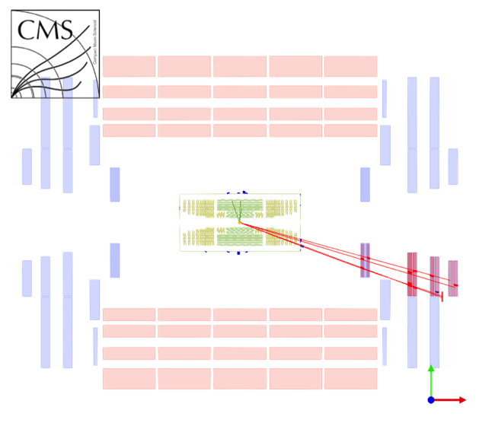
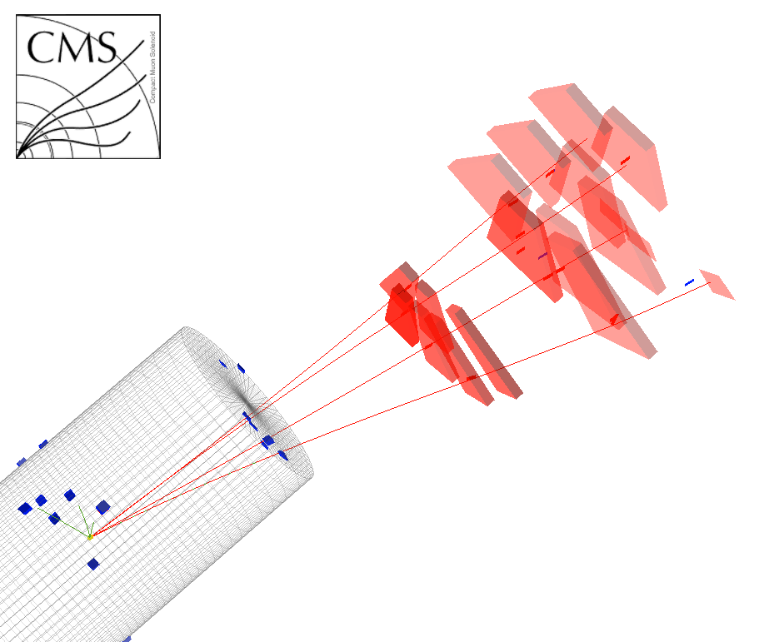
Muon Jets in the Detector
LHC CMS
Detector
Upgrade
Project
These events will have
multiple muons nearby
  We can reconstruct them in the
  offline
Trigger by requiring 2 nearby muons with p_{T}>10..15 GeV
Triggering is a challenge:
  If some of the stubs are lost before the Track Finder, TF may not have enough stubs to build a muon track
  Mixing/matching stubs will nearly always lead to under-measured p_{T}

Slide 6
CSC Trigger Efficiency
LHC CMS
Detector
Upgrade
Project
Efficiency to have
  At least two muon sim tracks with p_{T}>10 GeV matched to reconstructed LCTs in station 1 and at least in 2 other stations given that
  At least two muons with p_{T}>10 GeV are present in the muon jet at generator level
  only 1.7 < |eta| < 2.4 region is considered since ME4/2 is not in this simulation
as expected, efficiency to reconstruct two energetic muons from the muon jet is reduced if MPC transmits only 3 stubs
  Essentially random choice of 3 stubs among the many which are reconstructed
  8-muon jet case is much worse than 4-muon jet
These numbers do not include multiple interactions (pile up)
 | MPC ≤ 3 stubs | no MPC limit
muon jet of 4 muons | 0.83 | 0.92
muon jet of 8 muons | 0.45 | 0.91

Slide 7
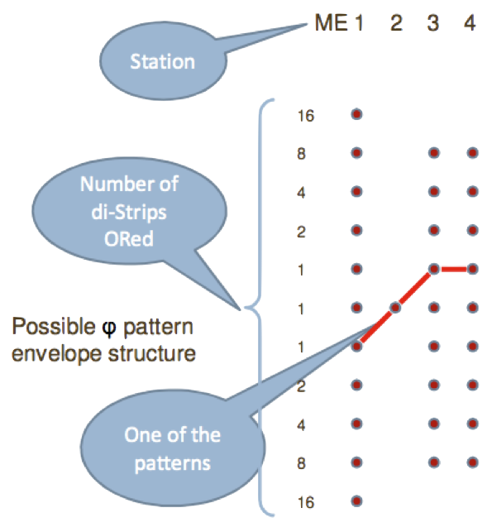
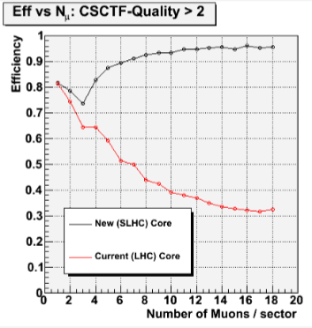
Track finding algorithm
current design - ∆ϕ comparisons, does not scale well
switch to pattern matching system for upgrade

Slide 8
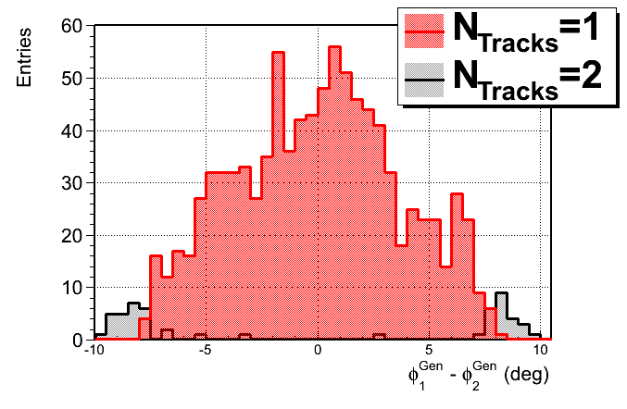
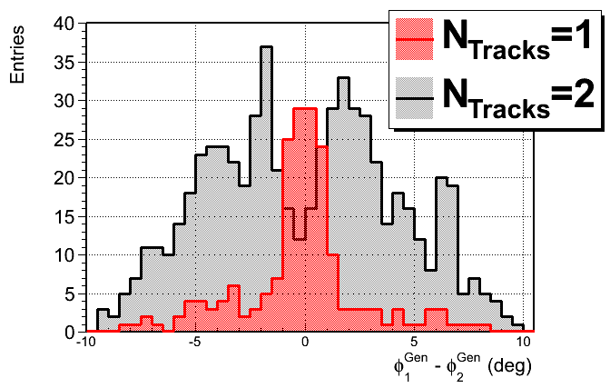
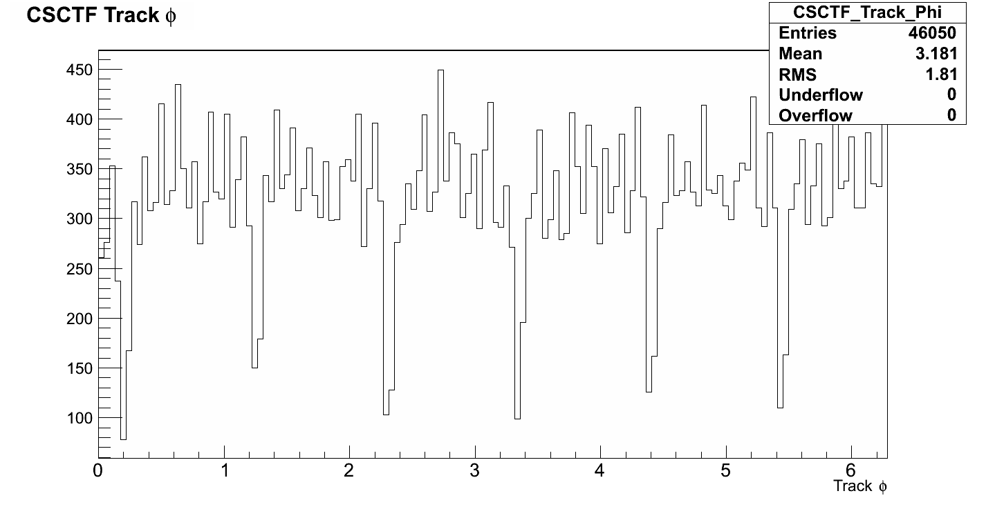
Upgraded Algorithms: Track Finding
Current
SP logic
Upgraded
SP logic
more sensitive to nearby muons
recover 5-7% of inefficiency due to sector cross-talk

Slide 9
Software Organization
“Machine” Generated
Emulator Module
Online Monitor
Offline Monitor
Data vs Emulator
Bitwise Comparator
(diagonal plots)
Test Stand
Code Package
Bad Event Filter
Data Production
Human-Readable
Emulator Module
MC Emulation
Offline Validation

Slide 10
p_{T} Assignment

Slide 11
p_{T} Assignment
CMS is in danger of saturating its L1 trigger with
single-lepton + di-lepton triggers at √s ~ 14 TeV
Endcap Muon Trigger: current p_{T} assignment system’s resources (LUT memories) are saturated
Studied potential for improvement from utilizing additional information [BDT as stand-in for LUT]
Studied potential for improvement from applying post-LUT corrections to LUT-assigned pT

Slide 12
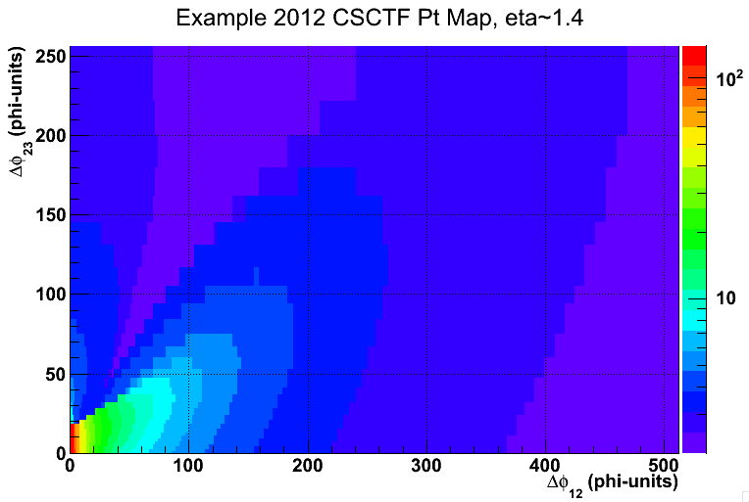
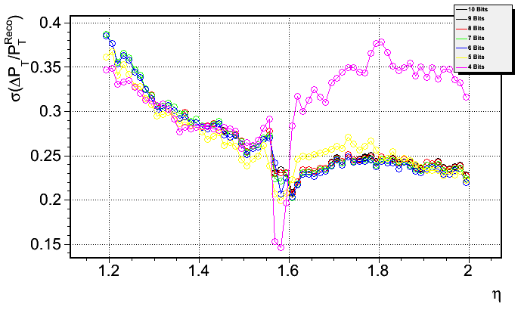
CSCTF pT Assignment Method
most powerful variables sent into η-specific LUTs
LUT outputs pT, currently hardwired to board output, content determined via max log-likelihood fit
variable Δφ binning of LUTs gives more precision where it is more useful for pT assignment

Slide 13
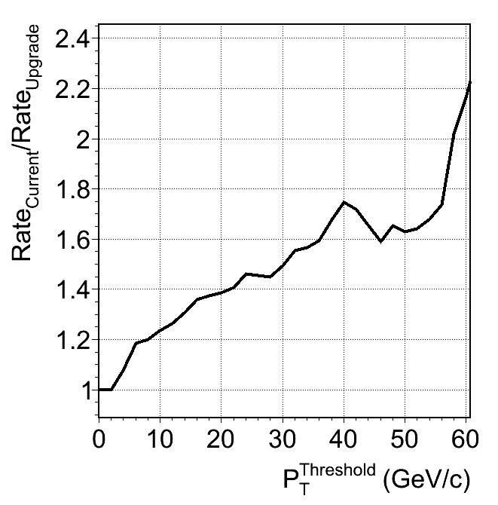
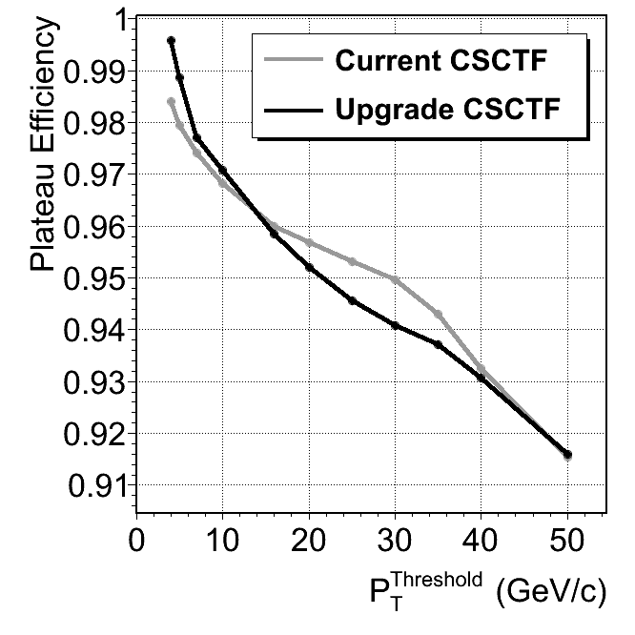
MVA pT assignment rate reduction
trained MVAs with current pT assignment information and with full information available at the track finding level
roughly ×√2 rate decrease at 20 GeV, with no real efficiency loss wrt current system
conclusion: there is power to be gained from including additional information into LUTs

Slide 14
Upgraded Algorithms vs Current Ones
Current System Diagram
ΔΦ based Track Finding
ΔΦ based
pT LUT
Test example of post-processing:
“Tail clipping” algorithm (next)
Upgraded System Conceptual Diagram
Pattern based Track Finding
Generalized
pT LUT
post-LUT Correction
Tail Clipping
Made possible by reading LUTs back into FPGA
in new muon track finder board

Slide 15
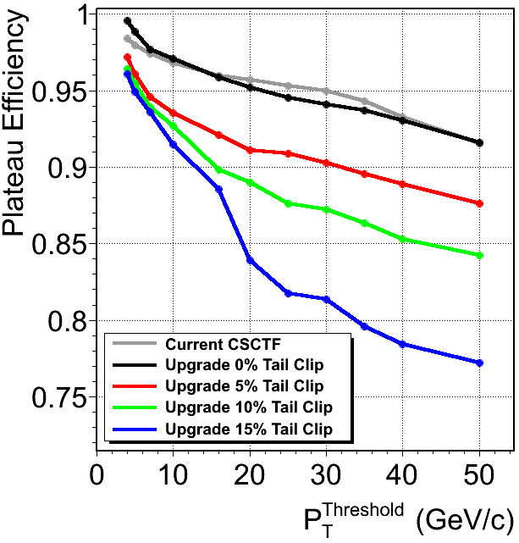
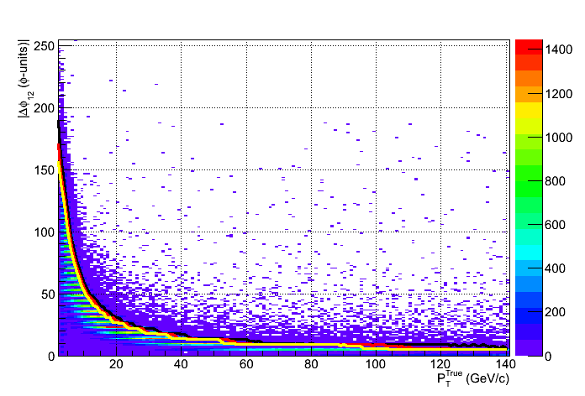
Post-LUT “Tail Clipping”
dPhi12 Tail Cuts
95% Clip
90% Clip
85% Clip
Δε ≈ -6%
Δε ≈ -10%
for a variable (example: Δφ12)
demote pT if variable is in the 5% (10%, 15%) tail
demote to most probable value for given Δφ12
repeat over all 10 variables, report lowest demoted pT

Slide 16
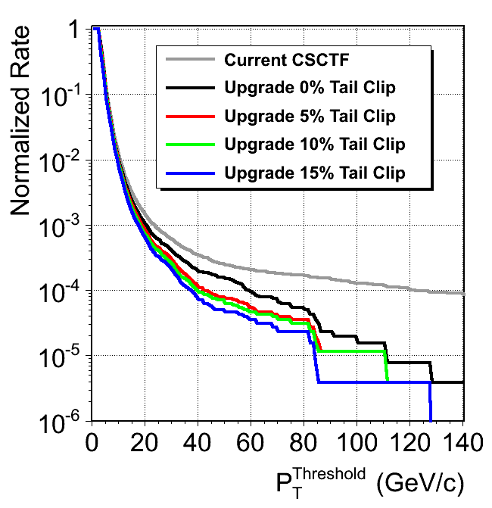
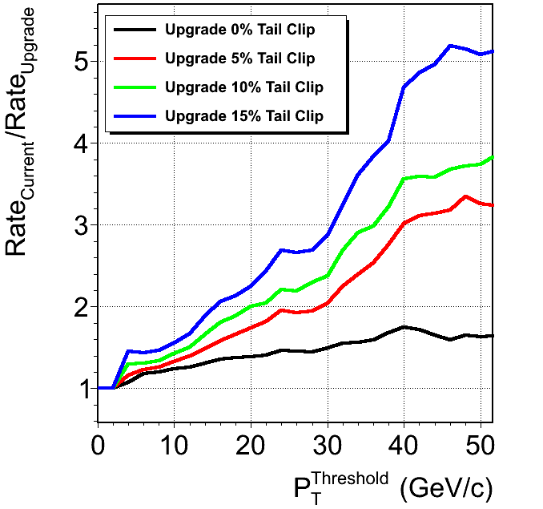
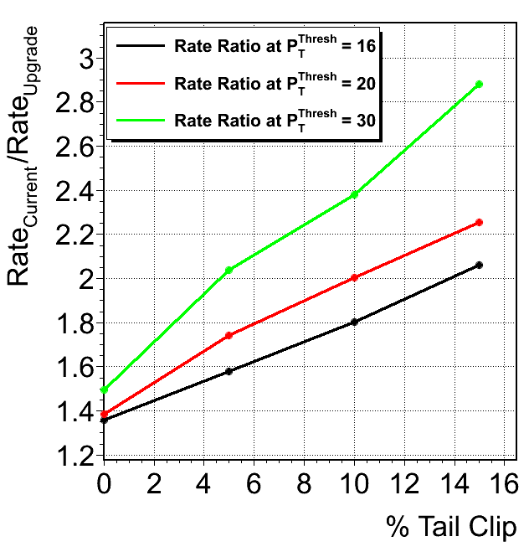
MVA + “Tail Clipping” Combined
Rate Ratio
further steepening of rate vs threshold curve
provides new dial for rate optimization - acceptable efficiency loss to trade for rate reduction

Slide 17
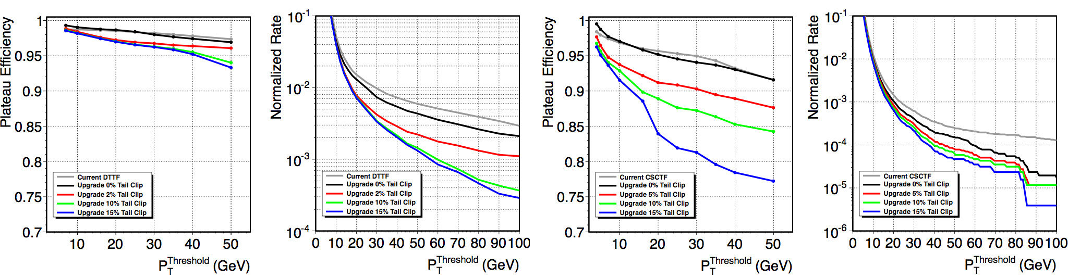
Upgraded Algorithms: p_{T} Assignment
No new updates or improved performance since L1 trigger upgrade TDR
Early May 2013 effort: port into L1TMu by Lindsey Gray and Bobby Scurlock
Our first priority is to complete the TDR software propagation into CMSSW, improve performance later
17

Slide 18
Evaluation of BDTs in FPGAs
studied BDTs expecting good algorithms to generate complex trees for LUT address calculation
design usage for regression is exactly the opposite:
  complex trees tend to latch onto details
  use simple trees, but lots of them in BDT
  example TMVA “default”: ~20 nodes, 500 trees
comp. values and outputs hardcoded after training
basically: lots of very simple, fast evaluations (comparisons)
same input values → all trees evaluated in parallel
closely matches the paradigm of FPGA computation
can we possibly evaluate our BDTs online at L1?

Slide 19
Implementation Sketch
CPU Evaluates BDT
Input
comp1
comp1
comp1
out1
comp2
out1
comp2
out1
comp2
out2
comp3
out2
comp3
. . .
out2
comp3
FPGA Evaluates BDT
out3
comp4
out3
comp4
out3
comp4
out4
comp5
out4
comp5
out4
comp5
out5
out6
out5
out6
out5
out6
tree 1 output
+
Tree 2 output
+ ... +
tree N output
BDT out

Slide 20
Exercise: DTTF Upgrade BDT
try porting the TDR algorithm into FPGA
choose DTTF:
  80% of tracks have hits only in two stations,
  only 4 input parameters, 10 bits per parameter
  for TDR study we used 6 different BDTs
  FPGA has to evaluate 4 muons, 6x4 = 24 BDTs
DTTF BDTs produced using ROOT’s TMVA package
reverse engineered for implementation in FPGA logic:
  parallel evaluation of all trees in forest
  inputs, outputs discretized

Slide 21
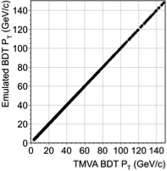
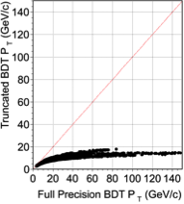
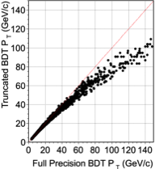
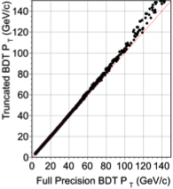
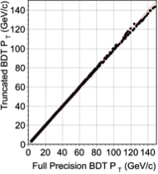
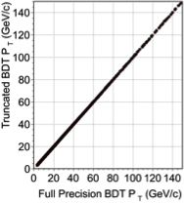
Implementation: 1/p_{T} Discretization
emulator
x-check
4 bits
6 bits
8 bits
discretization of BDT output with 10+ bits yields p_{T} values almost indistinguishable from floating point computed values
10 bits
12 bits
NTrees = 256 for this study

Slide 22
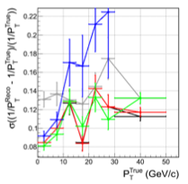
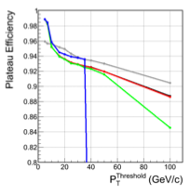
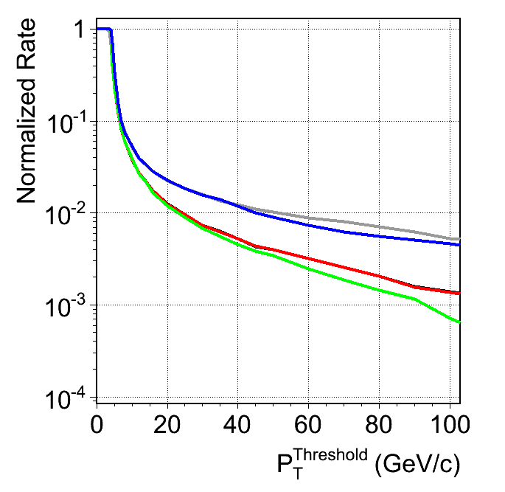
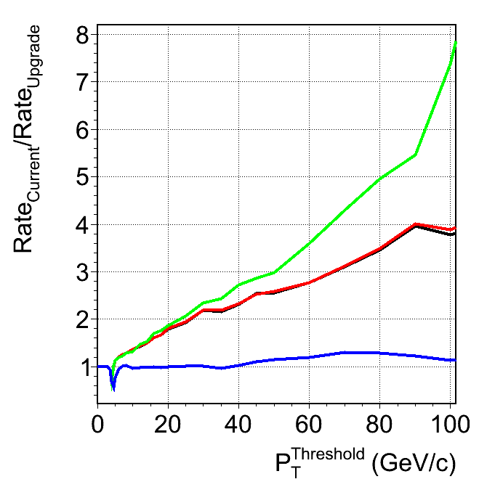
Discretization effects
Default DTTF
BDT Full Precision
BDT 10-bit Encoding
BDT 6-bit Encoding
BDT 5-bit Encoding
resolution
plateau efficiency
discretizing BDT output to 10 bits yields negligible performance differences wrt full floating point BDT
single μ trigger rate
rate reduction
factor

Slide 23
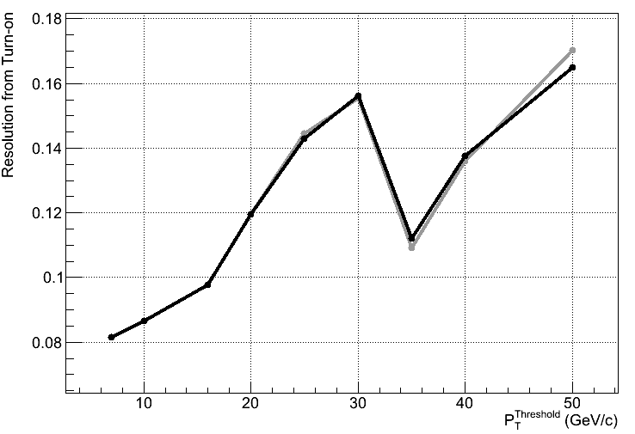
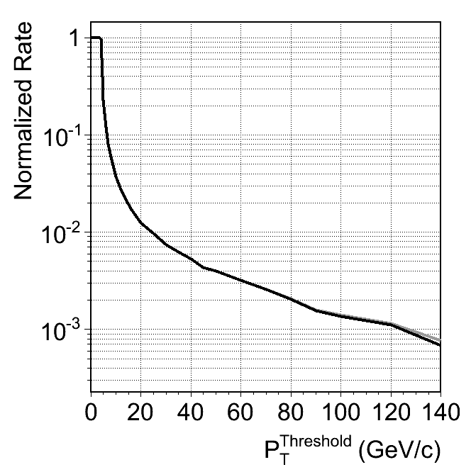
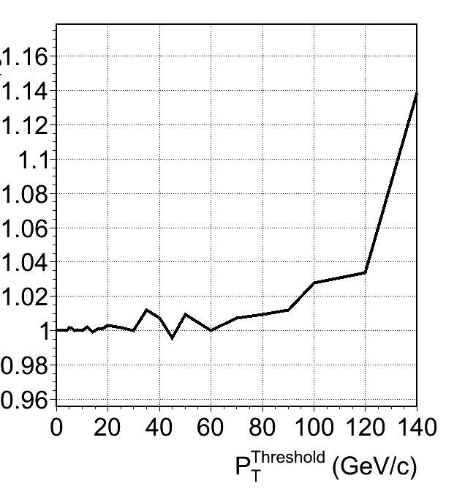
Reproducing the TDR
Grey = TDR Black = “FPGA ready” BDT, offline calc
ratio of single μ
trigger rates
single μ trigger rate
RFPGA / RTDR
resolution
“FPGA ready” BDT:
  256 trees, 10 nodes/tree, output discretized to 10 bits
  bitwise reproduced by firmware emulator
  reproduces TDR to within 2% in relevant pT range

Slide 24
FPGA Resource Usage
# BDTs | #Trees / BDT | Input bits* | LUTs used | Linear Scaling
1 | 256 | 10 | 2.30% | reference value
2 | 256 | 10 | 4.61% | 4.60%
3 | 256 | 10 | 6.94% | 6.90%
1 | 512 | 12 | 5.65% | 5.52%
2 | 512 | 12 | 11.36% | 11.04%
3 | 512 | 12 | 17.02% | 16.56%
* same # of input and output bits were used in this exercise
~ linear scaling of FPGA LUT usage, predicts:
24 BDTs, 256 trees/BDT, 10 I/O bits → 55% LUTs
technically fits into FPGA, but still 2-3x too large
resource usage far from optimal in these tests

Slide 25
BDT Evaluation Latency
consider ~ few LHC clock cycles (few × 25 ns) to be acceptable latency for L1 applications
every topology tested [on previous slide] executed within one LHC clock cycle
[the FPGA-based BDT computed 1/pT in <25 ns]
came as quite a shock to us - too good to be true?
works due to the parallel evaluation of all trees in the BDT, followed by adding outputs in groups of 16
logic synthesizer did a lot of optimization
largest configuration took ~12 hrs to compile
[3 BDTs = 1/8th of full device]

Slide 26
BDTs vs LUTs in MTF7
we just wrote a TDR in which we propose to use large LUTs + post-processing to assign p_{T}
can we just replace LUTs with BDTs?
not very likely:
  reminder: barrel 2-hitters are the simplest case we encounter in the muon system (least #inputs)
  BDT-only based solution might fit into Virtex 7
  overlap, endcap: η binning of information (CSCTF uses 32 bins), 4 hits → more complex problem
  also, BDT for CSCTF pT assignment in TDR used LUT output as one of its inputs

Slide 27
Summary
Presented new layout and initial algorithms for MTF7
(those used in L1 Upgrade TDR preparation)
Currently working on making these algorithms available in CMSSW (using L1TMu)
Lots of work to do
  10⁹ addresses in the LUTs need to be filled in the best possible way
  Investigate corrections to LUT output (polynomials, BDTs)
  Further investigate tail clipping (+ firmware implementation)
  Best possible balance of above components
  Or .. ignore everything I’ve said, design something from scratch
  (can even propose a new piece of hardware instead of LUT mezzanine)
Suggestions, ideas, studies, code is very welcome!

Slide 28
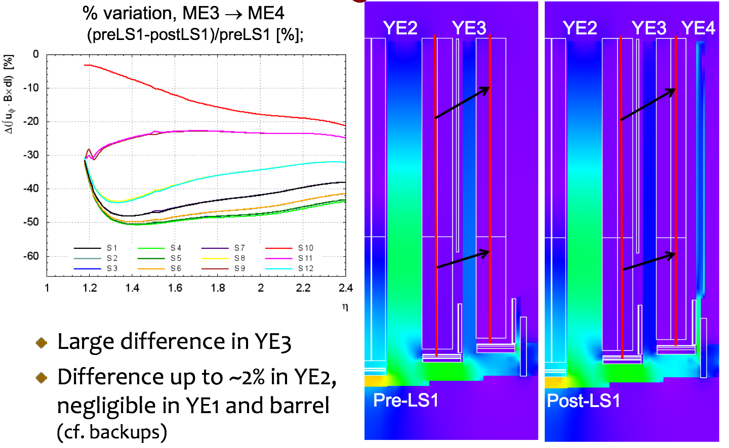
YE 4 Installation Implications

Slide 29
Online software / test stand
Currently completing CVS → svn migration for CSCTF online software [conservation of old system]
The new system will require completely new control and test stand online software (+hardware-check firmware)
Alex Madorsky is currently testing and debugging the prototype hardware with his private code
Doug Rank [UF / Rick Field] will be filling his service requirement through the muon trigger upgrade,
Doug will bump-start the online effort by integrating Alex’s private code into xDAQ
This will provide the basic test bench + run control handles, will expand as the firmware fully congeals

Slide 30
Software Organization
“Machine” Generated
Emulator Module
Online Monitor
Offline Monitor
Data vs Emulator
Bitwise Comparator
(diagonal plots)
Test Stand
Code Package
Bad Event Filter
Data Production
Human-Readable
Emulator Module
MC Emulation
Offline Validation

Slide 31


Emulators - Status and Progress
track finding algorithm described in L1 TDR
was “machine generated” [Verilog ↔ c++]
“human-readable” equivalent being developed
by Matt Carver [UF] with following goals:
  maintain bitwise agreement with hardware
  document algorithm in detail and speed up execution
implemented: local -> global coordinate transformation, pattern recognition, ghost cancellation
to be implemented: bunch crossing analysis, Δθ analysis, track candidate sorting and reporting
implementation directly within CMSSW [L1TMu]
31

Slide 32

Performance Evaluation
Legacy CSCTF system c/a 2010 developed
detailed study of CSCTF efficiencies
Wanted to combine with pT assignment,
expand to overlap region - never completed
Based on segment - LCT matching
Denominator definition: “fair muon”
  Global muon with 2 LCTs matched to segments
GP + David Curry [UF] revived the study
In the process of porting to L1TMu objects
First use case for L1TMu on data [vs MC] - keep bumping into technical obstacles
In contact with Lindsey - expect to resolve soon

Slide 33
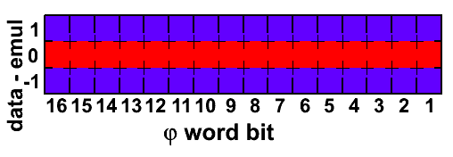
“Diagonal” Histograms
While developing CSCTF monitoring, J. Gartner pointed out that the diagonal plots are large and there are many of them
consider an 8-bit variable (“φ”); to monitor 256 values one uses over 256×256 floats (TH1F) → 256 kbytes
monitored for a number of variables per sector
alternative - monitor difference between data and emulator ?
propose to use a third method: bit-level “diagonal” plots
per variable bit, fill:
high bin if data = 1, emul = 0
center bin if data = emulator
low bin if data = 0, emul = 1

Slide 34
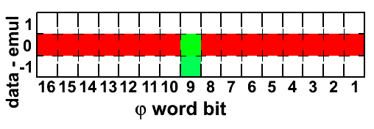
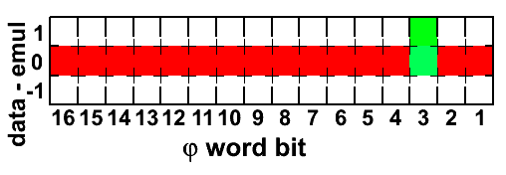
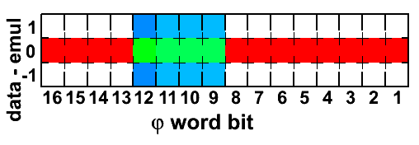
Examples
data bit 9 stuck on 0
data bit 3 stuck on 1
10% of the data random
bits 9-12 out of sync (modeled with random)

Slide 35
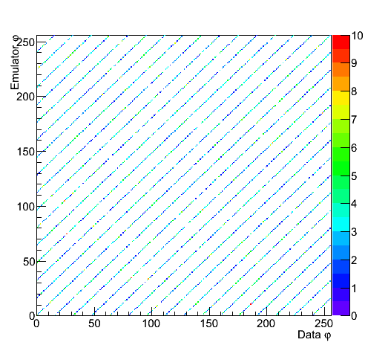
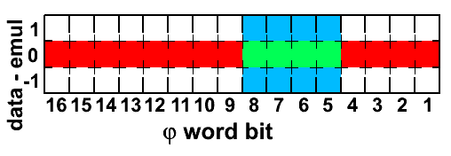
Size Comparison Example
4 GB = 65535 ×
vs
~192 B = 1 ×

Slide 36
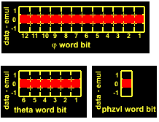
Bit-Level Monitor
Matt Carver and George Brown [UF]
Using bitwise monitoring objects
Compare “machine-generated” vs
“human-readable” emulator outputs
Generalize objects
Expand to monitor full
12-sector system
To complete monitoring,
add variables currently
being reported
(or some subset thereof)

Slide 37
Software development
Offline Software [provided these for CSCTF]
  Bitwise emulation based on firmware conversion (“machine gen”)
  Bitwise emulation based on algorithm declaration (“human gen”)
  Offline monitoring and validation, performance suite
Algorithm development
  Balancing LUT memory content vs. post-LUT corrections
  Merge with new track finding algorithm
  Further tuning possible once full offline emulator is completed
Online Software [provided these for CSCTF]:
  Run control / Run setup / FW loading / LUT loading
  Complete parallel online suite for running new system

