Slide 1
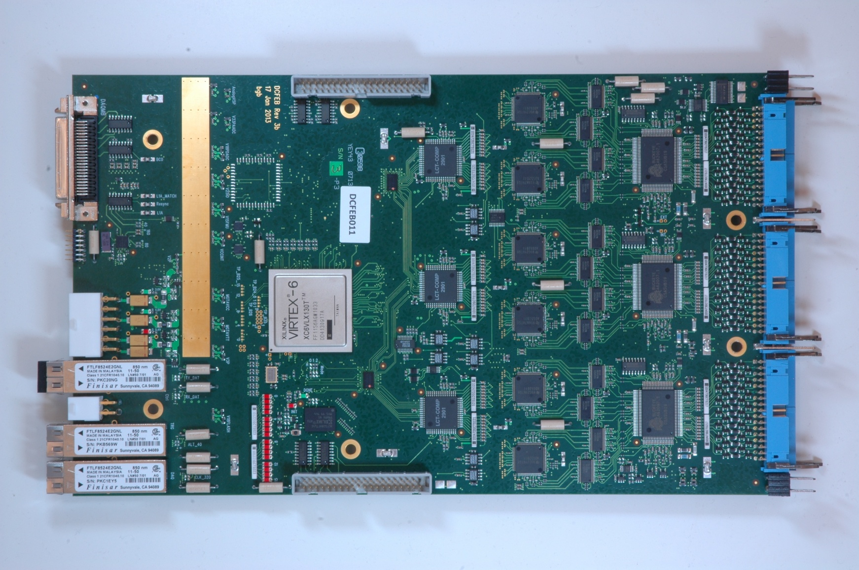
DCFEB
Firmware Updates

Slide 2
Future Firmware Features
Auto loading constants:
  Initializes firmware registers and DAC settings after hard reset from constants stored in the PROM.
Ring buffer to replace FIFO:
  For L1A separated by less than 400nS.
Possible TMB communication enhancments:
  Encoded BC0 for synchronization monitoring
SEU Mitigation:
  Soft Error Mitigation in FPGA configuration memory.
  ECC for data in stored in BlockRAMs.
  Triple voting critical logic.

Slide 3
Ring Buffer
Currently in firmware: Pipeline to FIFO
L1A
Pipeline
FIFO
Data Transmission
Ring Buffer upgrade: Pipeline to Memory, write address to FIFO, handles event overlap
L1A
Event n+1
Pipeline
Event n
Data Transmission
Read Addr
Address FIFO
Write Addr

Slide 4
SEM Controller
Xilinx Virtex 6 has built-in feature for Soft Error Mitigation
  Continuously reads configuration memory and checks each frame for errors.
  If single bit errors exist, it corrects the error and re-writes the frame.
But the built in feature has known issues.
  Experts suggest using the SEM Controller IP core.
The SEM Controller:
  Utilizes the built-in feature to do continuous readback and CRC checking
  Handles correcting single bit errors
  Has port for injecting errors for testing

Slide 5
SEM Controller
Taken from Xilinx document PG036

Slide 6
SEM Controller
Taken from Xilinx document PG036

Slide 7
SEM Controller
Expected sequence of events:
  Goto Idle state
  Inject error
  Error recognized by Frame_ECC_Virtex6 primative
  Goto Observation state
  Error detected
  Goes to Correction state
  Writes corrected frame through ICAP_Virtex 6 primitive
  Passes through classification state
  Back to Observation state.
What we see:
  In Correction state, “uncorrectable” bit set and goes back to Idle.

