Slide 1
DDUs and the FED Crates: Changes for LS1
30 Sept 2013
J. Gilmore
Texas A&M University

Slide 2
LS1 Changes for the FED Crates
Physical changes…
  DCCs will no longer carry the CSC payload to the CMS DAQ
    The 8 S-Link cards and FMM links will be removed
    The DCC will continue to perform fast control functions as always
      Basically a “CCB” for the FED crates: clocks, resets and triggers
  Each DDU will have an S-Link card mounted to transmit data
    Expands CSC bandwidth (under 2 GB/s currently) to 7.2 GB/s
    CSCs will have 36 S-Link and readout cables
      The original 8 from the DCCs will be reassigned for DDUs
    28 new S-Link cards and readout cables must be installed
    DDUs need physical modifications for the S-Link connectors
      The connectors for S-Link cards must be soldered onto the DDU boards
      The DDU front panels must be replaced for the S-Link cable connection
Logical (or programmable) changes…
  Each DDU must be programmed to be identified as a specific pre-defined SourceID for the CMS DAQ
  DDU firmware must be modified for compatibility with the new DMB data format (see following slides)
This work must be coordinated with the CMS DAQ group
  A period of testing will be required at completion

Slide 3
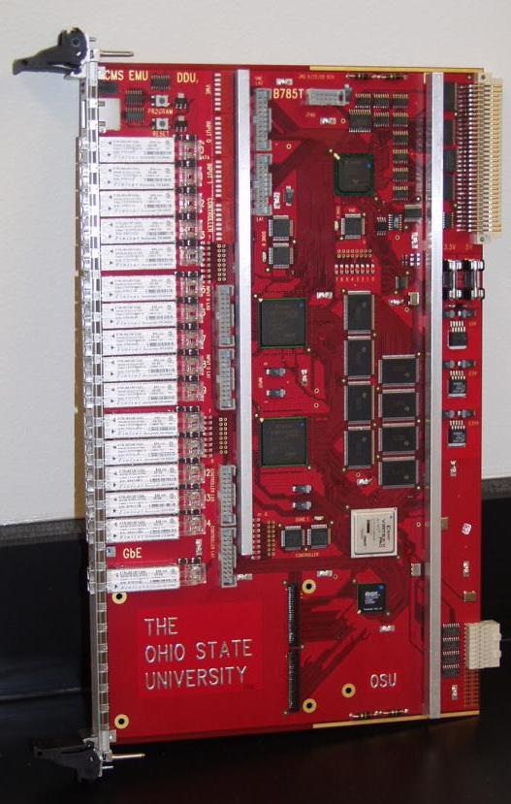
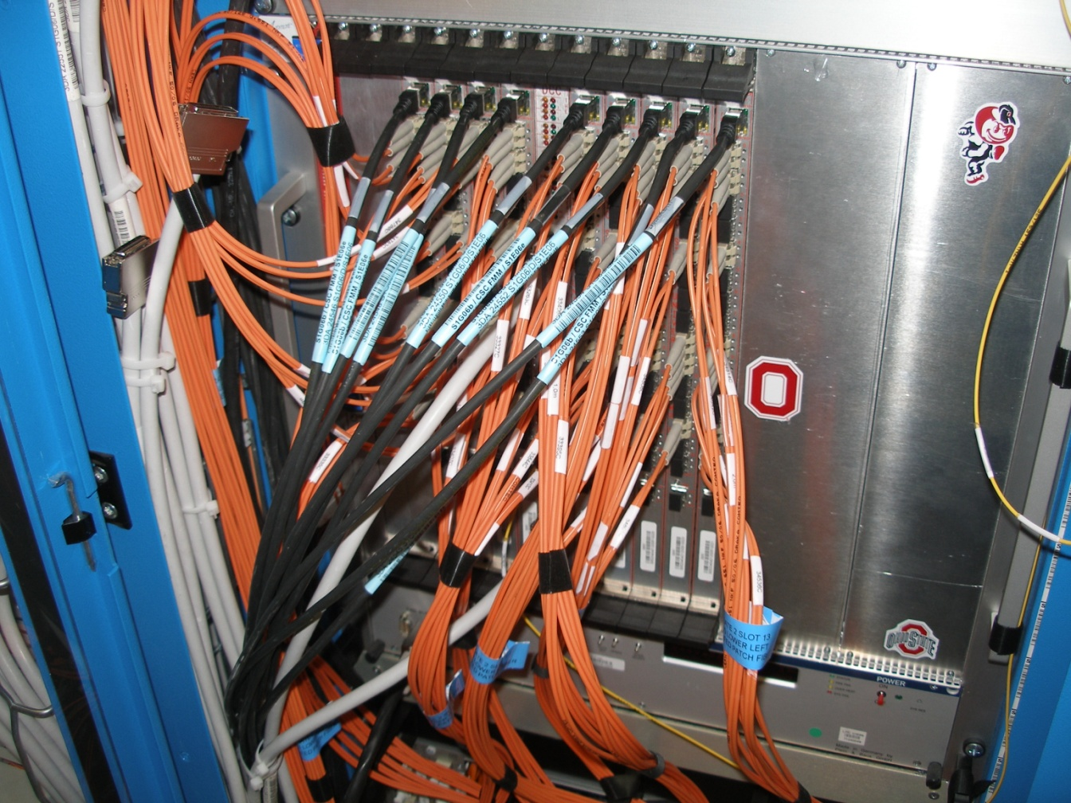
Required DDU Modifications
S-Link card installs here
  Most DDUs need to have these board connectors soldered on
  All DDUs need a new front panel for the S-Link cables

Slide 4
DMB Data Format Changes
We now have 7 DCFEBs per ME1/1 CSC
  Old standard DMB data format was designed for 5 CFEBs
    Many fields in event header and trailer have now been extended
      E.g. CLCT/DAV and Timeout bits, FIFO status signals
    These changes were identified, discussed and approved over a year ago
  We have also included a “Format Version” identifier in the header for reliable unpacking in software
    This identifier does not exist in the old data format
  The format for all DMBs and ODMBs will be upgraded
DMB format details can still be found here
  Old format
    http://www.physics.ohio-state.edu/~cms/ddu/ddu_pro.html
  New format
    http://www.physics.ohio-state.edu/~cms/ddu/ddu_new.html

Slide 5
Old DMB Data Format
Header Word | Highest 4 bits | DDU Code | Lowest 12 bits [11:0]
1a | 1001 | 9 | DMB_L1A[11:0]
1b | 1001 | 9 | DMB_L1A[23:12]
1c | 1001 | 9 | TMB_DAV(1) + ALCT_DAV(1) + CFEB_CLCT_SENT(5:1) + CFEB_DAV(5:1)
1d | 1001 | 9 | DMB_BXN[11:0]
2a | 1010 | A | TMB_DAV(1) + CLCT-DAV-Mismatch(1) + ALCT_DAV(1) + CLCT-DAV-Mismatch(1) + TMB_DAV(1) + CLCT-DAV-Mismatch(1) + ALCT_DAV(1) + CFEB_DAV(5:1)
2b | 1010 | A | DMB_CRATE(8) + DMB_ID(4)
2c | 1010 | A | CFEB_MOVLP(5:1) + DMB_BXN[6:0]
2d | 1010 | A | DMB-CFEB-Sync[3:0] + DMB_L1A[7:0]
Trailer Word | Highest 4 bits | DDU Code | Lowest 12 bits [11:0]
1a | 1111 | F | DMB_BXN[3:0] + DMB_L1A[7:0]
1b | 1111 | F | CFEB_MOVLP(5:1) + ALCT_HALF(1) + TMB_HALF(1) + CFEB_HALF(5:1)
1c | 1111 | F | DMB_L1PIPE(8) + ALCT_EMPTY(1) + TMB_EMPTY(1) + ALCT_Start_Timeout(1) + TMB_Start_Timeout(1)
1d | 1111 | F | CFEB_End_Timeout(5:1) + ALCT_End_Timeout(1) + TMB_End_Timeout(1) + CFEB_Start_Timeout(5:1)
2a | 1110 | E | ALCT_FULL(1) + TMB_FULL(1) + CFEB_FULL(5:1) + CFEB_EMPTY(5:1)
2b | 1110 | E | Duplicate Header 2b (DMB Crate & ID)
2c | 1110 | E | DMB_CRC_LowParity(1) + DMB_CRC[10:0]
2d | 1110 | E | DMB_CRC_HighParity(1) + DMB_CRC[21:11]

Slide 6
New DMB Data Format
Header Word | Highest 4 bits | DDU Code | Lowest 12 bits [11:0]
1a | 1001 | 9 | DMB_L1A[11:0]
1b | 1001 | 9 | DMB_L1A[23:12]
1c | 1001 | 9 | ALCT_DAV(1) + TMB_DAV(1) + Fmt_Vers(1:0) + CLCT-DAV-Mismatch(1) + CFEB_CLCT_SENT(7:1)
1d | 1001 | 9 | DMB_BXN[11:0]
2a | 1010 | A | ALCT_DAV(1) + TMB_DAV(1) + Fmt_Vers(1:0) + CLCT-DAV-Mismatch(1) + CFEB_DAV(7:1)
2b | 1010 | A | DMB_CRATE(8) + DMB_ID(4)
2c | 1010 | A | ALCT_DAV(1) + TMB_DAV(1) + CFEB_MOVLP(5:1) + DMB_BXN[4:0]
2d | 1010 | A | DMB-CFEB-Sync[3:0] + Fmt_Vers(1:0) + CLCT-DAV-Mismatch(1) + DMB_L1A[4:0]
Trailer Word | Highest 4 bits | DDU Code | Lowest 12 bits [11:0]
1a | 1111 | F | ALCT_End_Timeout(1) + DMB_BXN[4:0] + DMB_L1A[5:0]
1b | 1111 | F | CFEB_MOVLP(5:1) + CFEB_End_Timeout(7:1)
1c | 1111 | F | CFEB_FULL(3:1) + TMB_Start_Timeout(1) + DMB_L1PIPE(8)
1d | 1111 | F | ALCT_Start_Timeout(1) + CFEB_Start_Timeout(7:1) + CFEB_FULL(7:4)
2a | 1110 | E | ALCT_FULL(1) + TMB_FULL(1) + ALCT_HALF(1) + TMB_HALF(1) + TMB_End_Timeout(1) + CFEB_HALF(7:1)
2b | 1110 | E | Duplicate Header 2b (DMB Crate & ID)
2c | 1110 | E | DMB_CRC_LowParity(1) + DMB_CRC[10:0]
2d | 1110 | E | DMB_CRC_HighParity(1) + DMB_CRC[21:11]

Slide 7
FED Crate Plans & Timeline
Connectors & front panels already ordered by OSU
  How & where will we do the soldering work?
    We first have to extract the DDU, then put it back afterwards
      There are a lot of fiber connections involved, so care is required
      In USC might be convenient, but we will make fumes…
      We could do just ~2 DDUs at a time this way
        Fewer loose fibers, easier to keep them organized
    When will we do it, who will do it, etc?
The new front panels take just a few screws
  Relatively easy…
Then we install the S-Link cards
  We need to get them from the CMS DAQ group
    Then we can plug in the FRL cables (installed by CMS DAQ)
    We must coordinate testing with CMS DAQ too
Work on DDU firmware will begin this week
  I expect to have something to test by December

