Slide 1
Context for Phase 2 muon upgrade R&D discussion
CMS document to Resource Review Board will be presented Oct. 30, lays out our proposal and rough cost estimate for CMS Phase 2 upgrades
First draft already circulated to CMS Management Board
  Tracker upgrade has top priority
  Endcap calorimetry has a very difficult road ahead (3 competitors)
US-CMS R&D for 2014
  July 30 presentations at Snowmass
  Sept 30 deadline for Letters of Intent
  NB funds very limited, and management transitions are occurring
Today get feedback to incorporate into the muon upgrade LOI
  Don’t expect much funds (5-10%?), but get a good plan on the table

Slide 2
For 2014 *USCMS* R&D
Dear colleagues,
With the Phase 1 projects moving towards construction we plan to start providing funds from the Operation Program to support Phase 2 Upgrade R&D. We have started the processes to define the US-CMS phase 2 R&D priorities with a meeting of the US CMS Upgrade Steering Committee in Vanderbilt. Two intense follow-up meetings took place at Snowmass on the Mississippi where we heard interesting presentations about possible R&D directions. We are now calling for the submission of Letters of Intent for Phase2 R&D by September 30, 2013. You can find guidelines for the preparation of the Letter of Intent below, but note that the document should be two pages long and should clearly convey:
Why the proposed R&D is important to CMS
What are the technical challenges
What are the goals that you plan to achieve
What is the financial scale and duration of the proposed effort
The Letters of Intent will be reviewed internally by the US CMS Upgrade R&D steering Committee to evaluate the scope and to consolidate efforts if there are overlaps or redundancies. We will then ask the proponents who wish to continue with a request to submit more complete proposals that include technical details that will be read by us and, in some cases with comments, sent to CMS for their approval.
Thanks
Daniela, Joel, and Patty

Slide 3
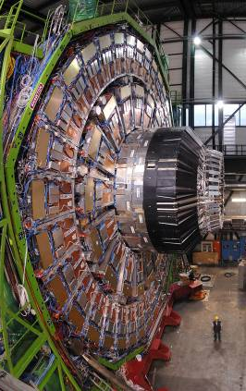
Phase 2 muon R&D discussion
The CSC muon system as one of the U.S. flagship projects
  The first truly successful endcap muon detector in a hadron collider
  Wide coverage of 1.0 < |η| < 2.4, provides trigger and precision pointing
  468 chambers, 2.5M wires, 0.5M channels, ~$40M construction cost
  Continuing commitment, for example, the 72 additional ME4/2 chambers and refurbishment of 72 ME1/1 chambers during LS1
Phase 2 basic plan:
  Required: ensure that the CSC⁺⁺ delivers muon triggering and ID under HL-LHC conditions
  Option: extend muon tagging coverage to as much as 2.4 < |η| < 4.0 with new detectors, such as an ME0 in the tail of a replacement HE

Slide 4
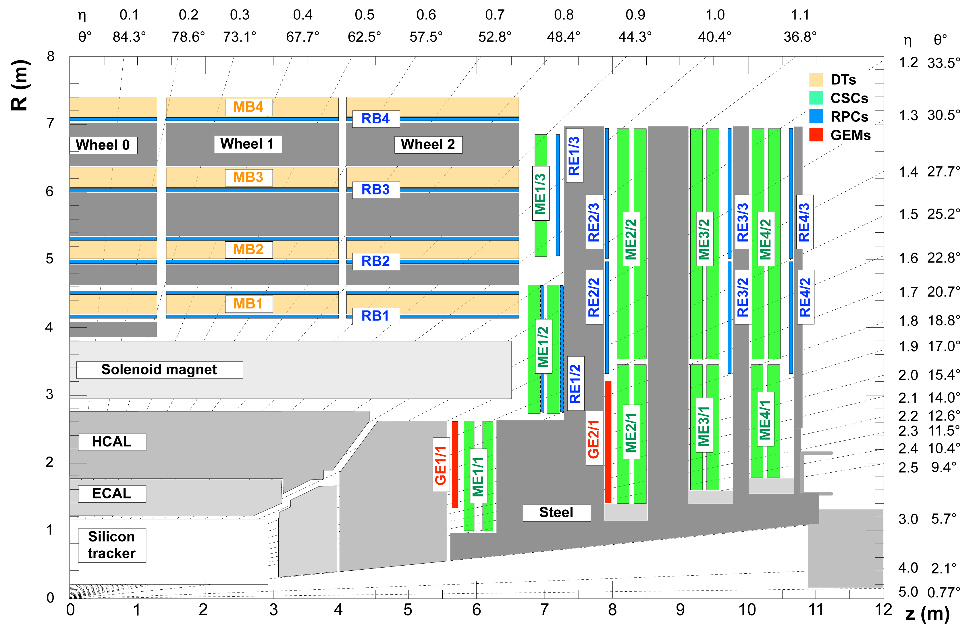
RE3/1
RE4/1
ME0
Station 2
Station 3
Station 4
Station 1

Slide 5
Specific Phase 2 muon R&D plans
Items proposed during Snowmass (7/30) meeting:
Ensure that the CSC⁺⁺ continues to deliver muon triggering and ID under HL-LHC conditions in 1.0 < |η| < 2.4
  (1) Longevity of CSC – need high rate test beam studies
  (2) Local triggering development (e.g. combination with GE1/1)
(3) Develop commercialized GEM chambers and supply 25% of GE1/1
Possibly extend muon tagging coverage to as much as 2.4 < |η| < 4.0 with new detectors, such as an ME0 in the tail of a replacement HE
  (4) Test beam studies with a prototype can be anticipated
  Would an EE/HE/muon integrated detector be a U.S. flagship project??

