Slide 1

On Direct Photon Production at RHIC and LHC-energies: A Theoretical Approach
Pradeepta Guptaroy
Department of Physics,
Raghunathpur College,
Purulia (West Bengal)

Slide 2
Direct photon production has long been considered to constitute an interesting penetrating probe for investigations of the proposed Quark-Gluon Plasma.
Reasons:
i) By ascription and by definition, direct photons are not produced by decays of either neutral pions or eta-mesons.
ii) Once produced they hardly ever interact, thus they leave the system with their energy and momentum unaltered. The mean free path of the produced photons are considerably larger than the size of the nuclear volume. Photons produced throughout all stages of the collisions will remain observable in the final stage, and are considered to be the best marker of the entire space-time evolution of the collisions.
In Standard Model-based approaches direct photons are produced either by Compton process or by annihilation process. But till date, the exact nature of apparent QGP-hadron phase transition is still plagued by uncertainties.
Here, instead of using SM-based approaches, we try to use an alternative approach to interpret the latest data of the direct photon production at RHIC and LHC.

Slide 3
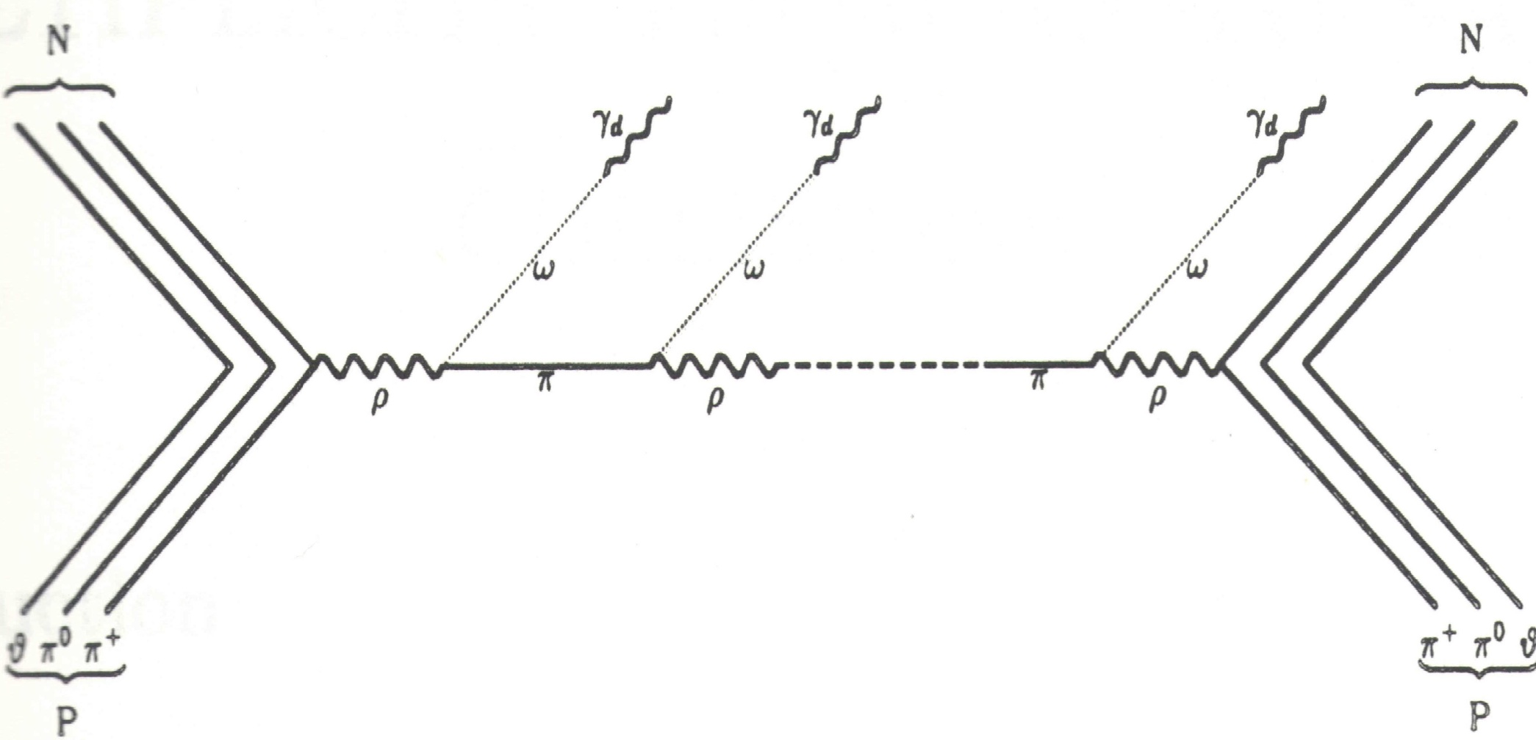
The Model (Sequential Chain Model)

Slide 4





The Working Formulae…
The inclusive cross-section for
With
And

Slide 5
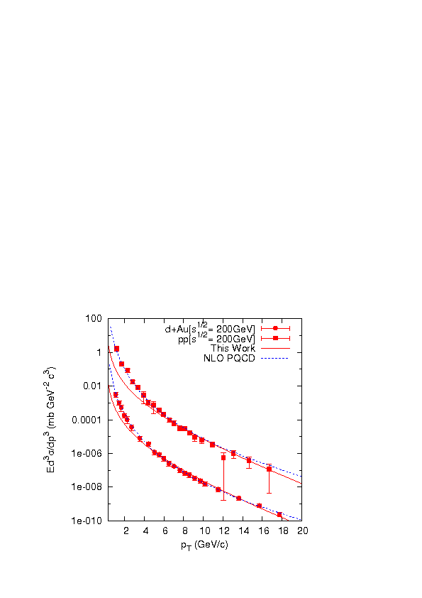
Results…
Data Ref: A. Adare et al., arXiv: 1208.1234v1 [nucl.ex]

Slide 6
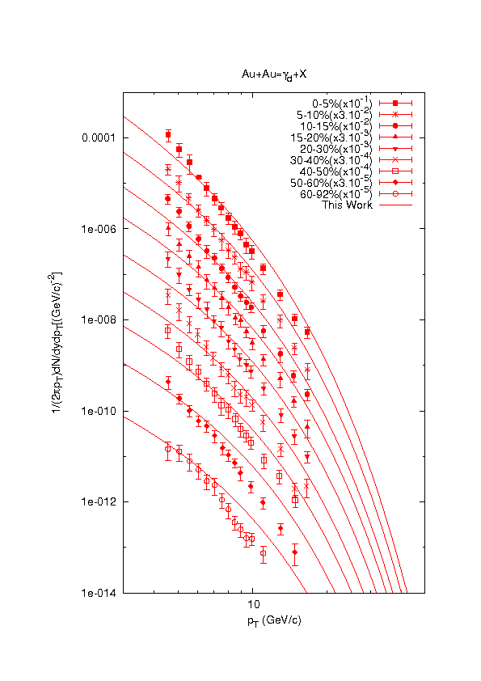
Data Ref: A. Adare et al.,
arXiv: 1205.5759v1 [nucl-ex]

Slide 7
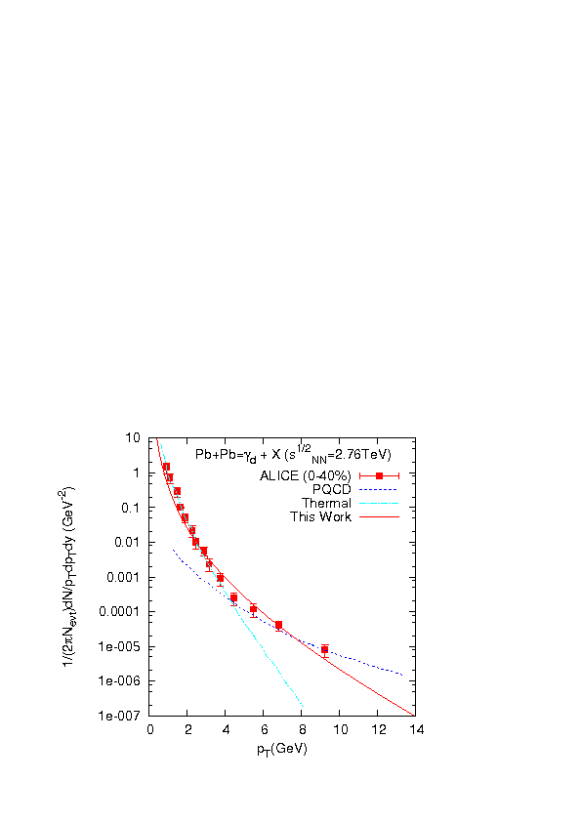
Ref.: M. Wilde et al., arXiv: 1210.5958 v2 [hep-ex]
J. Nayak, B. Sinha, arXiv: 1210.3993v1 [nucl-th]

Slide 8
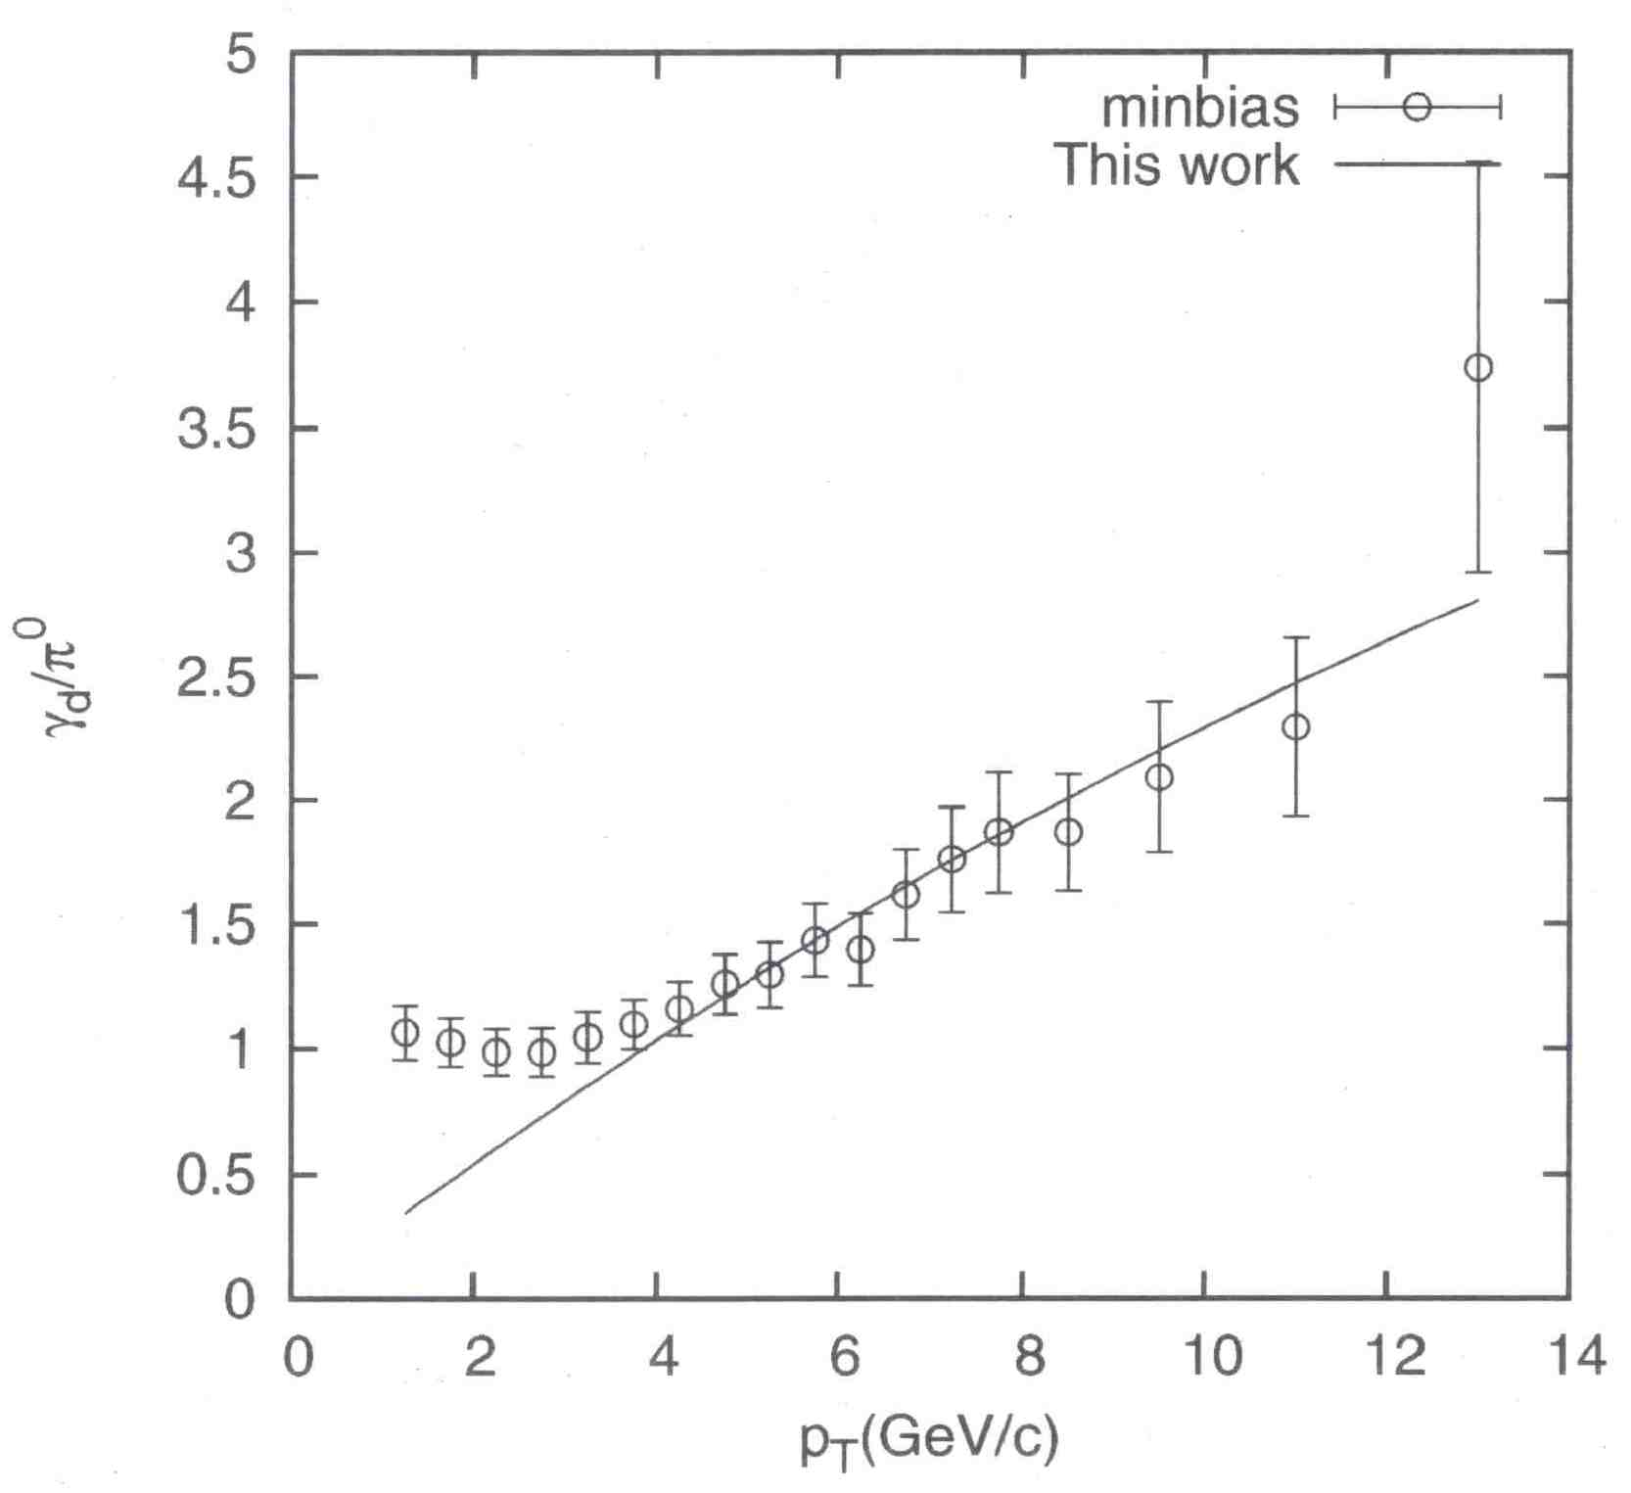
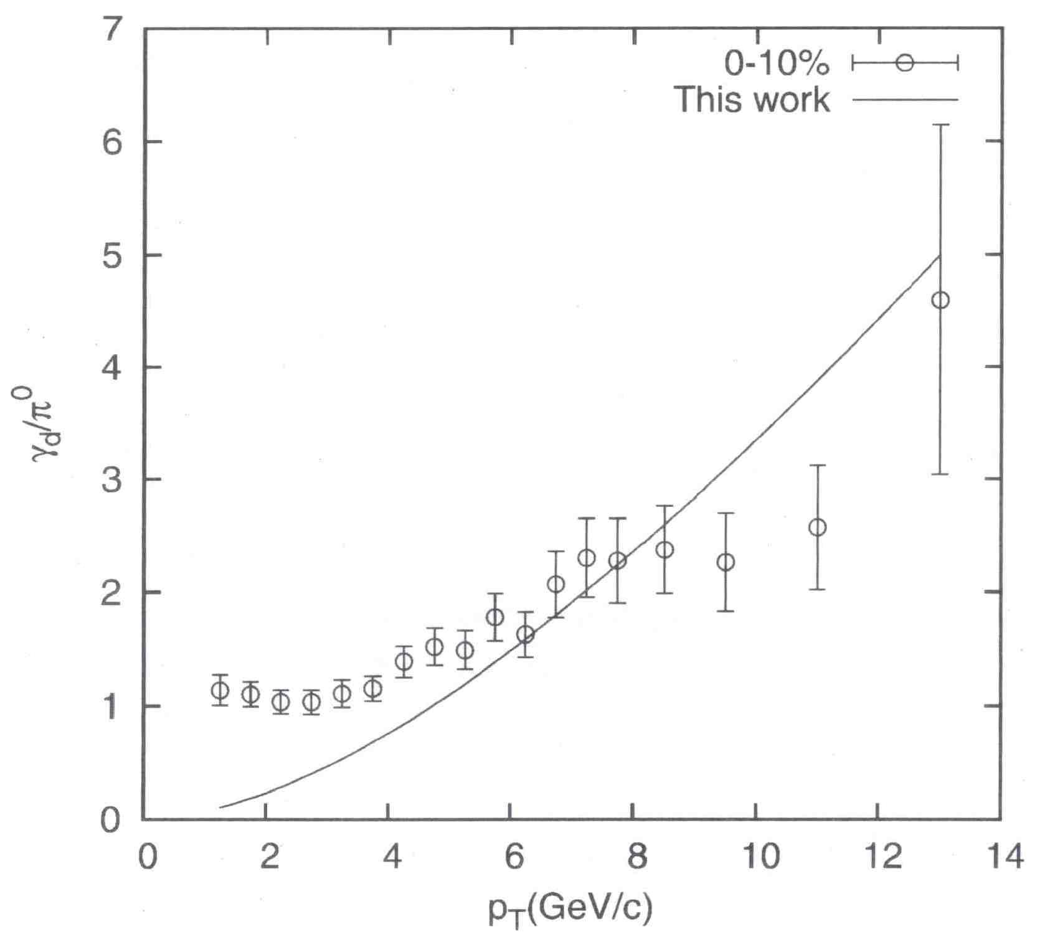
γ_{d} /π⁰ Ratio
Ref.: http://www.phenix.bnl.gov/phenix/WWW/info/data/ppg042_data.html

Slide 9

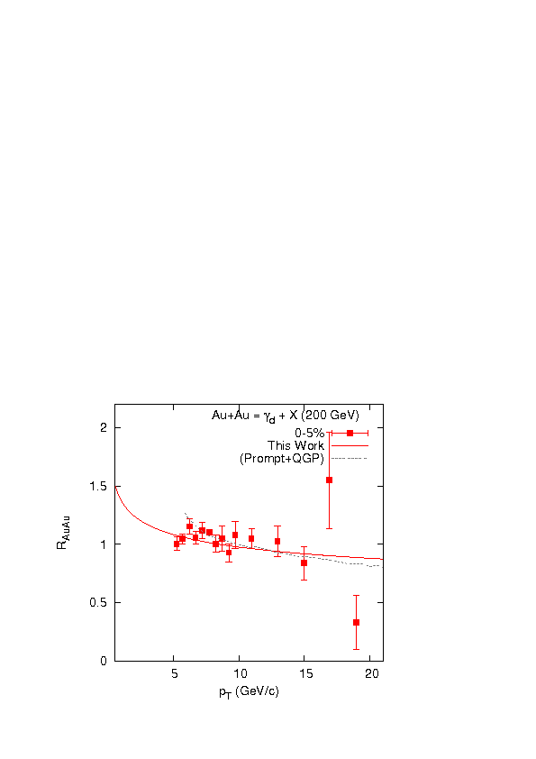
Nuclear Modification Factor

Slide 10
Final Remarks:
The model, presented here, works modestly satisfactorily for central and non-central collisions.
Selected comparisons of our model-based results with other models reveal neither sharp disagreement with any of them.
The issue of direct photon yields could be tackled even by such non-gluonization physics-approach.
Acknowledment:
Organising Committee, ICMEC, 2014.
References:
P. Guptaroy et. al., Chin. Phys. Lett. (2013) 30, 062502;
P. Guptaroy et. al., Mod. Phys. Lett. A (2008) 23, 1031;
P. Guptaroy et. al., Int. J. Mod. Phys. A (2003) 18, 5047;

Slide 11

THANK YOU

