Slide 1
Approximate Approach For The Solution Of Gluon Distribution Function With Respect To Nonlinear GLR-MQ Evolution Equation At Small-x
Mayuri Devee
and
J. K. Sarma
Tezpur University, Assam
ICMEC:TN, Bose Institute, January 15-17, 2014

Slide 2
Outline
Introduction
Solution of GLR-MQ equation
Results
Summery

Slide 3
Introduction
  Gluons at small-x and GLR-MQ evolution equation
  The study of parton (quark or gluon) distributions at small-x
  (x < 10⁻²) is one of the most interesting problems in QCD.
Perturbative QCD predicts that several new phenomena occurs at small-x
Growth of total hadronic cross-sections at ultra high energy
Growth of the mean transverse momentum of a parton inside the parton cascade
Saturation of the parton density

Slide 4
  The parton distributions is very important in understanding the standard model processes and the predictions for such processes at accelerators.
Precise knowledge of the gluon distribution at small-x is essential for reliable predictions of important high energy processes at RHIC and LHC.
The determination of the gluon density is of great importance at small x, where gluons are expected to be dominant.
Mainly predicted by using the QCD evolution equations.

Slide 5
QCD Evolution Equations
GLR-MQ
(by Gribov, Levin and Ryskin , Mueller and Qiu)
DGLAP
(by Dokshitzer, Gribov,
Lipatov, Altarelli and Parisi )
Modified DGLAP
(by Zhu, Ruan and Shen)
Evolution to large Q²
BK equation
(by Balitsky-Kovchegov)
BFKL
JIMWLK
(by Jalilian-Marian, Iancu,
McLerran, Weigert, Leonidov and Kovner)
(by Balitsky, Fadin, Kuraev and Lipatov)
……
Evolution to small x
Modified BFKL
(by Ruan, Shen,Yang
and Zhu)

Slide 6
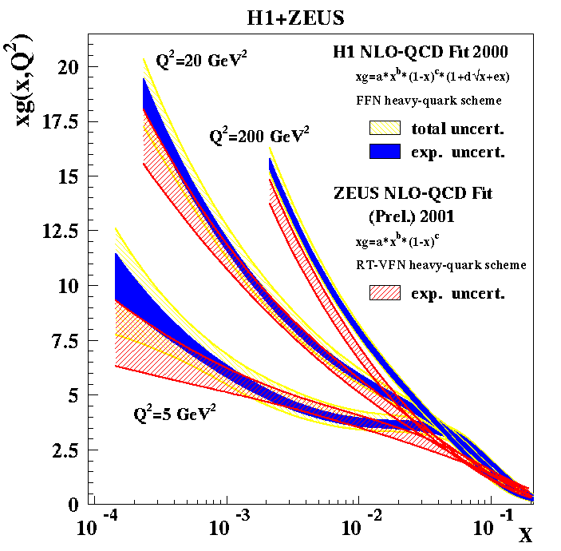
Distribution functions xg(x,Q²) rise steeply at small-x.
A flat gluon at small Q² becomes very steep after Q² evolution and F₂ becomes gluon dominated
(F.D. Aaron et al., JHEP 01 (2010) 109)

Slide 7
Froissart bound :
The total cross section cannot grow faster than the logarithm squared of the energy
M. Froissart, Phys. Rev. 123 1053 (1961)
with m_{π} being the scale which characterizes the range of the strong force.
How to modify the perturbative evolution in order to tame the growth of the cross section?

Slide 8
Why does DGLAP fail?
  At large gluon density the gluon start to spatially overlap.
  The number of small-x gluons becomes limited by gluon recombination (gg → g).
The correlations among the initial partons are neglected in the derivation of the DGLAP equation.
The corrections of the correlations among initial gluons to the elementary amplitude at small x should be considered.
  In the small-x region the linear DGLAP evolution equations are expected to breakdown.

Slide 9
DGLAP approach cannot provide a good description of the H1 data simultaneously in the region of large-Q² (Q² > 4 GeV²) and in the region of small-Q² (1.5 GeV² < Q² < 4 GeV²).
NLO global fitting of MRST2001 and CTEQ6M based on leading twist DGLAP evolution leads to negative gluon distribution.
  This leads to speculation that there may be a need for non-linear equations due to gluons recombination gg→g towars small-x and Q² (Q²≥Λ_{QCD}²).
  (K.J.Eskola et al., Nucl.Phys. B660 (2003) )
  These effects induce nonlinear power corrections to the DGLAP equations.

Slide 10

  Gribov-Levin-Ryskin and Mueller-Qiu first studied these non-linear ffects.
x 0
DGLAP
Corrections of gluon recombination
GLR-MQ=DGLAP+gluon recombination
(L.V. Gribov, E.M. Levin and M.G. Ryskin,
Phys. Rep.100 (1983) 1)
(A.H. Mueller and J. Qiu, Nucl. Phys. B268
(1986) 427)

Slide 11
The GLR-MQ equation is based on two processes:
The emission induced by the QCD vertex: G → G + G (At x~1)
emission probability
The recombination by the same vertex: G + G → G (At x →0)
recombination probability
Number of gluons per unit area:
In DIS: r ~ 1/Q
size of the gluon
R the correlation radius between two gluons
At x ≈ 1, only emission is essential because ρ<<1
At x 0 , ρ becomes very large
gluon recombination becomes important

Slide 12
The GLR-MQ equation is:
In terms of gluon distribution function:
(L.V. Gribov, E.M. Levin and M.G. Ryskin, Phys. Rep.
100 (1983) 1)
(A.H. Mueller and J. Qiu, Nucl. Phys. B268 (1986) 427)
gluon distribution function
for N_{C} = 3, as calculated by Mueller and Qiu.

Slide 13
Features of GLR-MQ equation
It predicts saturation of gluon distribution at very small-x.
It predicts a critical line separating the perturbative regime from the saturation regime.
It is only valid in the border of this critical line.
(A. M. Statso,
Acta Phys.
Polon. B35
(2004))
Larger the size of the parton (r ῀1/Q), earlier gluons gets saturated!

Slide 14
Solution of GLR-MQ evolution equation
(1)
nonlinear (quadratic) correction has “–” sign
Q² evolution is slower
The negative sign in front of the nonlinear term is responsible for the gluon recombination.
At small-x the strong growth generated by the linear term is damped whenever gluon density becomes large.
Non-linearity depends on R R = R_{h} → SC is negligibly small
R << R_{h}→ SC could be large
R_{h} radius of the hadron in which gluons are populated

Slide 15
We consider a variable,
(2)
In LO at small-x
(3)
(L.F. Abott et al., Pys. Rev. D
22 582 (1980))

Slide 16
To solve the GLR-MQ equation we consider a well known Regge like behavior of the gluon distribution function
(4)
(5)
λ_{G} Regge intercept for gluon distribution function
The values of Regge intercepts for all the spin-independent singlet, non-singlet and gluon structure functions should be close to 0.5 in quite a broad range of small-x.
(J. Soffer et al. PhysRev D. 56 1549 (1997))
We have chosen, λ_{G} ≈ 0.5

Slide 17
Substituting equations (3), (4) and (5) in equation (2) the GLR-MQ equation becomes
(6)
Performing the integrations and rearranging the terms, equation (6) takes the form
(7)

Slide 18
Solution of equation (7) is
(8)
At large t (t >>1) equation (8) takes the form
Again at large x (x ≈ 1)
So we expect that the solution given by Eq. (8) is only valid in the region of small-x and intermediate values of Q² (or t).
Region of validity of our solution

Slide 19
Q²-evolution of gluon distribution function
Defining for any lower value of Q = Q₀ , we get
(9)
which yields,
(10)
Substituting C in equation (11),
(11)
Q²-dependence of gluon distribution function in LO.

Slide 20
x-evolution of gluon distribution function
Again, defining at x=x₀,
(12)
we get,,
(13)
Substituting C from eq. (16) in eq. (11),
(14)
x-dependence of gluon distribution function in LO.

Slide 21
Q²-evolution of gluon distribution function

Slide 22
x-evolution of gluon distribution function

Slide 23
R and λ_{G} sensitivity
(b)

Slide 24
Summery
The effects of nonlinear GLRMQ corrections to the LO DGLAP evolution equations is studied.
Our obtained results of G(x,Q²) are compatible with the experimental data and parameterizations.
Our solution is expected to be valid in the kinematic region
2 GeV² ≤ Q² ≤ 20 GeV ² and 10⁻² ≤ x ≤ 10⁻⁵.
Due to the inclusion of the nonlinear terms evolution of G(x,Q²) is slowed down towards small-x and small-Q².

Slide 25
Thank you for your
attention

