Slide 1
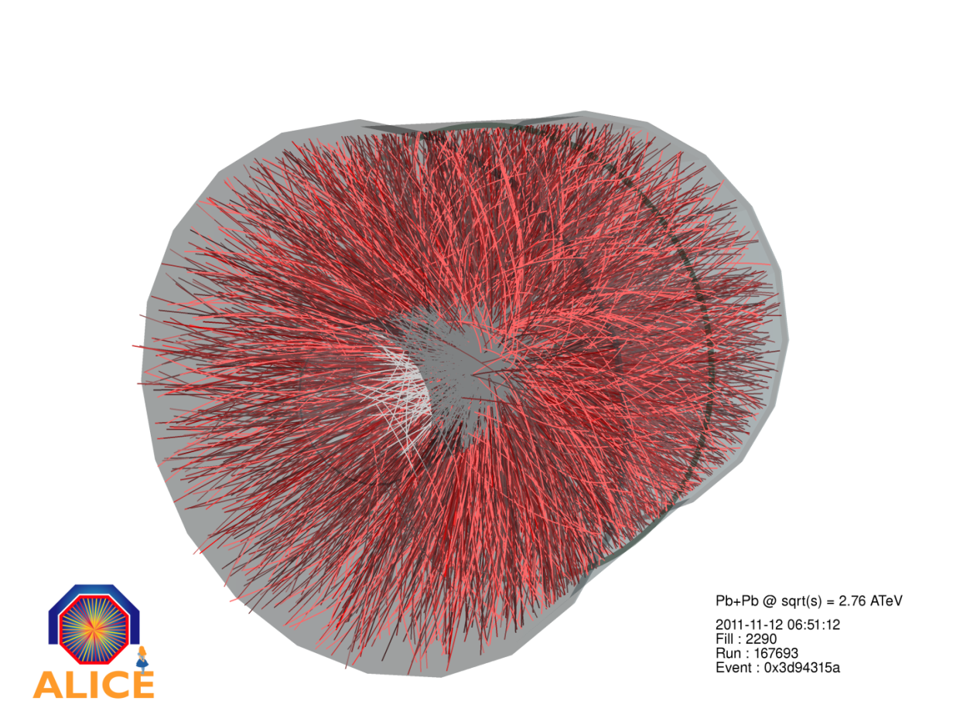


Heavy-Ion Physics
Experimental Overview
Karel Šafařík, CERN

Slide 2
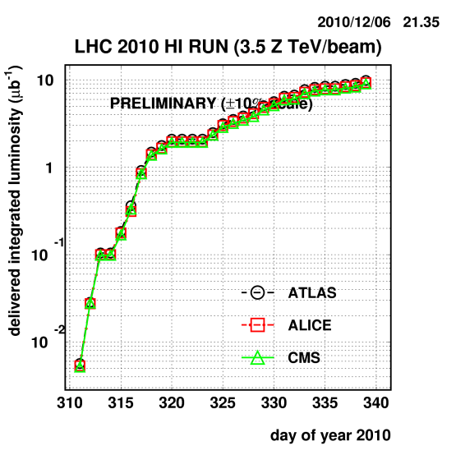
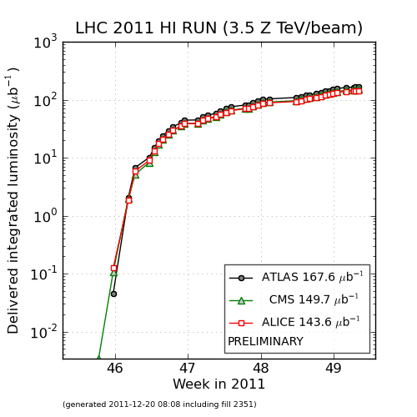
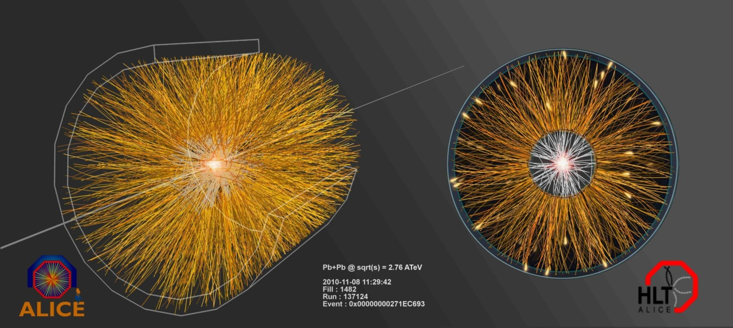
Nuclear collisions at the LHC!
Two successful Pb-Pb runs already
  2010 → ~10/µb
  2011 → ~150/µb
and p-Pb “control” run
  2013 → ~ 30/nb
some numbers (2011 Pb-Pb run):
~ 1.2 10⁸ ions/bunch
358 bunches
  200 ns basic spacing
β* = 1 m
L ~ 5 10²⁶ cm⁻²s⁻¹
~ 4000 Hz interaction rate

Slide 3
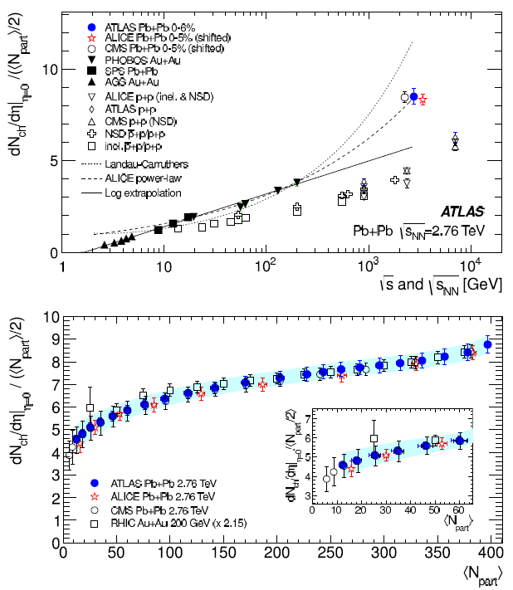
Particle multiplicity
most central collisions at LHC: ~ 1600 charged particles per unit of η
√s_{NN}=2.76 TeV Pb–Pb
0-5% central, |η|<0.5
dNch/dη / (<Npart>/2) =
8.3 ± 0.4 (sys.)
log extrapolation fails (finally!)
2.2 x central Au+Au
(√s_{NN}=0.2 TeV)
1.9 x pp (NSD)
(√s_{NN}=2.36 TeV)
Centrality dependence of pseudorapidity density: shape very similar to that at RHIC; per <Npart>/2 factor ~ 2.1 higher

Slide 4
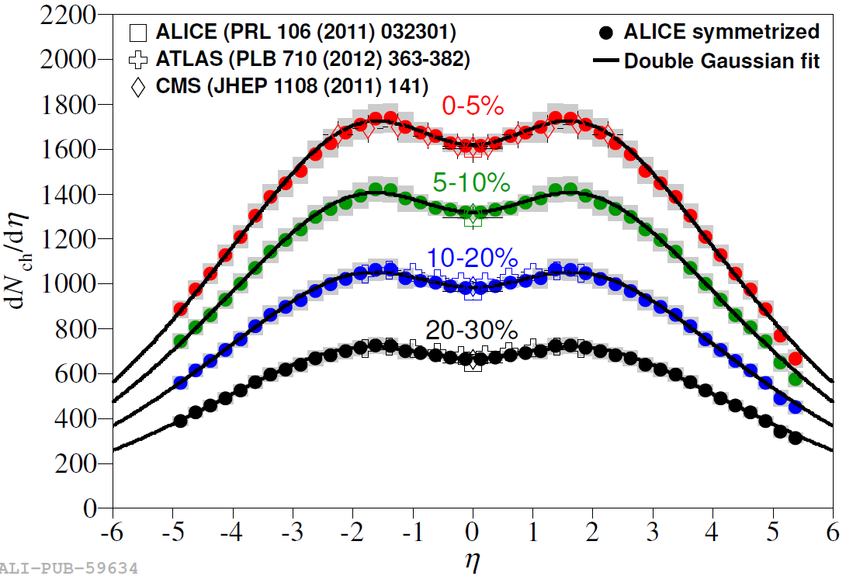
Particle density in η
Excellent agreement among LHC experiments
Comparing with BRAHMS and PHOBOS confirms limiting fragmantation
Integrating over full phase-space N_{ch,TOT} = 17 200 ± 800 for top 5% central

Slide 5
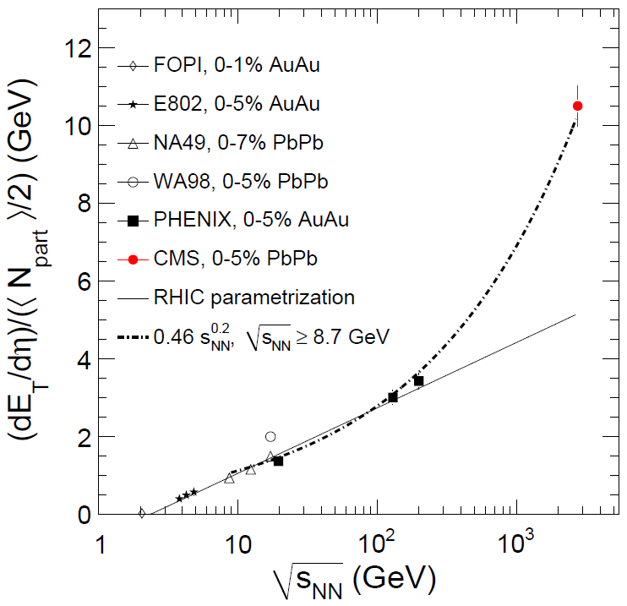
Transverse energy
Consistent behaviour for E_{T} and N_{ch}:
both increase with energy
Both show steady rise from peripheral to central collisions
E_{T}/ N_{ch} independent of centrality
E_{T}/ N_{ch} slightly increases with energy
Bjorken formula ετ₀ = (dE_{T}/dy)/S
ετ₀ = 14 GeV/fm²
Factor 2.6 increase with respect to RHIC

Slide 6
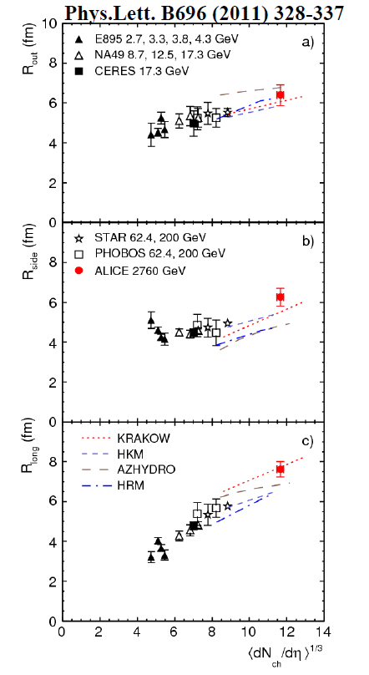
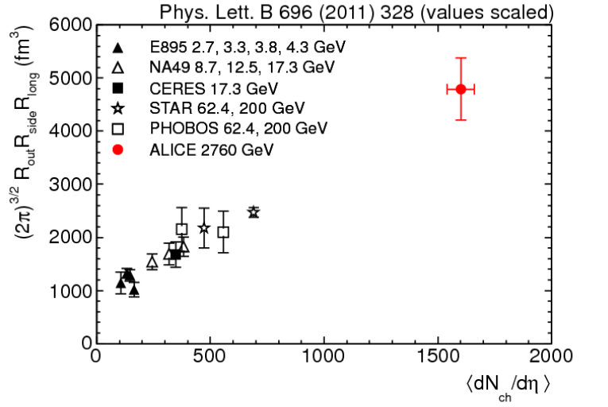
HBT interferometry
From RHIC to LHC:
increase of size in the 3 dimensions
  out, long, and (finally!) side
“homogeneity” volume ~ factor 2
for comparison: R(Pb) ~ 7 fm → V ~ 1500 fm³
substantial expansion!
R_{out}
R_{side}
R_{long}

Slide 7
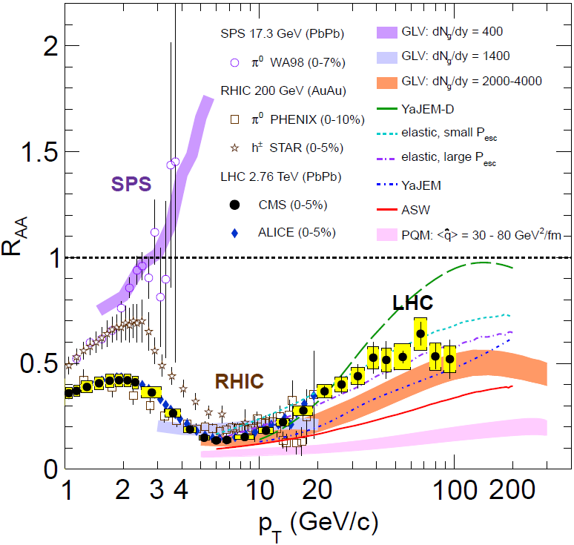
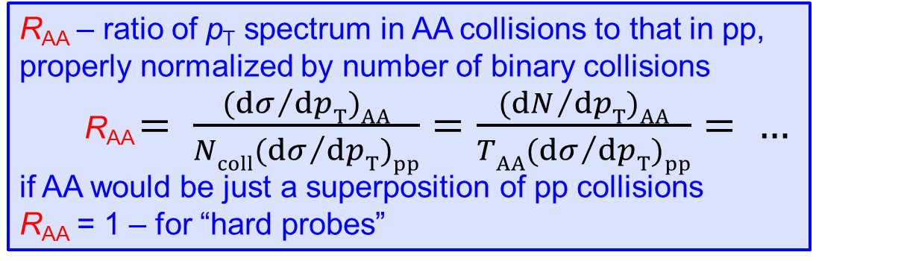
R_{AA} – charged particles
R_{AA} – ratio of p_{T} spectrum in AA collisions to that in pp, properly normalized by number of binary collisions
  R_{AA} $= \frac{{(dσ}/{dpT)AA}}{{Ncoll(dσ}/{dpT)pp}}=\frac{{(dN}/{dpT)AA}}{{TAA(dσ}/{dpT)pp}}= …$
if AA would be just a superposition of pp collisions
R_{AA} = 1 – for “hard probes”

Slide 8
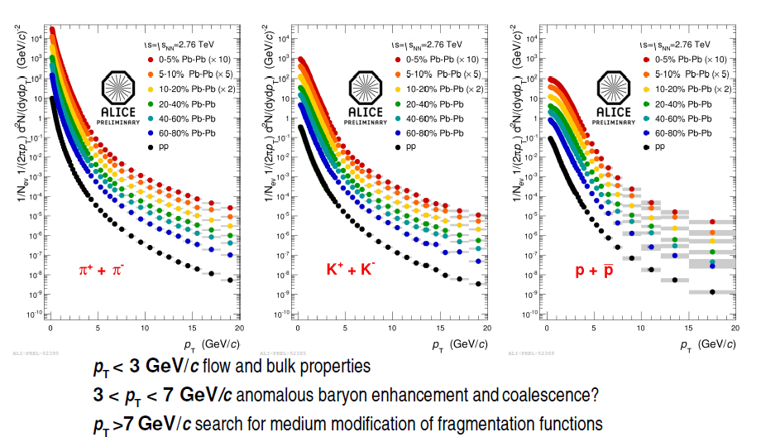
Transverse momentum spectra

Slide 9
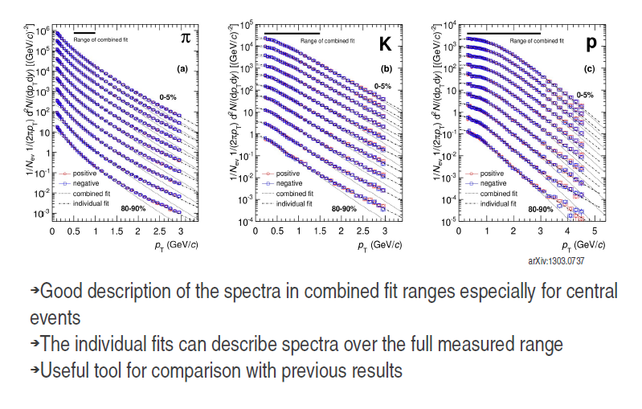
Blast wave fits

Slide 10
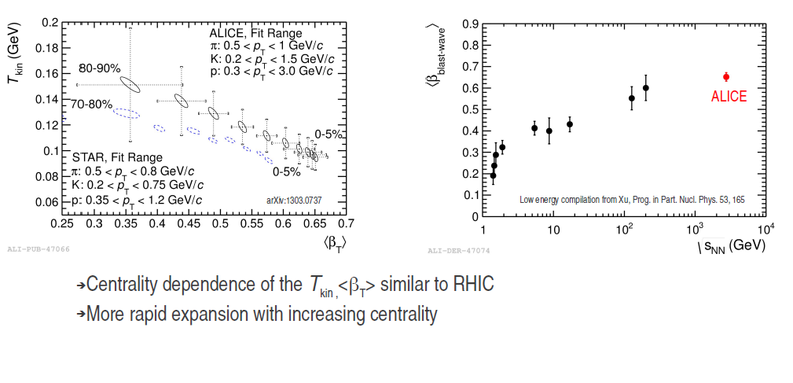
Radial flow

Slide 11
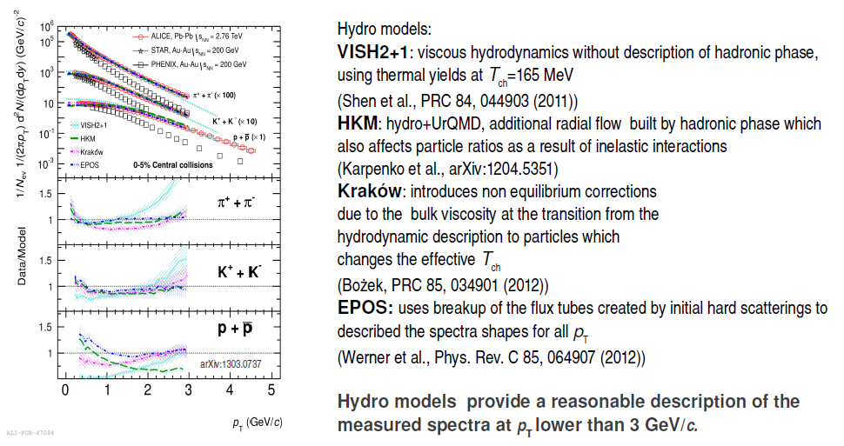
Hydrodynamical models
Pb-Pb central collisions 0 – 5 % centrality

Slide 12
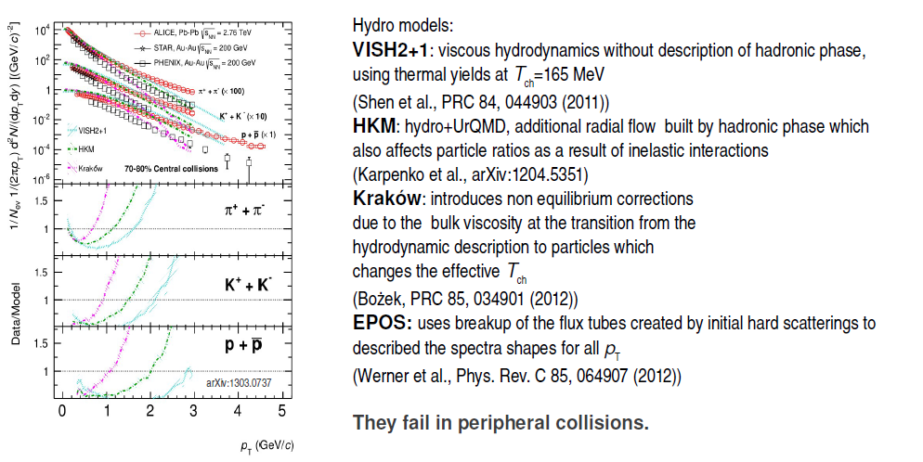
Hydrodynamical models
Pb-Pb peripheral collisions 70 – 80 % centrality

Slide 13
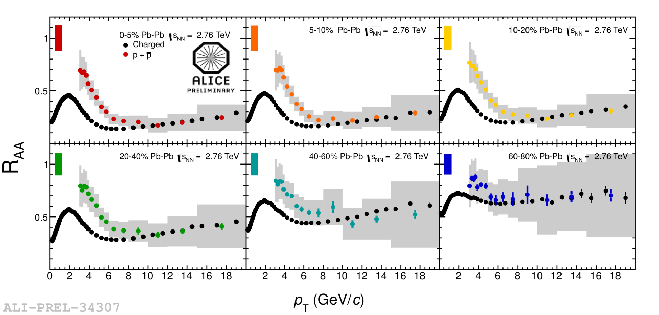
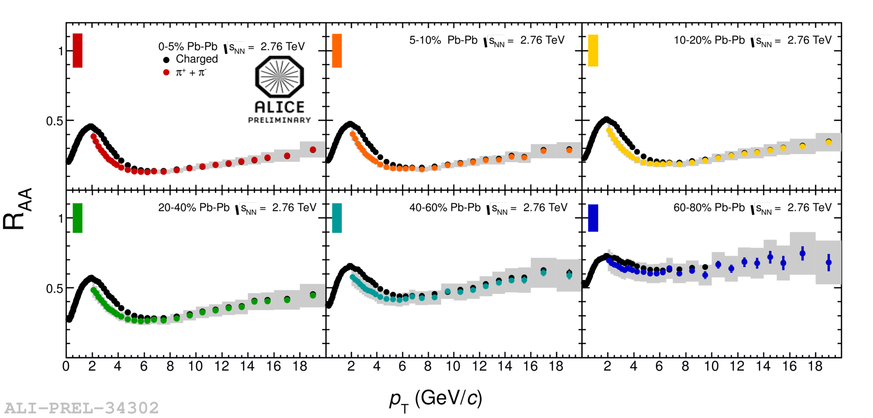
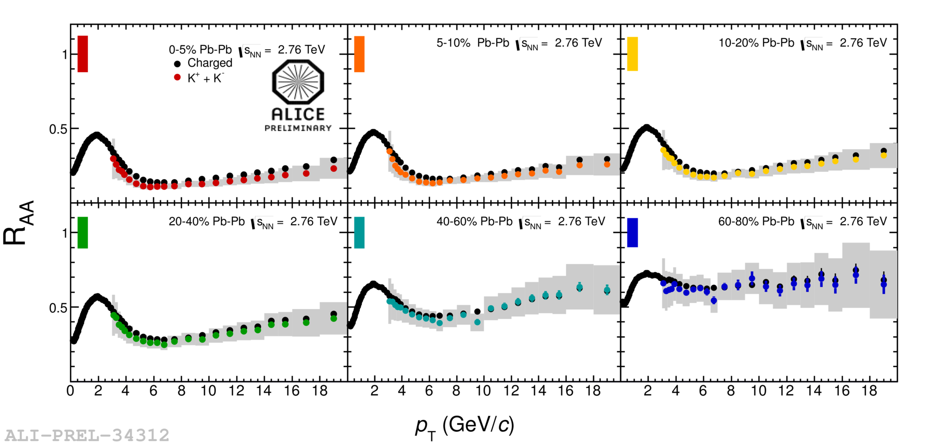
Identified particles at intermediate p_{T}
● charged particles ●●●●●● different centralities for identified particles
K⁺ + K⁻
p + p
π⁺ + π⁻
0–5%
5–10%
10–20%
40–60%
60–80%
20–40%
For p_{T} below ~ 7 GeV/c: R_{AA}(π) < R_{AA}(h±), R_{AA}(K) ≈ R_{AA}(h±)
For p_{T} below ~ 7 GeV/c: R_{AA}(π) < R_{AA}(h±), R_{AA}(K) ≈ R_{AA}(h±), R_{AA}(p) > R_{AA}(h±)
For p_{T} below ~ 7 GeV/c: R_{AA}(π) < R_{AA}(h±)
At higher p_{T}: R_{AA} are compatible

Slide 14
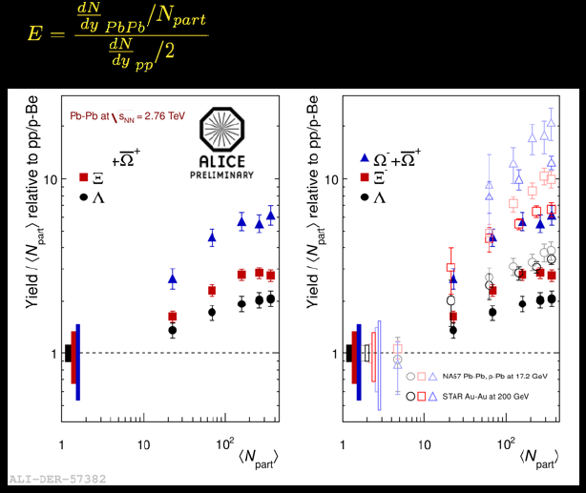
Strangeness enhancement

Slide 15
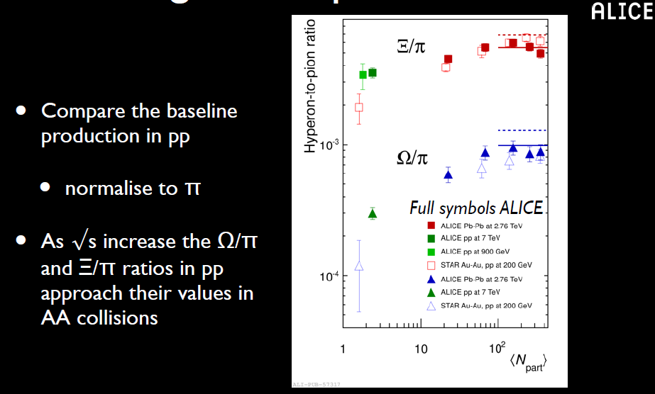
Strangeness to pion

Slide 16
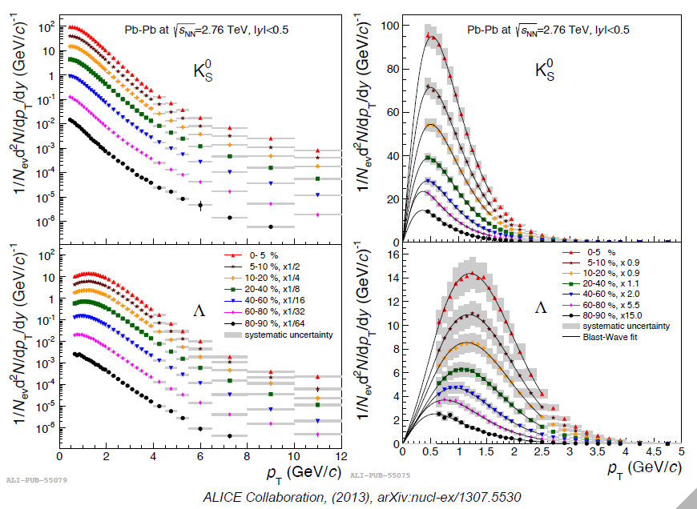
Strangeness spectra K⁰_{s} Λ

Slide 17
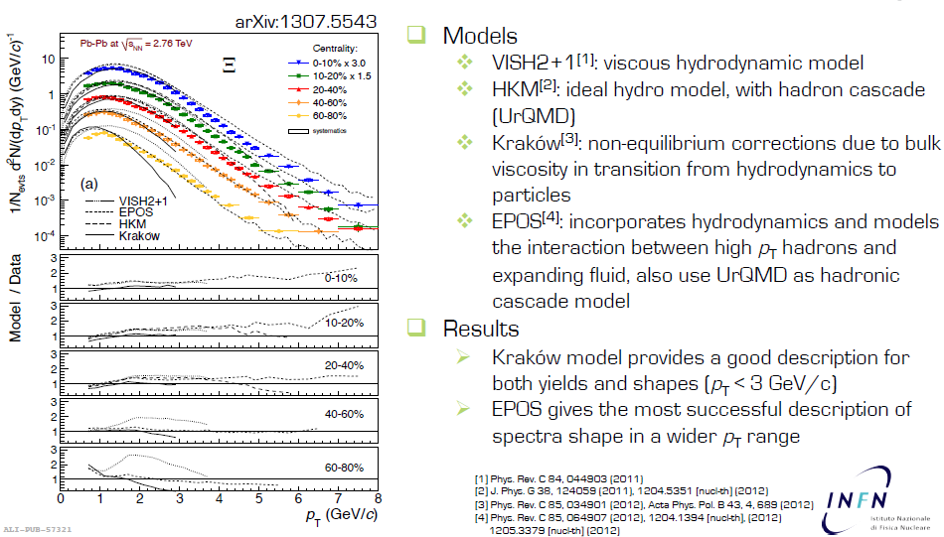
Strangeness spectra Ξ

Slide 18
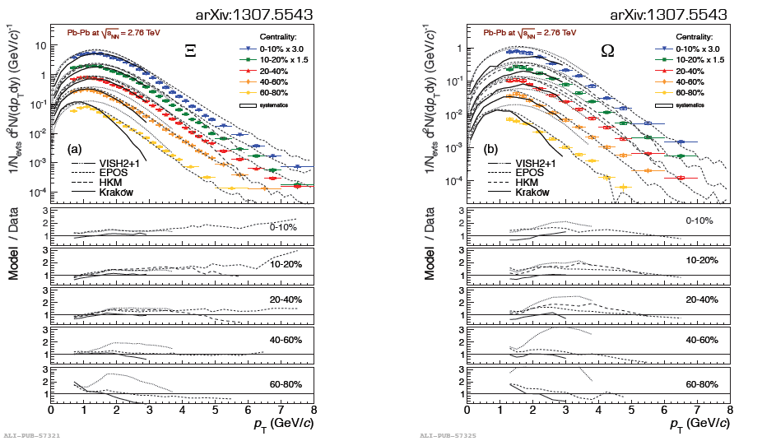
Strangeness spectra Ξ Ω

Slide 19
Hadronic resonances in Pb-Pb
Resonances:
  production/abundance sensitive to temperature and lifetime of fireball
    time between chemical to kinetic freeze-out
  Mass and width – sensitivity to chiral symmetry restoration
    No modifications seen in the data
<pT> at LHC larger than at RHIC
– consistent with stronger radial flow
Notes:
Hadronic Phase: Temperature and Lifetime of fireball
– Resonance formation at hadronization, through regeneration – Re-scattering prevents resonance reconstruction
• Most important at low pT (< 2 GeV/c)
– Statistical models, UrQMD predict resonance/stable ratios
• Given chemical freeze-out temperature and time between chemical and thermal freeze-out (Δt)
• Chiral Symmetry Restoration
– Resonances may decay when chiral symmetry was (partially) restored
– Mass shift and width broadening
• Near Tc ρ lifetime may increase by factor of ~5*

Slide 20
Hadronic resonances in Pb-Pb
A. Knospe
Ratios:
  K*⁰/K– decreases for central collisions – signature for re-scattering in central collisions
  φ/K independent of energy and system from RHIC to LHC
    Pb–Pb: consistent with Grand Canonical thermal model (Andronic et al.)
Notes:
Hadronic Phase: Temperature and Lifetime of fireball
– Resonance formation at hadronization, through regeneration – Re-scattering prevents resonance reconstruction
• Most important at low pT (< 2 GeV/c)
– Statistical models, UrQMD predict resonance/stable ratios
• Given chemical freeze-out temperature and time between chemical and thermal freeze-out (Δt)
• Chiral Symmetry Restoration
– Resonances may decay when chiral symmetry was (partially) restored
– Mass shift and width broadening
• Near Tc ρ lifetime may increase by factor of ~5*

Slide 21
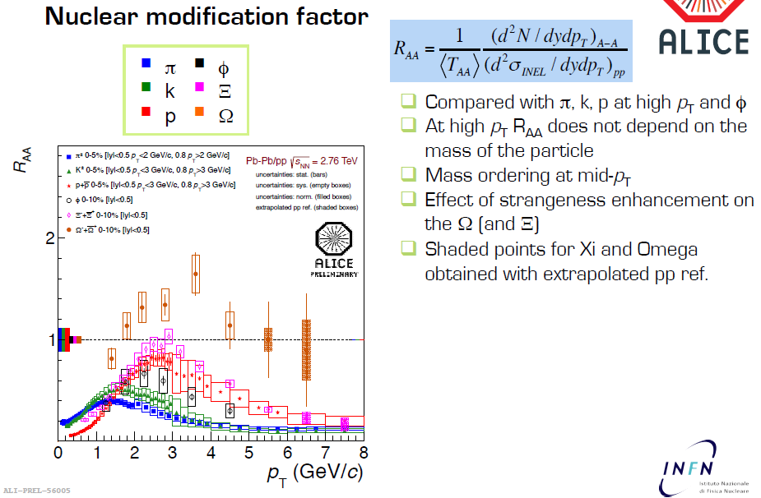
Strangeness R_{AA}

Slide 22
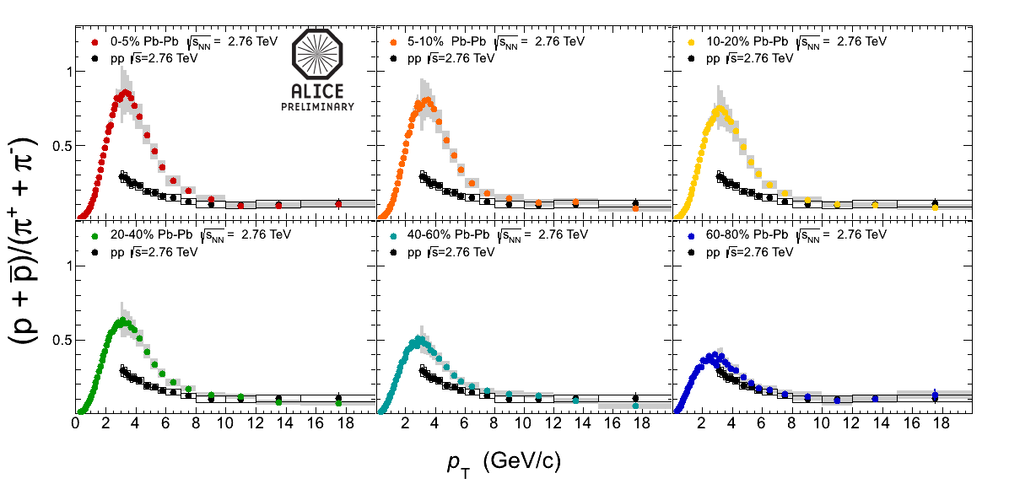
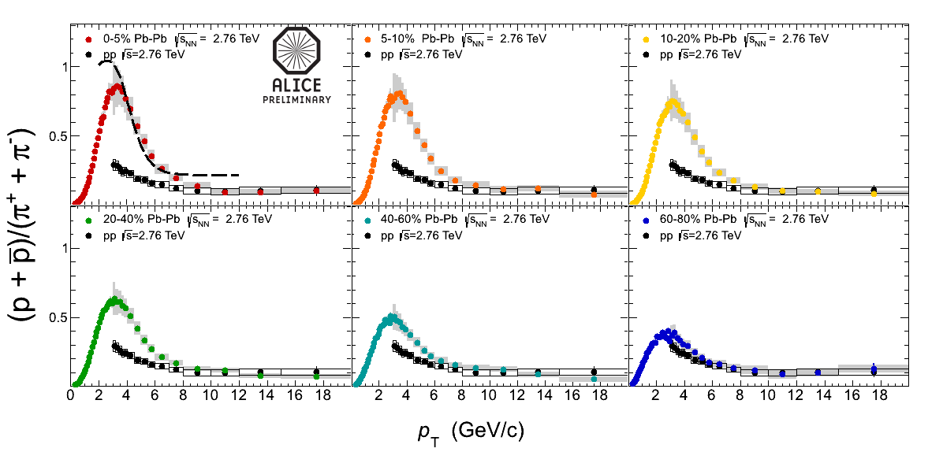
Baryon-to-meson ratio: p/π
● proton–proton ●●●●●● Pb–Pb different centralities
0–5%
5–10%
10–20%
recombination
model
20–40%
40–60%
60–80%
p/π ratio at p_{T} ≈ 3 GeV/c in 0–5% central Pb–Pb collisions factor ~ 3 higher than in pp
at p_{T} above ~ 10 GeV/c back to the “normal” pp value
recombination – radial flow ?
R.J.Fries et al., PRL 90 202303; PR C68 044902

Slide 23
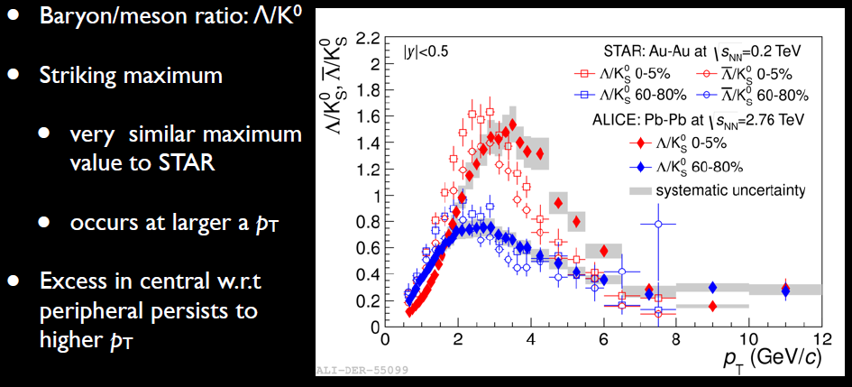
Baryon-to-meson ratio: Λ/K

Slide 24
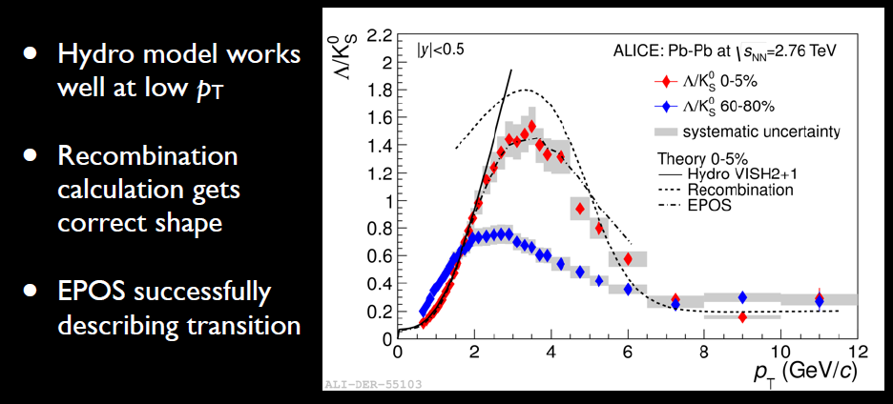
Baryon-to-meson ratio: Λ/K

Slide 25
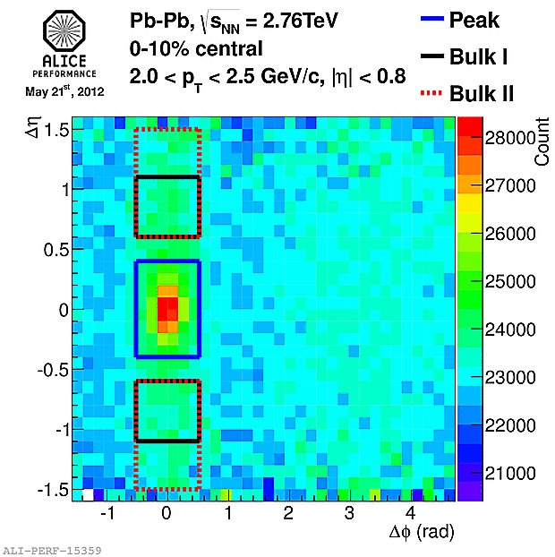
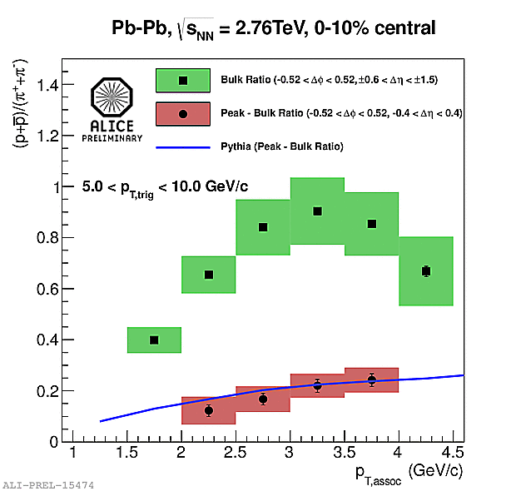
PID in jet structures
PYTHIA pp
Near-side peak (after bulk subtraction): p/π ratio compatible with that of pp (PYTHIA)
Bulk region: p/π ratio strongly enhanced – compatible with overall baryon enhancement
Jet particle ratios not modified in medium? Could this still be surface bias?

Slide 26
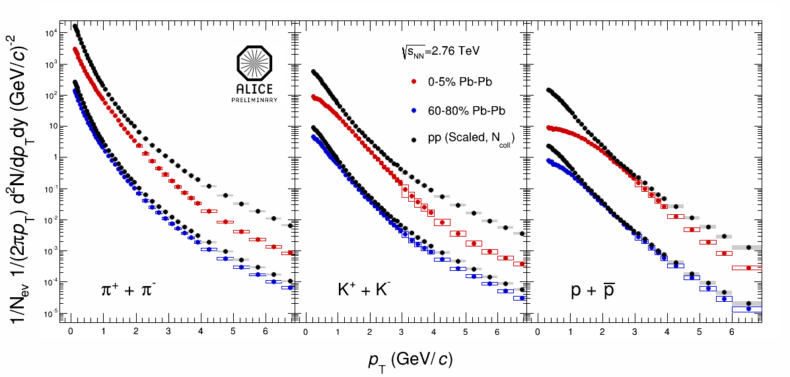
Pion/Kaon/Proton in Pb-Pb
Radial flow (mesons – protons – mass dependence)
Radial flow (pions – protons – mass dependence)
Baryon/meson anomaly
- Radial flow / recombination?
Jet quenching / modifications of jet
fragmentation?
Baryon/meson anomaly
- Radial flow / recombination?

Slide 27
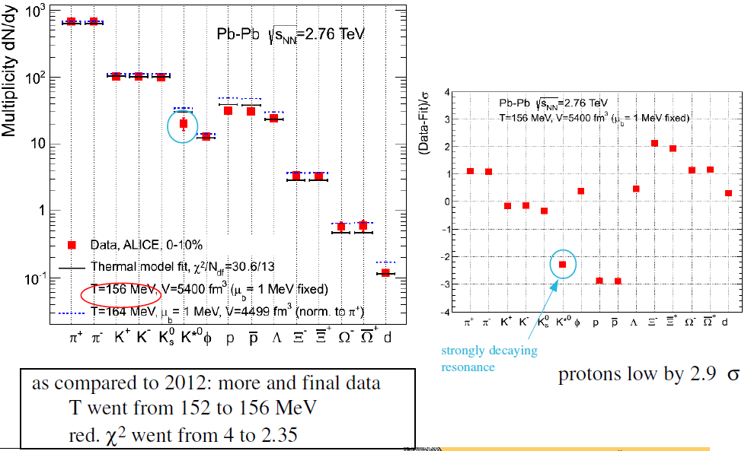
Thermal fit to all ALICE data

Slide 28
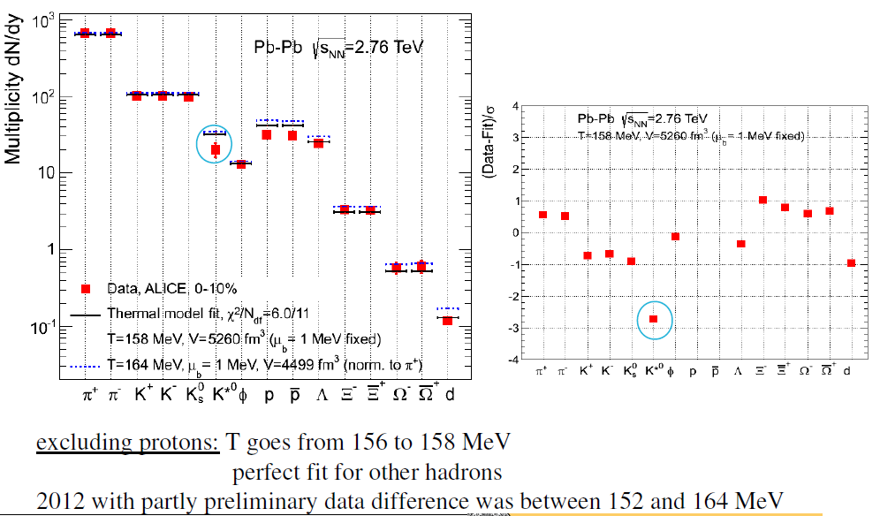
Thermal fit excluding protons
=> Unique chemical freeze-out T does not describe p, Λ, Ξ, Ω

Slide 29
Possible explanations
There was already this discrepancy at RHIC, but was overlooked due to
misinterpretation of feed-down corrections
At high hadron density, re-interactions after freeze-out are important,
especially baryon–antibaryon annihilations, this will affect mostly protons
Introduce non-equilibrium statistical hadronization, quark population of
phase space is frozen at phase transition and may differ from thermal
equilibrium, two more parameters γ_{q} and γ_{s} needed
In statistical hadronization models, the resonance spectrum is accounted
for only up to ~ 2 GeV, higher resonance would add mostly pions, thus
effectively decreasing the model prediction for p/π (buy also for strange
baryons)
The freeze-out temperature may be different for different flavours, some
evidence from lattice QCD

Slide 30
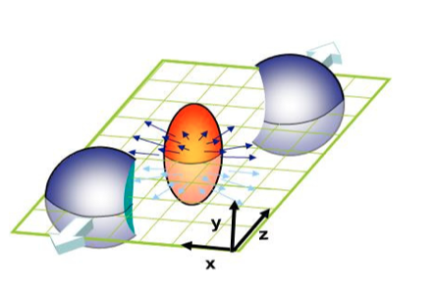
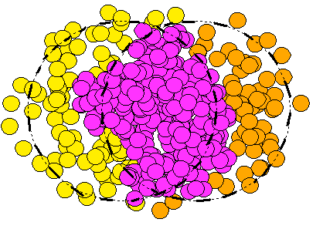
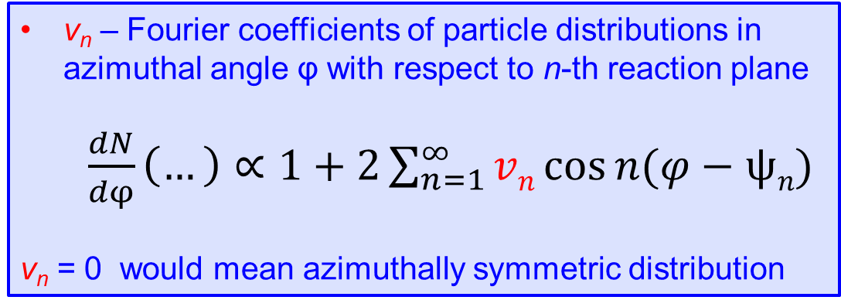
v_{n} – definition
v_{n} – Fourier coefficients of particle distributions in azimuthal angle φ with respect to n-th reaction plane
  $\frac{dN}{dφ}\left(…\right)∝1+2\sum_{n=1}^{∞}{vn\cos{n(φ−ψn)}}$
v_{n} = 0 would mean azimuthally symmetric distribution
ψ₂
ψ₃
ψ₄

Slide 31
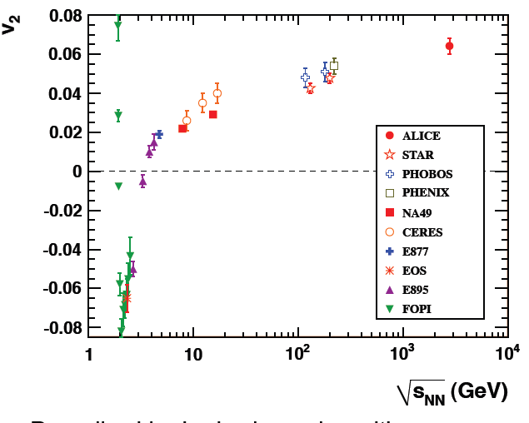
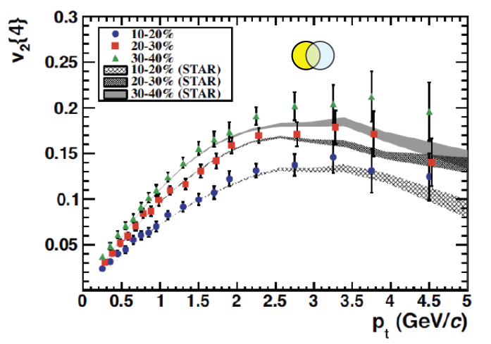
v₂ at the LHC
v₂ still large at the LHC
system still behaves very close to ideal liquid (low viscosity)
v₂(p_{T}) very similar at LHC and RHIC
→ similar hydrodynamical behaviour?
ALICE: PRL 105 (2010) 252302

Slide 32
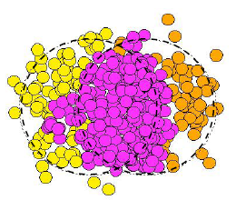
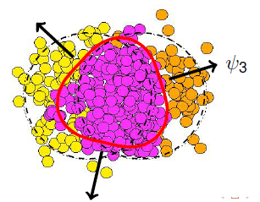
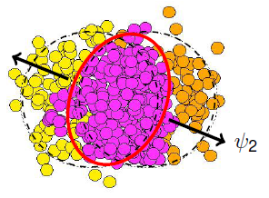
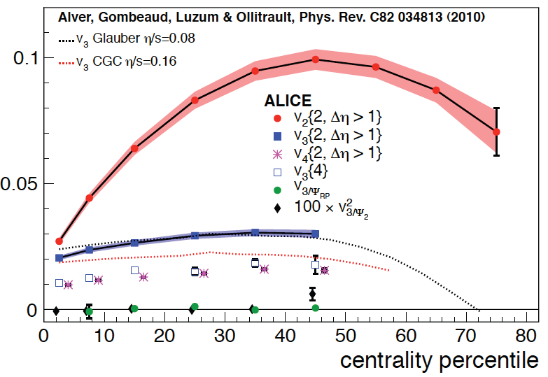
Fluctuations → v₃
“ideal” shape of participants’ overlap is ~ elliptic
  in particular: no odd harmonics expected
  participants’ plane coincides with event plane
but fluctuations in initial conditions:
  participants plane ≠ event plane
  v₃ (“triangular”) harmonic appears
  [B Alver & G Roland, PRC81 (2010) 054905]
and indeed, v3 ≠ 0 !
v₃ has weaker centrality dependence than v₂
when calculated wrt participants plane, v₃ vanishes
  as expected, if due to fluctuations…
Matt Luzum (QM 2011)
v₂
v₃
ALICE: PRL 107 (2011) 032301

Slide 33
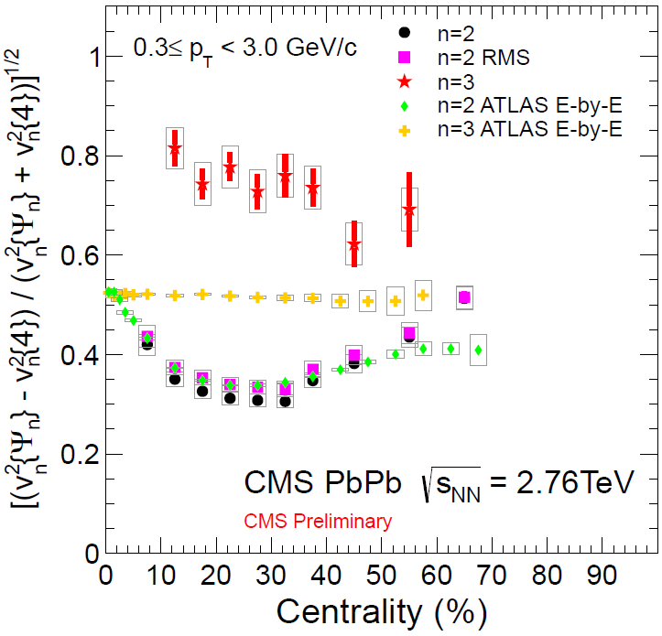
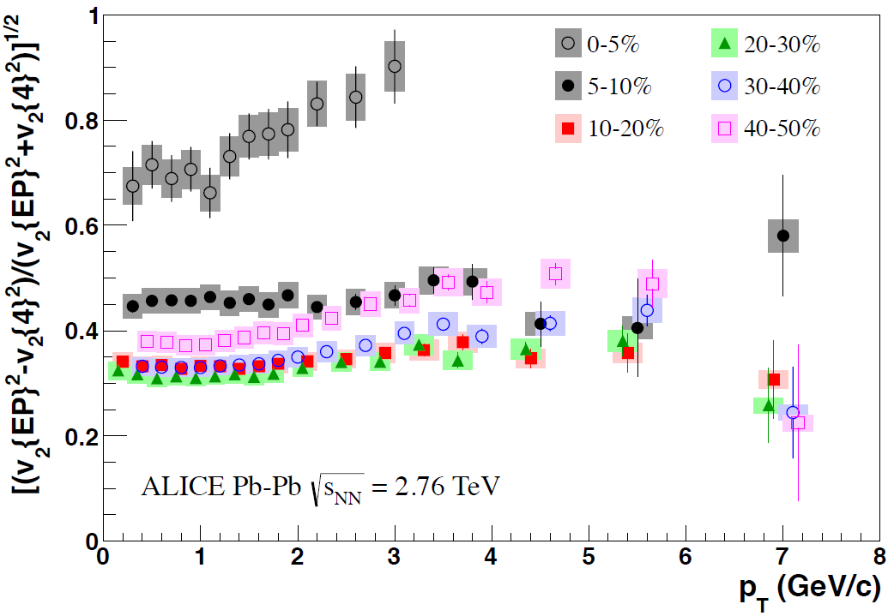
Flow fluctuations
Flow fluctuations:
not a large dependence on p_{T} and centrality except for v₂
- for central collisions increasing with p_{T}
- lower fluctuations for semi-central collisions

Slide 34
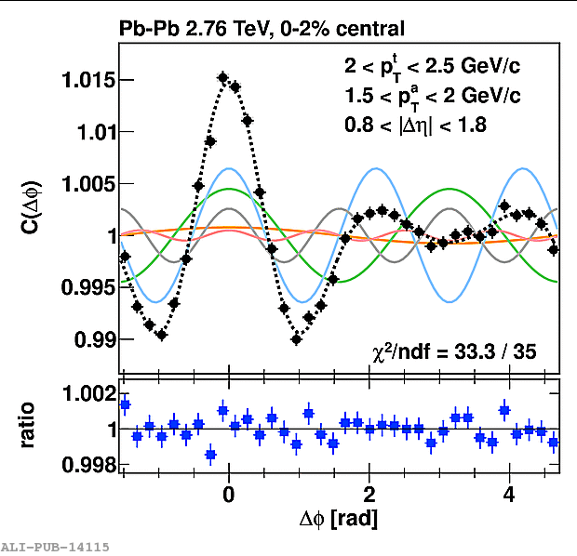
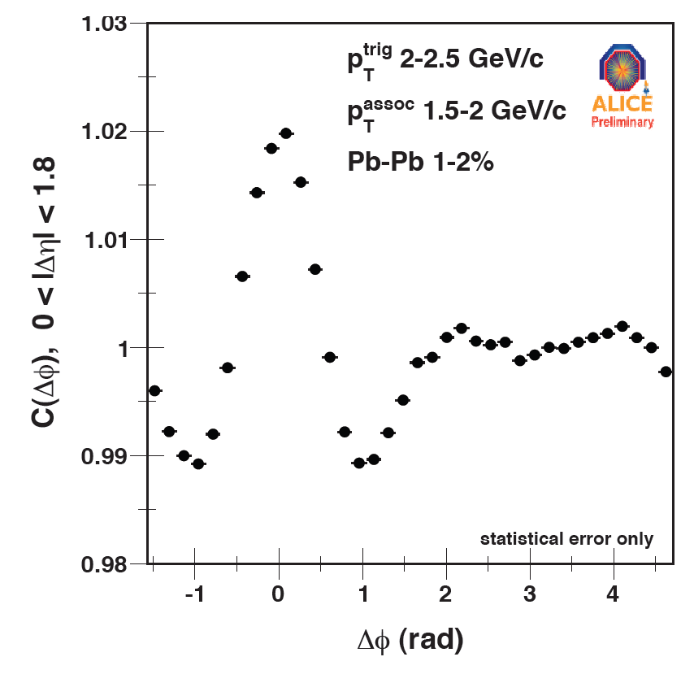
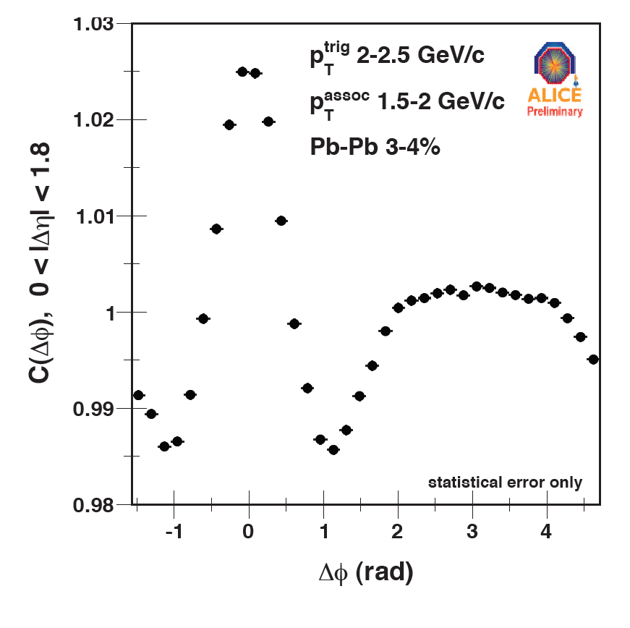
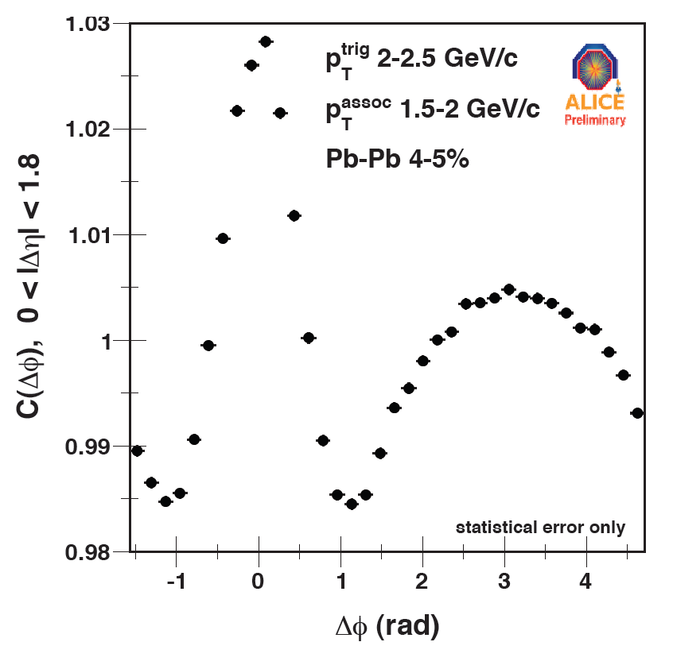
Long-η-range correlations
“ultra-central” events: dramatic shape evolution in a very narrow centrality range
double hump structure on away-side appears on 1% most central
  visible without any need for v₂ subtraction!
first five harmonics describe shape at 10⁻³ level
  “ridge” and “Mach cone”
  explanations based on medium response to propagating partons were proposed at RHIC
  Fourier analysis of new data suggests very natural alternative explanation in terms of hydrodynamic response to initial state fluctuations
Andrew Adare – ALICE (QM2011)
ALICE: Phys. Lett. B 708 (2012) 249

Slide 35
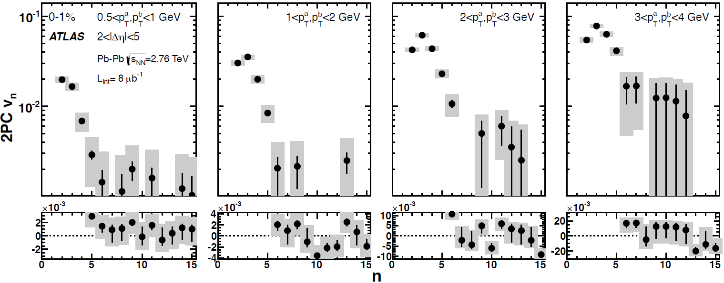
Angular power spectra
n dependence of harmonic coefficients v_{n} at different p_{T}
effectivelly: angular power spectra at different resolution scales

Slide 36


Directed flow v₁

Slide 37

Directed flow p_{T} dependence

Slide 38







Identified-particle v₂
v₂ for π, p, K±, K⁰_{s}, Λ, φ (not shown for Ξ, Ω)
φ at low p_{T} (<3 GeV/c) follows mass hierarchy
– at higher p_{T} joins mesons
overall qualitative agreement with hydro up to p_{T} 1.5–3 GeV/c (π–p); quantitative precision needs improvements – hadronic afterburner
n_{q}(m_{T})-scaling worse than at RHIC
n_{q}(p_{T})-scaling at p_{T} > 1.2 GeV/c violation 10–20%

Slide 39



v₂ and v₃ versus η
v₂ and v₃ measurements extended up to η = 5
observed plateau in pseudorapidity (|η| < 2)
very good agreement between ALICE and CMS for v₂ in |η| < 2.4
consistent with longitudinal scaling in η – y_{beam} with PHOBOS data

Slide 40


v₂ , v₃, v₄ versus p_{T}
arXiv:1205.5761 [hep-ex]
W.Horowitz,M.Gyulassy, J.Phys. G38 124114
0–5%
10–20%
5–10%
30–40%
40–50%
20–30%
v_{n} measurements up to 20 GeV/c – where dominated by jet quenching
Non-flow effects suppressed by rapidity gap or using higher cumulants
Non-zero value of v₂ at high p_{T} both for Δη > 2 and 4-particle cumulant
v₃ and v₄ diminish above 10 GeV/c – indication of disappearance of fluctuations at high p_{T}

Slide 41

Symmetry plane correlations

Slide 42

Chiral Magnetic Effects (CME)

Slide 43

Search for CME

Slide 44

Dijet asymmetry
Evolution of jet energy imbalance A_{J} = (E_{T1}-E_{T2}) /(E_{T1}+E_{T2}) with collision centrality
Δφ between two leading jets

Slide 45


Jet R_{AA}
jet R_{AA} flat out to highest available p_{T}, e.g. CMS:
change of behaviour at low p_{T}? it seems to decrease further…
caveat: different acceptance, different methods,…

Slide 46

Path-length dependence: v₂
Path-length dependence of jet quenching results in finite v₂ (similarly to high-p_{T} charged particles)
Observed in wide p_{T} and
centrality range

Slide 47

Modification of fragmentation
Longitudinal fragmentation function for different A_{J} (p_{T} > 4GeV)
No large difference compared to pp

Slide 48



Jet structure in Pb-Pb
Ratio σ(R=0.2)/σ(R=0.3) of jet cross sections in Pb-Pb compatible with fragmentation in vacuum (PYTHIA)
  Sensitive to the profile of the jet energy density
  No evidence of jet shape modification in jet core

Slide 49

Modification of fragmentation
Transversal distribution for different centralities (p_{T} > 1 GeV)
In central Pb–Pb clear effect of redistribution

Slide 50

Jet-energy flow
Σp_{T} projected on leading-jet axis for two back-to-back jets
(p_{T} > 0.5 GeV)
Monte Carlo
CMS data

Slide 51

γ – jet correlations
Distribution of p_{T} imbalance (jet/γ) for different centralities
In central Pb–Pb clear effect of non-balancing p_{T}

Slide 52

Electro-weak probes
Isolated photons, W, Z not suppressed
Hadrons and jets suppressed, b-jets similar to untagged ones

Slide 53


D meson R_{AA}
Average D-meson R_{AA}:
– p_{T} < 8 GeV/c hint of slightly less
suppression than for light hadrons
– p_{T} > 8 GeV/c both (all) very similar
no indication of colour charge dependence

Slide 54

R_{AA}: Flavour Dependence!
indication of R_{AA}(b) > R_{AA}(c) !
… finally!

Slide 55


The D_{s}
HF in-medium hadronisation!
a hint of strangeness enhancement?
more statistics needed!

Slide 56

Charmed elliptic flow
New: ALICE preliminary results with full 2011 sample (10⁷ events in 30-50%)
Indication of non-zero v₂
But uncertainties are substantial
Factor 3 larger statistics 2015-16 data?
Need precise measurement of v₂ of D and B mesons to answer these questions:
- is v₂ of charm the same as of pions?
- is v₂ of beauty smaller than of charm?
- comparison with models → HQ transport coefficient of QGP

Slide 57


J/ψ R_{AA} centrality dependence
0<p_{T}<2 GeV/c
5<p_{T}<8 GeV/c
J/ψ suppression measurements both in central and forward regions
– from N_{part} > 100 suppression independent of centrality
– in central collisions, less suppression than at RHIC
– at low p_{T} (< 2 GeV/c) less suppression than at high p_{T}, especially
in more central collisions
Indication of J/ψ regeneration at low p_{T} ?

Slide 58



J/ψ R_{AA} vs. centrality and p_{T}
total
primordial
total
regeneration
primordial
regeneration
40–90%
Comparison to regeneration model:
X.Zhao, R.Rapp NPA 859 114
Different suppression pattern at low/high-p_{T}
At low p_{T} ~50% J/ψ from recombination
Fair agreement for different centralities
Statistical hadronization model also
describes the data: P.Braun-Munzinger et al.
0–20%
total
total
regeneration

Slide 59


J/ψ R_{AA} p_{T} dependence
Comparison between different experiments
Qualitatively different behaviour at LHC compared to RHIC !

Slide 60


J/ψ elliptic flow
J/ψ produced by recombination of thermalized c-quarks should have
non-zero elliptic flow
– measurements give a hint for non-zero v₂
– qualitative agreement with transport models, including regeneration
– complementary to indications obtained from J/ψ R_{AA} studies

Slide 61

ψ(2S) to J/ψ double ratio
No firm conclusion on ψ’ enhancement
or suppression with centrality within
current stat. and syst. uncertainties
Large ψ(2S) enhancement with respect
to J/ψ reported by CMS at p_{T} above
3 GeV/c not confirmed
Is this a tension ?

Slide 62


Υ-family suppression
pp dimuon mass Pb–Pb dimuon mass
R_{AA}(1S) = 0.56±0.08(stat.)±0.07(syst.) R_{AA}(2S) = 0.12±0.04(stat.)±0.02(syst.)
R_{AA}(3S) = 0.03±0.04(stat.)±0.01(syst.) (centrality averaged)

Slide 63

Υ(1S)
Y(1S) R_{AA} (compared with J/ψ R_{AA})

Slide 64


Υ R_{AA}
Centrality dependence of R_{AA} and (2S)/(1S) double ratio

Slide 65


… and it shines!
Exponential fit for p_{T} < 2.2 GeV/c
inv. slope T = 304±51 MeV
for 0–40% Pb–Pb at √s 2.76 TeV
PHENIX: T = 221±19±19 MeV
for 0–20% Au–Au at √s 200 GeV
p_{T} < 2 GeV/c
~20% excess of direct photons
p_{T} > 4 GeV/c
agreement with N_{coll}-scaled NLO

Slide 66

asymmetrically…?
direct photon v₂ in 0-40% Pb–Pb

Slide 67


Control experiment: R_{pPb}
measurement of nuclear modifications in initial state
R_{pA} ~ 1 for p_{T}> 3 GeV/c → confirms quenching is due to QCD medium

Slide 68


Control experiment: R_{pPb}
But maybe surprise? (CMS at Hard Probes 2013)

Slide 69


R_{pPb} for charged jets
Charged jet spectrum in minimum bias p-Pb with anti-k_{T} for R=0.2 and 0.4 in |η_{lab}|<0.5
Reference spectrum for pp
using 7 TeV data and scaled
with PYTHIA6 (Perugia 2011)
No sign of nuclear modification
  Nuclear modification factor consistent with unity within
  large uncertainties
  Jet structure ratio consistent with that in pp
(largely correlated)

Slide 70


R_{pPb} for D
Reference constructed using data at 7 TeV scaled by FONLL
R_{pPb} for D-mesons consistent and unity (within large) uncertainty
both CGC and shadowing calculations describe the data

Slide 71


J/ψ production in p-Pb vs. y
ALICE, arXiv:1308.6726
R_{pPb} close to unity at backward rapidity
Suppression at mid-and forward rapidity
Models of CNM effects
  CEM(NLO)+EPS09: describes well the backward rapidity, strong shadowing favoured by data at forward rapidity
  Coherent energy loss: reproduces well the y dependence
  CGC-based calculations disfavoured by the data
Pb
p
p
Pb
Vogt, arXiv:1301.3395
Arleo et al., arXiv:1212.0434
Fuji et al., arXiv:1304.2221

Slide 72


p-Pb and Pb-Pb
J/ψ→μ⁺μ⁻ forward/backward y
J/ψ→e⁺e⁻ mid-rapidity
p-Pb, backward y
p-Pb
p-Pb, forward y
Pb-Pb
Pb-Pb
In a 2→1 kinematics, assuming that shadowing factorizes:
  Compare R_{AA} in Pb-Pb with R_{pPb}(y>0)xR_{pPb}(y<0)
Small CNM effects at high p_{T} (> 4-6 GeV/c)
At low p_{T}: similar (or lower) suppression in Pb-Pb relative to shadowing expectation

Slide 73


ψ(2S) production in p-Pb
NEW!
J/ψ
ψ(2S)
Stronger suppression of ψ(2S) in p-Pb relative to J/ψ
  Not described by initial state CNM effect and coherent energy loss
  Similar observation by PHENIX in d-Au at √s_{NN} = 200 GeV
  Final state effects?
PHENIX, arXiv1305.5516

Slide 74


ϒ (1S) production
p-Pb:
  Similar R_{pPb} of J/ψ and ϒ
  EPS09 shadowing in fair agreement with both J/ψ and ϒ within uncertainties
Pb-Pb:
  ϒ (1S) yield suppressed relative to binary-scaled pp
  Similar suppression at mid (CMS) and forward rapidity

Slide 75
Future plans
Precision measurement of the QGP parameters at μ_{b} = 0
to fully exploit scientific potential of the LHC – unique in:
  large cross sections for hard probes
  high initial temperature
Main physics topics, uniquely accessible with the ALICE detector:
  measurement of heavy-flavour transport parameters:
    study of QGP properties via transport coefficients (η/s, q)
  measurement of low-mass and low-p_{T} di-leptons
    study of chiral symmetry restoration
    space-time evolution and equation of state of the QGP
  J/ψ , ψ’, and χ_{c} states down to zero p_{T} in wide rapidity range
    statistical hadronization versus dissociation/recombination
ˆ

Slide 76
ALICE upgrade
  luminosity upgrade – 50 kHz target minimum-bias rate for Pb–Pb
  run ALICE at this high rate, inspecting all events
  improved vertexing and tracking at low p_{T}
  preserve particle-identification capability
  high-luminosity operation without dead-time
  new, smaller radius beam pipe
  new inner tracker (ITS) (performance and rate upgrade)
  high-rate upgrade for the readout of the TPC, TRD, TOF, CALs, DAQ-HLT, Muon-Arm and Trigger detectors
  target for installation and commissioning LS2 (2018)
  collect more than 10 nb⁻¹ of integrated luminosity
    implies running with heavy ions for a few years after LS3
  for core physics programme – factor > 100 increase in statistics
    (maximum readout with present ALICE ~ 500 Hz)
  for triggered probes increase in statistics by factor > 10

Slide 77

Summary
LHC heavy-ion programme is obtaining a wealth of physics results from the first two LHC heavy-ion runs:
  bulk, soft probes:
    spectra and flow of identified particles, thermal photons
  high-p_{T} probes:
    jet quenching and fragmentation, particle-type dependent
  heavy-flavour physics:
    suppression and flow of D mesons, leptons, J/ψ
Entering the precision measurement era – charmed era of the QGP
  before LS2 (2018): p–Pb and Pb–Pb, higher energy and increased statistics
Long-term upgrade for high-luminosity LHC based on:
  ambitious physics programme
  clear detector upgrade plan for improved vertexing and tracking
  high-rate capability of all subdetectors

Slide 78

What about p-A ?

Slide 79



Centrality in p-Pb ?
SPD
|η|<2.0
Estimator: V0A
  in p-Pb: multiplicity in Pb hemisphere
  in Pb-p: multiplicity in p hemisphere
Multiplicity -> geometry (Glauber)
  number of binary collisions
  large r.m.s. -> events with same N_{coll} fall in different multiplicity classes
Bias in binary scaling for multiplicity classes
V0C
-3.7<η<-1.7
V0A
2.0<η<5.1
Glauber

Slide 80

Centrality in p-Pb ?
SPD
|η|<2.0
Different bias on binary scaling for different multiplicity estimators
  correlations between high p_{T} particles in the tracker and measured multiplicity
    jet-veto effect at low multiplicity
  bias reduced by η gap
V0C
-3.7<η<-1.7
V0A
2.0<η<5.1
p-Pb
Pb-Pb

Slide 81

π K p spectra

Slide 82

and K⁰_{s} Λ spectra

Slide 83

p-Pb Blast-wave analysis

Slide 84
Blast-wave in pp, pPb and Pb-Pb
Proton-proton
p-Pb
Pb-Pb
Blast-wave fits: similar T vs Beta trend in p-Pb and Pb-Pb;
  however, also in pp collisions
Fits (spectra) sensitive not only to a collective behaviour (radial flow) but also to other sources of correlations? -> pp, pPb cases (Colour Reconnections ?)
Notes:
Add a figure with pp Pythia simulation and Bwave fits ? – depending on the tune etc…
simultaneous fit of all particles with 3 parameters:
<βT> radial flow
Tfo freeze-out temperature
n velocity profile
● global fit performed in the following pT ranges:
π 0.5 – 1.0 GeV/c
K 0.3 – 1.3 GeV/c
p 0.5 – 2.0 GeV/c

Slide 85

Comparison with models

Slide 86

Global event properties: mean pT vs multiplicity

Slide 87

Global event properties: mean pT vs multiplicity

Slide 88

<pT> of identified particles vs multiplicity

Slide 89

Baryon-to-meson ratio in p-Pb

Slide 90

Double ridge in p-Pb

Slide 91

Double ridge in p-Pb: v₂ v₃

Slide 92

p-Pb correlations with PID

Slide 93

p-Pb v₂ v₃ with PID

Slide 94

v₂ mass splitting in p-Pb

