Slide 1

U_{A}(1) breaking effects and η‘ at finite temperature
Su Houng Lee
Theme:
Will U_{A}(1) symmetry breaking effects remain at high T
Relation between Quark condensate and the η’ mass
Ref:
SHL, T. Hatsuda, PRD 54, R1871 (1996)
Y. Kwon, SHL, K. Morita, G. Wolf, PRD86,034014 (2012)
SHL, S. Cho, IJMP E 22 (2013) 1330008

Slide 2
η‘ mass , Chiral symmetry restoration and UA(1) effect ?
QCD Lagrangian
Finite T
Usual vacuum
mass
a₁
?
η‘
ρ
?
π

Slide 3
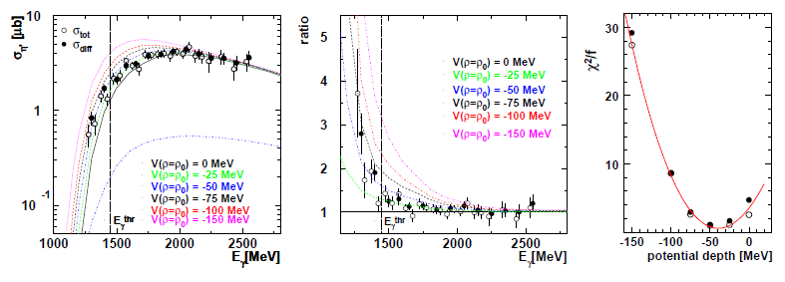
Experimental evidence of property change of η‘ in matter ?
CBELSA/TAPS coll
Only a small increase in width in nuclear matter; cf vector mesons
May be some indirect evidence from RHIC; T. Csorgo et al.
Lattice result ?

Slide 4
Correlators and symmetry
Correlators can be related to experimental observables
Chiral symmetry breaking in Correlator
U_{A}(1) breaking effects in Correlators
Cohen 96
Hatsuda, Lee 96

Slide 5
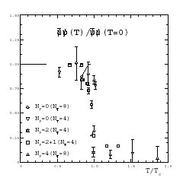
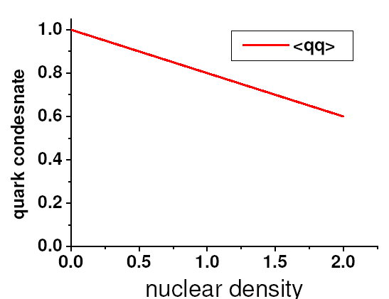
Quark condensate – Chiral order parameter
Finite temperature
Lattice gauge theory
1
T/Tc
Finite density
Linear density approximation
ρ/ρ_{n}

Slide 6
Chiral symmetry breaking (m→0) : order parameter
Quark condensate
→ Casher Banks formula:
→ Chiral symmetry breaking order parameter

Slide 7
Other order parameters: σ − π correlator (mass difference)
Remember:

Slide 8
Correlators and symmetry
Correlators can be related to experimental observables
Chiral symmetry breaking in Correlator
U_{A}(1) breaking effects in Correlators
Cohen 96
Hatsuda, Lee 96

Slide 9
U_{A}(1) effect : effective order parameter (Lee, Hatsuda 96)
Topologically nontrivial contributions
η ‘− π correlator (mass difference)
T. Cohen (96)

Slide 10
η ‘− π correlator (mass difference)
ν=1
Lee, Hatsuda (96)
→ For 2 point function, U(1) _{A} symmetry will effectively be broken for N_{F} <2 but restored for N_{F} >3
For N-point U(1)_{A} will be broken for N_{F} < N
→ so what happens to the η‘ mass?

Slide 11
Correlators and η’ meson mass
Witten – Veneziano formula
At finite temperature and density

Slide 12
η’ mass? Witten-Veneziano formula - I
Correlation function
Contributions from glue only from low energy theorem
When massless quarks are added
Large Nc argument
Need η‘ meson

Slide 13
Witten-Veneziano formula – II
η‘ meson
Lee, Zahed (01)
at m → 0 limit
Should be related to

Slide 14

Witten-Veneziano formula at finite T (Kwon, Morita, Wolf, Lee: PRD 12 )
Large N_{c} counting
At finite temperature, only gluonic effect is important
Glue N_{c}²
Quark N_{c}
Quark N_{c}² ?

Slide 15
Large Nc argument for Meson Scattering Term
Witten
That is, scattering terms are of order 1 and can be safely neglected
WV relation remains the same

Slide 16
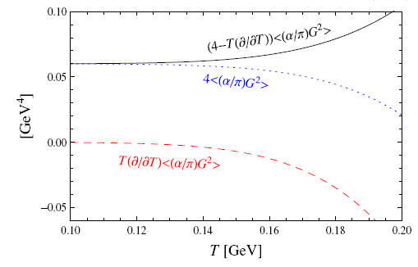
LET (Novikov, Shifman, Vainshtein, Zhakarov) at finite temperature : Ellis, Kapusta, Tang (98)
Lee, Zahed (2001)

Slide 17
at finite temperature
Cohen 96
Therefore, when chiral symmetry gets restored

Slide 18
W-V formula at finite temperature:
Smooth temperature dependence even near Tc
Therefore , : → eta’ mass should decrease at finite temperature

Slide 19
Summary
η’ correlation functions should exhibit symmetry breaking from N-point function in SU(N) flavor even when chiral symmetry is restored.
→ For SU(3), the two point function will become symmetric.
2. In W-V formula η’ mass is related to quark condensate and thus should reduce at finite temperature independent of flavor due to chiral symmetry restoration
→
a) Could serve as signature of chiral symmetry restoration
b) Dilepton in Heavy Ion collision
c) Measurements from nuclear targets ? Generalization to Nuclear medium possible

Slide 20
Summary
Chiral symmetry breaking in Correlator
U_{A}(1) breaking effects in Correlators
→ Restored in SU(3) and real world
WV formula suggest mass of η ‘ reduces in medium and at finite temperature: due to chiral symmetry restoration
Renewed interest in Theory and Experiments both for nuclear matter and at may be at finite T

Slide 21
Other order parameters: V - A correlator (mass difference)

