Slide 1
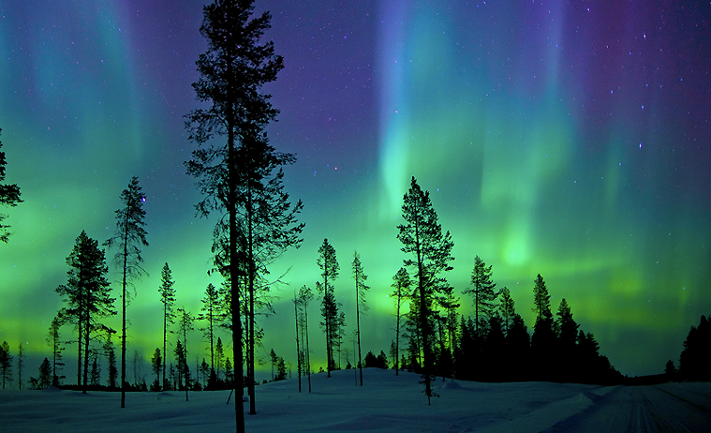
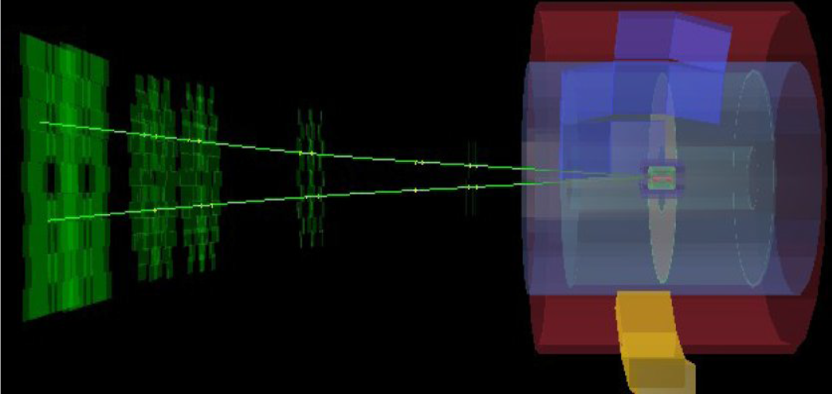
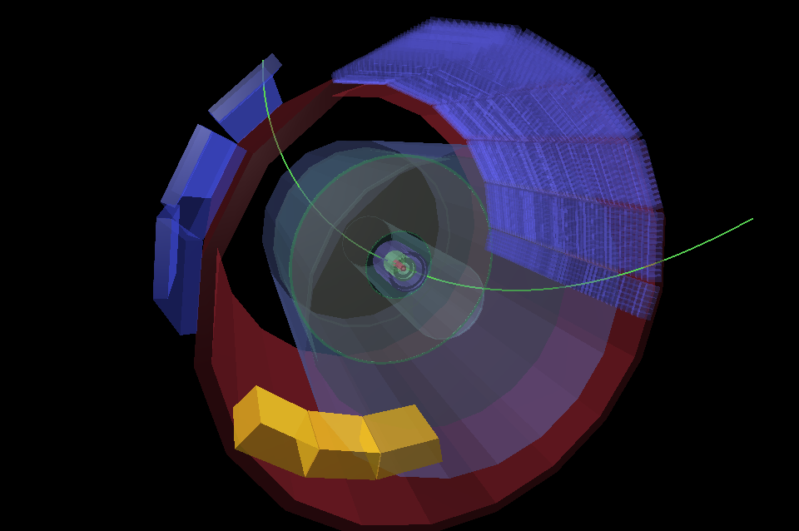
Results on ultra-peripheral interactions in Pb-Pb and p-Pb collisions in ALICE
E. Scapparone on behalf
of the ALICE Collaboration,
EDSBlois2013, Sep 10, 2013
Light provides outstanding performance both here and at CERN …

Slide 2
Ultra Peripheral Collisions at LHC
b
EM field → photon flux
When hadronic cross section becomes negligible
(b>2R) photons can give:
R
Coherent vector meson production:
photon couples coherently to all nucleons
⟨ p_{T}⟩ ~ 1/R_{Pb} ~ 60 MeV/c
no neutron emission in ~80% of cases
Incoherent vector meson production:
photon couples to a single nucleon
⟨ p_{T}⟩ ~ 1/R_{p} ~ 500 MeV/c
target nucleus normally breaks up

Slide 3

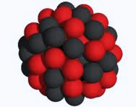
Pb-Pb collisions: shedding light on the nucleus
γ
γ
γ
γ
γ
γ
γ
γ
γ
γ
γ
γ
γ

Slide 4
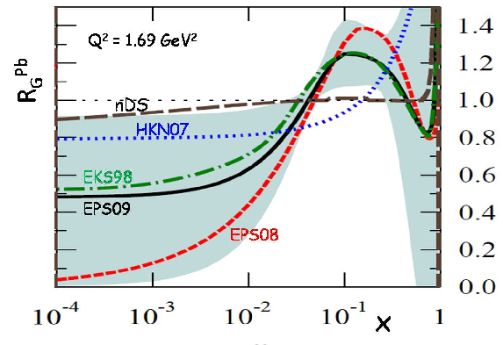
What do we expect to see ?
The main reason to shed light on the nucleus is to understand the nuclear gluon structure
function.
It’s not expected to behave as a simple superposition of the nucleon PDF.
G_{Pb}(x,Q²)
R_{g}^{Pb}(x,Q²) =
G_{p} (x,Q²)
Bjorken x ~ 10⁻² – 10⁻⁵
accessible at LHC
Large uncertainties at small x

Slide 5
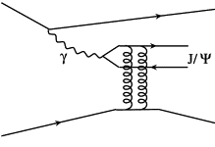
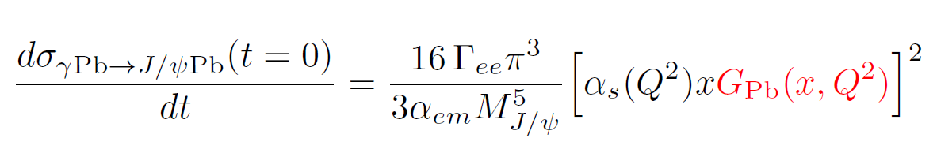
Why a nucleus, being hit by a γ, would unveil its gluon PDF ?
Pb
Pb
Pb
G_{Pb}(x,Q²)
R_{g}^{Pb}(x,Q²) =
G_{p} (x,Q²)
J/Ψ in Pb-Pb UPC is
a direct tool to measure
nuclear gluon shadowing
Bjorken x ~ 10⁻² – 10⁻⁵
accessible at LHC
…clearly UPCs at LHC are a nice physics opportunity

Slide 6
This was realized time ago by several people (you may find a lot of UPC reviews in the
last 10 years ), but bringing it from a suggestion to a results is not trivial….
STAR gave the golden definition…..“Two tracks in an otherwise empty detector”.
But “2-tracks” means triggering on few hits, fighting with noise, pile-up and so on.
You can select a part of the cross section triggering on events in which the
nuclei got excited (ZDC), but taking the full cross section is another business.
Leptons from J/Ψ decay, are soft e,μ (few GeV), usually below calorimeter threshold
ALICE is a light detector (barrel has < 1 rad length), nevertheless this is a non trivial analysis
(….and you have ≤ 2 hits/layer).

Slide 7

A 10⁻⁴ smaller ( cross section x branching ) wrt the hadronic cross section

Slide 8
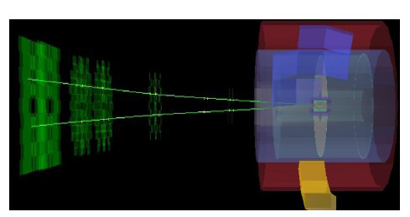
Where can we look at them in ALICE ?
Forward rapidity
2.6 < y < 3.6
Mid-rapidity
|y| < 0.9

Slide 9
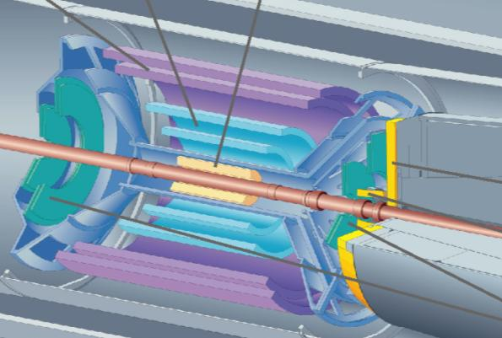
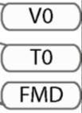
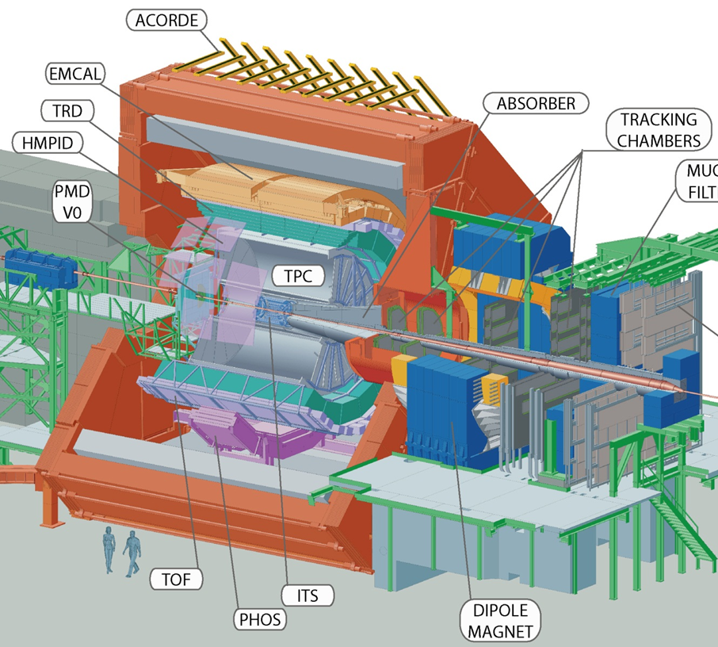
UPC J/ψ at central rapidity
UPC central barrel trigger:
2 ≤ TOF hits ≤ 6 (|η| < 0.9)
+ back-to-back topology (150° ≤ ϕ ≤ 180°)
≥2 hits in SPD (|η| < 1.5)
no hits in VZERO (C: -3.7 < η < -1.7, A: 2.8 < η < 5.1)
Offline event selection:
Offline check on VZERO hits
Hadronic rejection with ZDC
Track selection:
< 10 tracks with loose requirements
(|η| < 0.9 , > 50% findable TPC
clusters and > 20 TPC clusters)
Only two tracks: |η| < 0.9 , with ≥ 70 TPC clusters, ≥ 1 SPD clusters
p_{T} dependent DCA cut
opposite sign dilepton
|y| < 0.9, 2.2 < M_{inv} < 6 GeV/c²
dE/dx in TPC compatible with e/μ
ZDC
Integrated luminosity ~ 23 μb⁻¹

Slide 10
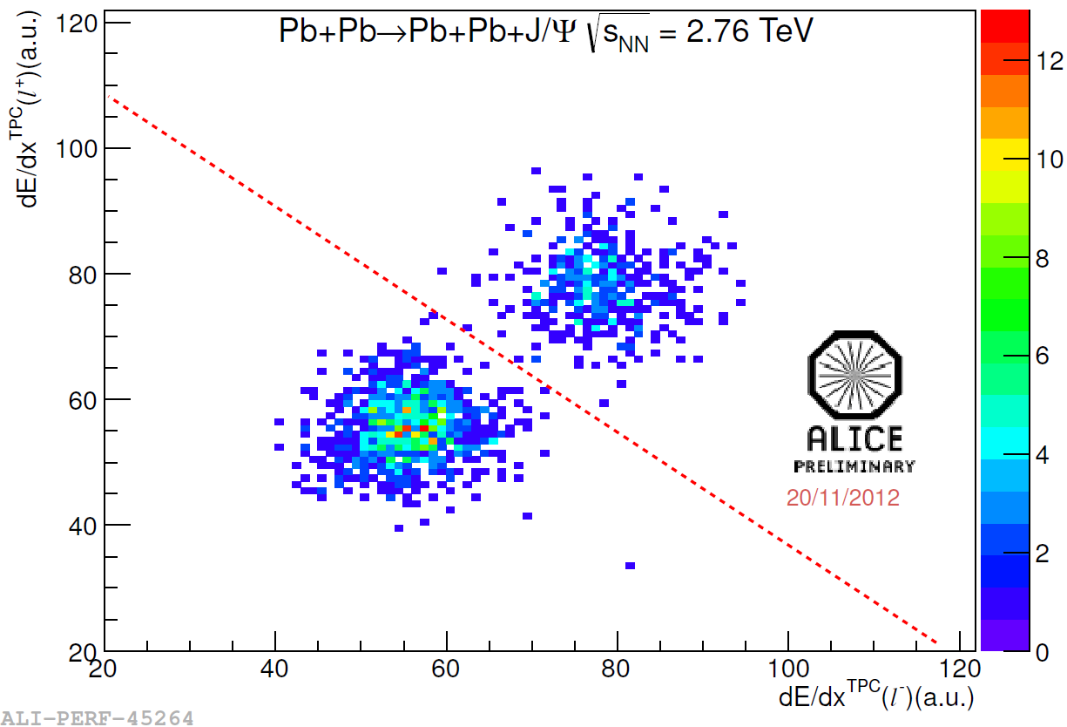
dE/dx selection in TPC
electrons
EMCAL
muons
dE/dx in TPC compatible with e/μ energy loss
Cross-checked with E/p in EMCAL
±2% systematics due to e/μ separation
P.S. we cannot distinguish μ from π

Slide 11
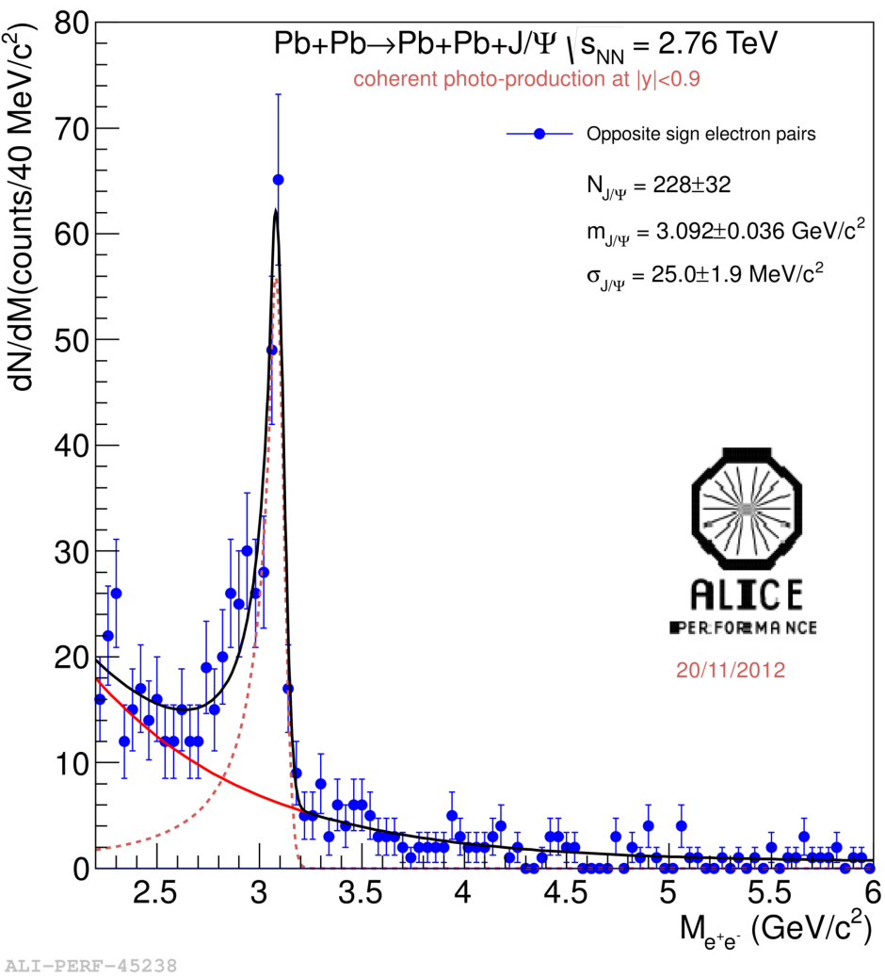
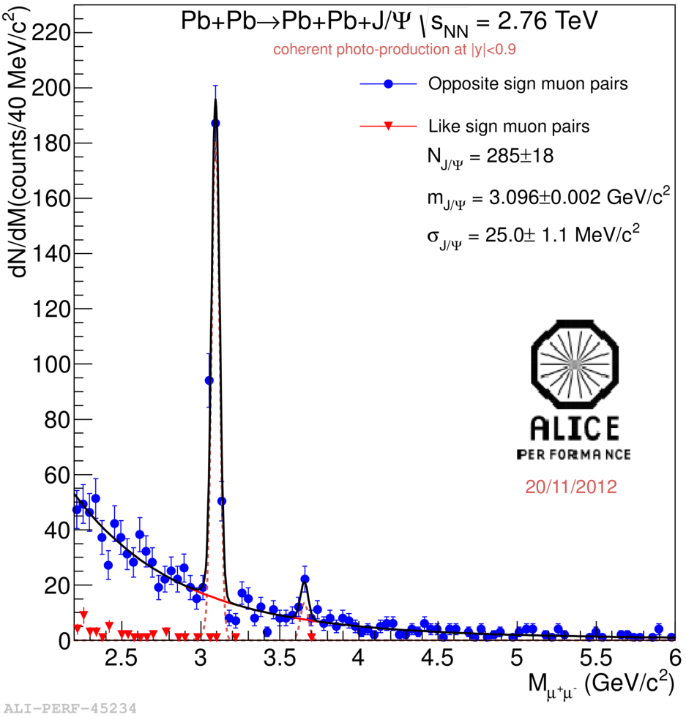
p_{T} < 200 MeV/c for di-muons (300 MeV/c for di-electrons) .and. < 6 neutrons in ZDC
→ Coherent enriched sample
ee
μμ

Slide 12
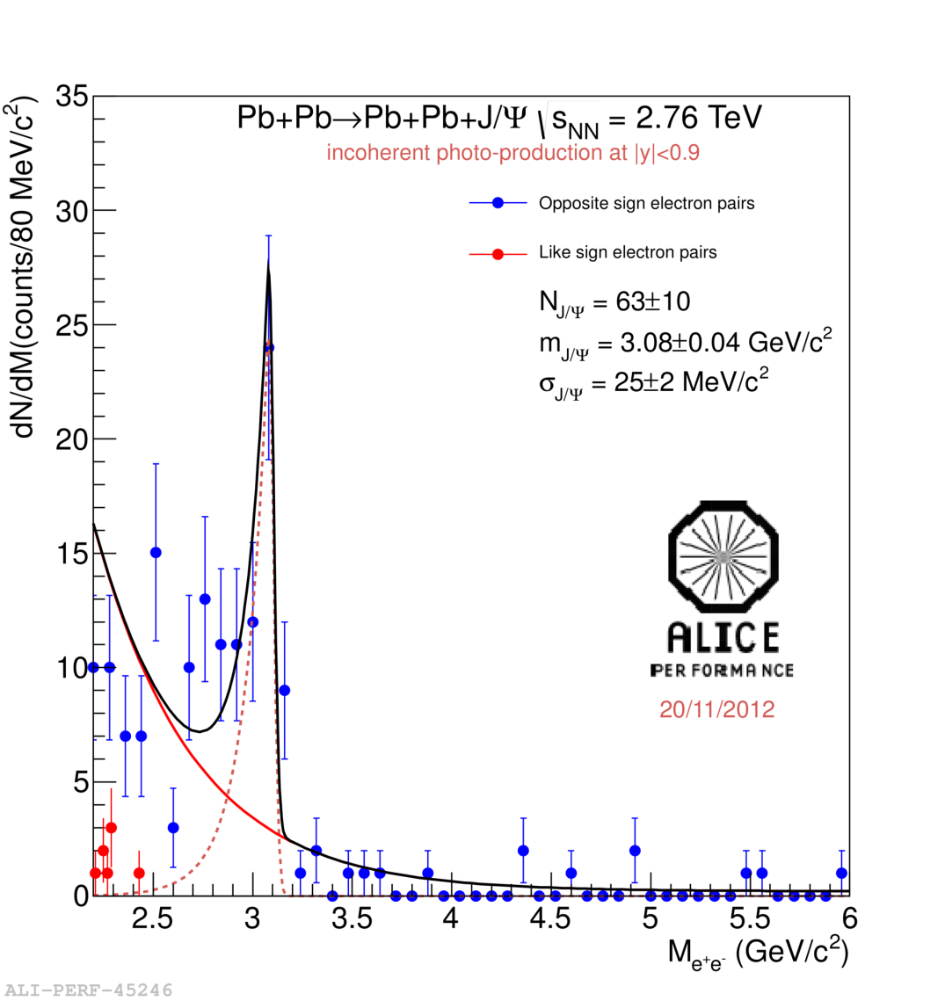
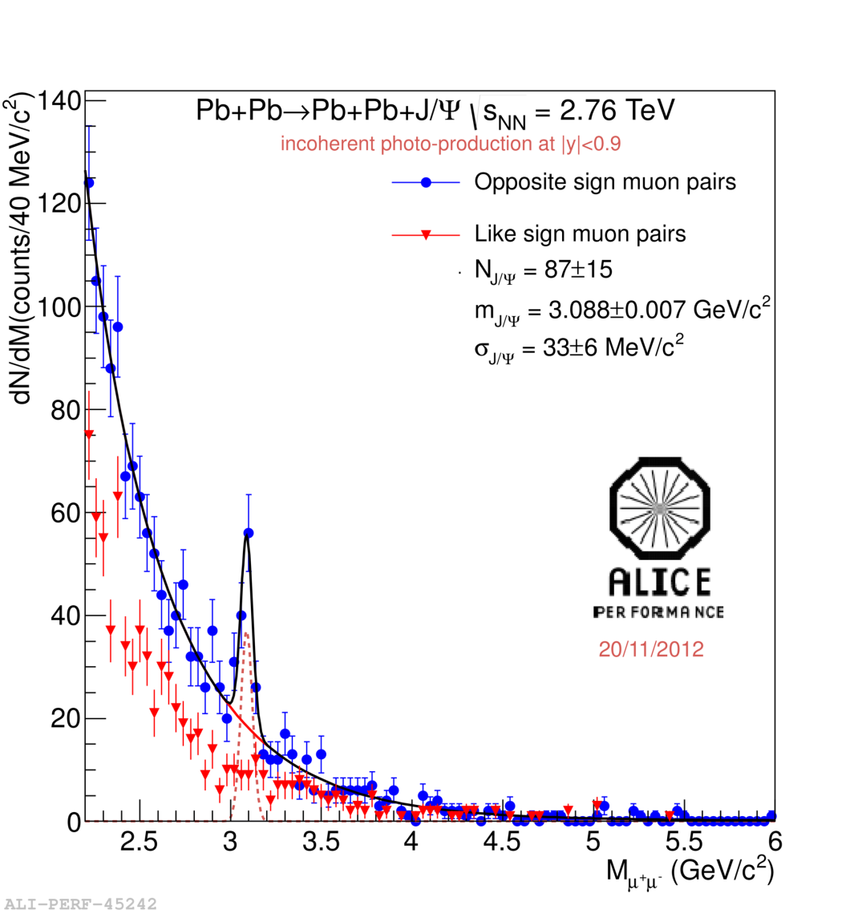
p_{T} > 200 MeV/c for di-muons (300 MeV/c for di-electrons)
→ Incoherent enriched sample
ee
μμ

Slide 13
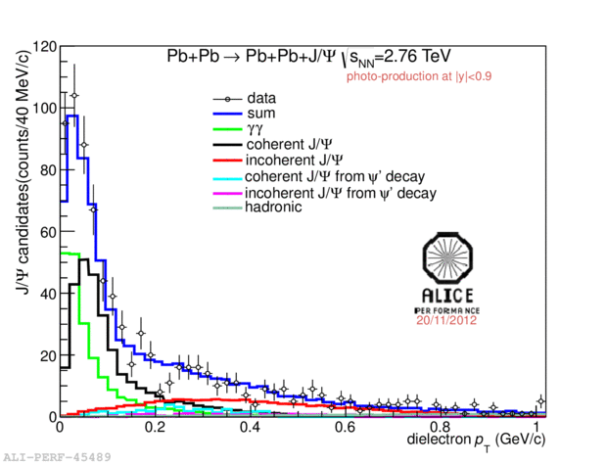
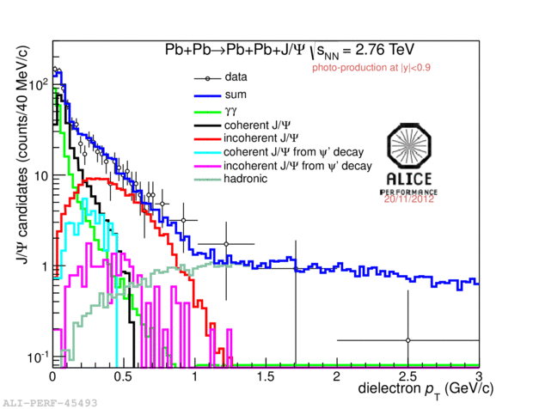
The J/Ψ peak region: 2.2 GeV/c² < M_{inv} < 3.2 GeV/c² for electron and
3.0 GeV/c² < M_{inv} < 3.2 GeV/c² for muons
Used templates:
- Ψ’ contribution to (in)coherent J/Ψ◊ f_{D};
Incoherent J/Ψ contribution to coherent J/Ψ (and vice-versa) → f_{I}
- γγ → l⁺l⁻ contribution to coherent J/Ψ
Hadronic J/Ψ;
ee
ee

Slide 14
Detailed study of the systematics including:
Luminosity;
Acc x ε;
Trigger efficiency (random sample);
Trigger dead time;
Signal extraction;
e/μ separation;
- γγ→ee in addition to the J/Ψ
(from the same or another Pb-Pb pair)

Slide 15
UPC J/ψ at forward rapidity
UPC forward trigger:
single muon trigger with p_{T} > 1 GeV/c (-4 < η < -2.5)
hit in VZERO-C (-3.7 < η < -1.7)
no hits in VZERO-A (2.8 < η < 5.1)
Integrated luminosity ~ 55 μb⁻¹
Offline event selection:
Beam gas rejection with VZERO
Hadronic rejection with ZDC and SPD
Track selection:
muon tracks: -3.7 < η < -2.5
matching with tracks in the muon trigger
radial position for muons at the end of absorber: 17.5 < R_{abs}< 89.5 cm
p_{T} dependent DCA cut
opposite sign dimuon: -3.6 < y < -2.6

Slide 16
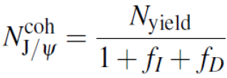

Four contributions in the p_{T} spectrum:
Coherent J/ψ
Incoherent J/ψ
J/ψ from ψ' decays
γγ →μμ
Invariant mass distribution:
Dimuon p_{T}< 0.3 GeV/c
Clean spectrum: only 2 like-sign events
Signal shape fitted to a Crystal Ball shape
Background fitted to an exponential
Exponential shape compatible with expectations from γγ →μμ process
ALICE: Phys. Lett. B718 (2013) 1273

Slide 17

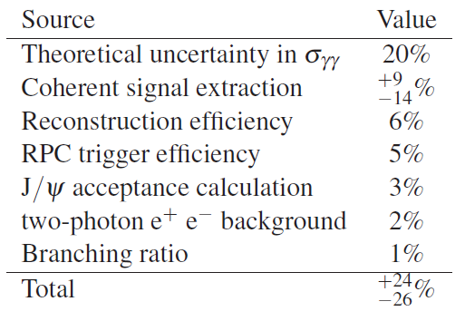
ALICE: Phys. Lett. B718 (2013) 1273

Slide 18
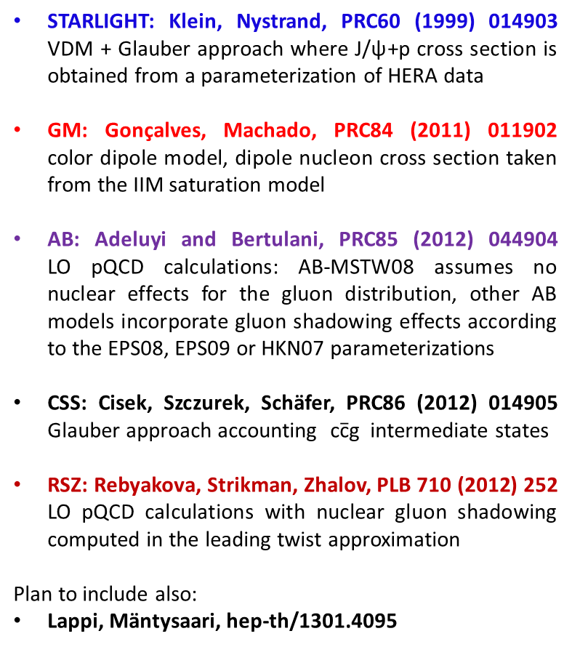
Coherent J/ψ: comparison to models
STARLIGHT: Klein, Nystrand, PRC60 (1999) 014903 VDM + Glauber approach where J/ψ+p cross section is obtained from a parameterization of HERA data
GM: Gonçalves, Machado, PRC84 (2011) 011902
color dipole model, dipole nucleon cross section taken from the IIM saturation model
AB: Adeluyi and Bertulani, PRC85 (2012) 044904
LO pQCD calculations: AB-MSTW08 assumes no nuclear effects for the gluon distribution, other AB models incorporate gluon shadowing effects according to the EPS08, EPS09 or HKN07 parameterizations
CSS: Cisek, Szczurek, Schäfer, PRC86 (2012) 014905
Glauber approach accounting $\text{c}\overline{\text{c}}\text{g}$ intermediate states
RSZ: Rebyakova, Strikman, Zhalov, PLB 710 (2012) 252
LO pQCD calculations with nuclear gluon shadowing computed in the leading twist approximation
Plan to include also:
Lappi, Mäntysaari, hep-th/1301.4095
x ~ 10⁻²
x ~ 10⁻³
arXiv:1305.1467 - submitted to EPJC
Good agreement with models which include nuclear gluon shadowing.
Best agreement with EPS09 shadowing
→ Yes, gluon shadowing is there…

Slide 19
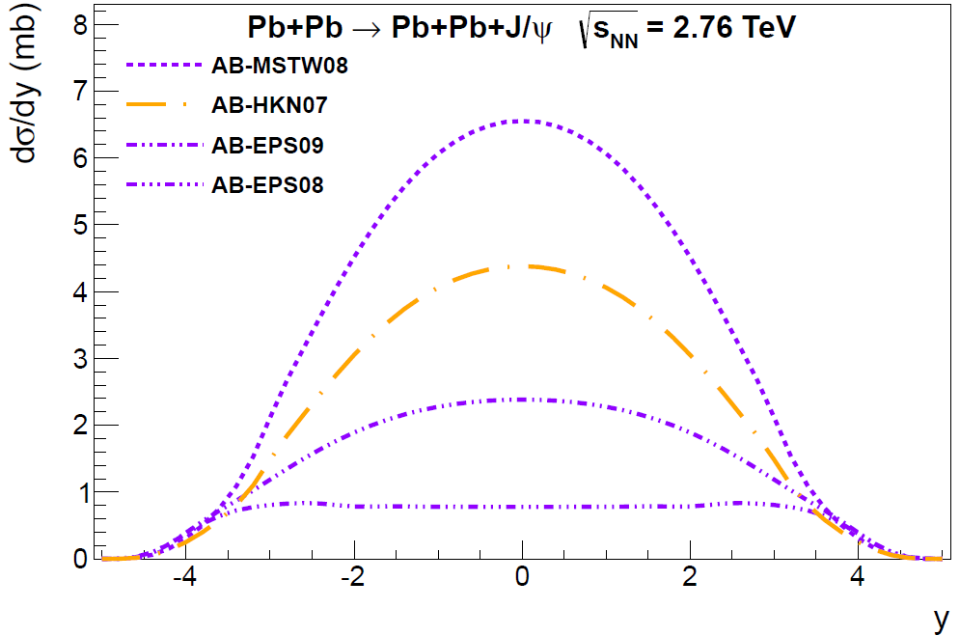
Disentagling the gluon shadowing
Similar amount of gluon shadowing,
different models
Same model, different gluon shadowing fits
→ Nuclear gluon shadowing required to reproduce data

Slide 20
Incoherent J/ψ: comparison to models
arXiv:1305.1467
Sent to EPJC
More model predictions welcome…
The ratio σ_{inc}/σ_{coh} provides further constraints on the treatment of the nuclear
modifications implemented in the different model. Starlight prediction 0.41
+ 0.10
- 0.08
ALICE result: σ_{inc}/σ_{coh} ± = 0.41 (stat+syst)

Slide 21
…and one more thing

Slide 22
Pb-Pb collisions: shedding light on ...light
γ
γ
γ
γ
γ
γ
γ
γ
γ
γ
γ
γ
γ
γ
γ
γ
γ
γ
γ

Slide 23
γγ → ee
Outside the J/Ψ peak opportunity to study γγ→ee
p
Pb
Pb
p
√α
Z√α
Higher orders could be not negligible. Few models predicted a cross section reduction
up to 30% (J. Baltz, Phys. Rev. C 80 (2009) 034901 ).
STARLIGHT(S.R. Klein and J. Nystrand) implements the above cross section at LO.
Data analysis performed in the invariant mass intervals 2.2 GeV/c² < M_{inv} < 2.6 GeV/c² and
3.7 GeV/c² < M_{inv} < 10 GeV/c²

Slide 24
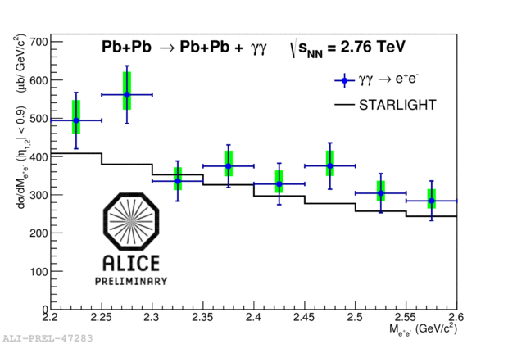
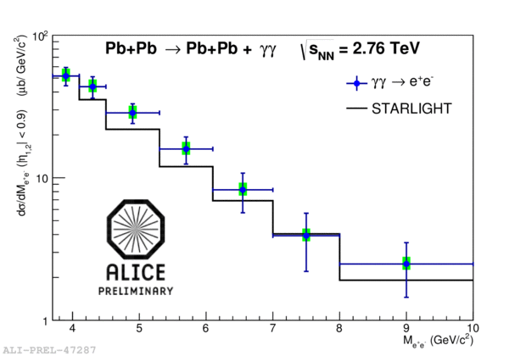
Previous γγ→ee measurement by STAR at RHIC: results compatible with STARLIGHT within 2 σ,
measurement precision 22.5% (stat+sys).
At LHC:
STARLIGHT prediction ( |η|<0.9,
2.2 GeV/c² < M_{inv} < 2.6 GeV/c² ):
σ_{γγ}=128 μb
STARLIGHT prediction ( |η|<0.9,
3.7 GeV/c² < M_{inv} < 10 GeV/c² ):
σ_{γγ}=77 μb
ALICE preliminary result:
σ_{γγ}=154 ± 11(stat) ^{+16.6} (sys) μb
^{-10.8}
ALICE preliminary result:
σ_{γγ}=91 ± 10(stat) ^{+10.9} (sys) μb
^{-8.0}
→ ~ 12% precision
→ ~ 16% precision
Data 20% above the predictions (compatible within 1 and 1.5 σ ). 30% cross section reduction
predicted in Phys. Rev. C 80 (2009) 034901 not supported. Consistent with STAR, measurement
precision improved.

Slide 25
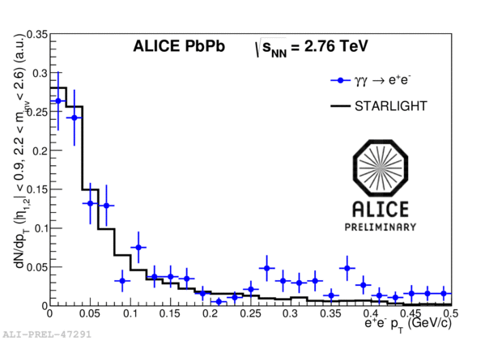
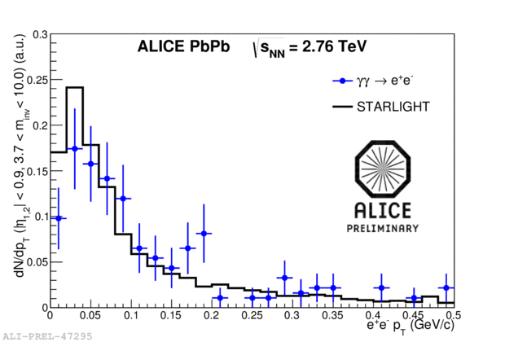
Moreover....
2.2 GeV/c² < M_{inv} < 2.6 GeV/c²
3.7 GeV/c² < M_{inv} < 10 GeV/c²
....p_{T} spectrum properly reproduced

Slide 26

p-Pb collisions: shedding light on the proton
γ
γ
γ
γ
γ
γ
γ
γ
γ
γ
γ
γ
γ

Slide 27



p-Pb
Two different configurations:
Pb-p
√s=5.02 TeV
p
p
J/Ψ decay product in the forward muon arm:
21 GeV ≤ W_{γp} ≤ 45 GeV 550 GeV ≤ W_{γp} ≤ 1160 GeV
J/Ψ decay product (1 μ in the barrel + 1 μ in the muon arm)
45 GeV ≤ W_{γp} ≤ 82 300 GeV ≤ W_{γp} ≤ 550 GeV
J/Ψ in the Barrel:
100 GeV ≤ W_{γp} ≤ 250 GeV
Access to a wide energy interval: W_{γp} varies by a factor 50

Slide 28
The present .....
Alice
Strategy: start from the region where already existing data and ALICE overlap
to check for consistency

Slide 29
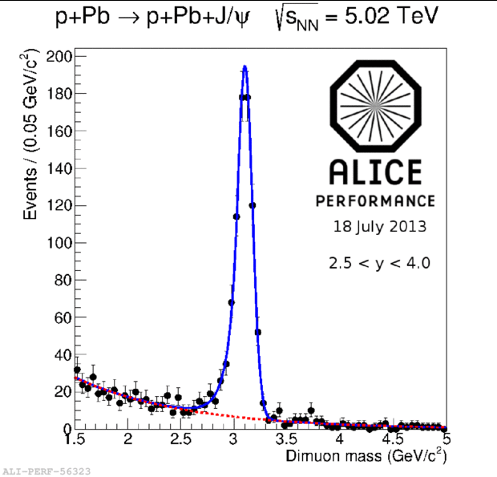
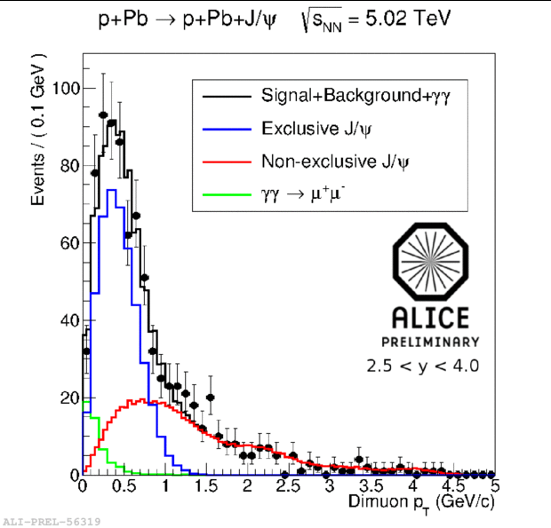
p-Pb analysis
Analysis with the forward muon arm ( lowest W_{γp} ). Non exclusive J/Ψ contribution
estimated by data ( events with ≥ 3 hits in the VZERO detector)
Alice preliminary

Slide 30
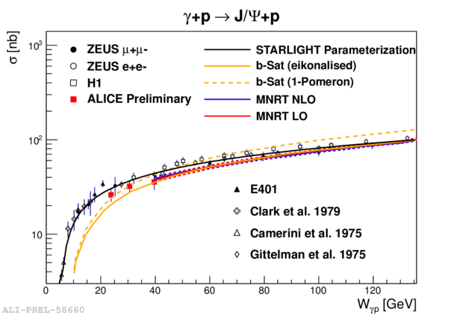
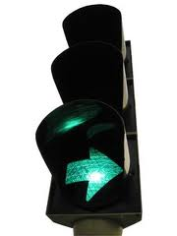
Once the photon spectrum n(γ) is calculated, the cross section for γ+p→ J/Ψ + p can be obtained
→ ALICE is consistent with previous experiment: go ahead to higher
W_{γp}

Slide 31
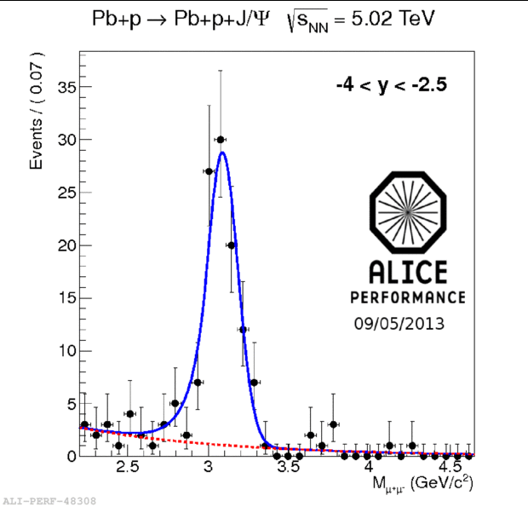
Pb-p: the unexplored region:
Analysis with the forward muon arm ( highest W_{γp} ).
Preliminary results coming soon…..

Slide 32
Conclusions and outlook
Done:
- The J/Ψ coherent cross section was successfully measured in ALICE both
at mid-rapidity and at forward rapidity;
- Models including nuclear gluon shadowing are favoured;
- The J/Ψ incoherent was measured at mid-rapidity too: more models please !
- σ_{γγ→ee} cross section measured at mid-rapidity: LO implementation gives a satisfactory
prediction
In progress:
Pb-Pb ρ vector meson production analysis;
γ+p→ J/Ψ+p cross section at W > 1000 GeV (and not only) in progress.
The future:
- ϒ measurement could be feasible: strong theoretical motivation would be important;
Any idea to understand the origin of the nuclear gluon shadowing ( saturation ) ?
→ Hints from theoreticians crucial to define the UPC program in the next years.

