Slide 1


Exclusive Production at HERA
The 15th conference on Elastic and Diffractive scattering
EDS Blois 2013 - Saariselkä 9 - 13 September 2013
Janusz Tomasz Malka
on behalf of the H1 and ZEUS Collaborations

Slide 2
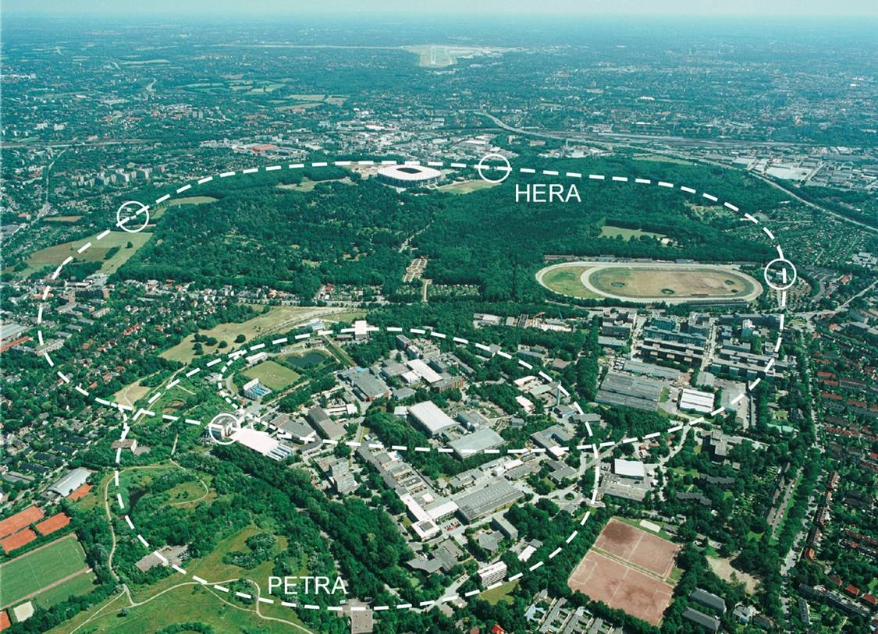
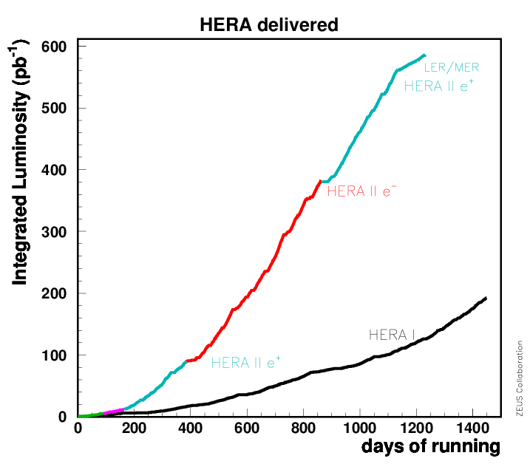
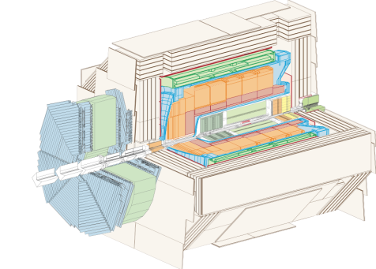
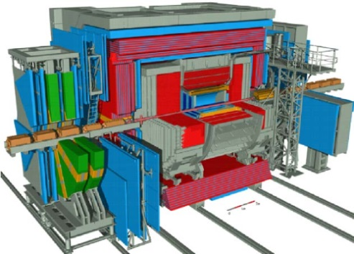
HERA ep collider (1992 – 2007)
The world’s only electron/positron-proton collider at DESY, Hamburg
E_{e} = 27.6 GeV, E_{p} = 920 GeV (820, 460, 575 GeV)
Two collider experiments: H1 and ZEUS
total luminosity ~ 0.5 fb⁻¹per experiment

Slide 3
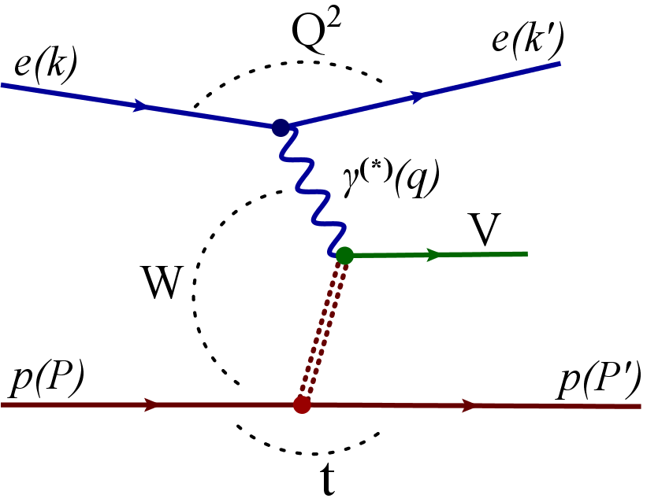
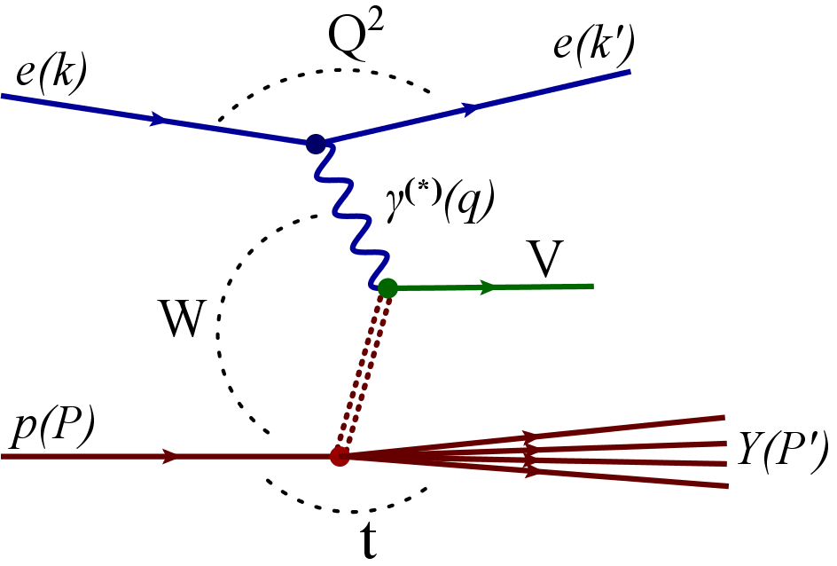
Exclusive diffractive processes
Diffraction - no quantum numbers are exchanged in the interaction
btw γ and p → no colour flux → large rapidity gap
V - Vector Meson (ρ, ρ’, ρ’’, ω, φ , J/ψ, ψ’, ϒ )
Q² - photon virtuality Q²=-q²=-(k-k’)²
(Q²≈ 0 – photoproduction , Q²> 0 – electroproduction)
W - c.m. energy of γp system W=(q+p)²
t - (4-mom. transfer)² at p-vertex t = (P - P’)²
The proton can stay intact p(P’) or dissociate Y(P’)

Slide 4
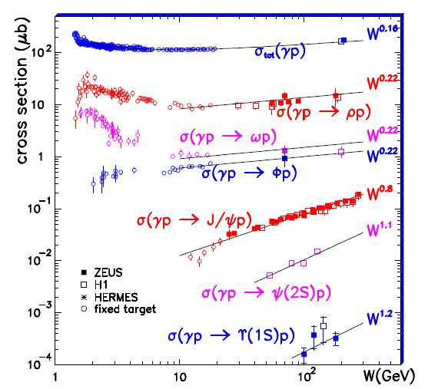
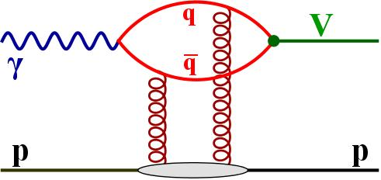
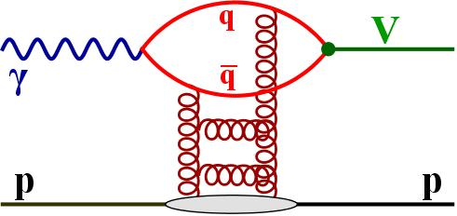

Vector Meson production
In presence of a hard scale (M_{VM}, Q², t) calculations in pQCD are possible
The cross section dependence on W can be parameterised as
the rapid rise of cross section with Wγp , can be explain by increasing gluon density with decreasing of fractional momentum x ∝ 1/W_{γp}²
The t-dependence of elastic cross section carries information about the transverse size of the interaction region
p-diss cross section becomes dominant for | t | > 1 GeV²

Slide 5
Vector Meson production
In presence of a hard scale (M_{VM}, Q², t) calculations in pQCD are possible
The cross section dependence on W can be parameterised as
the rapid rise of cross section with Wγp , can be explain by increasing gluon density with decreasing of fractional momentum x ∝ 1/W_{γp}²
The t-dependence of elastic cross section carries information about the transverse size of the interaction region
p-diss cross section becomes dominant for | t | > 1 GeV²

Slide 6
Vector Meson production
In presence of a hard scale (M_{VM}, Q², t) calculations in pQCD are possible
The cross section dependence on W can be parameterised as
the rapid rise of cross section with Wγp , can be explain by increasing gluon density with decreasing of fractional momentum x ∝ 1/W_{γp}²
The t-dependence of elastic cross section carries information about the transverse size of the interaction region
p-diss cross section becomes dominant for | t | > 1 GeV²

Slide 7
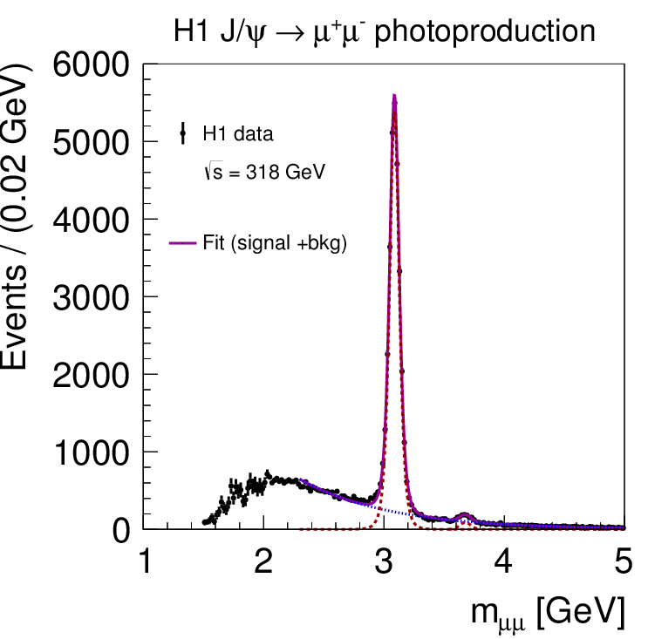
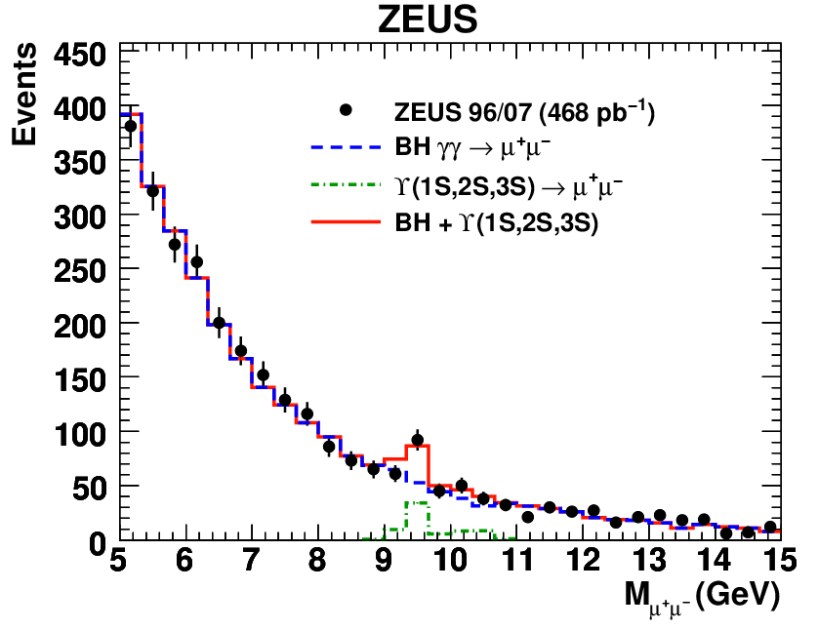
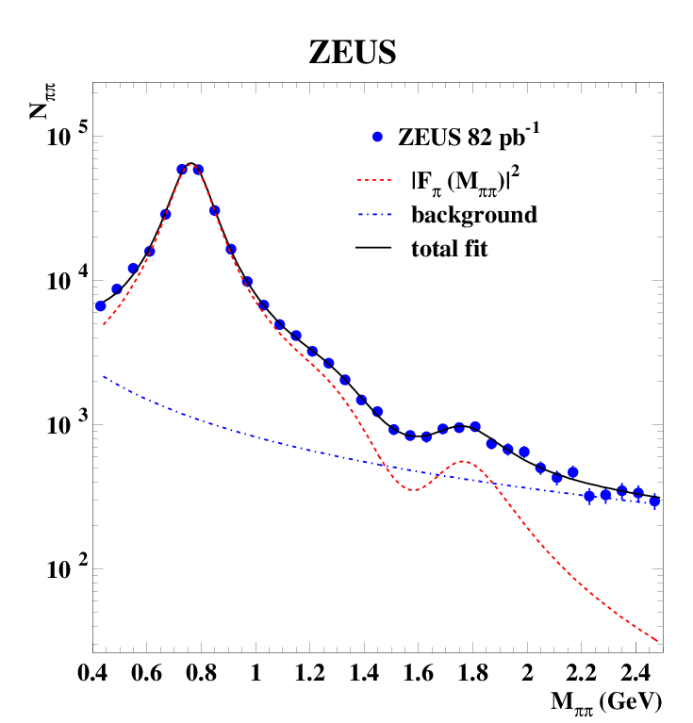
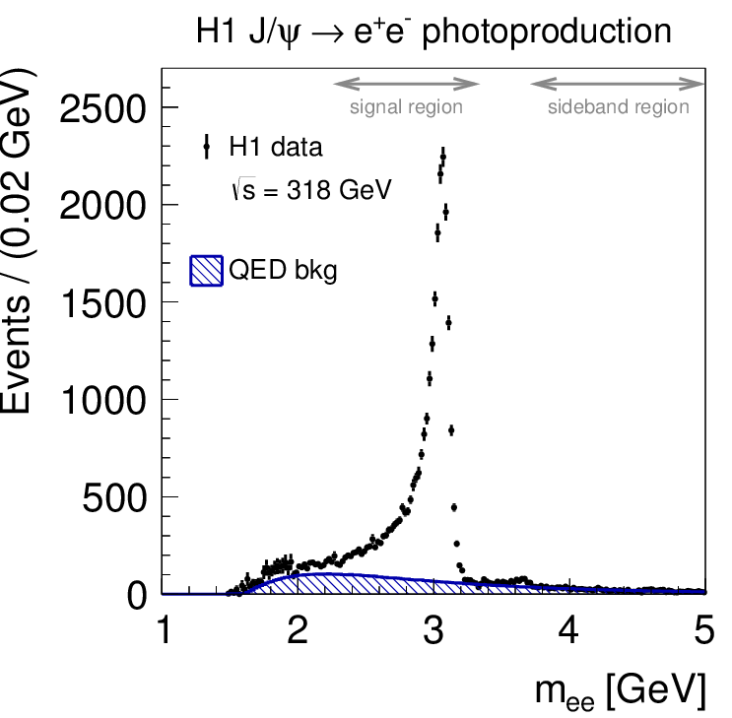
Vector Mesons mass distributions

Slide 8
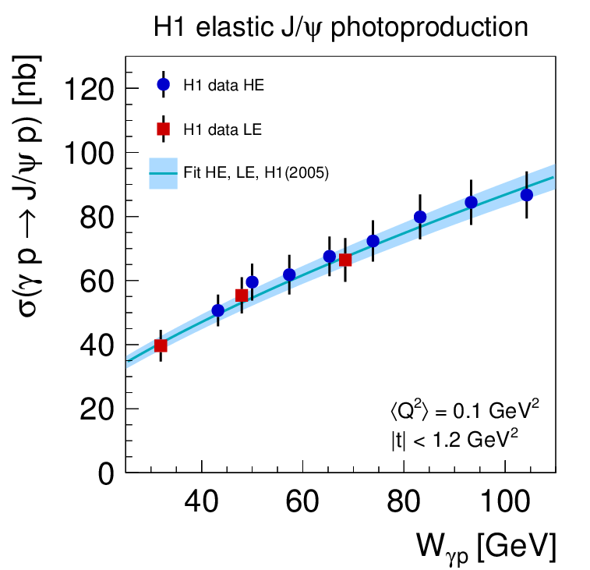
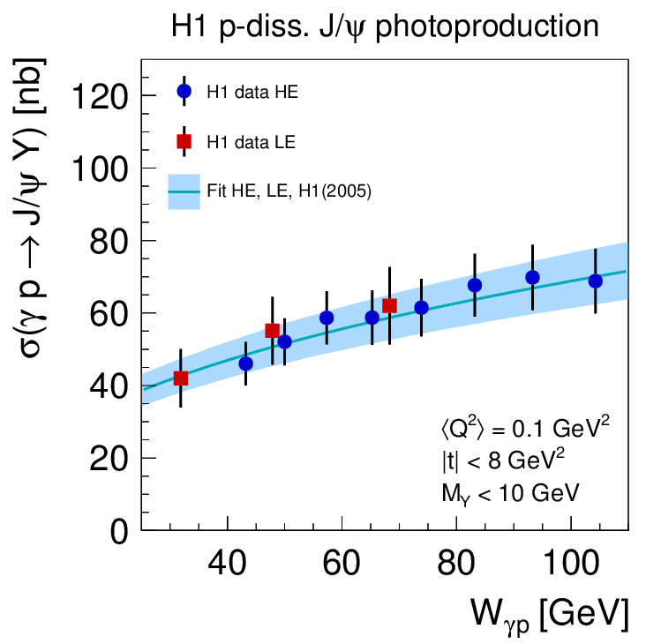
Elastic and p-diss cross sections as a function of Wγp
Phys. J. C73 (2013) 2466
Fit model:
  Parametrisation (for elastic and p-diss.):
σ = N (W_{γp} / W₀ )^{δ} with W₀ = 90GeV
Simultaneous fit of elastic and p-diss cross sections:
  including correlations, including previous H1 hep-ex/0510016
Results:
γp → J/ψp: δ_{el} = 0.67 ± 0.03
γp → J/ψY: δ_{pd} = 0.42 ± 0.05
δ_{el} = δ_{pd} - δ_{el} : -0.25 ± 0.06
A dependence of cross section ratio as a function of W_{γp} is observed

Slide 9
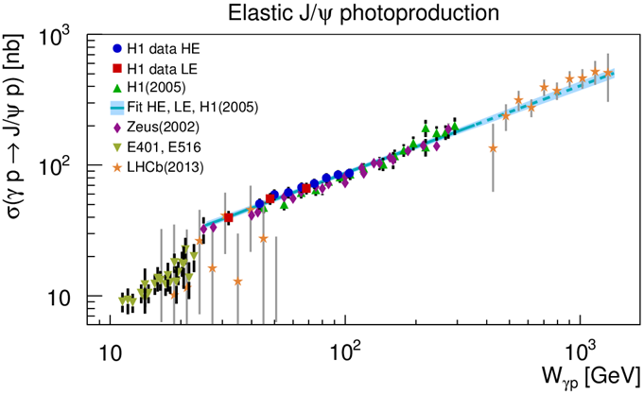
Comparison to other experiments
H1 measurement in the transition region from fixed target to previous HERA data
Good agreement with previous HERA measurements
Fixed target data: steeper slope, lower normalization
Fit to H1 data extrapolated to higher Wγp describes the LHCb data
Phys. J. C73 (2013) 2466

Slide 10
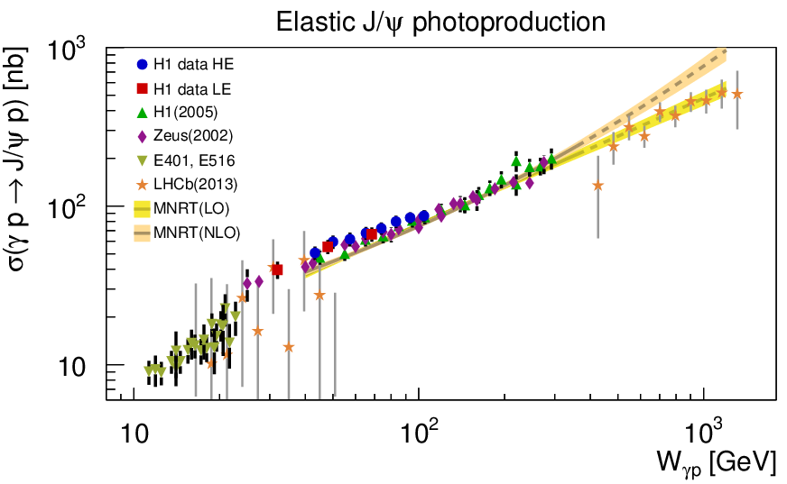
Comparison to fits based on QCD calculations
Phys. J. C73 (2013) 2466
LO and NLO fit to previous J/ψ data and extrapolated to higher Wγp.
LO fit describes the LHCb data.

Slide 11
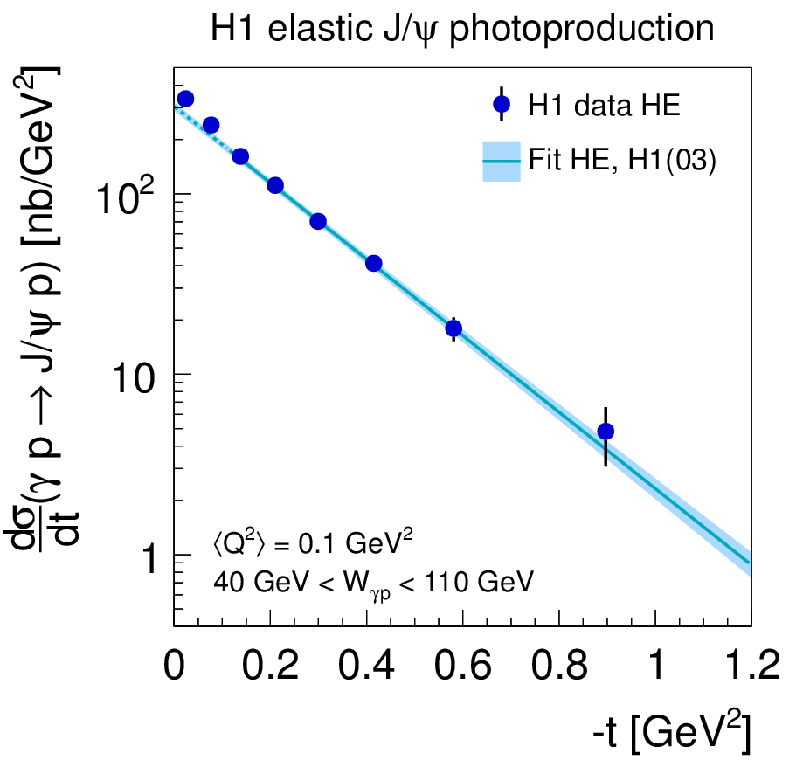
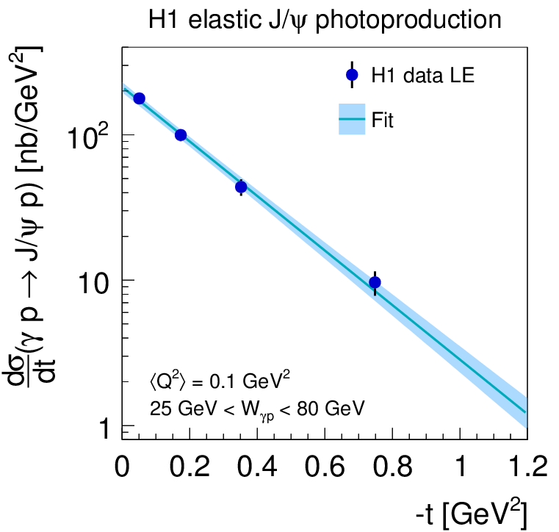


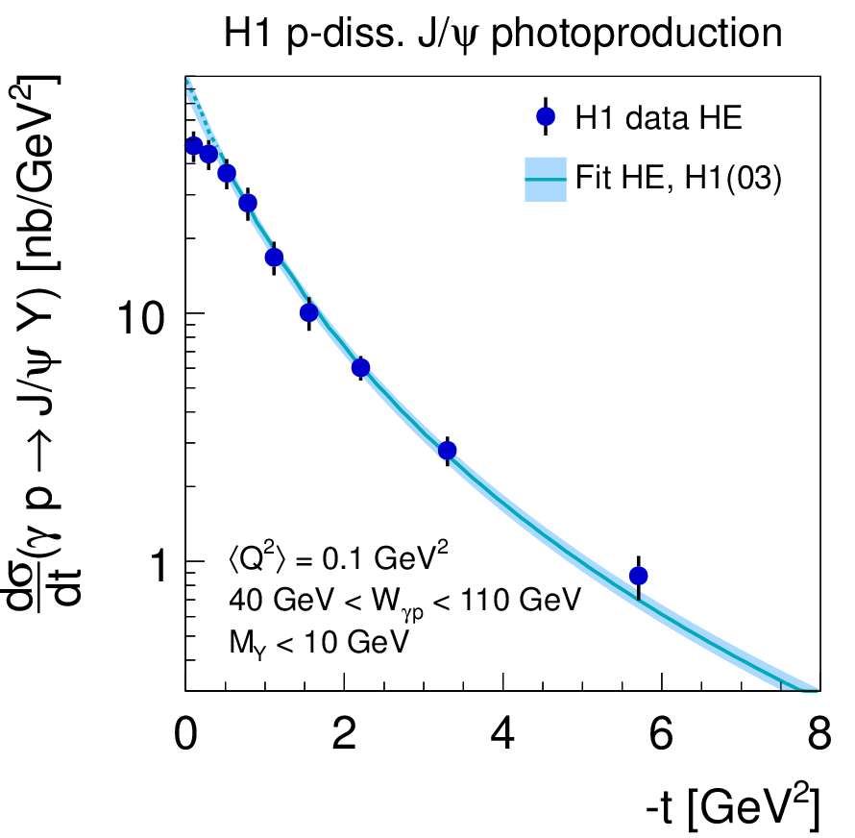
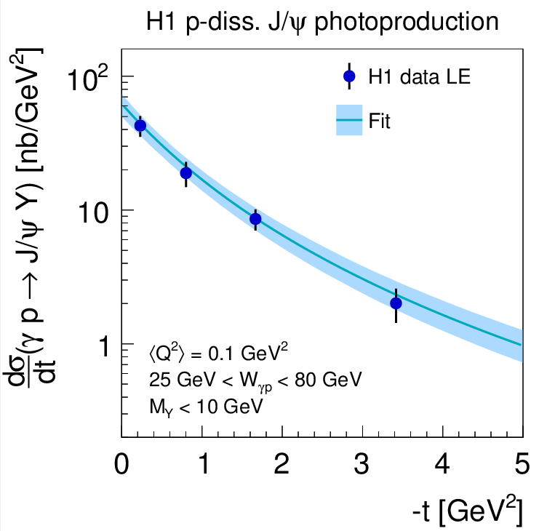
Elastic and p-diss cross sections as a function of t
Phys. J. C73 (2013) 2466
Phenomenological fit model:
  elastic:
  p-diss
including previous H1 high t-data hep-ex/0306013
Results:
HE: γp → J/ψp: b_{el} = (4.88 ± 0.15) GeV⁻²
γp → J/ψY: b_{pd} = (1.79 ± 0.12) GeV⁻²
n = 3.58± 0.15
LE : γp → J/ψp: b_{el} = (4.3 ± 0.2) GeV⁻²
γp → J/ψY: b_{pd} = (1.6 ± 0.2) GeV⁻²
n = (fixed value)

Slide 12
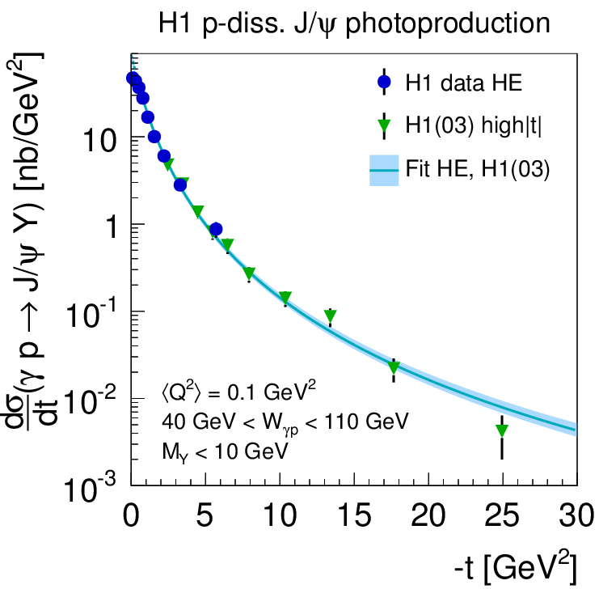
p-diss cross sections as a function of t
Phys. J. C73 (2013) 2466
The new data extend the reach to small values of |t|
Good agreement in overlap region

Slide 13
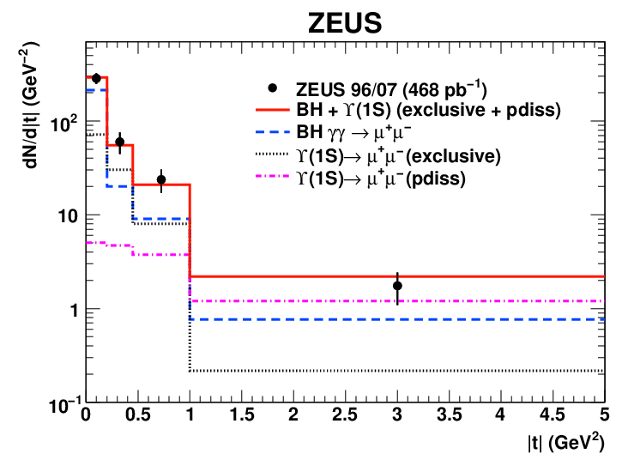
Elastic ϒ(1S) in photoproduction: b-slope
Phys.Lett.B 708 (2012) 14
60 < W < 220 GeV
Binned Poissonian
maximum log-likelihood
fit → elastic b, N(1S)
N(1S)= 41 ±10
events(44% of all events
in the mass window)
The first measurement of b-slop:
b = 4.3 ^{+2.0}_{-1.2}^{+0.5} _{-0.6} GeV⁻²
consisted with predictions based on pQCD models (b= 3.68 GeV⁻²)
Cox, Forshaw, Sandapen, JHEP 0906 (2009) 034

Slide 14
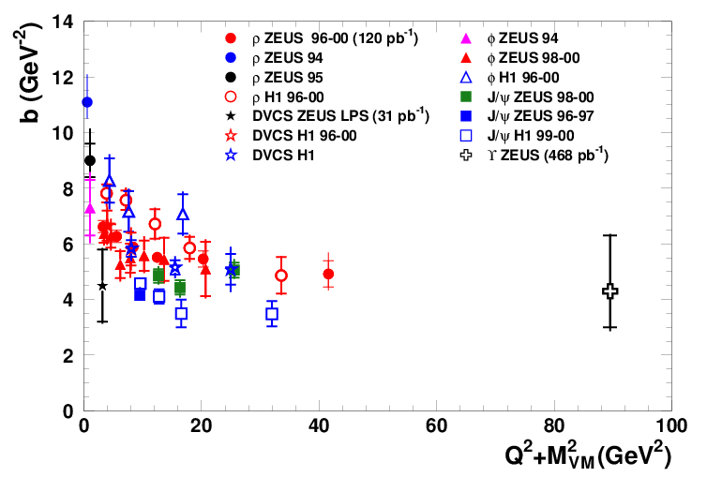
VM production and DVCS: b(Q²+M²_{VM})
Phys.Lett.B 708 (2012) 14
Analysis doubles
the explored range
In agreement with
an asymptotic behaviour
of Q² + M²_{VM}
In optical model approach:
b ≈ (R²_{p} + R²_{VM})/4
size of scattered VM getting smaller with Q² + M²_{VM}

Slide 15
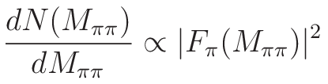
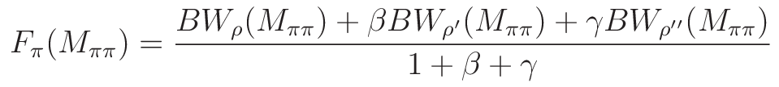
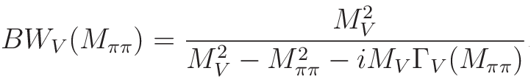
Exclusive electroproduction of two pions.
Eur.Phys.J.C72 (2012) 1869
The two-pion invariant-mass distribution is interpreted in terms of
the pion electromagnetic form factor:
Kuhn-Santamaria parameterization has been used:
in mass range < 2.5 GeV incudes contributions from:
  ρ(770), ρ’(1450) - radially excited 2S state, ρ’’(1700) - orbitally excited 2D state
β and γ are relative amplitudes, BW_{VM} – Breit-Wigner distribution:

Slide 16
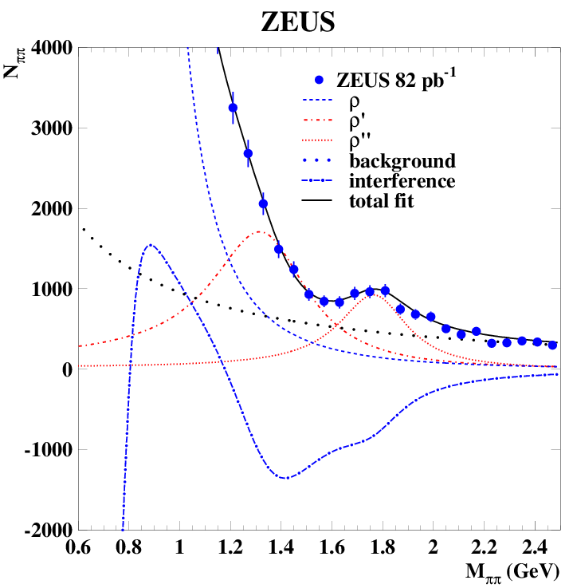
Exclusive electroproduction of two pions.
Eur.Phys.J.C72 (2012) 1869
Negative interference between all resonances results in the ρ’ signal appearing as a shoulder

Slide 17
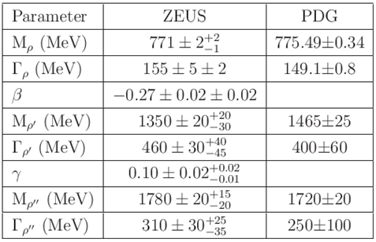
Exclusive electroproduction of two pions.
Eur.Phys.J.C72 (2012) 1869
Masses and widths consistent with expectations
Relative amplitudes found to be real

Slide 18
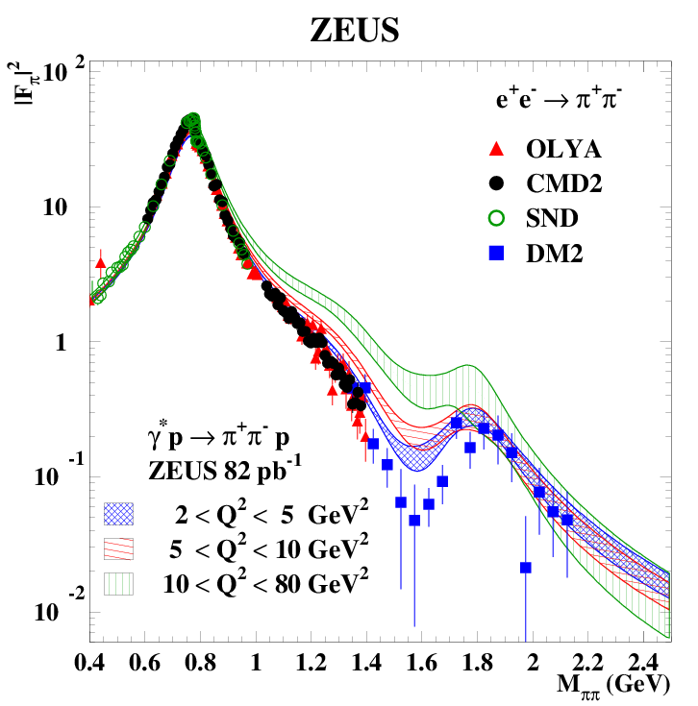
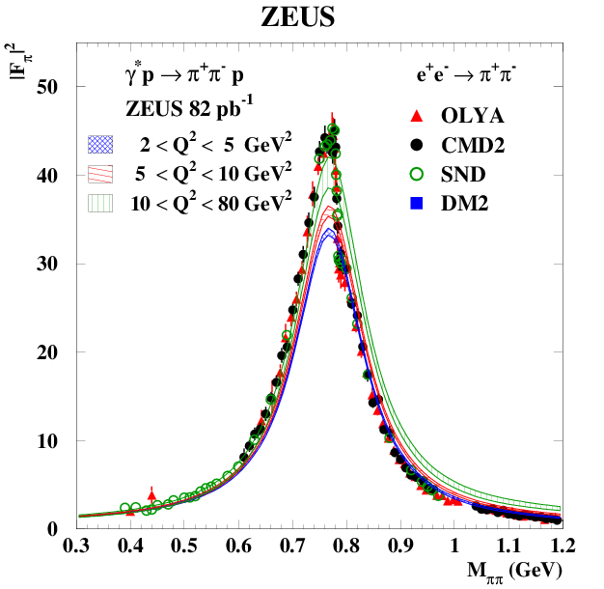
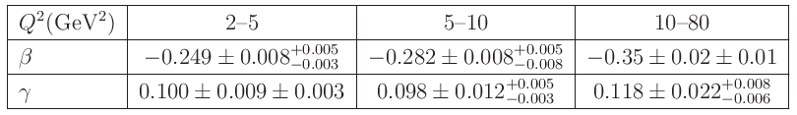
Exclusive electroproduction of two pions.
Eur.Phys.J.C72 (2012) 1869
features of pion form factor in ep are similar to e+e-:
  the prominent ρ peak
  a shoulder around the ρ’ peak
  a dip followed by enhancement in the ρ’’ region
some differences in the interference region
in the ρ peak, the pion form factor is highest at highest Q²
the absolute value of β increases with Q²
γ remains Q² independent within the uncertainties

Slide 19



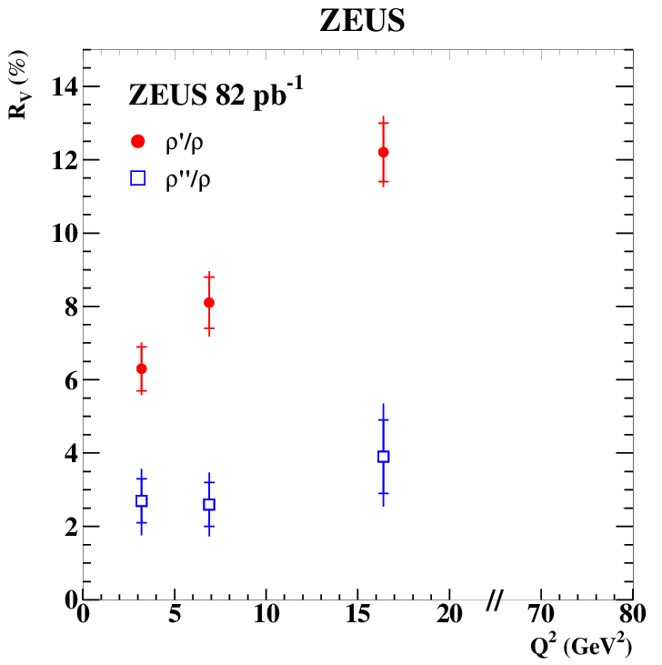
Exclusive electroproduction of two pions.
Eur.Phys.J.C72 (2012) 1869
The cross-section ratio:
- cross section for vector-meson production
- branching ratio of the vector meson V(ρ', ρ”) into ππ
ρ’/ρ ratio increases with Q²
  predicted by pQCD
  suppression of ρ’ is connected to a node
  effect at low Q²
ρ’’ behavior differs from that of ρ’
  due to large uncertainties - no conclusion

Slide 20
Conclusions
J/ψ:
The proton dissociative cross section is measured precisely at small |t|
for the first time at HERA
Data from the HERA low energy runs add information at low W_{γp} .
Data from fixed target experiments differ in slope
The ratio of the elastic to proton dissociative cross section slightly depends on W_{γp}
ϒ:
For the first time the b-slope for ϒ is determined
Asymptotic behavior of b-slope vs (Q²+M_{VM}²) is observed
ππ:
The ππ mass distribution is well described by the pion electromagnetic form factor
The ratio ρ'/ρ rises strongly with Q²
The Q² dependence of the pion form-factor is observed

