Slide 1
Summary of EDS Blois 2013
Michael Albrow, Fermilab

Slide 2
Summary of EDS Blois 2013
Highlights of EDS Blois 2013

Slide 3
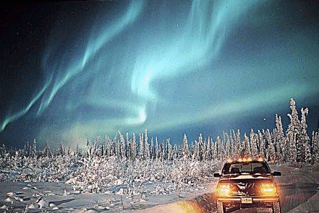
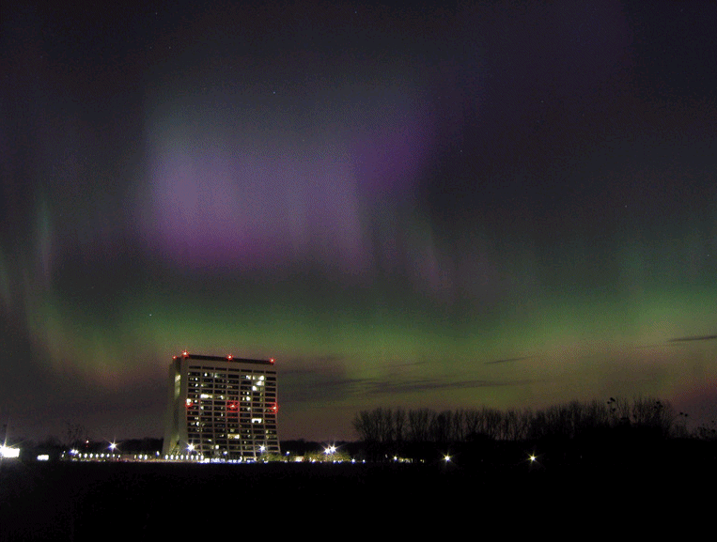
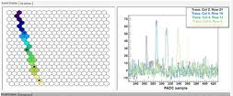
Highlights of EDS Blois 2013
Gzillions of very low energy particles
Aurora over Fermilab
One very high energy particle
make a shower
Cosmic ray shower in Auger fluorescence

Slide 4

Summary of EDS Blois 2013
Highlights of EDS Blois 2013
What little I remember (+ some)
Risto Orava to me: Don’t say the word “Pomeron”
Don’t say “rapidity gap”

Slide 5
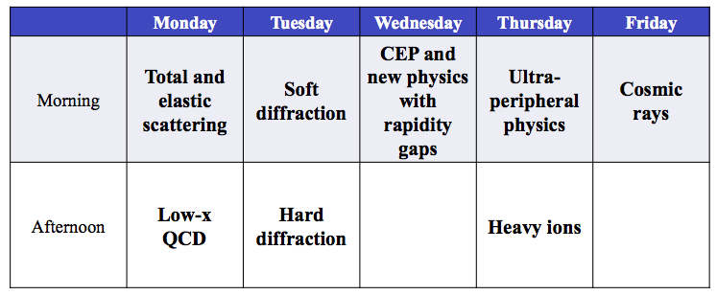
This week:
By here I got saturated, apologies to the heavy ion gang
And I cannot cover everything, apologies for not mentioning you
Emphasis on new(ish) experimental results
No cosmic rays (this morning’s talks)

Slide 6
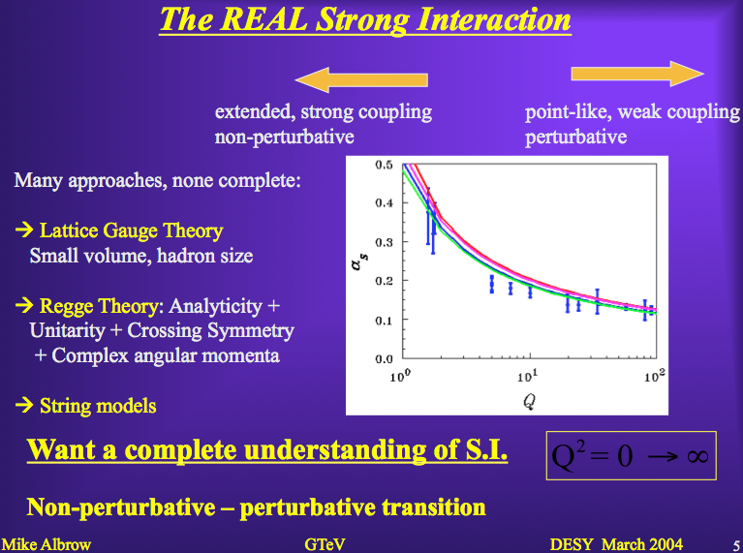
Q² = 0 ➔ ∞

Slide 7
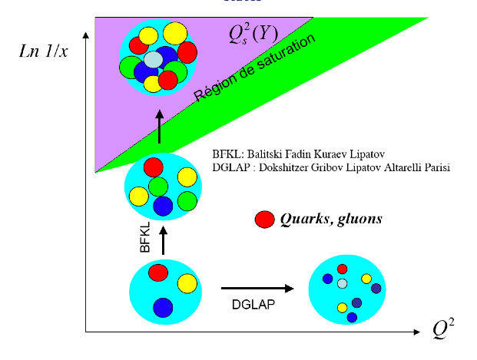
Funny cartoon, not really like that!
More and more soft gluons and q-qbar pairs →
Resolving finer and finer detail →

Slide 8
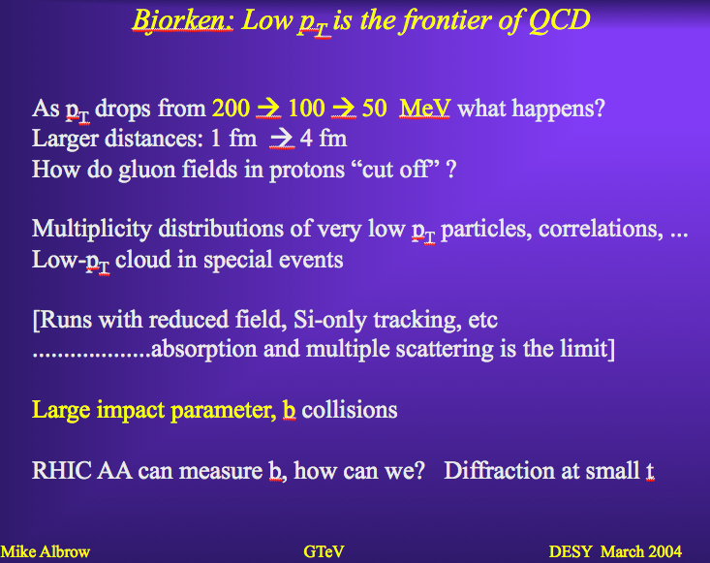

Slide 9
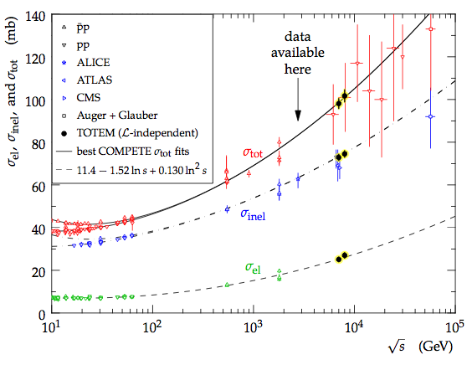
pp and ppbar TOTAL CROSS SECTION with new LHC/TOTEM values
Fit splits inconsistent Tevatron values
Rise because α(t-channel exchange) > 1.0 (=pomeron dominance)
Laszlo Jenkovsky + showed good fit

Slide 10
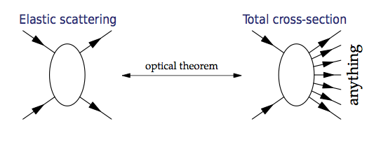
T
Σ_{anything}
Δy_{ij}
CONTRACT
Hey Presto!
y
Multiperipheral
Diagram

Slide 11
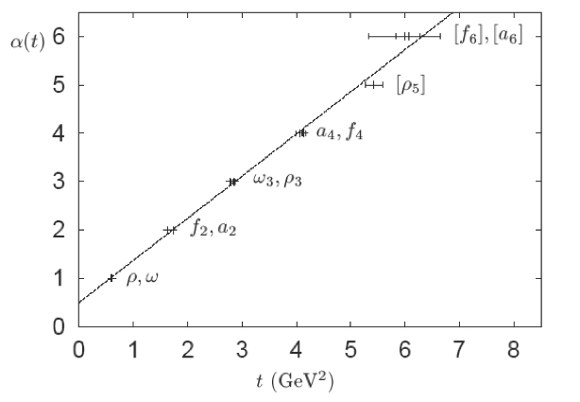
Reggeon shown
by Laszlo Jenkovsky,
pomeron added (me)
reggeon
pomeron
α_{P}(t=0) > 1.0
σ’s rising with Δy, s
daughter?
α_{R}(t=0) < 1.0
σ’s falling with Δy, s
t-channel exchange
t is negative
M² (real)
Expect a J = 2 glueball with M ~ 2 GeV
Scalar (J=0) glueball not on P trajectory.
“daughter trajectory” ?
π-
π⁰
“ρ”(R)
R
σ
P
p
n
ln s, Delta-y

Slide 12
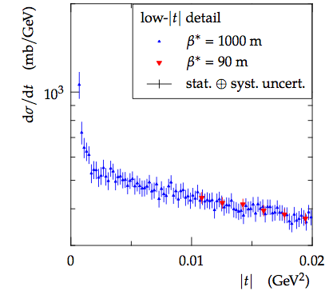
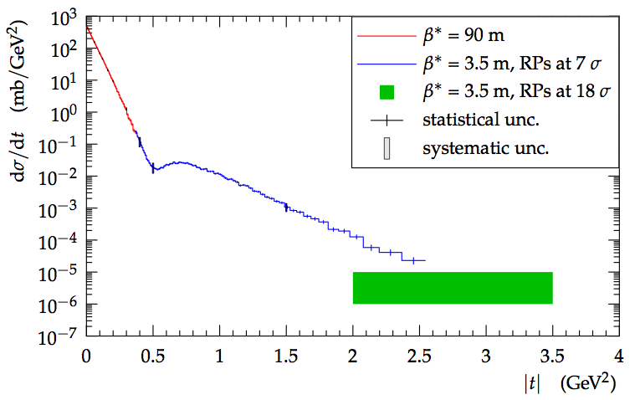
EDS
F
A
N
T
A
S
T
I
C
Jan Kaspar for TOTEM
Into the Coulomb region
(large distances)
Out to the hard – t region
small distances : the “core”
L
A
S
T
I
C
~0.2 fm?
Odderon?

Slide 13
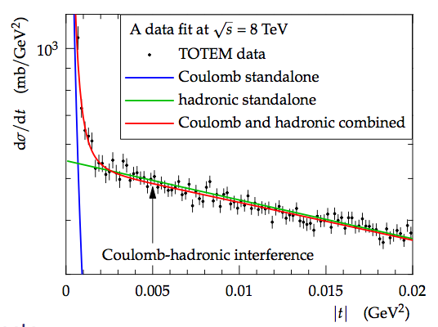
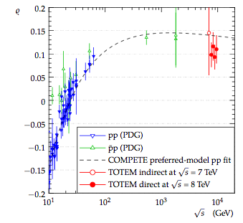
Jan Kaspar for TOTEM
Through dispersion relations ρ = Re/Im
tells you about the behaviour of σ_{TOT} at
higher energies! It is constrained by
analyticity of scattering amplitudes S(s,t).
First sign of ρ ➔ 0 at much higher s ?
Purely imaginary : saturation?

Slide 14
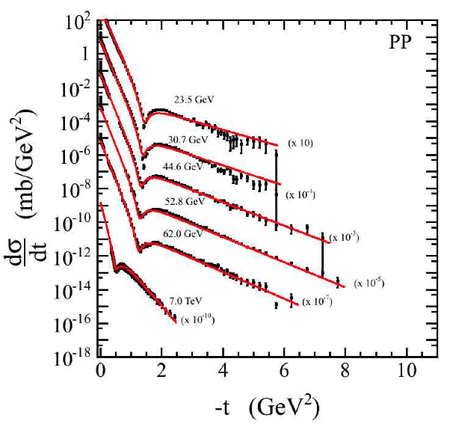
ISR was 1st hadron-hadron collider
Great machine: p,pbar,d,α
Dip moves in, peak shrinks, pp NE ppbar in dip region
Discovered rising σT
Discovered high mass diffraction (>2 GeV)
Discovered double pomeron exchange
Co-discovered w/SppS high E_{T} jets
(Schopper)
ISR
LHC
Shown by Laszlo Jenkovsky

Slide 15
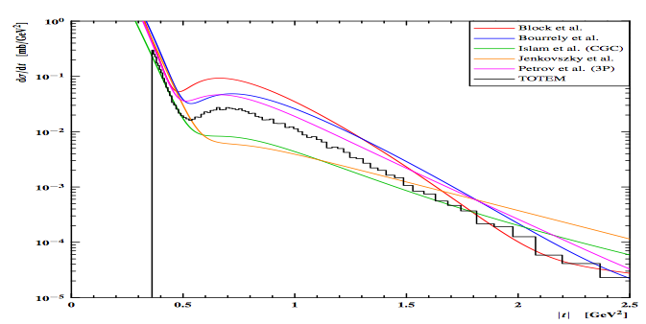
Shown many times:
TOTEM, ALFA to extend this range
Nobody gets full marks especially around |t| = 0.5 – 2.0 GeV²
... except the TOTEM experiment (we hope!)

Slide 16
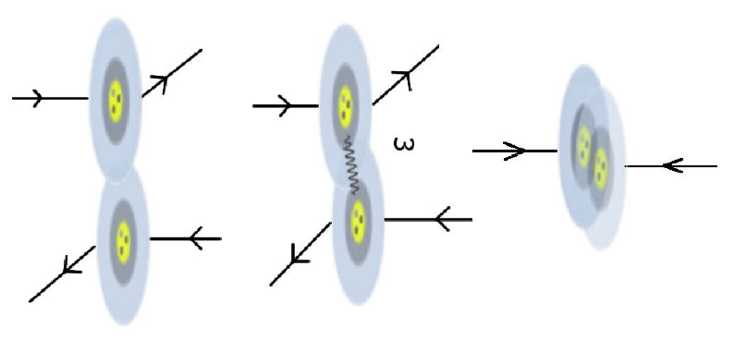
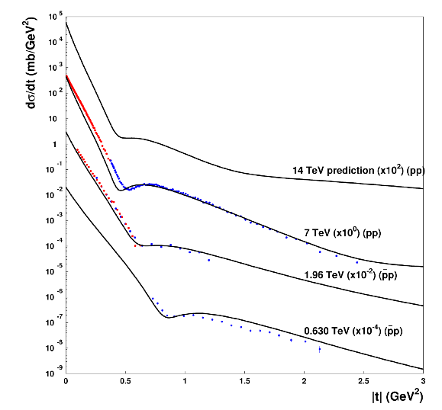
“Elastic scattering is the grandfather of all exclusive processes.”
Munir Islam:
Condensate enclosed chiral bag model
Michael Albrow
(Munir Islam told me to quote myself)
3 valence quarks in ~0.2 fm core
Shell of “baryonic charge”
Outer q-qbar condensate
14 TeV very flat!!
Can q-core be tested another way?
Drell-Yan only happens at small impact parameter
→ highest multiplicity events.
Double Drell-Yan enhanced, depends on core size.
Double parton scattering also, but jets from gg too

Slide 17
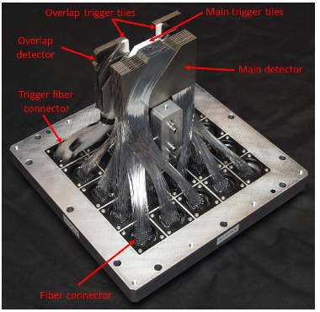
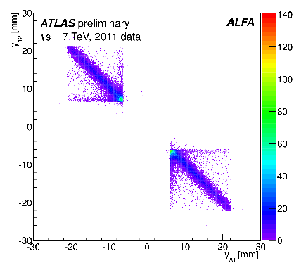
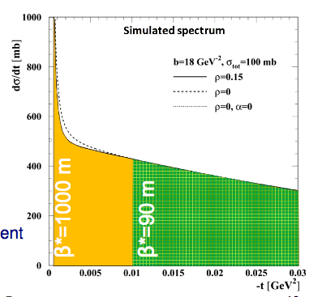
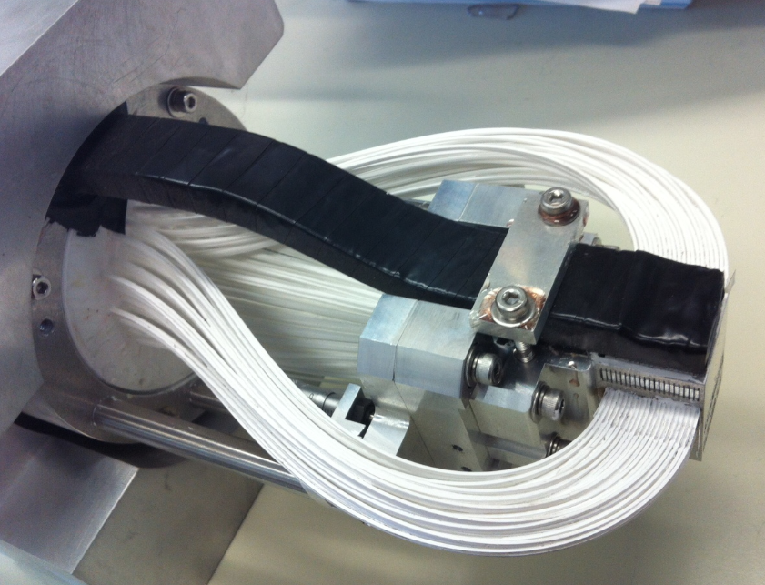
Samah Abdel Khalek: ALFA in ATLAS
Small t elastics for luminosity measurement (calibrate L monitors)
Elastic scattering
events seen
ALFA Roman pot
fiber tracker, welcome!
Ambition:
(not data!)
CDF Roman pot
fiber tracker, RIP

Slide 18
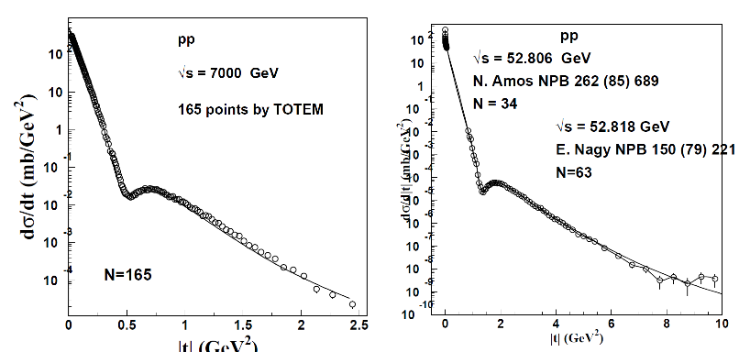
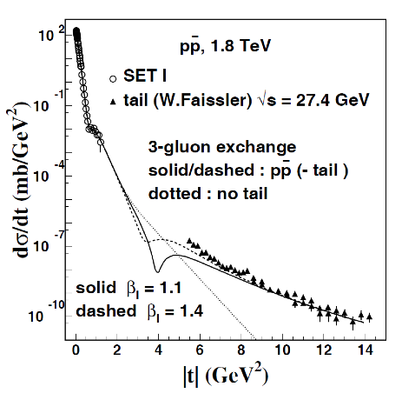
A.K.Kohara : Elastic scattering amplitudes in t and b space
LHC
ISR
Note different scales:
old ISR at 53 GeV → 10 GeV²
LHC at 7 TeV → 2.5 GeV2
Dip moves way in, 1.5 – 0.6
Growth of interaction radius.
Small |t| data from Tevatron
Large |t| data from Fixed Target Fermilab (200/400 GeV/c)
Predicted second dip around -4 GeV² missed?

Slide 19
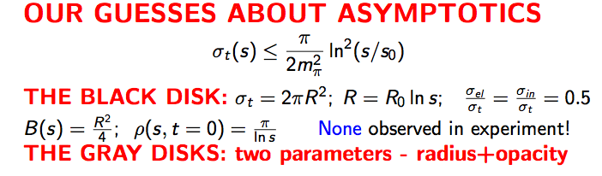
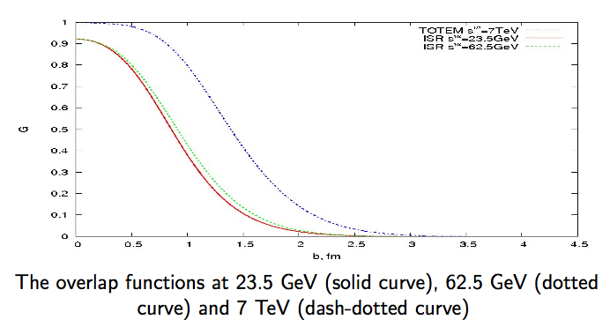
From Igor Demin
The parton density in the peripheral
region increases with s; geometrical
scaling does not apply.
ρ(t) away from t = 0 (Orear regime):
ID finds (from experimental data +)
<ρ> ~ -2.1 !
Unsolved problem.

Slide 20
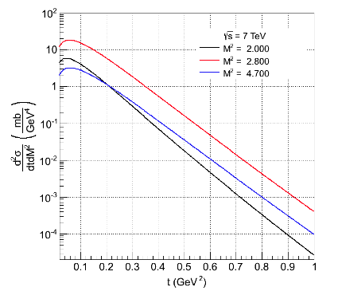
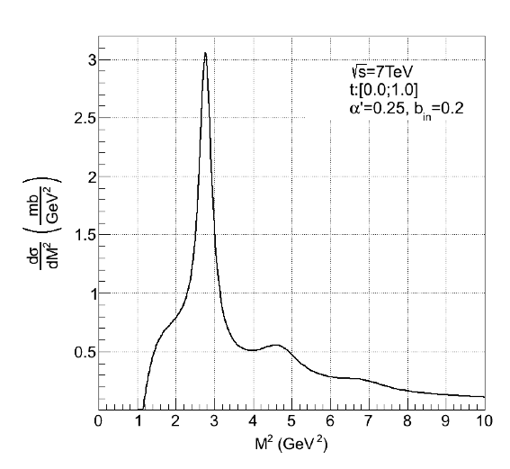
Laszlo Jenkovsky: Reggeized dual Breit-Wigner single diffraction
LJ expects turn-down of SD cross sections
at |t| < 0.1 GeV2
Integrated over t = 0.0 – 1.0
Resonances N* give big contributions.
→ Careful if extrapolating to unseen
forward regions!
FSC counters can give information here.

Slide 21
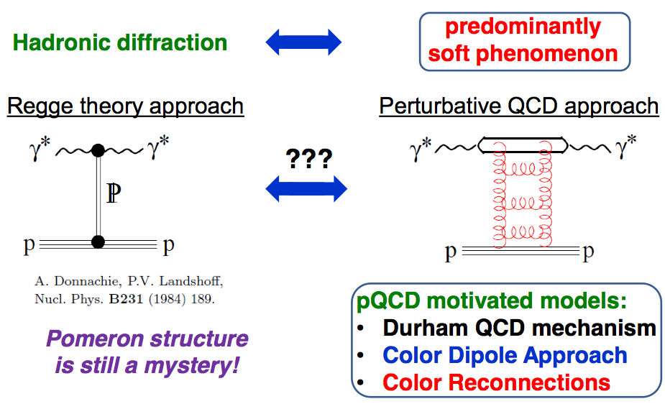
Roman Pasechnik

Slide 22
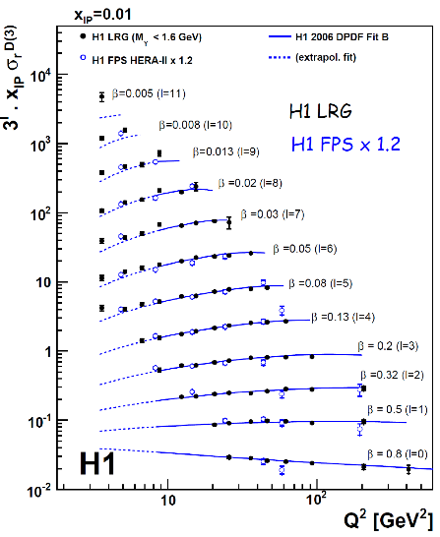
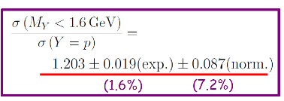
Alice Valkarova (H1 + ZEUS) e-p collisions at HERA

Slide 23
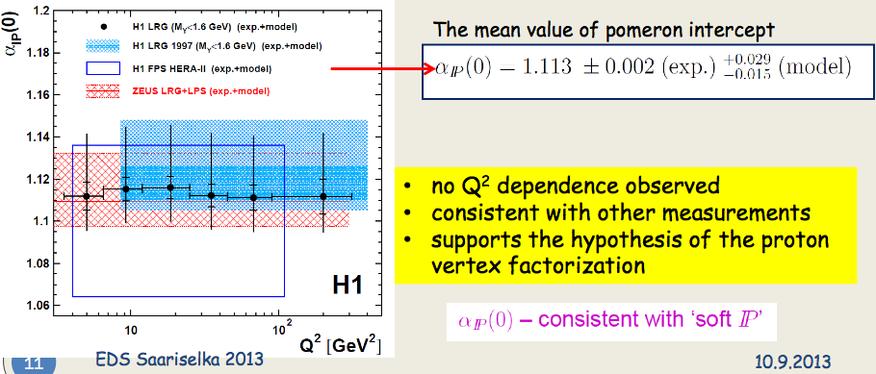
Alice Valkarova (H1 + ZEUS)

Slide 24
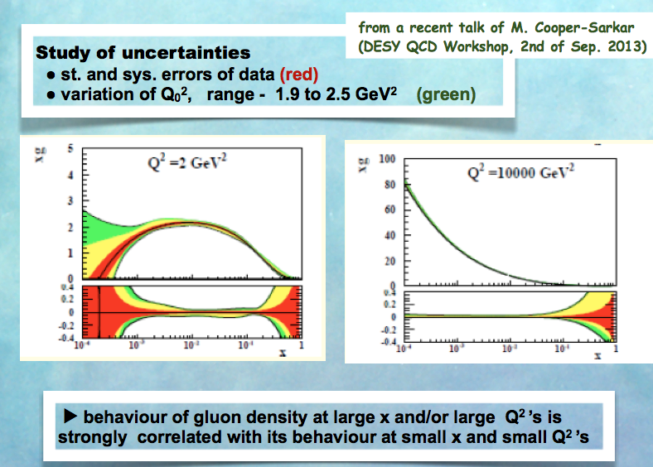
Henry Kowalski: HERA Low-x physics

Slide 25
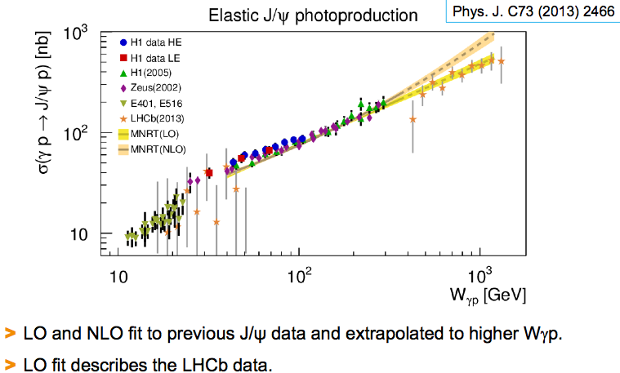
Janusz Malka: HERA exclusive production, and LHCb data

Slide 26
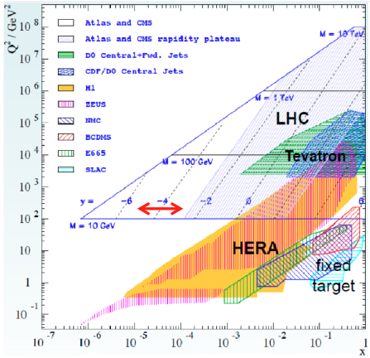

Slide 27
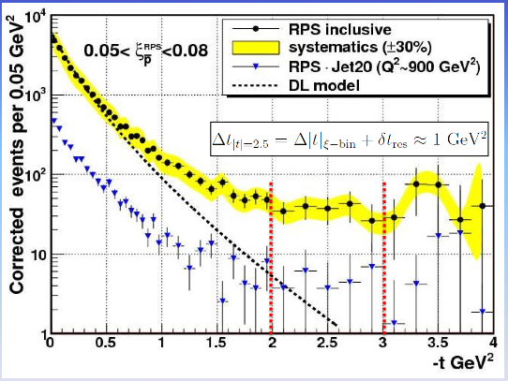
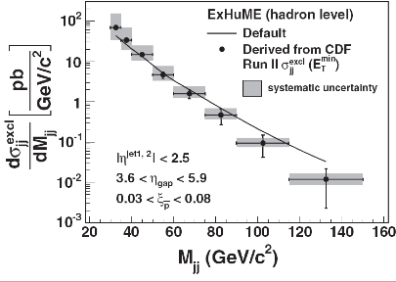
Konstantin (Dino) Goulianos High mass SDE
Remarkably flat t distributions for high mass diffraction at CDF
“Exclusive” dijets:
p-bar detected,
M(JJ) > 0.8 M(X)

Slide 28
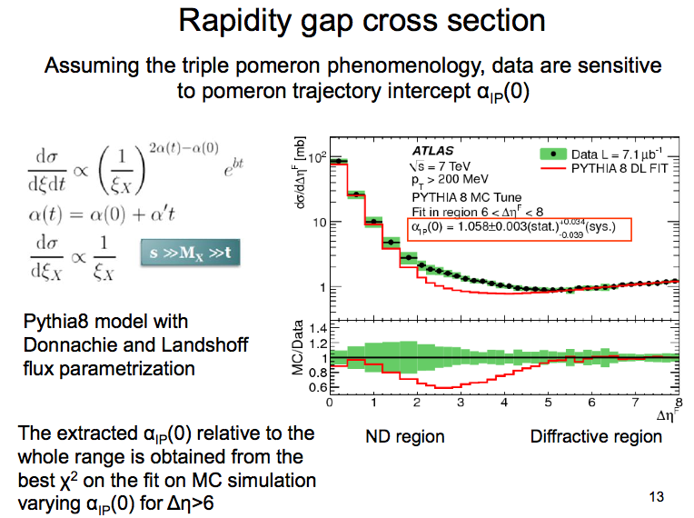
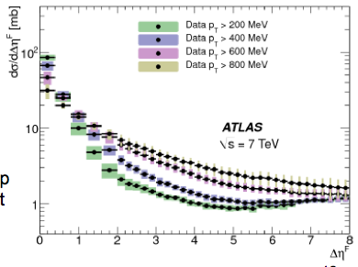
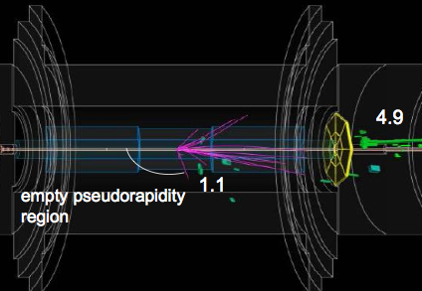
Simone Monzani: ATLAS
Cross section
σ(gap ~ 8) >
σ(gap ~ 5) !
IP exchange α > 1.0
Gap really should be no
hadrons. Sometimes use
“no jets” but not same.
With p_{T}(cut) at 400(200) MeV
still not pure.

Slide 29
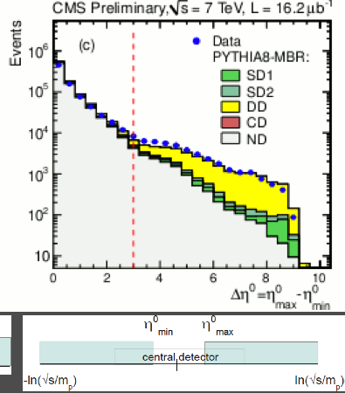
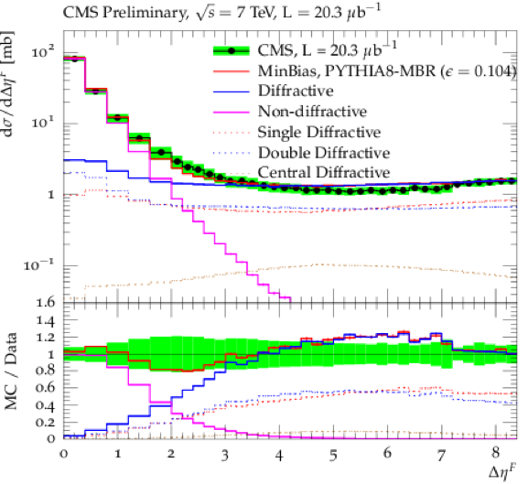
Konstantin (Dino) Goulianos : CMS
Double Diffraction = central gaps
As Δη exceeds 3 separate class of DD events
grows and becomes dominant
Agreement with ATLAS on rise at high Δη

Slide 30
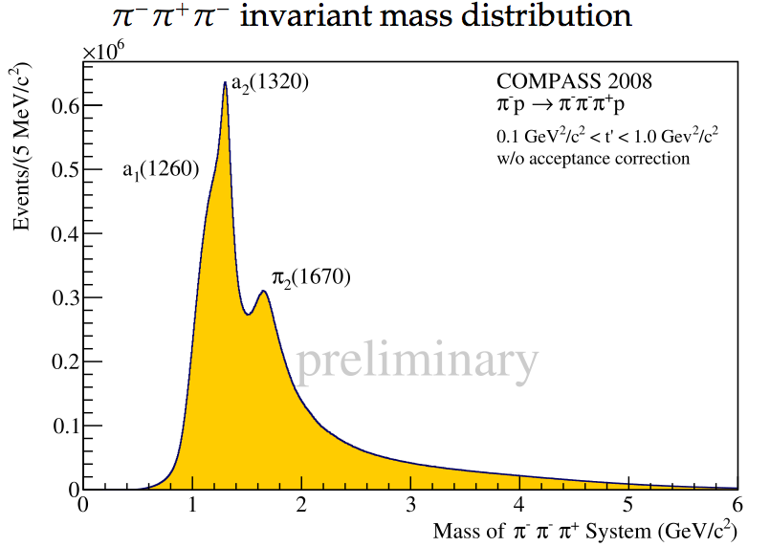
Su-Urk Chung and Alex Austregesilo : Compass, SPS fixed target π- beam
FANTASTIC!
(wish it were in high energy DPE region)

Slide 31

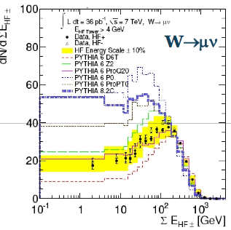
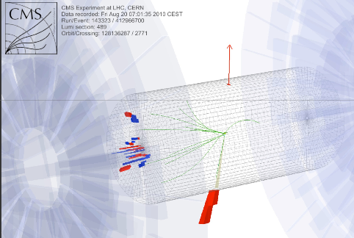
Christina Mesropian CMS
Diffractive W & Z production (rapidity gaps)
Compare to models: range of predictions:
More gap events than PYTHIA D6T, less than PYTHIA 6Z2, 8
Roman Pasechnik : Soft color interaction SCI and reconnection models applied to Diff W

Slide 32
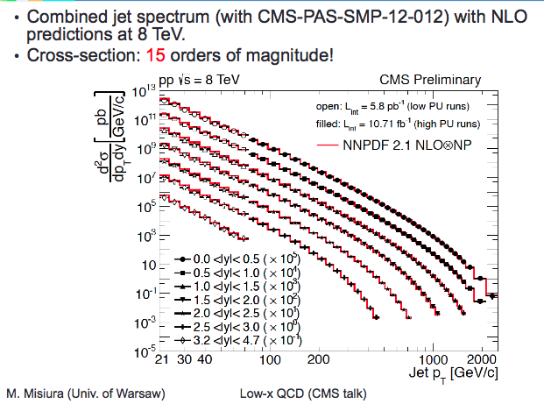

Slide 33
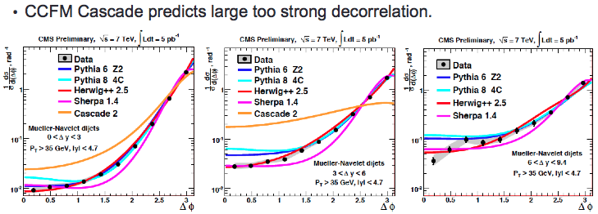
M.Misiura: CMS jets and BFKL (no sign of it)
More forward jet pairs →

Slide 34
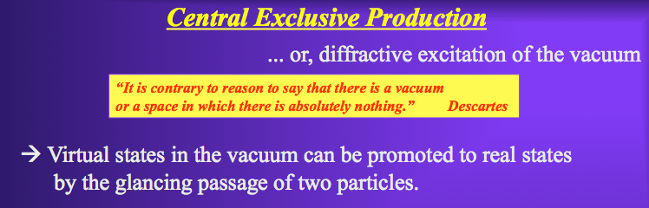

Slide 35
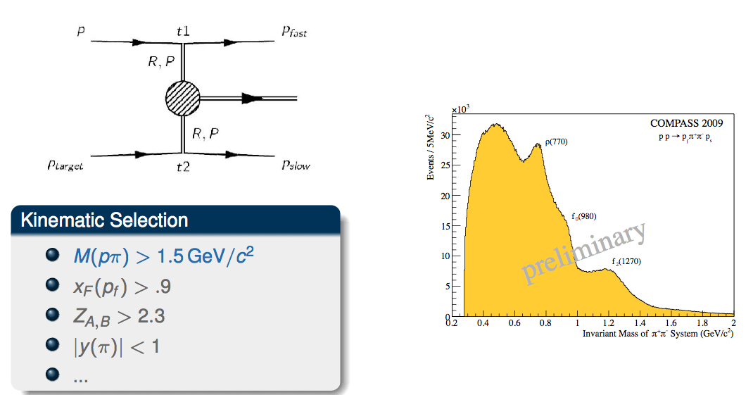
Alex Austregesilo : Compass, SPS fixed target
190 GeV/c p beam on hydrogen target
√s ~ 17 GeV so Δy(p-p) ~ 5.8 too low for DPE
Hence large ρ signal (Regge exchange)

Slide 36
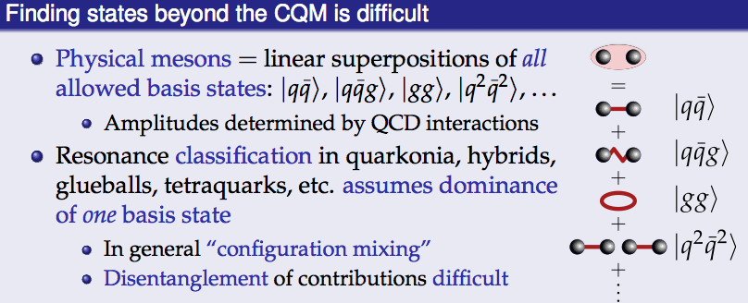

Su-Urk Chung : Compass, Multiparticle forward spectrometer at SPS fixed target

Slide 37

Konstantin (Dino) Goulianos
I cannot resist showing this slide of Dino’s, showing “my” AFS glueball search spectrum
The spectrum above 1.5 GeV has not been properly explained, but new data is arriving!

Slide 38


A good start, more to come ...

Slide 39

Mike Albrow for CDF: Exclusive central π+π- production (double pomeron exchange)
fo(980), f2(1270), f0(1370)?, ...

Slide 40

Scott Stevenson, LHCb

Slide 41

Lucien Harland-Lang with Valery Khoze, Durham group. CEP of meson pairs at Tevatron

Slide 42

Marco Meissner, Scott Stevenson, LHCb
Excellent multi-particle forward spectrometer, very good particle identification.
Plans for HERSCHEL : forward shower counters (gap detectors) on other side.
SD: p + p → p + X, with p (or p*) inferred from empty HERSCHEL, X studied in “MPS” !
Also Central Exclusive Production in 2 < |η| < 4.5

Slide 43

Fedrik Oljemark, TOTEM + CMS

Slide 44

Fedrik Oljemark, TOTEM + CMS
qqg or ggg
Note Forward Shower Counters
FSC, gaps requred 6 < |η| < 8
Events from July 2012 90m β* run
CMS: >= 2 jets ET > 20 GeV. Short low-pile-up run with ~ 100 bunches.
Large sample of p + JJ SD data. + some p + JJ(J) + p events.

Slide 45



Event from 90m β* run, low PU,
with TOTEM:
p + JetJet + p
with FSC empty both sides

Slide 46


Precision Proton Spectrometer
z = 240-250 m region
Just asking for detectors to be put there!
Looking down from an alcove balcony

Slide 47


Slide 48

M.Albrow
The future: very forward proton spectrometers for CMS(PPS) and ATLAS(AFP)
for high luminosity running, 100 fb-1/year: Jets, WW, etc

Slide 49

Oldrich Kepka: LHC Forward physics working group

Slide 50

Oldrich Kepka: LHC Forward physics working group
Frequent meetings, all experiments + theorists/phenomenologists.
Goals:

Slide 51

Shown by Laszlo Jenkovsky

Slide 52

Getting to Low-x in pp
Simple kinematics:
Mapping of partons’ x₁, x₂
to jets (objects) p_{T1} = p_{T2}
and y₁ = y₂
for Tevatron √s = 2 TeV.
For LHC-13 multiply x-axes by
2/13 = 0.15
Good:
D-Dbar pairs in LHCb, both large y
and low pT.
A) Inclusive
B) Exclusive

Slide 53


Can we measure identified
π+-, K+-, p, pbar over all Feynman x_{F} ?
Bent crystal channelling
Good hadron calorimeter: E
Transition radiation detector: γ
Hence M
Bending magnet + precision tracker: Q

Slide 54

Oscar Adriani: LHCb

Slide 55



We had some lively discussions!

Slide 56

Our field has a golden future, and Tuula found some!
Enough for the Au + Au collisions in the LHC for a decade!
Thanks Tuula and Risto and all organisers for a great conference!

Slide 57
Discussion Session
What do you mean by a pomeron?
What do you mean by a rapidity gap?
What do you mean by diffraction?
Risto left already

Slide 58
Thank you

