Slide 1


Recent gain calculations
Özkan ŞAHİN & Tadeusz KOWALSKI
Uludağ University, Physics Department,
Bursa – TURKEY
Faculty of Physics and Applied Computer Science, AGH University of Science and Technology,
Krakow – POLAND

Slide 2
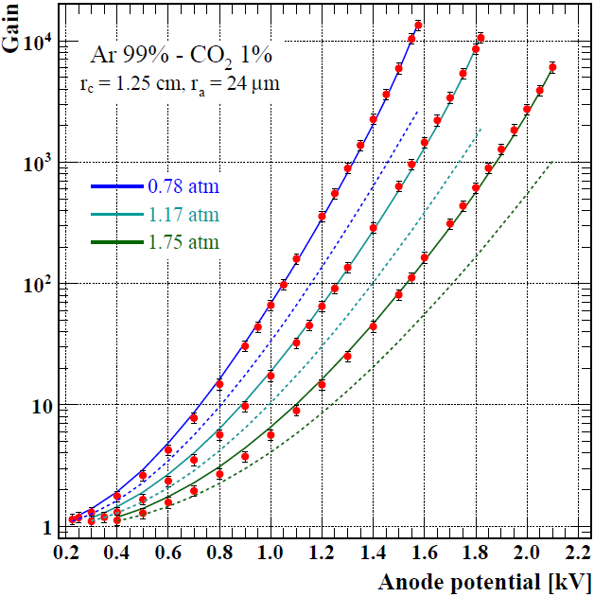
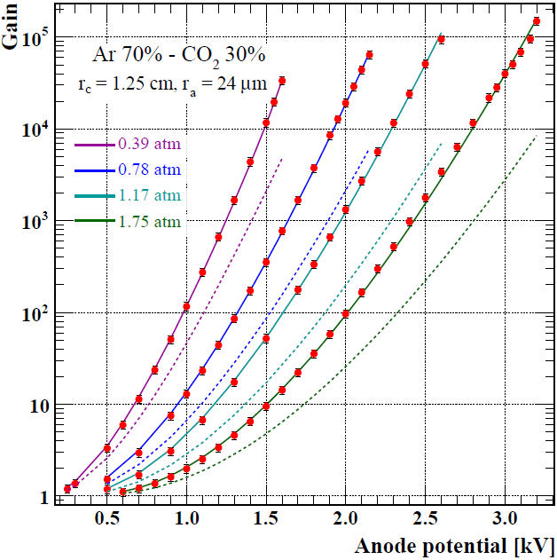
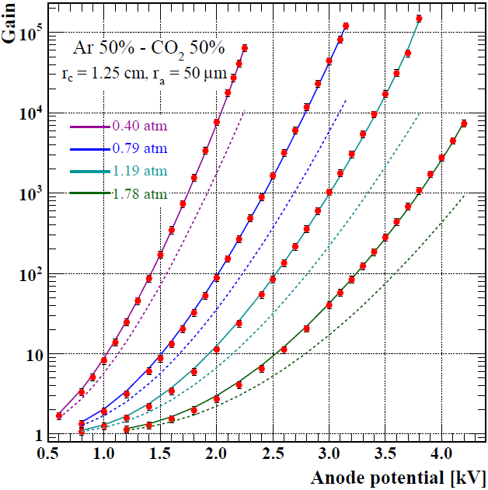
Gain measurements and fits for Ar – CO₂ mixtures
High precision gain measurements in Krakow (Tadeusz KOWALSKI)
  special guard for dark current
no need to use gain scaling
Wide gain regime: ionisation to gain of 10⁵; less than 5% error on gas gain
Pressure range: 0.4 – 1.8 atm
Admixture concentration: 1 – 50 % CO₂

Slide 3
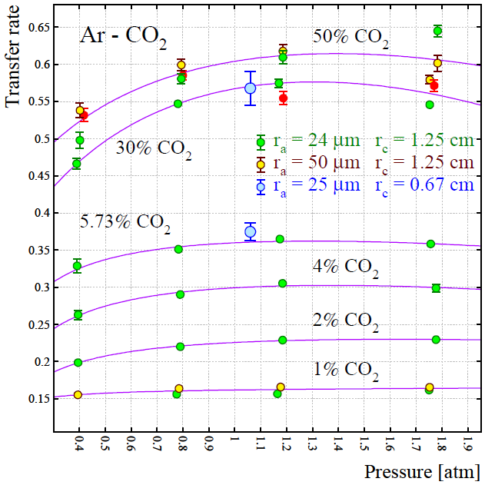
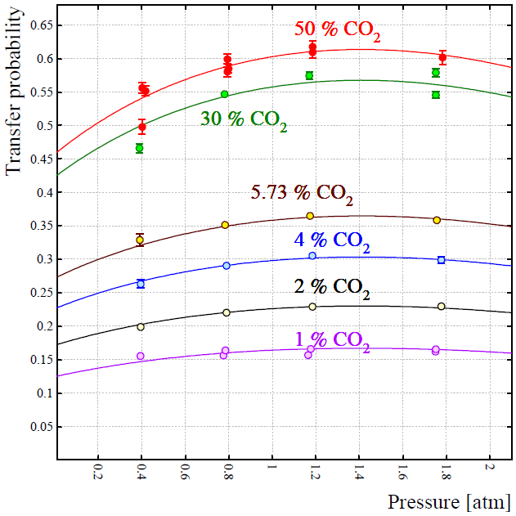
Extracted transfer rates
Fit function for 1%, 2%, 4% CO₂
Scaled fits: normalised to 50% CO₂, using its fit parameters (plot on the left)
Fit function for 5.73%, 30%, 50% CO₂
p² dependence:
evidence of 3–body interactions

Slide 4
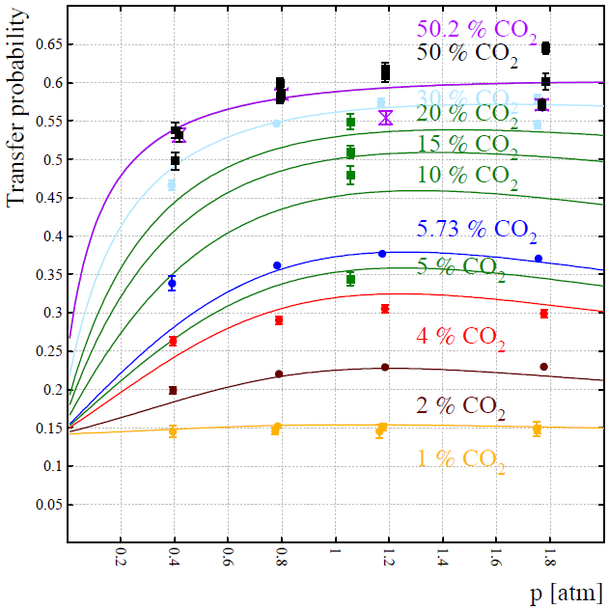
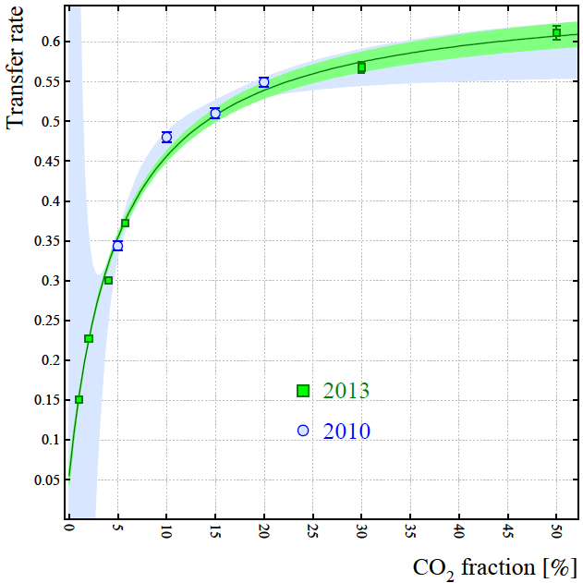
Modelling of the transfer rates
From recent gain measurements
[Ö. Şahin et al. JINST P05002 (2010) 1–30]
Plotted by Rob Veenhof
Combined fit (concentration + pressure)
All transfer rates included: Green curves extracted from T.Z. Kowalski et al. NIM A 323 (1992) 289–293
Confirmation of the transfer curves with earlier data at 1070 hPa
Lower uncertainty with recent data
Positive radiative term at low CO2 concentrations

Slide 5
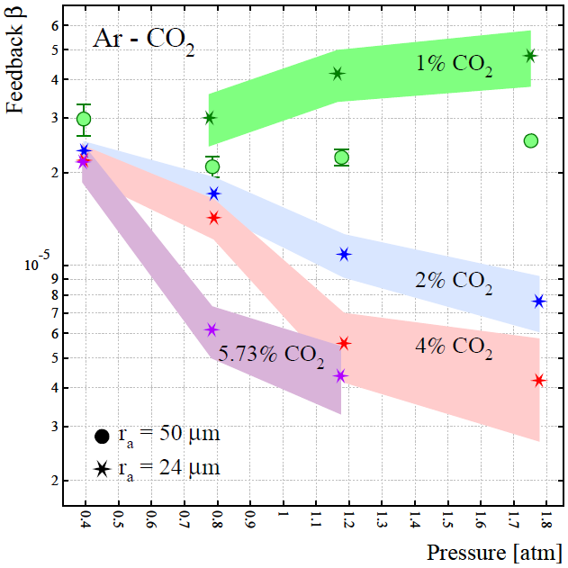
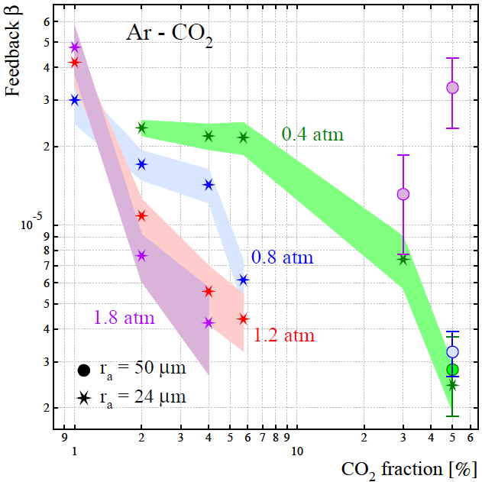
Pressure and concentration depence of feedback
1% CO₂ : increase with gas pressure
  higher β for 24 μm anode radius
2%, 4%, 5.73% CO₂ : decrease on β with pressure
0.4 atm: almost flat β for the mixtures with 2%, 4% and 5.73% CO₂
0.8 atm – 1.2 atm: β decrease with CO₂ concentrations
Decreases of β easy to explain in terms of photon mean free path !!!

Slide 6
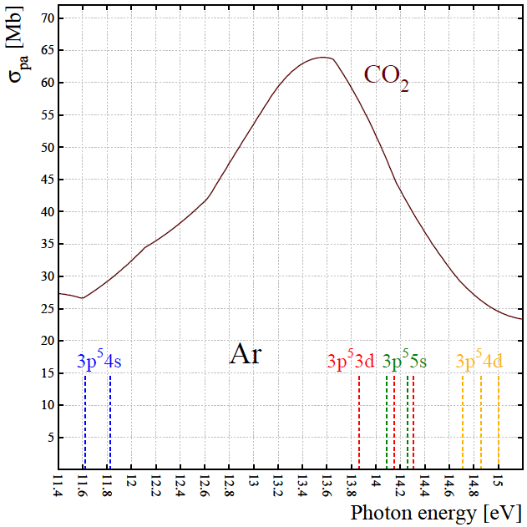
Photo – absorption cross section of CO₂
photons from 3d and higher radiative levels can ionise CO₂
4s photons produce photo – electron if they arrive the cathode but they can not ionise CO₂
non – radiative states decays to intermediate states; they have not enough energy to ionise CO₂ or to extract electron from cathode
σ_{pa} : 3d, 5s > 4s > 4d
Cross section compiled from J. Berkowitz,
Atomic and Molecular Photoabsorption, Chapter 5, p. 189–197, Academic Press (2002)

Slide 7
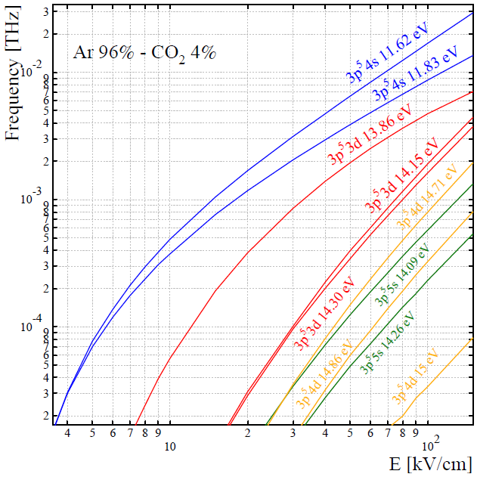
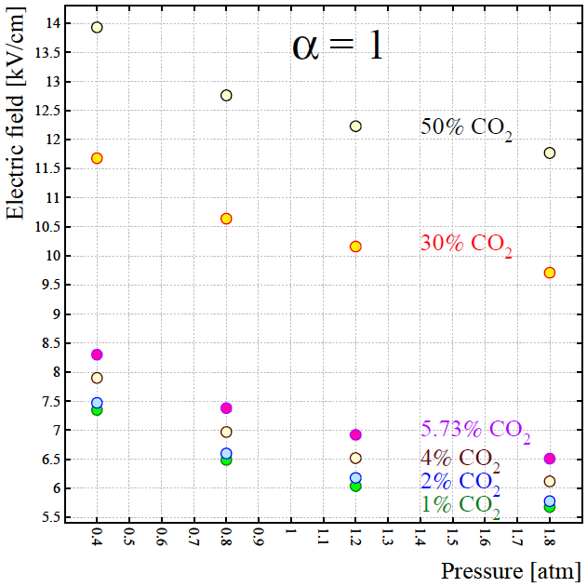
Production rates and avalanche region
4s levels are the most abudantly produced
  they are not lost in Penning transfers
  they can contribute to feedback effectively by arriving the cathode ???
α = 1 used to define avalanche sizes

Slide 8
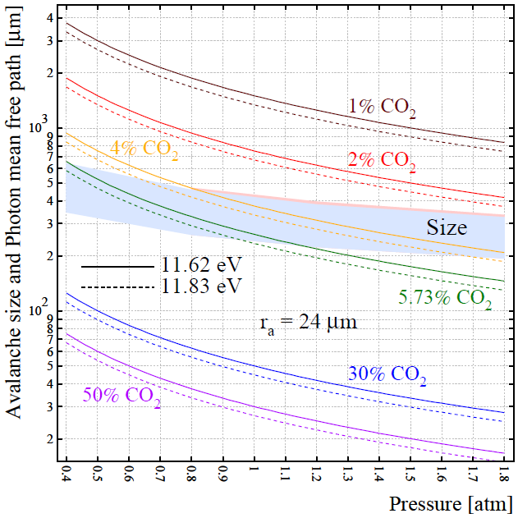
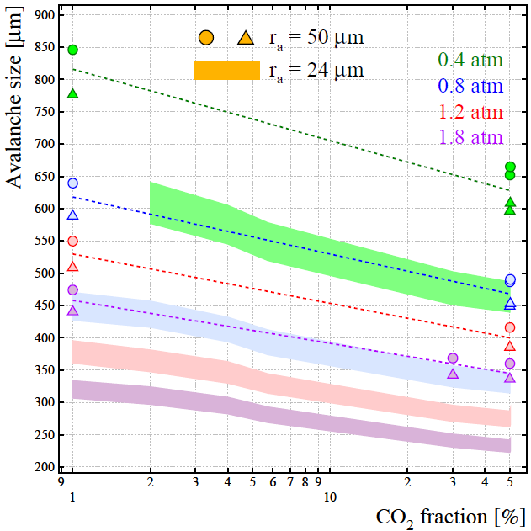
Absorption distance of the excited states
Gain: 80 – 8000
Gain: 2000 – 8000
Both avalanche sizes and photon mean free path decreases with pressure and size reduction is smaller than the mean free path
photons in 1% and 2% CO₂ stopped outside the avalanche (still in gas) while the rest are absorbed in the avalanche
Size in the tube with thinner anode wire is smaller: explains bigger beta for r_{a} = 24 μm
r_{a} = 50 μm

Slide 9
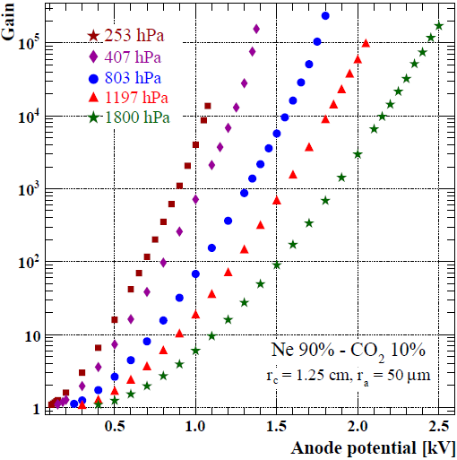
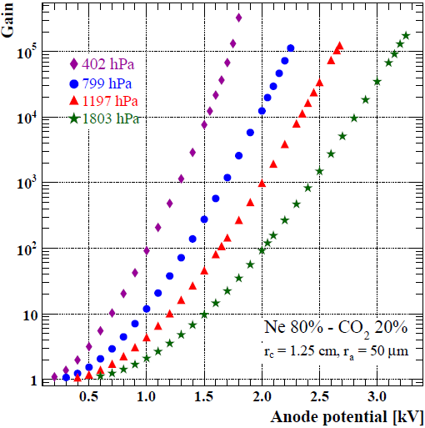
Gain in Ne – CO₂ mixtures
Measured by Tadeusz KOWALSKI with the same technique and equipment
Present calculations cover 2% – 20 % CO₂ mixtures
  All excited states of Ne can ionise CO₂ (3d and higher in Ar – CO₂ mixtures)
  No gain scaling needed as before

Slide 10
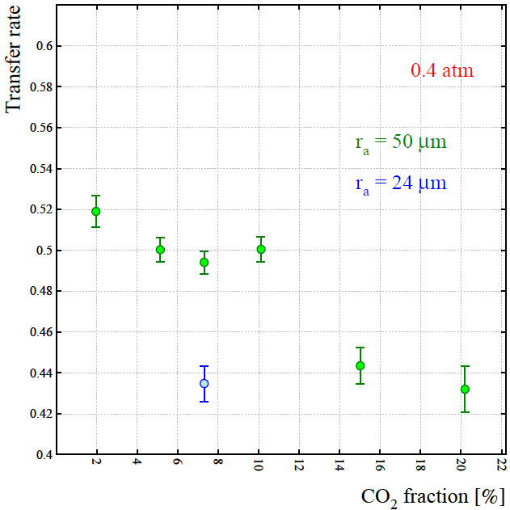
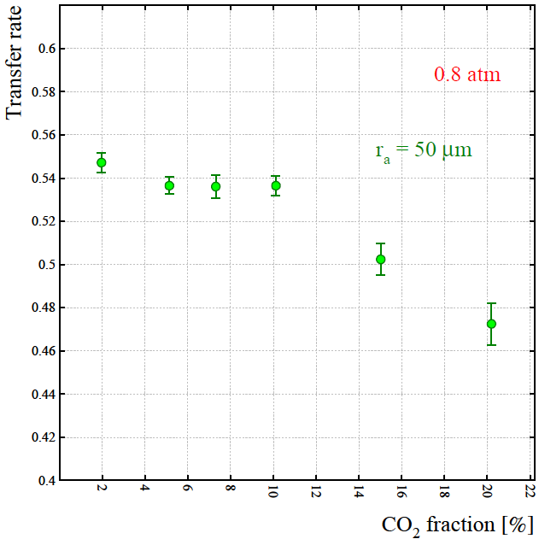
Transfer rates (0.4 and 0.8 atm)
the biggest transfer at the lowest CO₂ concentration
bump in 10% CO2 mixture then sharp decrease for higher fractions
larger rate for the tube with thicker anode wire (r_{a} = 50 μm)
rates are almost flat including 10% CO₂
then they decrease in 15% and 20% CO₂
the rates are bigger at 0.8 atm
errors on transfer rates are getting bigger for high concentrations

Slide 11
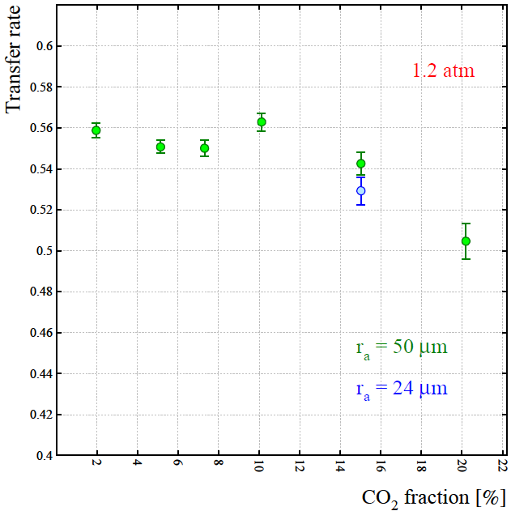
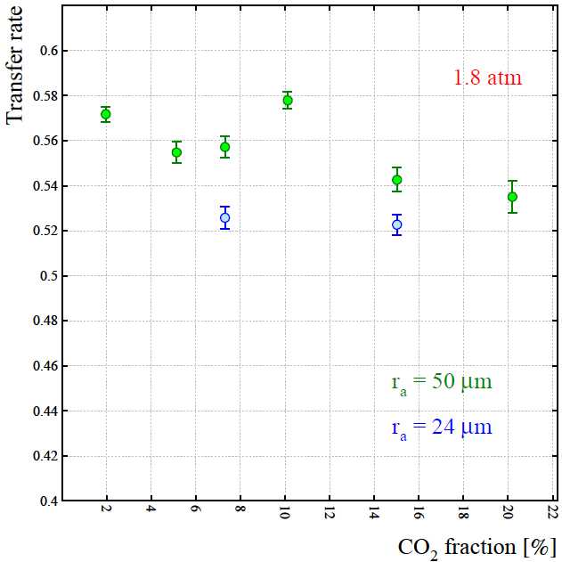
Transfer rates (1.2 and 1.8 atm)
the rates reach a maximum for 10% CO₂ mixture (see bumps)
maximum and minimum transfer rate gaps over CO₂ concentrations become smaller with increasing pressure
we get smaller rate in the tube with thinner anode wire (blue circles on the plots)
the rates interestingly decrease with increase of CO₂ fraction (first time) !!!

Slide 12
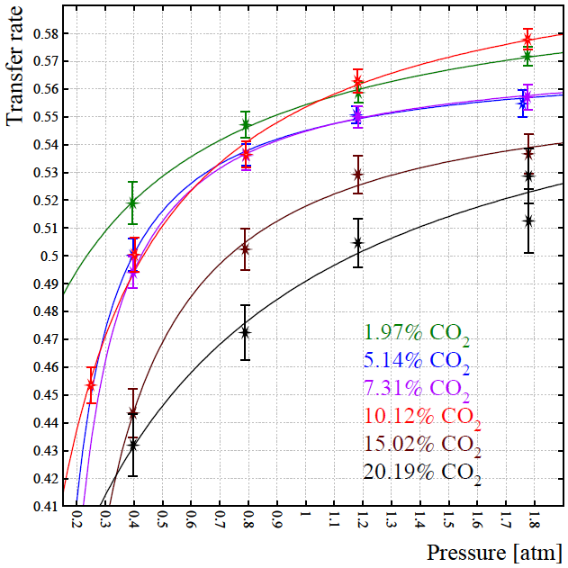
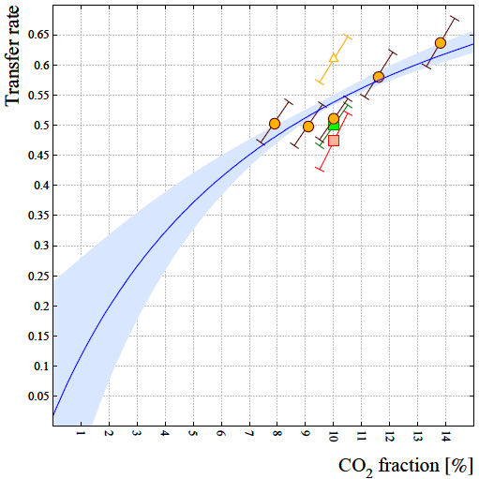
Modelling the transfer rates
no drops at the highest pressure
  there was in Ar – CO₂ mixtures
fit parameters for some mixtures are not physically meaningful
  measurements below 0.4 atm may help to get more sensible results for radiative terms
ALICE TPC results does not confirm the decrease with CO₂ concentration
  0.5% uncertainty on CO₂ fraction
  gain range: 2 10⁴ – 5 10⁵
Experimental data:
C. Garabatos, The ALICE TPC, NIM A 535 (2004) 197–200. Proceedings of the 10th International Vienna Conference on Instrumentation.
Unpublished data for R. Veenhof, Choosing a gas mixture for the Alice TPC, ALICE-INT-2003-29 version 1.0, CERN,2003.

Slide 13
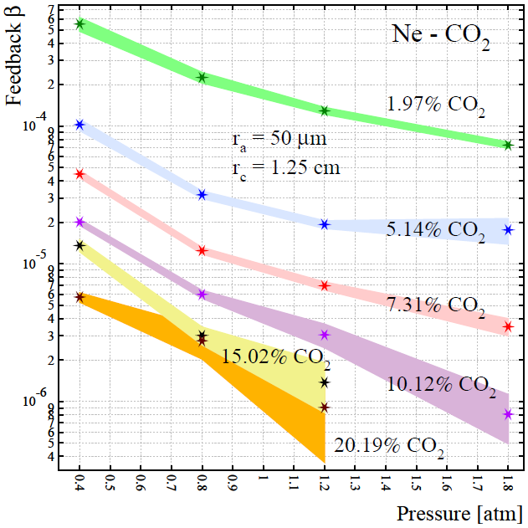
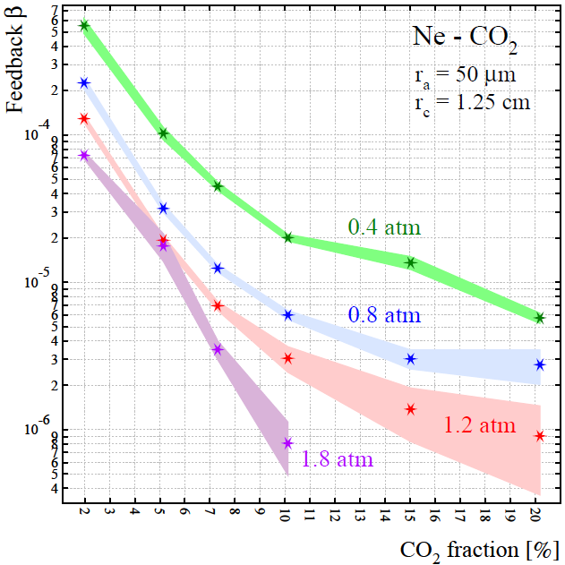
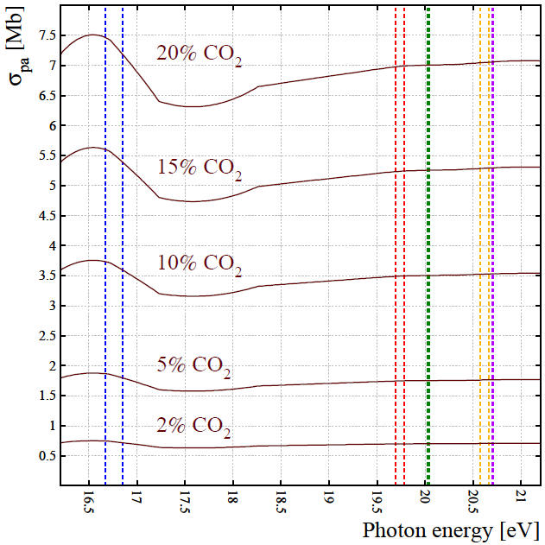
Feedback parameters in Ne – CO₂ mixtures
both increase of pressure and CO₂ concentration lead decrease on feedback parameters
feedback in Ne – CO₂ mixtures is change broader range compared to Ne – CO₂ mixtures
  Ar – CO₂ : 3 – 20 10⁻⁶, Ne – CO₂ : 0.7 – 600 10⁻⁶
calculations on avalanche sizes and photon mean free paths for Ne – CO₂ mixtures are in progress

Slide 14
Next
Hope to publish the results that we have for Ar – CO2 mixtures in very soon
We have last minute experimental gain data for Ne – CO₂ mixtures only 3 days ago; measured in 30% and 50% CO₂ fractions
  3.5% CO₂ data will also be ready in a few days (private communication with Tadeusz KOWALSKI, 13th Oct)
  very important to fill gaps modelling of the transfer rates
  calculations are in progress
  measurements in 1% CO₂ would also be very useful !!!
Physical meaning of drops of the transfer rates at high CO₂ fractions has to be worked closely
  We will check Magboltz cross sections for Ne by comparing the literature

Slide 15
Thanks and ???

