Slide 1

MICE Magnetic Field Mitigation Review
-- Design, engineer and build a section of cooling channel capable of giving the desired performance for a Neutrino Factory;
-- Place it in a muon beam and measure its performance in various modes of operation and beam conditions, thereby investigating the limits and practicality of cooling.

Slide 2
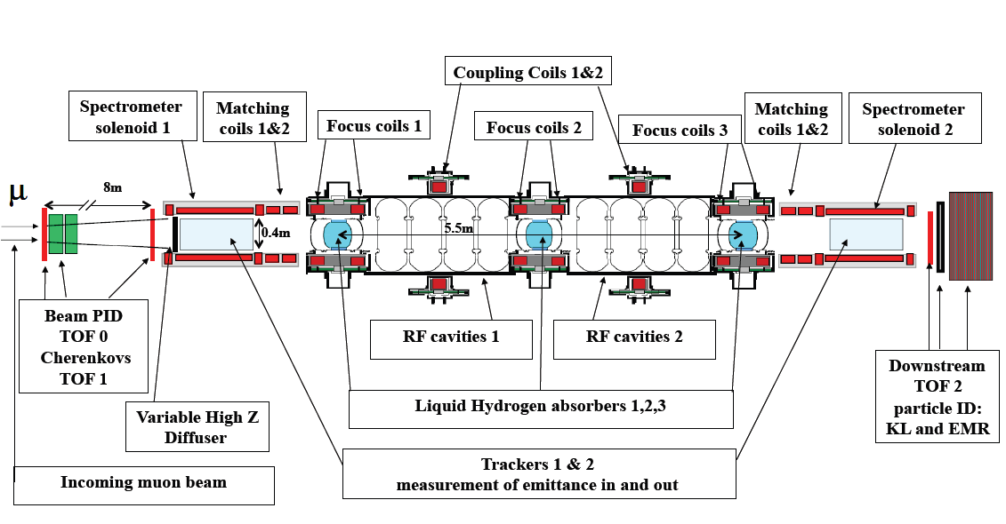
MICE the Muon Ionization Cooling Experiment
Measure input particle
x,x’,y,y’, t, t’=E/Pz
➔ input emittance ε^{in}
Measure output particle
x,x’,y,y’, t, t’=E/Pz
➔ output emittance ε^{out}
COOLING CHANNEL
Particle by particle measurement, then accumulate few 10⁵ muons
→ Δ[ (ε^{in}- ε^{out})/ε^{in} ] = 10⁻³

Slide 3
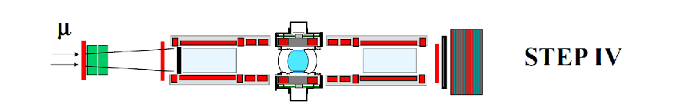
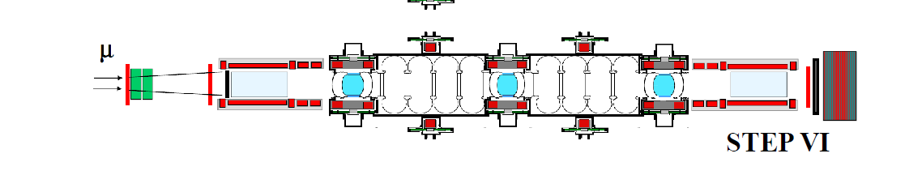
Provisional MICE SCHEDULE
update: June 2013
μ
Run date:
STEP I
EMR run Oct 2013
(possibly
w/o field:
Q2 2014)
Q1 2015
to Q1 2016
Under construction:
Target date Q3 2019
Step V run possible 2018

Slide 4
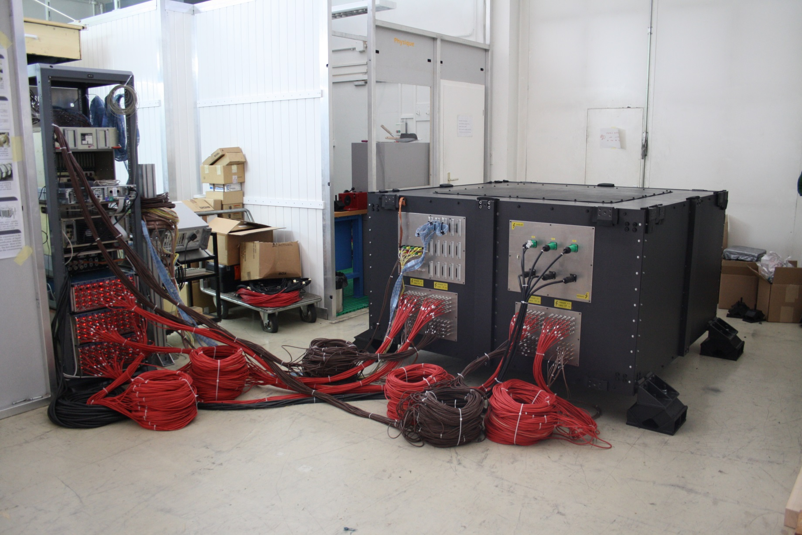
MICE EMR running cosmics at Geneva and ready to ship.
Will arrive at RAL (this) Thursday 26 Sept. 2013
A 5cm thick plate for
magnetic shielding

Slide 5
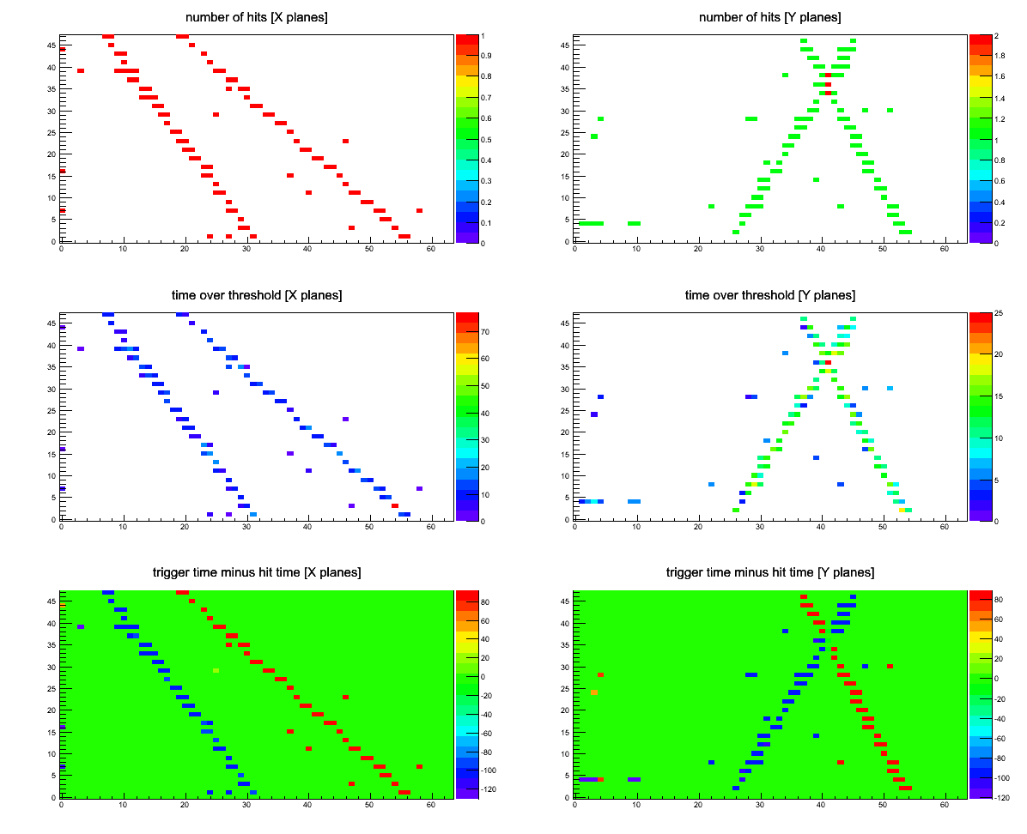

Slide 6
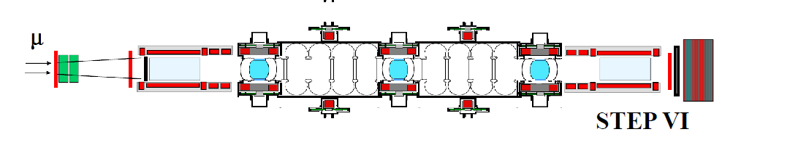
Flashback: The MICE magnets
Are simple superconducting coils without return yokes
From MICE proposal: (2003):
The baseline MICE magnetic channel does not include either active or passive magnetic shielding in the vicinity of the experiment and generates a significant magnetic field in the experimental hall.
This design feature cannot be modified very easily since the focusing properties of the coils in the cooling section originate from the fringe fields themselves.
Therefore, it has to be checked that the field within the MICE experimental hall, as well as the stray field in the nearby buildings, in particular the ISIS linac and control room, are below the required safe levels.
This was done and led to the installation of shielding walls around the experiment
Individual equipement owners were deemed to worry about effect of magnetic field
(this is what TOF and EMR did for instance by designing large shieding plates)

Slide 7
In 2011 (at the occasion of an RF equipment review) it was realized that
the issue needed to be revisited.
A small working group (Blackmore, Courthold, Preece, Zisman) was asked
to review the effect of stray magnetic fields on equipment in the MICE hall.
Report in June 2012. red alarm: local shielding of equipements such as compressors for cryocoolers affects field map and problem is 'run-away'.
Magnetic Field Mitigation group (Bross, Long et al) took on problem energetically
Two solutions studied in parallel on the two sides of Atlantic

Slide 8
two possible solutions for step IV field mitigation
1. “baseline” solution
take everything sensitive away from the high field region.
++ hope to be able to maintain goal of running before August 2014 (7 month ISIS shut down)
++ led to increase of space for experiment (new rack room and excellent use of west wall)
-- a number of magnetically sensitive elements cannot be moved and must be shielded individually (tracker VLPC readout system among others)
-- the risk of having forgotten something is perceived as high and very dangerous,
-- possible degradation of performance of some components
-- the MICE hall remains a high magnetic field region
-- this is not a viable solution for step V/VI
2. Partial Return Yoke (PRY):
provide a return yoke to the experiment to contain the field around the magnets
++ reduces fields in the hall to small level and solves problem of risk to individual equipment
++ does not modify field along the beam line significantly
++ is a first step towards the solution for step V/VI
-- new development
-- installation, cost, risk and schedule implications need to be understood
-- must allow interchange of absorbers in reasonable time for the step IV running

Slide 9
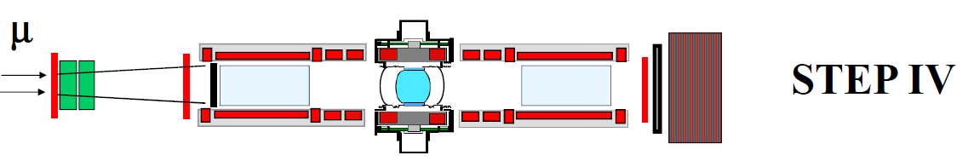
STEP IV EXPERIMENTS (2015-2016)
No absorber
Alignment
Optics studies
Liq H₂ absorber
(full/empty)
Multiple scattering
Energy loss
➔ Cooling
Solid absorber(s)
LiH
Plastic
C, Al, Cu
LiH Wedge absorber
Emittance exchange

Slide 10
Collaboration boundary condition that a solution be decided by August 2013 and to hold a review in September 2013. NOW.
MICE Project Board requested (as action) the same of us. (May 2013)
Since then:
-- initial aim of having step IV installed and running usefully before August 2014 is now out of reach in any configuration
-- still not certain that all magnetically sensitive elements can be identified and shielded without PRY
The collaboration :
++ praises the hard work and excellent analysis of the problem by the Magnetic Field Mitigation group
++ endorses the recommendation of PRY implementation
➔ the PRY is the solution that the committee is asked to review today
Possibility to install all step IV equipment for a dry run before August 2014 would be a very welcome asset as it will save time and risk towards step IV

