Slide 1
Magnetic Field Mitigation
Schedule Options
Alan Grant

Slide 2
Overview
Option 1
  Step IV base line schedule - NO PRY (Partial Return Yoke)
Option 2
  Step IV schedule – Spectrometer Solenoids Installed BEFORE PRY

Slide 3
  Option 1 - Step IV base line schedule - NO PRY
  Critical Path
(Risk)-(R2) 40day delay
(Risk)-(R3) 20day delay
(Risk)-(R4) 10day delay

Slide 4
  Option 1 - Step IV base line schedule - NO PRY
  Critical Path
29/9/15
2/1/15
Assumes we can engineer solutions to known localised shielding issues
More risky – may have overlooked some components
Critical path driven by West Mezzanine Wall and compressor installation
Magnets cooled in September 14
If channel does not work may have to install PRY – risk of delay for stepIV completion

Slide 5
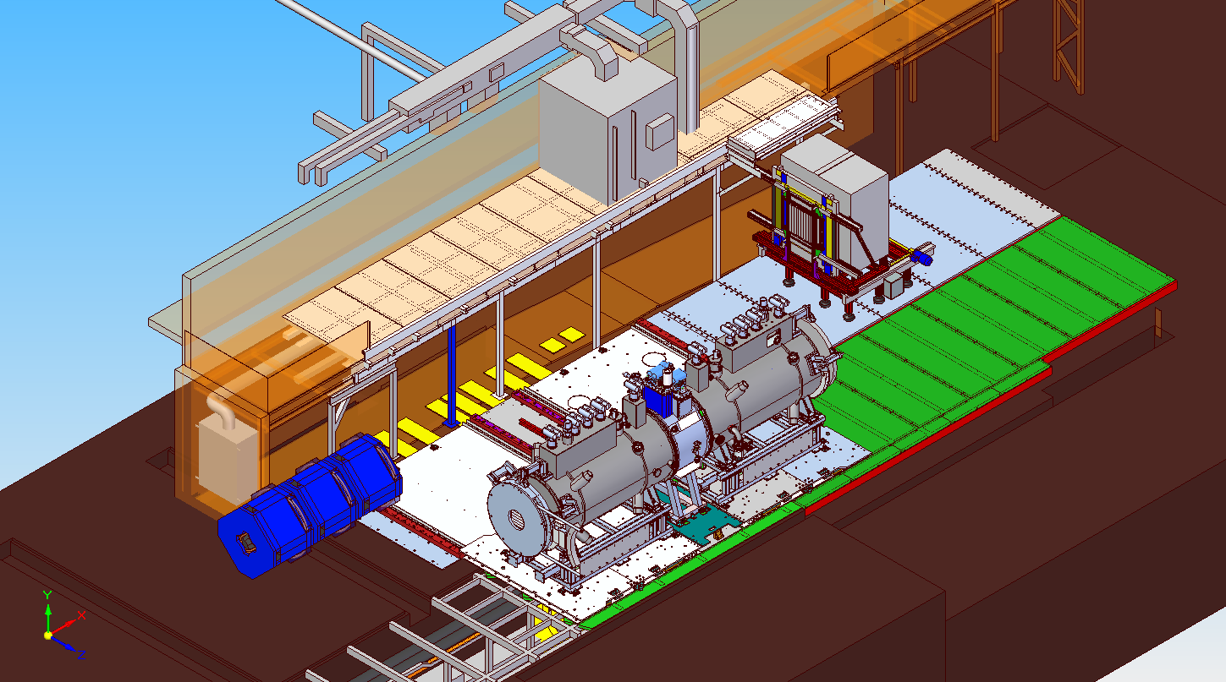
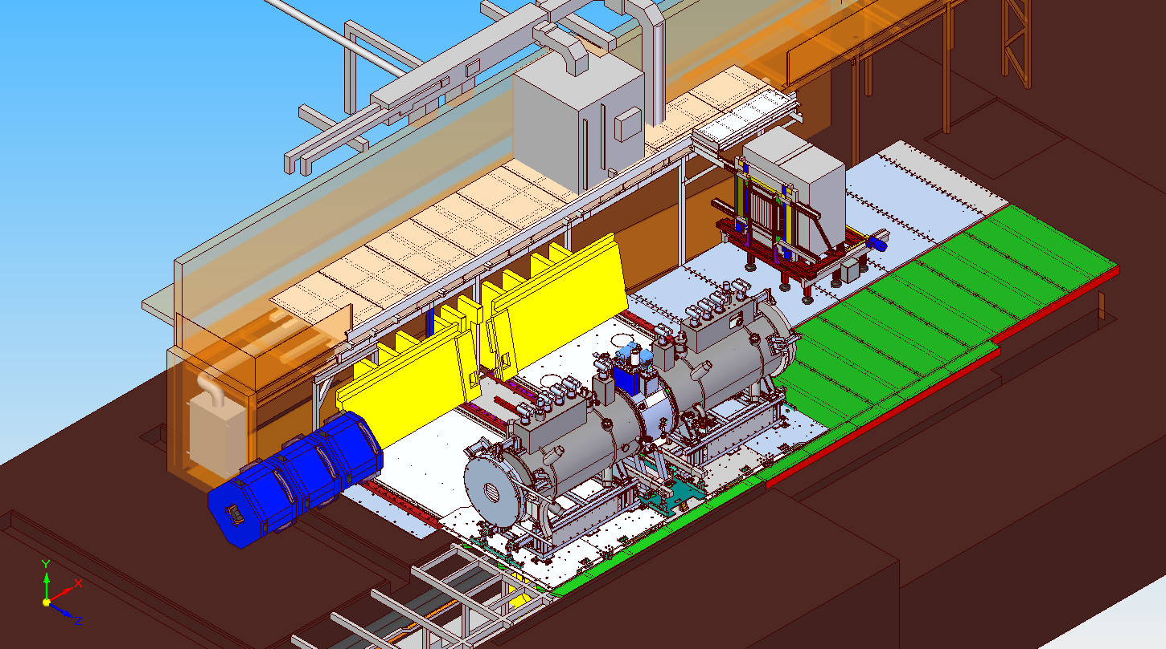

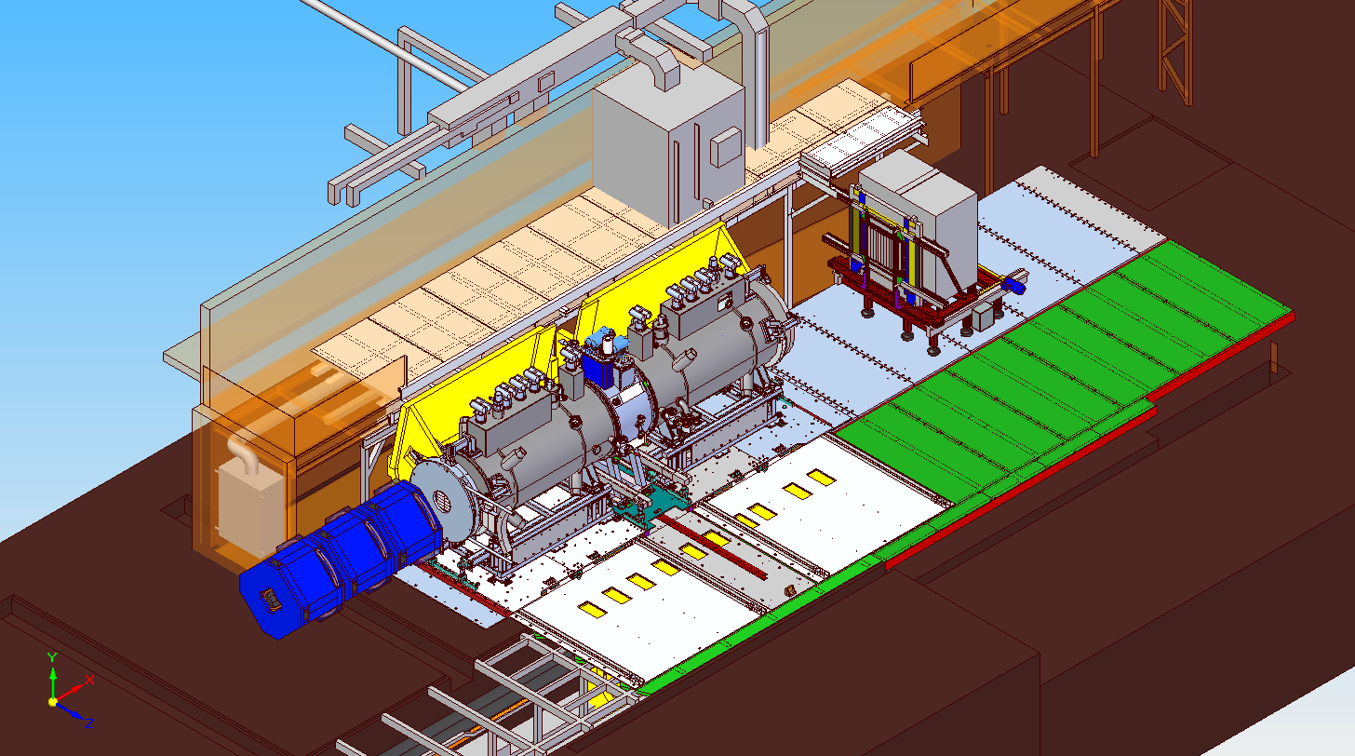
  Option 2 - Step IV schedule – Spectrometer Solenoids Installed BEFORE PRY
(Risk)-(R1) 80day delay
Fig 1. Devices installed online initially.
Fig 2. Devices moved offline. South PRY lower installed
Fig 3. South PRY upper installed
Images courtesy of Jason Tarrant

Slide 6
  Option 2 - Step IV schedule – Spectrometer Solenoids Installed BEFORE PRY
  Critical Path
(Risk)-(R2) 40day delay
(Risk)-(R3) 20day delay
(Risk)-(R4) 10day delay

Slide 7
  Option 2 - Step IV schedule – Spectrometer Solenoids Installed BEFORE PRY
  Critical Path
27/10/15
30/1/15
Assumes South side PRY available mid April
Assumes North side PRY available mid July – but not installed until mid September
Critical path driven by West Mezzanine Wall and compressor installation
Magnets cooled in September 14
Magnet training can only take place after full PRY is installed

Slide 8
Summary
 | Finish Date | Delayed finish due to Risk
StepIV base line | 2/1/15 | 29/9/15
SS before PRY | 30/1/15 | 27/10/15
Critical path driven by West Mezzanine Wall and compressor installation
Further work required to identify & quantify risks.
Estimated cost:- £500k & 5man yrs effort UK
Assumes delivery of South PRY mid April 14 and North PRY mid July 14
North PRY not installed until September 14
Risk Delay – assumes we incur all identified delays
Schedule & risks need to be monitored as these will change

