Slide 1
Partial Return Yoke
-
Concept and Magnetic Design

Slide 2
Overview
Introduction and Concept
Performance
Integration with MICE
Risks

Slide 3
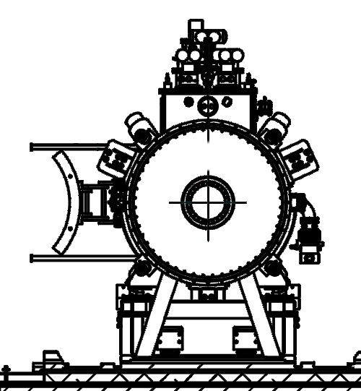
Partial Return Yoke
MICE hall: solenoids cause large stray field
Aim of PRY:
Reduce stray field in hall to tolerable level
Shielding plates
  wall thickness >10 cm
  weight: 35t
Performance
  Reduces stray field outside of shield to 5-10 Gauss
H Witte. Step IV & VI: Local Flux Return. MICE CM 34, October 2012.
(Note: not to scale)

Slide 4
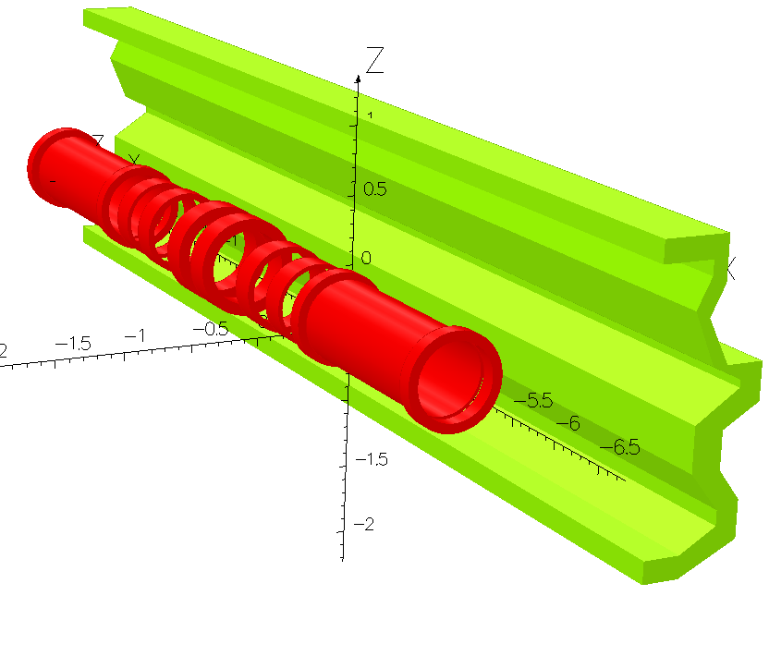
Geometric Variations
Initial Design
Vertical Extensions +
New Virostek Plates
Present Design
Engineering driven
MICE CM 2012

Slide 5
Principle

Slide 6
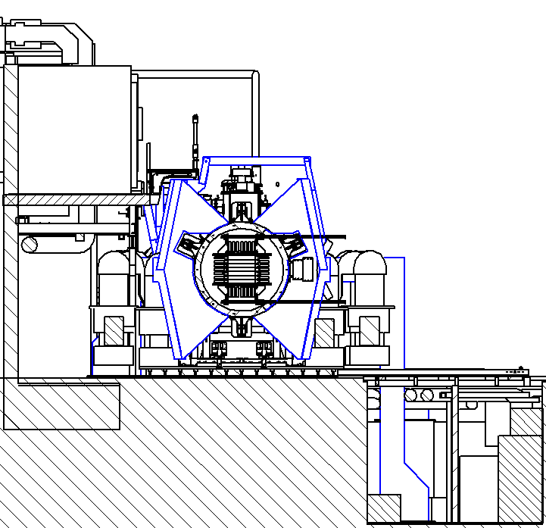
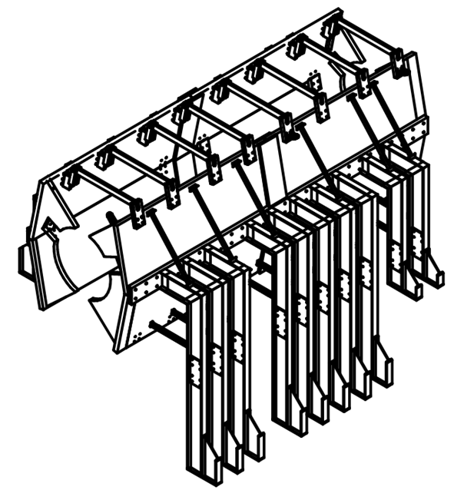
Partial Return Yoke
Shielding plates
8m
3m
Courtesy of Jason Tarrant / Steve Plate
Support Structure

Slide 7
Performance

Slide 8
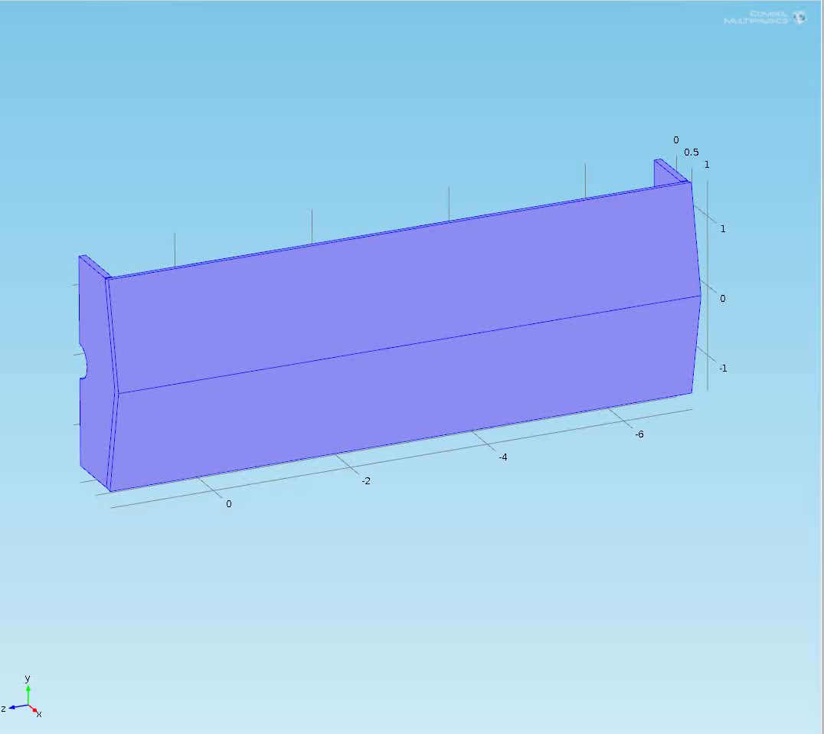
5 Gauss Surface

Slide 9
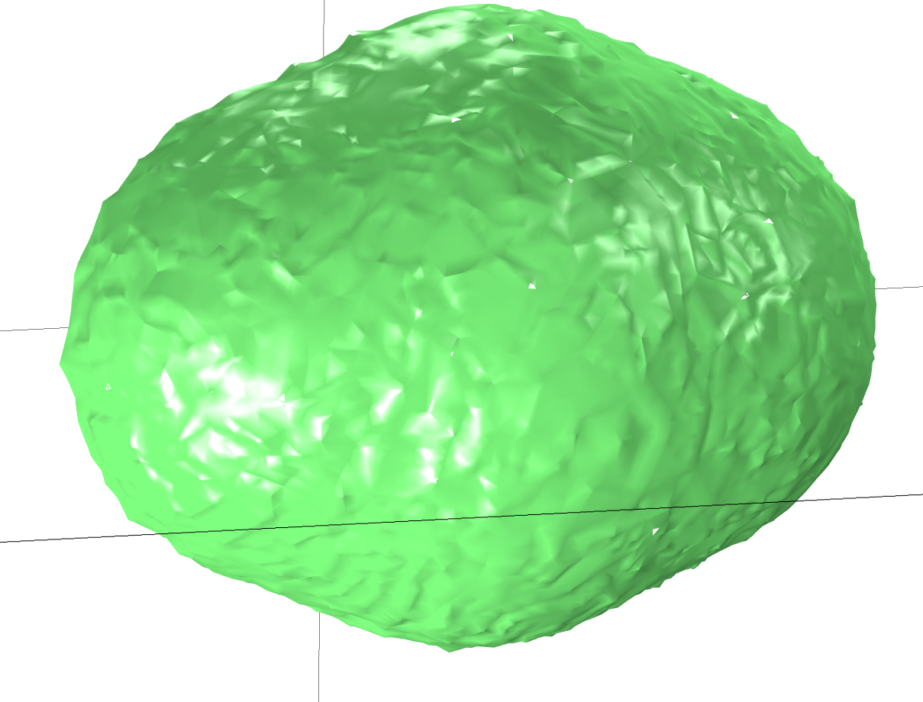
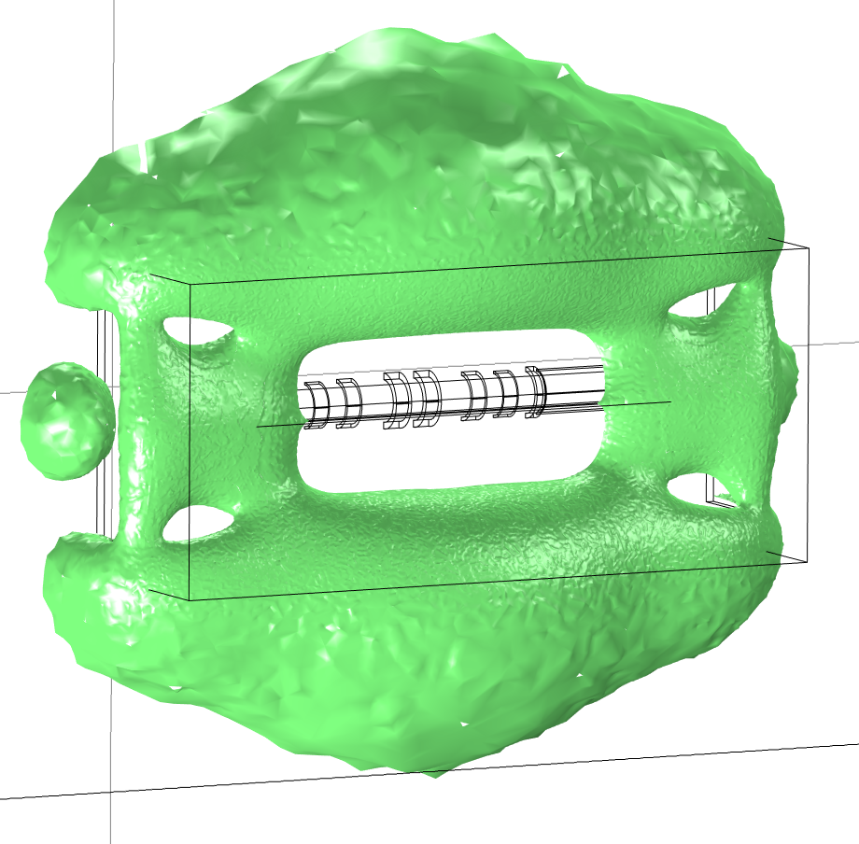
Iso-Surface 0.5 mT
No Shield
12 cm Shield
MICE Solenoids
9 m
Step IV
200 MeV Flip

Slide 10
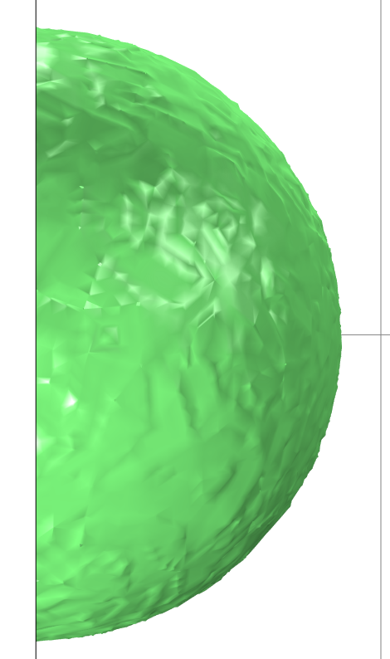
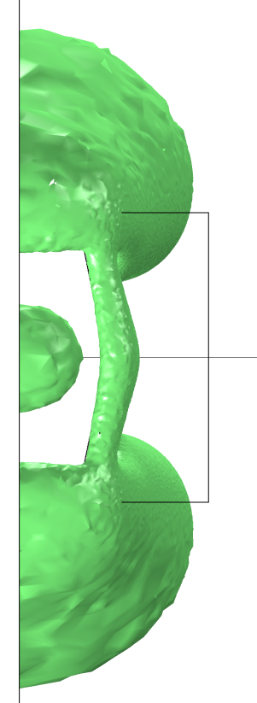
Frontal View – 240 MeV Solenoid
0 m
10 m
All 5 Gauss
0 m
1.3 m
12 cm Shield
No Shield

Slide 11
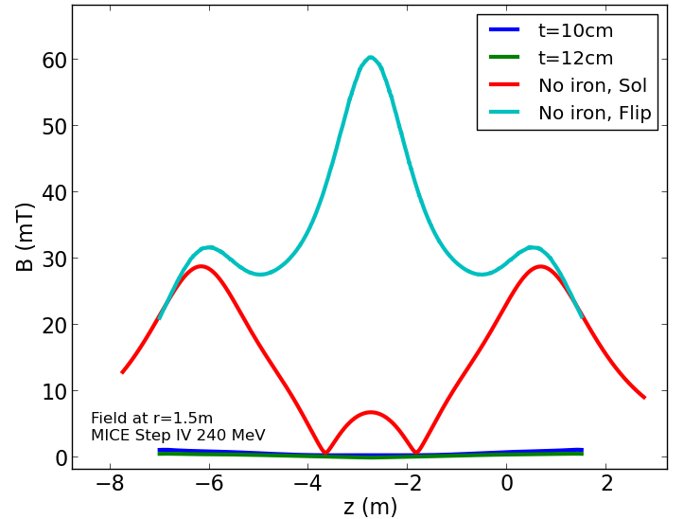
240 MeV Solenoid/Flip Mode
Notes:
Redo plot

Slide 12
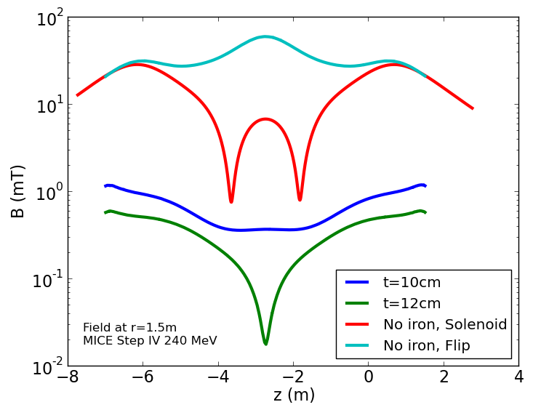
240 MeV Solenoid/Flip Mode

Slide 13
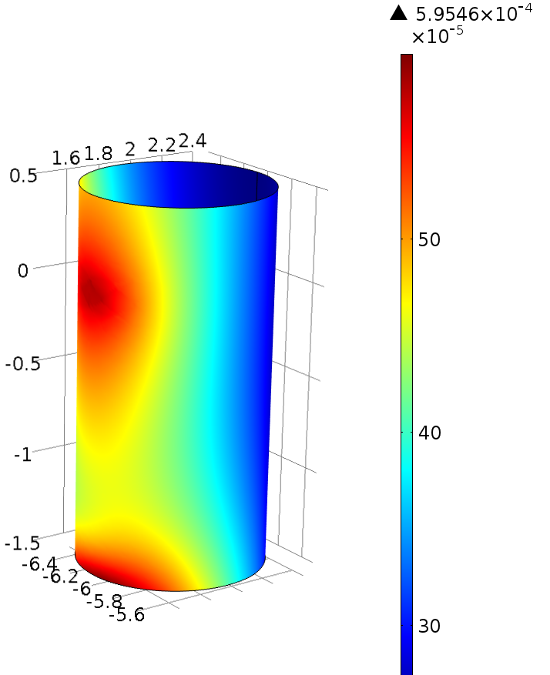
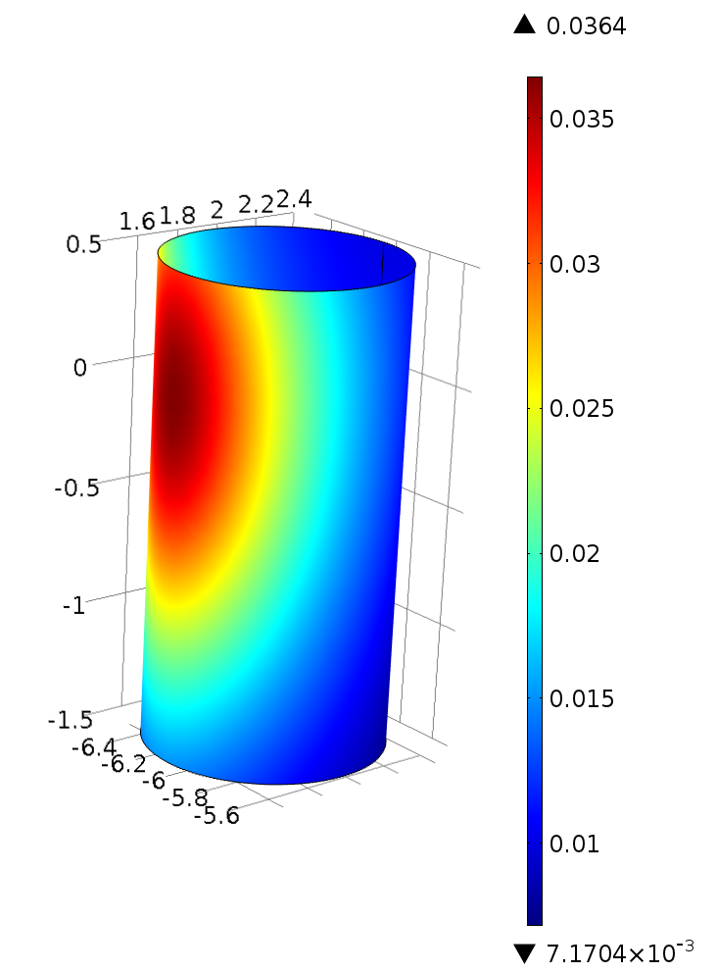
Field Tracker Cryostat
Tracker readout position:
  Longitudinally same height as End Coil 2
  Diameter 1 m
  Just next to shield
Fields
  No iron: 36.4 mT
  Shield: 0.6 mT
  Difference: factor 60
  240 MeV Solenoid
  (12 cm shield)
  Falls off quickly
No Shield
Shield

Slide 14
Integration

Slide 15
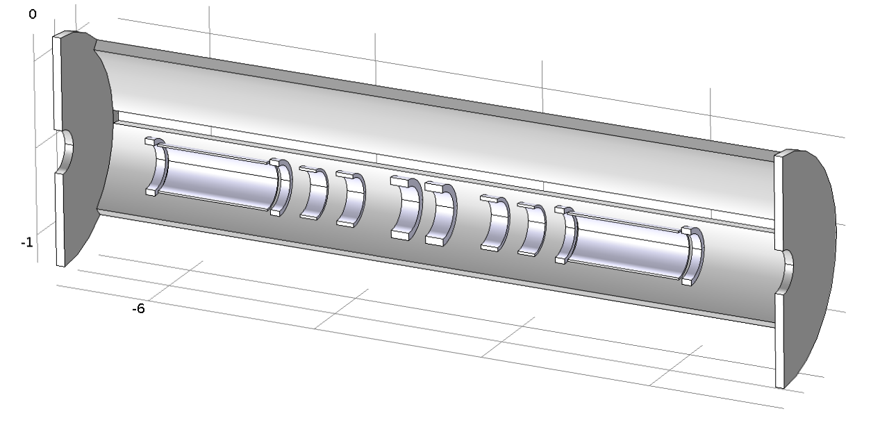
Horizontal Gaps
Gap
H Witte. Update on Shield, Presentation 14.11.2012, Magnetic shielding meeting.
MICE Step IV, 200 MeV, Flip Mode
Thickness shield 12 cm

Slide 16
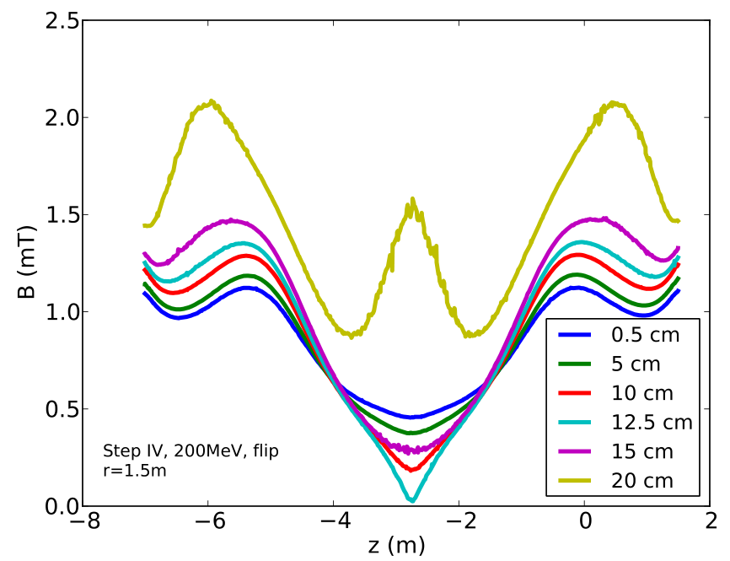
Horizontal Gaps
Low sensitivity
No issue if gap is not too large

Slide 17
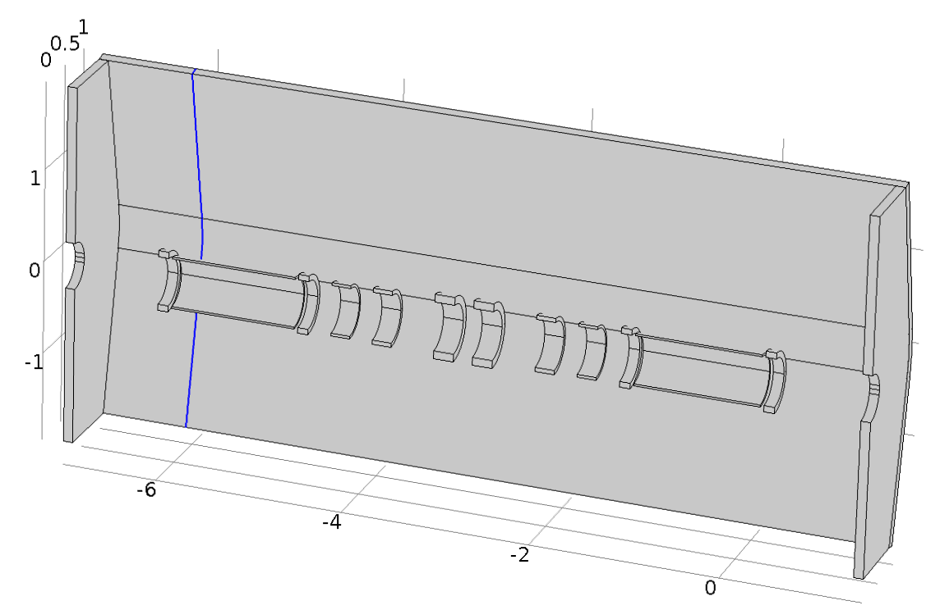

Vertical Gaps
Gap
Modeled using
thin permeability gap BC:
H Witte. Azimuthal Gaps, Presentation 10.1.2013, Magnetic shielding meeting.
Notes:
Redo colours

Slide 18
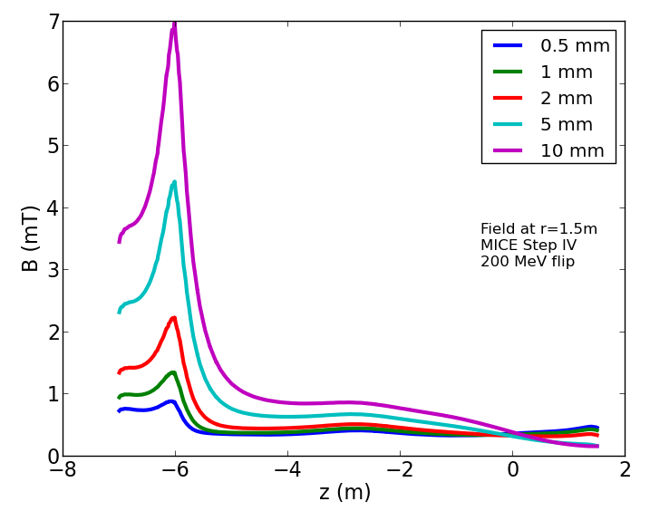
Vertical Gaps
High sensitivity: Small gap leads to large flux leakage

Slide 19
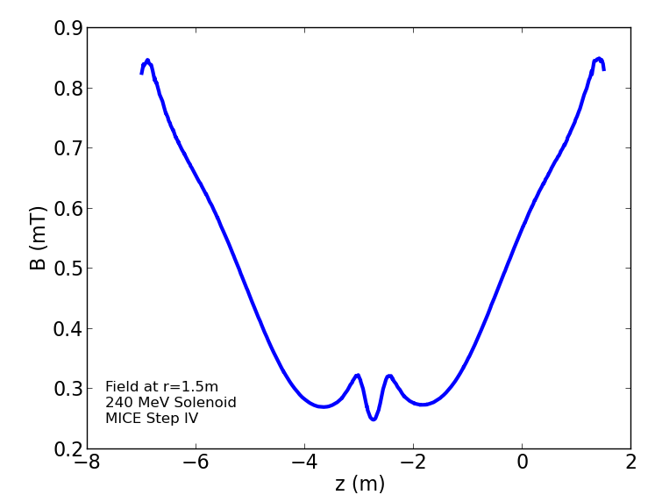
240 MeV Solenoid
Vertical joint
t=10cm
R = 1.5 m
H Witte. Racks and Compressors-Fields, Presentation 23.1.2013, Magnetic shielding meeting.

Slide 20
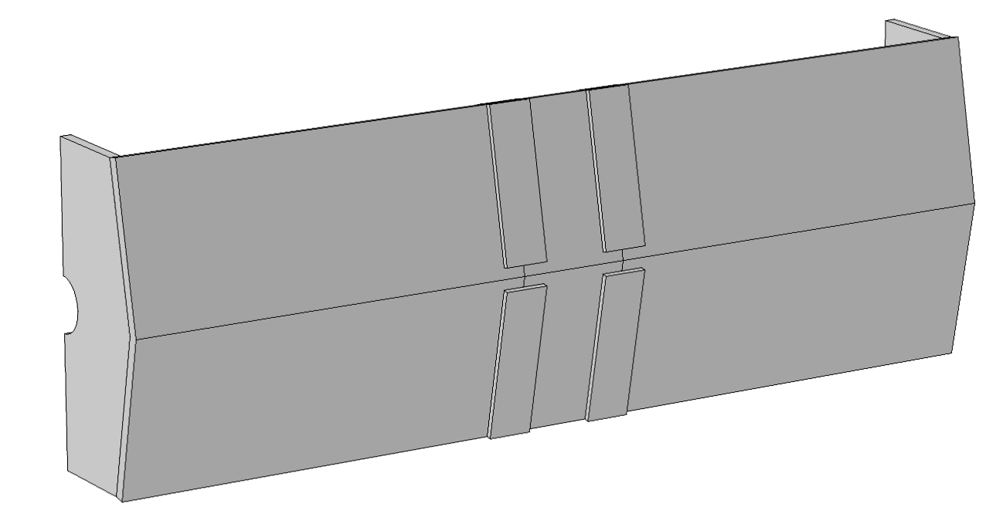
PRY 3 Sections
Recent development
Allows to change absorbers without dismantling entire shield
1 m

Slide 21
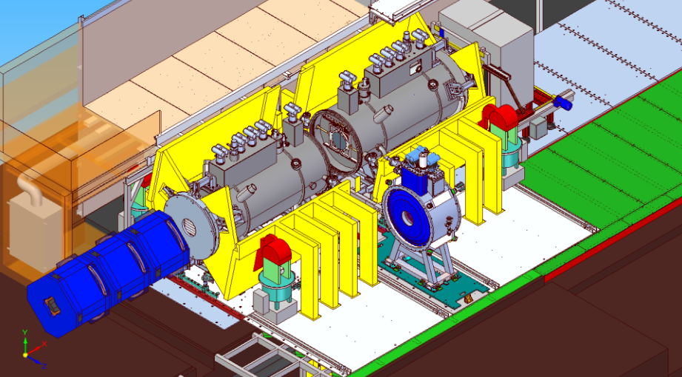
Absorber Change
Procedure in place (J. Tarrant)

Slide 22
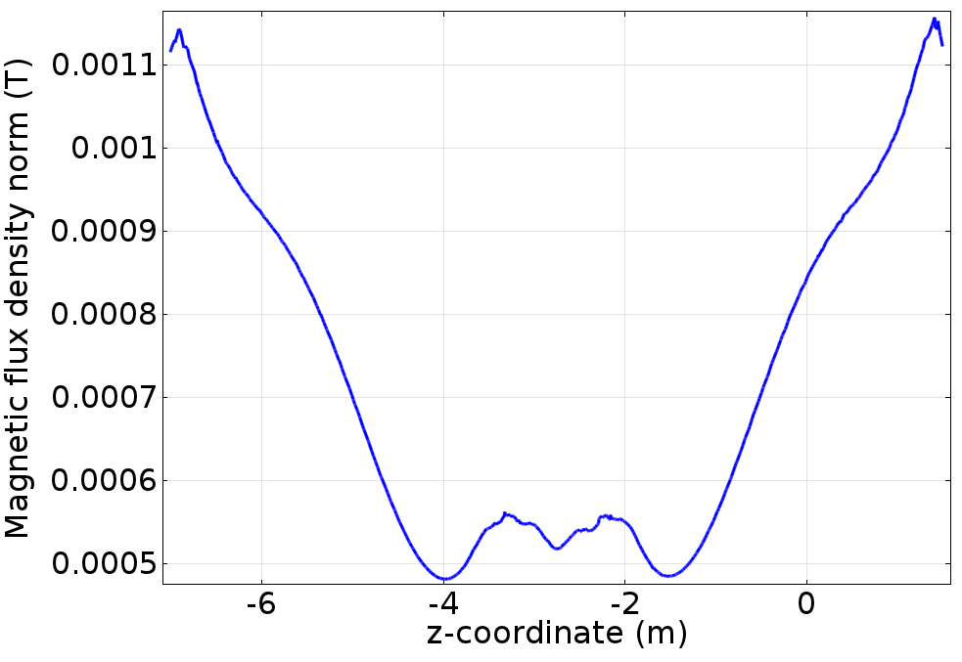
Field R=1.5 m
Joints increase field by 0.05 mT

Slide 23
Forces
Force on Partial Return Yoke
  Horizontal: 8.7 kN per shielding plate
  (35 kN for one PRY half)
  Support structure designed for this
  (see Steve Plate’s talk)
Forces on coils: no significant change
  <1% in longitudinal direction

Slide 24
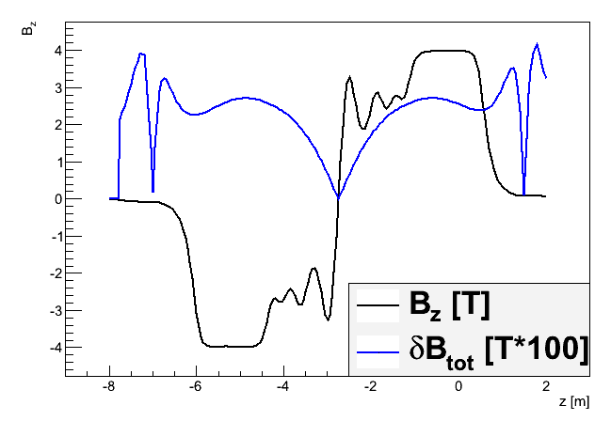
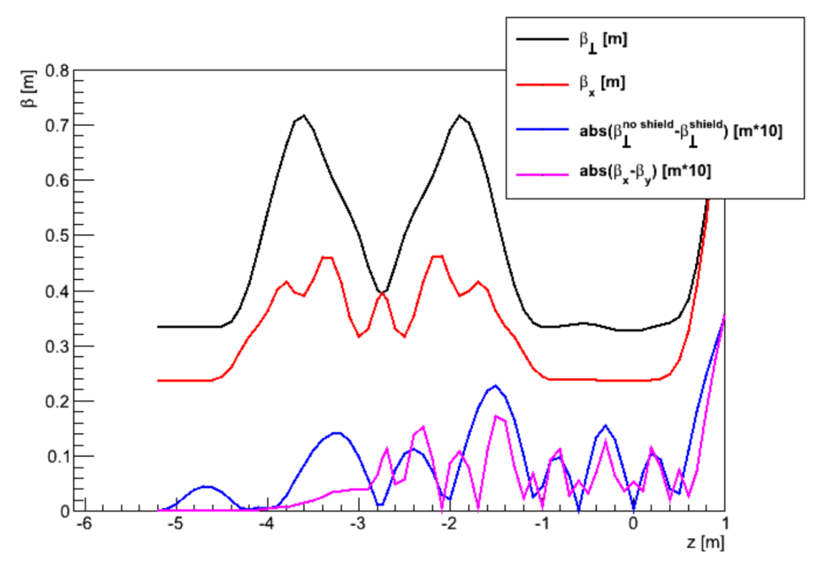
Effect on Beam
MAUS tracking study
  200 MeV Flip
  Error field map: all iron versus no iron at all (worst case)
    Original and current geometry
    Misalignments (1 mm + rotation)
  Discussed at MICE analysis meeting 24/1/2013
Conclusion
  …barely measurable effect on the beam travelling through MICE.
  There is no reason, from a beam dynamics perspective, not to implement a shielding wall as described herein.
C. Rogers and H. Witte. Effect Of Iron Partial Return Yoke on the MICE Beam. 23/01/2013, http://micewww.pp.rl.ac.uk/issues/1161

Slide 25
Cryocooler Heads
CAD model courtesy of S. Plate / J. Tarrant
1.463 m
Concern: PRY may increase field at cryocooler heads

Slide 26
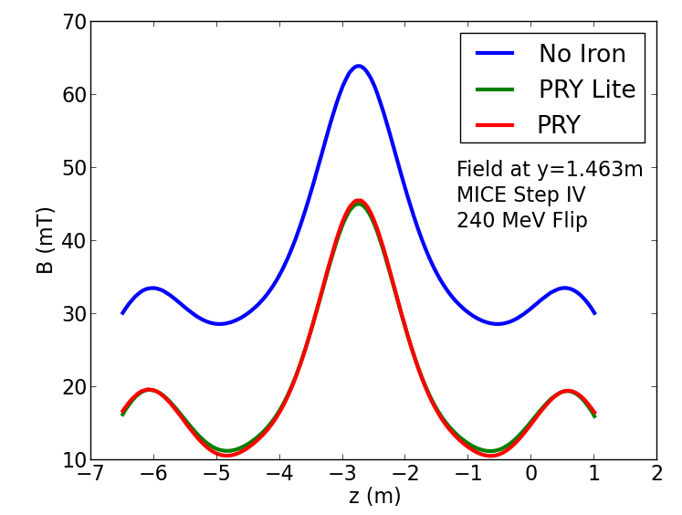
Field Cryocooler Head
PRY reduces field by 30%

Slide 27
Hysteresis Effects
Residual field after ramp-down?
Implementation: Jiles Atherton model
  Description of hysteresis loop with five parameters
Parameters: a, k, c, M_{sat}, α
  Parameters have physics meaning

Slide 28
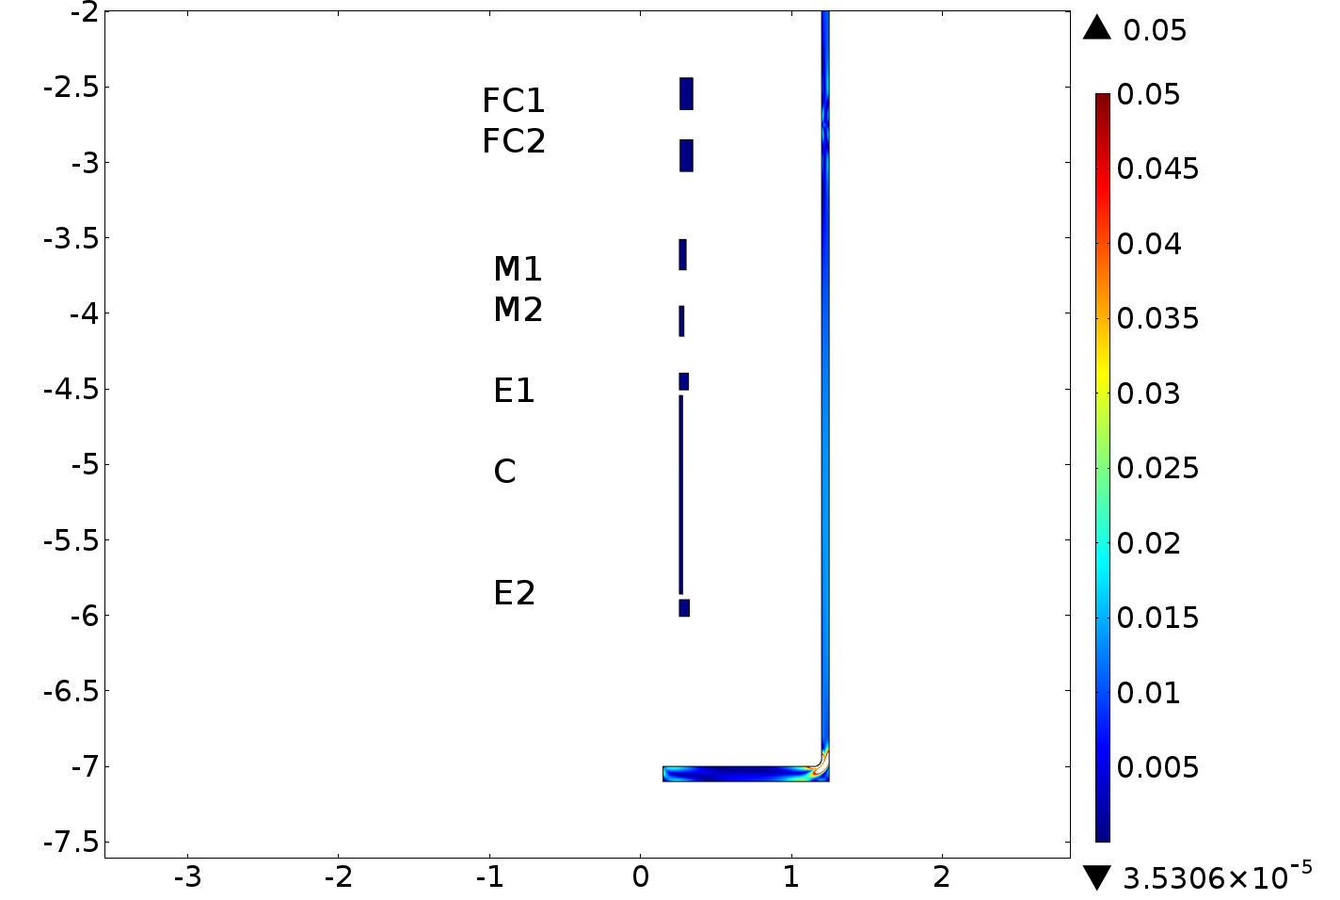
MICE - Hysteresis

Slide 29
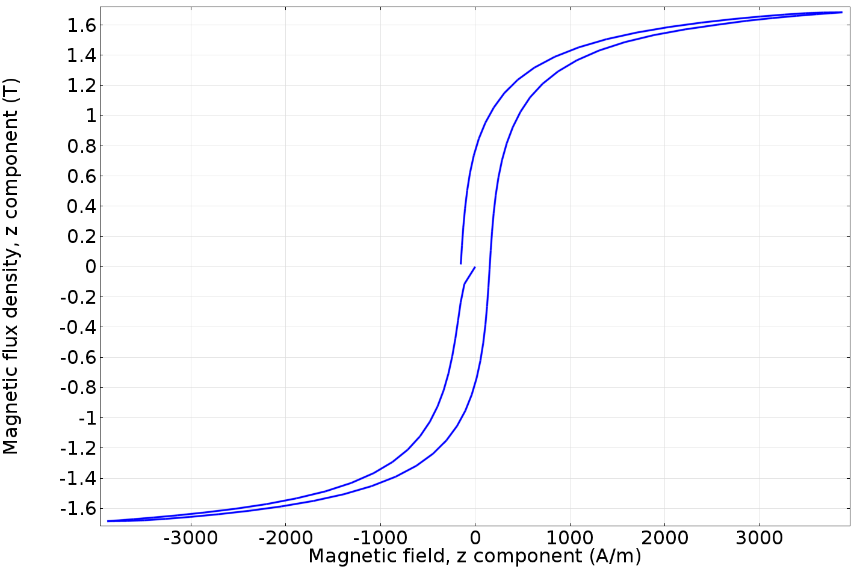
AISI 1008
A. Ito et. al. B vs. H Curves for 1008 and 1020 Steels. Fermilab, TM-1197, 1983.

Slide 30
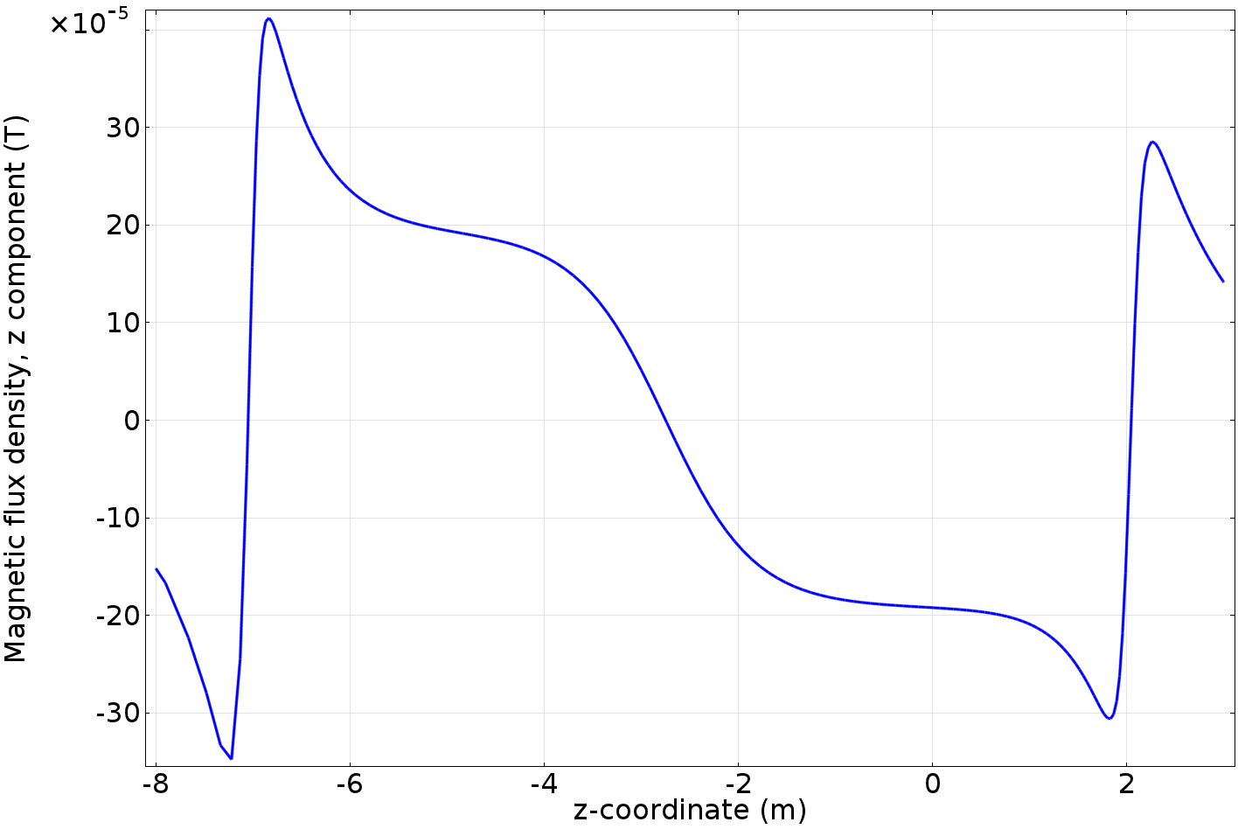
Field On-Axis
After one full cycle

Slide 31
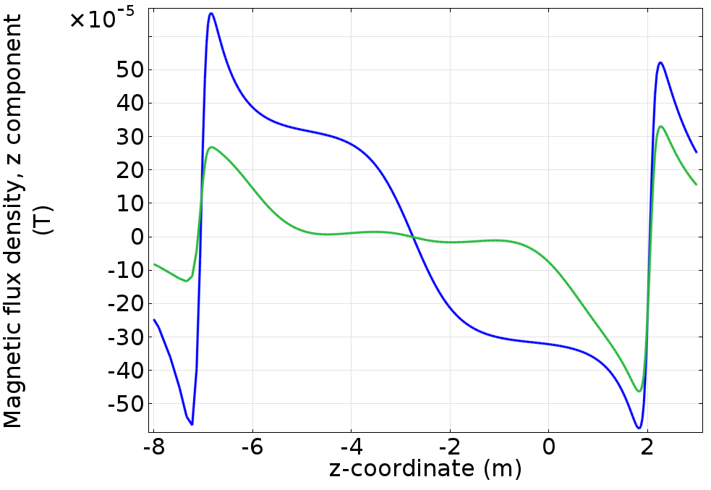
Field On-Axis
Additional cycle with 1% J

Slide 32
Risks

Slide 33
Performance – Risks
Software simulations
  Two different FEA codes show similar performance
  Simple concept
  Low risk
Material Properties
  Magnetization curve AISI 1010
Mitigation strategies
  Margin (increase shield thickness 10→12 cm)
  Different material

Slide 34
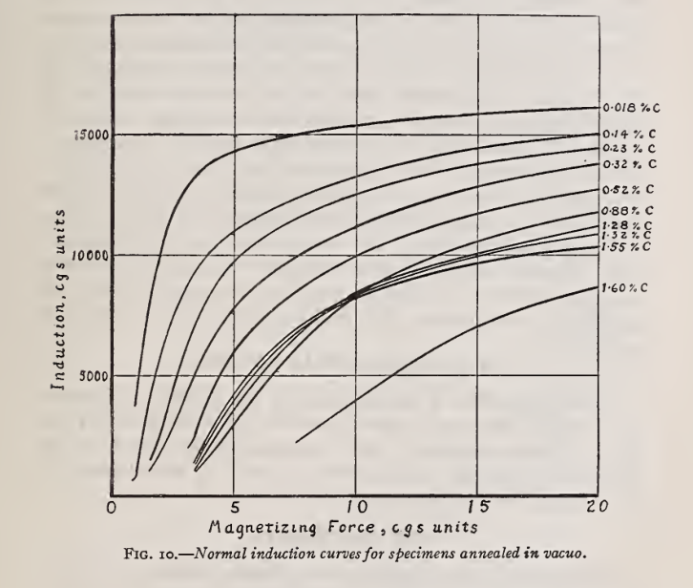
Iron Alloys
C (weight %):
1010: 0.08-0.13%
1008: <0.1%
1006: <0.08%
W. L. Cheney: Preparation and Properties of Pure Iron Alloys. Scientific Papers of the Bureau of Standards. Washington, July 24, 1922.

Slide 35
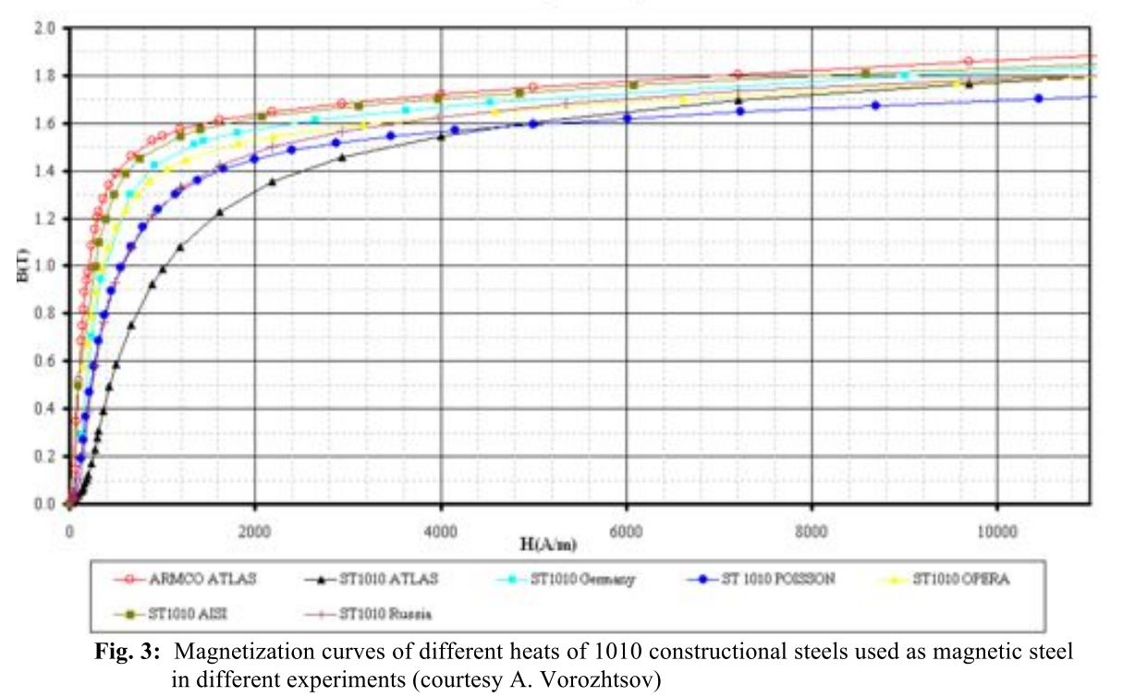
AISI 1010 Steel
1
2
3
S. Sgobba. Physics and measurements of magnetic materials.
arXiv:1103.1069 [physics.acc-ph]
1
3
2

Slide 36
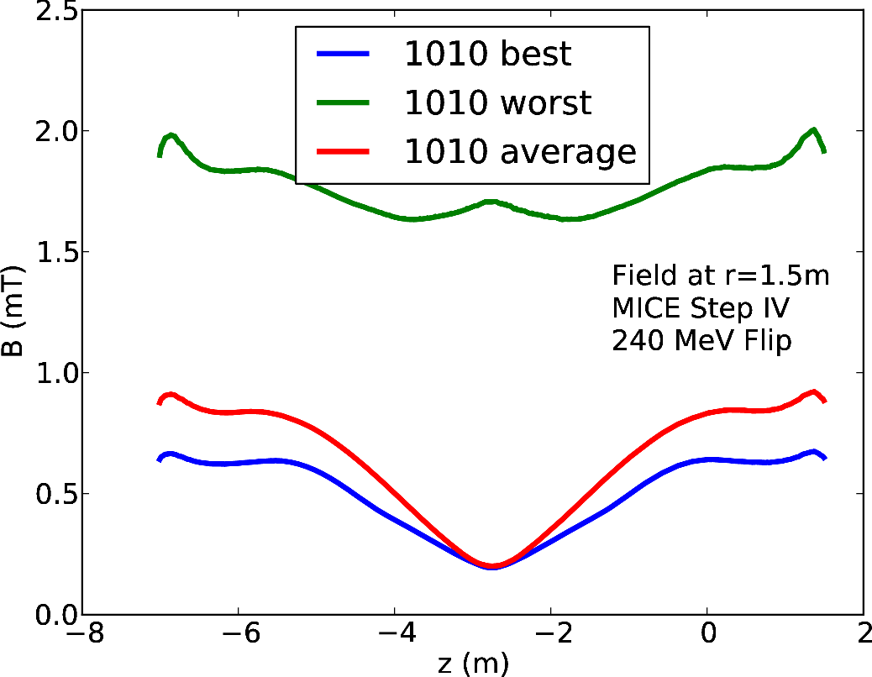
Field at R=1.5 m
t=10 cm

Slide 37
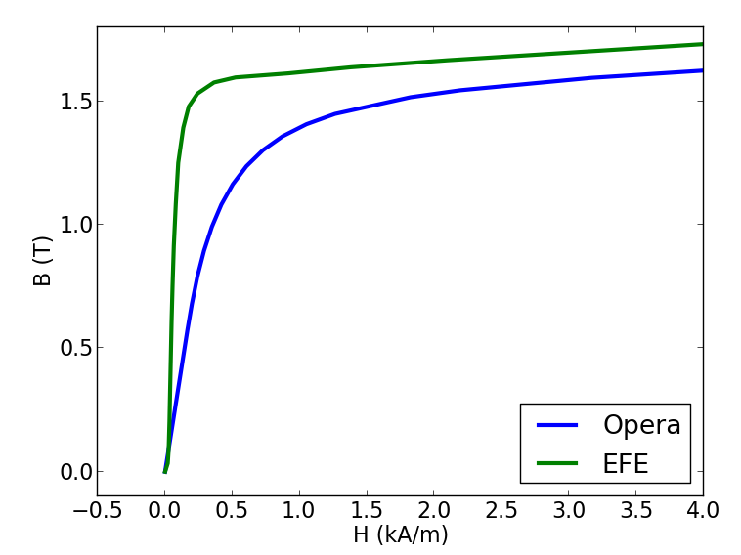
JFE: Extra Ferrite Electric
Data provided by JFE

Slide 38
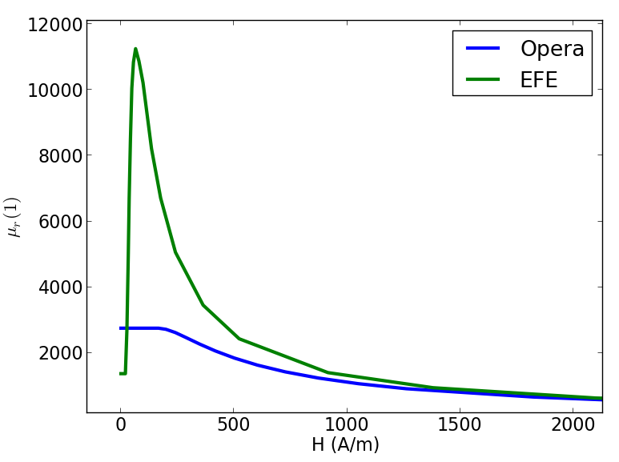
Steel Vendor

Slide 39
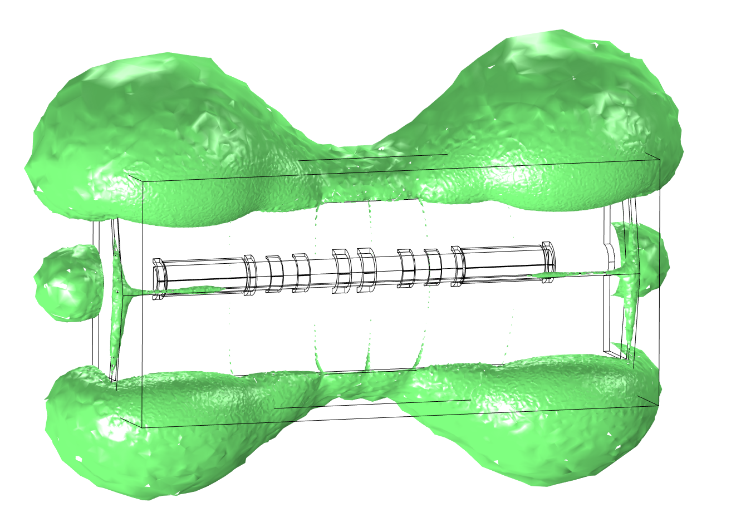
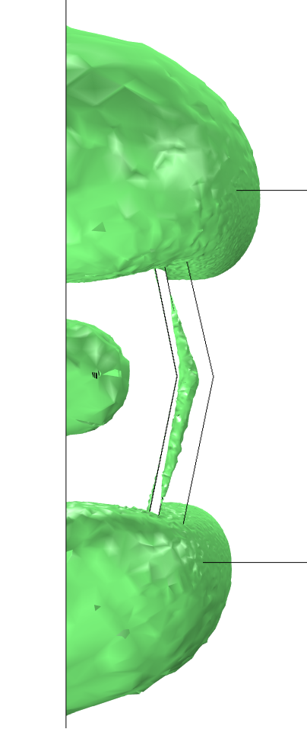
3D Iso-Surface Plots
240 MeV Solenoid
10 cm PRY

Slide 40
Step VI

Slide 41
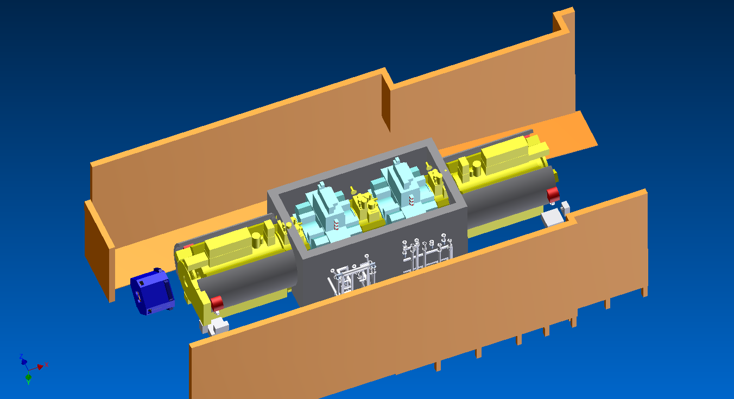
Step VI
3.3 m wide
6.4m X 4m X 0.3 m

Slide 42
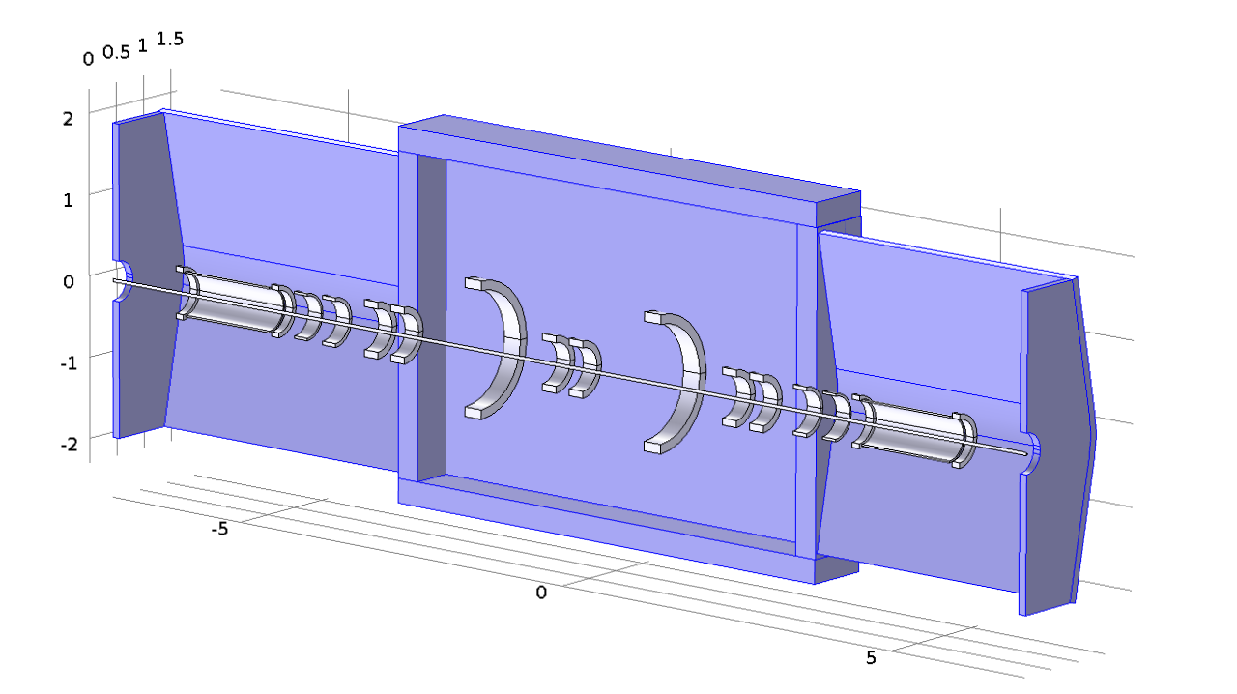
COMSOL Model
Same shape as Step IV
Based on Steve Plate’s shield design

Slide 43
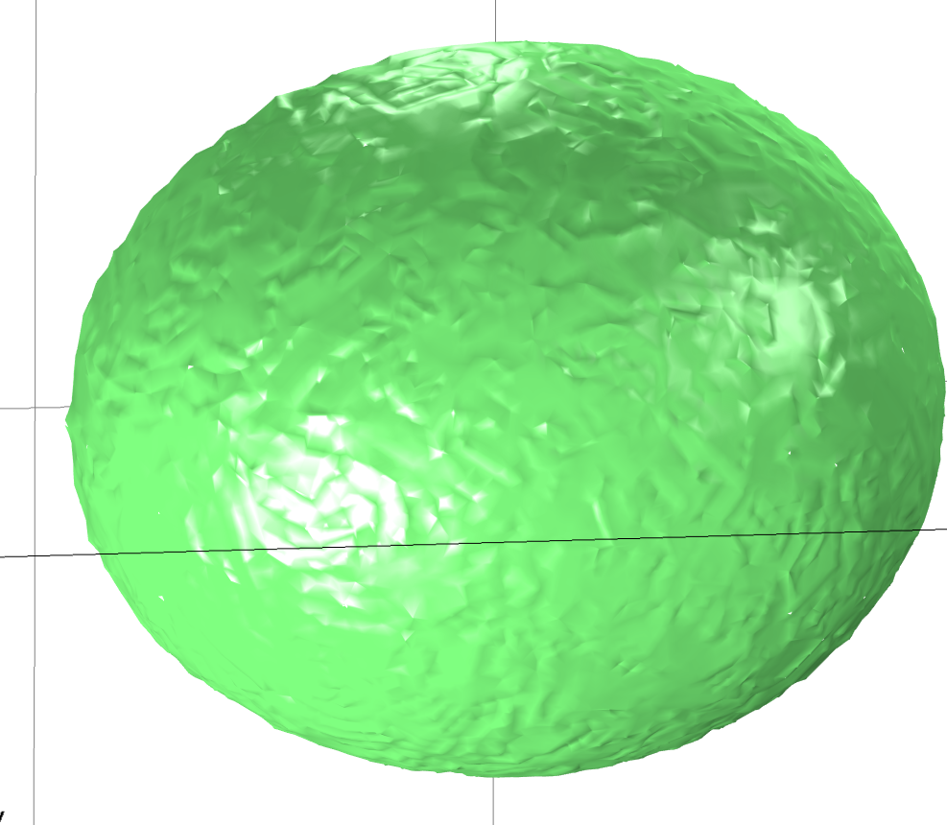
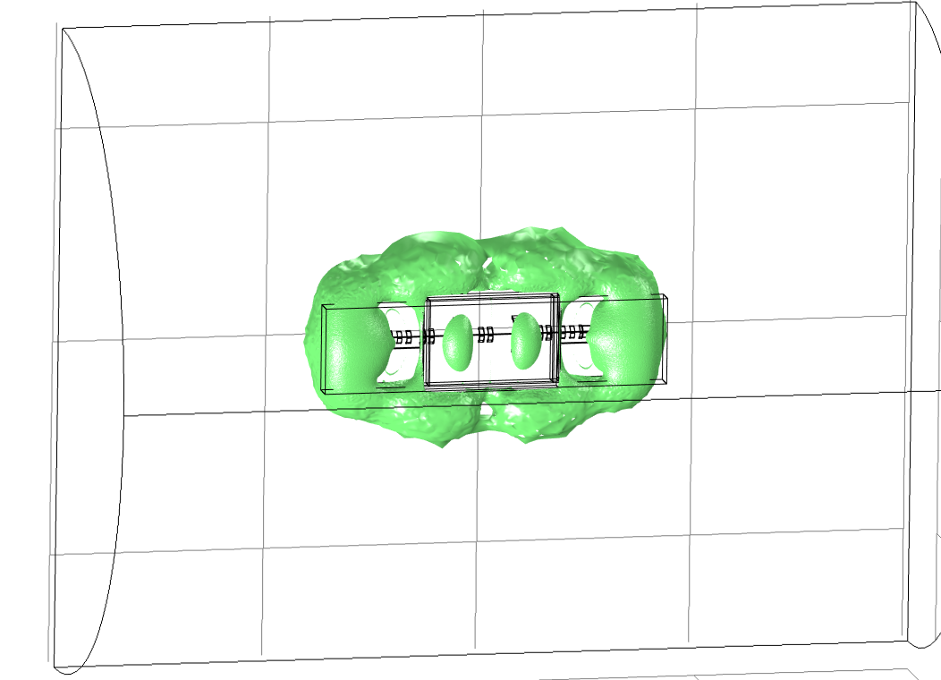
5 Gauss Surface
Step VI, 240 MeV Solenoid
40 m
15 m
No Shield
Shield

Slide 44
Summary
Performance
  Reduces stray field to 5—10 Gauss (10/12 cm)
  (No shield: 300—600 Gauss = factor 50+)
  Also for Step VI
Integration
  Penetrations – tracker waveguides, vacuum, …
  Connections for vertical gaps
Effect on beam: no issue
Risks: material
  Presently considering AISI 1008/1006/JFE-EFE
Engineering: Steve Plate’s talk

Slide 45
Additional Slides

Slide 46
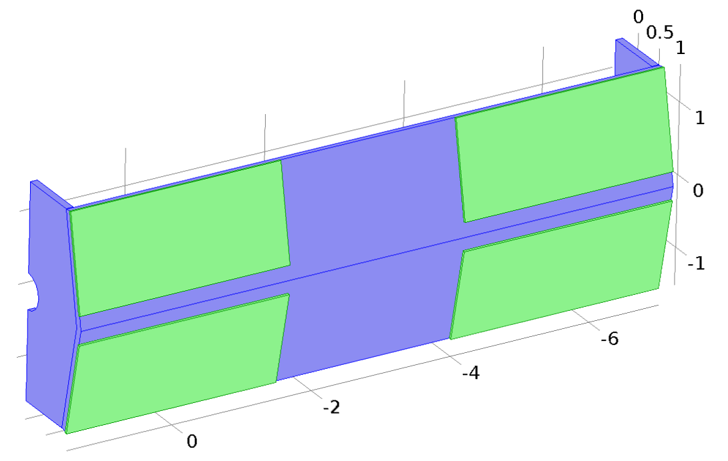
Booster Plates – Concept
Pros:
can be added later if necessary
Procurement not an issue
3 cm thick plates
Cover MICE Spectrometer Solenoid

Slide 47
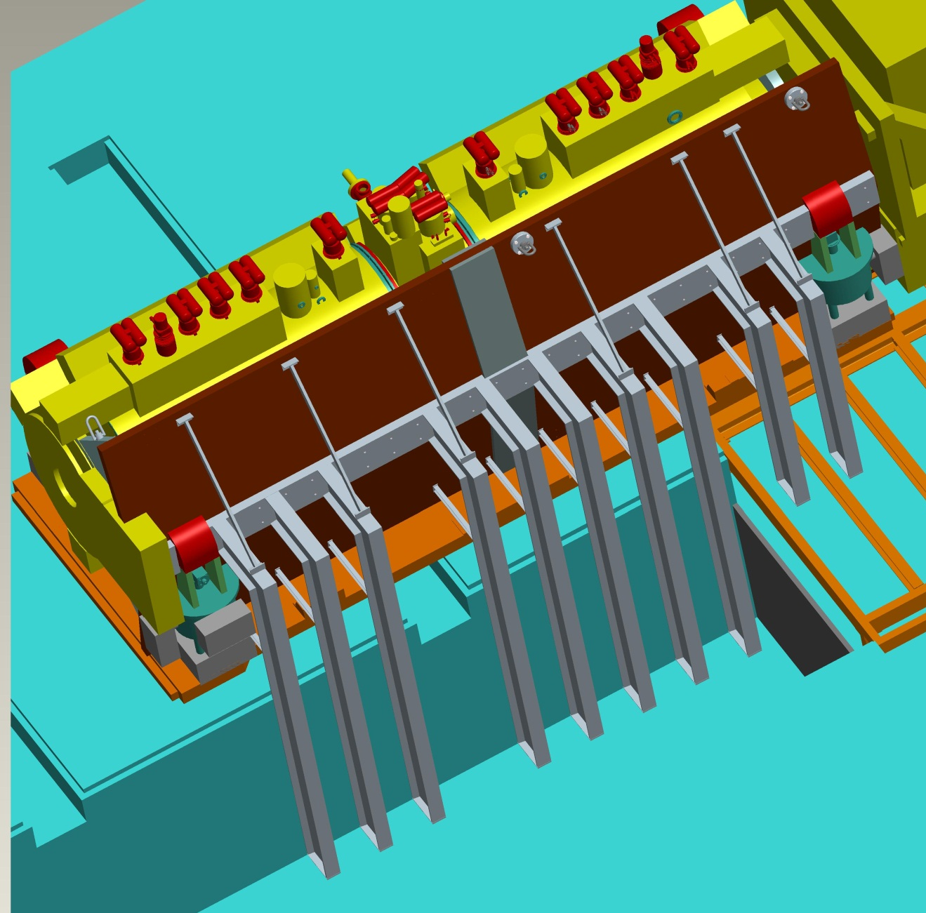
Booster Plates

Slide 48
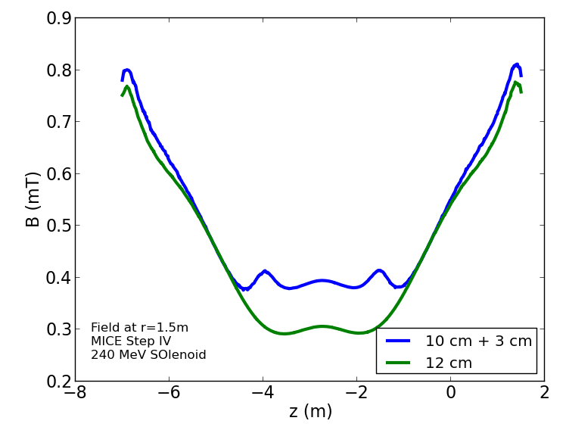
Performance
Simulation assumes 3 mm gap between
PRY and additional plates

Slide 49
Forces
Vertical Forces
 | FC | M1 | M1 | E1 | Center | E2
240 MeV Flip | -192 | 2340 | 1894 | -1140 | 366 | 2452
240 MeV Sol | -642 | 582 | 672 | -980 | 380 | 2450
240 MeV Flip Iron | -244 | 2286 | 1910 | -1236 | 226 | 2416
240 MeV Sol Iron | -644 | 584 | 678 | -1012 | 326 | 2430
Longitudinal Forces
 | FC | M1 | M1 | E1 | Center | E2
240 MeV Flip | -3120138 | -173582 | -41260 | -825222 | -22034 | 1376086
240 MeV Sol | 602814 | -8436 | -90834 | -1003108 | -107532 | 1375458
240 MeV Flip Iron | -3140296 | -178038 | -42670 | -825900 | -21886 | 1374424
240 MeV Sol Iron | 603188 | -8762 | -91544 | -1005390 | -114202 | 1372800
All forces in Newton
No significant change

Slide 50


