Slide 1
  (BDS) Lattice Integration Process at ILC
  Benno List
  DESY –IPP–
  BDS Lattice Webex Meeting 30.8.2013

Slide 2
Introductory Remark
I have extended the charge of my talk:
More important than the tool(s) to store the lattices is an overview over
The documents that define the design
The process to update the official design
Anybody is free to investigate new, better lattice solutions for the ILC BDS. But changing the official baseline requires the observation of due process - which is currently not completely defined!
I will cover the SVN repository in the 2nd part of the talk

Slide 3
Technical Design Documentation in EDMS
EDMS is the authoritative single point of information for the ILC design
The TDD web pages at
http://www.linearcollider.org/ILC/GDE/technical-design-documentation
provide links into EDMS
Some documents (not all) require EDMS user ID for full access. If you do work related to the ILC, you will get this EDMS user ID (no DESY user account needed). Just drop me a mail!
ILC EDMS home page is http://ilc-edms.desy.de/

Slide 4
Defining Documents for BDS (in EDMS)
http://www.linearcollider.org/ILC/GDE/technical-design-documentation/beam-delivery-system
Treaty Points: D*0970685 (Excel), and D*0972425
Beamline overview: D*0976355
(nomenclature of beamlines, markers, dumps etc)
Lattice (as zip file): D*0972985
provides a reference snapshot of the lattice as used for further work (component counts, costs, CFS)

Slide 5
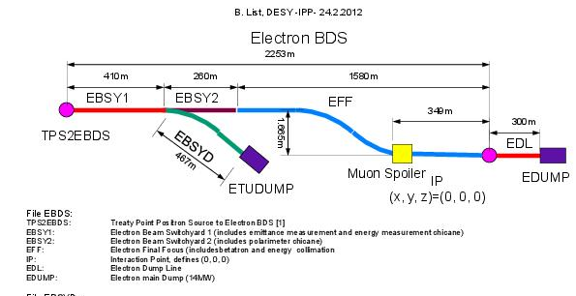
Beamline Overview (D*0976355) defines beamline and marker names

Slide 6
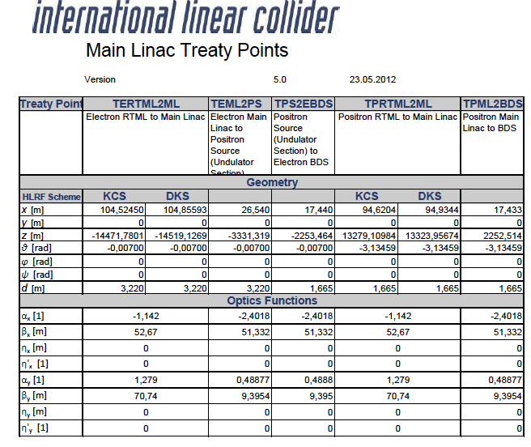
Treaty Points (D*0970685)

Slide 7
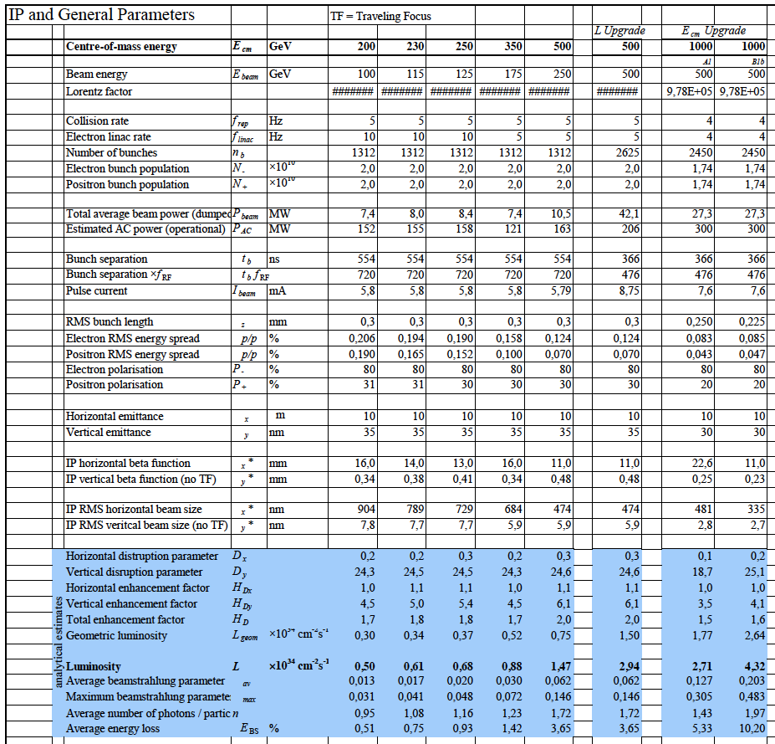
Top Level Parameters (D*0925325)

Slide 8
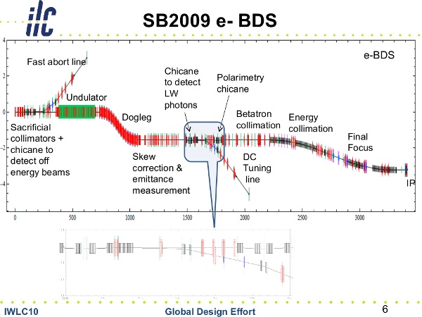
BDS Lattice (D*0972985)

Slide 9
From Lattice to Tunnels
For TDR, we have established a process to translate the MAD lattice files to conceptual 3D models of the accelerator and provide them for the tunnel design
We have a geometrically consistent global for the ILC in the TDR configuration
Changes in the lattice geometry cause changes in the tunnel layout!
-> All future lattice design must incorporate / respect
Boundary conditions from CFS (site-dependent!)
Layout of the “rest” of the accelerator!

Slide 10
From Lattice to Tunnels, cont’d
Technically:
Run MAD-8 (not MAD-X, not BMAD, but MAD-8),
with initial conditions for SURVEY from treaty point document
Map MAD-Elements to physical components
(needs conventions for lattices, e.g. TYPE attribute)
Generate Excel-files and 3D-models (VRML) with positions and counts of all components
MAD-8
Component Mapping
3D Visualization

Slide 11
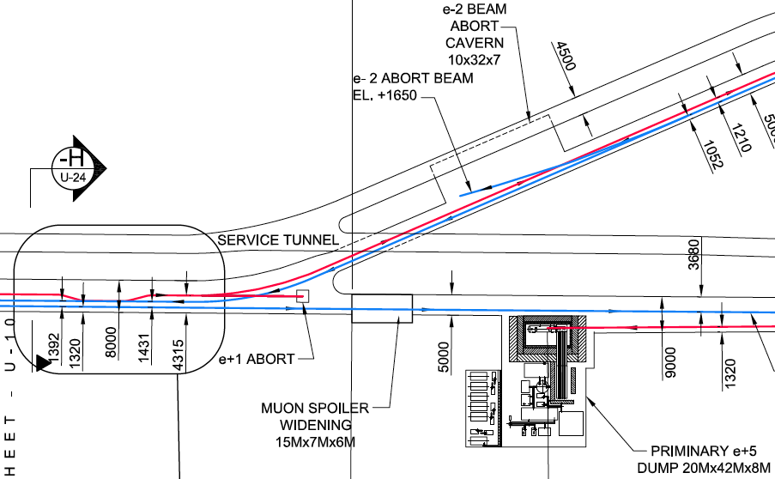
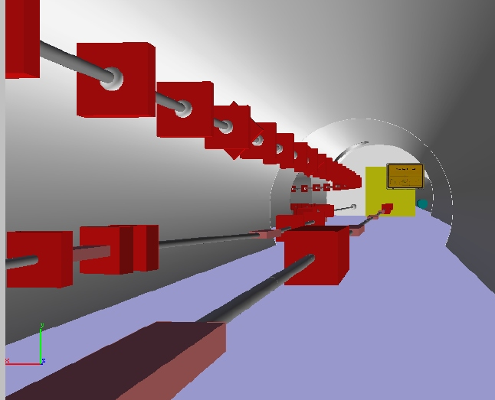
Example: Transfer Tunnel Branch-Off

Slide 12
Lattice Integration Process
For a new lattice version:
Integration team checks lattice for
  Geometry (clashes with other beamlines)
  Formalities (type attributes, apertures given, markers)
For geometry changes (start/end points, location of dump, muon shield etc) or changes in functionality (diagnostics, corrections) a formal change request must be issued before lattice can be considered
If lattice fulfills geometric and functional specs, a change request can be issued to make the new lattice official

Slide 13
EDMS and SVN
For lattice development, EDMS provides
  Specification documents
  The lattice as zip-file for reference
EDMS is not a lattice development platform
For this, we have SVN
The ILC lattice resides in
https://svnsrv.desy.de/basic/ilclattice
Browser interfaces (read access for everyone!):
https://svnsrv.desy.de/websvn/wsvn/General.ilclattice?
Or https://svnsrv.desy.de/viewvc/ilclattice/
Based on Mark Woodley’s ILC2006e lattice
retains Mark’s directory and include file structure
Send me an email to get an account to check out/in!

Slide 14
SVN repository at DESY
“ilclattice” is the repository for the integrated ILC lattice
Development work on new lattices should be done in a separate repository
We offer to create such a repository (takes <1 day) and give full access to all interested parties

Slide 15
Summary
ILC has an integrated lattice as basis for further planning
We have to keep it that way -> new lattices need formal review&approval to become official
EDMS is authoritative source of information
SVN repository is available

