Slide 1
Use of SVN as lattice repository
Andrea Latina
Common paths for CLIC and ILC BDS – Friday, 30 August 2013 – CERN

Slide 2
Outline
What is SVN
How we could benefit from it
Example of existing lattice repository
Proposed structure

Slide 3
What is SVN / How we could benefit
Apache Subversion (abbreviated SVN) is a software versioning and revision control system, distributed under an open-source license
Developers use Subversion to maintain current and historical versions of files such as source code, web pages, and documentation
Thanks to its robustness and simplicity, it has widely been used by a variety of open-source projects: Apache, GCC, SourceForge, Google Code
Main features:
Renamed/copied/moved/removed files retain full revision history. The system maintains versioning for directories, renames, and binary files.
Users can move and/or copy entire directory-trees very quickly, while retaining full revision history
Versioning of symbolic links
Supports branching and tagging
Easy to use, comes with a friendly web interface
At CERN it’s automatically backup’d on AFS

Slide 4
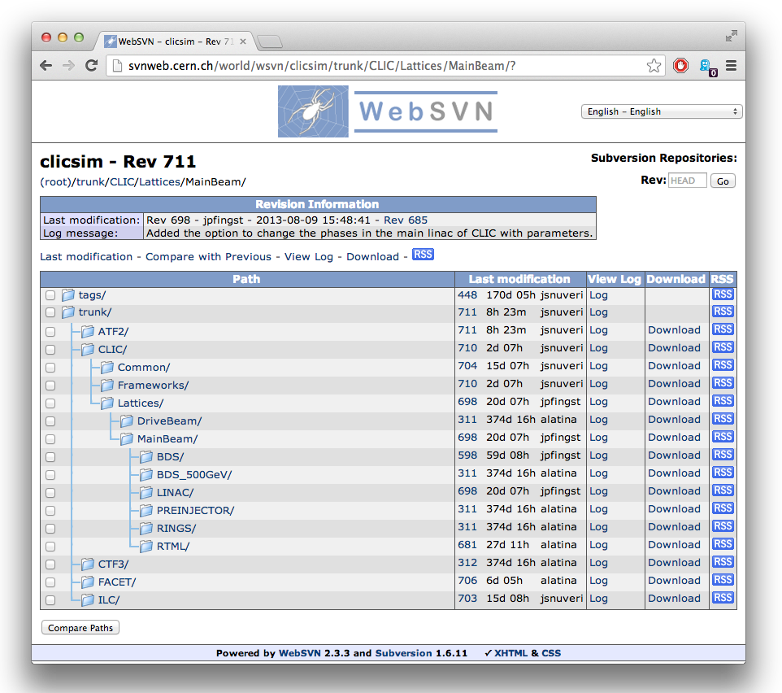

Slide 5
New Proposed Structure
http://svnweb.cern.ch/world/wsvn/clicsim/
  baseline/ symbolic link to all baseline lattices
  tags/ contains all tagged versions
  trunk/ work-in-progress version
  current symbolic link to trunk/

