Slide 1
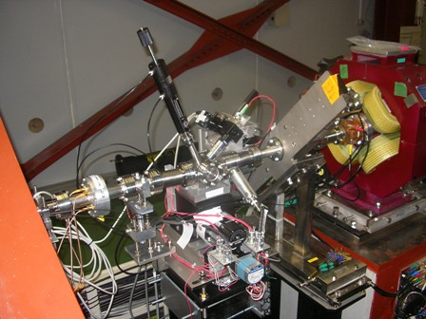


Common paths for ILC and CLIC BDS
m-OTR systems
  m-OTR system in ATF2
  m-OTR system for ILC and CLIC RTML
Halo collimation studies for ATF2
CLIC DR Extraction Kickers, design, construction and experimental verification

Slide 2

m-OTR systems
The system itself:
Making a turn-key and reliable system giving accurate and consistent measurements:
  Technical improvements: camera gain and iris control, tilt and optical alignment
  Issues: Systematic errors from intensity dependence and wakefiels from simultaneous measurements
  m-OTR system for ILC and CLIC RTML:
The study of a optimized system from the point of view of emittance reconstruction.
  Multi-OTR systems can be used to make fast emittance measurements and contribute to the tuning of the RTML of Linear Colliders. They could be used in single bunch or low charge mode operation of the machine and they could be very useful during setup and commissioning phases.
  The key point is the selection of suitable materials to make OTR targets, which survive the impact of the pulses. According to the thermal calculations presented in this paper, Kapton and Be could be good candidates to be used as OTR radiators in the context of both the ILC and CLIC RTML.

Slide 3

Halo collimation studies for ATF2
Study of a possible implementation of an halo collimator device for reducing the background in the instrumentation after the IP of ATF2 FFS
Tracking simulation with “realistic hallo” of the possible scenarios of implementing a retractable hallo collimator jaw in the FFS of ATF2
  Betatron collimation (mainly vertical, IPBSM background reduction)
  Energy collimation (mainly horizontal, Compton electron diamond detectors)
  Halo generation (two Gaussian superimposed, measurements in ATF2 or others accelerators)
If the simulations studies show that such a system is efficient for the background reduction we will present a proposal in next Technical Board in December
If the TB approved the proposal we will start the design, construction and implementation of a retractable hallo jaw collimator. Including dedicated measurements after IP and comparison with simulations. These studies will be complemented by a complete analytical and experimental study of the impact of such a device in the FFS of ATF2 from the point of view of the wakefield effect.

Slide 4
Halo collimation studies for ATF2
Preliminary results
Tracking simulation with “realistic halo” (two Gaussian superimposed) has been started with MADx to evaluate and compare the particle losses along the ATF2 FFS ( FFS quads, IP, bending after the IP) in the following cases:
  With reference cavity (16 mm aperture)
  Standard beam pipe (24 mm aperture)
  Tapered beam pipe (16 mm aperture)
Compare the effect from the wakefield point of view ( geometrical and resistive analytical kick) with reference cavity and with the tapered beam pipe

Slide 5


CLIC DR Extraction Kickers, design, construction and experimental verification
Design and Construction:
The electromagnetic design of the striplines, including a detailed study of both the electrode supports and the feedthroughs, has been completed. A prototype of the extraction stripline kicker for the CLIC DR is presently being manufactured by G&P Vacuum Projects (Valencia, Spain).
The performances are excellent from the point of view of field homogeneity, power transmission and low broadband beam coupling impedance. The effect of manufacturing tolerances has been also studied. The field inhomogeneity requirement relaxation has to be studied
A 5-layer prototype inductive adder has been assembled. A second 5-layer prototype, and two full-size 20-layer prototypes are planned to be built in the next months.
Experimental verification:
After the striplines manufacture, several tests will be carried out without beam at IFIC, CIEMAT and CERN labs.
The 5-layer prototype inductive adder is being tested at CERN.

Slide 6
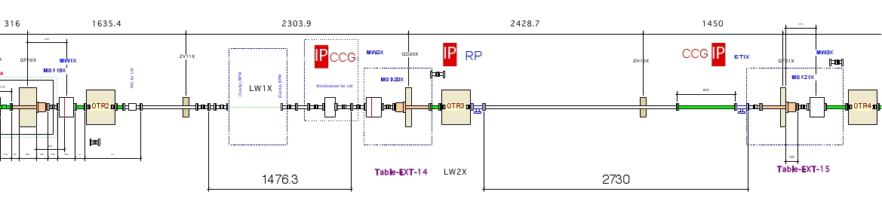
CLIC DR Extraction Kickers, design, construction and experimental verification
Striplines not used as a extraction device and without inductive adder (ALBA or ATF2)
  Longitudinal and transverse beam coupling impedance
Striplines not used as extraction device and with inductive adder (ATF2) (after June 2014)
  Field inhomogeneity
  Pulse shape and repeatability
  Long term reliability of the system
Possible use as extraction device (ATF2)
Possible location of the stripline kicker in ATF2 for being tested: Final Focus System
STRIPLINE KICKER

Slide 7
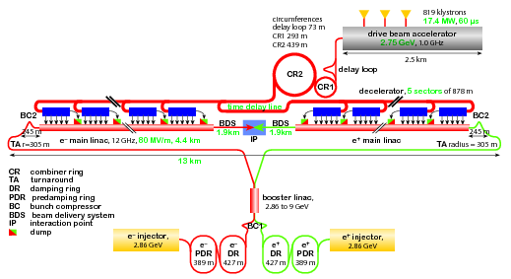
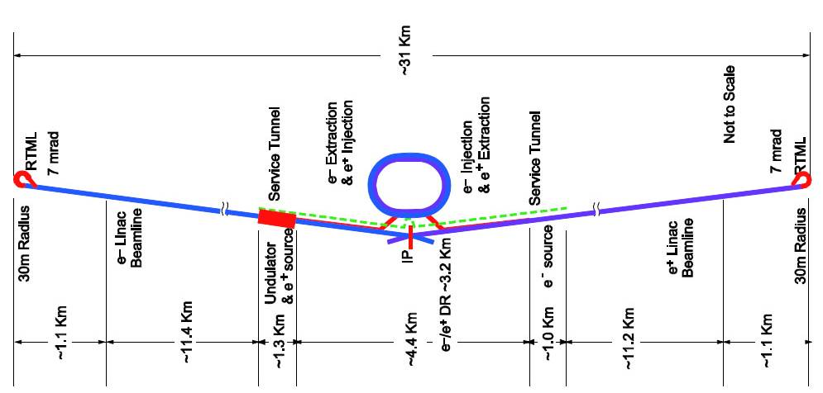
CLIC DAMPING RINGS vs ILC DAMPING RINGS
ILC layout
CLIC layout
DRs parameters | ILC | CLIC
Energy (GeV) | 5 | 2.86
Circumference (km) | 3.2 | 0.427
RF frequency (GHz) | 0.650 | 2
Normalized emittance (nm) | 5500 (H) 20 (V) | 500 (H) 5 (V)
Repetition rate (Hz) | 5 | 50
Bunches/train | 1 | 1
Number of bunches | 1312 | 312
Bunch length (mm) | 6 | 1.6
Bunch spacing (ns) | 3.1 | 0.5
Bunch population [10⁹] | 20 | 4.1
Kickers parameters | ILC | CLIC
Deflection angle (mrad) | 0.7 | 1.5
Striplines aperture (mm) | 24 | 20
Striplines length (cm) | 32 (20 multi-units) | 170
Field rise and fall times (ns) | < 3 for e⁻ ring < 6 for e⁺ ring | 900
Pulse rise and fall times (ns) | 1.2 | ≈ 100
Pulse flat-top (ns) | 2 | 160
Extraction field inhomogeneity (%) | ± 0.07 (over 1.8 mm) | ± 0.01 (over 1 mm)
Stripline voltage (kV) | ± 5 (per multi-unit) | ± 12.5
Notes:
-Multi-units (ILC kickers) to improve the rise and fall time.
The effective rise and fall time of the kick field in the strip-line electrode is determined by the propagation time and by the rise and fall time of the pulse.
The rise time of the kick field must be less than 3 ns to extract each bunch without any effect on the circulating bunches, which are spaced 3 ns on either side of the extracted bunch.
Total length of the striplines (ILC):6.4 m

