Slide 1
BI LIU Review
- Introduction -
R. Garoby
3/10/2013

Slide 2
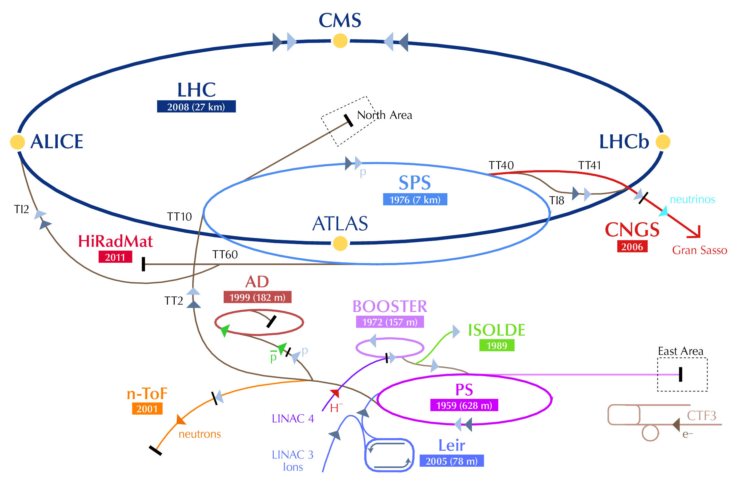
LIU Project Definition
Mandate
“The LHC Injectors Upgrade should plan for delivering reliably to the LHC the beams required for reaching the goals of the HL-LHC. This includes LINAC4, the PS booster, the PS, the SPS, as well as the heavy ion chain.”
Objective
Combined effect of HL-LHC and LIU projects:
Levelled luminosity in LHC after LS3:
5 10³⁴ cm⁻²s⁻¹
Integrated luminosity in ~2035:
≥ 3000 fb⁻¹

Slide 3
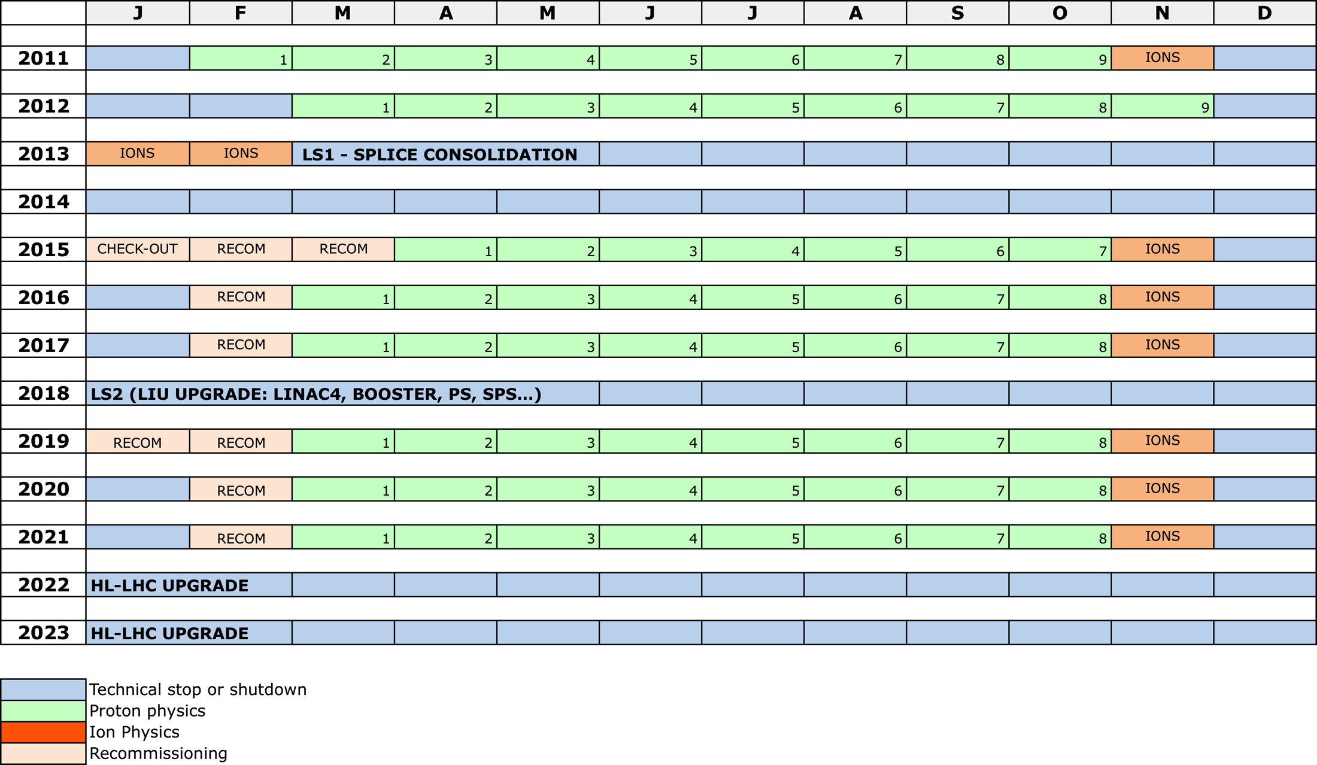
Baseline planning

Slide 4
Overall baseline (as of June 2013) planning
 | Deliverables | Proton beam characteristics at LHC injection
2013 – mid 2014 (Long Shutdown 1) | TDR, CtC and planning Start of commissioning of Linac4 Exploitation of MDs and simulations Modifications and installation of prototypes in PSB, PS and SPS Design § construction of equipment
Mid 2014 - 2017 | Regular operation with BCMS Test/validation of installed prototypes Full commissioning & reliability run of Linac4 Equipment design § construction for PSB, PS and SPS Beam studies § simulation [If long shutdown in 2017: PSB modification for connection to Linac4 Progressive increase of PSB brightness with benefits for PS and SPS] | Potential for exceeding LHC nominal luminosity (~2x) with 25 ns bunch spacing…
2018 – mid 2019 (Long Shutdown 2) | Extensive (?) installations in PSB, PS and SPS Hardware commissioning
Mid 2019 –2022 | Beam commissioning : recovery of previous beam characteristics for LHC restart MDs and studies for improving beam characteristics Installation of last upgrades for protons and ions during the first winter shutdown. | Before LS3: LIU «baseline» beam characteristics attained

Slide 5
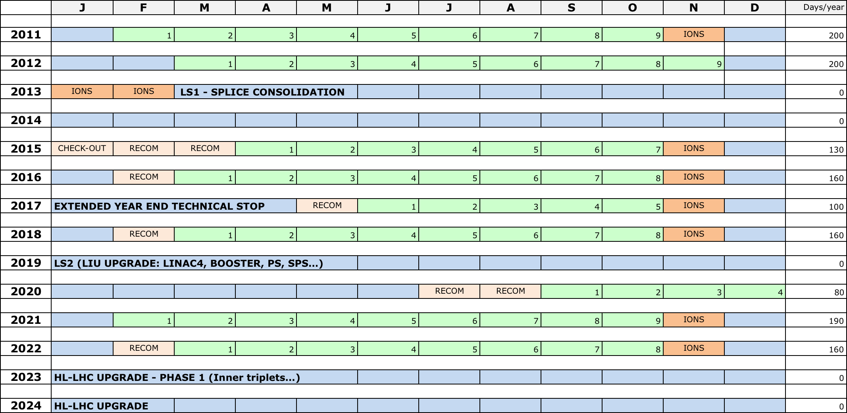
Slipped baseline (typical example)

Slide 6
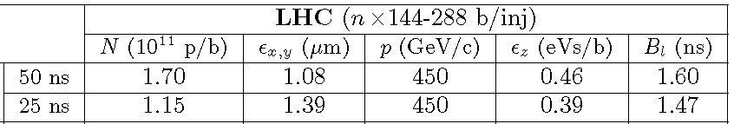
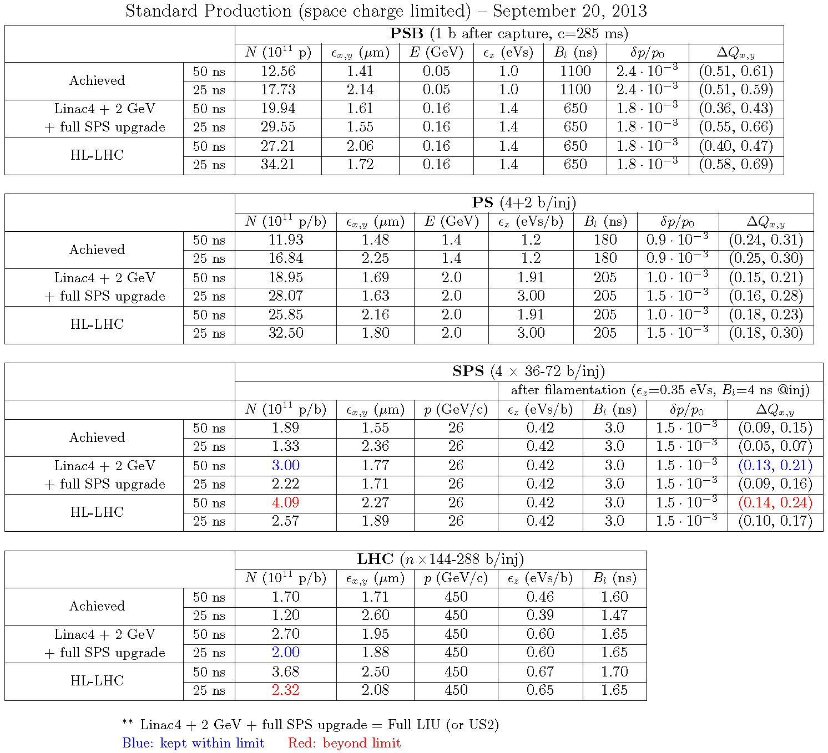
Typical beam characteristics
Between LS1 and LS2:
[ from https://edms.cern.ch/file/1296306/1/table-BCMS-e20percentLHC.pdf ]
After all upgrades (post-LS2):
[ from https://edms.cern.ch/file/1296306/1/table-e20percentLHC.pdf ]

Slide 7
Purpose of the BI LIU Review
CERN internal meeting with the goal of reviewing the status and plans for beam instrumentation in the LHC injector complex (except Linac4) and checking its coherence with the needs of the LIU project.
The following questions are to be addressed:
Are the specifications clear and can they be met by the proposed systems?
What is the installation/commissioning planning of the various instruments?
Are there resource conflicts between machines/systems/projects, and if this is the case how can they be resolved?
Does LIU need to provide priorities?

