Slide 1
ELENA injection, extraction and transfer lines
W. Bartmann, B. Balhan, D. Barna, J. Borburgh, E. Carlier, T. Fowler, V. Namora, A. Prost, L. Sermeus, G. Vanbavinckhove, N. Voumard, H. Yamada
ELENA Review, 15th/16th October 2013

Slide 2
Outline
Parameter table
Injection
Extraction
Source for commissioning
Geometry of lines
Why electrostatic lines
Optics of lines
Electrostatic HW
List of potential issues

Slide 3
ELENA parameters
Table 1: ELENA beam parameters. Assuming the nominal operation of 4 bunches at extraction.
Beam parameters | Unit | Injection | Extraction
Ekin | MeV | 5.3 | 0.1
β_{rel} |  | 0.1064 | 0.0146
Revolution period | µs | 0.958 | 6.946
Magnetic rigidity | G.m | 3329 | 457
Electric rigidity | kV | 10570 | 200
# bunches |  | 1 | 1-4
Emittanceª, geo, 95%, h/v | π.mm.mrad | 15/15 | 6/4
Momentum spread, 95% |  | 1e-3 | 2.5e-3
Total intensity |  | 3e7 | 3e7
ªThe maximum emittance during the cycle is assumed to be 50 π.mm.mrad

Slide 4
BT equipment limits
Table 2: Specification values of ELENA injection and extraction hardware
 |  | Injection kicker | Injection septum | Extraction kickers
# units |  | 1 | 1 | 2 + 7
Type |  | Magnetic | Magnetic | Electrostatic
Kick | mrad | 84 | 340 | 240
B.dl (antiprotons) | G.m | 280 | 1132
B.dl (protons, H⁻) | G.m | 38 | 155
Rise/fall timeª | ns | 900 | - | 1000 (99.9 - 0.1%)
Flattop length | ns | 400 | - | 400 - 7000
Flattop stability | % | 0.1 | 0.1 | 0.1
Field homogeneity | % | +/- 1 | +/- 1 | +/- 1
GFR h/v | mm | 80/40 | 130/40 | 38/42
ª Only fall time relevant for the injection kicker; rise and fall time relevant for the extraction kicker

Slide 5
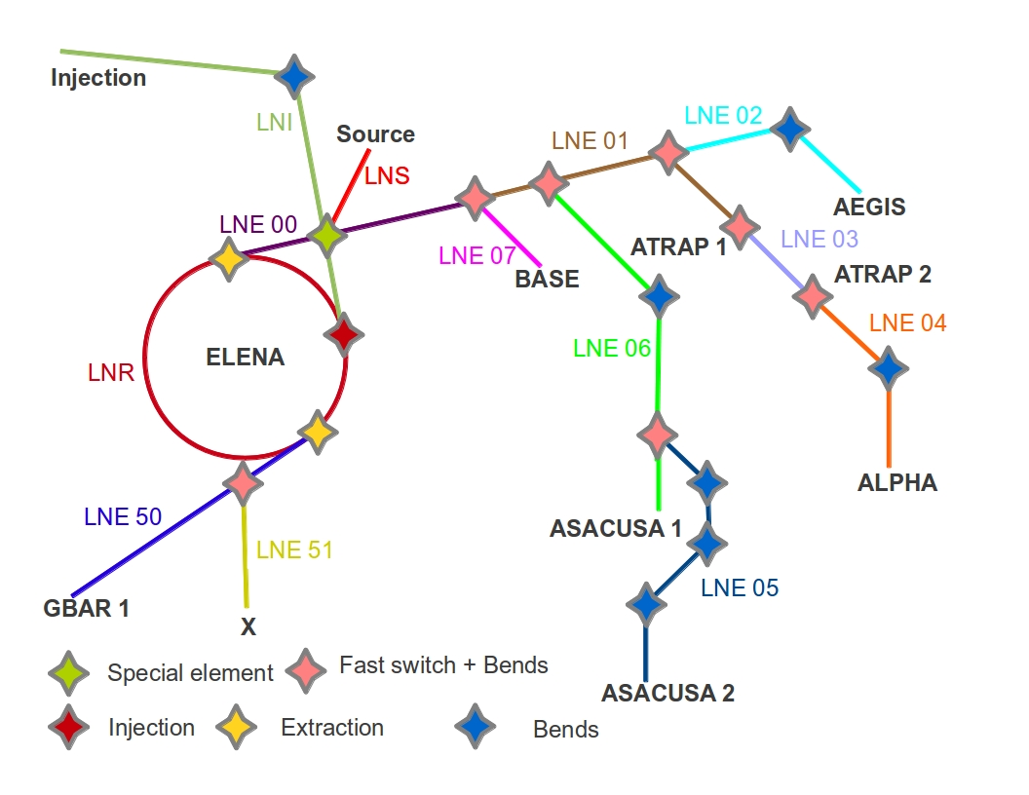
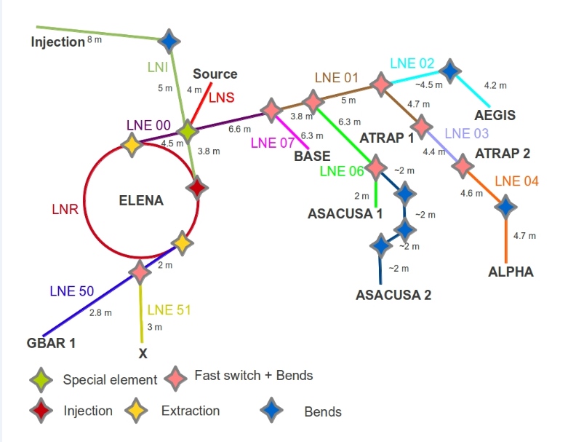
Sketch of TLs

Slide 6
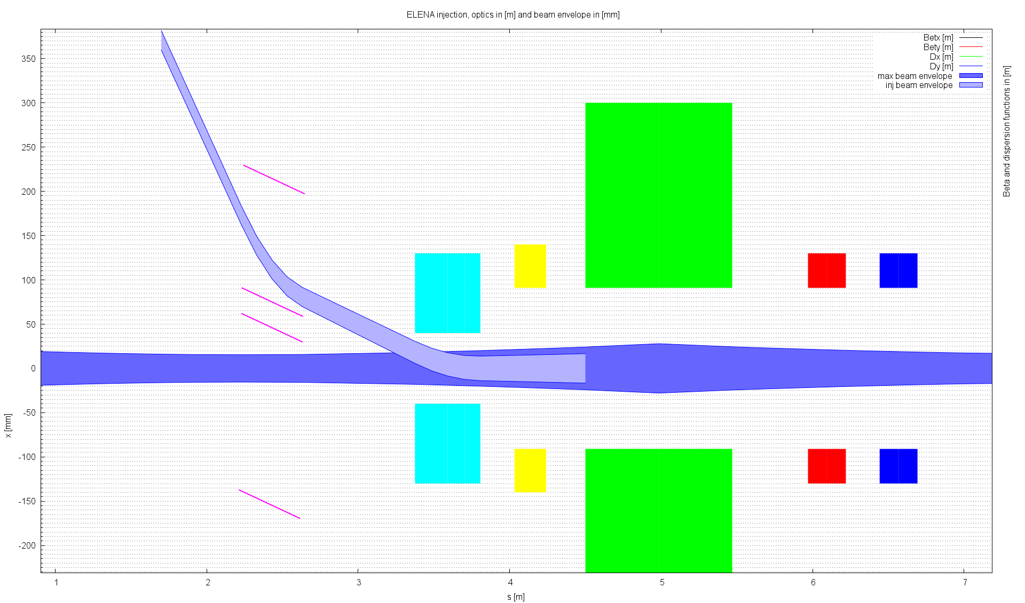
Injection
Fast bunch-to-bucket transfer
Magnetic septum (295 mrad)
Magnetic kicker (84 mrad)

Slide 7
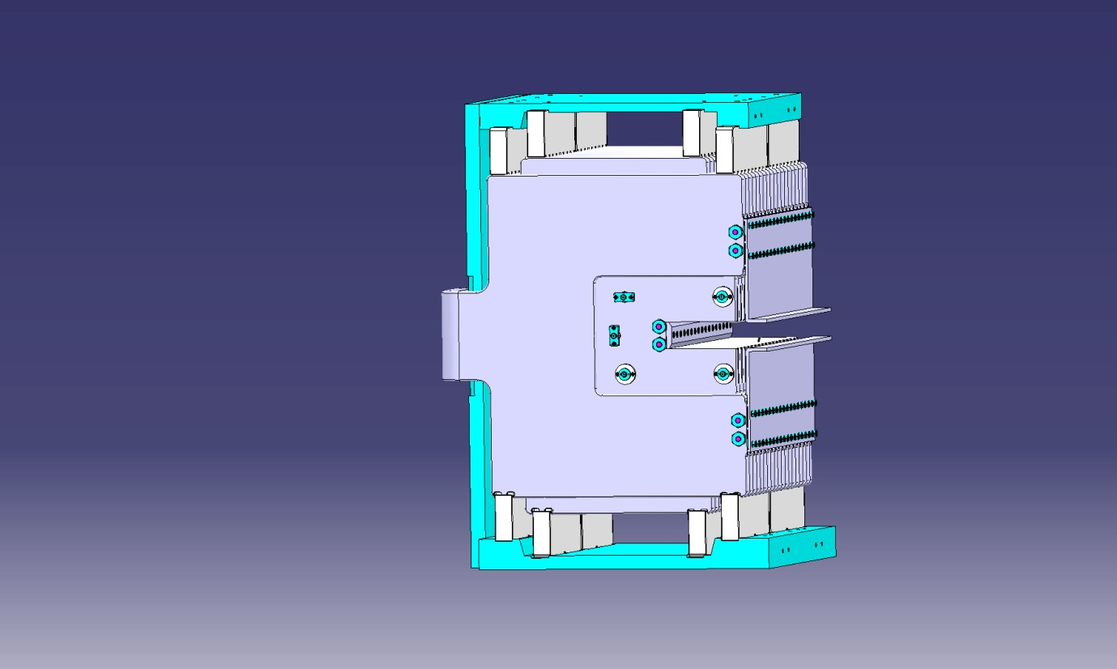
Injection kicker
Existing (1986), from AA ring
Magnet installed into new vacuum tank to be bakeable upt 300 deg in situ
HV power converter recuperated from AAC
PFL (SF6, 15 Ohm, 40kV) discharged by fast thyratron switches
Terminated by matched resistor
Pulse length can be adjusted with a dump thyratron
Polarity reversal by swapping HV in/out cables in magnet connection box

Slide 8
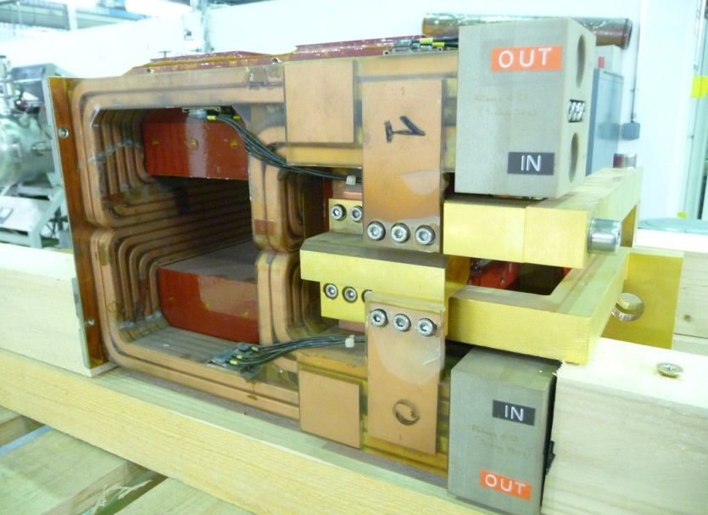
Injection septum
Existing, recovered from LEIR (SM12)
Full spare magnet available (since not used at extraction)
Magnetic performance (field homogeneity and leak field) to be measured within 2014
Magnets need to be removed for bake-out → requires dedicated support structure
Power supply covered by J. Baillie (TE-EPC)

Slide 9
Extraction
In Feasibility report (2010) the extraction was assumed to be magnetic with recuperated HW
Study of alternatives showed:
Also the electrostatic device allows to choose between extracting single bunches up to the full machine length → increased flexibility and less prone to SC/IBS effects at flat bottom
Standardisation with fast switches in transfer lines
Choice for one electrostatic device for extraction instead of 2 magnetic
Extraction | Magnetic |  | Electrostatic
 | 1 extraction (no spare) | 2 extractions (no spare) | 2 extractions (1 spare)
Septa | 38 kCHF, 0.5 MY | 38 + 110 kCHF, 0.5 + 0.3 MY | 420 kCHF, 1 MY
Kicker | 285 kCHF, 1.5 MY | 285 + 285 kCHF, 1.5 + 1.5 MY
Controls | 150 kCHF, 0.5 MY | 150 + 150 kCHF, 0.5 + 0.5 MY
SUM | 473 kCHF, 2.5 MY | 1018 kCHF, 4.8 MY | 420 kCHF, 1 MY

Slide 10
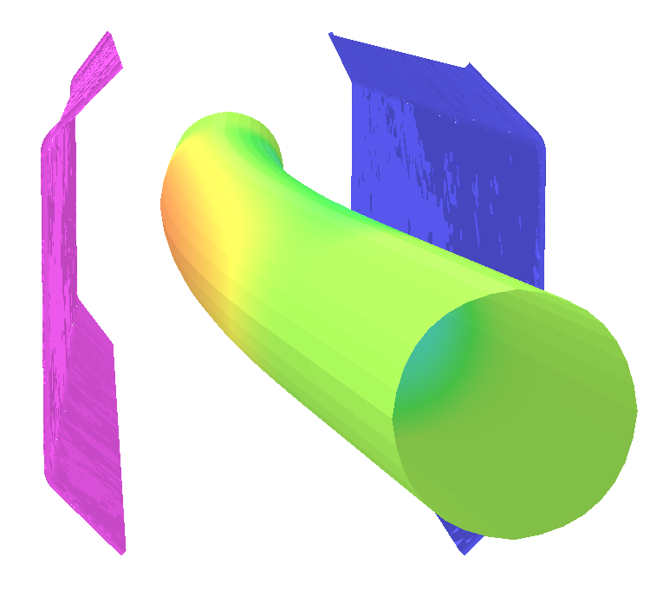
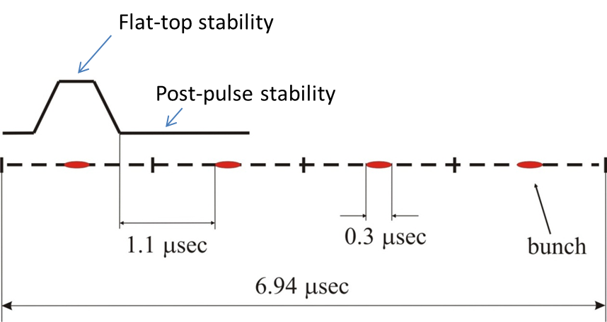
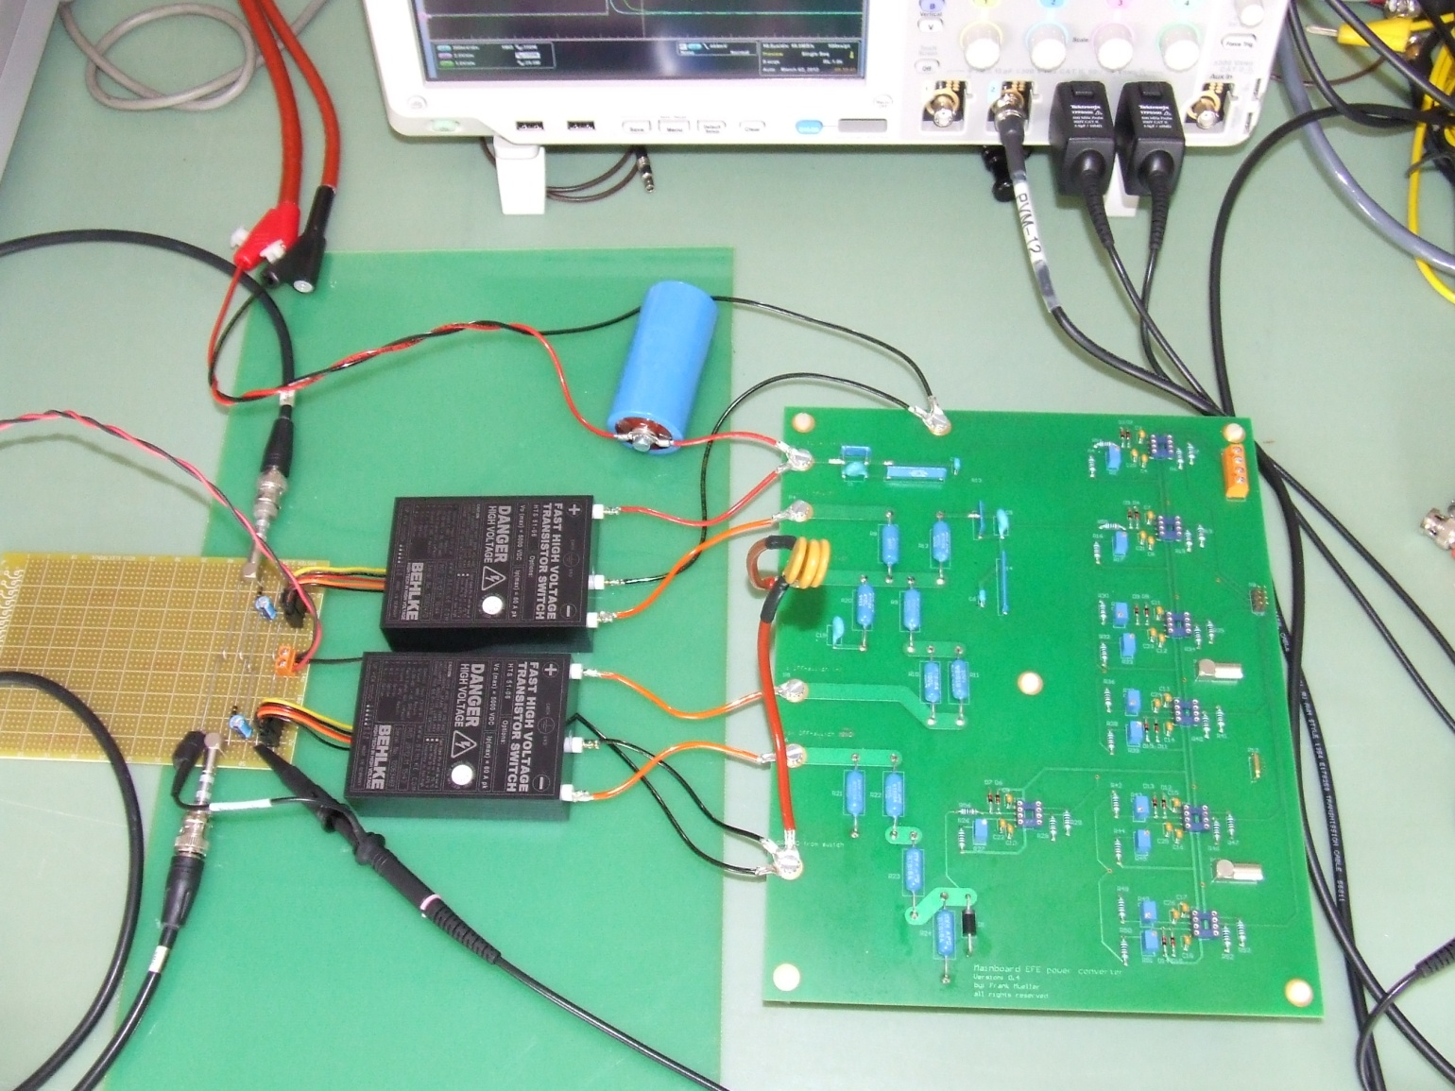
Electrode geometry and power supply
Electrode design from scratch
Power supply based on developments for Linac4 and Medaustron
Flat top and post pulse stability of 0.1%
  corresponds to ~ few Volts

Slide 11
Why a source for commissioning?
The low energy part of ELENA (100keV) is reachable via an external source
ELENA will get every 100 s a shot from AD → slow commissioning
ELENA ring installation shall be in 2015 while AD experiments still use the AD beam
Removal of existing magnetic and installation of electrostatic TLs will be one year later
As soon as the ring is installed, the source beam can be used to commission main accelerator systems
The source could also be used for re-commissioning of the machine and TLs after shutdowns before operational beams are available

Slide 12
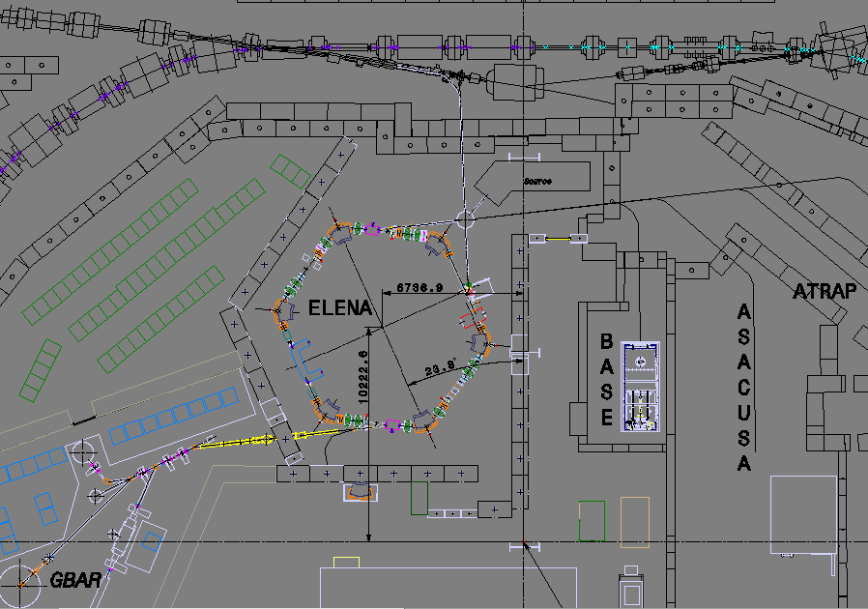
Where to place the source?

Slide 13
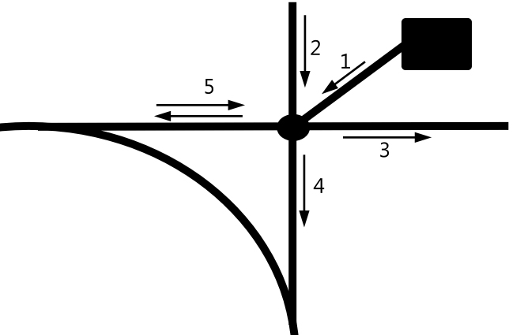
Source operation modes
Want to use both beams, H- and protons
Protons via the extraction channel allows for keeping the ring polarity
Protons via injection channel for cooler tests (H- lifetime)
Mode | LNI | LNE00 | LNE50 | RING | Purpose | Figure
Pbar (injection) | + | + | + | + | Normal operation | 2,4
H- (injection) | + | NU | NU | + | Cooling tests | 1,4
P (ejection) | NU | - | - | + | Optics studies | 1,5
P (injection) | - | NU | NU | - | Cooling tests | 1,4

Slide 14
Why electrostatic transfer lines?
100 keV is in the reachable range for electrostatic elements
Advantages
  Cheap production, easy field shaping, no hysteresis, low power consumption, cheap power supplies, good magnetic shielding possibilities
Disadvantages
  Vacuum compatibility of electrode material (outgassing), fault detection of bad connections, vacuum has to be opened for repair, interlocking against sparks

Slide 15
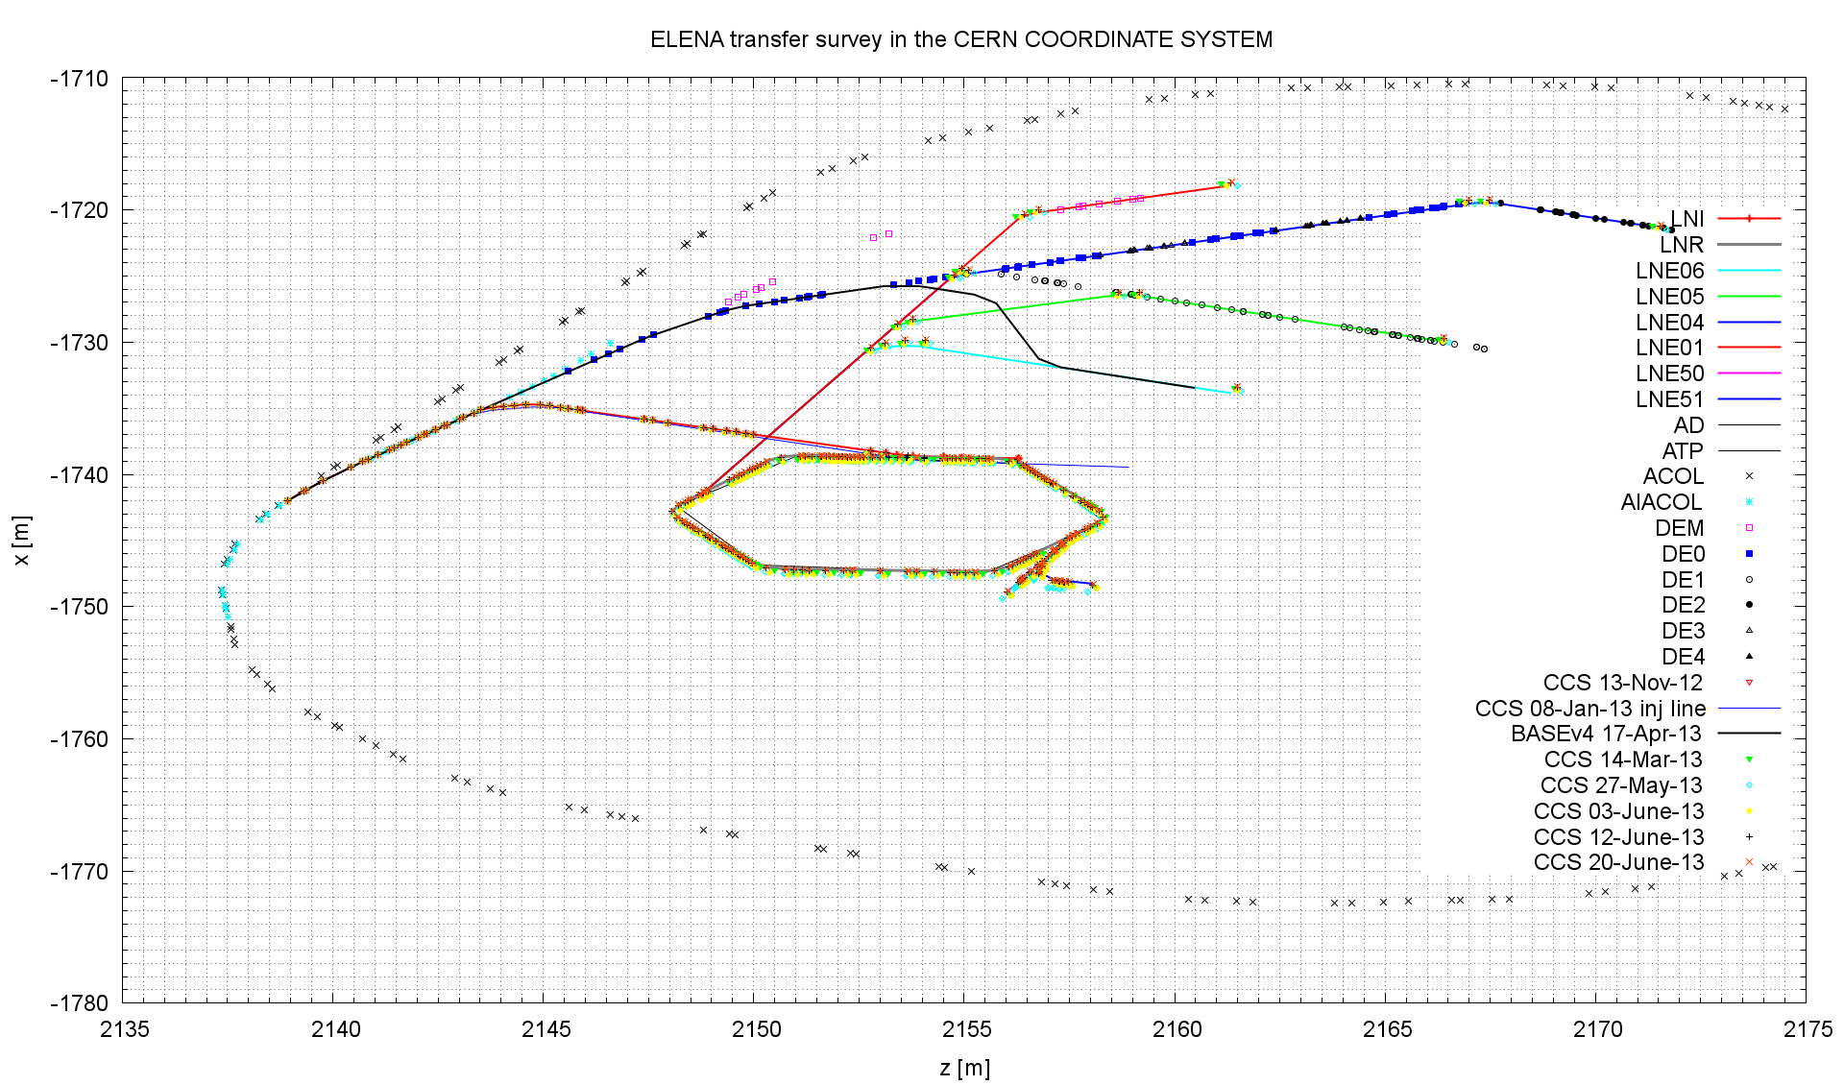
Geometry of lines
Optimisation of:
# bending angles in lines
Position of Elena ring wrt shielding
Straight extraction line to Gbar
Minimizing the ion switch angle

Slide 16
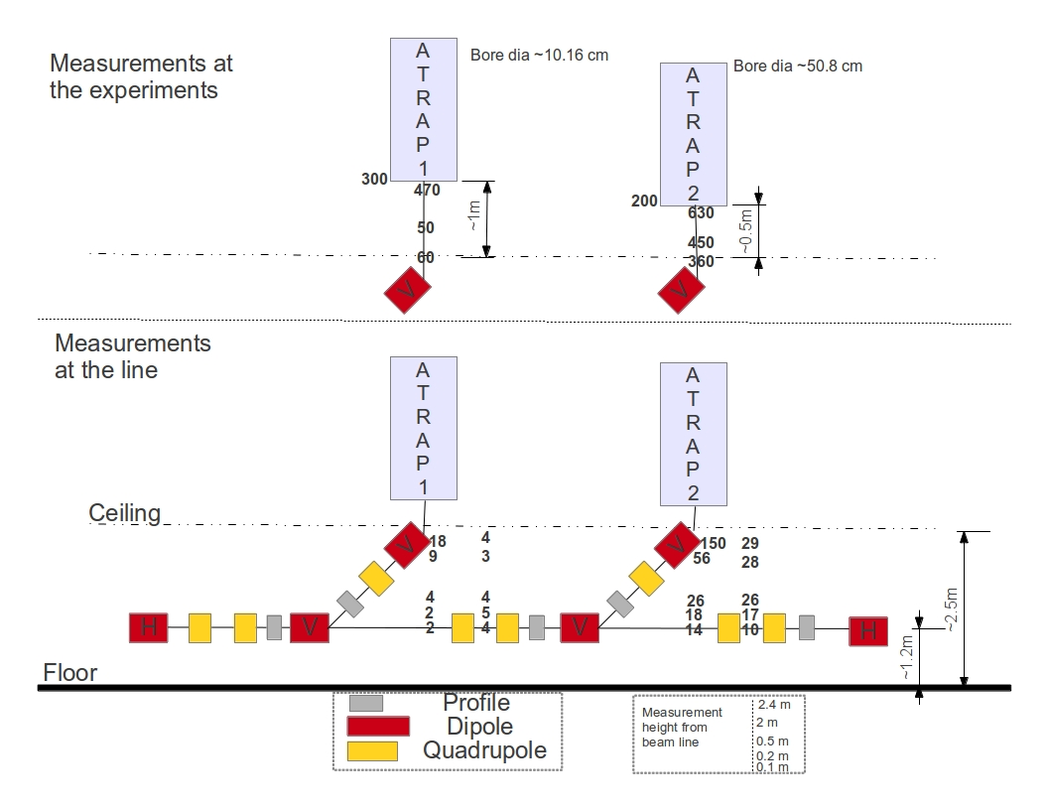
ALPHA line below ATRAP
ATRAP has two vertical lines branching off the line which leads further to ALPHA
Disturbance of 100 keV beam?
Measurements of stray field with ATRAP solenoids ON (without enhancing magnets – assume conservative factor 2 in addition)
Simulated in MADX the effect on the trajectory – up to 4 mm offset
Mitigation
  Increased number of BPM/corrector pairs in this part of the line
  Careful magnetic shielding of the area; need about a factor 10 reduction to compensate for factor 7 lower momentum compared to present situation (detailed studies to be conducted)
  Higher number of quadrupoles than presently

Slide 17
Optics
Main challenge how to treat electrostatic elements
Quadrupoles: use magnetic quadrupole and adjust gradient according to voltages applied on electrodes
Bends: more complicated, calculate field shape from electrode geometry, track particles through field and fit transfer matrix, use this transfer matrix in MadX to calculate optics
Compare with different codes like COSY and WinAgile
Procedure rather extensive: changes in bending strength, trajectory correction

Slide 18
Beam parameters at experiments
Beam size of 1-2 mm
  No particular request on dispersion, kept as free parameter to reduce number of quadrupoles
  Dispersion added linearly for TL aperture calculations
Alphas not very important; keep reasonably small
Momentum spread not very critical for most experiments but Gbar
  Dp/p (95%) < 2.5e-3
  Discussion next week to optimise beam parameters for Gbar

Slide 19
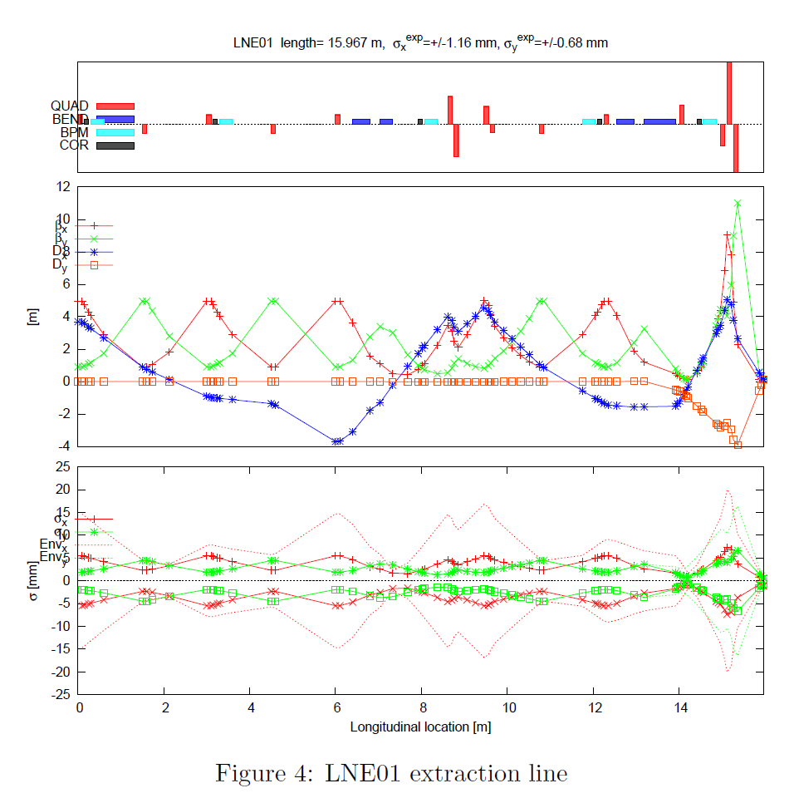
Optics for ATRAP 1
90 deg FODO as standard where possible
Quadrupole centre to centre distance in FODO is 1.5 m
+/-1.7 kV for FODO
+/- 13 kV in matching sections
Matching of beam size at experiment, leave dispersion as free parameter in matching area to reduce number of quadrupoles
Beam sizes in lines limited to 2/3 of the physical aperture
Trajectory correction studies → H/V correctors at 90 deg

Slide 20
Number of elements (incl spares)
Element | #
Quadrupoles electrostatic | 100
Fast deflectors (incl. extraction) | 10
Bends electrostatic | 16
Correctors H/V | 44
BPM | 44
Ion switch | 1

Slide 21
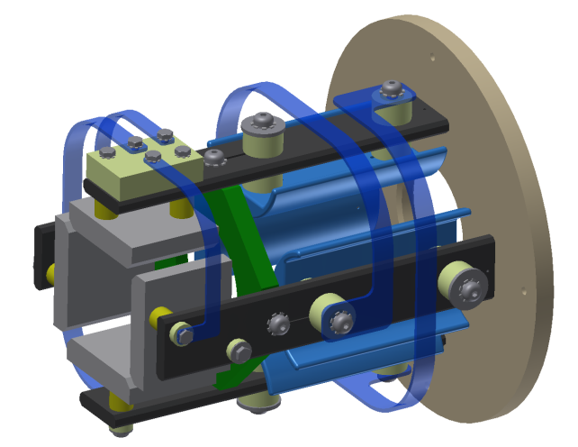
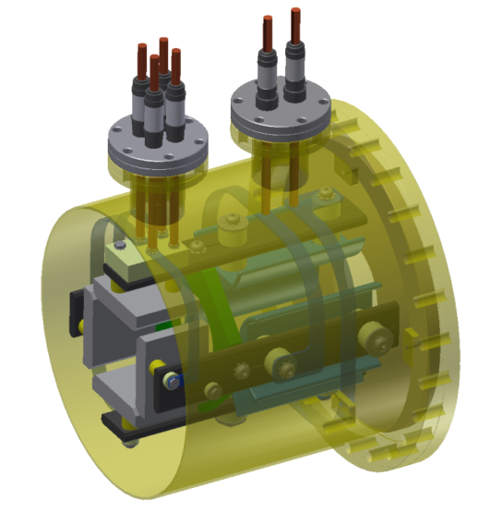
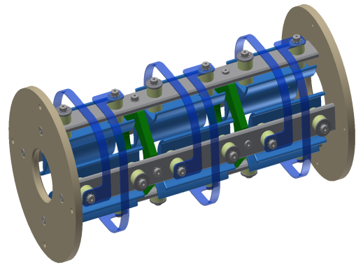
Electrostatic Quadrupoles
Cylindrical electrodes:
  avoid higher E-fields for hyperbolic ones due to smaller gap
  Extruded aluminium profiles
  100 mm long
Quadrupoles mounted on flanges, every 1.4 m in FODO structure
In matching sections
  several quads spaced by 5 cm mounted on longitudinal rail supported on both sides
  Aperture disks in between define fringe fields
No alignment possibility of electrodes inside vacuum foreseen
Field distortion due to electrical connections negligible
Vacuum chamber of 200 mm diameter (reduced in vicinity to extraction)
~100 elements

Slide 22
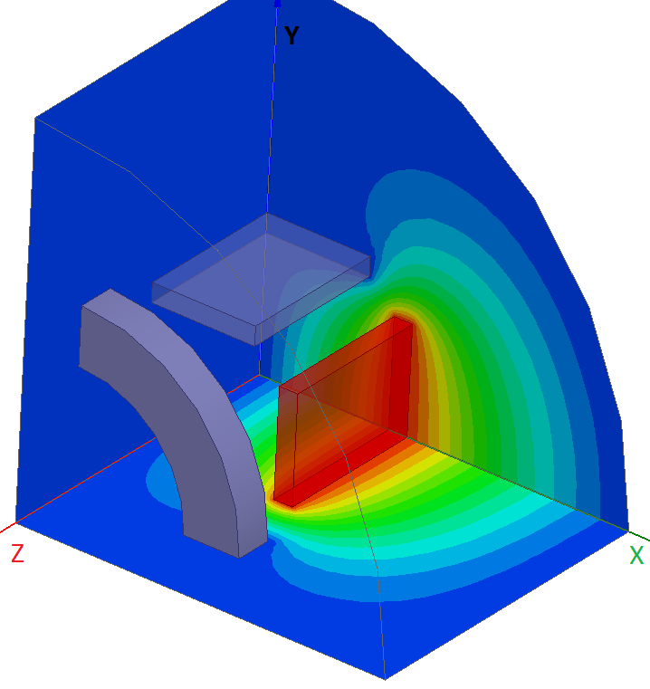
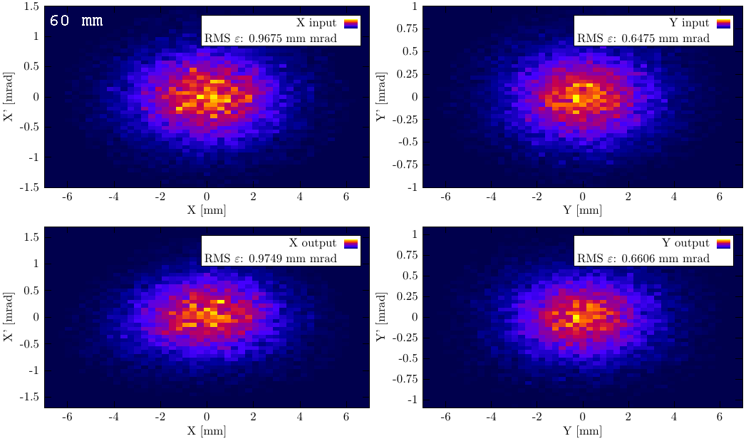
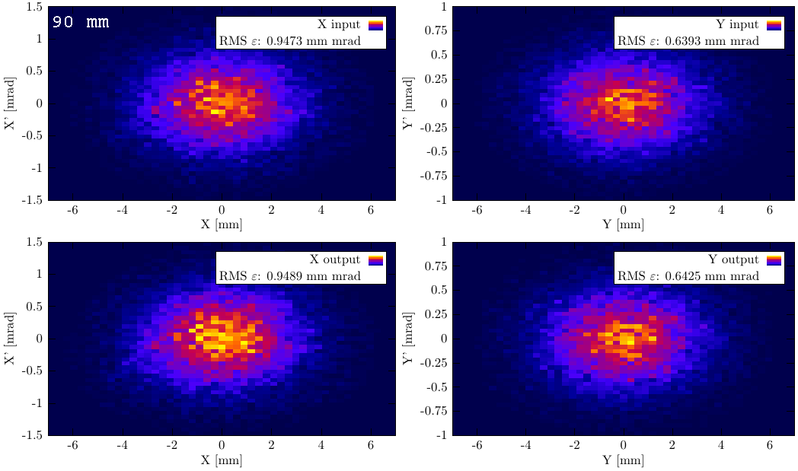
Steerers
Integrated on same rail as quadrupoles
Trajectory correction studies showed the necessity of dual plane correctors with 90 deg phase advance
Checked the emittance increase due to field distortion of second electrode pair
Assuming an 8 mrad kick (10 mm displacement at downstream quad):
1-2% increase of rms emittance for 60 mm opening
no significant increase for 90 mm opening

Slide 23
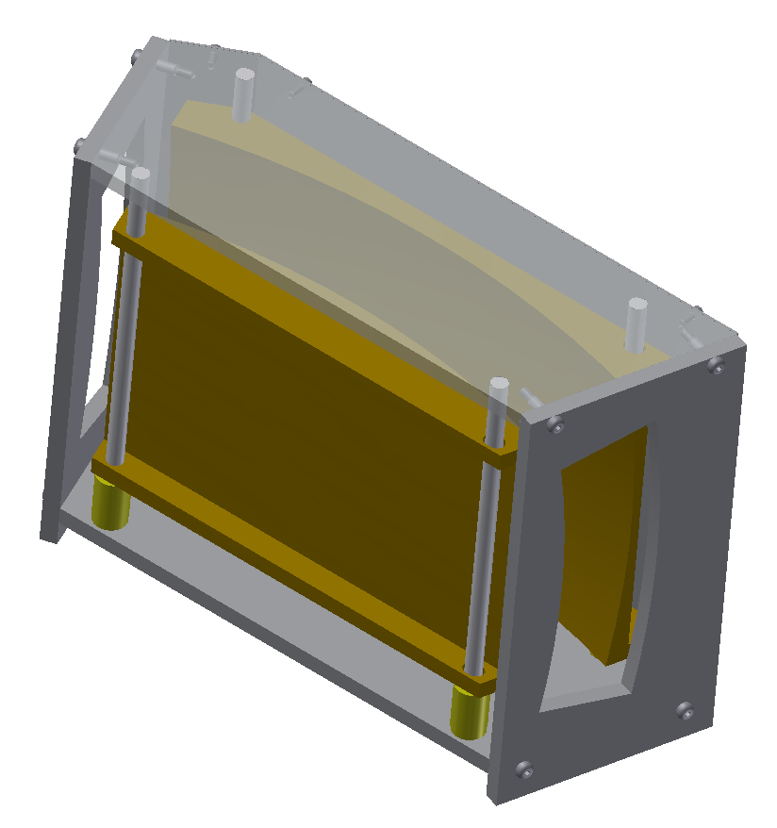
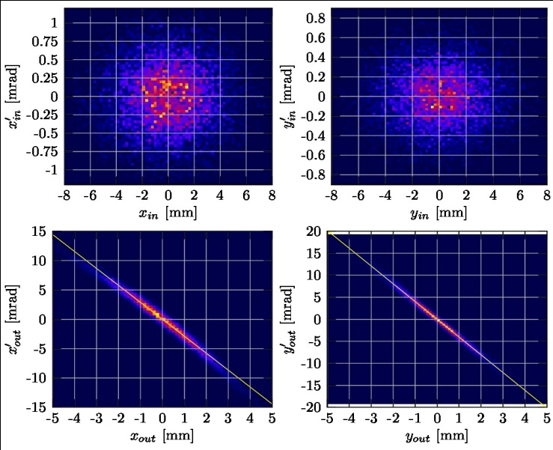
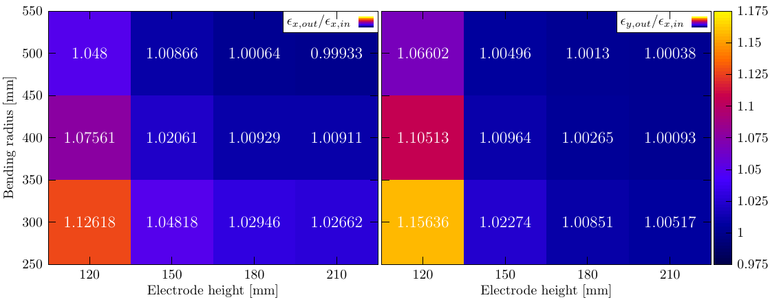
Deflectors I
Electrostatic deflectors introduce strong focussing
Spherical deflectors (focussing in both planes)
Emittance growth due to field imperfections → larger bending radii and electrode height preferable
Choice for 500 mm radius for all transverse bends, reduces also required voltage
Vertical bends

Slide 24
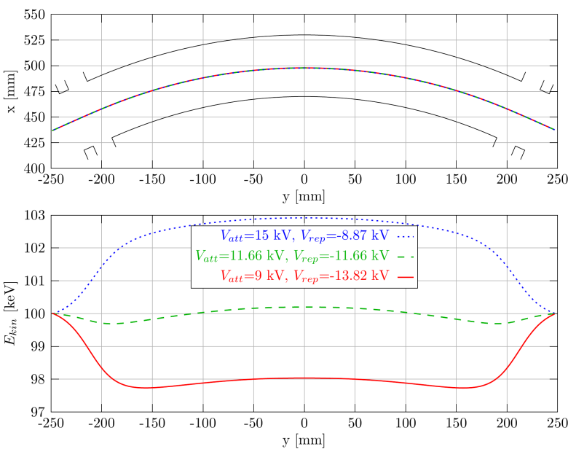
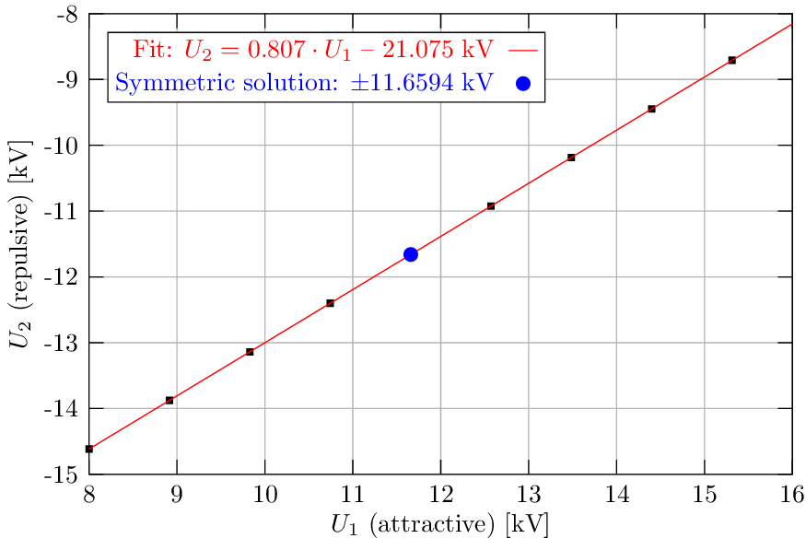
Deflectors II
Choice for 500 mm bending radius and electrode height of 180 mm
  Reduces also required voltage
Operating voltage optimum
  Minimum variation of energy
  Balanced focussing properties in both planes
200 mm | ±30 kV
400 mm | ±15 kV
500 mm | ±12 kV
700 mm | ±8.5 kV

Slide 25
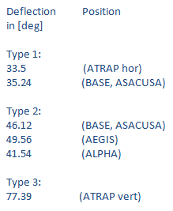
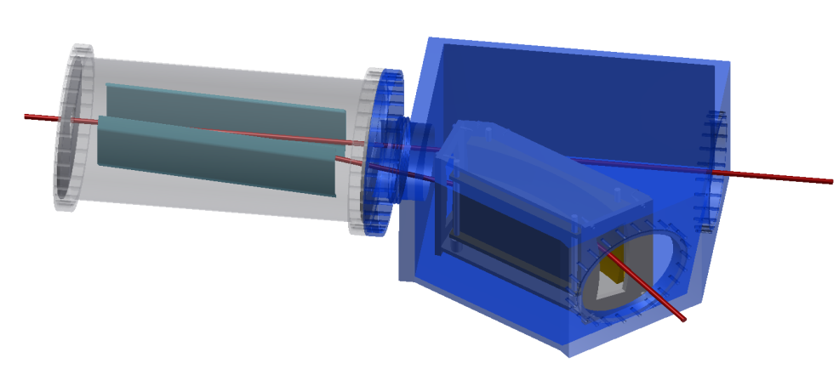
Fast switch + deflector
We have a total of 12 bends of which 7 are combined with a fast switch
Fast switch is standardized in specification and mechanical layout with the fast deflector for extraction
3-4 types of bends

Slide 26
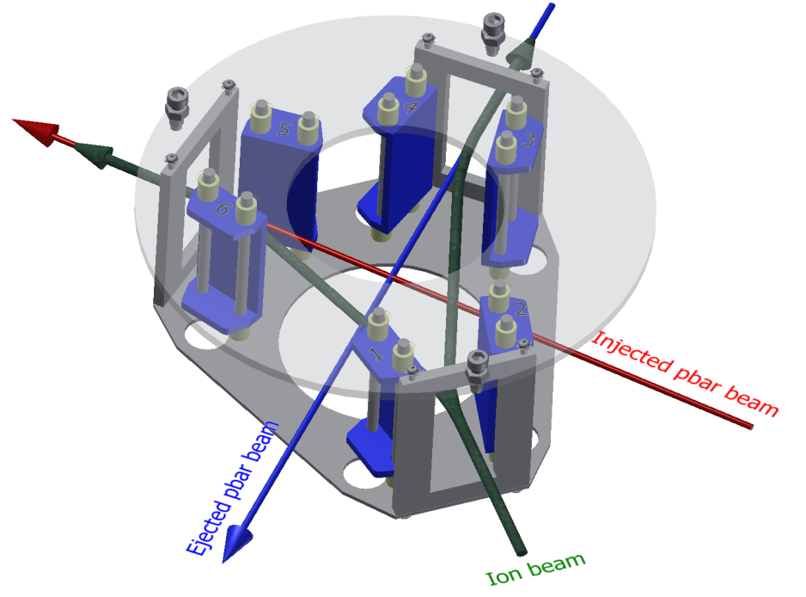
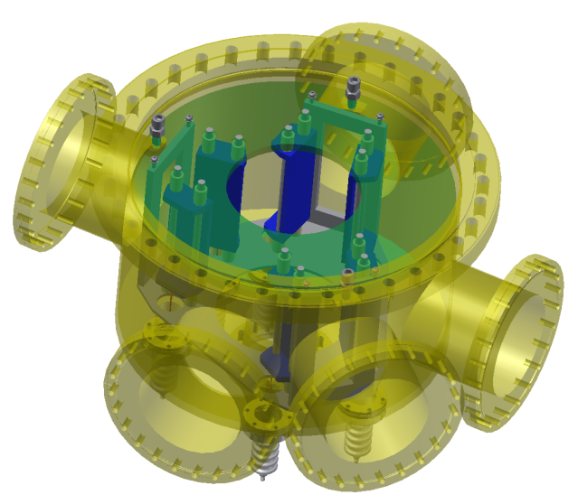
Ion switch
Need to deflect H⁻ and p⁺ by 42 deg into extraction and injection line
Same time the injected and extracted antiproton beam has to pass the device
Use only two high-voltages
Fabrication in the CERN workshop
  Single item
  316LN
Foreseen to test this device together with the source at Juelich

Slide 27
Items which deserve attention
Simulation of electrostatic elements
  External collaboration with Triumf and Cockroft
Magnetic shielding around ATRAP
Source
  Beam parameters from source
  Current vs vacuum load vs beam parameters
  Vacuum: differential pumping needed, need a more detailed step into the integration of the source elements
  NEG coating in TLs?
  Depends on requirements from the experiments
  Compatibility with magnetic shielding
  Experiment handover points

Slide 28
Spare slides

Slide 29
Septum parameters (max, 1152A)
Deflection angle | 340 | mrad
Beam momentum | 100 | MeV/c
Beam energy | 5.3 | MeV
Integrated magnetic field (∫B.dl) | 113 | mT.m
Gap field | 378 | mT
Integrated magnetic leak field (w.r.t. ∫B.dl of nominal gap field) | <0.1 | %
Gap height | 74 | mm
Gap width between conductors | 135 | mm
Magnet length (physical) | 400 | mm
Magnetic equivalent length | 300 | mm
Septum conductor thickness | 22.8 | mm
Number of conductor turns | 20
Current (DC) | 1.1 | kA
Magnet inductance | 400 | μH
Magnet resistance | 6.7 | mΩ
Demineralised cooling water requirement | ~20 | l/min.

Slide 30
Injection kicker parameters
Injection kicker magnet data | Unit
Required angle @5.3 MeV | mrad | 84
Effective magnetic length | mm | 432
Maximum B.l | mT.m | 31.36
Rise/Fall time (2-98) % | ns | 200
Flat top (max) | ns | ~600
Aperture w × h | mm × mm | 110 × 45
Good field region, h × v (nominal ± 1 %) | mm × mm | 72 × 36
Magnet impedance | Ω | 15
Magnet transit time | ns | 106.2
Magnet termination | Ω | 15
Maximum magnet current/voltage | kA/kV | 2600/40
B max | mT | 72.6
Remnant B.l max | µT.m | 75

Slide 31
Cost estimate
Total cost of 6.6 MCHF for ~110 m transfer lines
Including spares
Fast switches include also the extraction kickers
Not including:
  Magnetic elements of LNI
  Vacuum pumps, gauges, valves, bake out equipment
No cost splitting for
  BI contribution from Tokyo which accounts for ½ of the instrumentation
  GBAR TL
  2nd ASACUSA line, BASE, source line

Slide 32
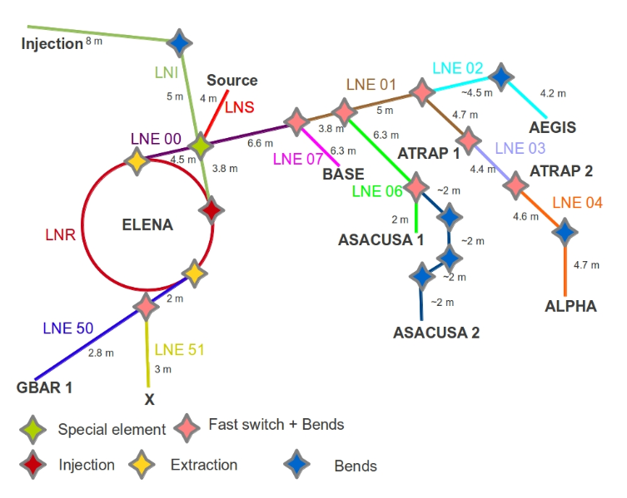
Installation dates by line
Line | Installation start | includes
LNI (magnetic) | 04/2015 | Magnetic + possibly electrostatic quadrupoles
LNS | 04/2015 ? | Ion switch, matching unit
LNE00 | 09/2015 | Fast deflector, matching unit
LNE50 | 09/2015 | Fast deflector, matching unit
All other lines | 12/2016 | Fast deflector, matching unit, quadrupole unit, bend unit

